Slide 1
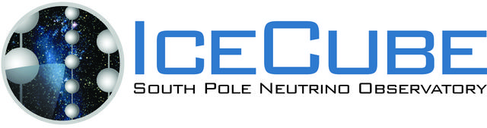
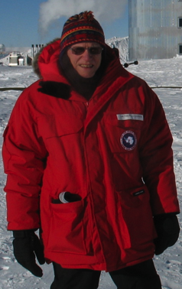



Catching a neutrino!
Prof. Tom Gaisser, University of Delaware

Slide 2
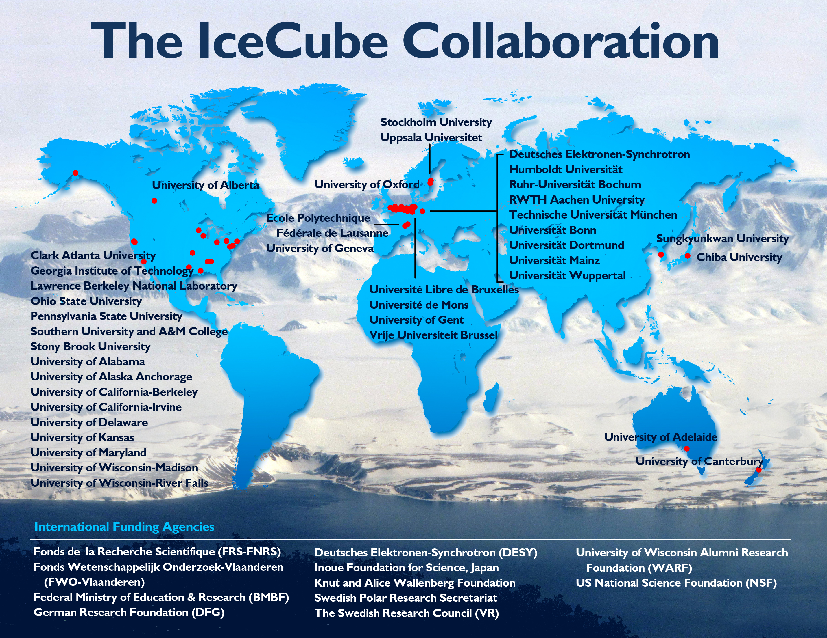

Slide 3
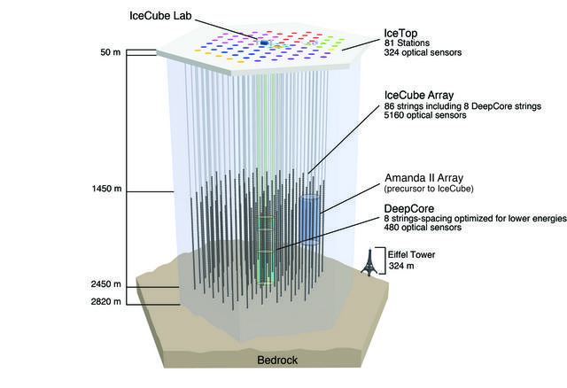
Deployment history
2002: proposal
2003-04 staging
2004-05 1 4
2005-06 9 16
2006-07 22 26
2007-08 40 40
2008-09 59 59
2009-10 79 73
2010-11 86 81
Deep strings
Surface stations

Slide 4
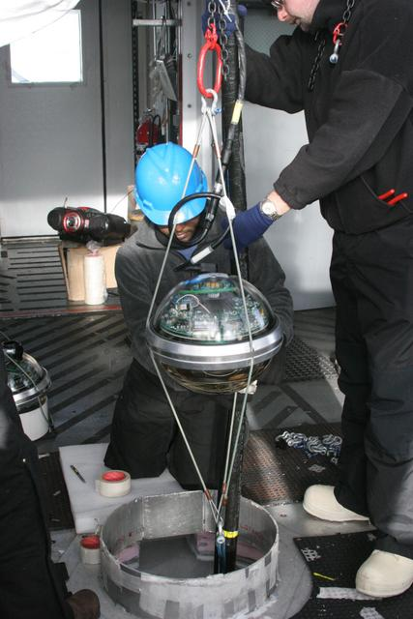
IceCube Digital Optical Module and Deployment
LED flasher board
HV board
Main board for digitizing and time stamping

Slide 5
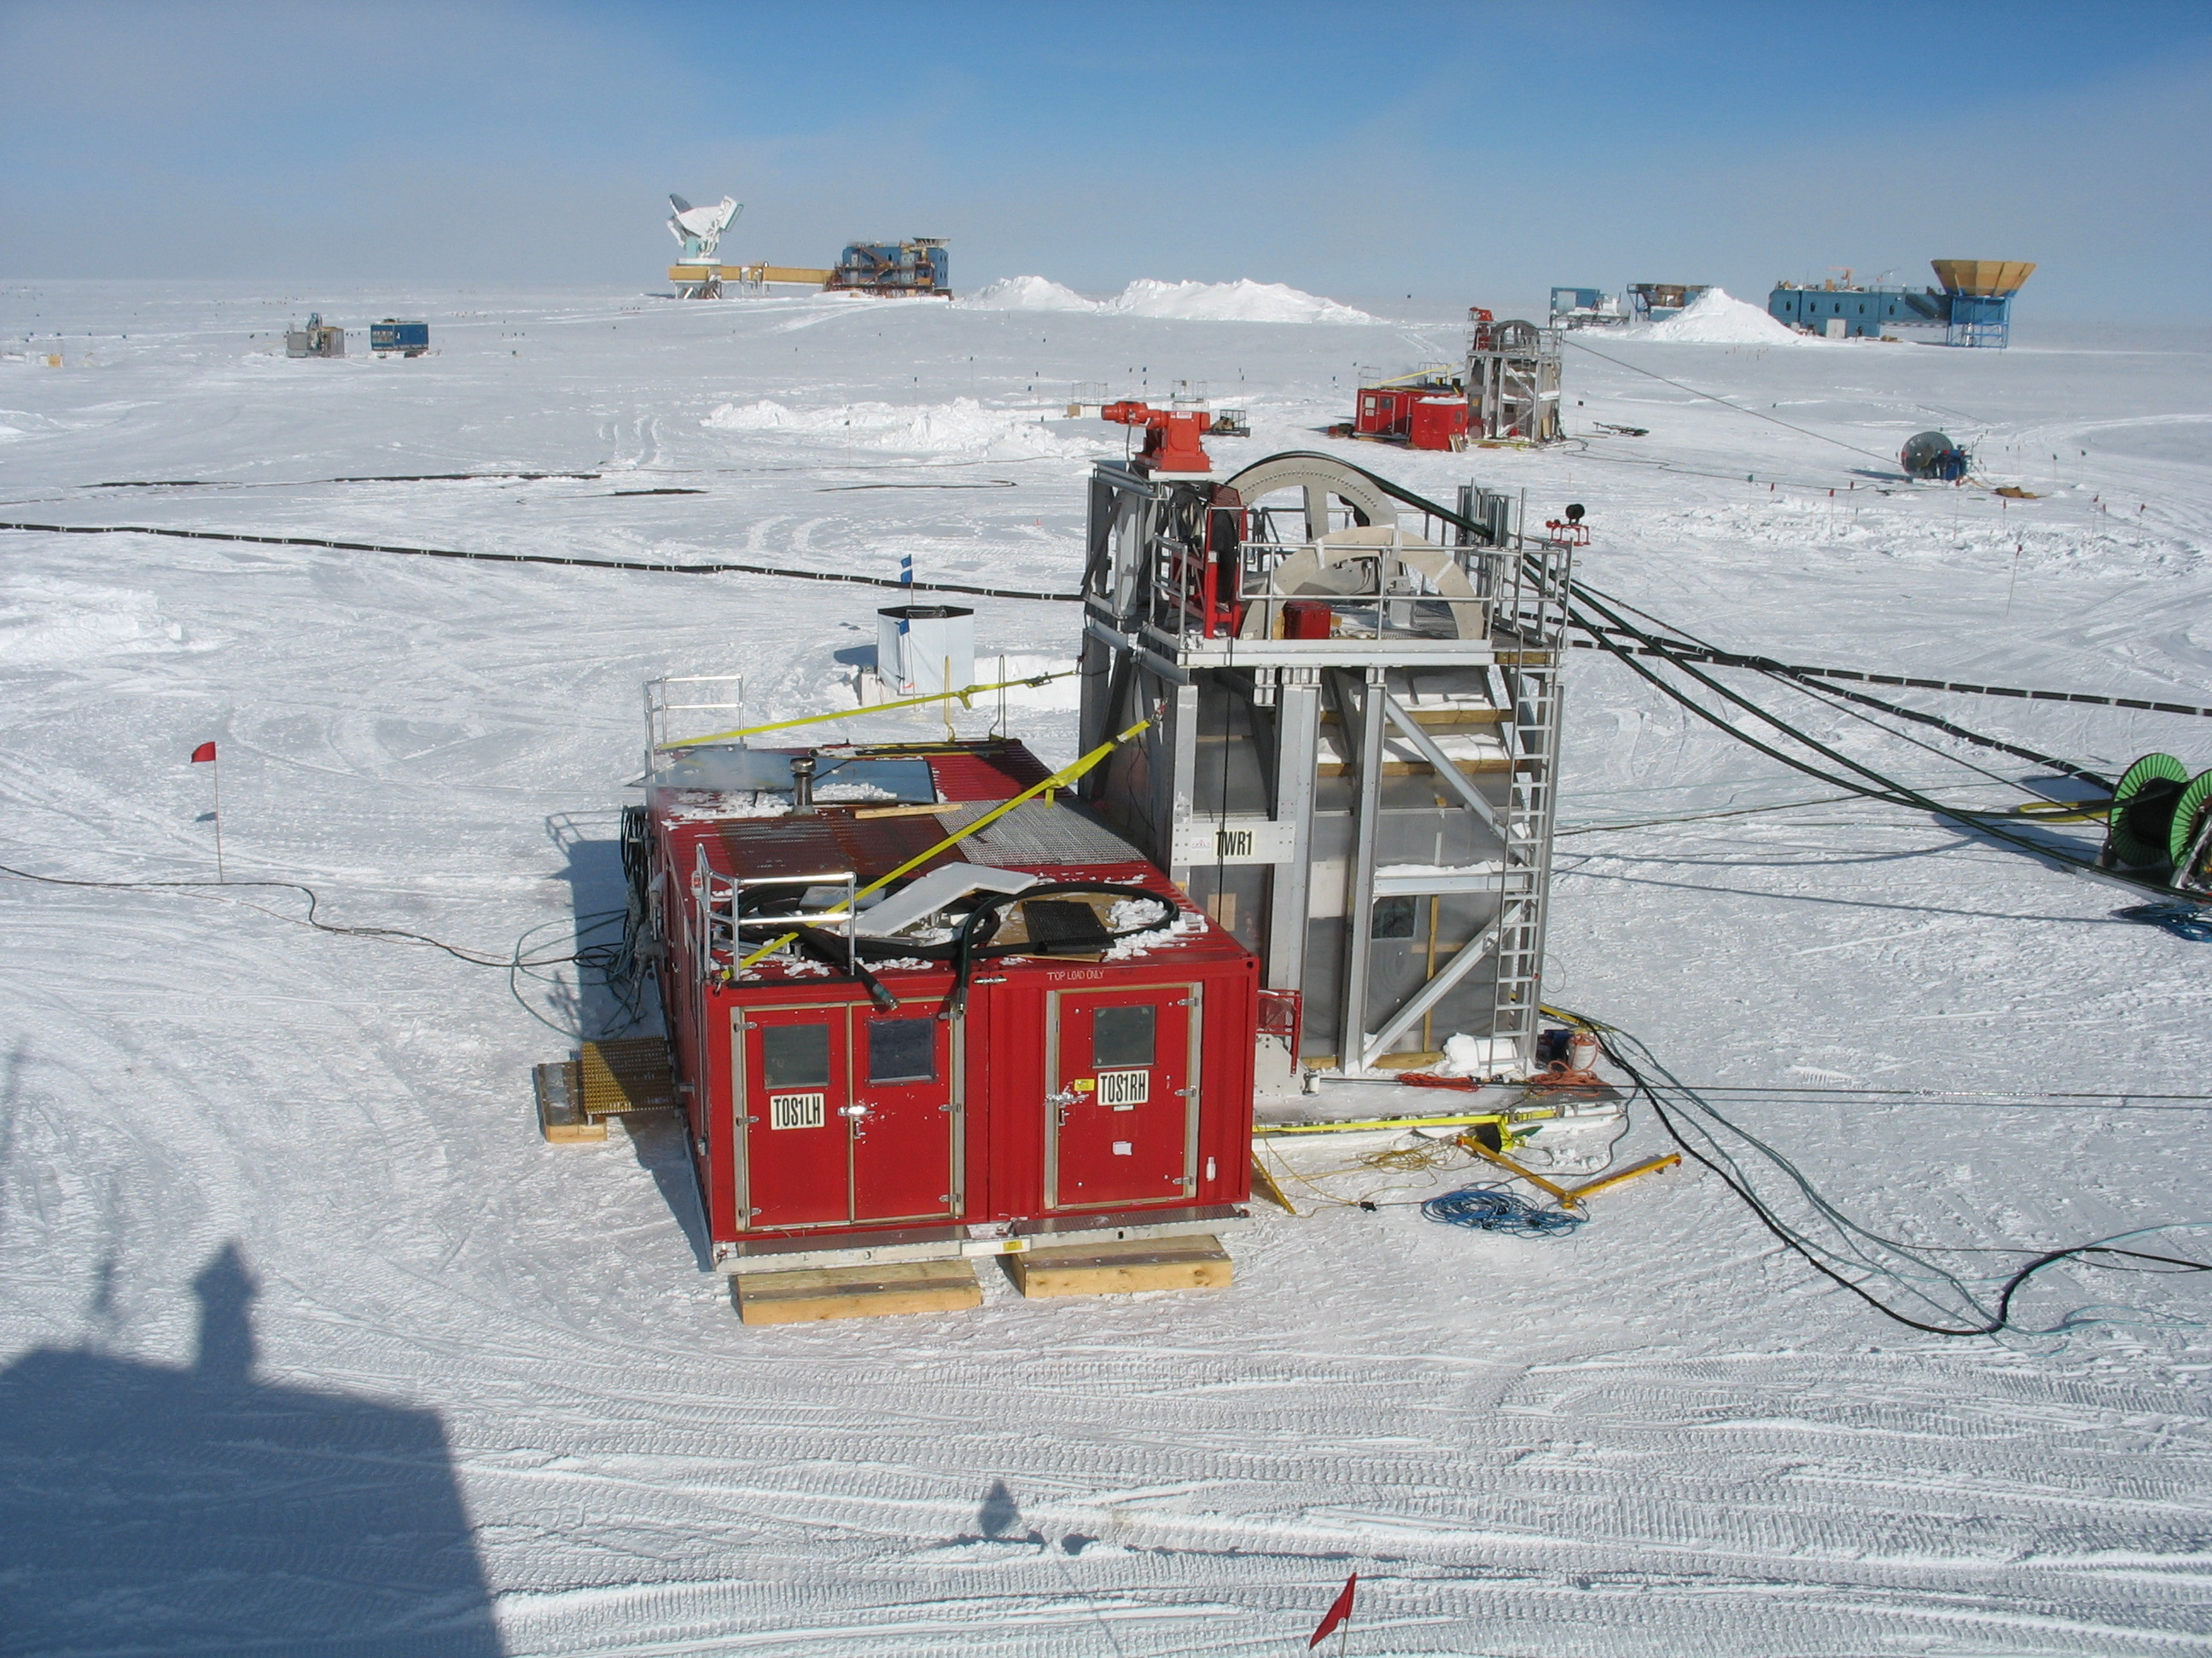
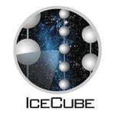
Credit: Tom Gaisser, IceCube/NSF

Slide 6
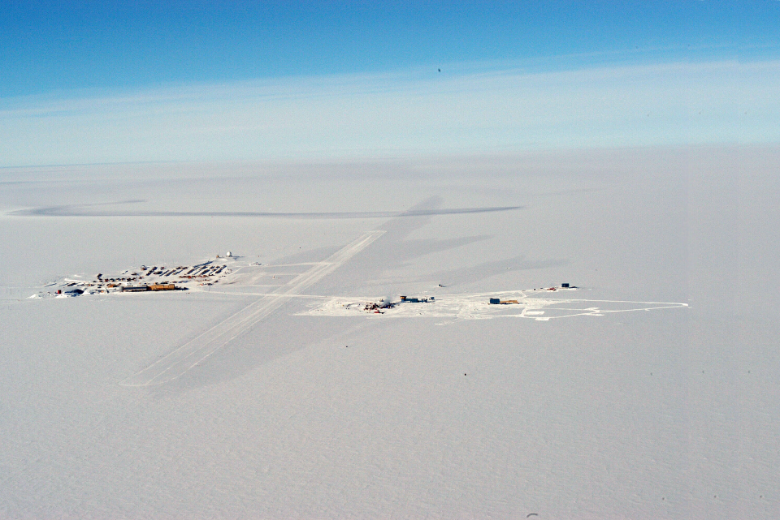
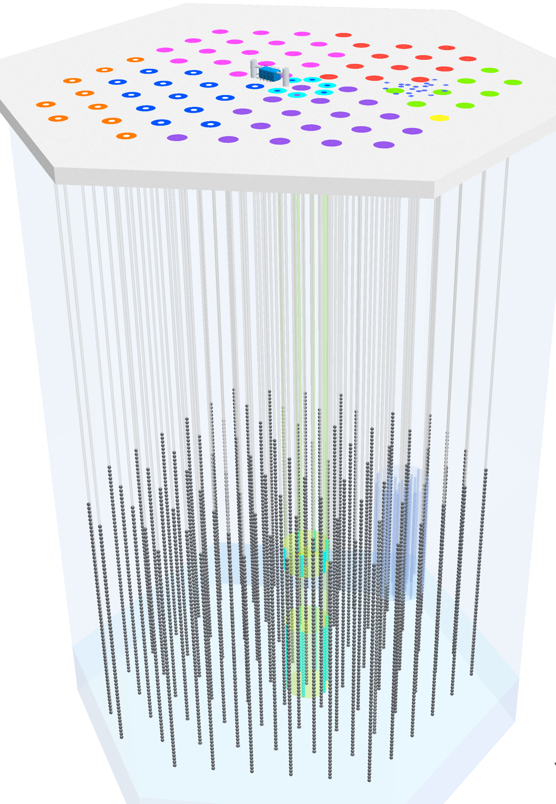
Cosmic rays from above
South Pole Station
altitude: 10,000 ft.
IceTop
1450 m
IceCube
2450 m

Slide 7
Neutrino events
PeV = 10⁶ GeV = 10¹⁵ eV. These are the highest energy neutrinos ever detected!
Physical Review Letters 111, 021103 (2013)

Slide 8
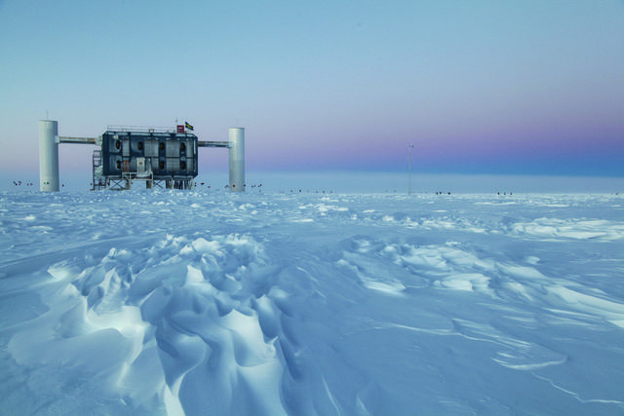
Credit: Sven Lidstrom, IceCube/NSF

