Slide 1

A Practical Workshop on EXAFS Shell Fitting for Environmental Samples
Matt Siebecker, PhD
Delaware Environmental Institute
August 17, 2016

Slide 2
Outline for Today’s Workshop
Three hour morning session
  Goal for this workshop
  Purpose of shell fitting
  How do we do shell fitting
  EXAFS signal & Fourier Transform
  EXAFS equation and it’s variables
  Five variables generally fit by user
  Knowing when the fit is done
    Hamilton test
  What parameters to publish?
  Example (Ni-foil)
Three hour afternoon session
  Small group practice – nickel foil
  Small group practice – nickel hydroxide
  Small group practice – nickel reacted with pyrophyllite (6 yrs)

Slide 3
Goals for this Workshop
#1 goal is to learn the basics of how to perform shell fitting of EXAFS data using Artemis
  Ask questions, promote discussion
Present basic techniques to fit “shells” of a Fourier transformed EXAFS spectrum
  Briefly illustrate background subtraction & normalization
  Provide a basic “protocol” for getting data loaded and starting a fit
A “crash course” to give you the skills to learn how to fit and provide learning resources
  Cannot be learned in one day, or several days
  Each system is distinct (crystalline, amorphous, sorption …)

Slide 4


Resources
Software help with Demeter (Athena, Artemis)
  http://bruceravel.github.io/demeter
Video tutorials on Artemis
  https://vimeo.com/channels/exafs
IFEFFIT Mailing list
  https://www.mail-archive.com/ifeffit@millenia.cars.aps.anl.gov
*Shelly Kelly et al., 2008. Soil Science Society of America, Methods of Soil Analysis. Part 5. Mineralogical Methods. Analysis of Soils and Minerals Using X-ray Absorption Spectroscopy, Chapter 14
*XAFS for Everyone (2013) by Scott Calvin
Many more resources listed at end of presentation
*many figures in this presentation are copied straight from these resources

Slide 5
Purpose of EXAFS Shell Fitting
What is the purpose of EXAFS shell fitting?
  determine inter atomic distances (distances between neighboring atoms)
  determine coordination number (number of atoms at a specific distance)
What can we do with this information?
  confirm or disprove our hypotheses about the chemical species in which we are interested
For our environmental samples, we generally employ the polyhedral approach to understanding sorption, molecular bonding on mineral surfaces, and crystal structure
  Monodentate mono nuclear, bidentate binuclear, bidentate mononuclear, edge sharing, double corner sharing, triple corner sharing, atomic substitution into mineral lattice structure

Slide 6
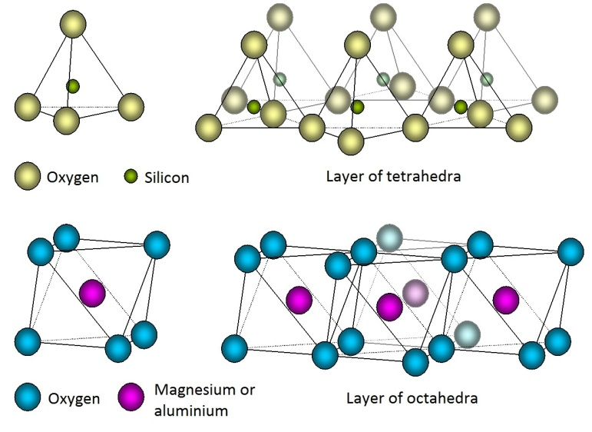
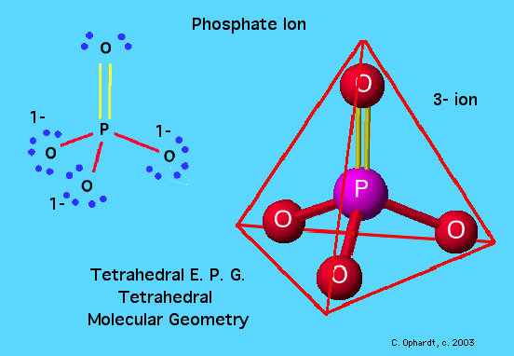
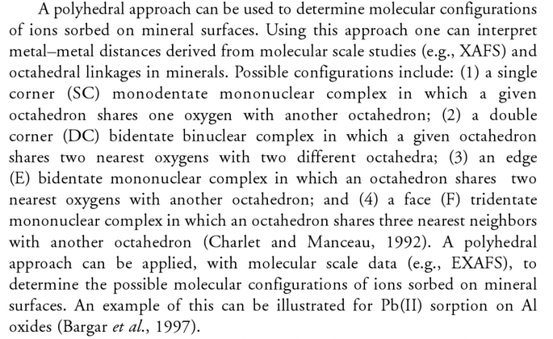
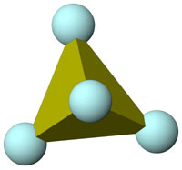
The Polyhedral Approach
Arsenic tetrahedron
Sparks, 2002

Slide 7
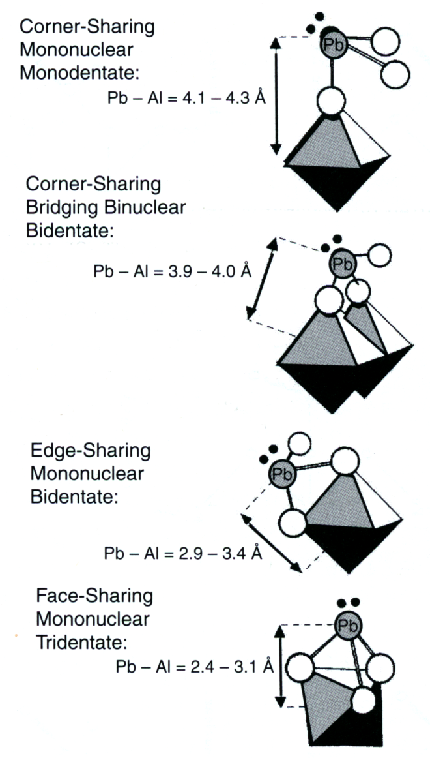
The Polyhedral Approach
Sparks, 2002

Slide 8
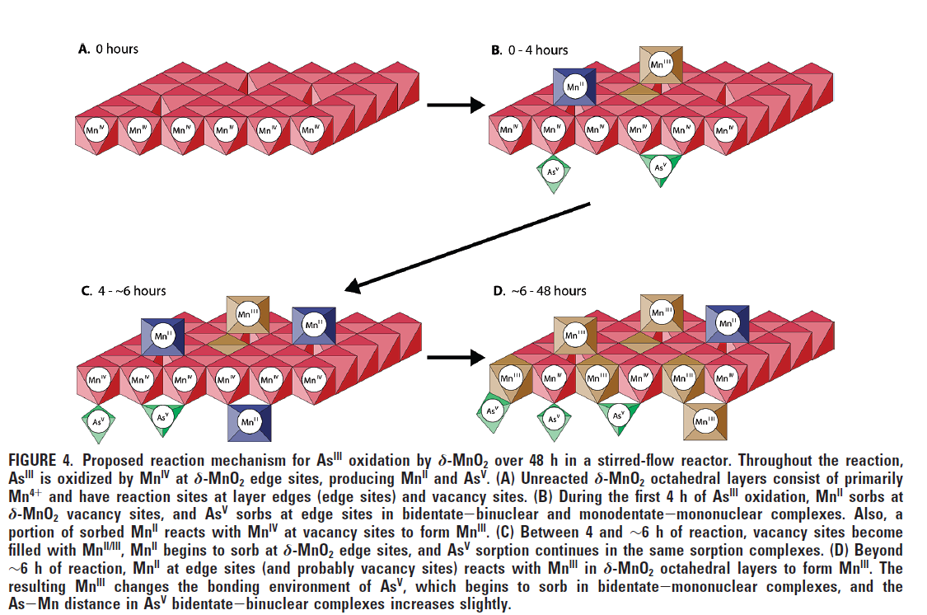
The Polyhedral Approach
Lafferty

Slide 9
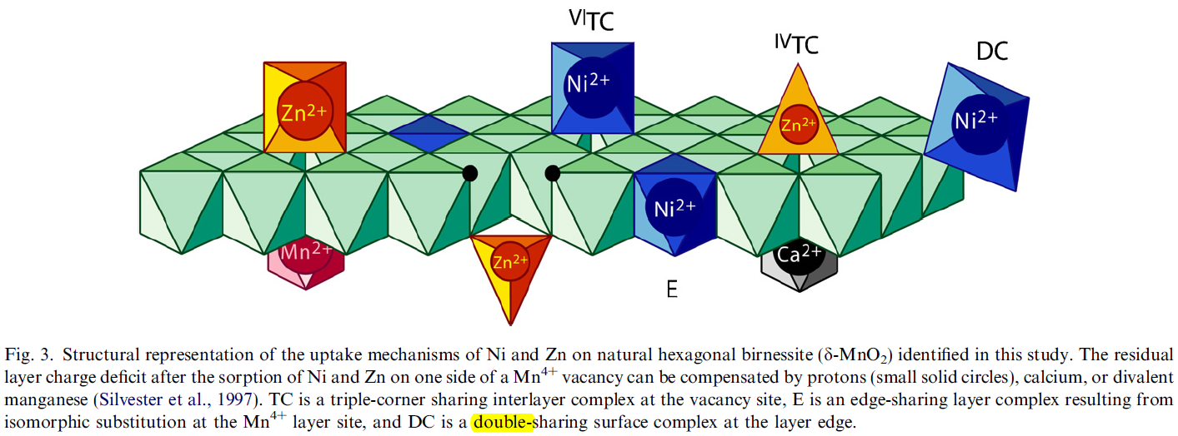
The Polyhedral Approach
Manceau

Slide 10
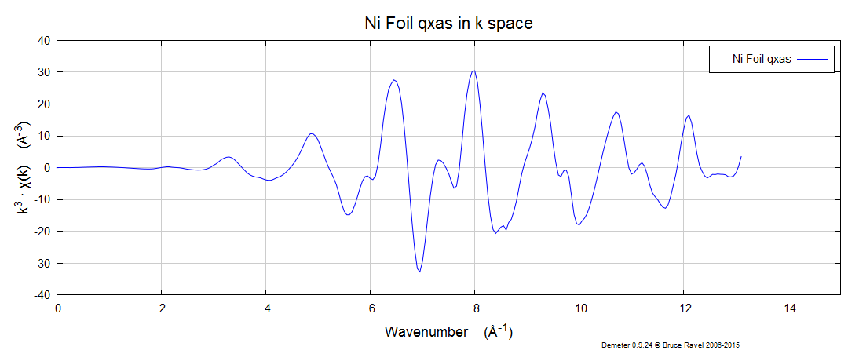
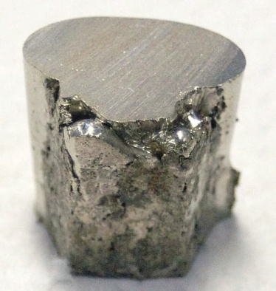
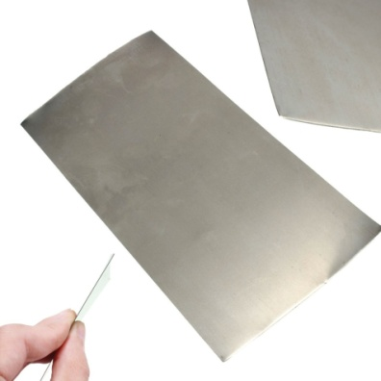
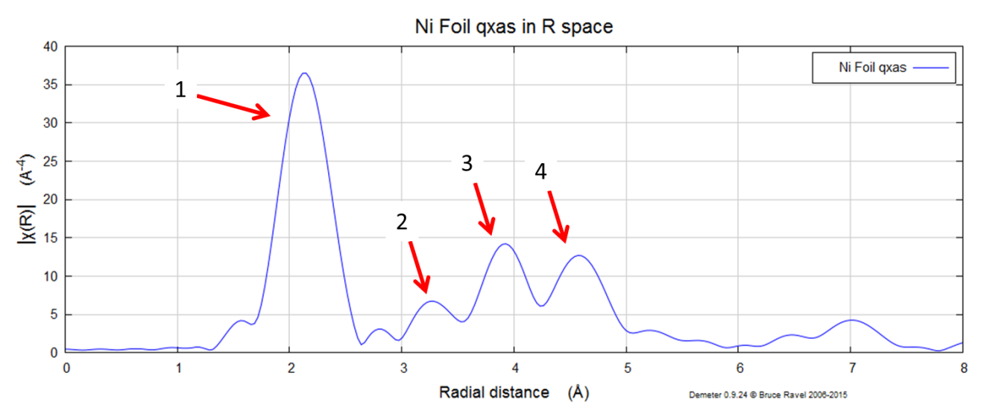
What is a “shell” and how do we “fit it”
nickel metal foil

Slide 11
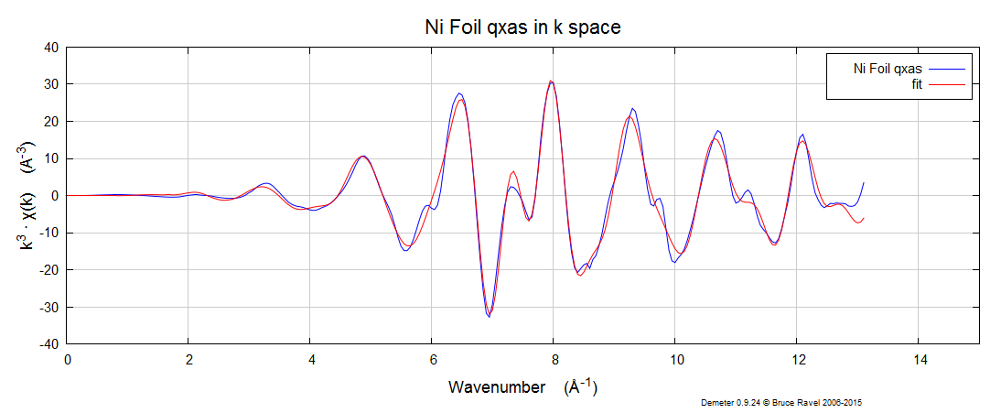
How do we do EXAFS shell fitting?
Try to get the squiggly lines to lie on top of each other
Get the red line [the fit] follow the blue line [the data]
Create a model that “fits” the data
A graphically (visually) “good” fit is not definitive. The statistical results and calculated values tell the real story of the fit (quantitative results).

Slide 12
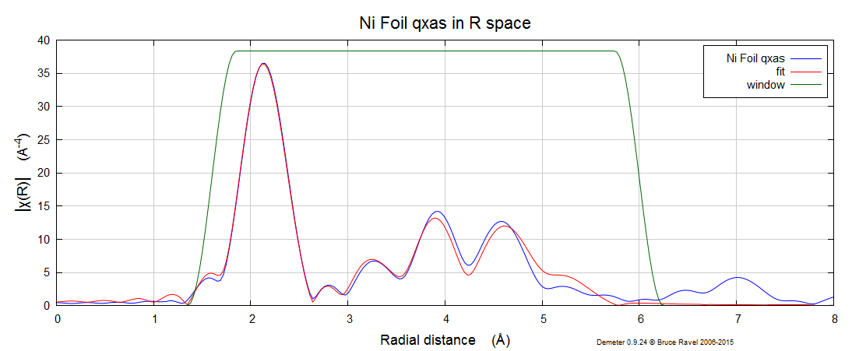
How do we do EXAFS shell fitting?
A graphically (visually) “good” fit is not definitive. The statistical results and calculated values tell the real story of the fit (quantitative results).

Slide 13
What statistical results and calculated values?
There are in general five (5) variables that you fit. These variables are part of the EXAFS equation.
The EXAFS equation describes the features seen in EXAFS data (e.g., amplitude and frequency of oscillations)
  to determine interatomic distances and coordination number we fit five variables that are part of the EXAFS equation.
Create the best fit possible with the least number of fitted variables
  “BEST FIT” = physically realistic values with lowest amount of misfit using least amount of fitted variables
  R-factor, “chi square” (χ²), “reduced chi square” (χ²_{v})
  “chi” is pronounced “kahy”
  Using constraints based on prior knowledge about the sample
    Crystal structure, predicted interatomic distances, disorder (amorphous vs, crystalline)

Slide 14
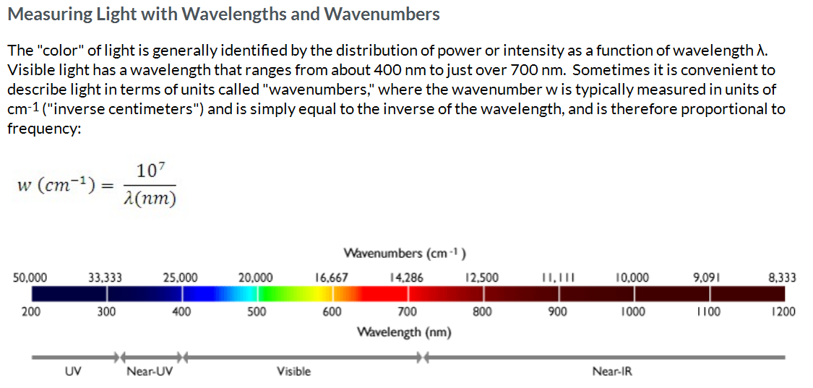
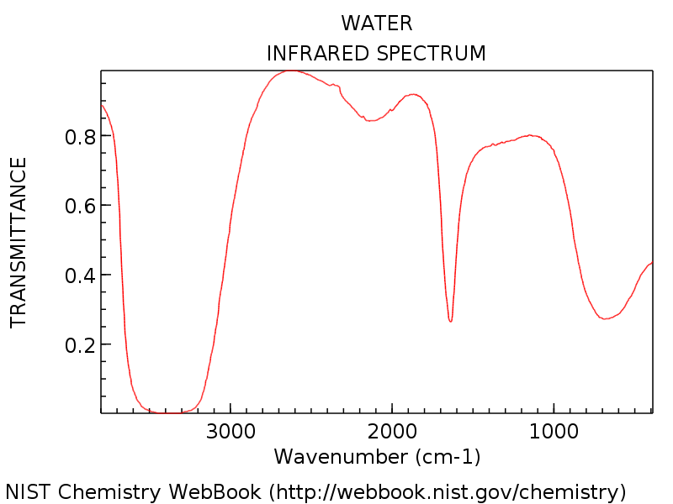
What is an EXAFS spectrum?
2000
5000
IR

Slide 15
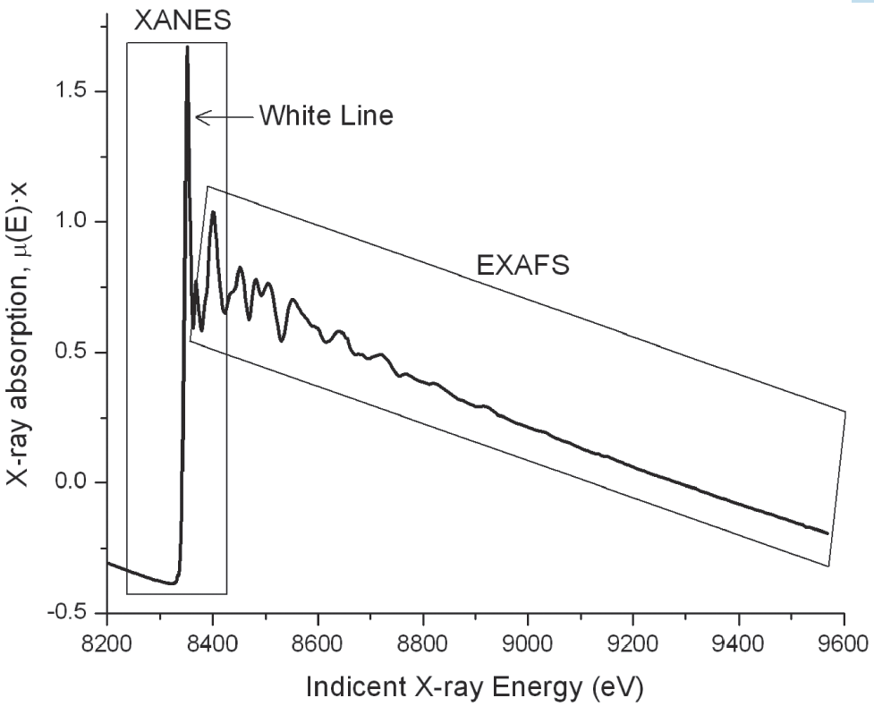
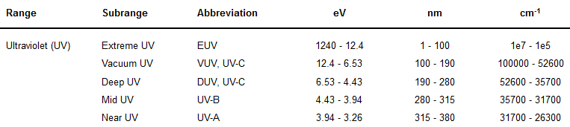
What is an EXAFS spectrum?
Absorption edge
Kelly et al 2008 SSSA book chapter 14
http://halas.rice.edu/conversions

Slide 16
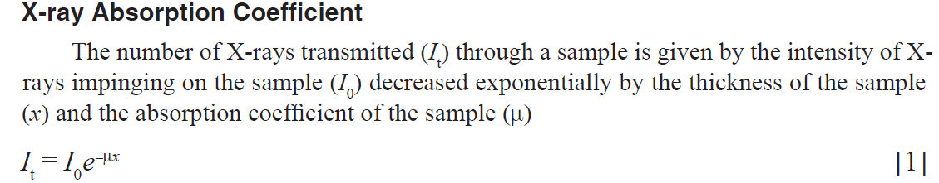
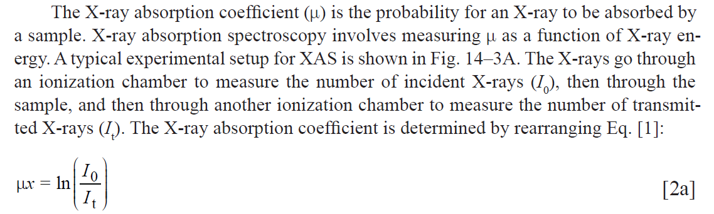
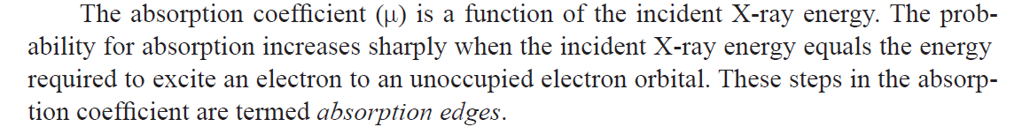
What is an EXAFS spectrum?
Kelly et al 2008 SSSA book chapter 14

Slide 17
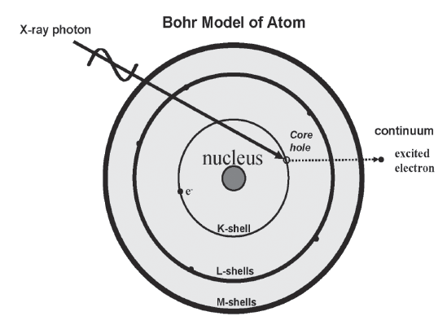
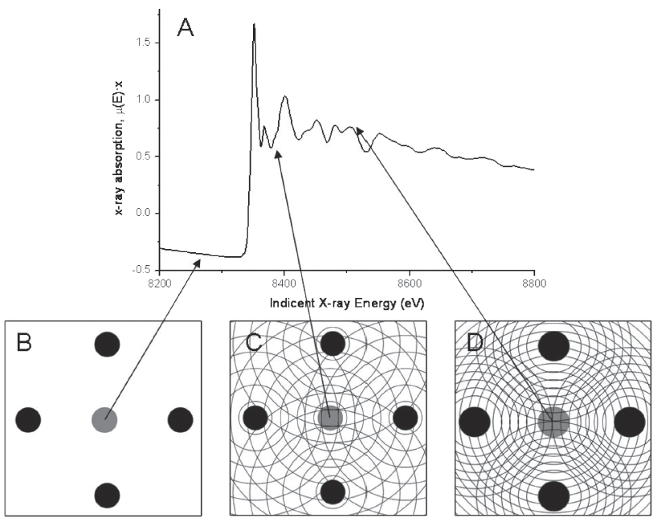
What is an EXAFS spectrum?
The main “step-like” feature of the absorption edge is due to the excitation of the photoelectron into the continuum
The excited electrons are termed photoelectrons because the absorbed X-ray is a photon.
The photoelectrons can be described as spherical waves propagating outward from the absorber atoms
These photoelectron waves are scattered from the atoms surrounding the absorber
Different features are caused by differences in the density of unoccupied electron orbitals that can be occupied by the excited photoelectron.
The relative phase of the outgoing photoelectron wave and the scattered wave at the absorbing atom affects the probability for X-ray absorption by the absorber atom.
photoelectron
Kelly et al 2008 SSSA book chapter 14

Slide 18
What is an EXAFS spectrum?
An illustration of the X-ray absorption process.
(A) Nickel K-edge X-ray absorption spectrum of NiO.
(B) At X-ray energies below the absorption edge no photoelectron is produced.
(C) At X-ray energies above the absorption edge photoelectrons are produced.
  The crests of photoelectron waves produced by X-ray absorption by the absorber atom (Ni) and by scattering from neighboring oxygen atoms are shown as concentric circles about Ni and O atoms, respectively.
  A minimum in the oscillatory part of the absorption coefficient is produced because the outgoing and scattered parts of the photoelectron meet at a minimum at the absorbing atom (the peak crests are completely out of phase at the center of the absorber atom)
(D) A maximum in the oscillatory part of the absorption coefficient is produced because the outgoing and scattered parts of the photoelectron are in phase and meet at a maximum at the absorber atom (in phase)
Nickel absorber atom (gray filled circle) and four of six neighboring oxygen atoms (black filled circles).
Kelly et al 2008 SSSA book chapter 14

Slide 19
What is an EXAFS spectrum?
Phase is determined by the photoelectron wavelength and the interatomic distances between the absorber and scattering atoms.
When the waves are out of phase, a minimum in absorption occurs, causing a drop in the oscillatory part of the absorption coefficient.
As the incident X-ray energy is increased above the edge the photoelectron wavelength becomes shorter.
Because the average distance between the absorber and the neighboring atoms does not change, the waves will progressively become in phase, causing a maximum in the oscillatory part of the absorption coefficient.
As the incident X-ray energy increases, the photoelectron wavelength progressively decreases, and the sum of the outgoing photoelectron wave and the scattered waves at the absorber atom oscillate with a periodicity that is related to the average distances between the absorber and coordinating atoms.
Nickel absorber atom (gray filled circle) and four of six neighboring oxygen atoms (black filled circles).
We “fit” scattering paths of the photoelectrons.
Those paths are based of off models.
Kelly et al 2008 SSSA book chapter 14

Slide 20
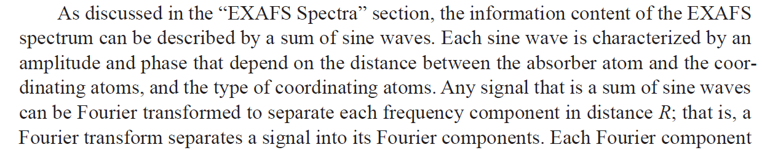
What is an EXAFS spectrum?
Kelly et al 2008 SSSA book chapter 14

Slide 21
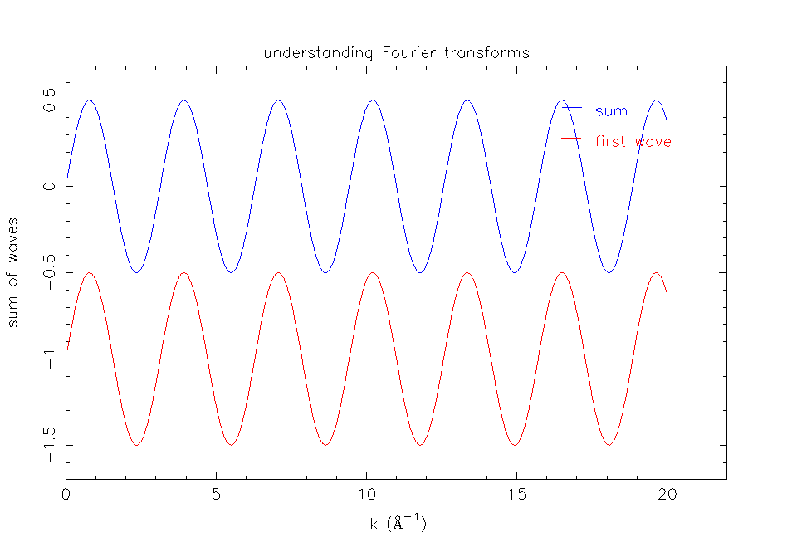
Fourier Transformation

Slide 22
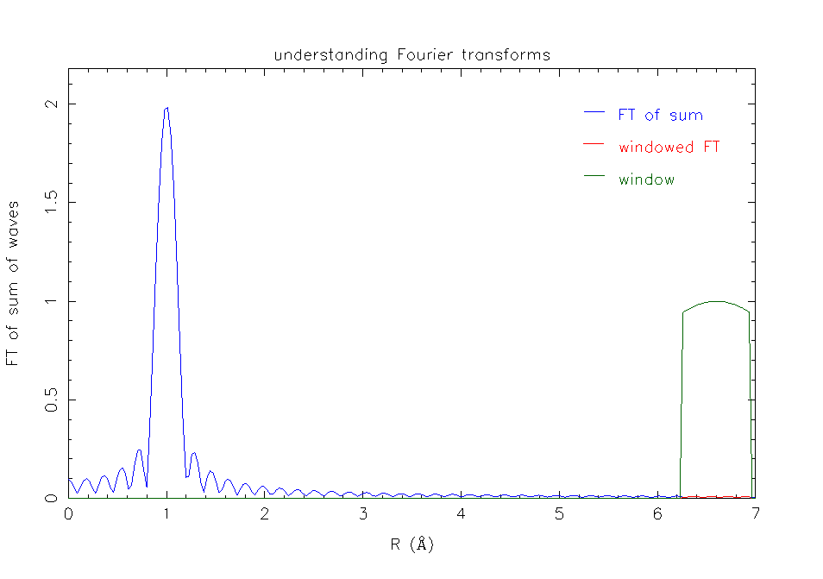
Fourier Transformation

Slide 23
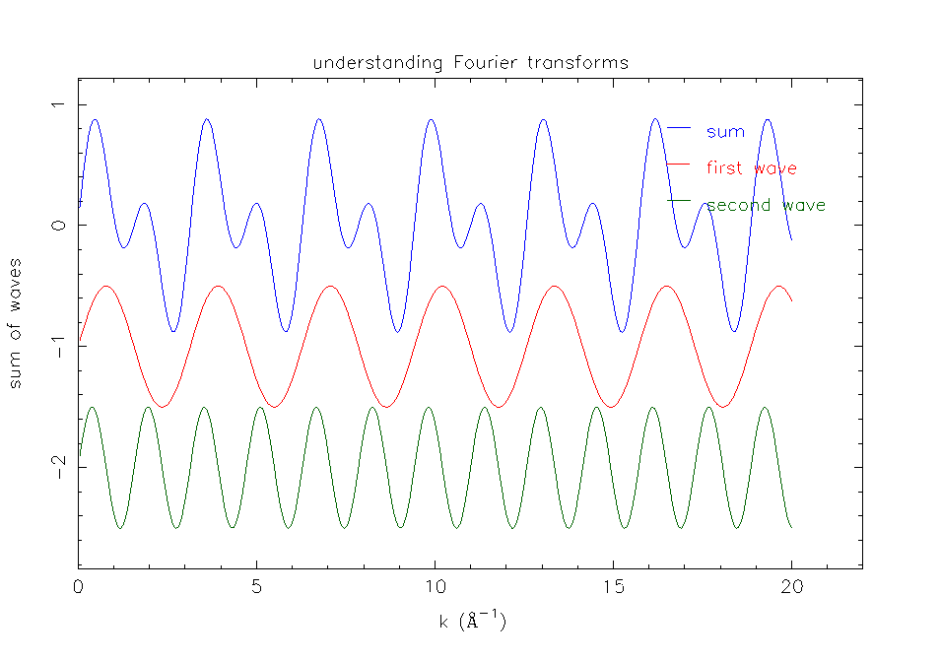
Fourier Transformation

Slide 24
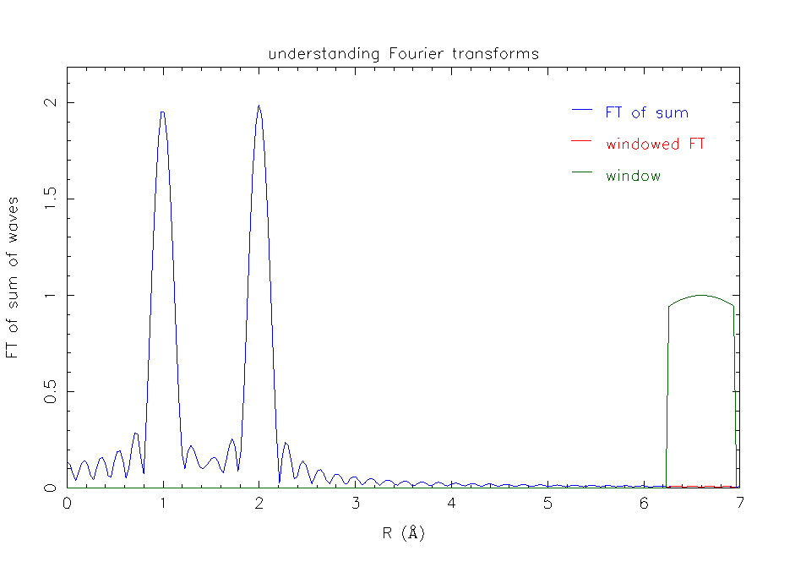
Fourier Transformation

Slide 25
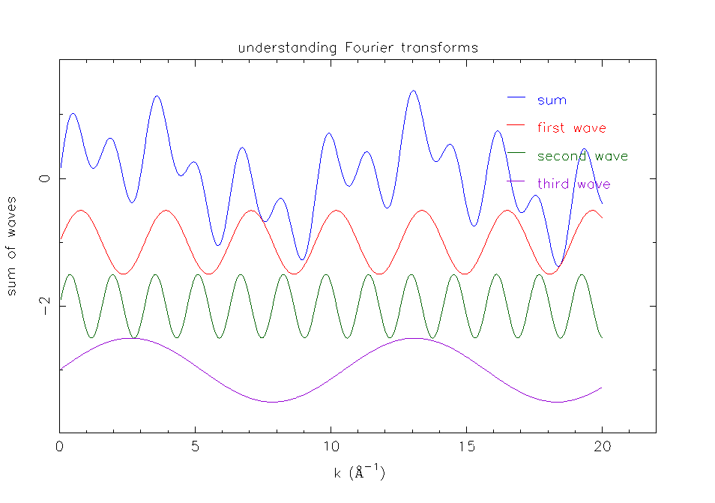
Fourier Transformation

Slide 26
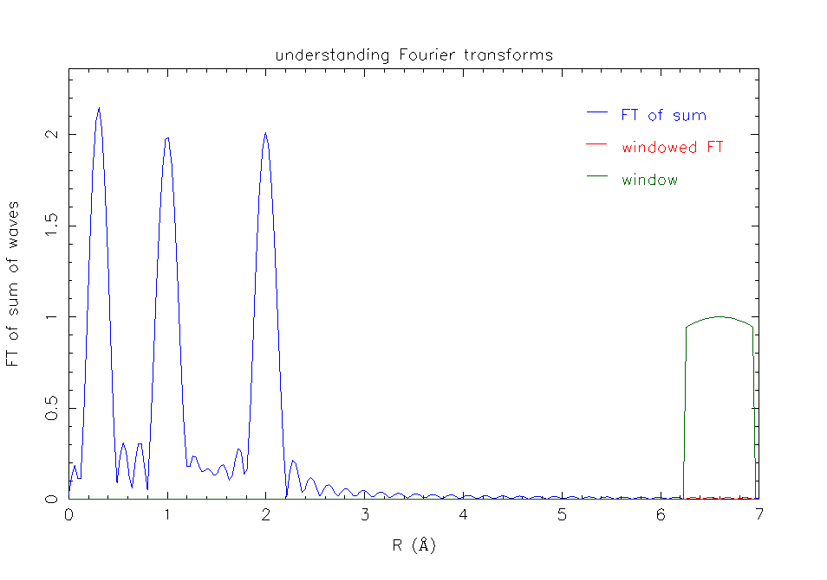
Fourier Transformation

Slide 27
Fourier Transformation
load old Athena, https://sourceforge.net/projects/ifeffit/

Slide 28
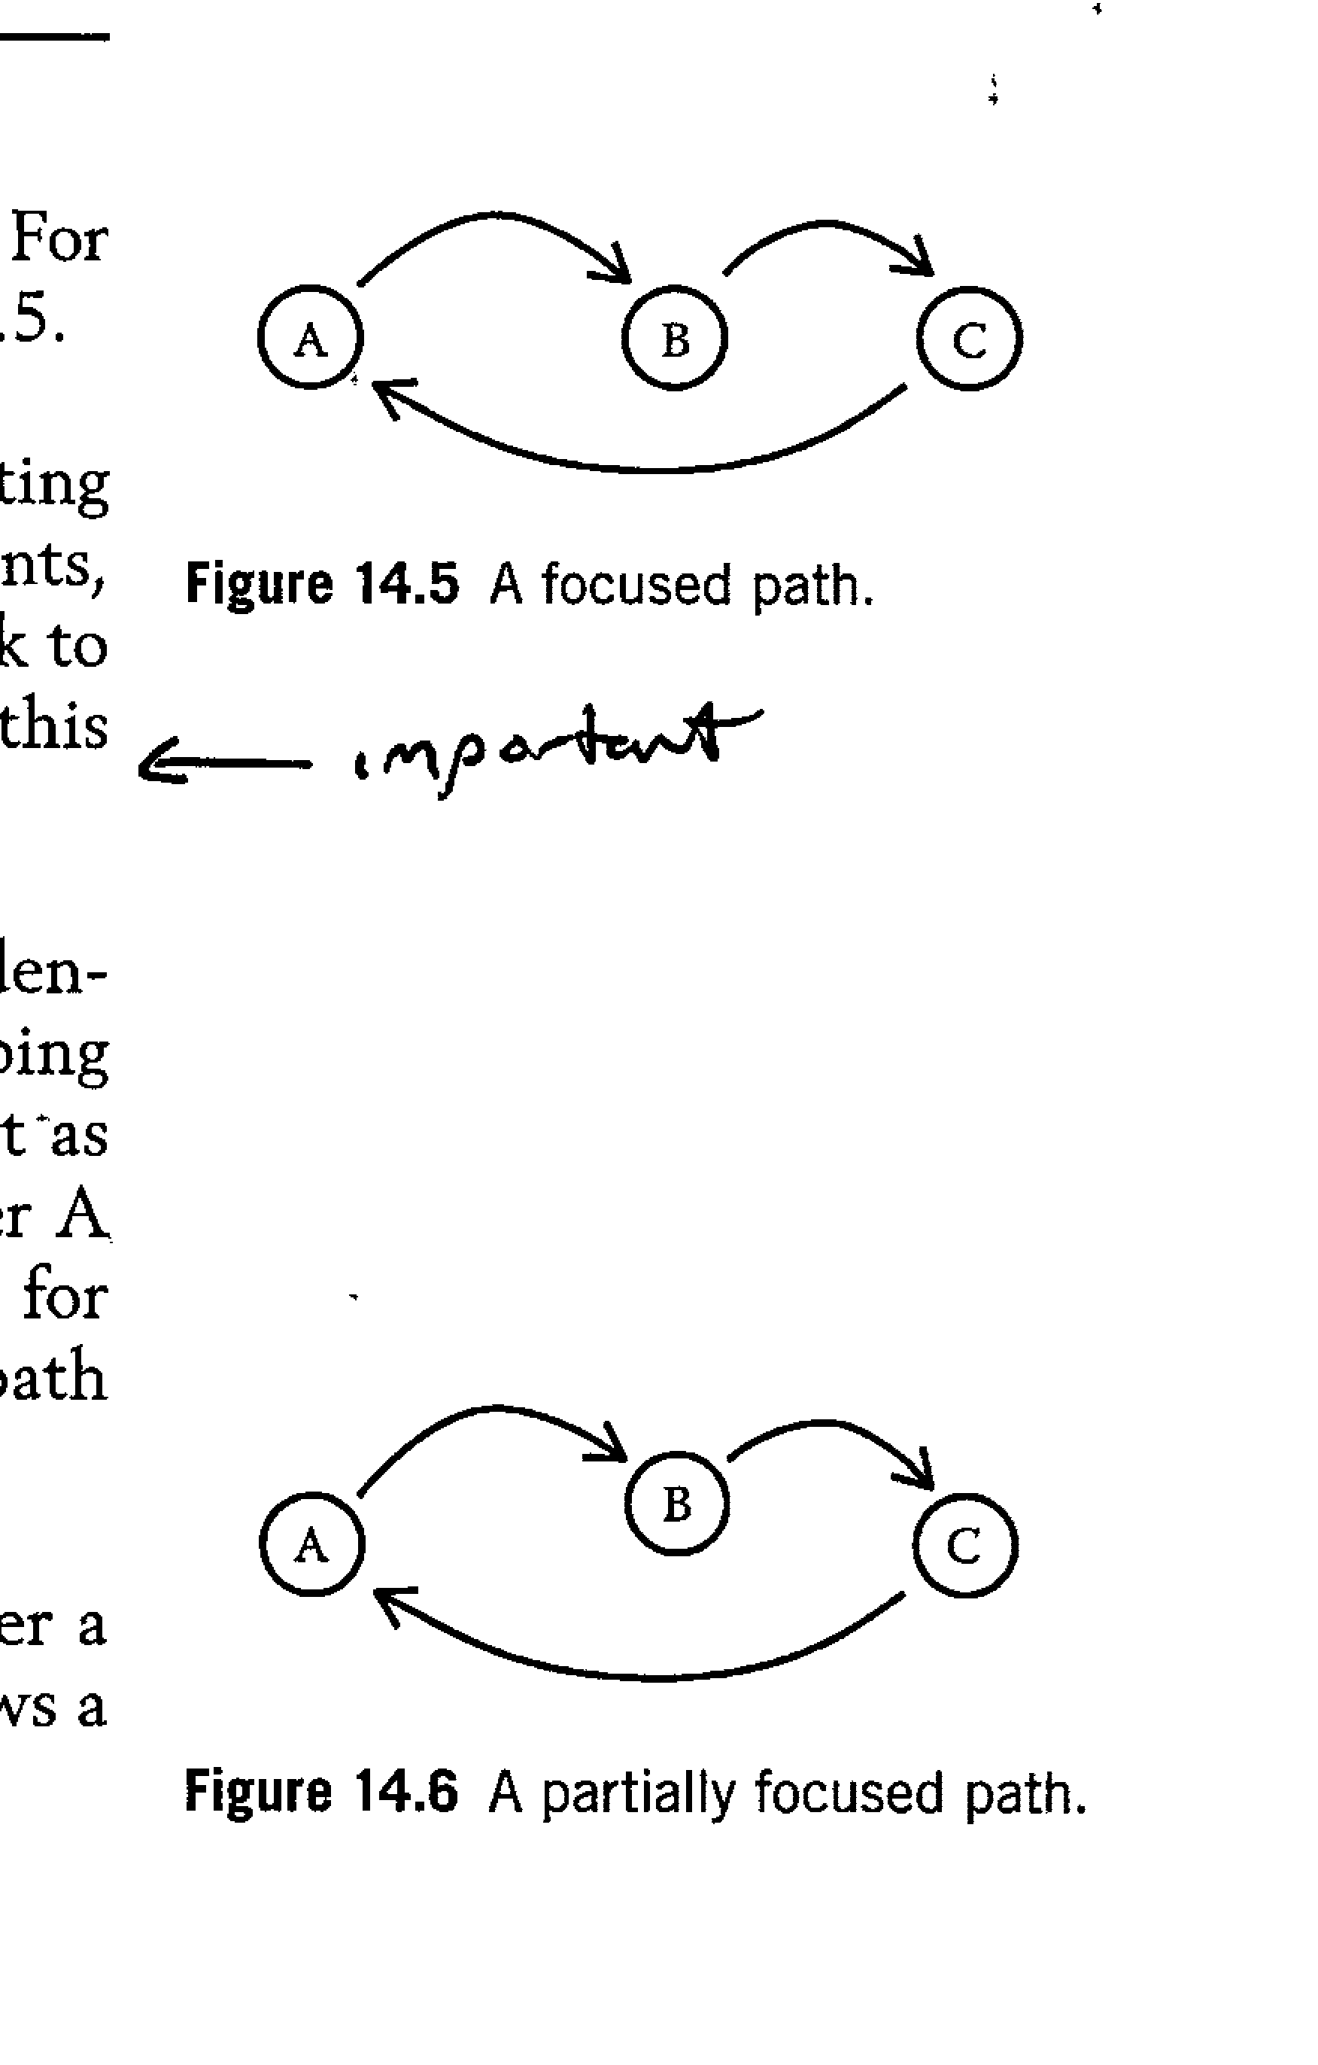
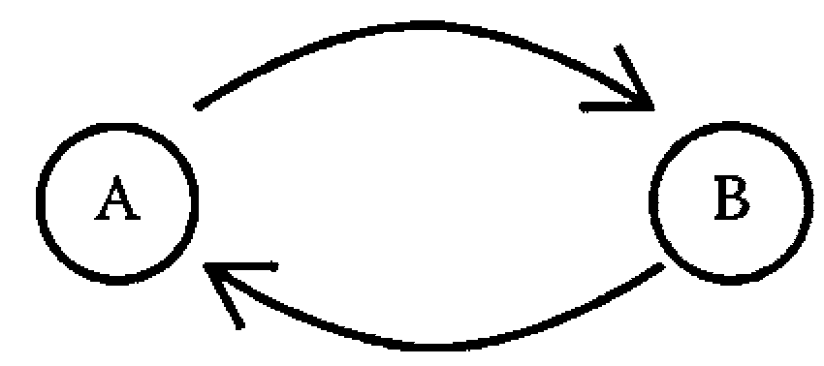
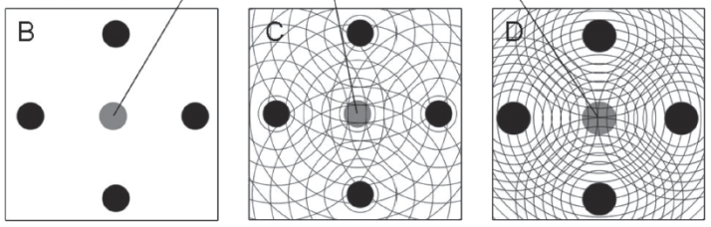
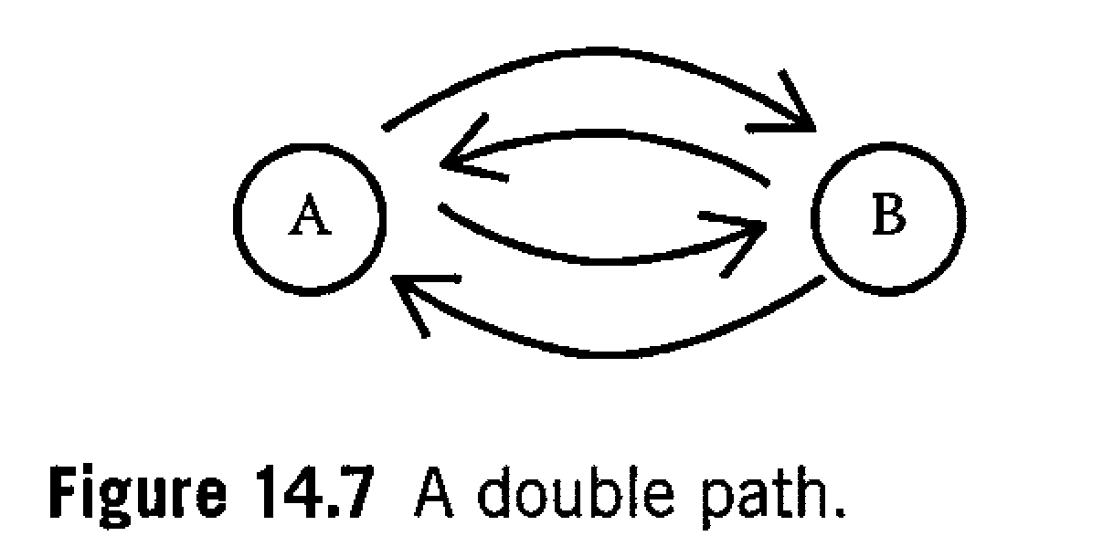
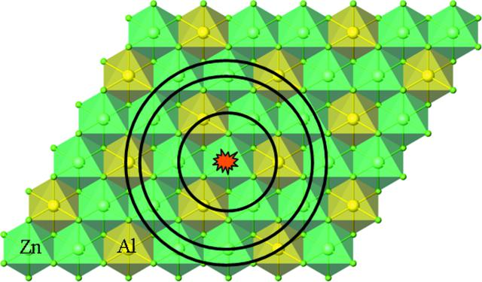
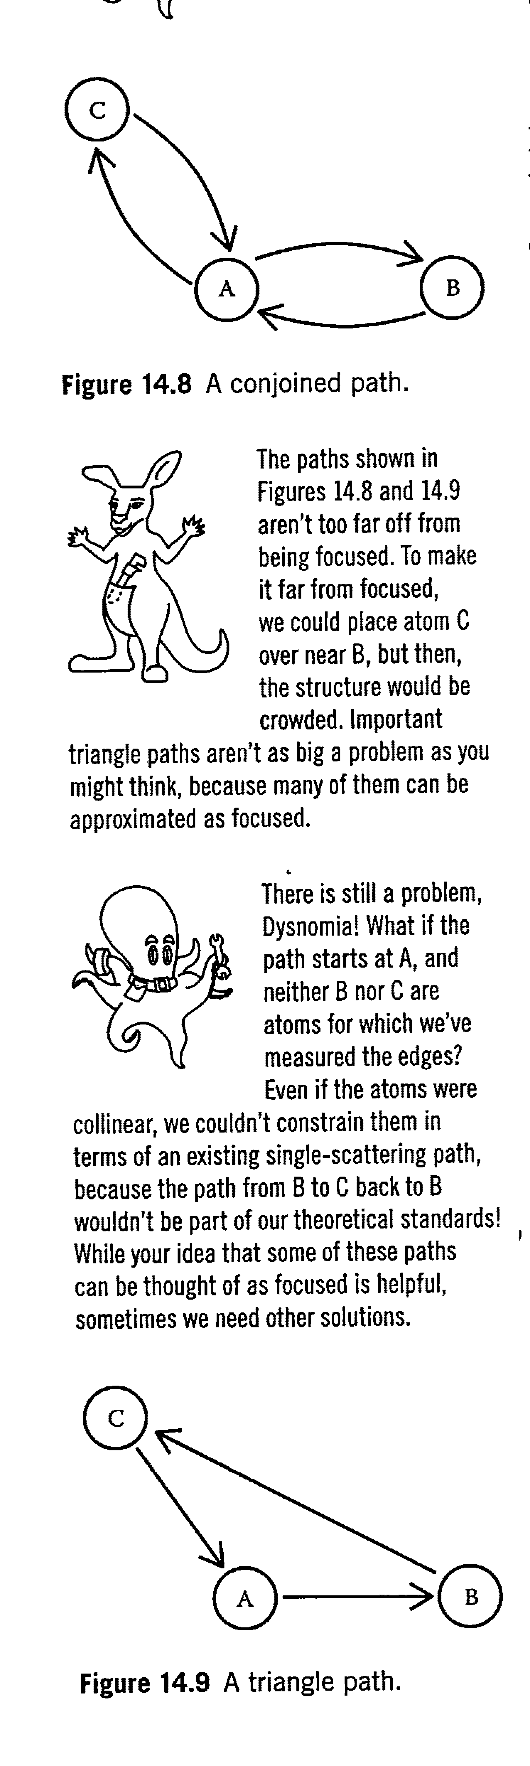
What do we fit?
Kelly et al 2008
A single scattering path (back and forth)
We “fit” scattering paths of the photoelectrons.
Those paths are based of off models.
Funke et al 2007, doi:10.1107/S0909049507031901
Calvin, 2013

Slide 29
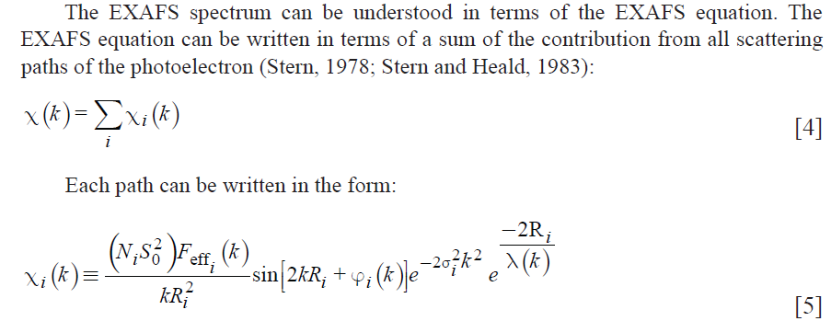
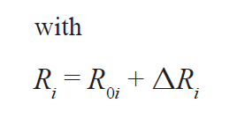
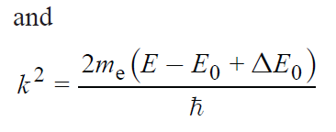
What do we fit?
There are in general five (5) variables that you fit. These variables are part of the EXAFS equation.
To know specifically what each variable stand for in the EXAFS equation, see Kelly et al 2008.
Many of the terms can be calculated by a computer program such as FEFF, we are only going to focus on the five generally concern us as users
5
2
1
3
4

Slide 30
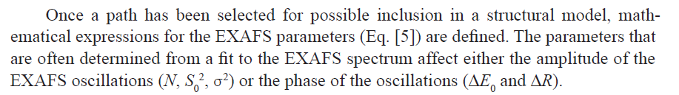
What do we fit?
1
2
3
4
5
(1) N – coordination number (CN), (4, tetrahedral, 6 octahedral)
(2) S_{o}² – Amplitude reduction factor (“es-oh-tu”)
(3) σ² – the disorder term (“sigma squared”)
(4) ΔE – the change in energy from theoretical data (“delta E”)
(5) ΔR – the change in interatomic distance (“delta R”)

Slide 31
What do we fit?
N - coordination number (CN)
Degeneracy (the number of equal path lengths)
  For tetrahedrally coordinated atoms (arsenate, arsenite, phosphate), CN=4
  For octahedrally coordinated atoms (hydroxide sheets, many aqueous metal ions), CN=6
Typical values – never negative, generally less than 8 for oxides for single scattering
When fitting a “standard” this value can be constrained to equal the CN of the model to determine S_{o}²
Generally for the first shell, we have a good idea if it is 4 or close to 6 (tetrahedral or octahedral)
  For the second shell, It is guessed when fitting an unknown CN (e.g., sorption sample or precipitate)

Slide 32

What do we fit?
N - coordination number (CN)
Arsenic tetrahedron

Slide 33
What do we fit?
S_{o}² - Amplitude reduction factor
Accounts for the slight relaxation of the remaining electrons in the presence of the core hole vacated by the photoelectron
Is different for different elements, but the value is generally transferable between different species from the same element and the same edge (chemically transferable)
Acceptable values
  Should be “a bit less than 1”
  0.7 to 1.05 are reasonable, normal values commonly seen between 0.8 an 1
Constraint: it should be the same value for every scattering path (all paths use the same value)
Can be determined from the fit of a “standard” (e.g., well defined mineral or aqueous ion)
Can be fixed to 0.9 but you must account for the added uncertainty to the CN (see how to do this in Calvin, 2013)
Directly correlated to CN!

Slide 34
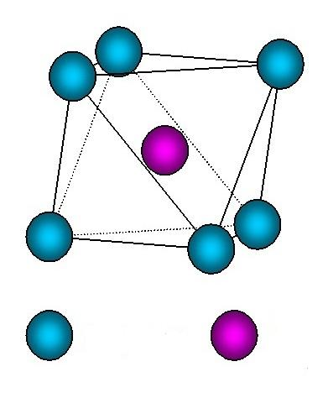
What do we fit?
σ² - Sigma squared, MSRD
the Mean Square Relative Displacement (MSRD)
  aka Debye-Waller factor
It is the variance in the half path length
  the square of the standard deviation of the half path length
Static and or thermal disorder term
  a measure of these kinds of disorder
STATIC DISORDER
THERMAL DISORDER
1.92 Å
1.97 Å
1.97 Å
1.92 Å
oxygen manganese
oxygen manganese

Slide 35
What do we fit?
σ² - Sigma squared, MSRD
In general, the values for σ² become bigger with increasing bond length or shell number (Kelly et al., 2008)
  E.g., 0.006 for first shell, 0.01 for second shell
Typical values: 0.002 to 0.03 Å², if any larger, the path is so disordered that it is contributing little to the fit which can be a sign the model is wrong in some way (Calvin, 2013)
There are many, many ways to constrain this variable:
  Use one value “constrain” for atoms of similar type (Z) and similar distance
  Constrain values for atoms overlapping in their error bars
  Use one value for the first shell and one value for the second shell
  See Calvin, 2013 for more discussion

Slide 36
What do we fit?
ΔE – “delta E” (E₀, “Enot”)
This term relates to a change in the photoelectron energy and is used to align the energy scale of the theoretical spectrum to match the measured spectrum (Kelly et al., 2008)
  https://www.researchgate.net/publication/237626147_EXAFS_Energy_Shift_and_Structural_Parameters
In general, these shifts should be less than 2 to 3 eV
  See “Aligning Energy Scales of Experimental and Theoretical Spectra” in Kelly et al., 2008 for adjust for shifts larger than this
  Generally, for "decent data" and a good fit E₀ has uncertainty of 0.5 to 1.0 eV (IFEFFIT mail list)
E₀ should always be on or near the rising portion of the edge, never on the smooth pre-edge or in the EXAFS region (Calvin, 2013)
Constraint: Use one ΔE for all scattering paths

Slide 37
What do we fit?
ΔR - delta R
This term represents a change to the interatomic distance relative to the initial path length
Interatomic distance is the same thing as half path length, where path length is the length of the complete scattering path
Constraints: isotropic expansion–contraction term applied to all paths (good for cubic systems) or values can be grouped depending on path length or direction (Kelly et al 2008)
The path length can be changed slightly (<0.1 Å) to optimize the model to the data (Kelly et al 2008
Generally, for "decent data" and a good fit, R has uncertainty of 0.01 or 0.02 Å (IFEFFIT mail list)
1.97 Å
For example:
if R_{i} = 1.97
and R = 2.04
then ΔR = 0.07
ΔR
oxygen manganese

Slide 38
Constraints - Why would constraining your fit be a good idea?
A constrained fit shows that your model and data are in good agreement (i.e., the data are what you thought they were)
A constrained fit reduces the number of fitted variables, which supports your argument that your data are similar to the model you’ve chosen
A constrained fit decreases your reduced chi square value (a statistical parameter used to measure goodness-of-fit)
A constrained fit can help keep variables in a physically realistic range of results
  sometimes variables, when given too much freedom, will change too much and move out of acceptable ranges in order to improve the fit. By constraining them, you keep them where they should be while maintaining reasonable fitting parameters

Slide 39
Fit statistics – How good is the fit?
Statistical parameters (the standard goodness-of fit parameters) include:
  the number of independent points, N_{idp}
  the number of variables, N_{var}
    must be less than N_{idp}
  “chi square” (χ²)
  “reduced chi square” (χ²_{v})
  R-factor
  All these values are calculated by the software (except N_{var})
The isolated EXAFS signal is denoted as χ(k) and should not be confused with the goodness-of-fit parameter χ²
Changes in the goodness-of-fit parameter χ²_{v} are used to compare fits with different number of variables (N_{var})
The R factor is a major fit parameter that needs to be included in the published table

Slide 40
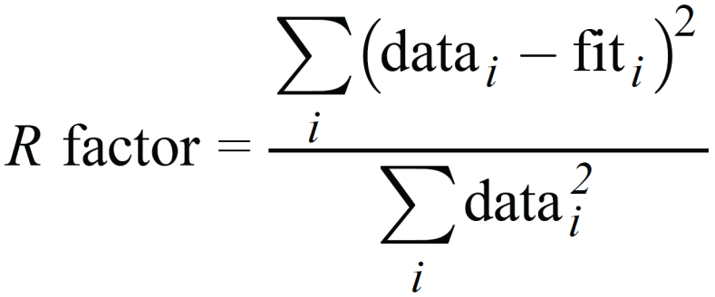
Fit statistics – How good is the fit?
The R factor is a major fit parameter that needs to be included in the published table
  is the sum of the squares of the differences between the data and the fit at each data point, divided by the sum of the squares of the data at each corresponding point.
  It represents the mean square misfit between the data and the fit for both the real and imaginary parts of the Fourier transform
R factor values less than 0.05 are considered to reflect a reasonable fit
For mathematical definitions of χ²_{v} , χ², and R-factor, see Kelly et al, 2008; Calvin 2013; and IFEFFIT manual (http://cars.uchicago.edu/~newville/feffit/feffit.pdf)

Slide 41
Knowing when the fit is done: the Hamilton test
Adding more variables will always improve the fit, so how can you tell if you are really making progress?
The Hamilton test is a very useful tool to determine if your fits are statistically improving or not when add more variables
  reducing N_{var} by using the Hamilton test
  useful when testing constraints on fits
Regularized Lower Incomplete Beta Function Calculator
  http://www.danielsoper.com/statcalc/calculator.aspx?id=37
This test is also applicable to linear combination fitting of EXAFS data, where you also have the same problem of adding more variables (standards)
See Calvin, 2013 for many examples of how to use this test (plus we’ll illustrate it today)

Slide 42
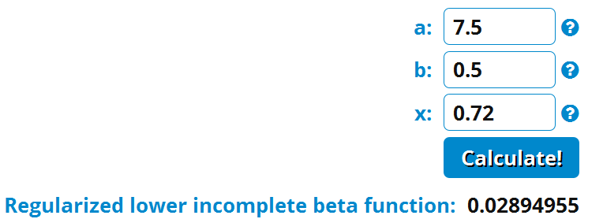
Knowing when the fit is done: the Hamilton test
Need several values:
  R-factor for each fit
  the degrees of freedom for the fits
  the number of variables used in each fit.
Degrees-of-freedom is defined as the number of independent points in the measured spectra minus the number of variables fit in the model (N_{idp} – N_{var}) (Kelly et al., 2008)
How to do Hamilton Test:
  Calculate ratio of R-factors between two fits, better fit in numerator (Ratio < 1)
  For the better (closer) fit, divide # degrees of freedom by 2. This = a.
  Divide the difference in N_{var} (i.e., the difference between N_{var} used in each fit) by 2. This = b.
  Plug values into online calculator
    http://www.danielsoper.com/statcalc/calculator.aspx?id=37
    Employ a 95% confidence interval
    Anything below 0.05 (5%) indicates a statistically significant improvement in the fit
    There is less than a 5% chance that the difference between the fits would occur by random variation
    There is less than a 5% chance that the difference is just due to noise in the data
Example pg. 218 Calvin, 2013

Slide 43
What parameters to publish?
See Kelly et al., 2008 and Calvin, 2013 for exhaustive lists in terms of:
  Beamline characteristics and light sources
  Fitting statistics
Example table header & data
Sample & CIF reference | R-factor & # in Table 5 | N_{idp} & k-range fit | N_{var} & R-range fit | χ² & χ²_{n} | Path | CN | R (Å) | σ² (Å²) | ΔE (eV) | ±CN | ±R (Å) | ±σ²(Å²) x10⁻³ | ±ΔE (eV)
Ni-Acid birn. | 0.007 | 13.5 | 9 | 3674 | Ni-O | 6.4 | 2.055 | 0.006 | 0.9 | 1.1 | 0.010 | 2 | 1.0
(Post and Veblen, 1990) | 8 | 2.5 - 11.5 | 1.2 - 3.6 | 823 | Ni-Mn | 1.2 | 2.886 | 0.008 | 0.9 | 0.5 | 0.030 | 3 | 1.0
 |  |  |  |  | Ni-Mn | 5.5 | 3.494 | 0.008 | 0.9 | 1.7 | 0.014 | 3 | 1.0

Slide 44
Resources
Software help
  http://bruceravel.github.io/demeter/
Video tutorials
  https://vimeo.com/channels/exafs
Mailing list
  https://www.mail-archive.com/ifeffit@millenia.cars.aps.anl.gov/
Hamilton Test calculator
  http://www.danielsoper.com/statcalc/calculator.aspx?id=37

Slide 45
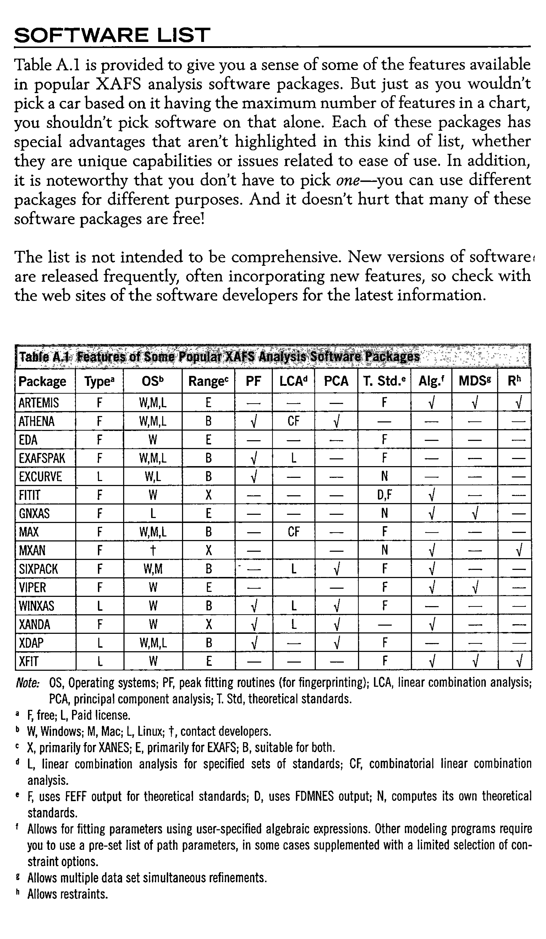
Resources
Calvin, 2013

Slide 46
Resources – XAFS.org
http://www.xafs.org/Tutorials
- XAFS Online Orientation, in interactive Flash-based tutorial produced by the National Synchrotron Light Source
- XAFS Tutorials from Grant Bunker, at IIT
Videos of lectures and demonstrations from an XAS training course at the Diamond Light Source, November 2011
Matt Newville's Tutorials
Shelly Kelly's Tutorials
Bruce Ravel documentation
  http://bruceravel.github.com/demeter
    Athena: A User's Guide
    Artemis Users' Guide
    http://vimeo.com/channels/exafs
    http://www.diamond.ac.uk/Home/Events/Past_events/XAS-workshop-2011.html?mgnlCK=1339516257183
    https://speakerdeck.com/bruceravel
    http://bruceravel.github.com/XAS-Education
Six pack documentation
  http://www-ssrl.slac.stanford.edu/xraywiki/xraywiki.php?n=BeamLine02.SIXPACK
Databases for crystal structure files
  http://www.xafs.org/Databases
  http://rruff.geo.arizona.edu/AMS/amcsd.php
  http://cars.uchicago.edu/ifeffit/FAQ/RunningFeff#crystal

Slide 47
Resources – IFEFFIT home page
http://cars.uchicago.edu/ifeffit/Ifeffit
  Frequently Asked Questions
    http://cars9.uchicago.edu/ifeffit/FAQ
      General Questions about Ifeffit and XAFS
      Getting and Installing Ifeffit
      Basic Data handling in Ifeffit
      Plotting Issues with Ifeffit
      Running and Using FEFF
      Background subtraction (Autobk, Athena, SixPack)
      Modeling XAFS with Feffit, Artemis, and SixPack
        http://cars9.uchicago.edu/ifeffit/FAQ/FeffitModeling
      Running and using Athena, Artemis, and Hephaestus
      Modeling and Interpreting XANES
      Scripting and Programming Ifeffit
  http://cars9.uchicago.edu/ifeffit/HoraeTipOfTheWeek
ATOMS on the web (i.e., the program incorporated into Artemis, but on the web)
  http://cars9.uchicago.edu/cgi-bin/atoms/atoms.cgi

Slide 48
Resources – Mail List
Ifeffit mail list discussions (very informal – human voice)
  http://cars.uchicago.edu/ifeffit/Mailing_List
  Join it to get the emails
Search the archive at The Mail Archive.
  http://www.mail-archive.com/ifeffit@millenia.cars.aps.anl.gov/
Search mail list public archive for older/all messages with the following Google search:
  “use of constraints” site:http://millenia.cars.aps.anl.gov/pipermail/ifeffit/
  “so2” site:http://millenia.cars.aps.anl.gov/pipermail/ifeffit/
  Other examples: Linear combination fitting, negative sigma square values

Slide 49
Resources – Mail List
Fitting procedure
  http://www.mail-archive.com/ifeffit@millenia.cars.aps.anl.gov/msg01694.html
Coordination Number
  http://millenia.cars.aps.anl.gov/pipermail/ifeffit/2002-October/000151.html
  http://www.mail-archive.com/ifeffit@millenia.cars.aps.anl.gov/msg03435.html
Guide Lines for acceptable fitting parameter values
  http://www.mail-archive.com/ifeffit@millenia.cars.aps.anl.gov/msg01861.html
The use of constraints & restraints in fitting, use of dopants*, other good techniques
  http://millenia.cars.aps.anl.gov/pipermail/ifeffit/2010-May/009446.html
  http://cars9.uchicago.edu/feff/feffusers/msg00047.html
* - very useful knowledge when you need to substitute atoms into/out of feff.inp files – most of you will need to do this at some point

Slide 50
Resources – book chapters & papers
***Kelly, S. D., Hesterberg, D. and Ravel, B. (2008). Analysis of soils and minerals using X-ray absorption spectroscopy. Methods of soil analysis, Part 5 -Mineralogical methods. Ulery, A. L. and Drees, L. R. Madison, WI, USA, Soil Science Society of America: 367-463.
Quantitative speciation of heavy metals in soils and sediments by synchrotron X-ray techniques. Author(s): Manceau, A; Marcus, MA; Tamura, N Book Editor(s): Fenter, PA; Rivers, ML; Sturchio, NC; et al. Source: APPLICATIONS OF SYNCHROTRON RADIATION IN LOW-TEMPERATURE GEOCHEMISTRY AND ENVIRONMENTAL SCIENCES Book Series: Reviews in Mineralogy & Geochemistry Volume: 49 Pages: 341-428 DOI: 10.2138/gsrmg.49.1.341 Published: 2002
Fendorf, S.E., and D.L. Sparks. 1996. X-ray absorption fine structure spectroscopy. In Methods of Soil Analysis: Chemical Methods. J.M. Bigham (Ed), ASA, Madison, WI.. : p. 377-416.
J. Am. Chem. SOC. 1994,116, 2938-2949 Extended X-ray Absorption Fine Structure (EXAFS) Analysis of Disorder and Multiple-Scattering in Complex Crystalline Solids P. A. O'Day. J. Rehr,i S. I. Zabinsky,t and C. E. Brown, Jr.

Slide 51
Resources – book chapters
An overview of synchrotron radiation applications to low temperature geochemistry and environmental science Author(s): Brown, GE; Sturchio, NC Book Editor(s): Fenter, PA; Rivers, ML; Sturchio, NC; et al. Source: APPLICATIONS OF SYNCHROTRON RADIATION IN LOW-TEMPERATURE GEOCHEMISTRY AND ENVIRONMENTAL SCIENCES Book Series: Reviews in Mineralogy & Geochemistry Volume: 49 Pages: 1-115 DOI: 10.2138/gsrmg.49.1.1 Published: 2002
Sorption of trace elements on mineral surfaces: Modern perspectives from spectroscopic studies, and comments on sorption in the marine environment Author(s): Brown, GE; Parks, GA Source: INTERNATIONAL GEOLOGY REVIEW Volume: 43 Issue: 11 Pages: 963-1073 Published: NOV 2001
Molecular environmental geochemistry .Author(s): O'Day, PA Source: REVIEWS OF GEOPHYSICS Volume: 37 Issue: 2 Pages: 249-274 DOI: 10.1029/1998RG900003 Published: MAY 1999
Mineral surfaces and bioavailability of heavy metals: A molecular-scale perspective Author(s): Brown, GE; Foster, AL; Ostergren, JD Source: PROCEEDINGS OF THE NATIONAL ACADEMY OF SCIENCES OF THE UNITED STATES OF AMERICA Volume: 96 Issue: 7 Pages: 3388-3395 DOI: 10.1073/pnas.96.7.3388 Published: MAR 30 1999
Metal oxide surfaces and their interactions with aqueous solutions and microbial organisms Author(s): Brown, GE; Henrich, VE; Casey, WH; et al. Source: CHEMICAL REVIEWS Volume: 99 Issue: 1 Pages: 77-174 DOI: 10.1021/cr980011z

Slide 52
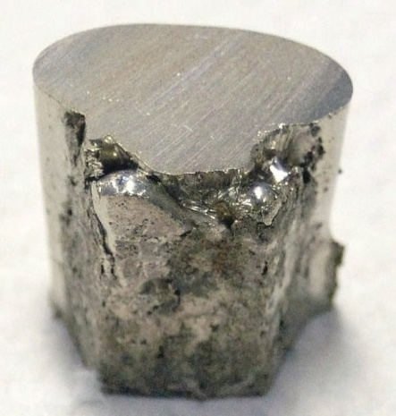

Let’s Start Fitting – Ni foil
Athena
  Data normalization
  Illustrate back FT in Athena
    Expanding R- range changes the back-FT reproduce smaller feature from higher shells and MS paths
Artemis
  Shell Fitting
  For a clear explanation of the windows and buttons used in Artemis, see videos by its author:
    https://vimeo.com/channels/exafs
open lesson plan doc

Slide 53
“Protocol” for shell-by-shell fitting
This “protocol” is a general step-by-step process for loading data and getting started on the fit
Identify a crystal structure file [Crystallographic Information File (CIF)] as a model that is suitable to fit your data. Results from density functional theory (DFT) are also suitable.
  http://rruff.geo.arizona.edu/AMS/amcsd.php
  http://www.crystallography.net/
Load your chi weighted data into Artemis
Load your CIF file into Artemis
  Some CIF files have partial occupancy of atoms (eg Na-birnessite). The Na atom can be removed so that Atoms can perform its operation of making a cluster. It will not function with partial vacancies because it needs to have an atom be present or absent, not partial filled.
slide accompanied by hands on work in Artemis

Slide 54
“Protocol” for shell-by-shell fitting
Run ATOMS with 9 angstrom cluster and 6 angstrom scattering path
  cluster needs to be bigger than scattering paths so atoms have well defined boundaries
  modify atom list to include the ones you need (doping)
  change absorbing atom (ipot value) to the one you need
    e.g. for a nickel-doped manganese or iron oxide , you change the absorbing atom from Mn or Fe to Ni (ipot line will be 0 28 Ni, not 0 25 Mn)
    ………………..run Feff
Start fitting the first shell until satisfactory values are determined
  See previous slides and resources for what “satisfactory values” are
Fit higher shells by expanding R-range
  show how individual paths contribute to EXAFS spectra and how sine wave interact
  make sum of all paths (V_{path} and plot in R and q)
  careful: program can crash with too many clicks
Test different constraints on delr, σ², and MSRD to reduce fitted variables
slide accompanied by hands on work in Artemis

Slide 55
“Protocol” for shell-by-shell fitting
After fitting with multiple independent variables, try to combine overlapping values to reduce the number of variables (this will bring down reduced chi square value)
  This is called constraining the fit
  You can also start with a more constrained fit and relax (add) more variables if necessary and defendable
  look for variables that have overlapping values like delr or ss that are in the same shell, close together physically. See previous comments in presentation about constraints. See Kelly et al., 2008 and Calvin, 2013 for good recourses on constraints.
For difficult fits sometimes you have to set a parameter (e.g., delr set at 0 or at -0.1) to force the fit to go a certain way. Afterwards release the “set” and change all to “guess” to make sure the fit is stable
For adsorbed or amorphous samples, you don’t have CIF files as a base for your model, that is OK
  You can use related crystal structures and dope atoms into them (e.g., Ni adsorbed on to gibbsite, use the gibbsite CIF and change the absorbing atom to Ni and several of the atoms in Al positions to Ni.
slide accompanied by hands on work in Artemis

Slide 56
“Protocol” for shell-by-shell fitting
For each shell:
  select paths that are major contributors to scattering (single scattering) first
  Multiple scattering is important for some structures, like tetrahedral structures (arsenate, arsenite, phosphate) and some distorted octahedra
Phase Shift
  The distances you see in R-space are a little shorter than what are in the CIF file and thus in the FEFF path lengths. This is called “phase shift”.
  Normally in papers you show figures that are UN-corrected for phase shift (i.e., exactly what you see on your computer) and you label the graphs accordingly. The tabulated data show the real distances.
  It is normally about a -0.5 angstrom shift in the graph to the R_{eff} value
Graphical results of the fit serve as a visual aid, but the data tables tell the real story.
  You can have a great looking fit but with e.g., unrealistic sigma squared values. “Happiness factor” helps detect unrealistic values, but you still have to keep a watchful eye on all the parameters
slide accompanied by hands on work in Artemis

Slide 57
“Protocol” for shell-by-shell fitting
What is the “phase shift” ?
  A phase shift of the photoelectron caused by the interaction of the photoelectron with the nuclei of the absorber atom and the interaction with the nuclei of the coordinating atoms of the photoelectron path. Because the photoelectron has a negative charge and the nucleus is positively charged, the photoelectron loses energy and its wavelength lengthens as it interacts with the coordinating atoms and the absorber atom (Kelly et al., 2008)
slide accompanied by hands on work in Artemis

Slide 58
“How do I do x?”
How to calculate uncertainties in CN (searched coordination+number+uncertainty)
  https://www.mail-archive.com/ifeffit%40millenia.cars.aps.anl.gov/msg04767.html
Significance of correlation values
  https://www.mail-archive.com/ifeffit%40millenia.cars.aps.anl.gov/msg05364.html
How do I do the Hamilton test (example)
  https://www.mail-archive.com/ifeffit%40millenia.cars.aps.anl.gov/msg04931.html
How to fit coordination number
  https://www.mail-archive.com/ifeffit%40millenia.cars.aps.anl.gov/msg03650.html
How to use restraints:
  https://www.mail-archive.com/ifeffit%40millenia.cars.aps.anl.gov/msg02299.html
  https://www.mail-archive.com/ifeffit%40millenia.cars.aps.anl.gov/msg01444.html
  http://millenia.cars.aps.anl.gov/pipermail/ifeffit/2003-July/000401.html
How do I do dopants
  https://bruceravel.github.io/demeter/documents/Artemis/extended/dopants.html
  https://bruceravel.github.io/demeter/artug/extended/dopants.html
How do I do “X”?
  Search the internet and/or IFEFFIT mail list and /or post questions

Slide 59
EXTRAS

Slide 60

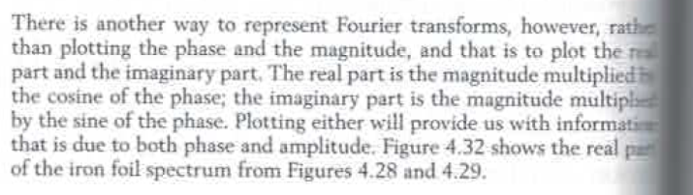
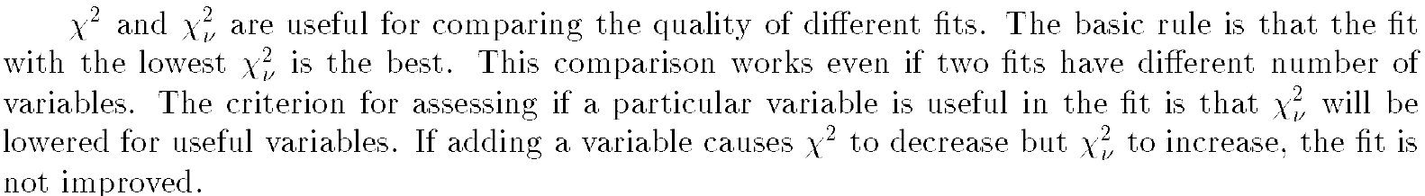
Newville – ifeffit document

Slide 61
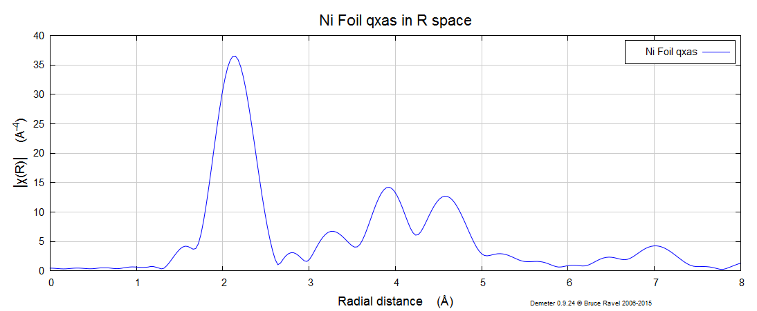
1
3
4
2

