Slide 1
Effort Training Part I Why is it so much effort?
Office of Sponsored Programs
July, 2011

Slide 2
Some Questions?????
We only certify effort paid on federal funds?
Teaching overload is included in effort certification?
The tolerance level for evaluation is 10% at UD?
Hourly wage earners are not included in effort certification process?
The UD has an effort certification reporting policy?
Only faculty have to certify effort?
Effort is based on a 40 hour workweek?

Slide 3
The purpose of effort reporting is to provide a reasonable basis for distributing salary charges among direct activities (e.g., sponsored projects and non sponsored activities such as instruction, administration, and service)

Slide 4
Why Report?
Federal audit personnel rely on effort reporting to evaluate whether the salary paid on an award is reasonable relative to the effort expended on the award
PI and University are ultimately responsible for ensuring that all charges to an award are appropriate, including salary charges
Salary and wage charges typically represent more than half of all direct costs
Effort reports document and account for the use of those funds
UD Policy 6-5 addresses effort certification at UD.

Slide 5
Compensation for Personal Services
OMB Circular A-21 (2 CFR, Part 220) J10
Includes amounts paid by the institution for services of employees rendered during the period of performance under sponsored agreements
Total compensation conforms to established policies of institution
Consistently applied
Reasonable amounts contributing to & intimately related to work under sponsored agreements

Slide 6
Payroll Distributions
OMB Circular A-21 (2 CFR, Part 220) J10b(1) General Principles
Distribution based on payrolls documented in accordance with generally accepted practices of colleges and universities
Equitable distribution of charges for employees activities
Method used for apportioning salaries – teaching, research, service and administration – inextricably intermingled
Reliance placed on estimates – with a degree of tolerance
No single best method for documenting distribution

Slide 7
Criteria Acceptable Methods
Incorporated into the official records of the institution
Reasonably reflect the activity for which the employee is compensated
Encompass both sponsored and all other activities
Must recognize after the fact confirmation – represent actual costs
Confirmed by responsible persons with suitable means of verification that the work was performed
Distribution may reflect categories of activities expressed as a percentage distribution of total activities

Slide 8
Institutional Base Salary (IBS)
The University of Delaware has defined IBS as an individual’s total contractual compensation from the university as is defined in a standard offer letter. Payments for work outside of the duties for which one was hired, are not part of the IBS.
As the majority of faculty have in their workload non sponsored activities such as instruction, course development, advisement of students, administrative assignments, writing of proposals, service on committees or review boards, it should be extremely rare for any faculty member to be 100% sponsor funded.

Slide 9
UD Institutional Base Salary
Individual’s total contractual compensation
Included in IBS | Not included in IBS
Instruction/University supported academic effort | Activities outside of contract - overload
Externally sponsored research | External consulting, serving on boards
Departmental research | Volunteering – public service
Administrative or University service | One-time, extra payments – special activities
Public Service on behalf of University | Other activities unrelated to primary job
Unpaid service to professional organization

Slide 10
Incidental Work
Personal Time
In excess of normal for the individual
Supplemental compensation is paid under institutional policy
Need not be included in effort certification system
Compensation is separately identified and documented in the financial management system
No standard number of hours for work week.
Fair amount of time spent outside of lab/office is expected.
Work performed for institution part of IBS
Cannot claim they performed work on “their own time” if institutional activity

Slide 11
Sponsored Activities
Non Sponsored Activities
Effort on federal/non federal research projects
Writing progress reports
Meeting with lab staff
Attending scientific conference to present research results
Reading scientific journals to keep up to date with latest advances in field
Typical Teaching
Writing a new grant application
Mentoring junior faculty member
Attending department faculty meeting
Serving on IRB/IACUC
Servicing on NIH student section or NSF peer review panel

Slide 12
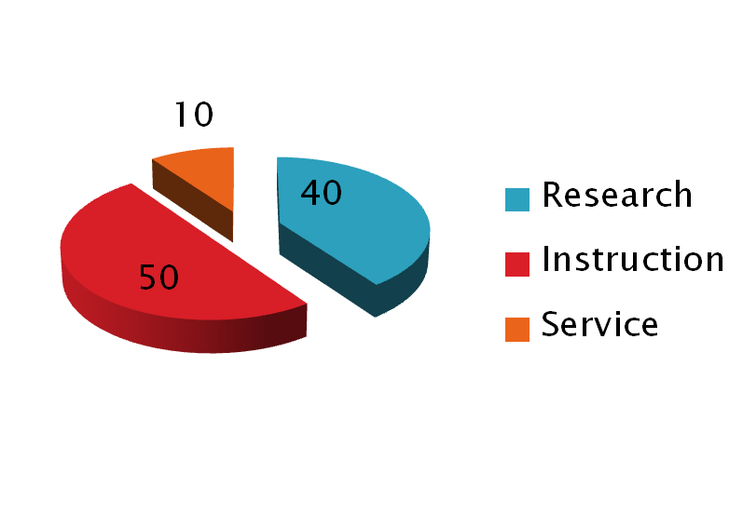
Total Compensation
External Research
Effort provided for external sponsors
Departmental Research
Writing proposals
Journal review/editing
Non sponsored research
Grants/Contracts
Notes:
Flexibility between external/departmental research

Slide 13
Effort Process
The effort process begins well before the effort report is generated
Appointing Faculty & Staff
Preparing the Proposal Budget
Charging Salary
Relating pay to the effort
Employment
Terms established
Contract period
Contract months
Salary base
Special terms
Effort is
proposed,
Commitment
is made to
sponsor
Salary charged
Effort is
attested to
after activity
has occurred

Slide 14
Award Proposals
Include effort in proposal for all personnel anticipated to work on the project, this includes both direct and cost shared effort
Current and Pending is accurate
PI/CPI/Key Personnel effort that is committed must be met
Faculty commitments may exceed their workload as it is recognized that not all proposals are awarded
Direct or cost share commitment should be calculated for the budget using the base pay rate
Effort proposed should be based on reasonable amount of time that will be expended on the sponsored project if awarded
F101 proposal should reflect correct budget item

Slide 15
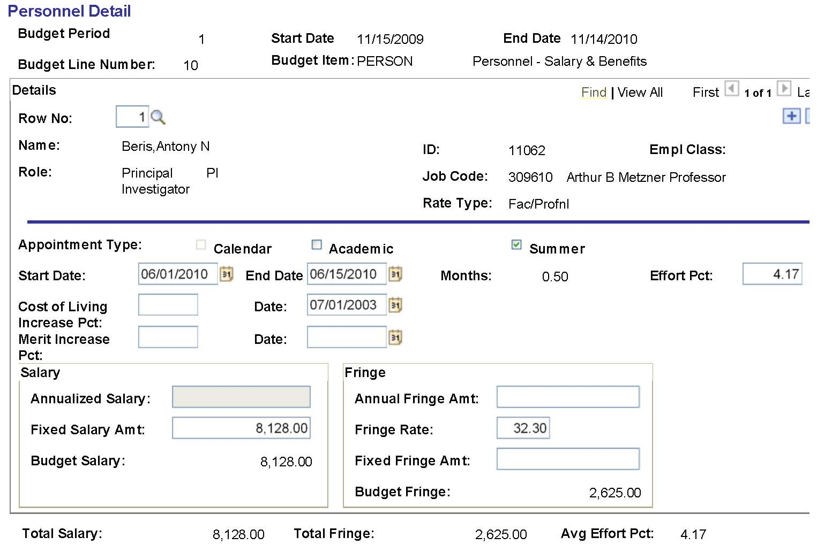
Proposal Budget Detail

Slide 16
Award
Faculty/PI/Key personnel commitments to be met
This is reflected in the project team table by the Contract and Grant Specialist based on information in F101 proposal
If PI/CPI/Key personnel exceeded research workload modifications are required
If PI/CPI/Key personnel cannot meet committed effort modifications are required
LAM data entry to allocate effort
Plan for summer salary
Award management – continuous and timely

Slide 17
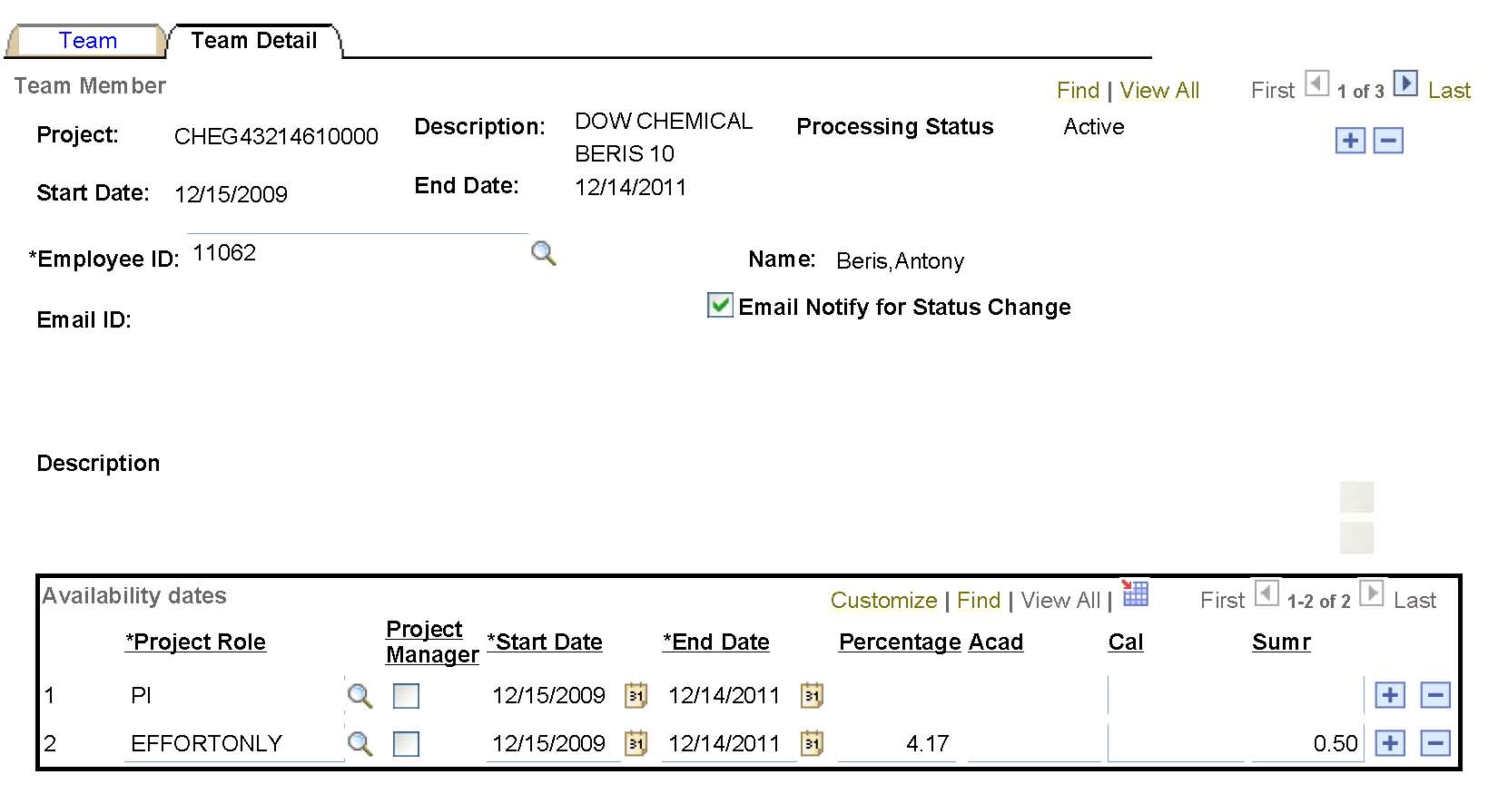
Project Team Detail
4.17% effort is committed
Plan to pay ½ month summer salary

Slide 18
Effort Certification
Values drawn from UOD Trans
Commitments drawn from project team data in PS
Employee certifies for self at UD
Suitable means of verification – first hand knowledge
Tolerance level – within 5% points is close enough
Roles & Responsibilities

Slide 19
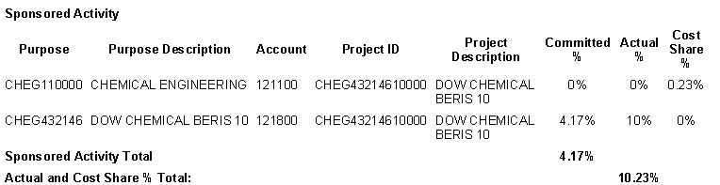
Effort Certification
121100 indicates academic time
‘Cost Share’ means this amount was paid by the university
121800 indicates summer research
‘Actual’ means this amount was paid by the grant
Total amount of effort committed on sponsored activities
Total amount of effort reported on sponsored activities

Slide 20
Roles & Responsibilities
PI
Importance of effort reporting compliance
Effort changes for themselves as well as other individuals
Effort Administrator
One staff member per unit/dept.
Request omitted reports when needed
Effort Manager
Ensuring University effort system meets federal requirement and adheres to UD policy
Produce & release reports to effort administrators
Proper grant management
Meet workload without over committing
Report any substantial changes in effort in a timely manner
Facilitate the timely/accurate completion of reports
Reviewing reports for errors
Distribution of reports
Making necessary adjustments to salary allocations
Review effort JVs
Retain electronic copies for retention period

Slide 21
Q&A
Only Faculty members are required to certify effort expended in support of sponsored projects?
True
False

Slide 22
Q&A
Only Faculty members are required to certify effort expended in support of sponsored projects?
False
Explanation: Effort certification must be completed by individuals who are charged either directly or as cost share to sponsored projects, who do not complete timecards.
Remember: An administrator may help review effort and pay
distribution but generally is not the appropriate person to certify effort

Slide 23
Q&A
Which of the following are true? The purpose of an effort form is to:
Confirm, after the fact, that the paid effort reported for each activity is a reasonable estimate of the work performed.
Allow for the inclusion of external consulting
Distribute effort based on the remaining funds in the award(s)
A
B
C

Slide 24
Q&A
Which of the following are true? The purpose of an effort form is to:
Confirm, after the fact, that the paid effort reported for each activity is a reasonable estimate of the work performed.
True.
Allow for the inclusion of external consulting
False, external consulting is not a University activity.
Distribute effort based on the remaining funds in the award(s)
False. This would be unallowable.
A
B
C

Slide 25
Q&A
Teaching overload is part of effort certification?
True
False

Slide 26
Q&A
Teaching overload is part of effort certification?
False
Explanation: Teaching overload is not part of the IBS. It is in excess of a faculty member’s normal job responsibilities.

Slide 27
Q&A
The tolerance level for evaluation is 10% at UD?
True
False

Slide 28
Q&A
The tolerance level for evaluation is 10% at UD?
False
Explanation: per UD policy, the tolerance level for certification is 5% points.

Slide 29
Q&A
Hourly wage earners are not included in effort certification process?
True
False

Slide 30
Q&A
Hourly wage earners are not included in effort certification process?
True
Explanation: the requirements of payment for hourly wage earners, such as reporting of hours after work is performed, satisfy the requirements of A-21 section J.10.

Slide 31
Q&A
The UD has an effort certification reporting policy?
True
False

Slide 32
Q&A
The UD has an effort certification reporting policy?
True
True. It is policy number 6-5.

Slide 33
Q&A
Effort is based on a 40 hour workweek?
True
False

Slide 34
Q&A
Effort is based on a 40 hour workweek?
False
Explanation: Effort includes all activities for which an employee is paid by the University for work related to their primary job responsibilities, regardless of the number of hours worked.

Slide 35
Q&A
We only certify effort paid on federal funds?
True
False

Slide 36
Q&A
We only certify effort paid on federal funds?
False
Explanation: At UD, we certify effort paid on all funding sources for any employee who had any effort allocated to any sponsored funding source, Federal or otherwise.

