Slide 1
The role of submarine landslides in the Great Eastern Japan tsunami of 2011
David Tappin (1),
Stephan Grilli (2), Jeffrey Harris (2), Robert J. Geller (3),Timothy Masterlark (4), James Kirby (5), Fengyan Shi (5), Gangfeng Ma (6), K.K.S. Thingbaijam (7), P.M. Mai (7)
(1) British Geological Survey, (2) University of Rhode Island, (3) University of Tokyo, (4) South Dakota School of Mines,(5) University of Delaware, (6) Old Dominion University, Norfolk, (7) King Abdullah University

Slide 2
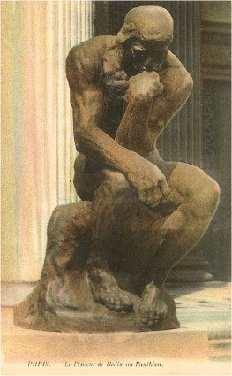
Is a submarine landslide required to explain the March 11th 2011 Tohoku tsunami?
But not all of it!
Context is recent events (e.g. Papua New Guinea, Indian Ocean) that have led to significant reappraisals of tsunami generation mechanisms, both EQ and submarine landslides,
Previously submarine landslides not recognised as a serious hazard,
For Japan, why is an additional mechanism required - the EQ is M9.1?
Why is a submarine landslide the most likely candidate?

Slide 3
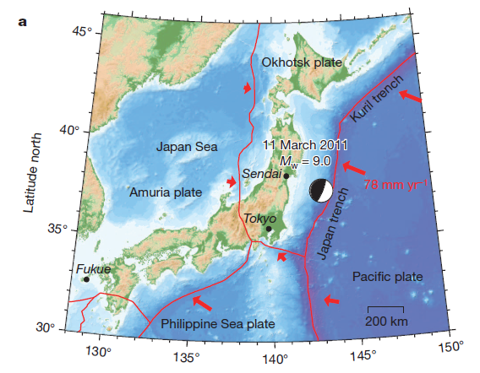
Japan tsunami - 2011
Probably the most comprehensively geophysically recorded EQ and tsunami,
Global and local seismic networks,
Geodetic networks across Japan,
Onshore tide gauges,
Nearshore GPS pressure gauges,
DART buoys,
Onshore runup and inundation measurements,
But some aspects of the tsunami do not tie in to the M9.1 earthquake

Slide 4

First indications – helicopter video
Land flooded before these waves struck

Slide 5
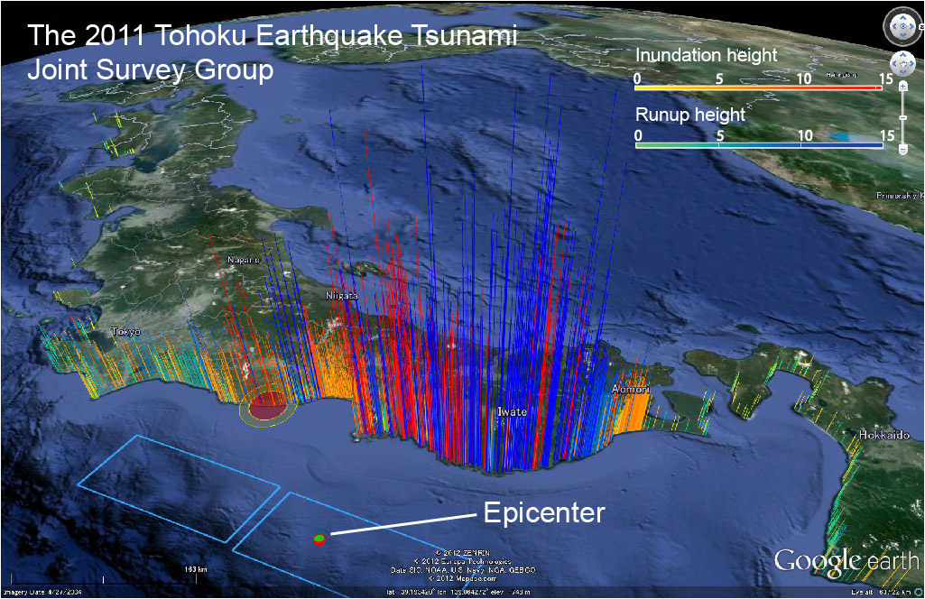
Runup distribution cf EQ rupture
Elevated runups along the Sanriku coast in the north
Perhaps wave focussing by the coastal valleys?

Slide 6
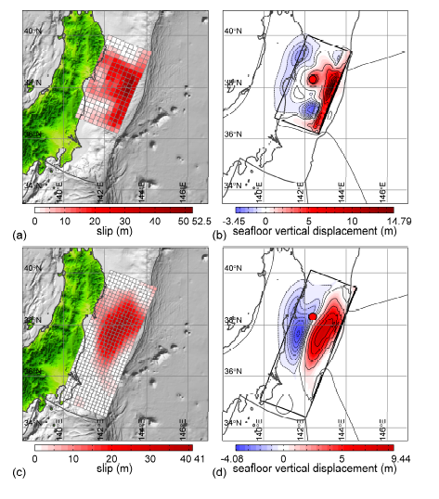
Japan 2011 Rupture - Seismic inversion
Fault dislocation distribution of the finite fault inversion of P-waves (P-Mod).
Vertical seafloor displacement for P-Mod.
Fault dislocation distribution of the finite fault inversion of P-waves, Rayleigh wave relative source time functions, and high-rate GPS recording (J-Mod) (Ammon et al., 2011).
Vertical seafloor displacement for J-Mod.
(Lay et al., 2011)
Rupture in the south

Slide 7
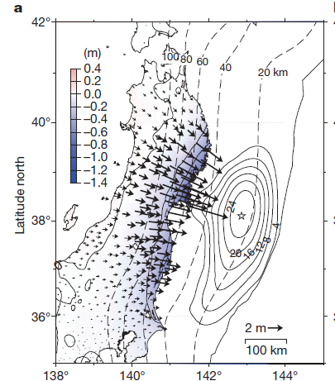
Japan 2011 Rupture - Geodetic
Coseismic displacements for 10–11 March 2011, relative to the Fukue site. The black arrows indicate the horizontal coseismic movements of the GPS sites. The colour shading indicates vertical displacement. The star marks the location of the earthquake epicentre. The dotted lines indicate the isodepth contours of the plate boundary at 20-km intervals.
The solid contours show the coseismic slip distribution in metres.
(Ozawa et al. 2011)
Rupture in the south

Slide 8
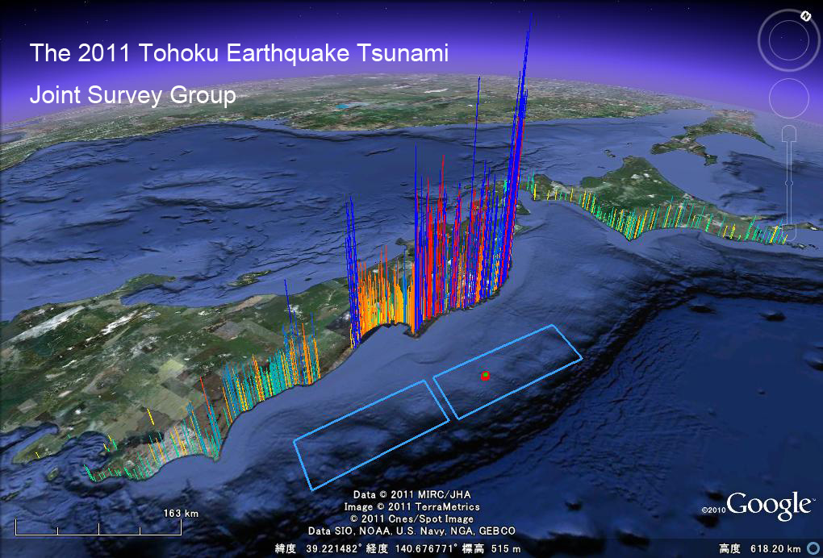
Japan tsunami runups
“A major issue is the 100 km latitudinal displacement of the highest runups to the largest slip”
Highest runups here!
EQ rupture here!

Slide 9
Comparison of CMT solutions from seismic and tsunami inversion
Tsunami waveform inversions are biased towards the trench and these are shifted 60km northward from seismic inversions

Slide 10
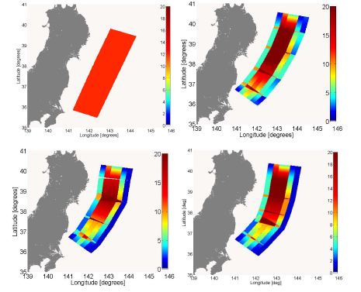
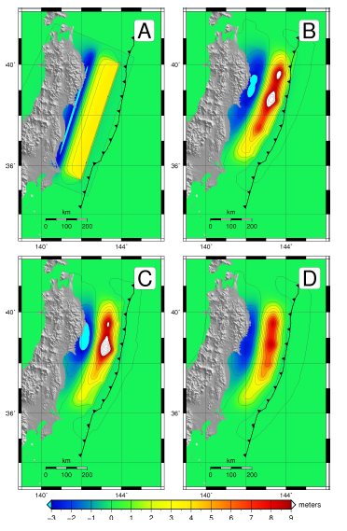
Tsunami modelling
Based on adjusted EQ sources
Upper Figure. Slip distribution for the four different earthquake source scenarios A–D.
Lower Figure. Initial surface elevations for the four different earthquake source scenarios A–D.
(Lovholt et al 2012)

Slide 11
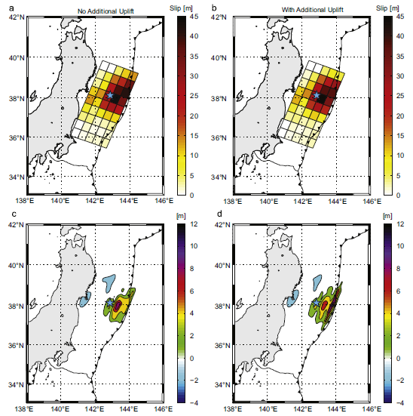
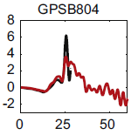
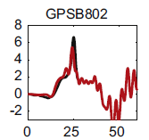
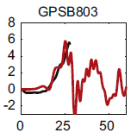
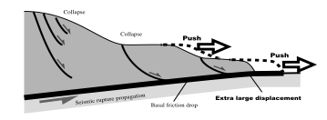
Combination approach
Slip distribution by a joint inversion using the tsunami waveforms and crustal deformation data.
(Gusman et al., 2012).
Runups still require additional Sediment contribution from the plate margin. (Tanioka and Seno, 2001).

Slide 12
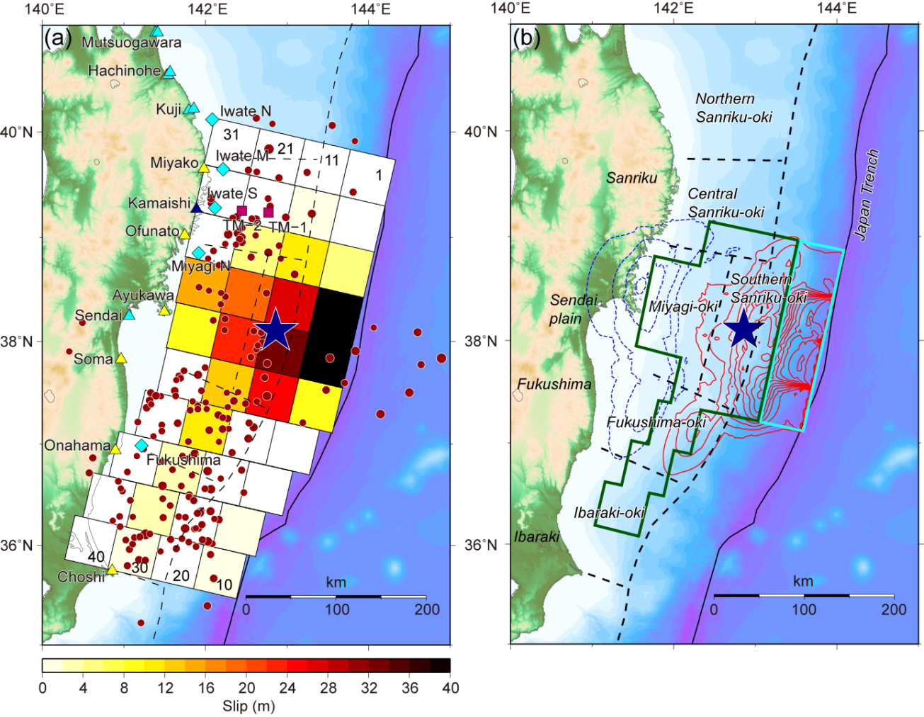
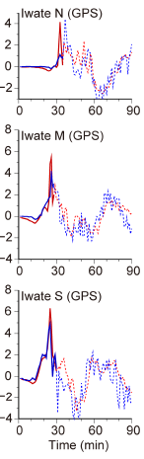
Tsunami waveform inversion
Seafloor deformation computed from the estimated slip distribution(red uplift, blue subsidence.
Slip distributions estimated by tsunami waveform inversion.
(Fuji et al., 2011)
But wave inversion does not explain the high runups in the north.

Slide 13
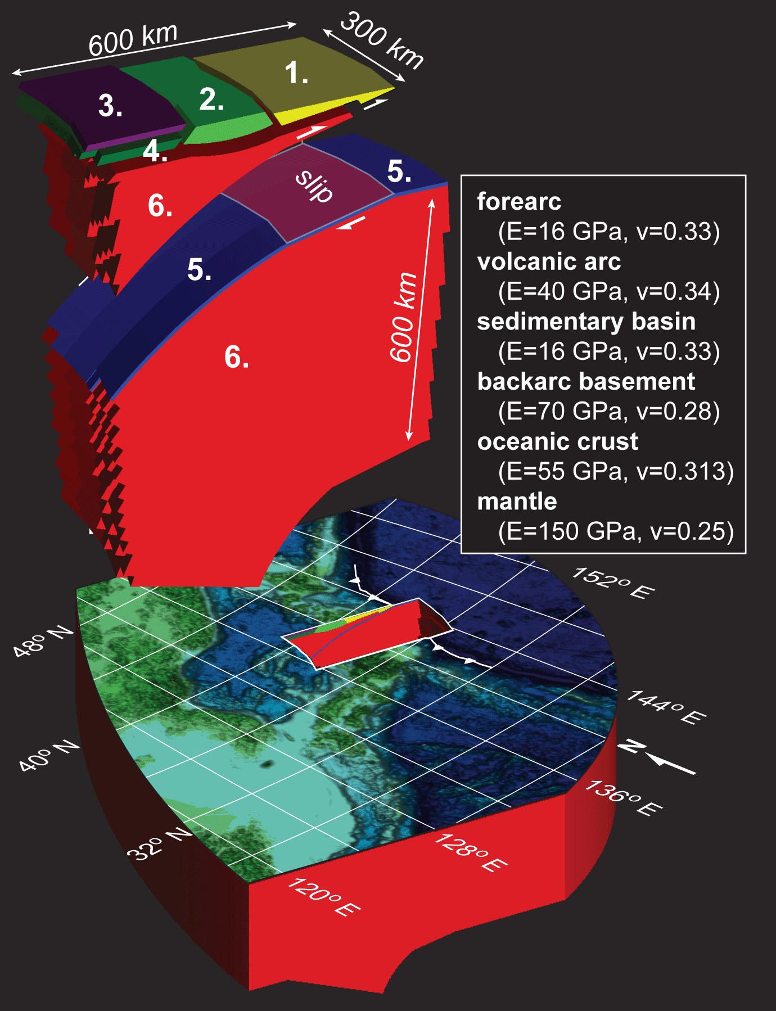
Simulation of sole earthquake source – by Grilli et al (2012)
1. Simulating fault-slip within a complex domain
1.
2.
3.
4.
5.
6.
Finite element model (FEM) of the 2011 Tohoku Earthquake
Rather than Okada
3D FEM domain:
360,000 nodes
340,000 elements
(Grilli et al., 2012)
Geological model
Notes:
13
Here it is easily seen that in quadrants under compression, pore pressure increases.
And in quadrants under tension, pore pressure decreases.

Slide 14
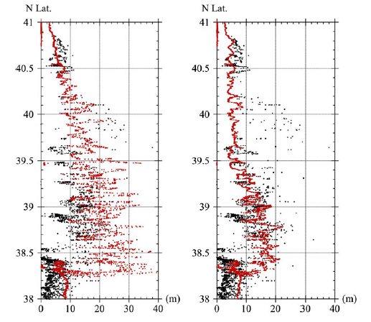
Model (red) vs. measured (black) inundation:
Sanriku coast – north of 38ºN
Northern high runups not modelled
Left: a M9 UCSB source; and
Right: a M8.8 UA source.
(Grilli et al., 2011)

Slide 15
Comparison of Earthquake Source Models for the 2011 Tohoku Event Using Tsunami Simulations and Near-Field Observations
MacInnes, et al, 2013
Compared 10 sources
Their conclusion:
“Most of the earthquake sources tested at sites with high grid resolution were unable to reproduce the magnitude of runup north of 39° N, indicating that an additional source of tsunamigenic energy, not present in most source models.”
Alternatives: splay fault or landslide, but the former discounted

Slide 16

Tsunami runups north Honshu
Inversion does not explain the high runups in the north.
So without ‘adjustments’ the northern Honshu high runups remain unexplained – an additional tsunami source is required. Thus a two source model is needed!

Slide 17
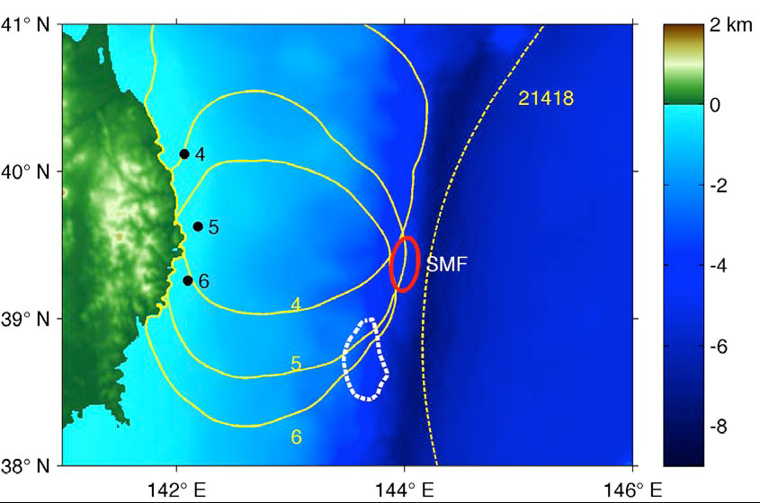
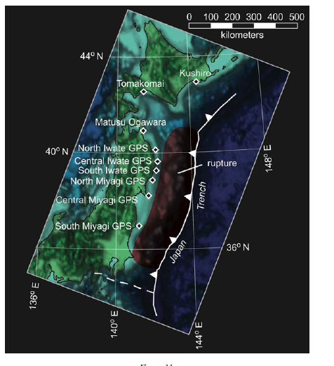
Submarine landslide source?
Backward ray tracing of high frequency wave component from offshore GPS buoys indicates possible source location
Higher frequency waves = SMF source
For 3’-4’ period (higher frequency) waves in the records
(dashed: Kawamura et al., 2012)
High frequency waves from landslides
Kawamura

Slide 18
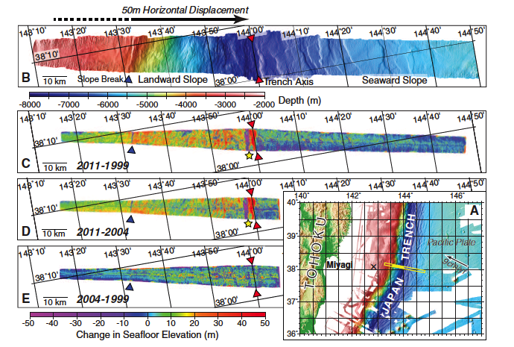
Pre- and Post-event surveys near epicentre suggest seafloor motion all the way to forearc boundary (Fujiwara et al, Science 2011) – but south of the source location

Slide 19
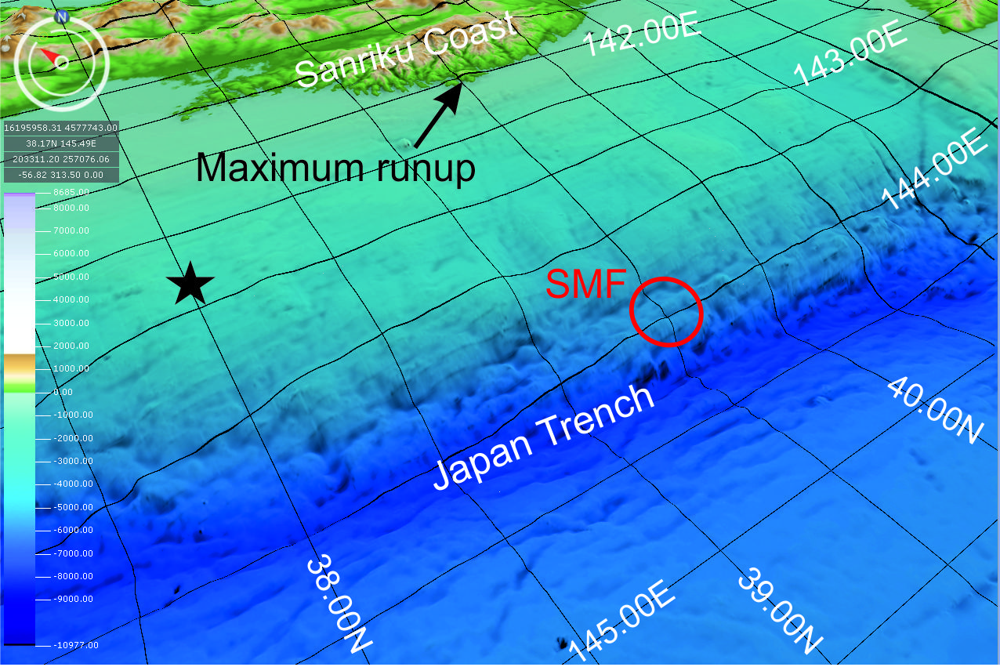
Submarine landslide source?
Is a SMF present where the ray tracing suggests?

Slide 20
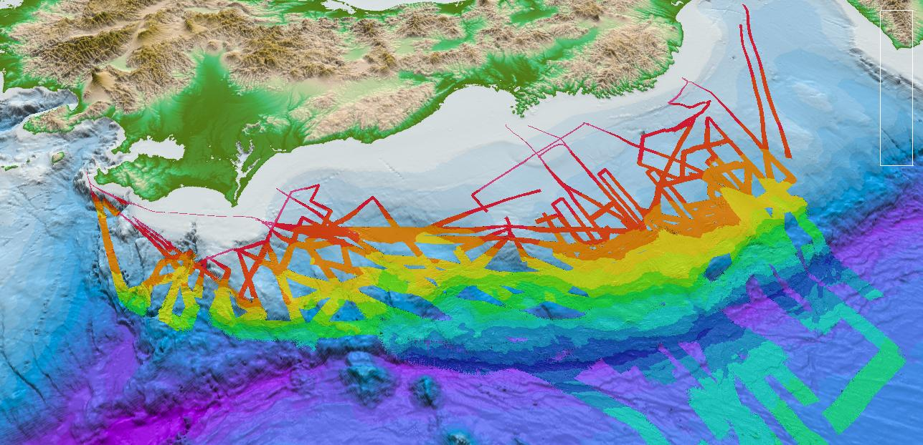
Submarine landslide source
30 km
Post 2011 tsunami multibeam bathymetry –
(Courtesy JAMSTEC)

Slide 21
Submarine landslide source
SMF
SMF
30 km
Several large SMFs (slumps) present

Slide 22
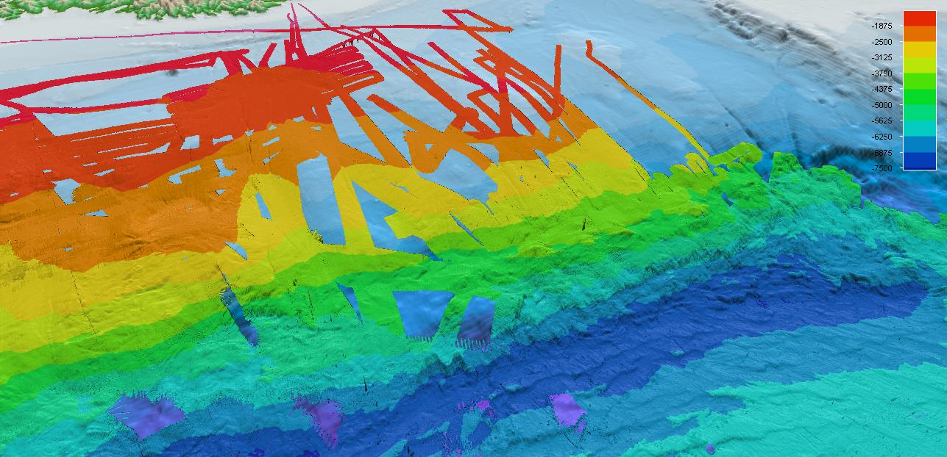
Overview northern Honshu
Highest runups
Most likely SMF location
20km
30km
Pre-2011 bathymetry - numerous SMFs
Courtesy of JAMSTEC and IFREMER

Slide 23
Bathymetry: pre-2011
500m grid
(JODC)
Slumps

Slide 24
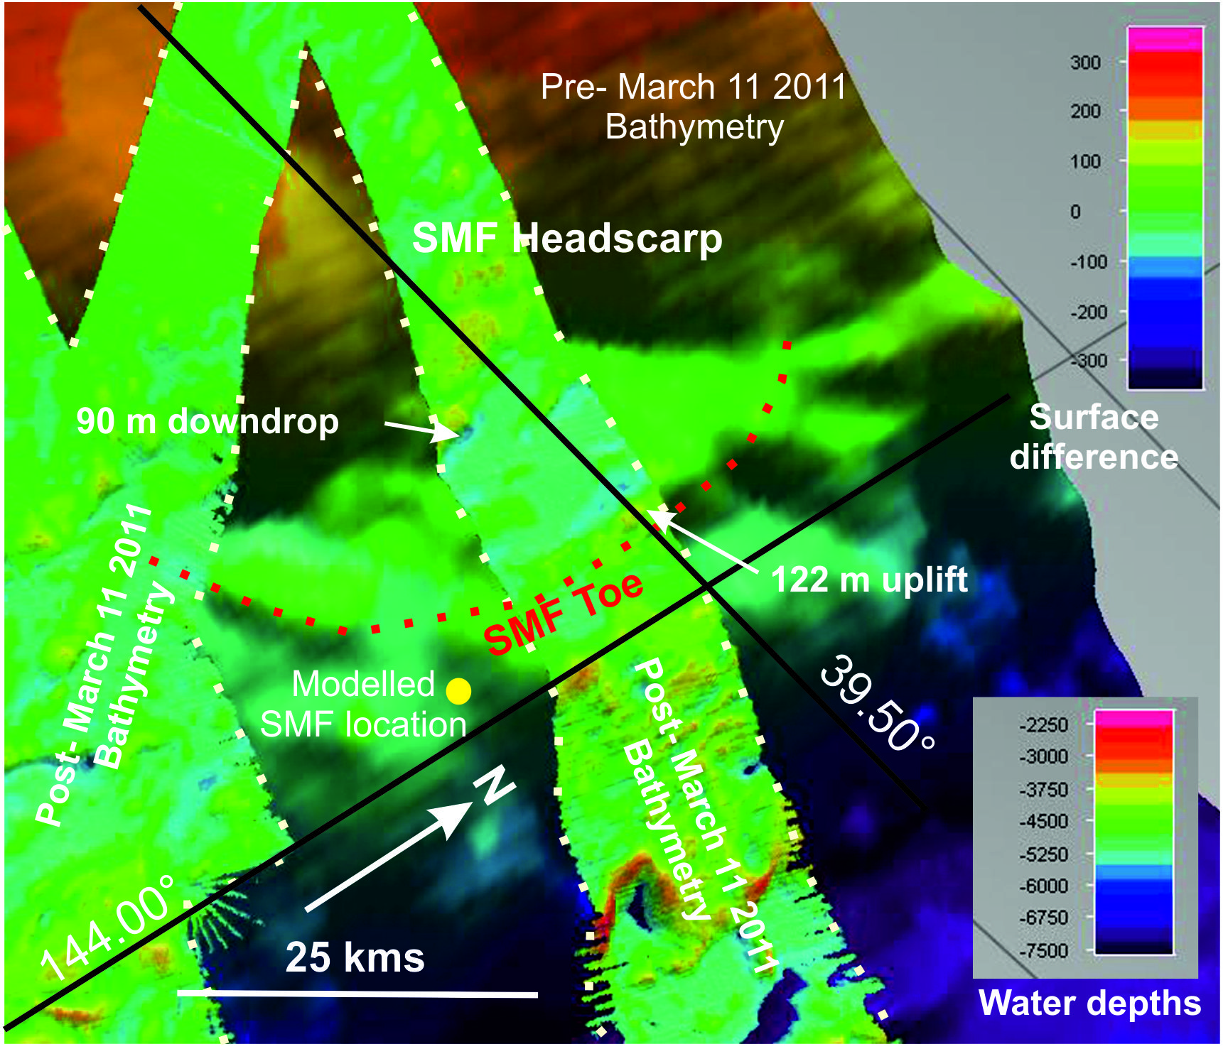
Bathymetry of seafloor failures
Pre and post tsunami bathymetry
Direct observations of SMF ?
Difference [multibeam echosounder swath data, acquired during the R/V YOKOSUKA cruise YK11-E06] shows SMF/slump with average -100, +100 m
displacement
(Data JODC, JAMSTEC)

Slide 25
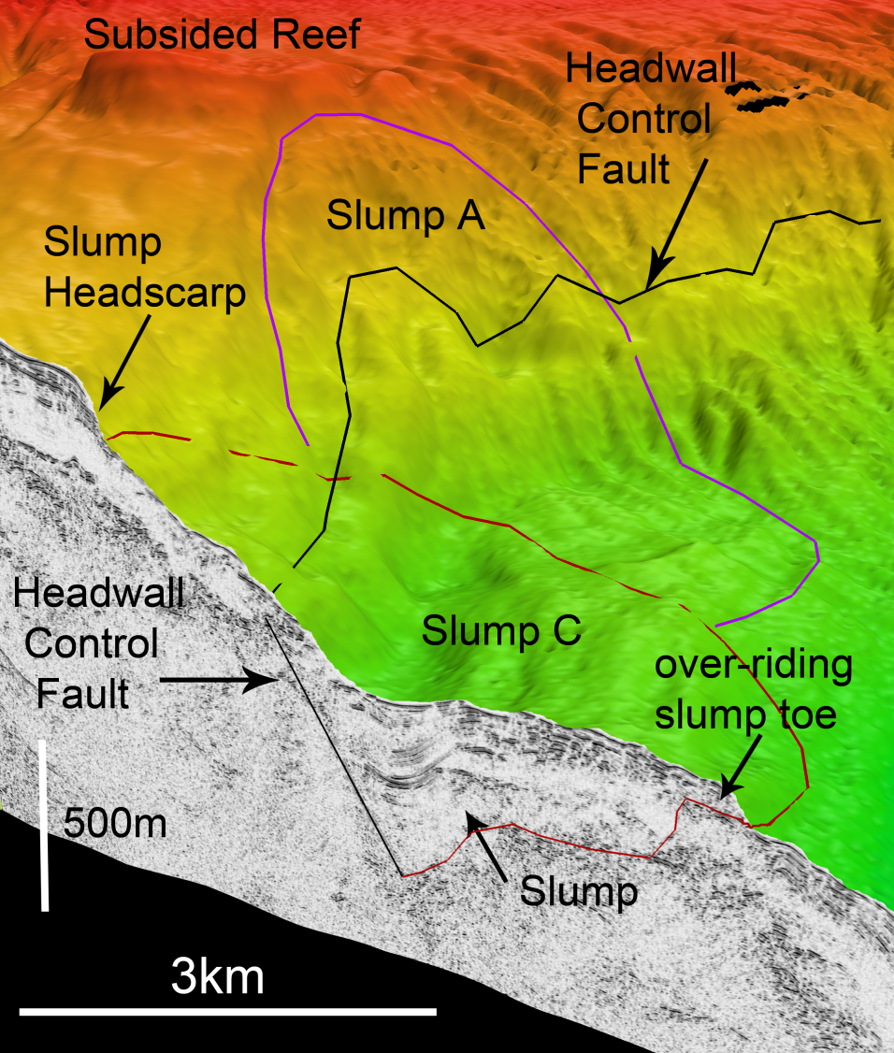
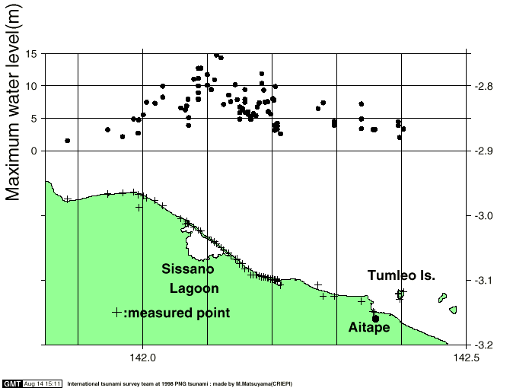
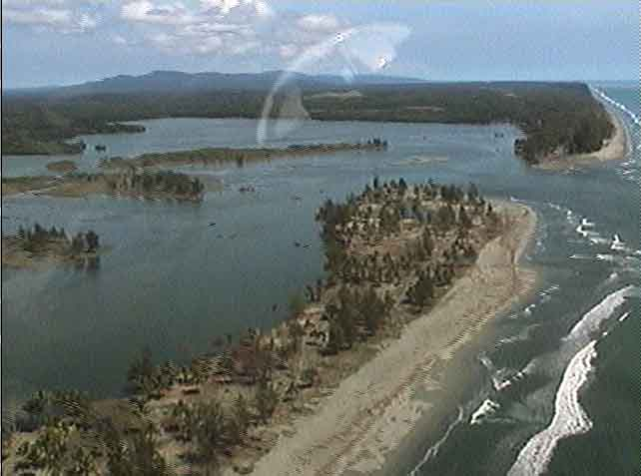
Papua New Guinea 1998
The only validated devastating submarine landslide tsunami along a convergent margin is PNG tsunami where 2,200 died.
7.1M EQ
Runups up to 15m
But small landslide at 6km³

Slide 26
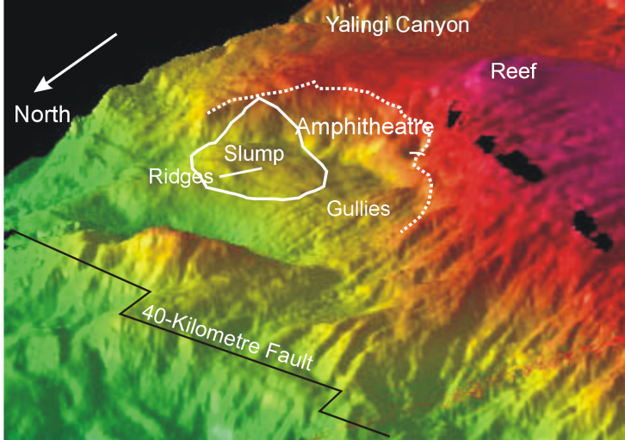
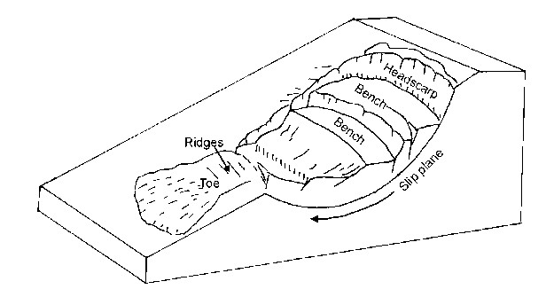

Comparison PNG - Japan
Classic rotational failure – a slump
5km
PNG 6km ³
Japan 2011 landslide much larger at ~600km ³
2000m thick
Major difference in scale!

Slide 27
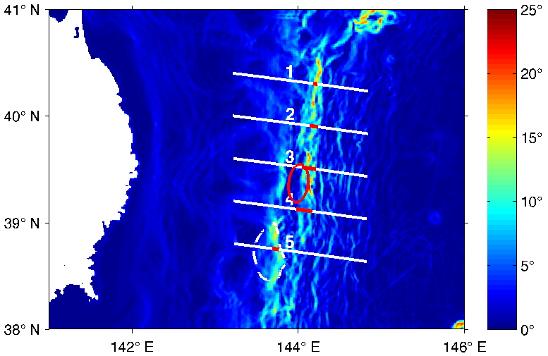
Slope stability analysis along Sanriku coast
Five bathymetric transects studied, based on seafloor slope and morphology:
[Bottom slope
(color) and
Transects]

Slide 28
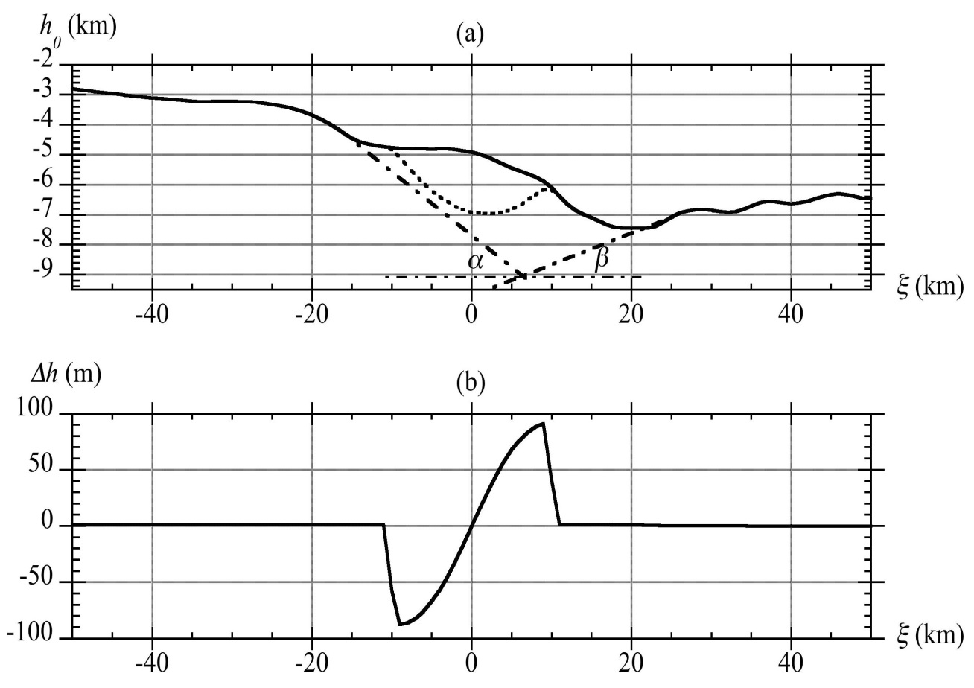
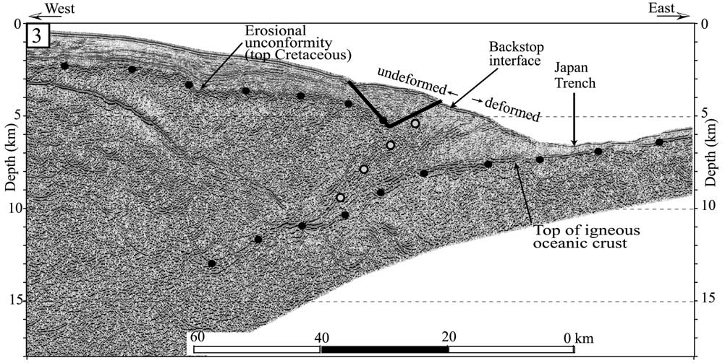
Slope stability analysis along Sanriku coast
Transect through SMF
w = 38 km; b = 20 km
T = 2 km; s₀ = 300 m
Triggered after 135 s
Rupture mechanism:
Slump motion constrained by period and amplitude of observed high frequency waves
Slump located from the ray tracing could be triggered by seismic loading from the 2011 EQ

Slide 29
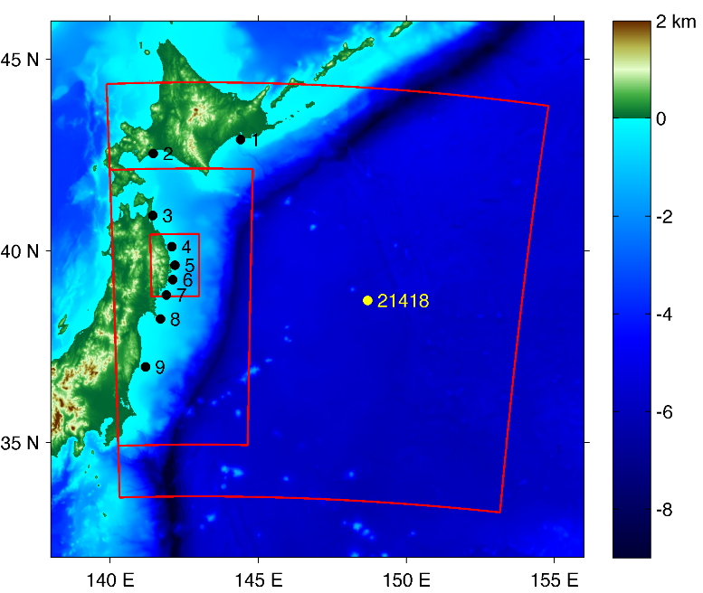
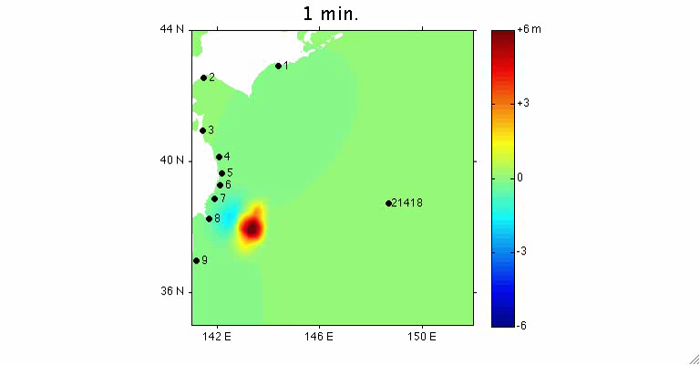
=> NHWAVE (300 s) & FUNWAVE Simulation of FEM co-seismic source + SMF (best location)
Nested Grids
Near field: 50m, 250m, 1000m; and Ocean (2’) tsunami grids
High frequency waves in the north from the slump, low frequency EQ

Slide 30
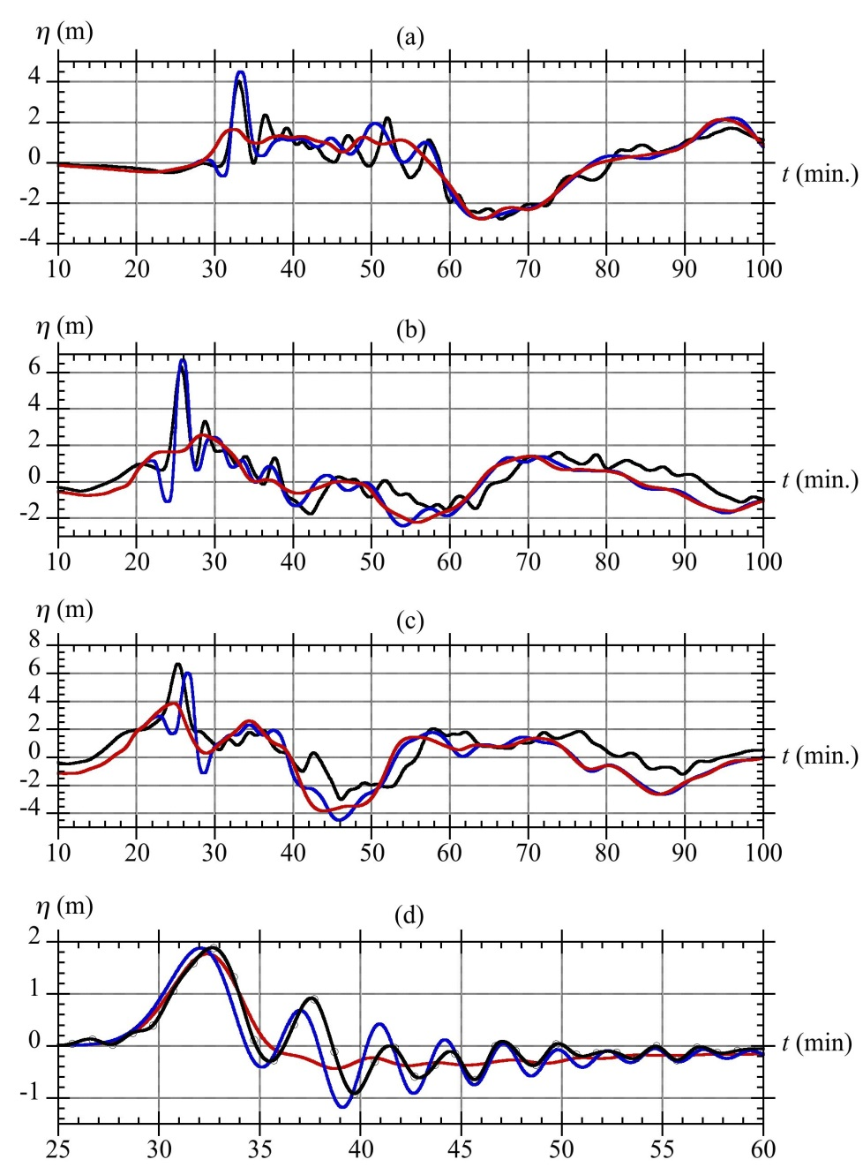
Response at GPS and DART buoys
[black (measured); red (FEM – coseismic), blue (FEM + slump)]
North Iwate
Central Iwate
South Iwate
Close correlation in timing, elevation and wave frequency
DART #21418

Slide 31
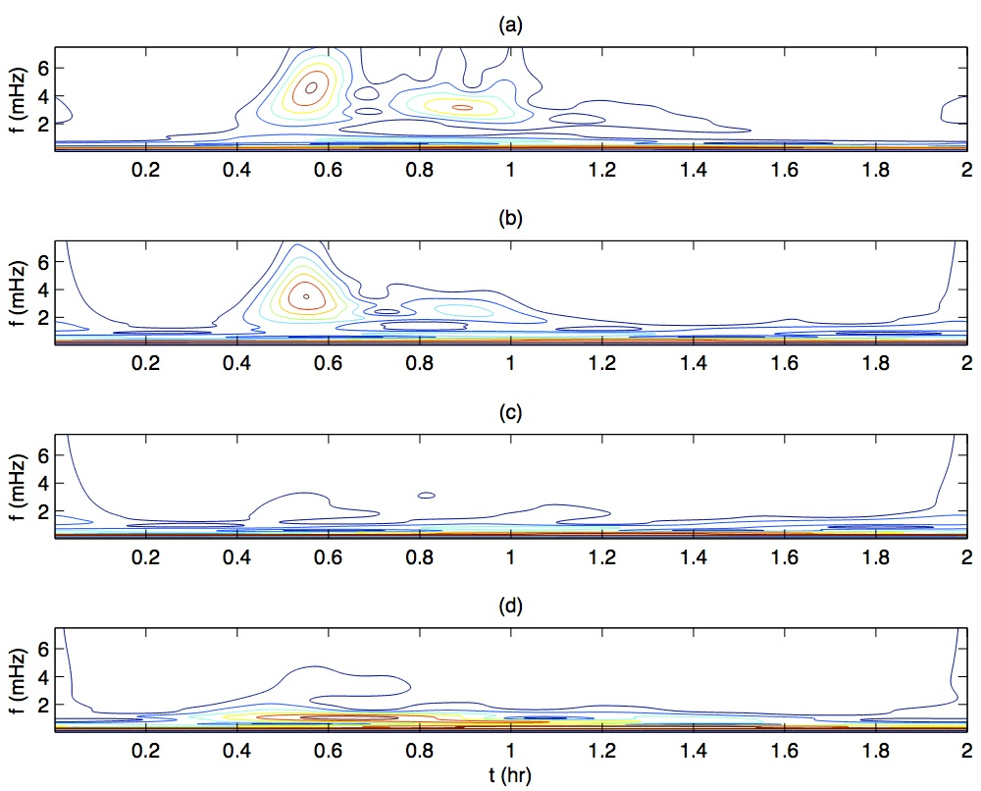
Wavelet analysis of time-frequency structure at buoys
Closest correlation
a) observed; b) FEM + slump; c) FEM; d) Caltech.

Slide 32
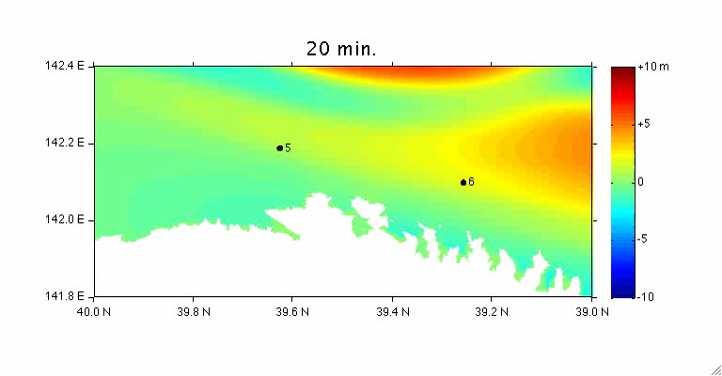
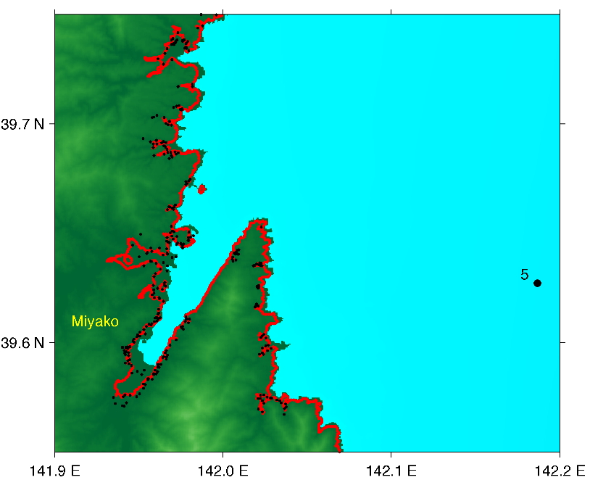
Coastal impact along Sanriku coast
Partial plot of modeled (red) and measured (black) horizontal inundation limits near Miyako.

Slide 33
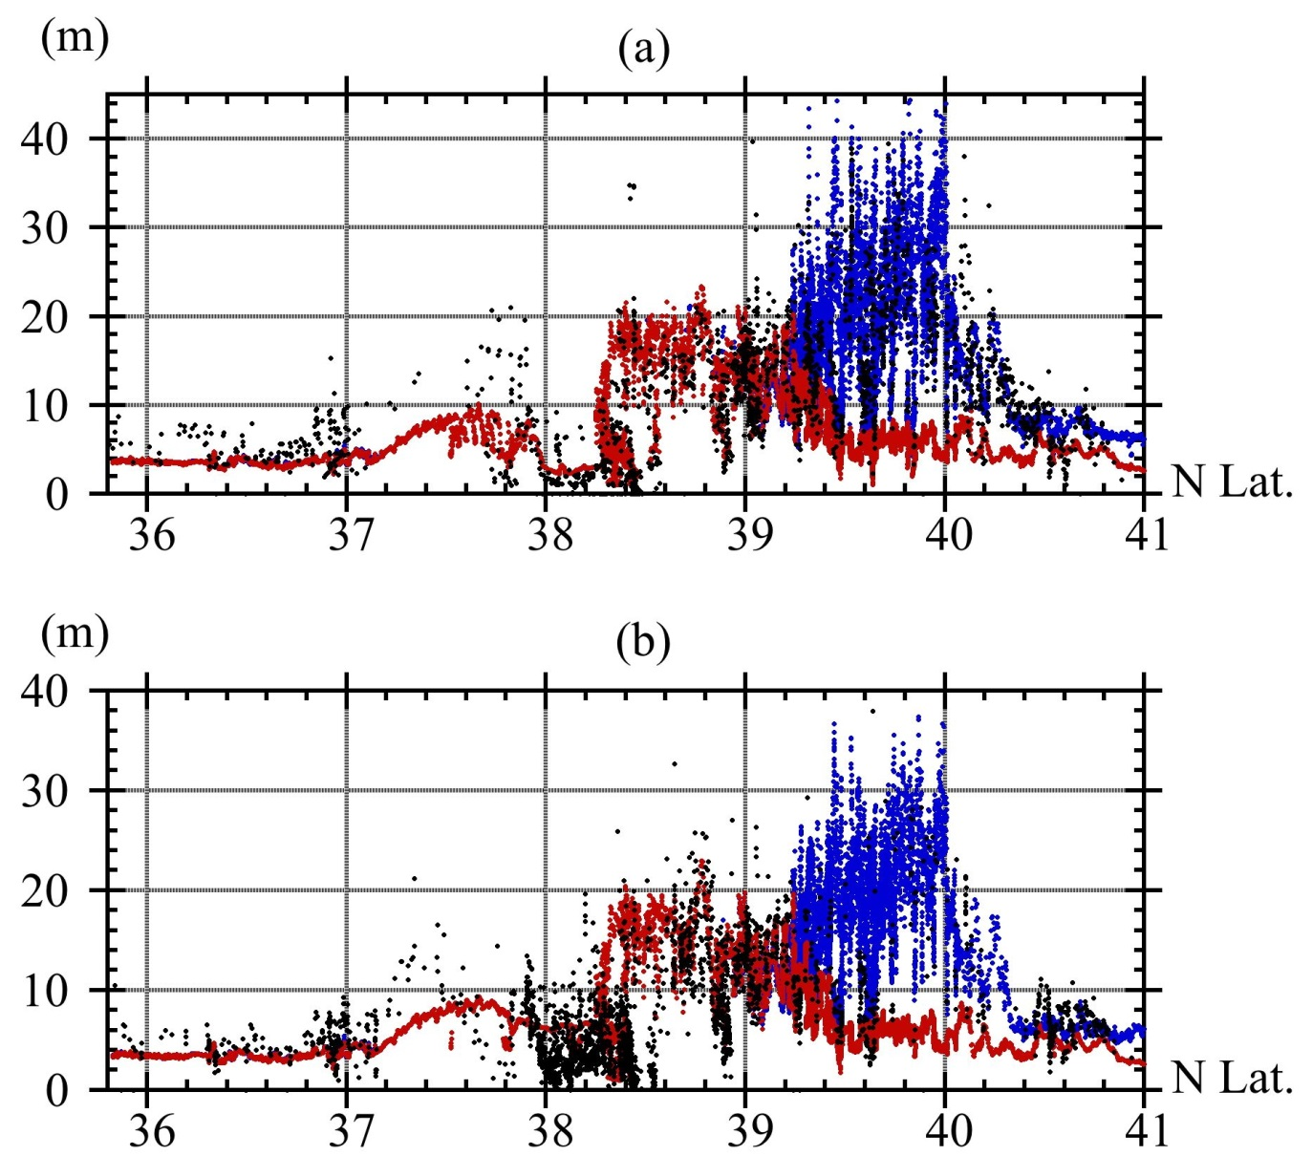
Coastal impact along Sanriku coast
North of 39 close correlation
Inundation and
b) runup
Measured (black), FEM (red), FEM + slump (blue)

Slide 34
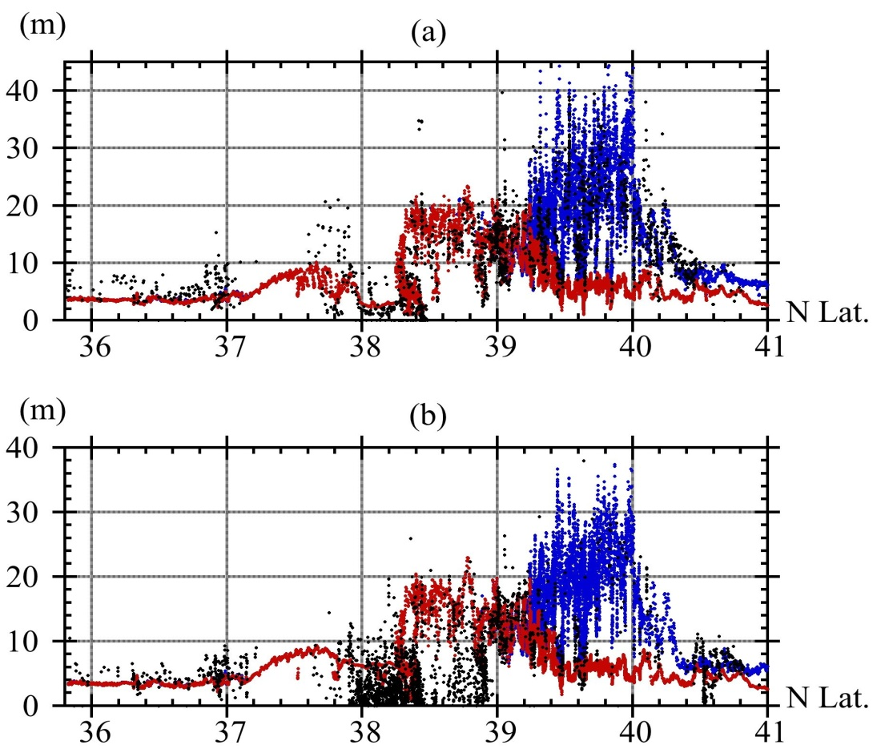
Tohoku Tsunami source – EQ and SMF combined
Tsunami simulations from a solely earthquake source cannot explain the 40 m runups in northern Honshu, the Sanriku coast,
Explained by focussing along the ria coast – NO!
If there was significant focussing, the EQ source would be affected too – it is not

Slide 35
SMF source confirmed?

Slide 36
Dual tsunami source?
A first consideration of the Japan 2011 tsunami in the context of the associated 9.1M earthquake would sensibly lead to the conclusion that this would be the source,
However, numerous models based on different source datasets inverting both seismic and tsunami waveform data cannot without adjustments replicate the waveforms recorded at the buoys offshore of central Sanriku nor the elevated runups along the central Sanriku coast,
Analysis of the tsunami using a new FEM earthquake model confirms that, without additional forcing, the earthquake cannot generate all the tsunami no major focussing along Sanriku coast,
A dual source (EQ and landslide) does indeed simulate the elevated runups along the Sanriku coast and the waveforms recorded at the nearshore and offshore buoys.
The location of the landslide is validated by MBES data.

Slide 37
Finally!
The results of this study will be published soon in Marine Geology
Domo Arigato

Slide 38
Overview northern Honshu
20km
30km
Pre-2011 bathymetry - numerous SMFs

Slide 39
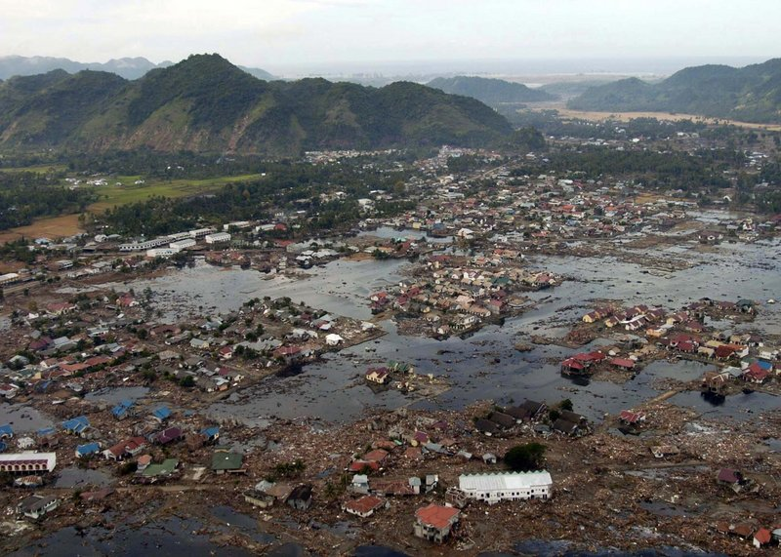
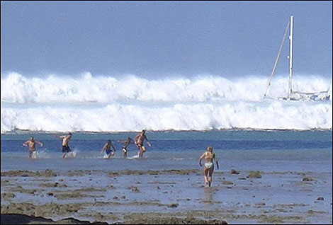
Recent tsunami events
Papua New Guinea 1998
Submarine landslides generated catastrophic tsunamis
Indian Ocean 2004
Great earthquakes occurred in many more places than previously realised

Slide 40
Indian Ocean 2004
The event overturned all our understandings on where Great EQs may take place,
Indian Ocean tsunami
220,000 died,
120,000 in Banda Aceh
100,000 elsewhere

Slide 41
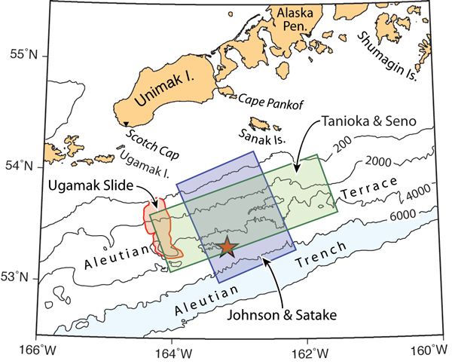
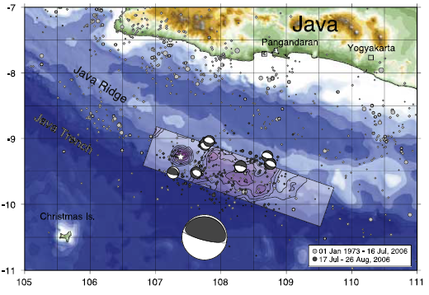
Anomalous tsunami events – EQ and submarine landslide
Alaska 1946
Java 2006
Elevated, focussed local runups didn’t fit the earthquake magnitude - landslide component? EQ Magnitude not so great

Slide 42
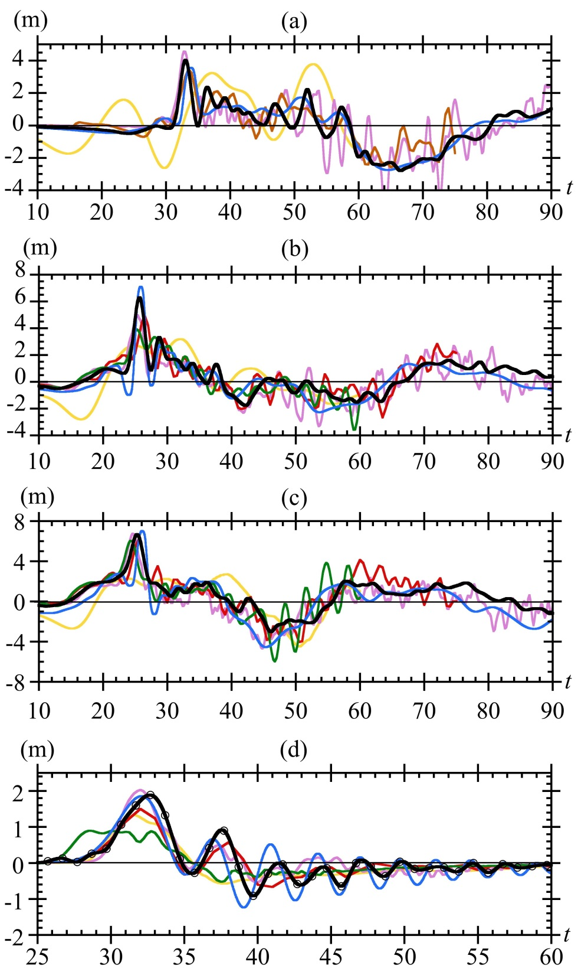
Comparison with other mechanisms

