Slide 1

The Bird Is The Word
The ins and outs of the Twitter world
By: Andrea DeMaio

Slide 2
Overview
This Twitter Tutorial will cover the following sections:
What is it?
Twitter Lingo
Twitter Shorthand
How Do I View Tweets?
How Do I Interact with Others?
What is a Hashtag?
What Should I Tweet About?
Privacy and Security
Summary

Slide 3

What is it?
An online social network allowing you to send and read 140 character messages, or “tweets”.
These tweets appear in your custom newsfeed
It is a way to communicate with friends or read real-time news from credible sources or from celebrities.
Some use it as a micro-blog, some as a way to communicate with friends, some as a way to share their thoughts with the public.

Slide 4
Twitter Lingo
Tweet: a 140 character message
Feed: stream of tweets on your homepage, comprised of those that you follow
“Following” people: choosing to subscribe to their tweets, this means that they will appear in your newsfeed. The other party must choose to follow you back in order for them to see your tweets in their feed.

Slide 5

Handle: Your username (ex: @BarackObama)
Mention: referencing or interacting with someone by putting their handle (@) in your tweet. The other party will receive a notification when you mention them.
Hashtag: when followed by a word, it is used to denote the subject of your tweet or categorize it in some way. By clicking on the hashtag, one can see others tweets that used that same hashtag.

Slide 6

Twitter Shorthand
DM=Direct Message
RT=Retweet
MT=Modified Tweet

Slide 7
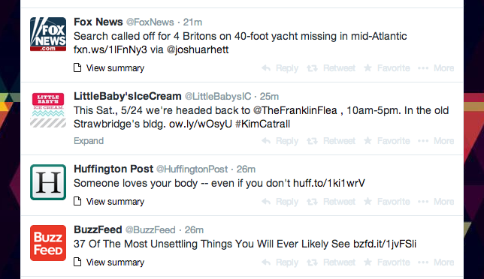
How do I view tweets?
On Twitter, you determine who you will follow which determines whose tweets you will see.
You will see tweets from people you follow in your newsfeed, as shown below.

Slide 8
How do I interact with others?
There are four main ways to interact on Twitter:
-if someone tweets something that you want to reply to, put their handle in your tweet and they will receive a notification that you mentioned them.
-if you want to talk with someone privately without it showing up on your newsfeed, use the Direct Messaging function.
-you can only Direct Message someone that you follow and vice versa.
Mentioning
Direct Messaging

Slide 9
-When you retweet someone, you are forwarding their tweet and posting it from your account but still giving them the credit. You can also quote the tweet by writing your own thought before it
-favoriting a tweet is similar to “liking” something on Facebook. This lets the person who posted know that you like it or agree.
Retweeting
Favoriting

Slide 10

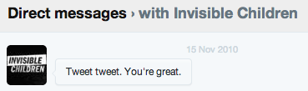
Examples
Mentioning
-since @KashiFoods was mentioned in this tweet, they will get a notification about this.
Direct Messaging
-an organization’s account (@InvisibleChildren) sent me a direct message. This means that only myself and their account can see this content.

Slide 11


3. Retweeting
-University of Delaware’s Twitter account originally tweeted this, but since I retweeted it, it will now appear on my timeline.
4. Favoriting
-This is the same idea as “liking” a status on Facebook.

Slide 12
What is a hashtag?
Hashtags are ways to group or label tweets
How to hashtag
1. In order to hashtag, type any word or phrase you want after the ‘#’ symbol
2. Doing this turns the hashtag blue, which means it can be clicked on
3. When clicked on, you can see a news stream of all other tweets that used this hashtag as well

Slide 13


You can create any type of hashtag you want, but punctuation & spaces will break a hashtag
Hashtags are not case sensitive
Broken Hashtag→
Correct Hashtag→
=
#iLOVEpizza
#ilovepizza

Slide 14
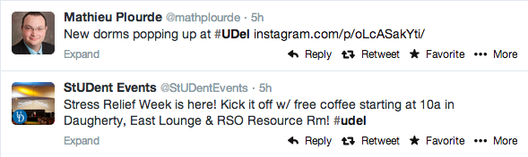
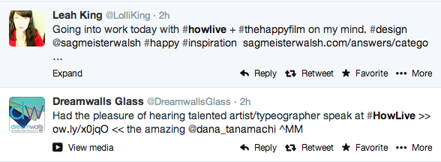
Hashtags are often used to group together tweets for events or organizations.
Ex: UD’s official hashtag is #udel
Ex: Tweets from an event whose hashtag was #HOWlive

Slide 15
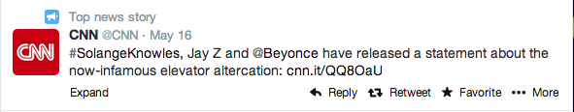

What should I tweet about?
The beauty of twitter is that you can tweet about anything!
Share your thoughts, post news, and use hashtags to get the right audience.

Slide 16

Privacy and Security
On Twitter, you can make your profile public or private.
Public: anyone can see your profile and tweets regardless if they follow you or even have an account.
Private: only those who follow you can see your tweets & you must approve them to follow you.
Private accounts cannot be retweeted

Slide 17

Summary
Now that you’re a Twitter pro, go on over to www.twitter.com and set up your profile!
Remember to utilize the tips and tricks in this tutorial.

Slide 18
Sources Cited
http://mashable.com/2014/03/21/twitter-8th-birthday-video/
http://johncade.com/how-to-properly-use-hashtags-and-five-common-mistakes-to-avoid/
http://www.edudemic.com/simple-ways-to-use-twitter/
http://www.smartinsights.com/social-media-marketing/twitter-marketing/how-to-find-the-best-hashtags-to-use-in-twitter/
http://mashable.com/2012/06/05/twitter-for-beginners/

