Slide 1

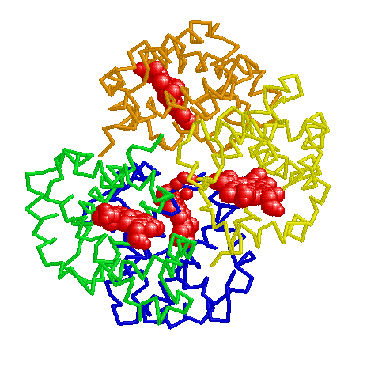




Nine selected student comments among 25 responses in May 2011 to the prompt “Comment on the course”.
All Narrative and Numerical evaluations since 2001 are posted at: <http://www.udel.edu/chem/white/C342/342EvalS11.pdf>
I love the PBL style. In my opinion it is a much more effective style of teaching than lecture. My father teaches people getting their Master's degree in education how to be effective teachers and is ecstatic with the fact that I finally had a course where I wasn't just lectured at the entire time. It required a lot of work every night, but I enjoyed doing the research and didn't want to let my group down. I wish more chem courses were this style.
Coming into the course, I thought I was going to hate problem based learning, because of the constant work required to keep up in the class rather than being able to pace myself through each exam. This requirement completely changed my study habits in all my classes, as I used to procrastinate until the last few days to learn a month’s worth of material and then forget it right about the exam. Now, I'm ahead in all my classes and often find myself with nothing to do the night before an exam, instead of staying up all night cramming.
The course requires a lot of work. It can be frustrating at times to spend hours researching things but it is worth it in the long run. This course brought together all my prerequisite math and science courses and made me see and understand the relevance.
The course was less about biochemistry aspects itself and more about applying information we've learned previously to tackle new issues at hand. Of course, aspects of biochemistry were part of the material we learned but not in a lecture- style format. This intro course was very helpful, however, in helping students learns how to work through problems and issues with difficult material that will later be very helpful.
My favorite science course that I have taken at Delaware. Made me realize just how much I loved my major and got me excited about taking more biochemistry classes. The hemoglobinopathy paper, though a lot of work, was a great assignment that I thoroughly enjoyed doing.
Very refreshing way to learn chemistry. After sitting in lectures for hours and hours it’s nice to be able to discuss material and getting different views on the material, not just writing down everything the professor says for an hour than trying to memorize it all later.
If you didn't understand the material you couldn't do well in the course. I feel that I will retain this knowledge for the rest of my life rather than for 10 minutes after a test because of the way it was taught.
HIGHLY recommended. personally, I took many science courses and was able to memorize the materials but I was never able to gather everything together. simple concepts such as equilibrium , I knew the definition but I learned to realize that I truly did not understand what equilibrium was. Being able to probe for deeper understanding of the material simply enhanced my academic career and the methods as to how I approach materials i do not understand.
Great course, most interesting I've had yet. Not easy, but if you work hard you will do well.
Lectureless Introduction to Biochemistry
Classic Articles as PBL Problems: 19-Year Experience
Hal White, Department of Chemistry and Biochemistry
What do Students Think About the Course?
Course Evaluation Responses 1995-2011
Interdisciplinary Learning Issue Matrix
Selected Student Comments – May 2011
Nine selected student comments among 25 responses in May 2011 to the prompt “Comment on the course”.
All Narrative and Numerical evaluations since 2001 are linked to the course homepage at: http://www.udel.edu/chem/white/CHEM342.html
I love the PBL style. In my opinion it is a much more effective style of teaching than lecture. My father teaches people getting their Master's degree in education how to be effective teachers and is ecstatic with the fact that I finally had a course where I wasn't just lectured at the entire time. It required a lot of work every night, but I enjoyed doing the research and didn't want to let my group down. I wish more chem courses were this style.
Coming into the course, I thought I was going to hate problem based learning, because of the constant work required to keep up in the class rather than being able to pace myself through each exam. This requirement completely changed my study habits in all my classes, as I used to procrastinate until the last few days to learn a month’s worth of material and then forget it right about the exam. Now, I'm ahead in all my classes and often find myself with nothing to do the night before an exam, instead of staying up all night cramming.
The course requires a lot of work. It can be frustrating at times to spend hours researching things but it is worth it in the long run. This course brought together all my prerequisite math and science courses and made me see and understand the relevance.
The course was less about biochemistry aspects itself and more about applying information we've learned previously to tackle new issues at hand. Of course, aspects of biochemistry were part of the material we learned but not in a lecture- style format. This intro course was very helpful, however, in helping students learns how to work through problems and issues with difficult material that will later be very helpful.
My favorite science course that I have taken at Delaware. Made me realize just how much I loved my major and got me excited about taking more biochemistry classes. The hemoglobinopathy paper, though a lot of work, was a great assignment that I thoroughly enjoyed doing.
Very refreshing way to learn chemistry. After sitting in lectures for hours and hours it’s nice to be able to discuss material and getting different views on the material, not just writing down everything the professor says for an hour than trying to memorize it all later.
If you didn't understand the material you couldn't do well in the course. I feel that I will retain this knowledge for the rest of my life rather than for 10 minutes after a test because of the way it was taught.
HIGHLY recommended. personally, I took many science courses and was able to memorize the materials but I was never able to gather everything together. simple concepts such as equilibrium , I knew the definition but I learned to realize that I truly did not understand what equilibrium was. Being able to probe for deeper understanding of the material simply enhanced my academic career and the methods as to how I approach materials i do not understand.
Great course, most interesting I've had yet. Not easy, but if you work hard you will do well.
Concept Map Question on a Final Examination
Peer Facilitator Funding

