Slide 2
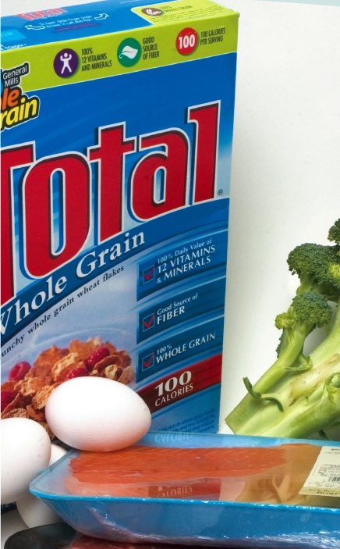
Chapter 2
Atoms, Molecules, and Ions

Slide 3
2.1 The Atomic Theory
5th century B.C. - Greek philosopher Democritus proposed that all matter consists of very small, indivisible particles, which he named atomos (meaning uncuttable or indivisible)
No support was given to this theory by contemporaries Plato or Aristotle
1808 - English scientist and school teacher John Dalton formulated an accurate definition of the indivisible building blocks of matter that we call atoms

Slide 4
Lavoisier’s Laws
Law of Conservation of Mass: In a chemical reaction, the total mass of the products = the total mass of the reactants.
(Very close to true: E = mc2, so when energy is released or absorbed there are extremely tiny changes in mass)

Slide 5
Law of definite proportions states that different samples of a given compound always contain the same elements in the same mass ratio.
Examples

Slide 6
Law of multiple proportions states that if two elements can combine to form more than one compound with each other, the masses of one element that combine with a fixed mass of the other element are in ratios of small whole numbers.
Example

Slide 7
Dalton’s atomic theory
Elements are composed of extremely small particles called atoms.
All atoms of a given element are identical, having the same size, mass, and chemical properties*.
The atoms of one element are different from the atoms of all other elements.
*Dalton wasn’t quite right on this point—more on “isotopes” later

Slide 8
Compounds are composed of atoms of more than one element. In any given compound, the same types of atoms are always present in the same relative numbers.
A chemical reaction rearranges atoms in chemical compounds; it does not create or destroy them.
Combination of oxygen and carbon to form carbon dioxide

Slide 9
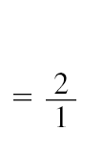
Illustration of the Law of Multiple Proportions

Slide 10
2.2 The Structure of the Atom
Atoms are the basic unit of an element that can enter into a chemical reaction
By mid 1800’s it became evident that atoms are divisible - there is an internal structure to the atom. (subatomic particles)

Slide 11
Discovery of the electron
J.J. Thomson
discovered the ratio of the electric charge to the mass of an individual electron using the cathode ray tube
(−1.76 × 10⁸ C/g ); C = coulomb

Slide 12
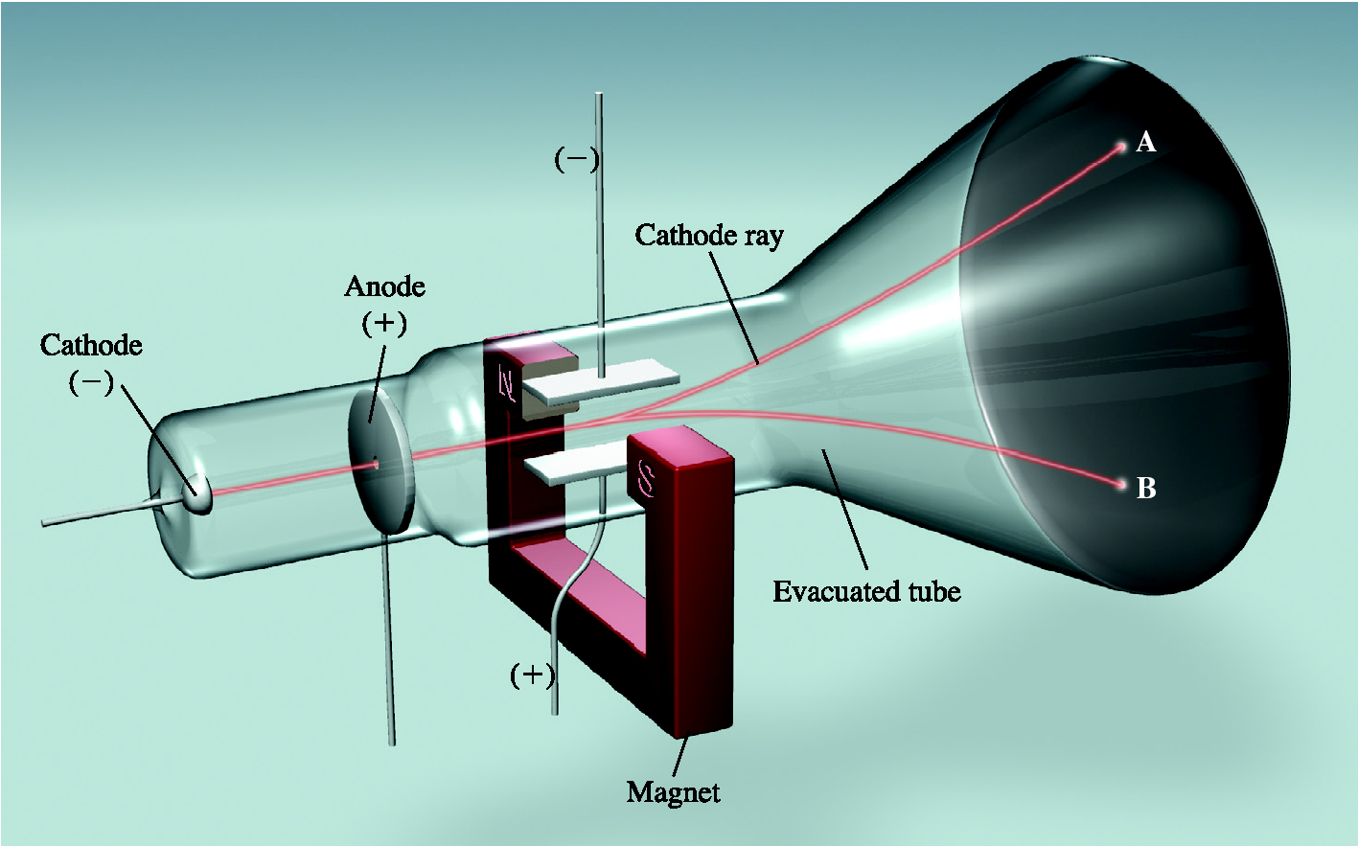
Cathode Ray Experiment

Slide 13
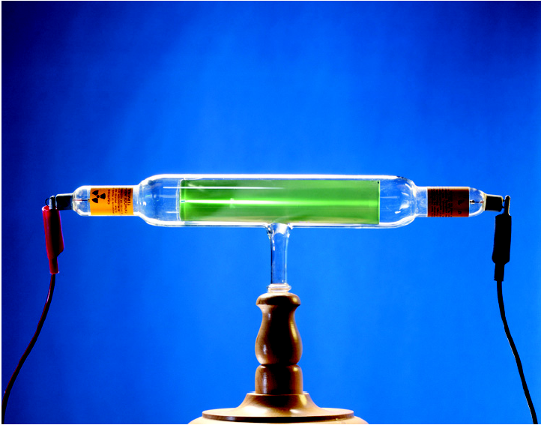
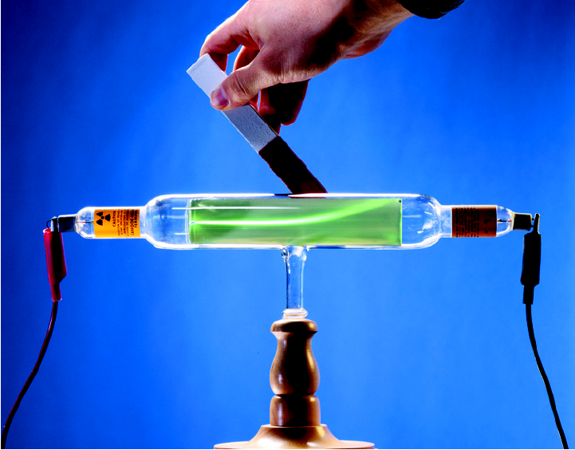
Effect of a Magnetic Field on a Cathode Ray

Slide 14
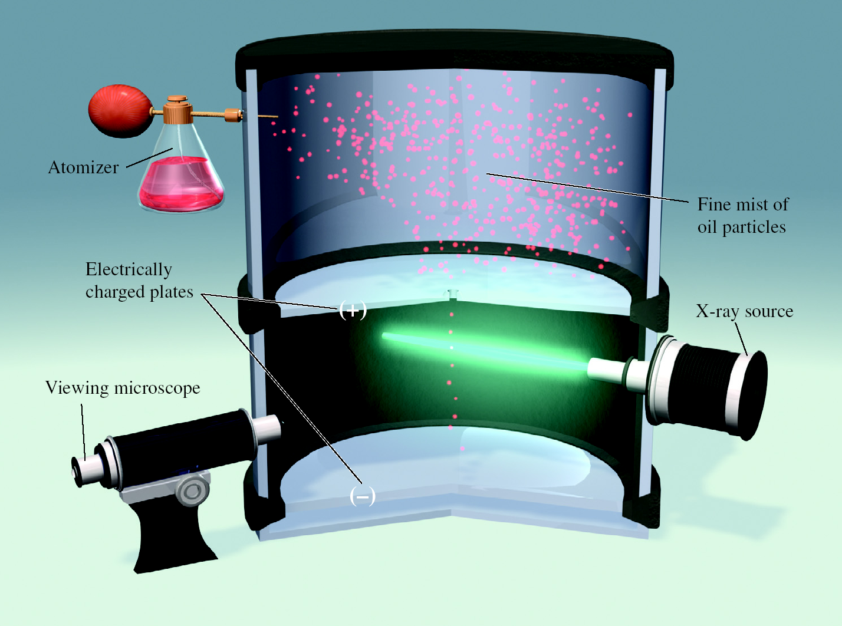
Millikan
Determined the charge on an electron
−1.66022 x 10⁻¹⁹ C

Slide 15
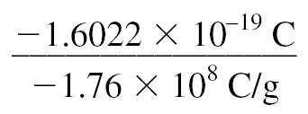
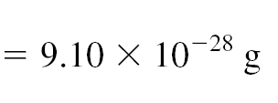
The mass of the electron could be derived from
Millikan’s charge
−1.66022 x 10⁻¹⁹ C
Thomson’s charge to mass ratio
−1.76 × 10⁸ C/g
mass of electron

Slide 16
Radioactivity – historical prespective
1895 -Wilhelm Röentgen - German physicist
Noticed that cathode rays caused glass and metal to emit another type of ray
He named the rays “X rays” because of their mysterious nature
Caused fluorescence
Were not deflected by a magnet

Slide 17
Antoine Becquerel - French physicist
Accidentally discovered that uranium darkened photographic film
Marie Curie (a student of Becquerel) suggested name “radioactivity”
Rays were highly energetic and not deflected by a magnet
However, rays arose spontaneously unlike the rays discovered by Röentgen

Slide 18
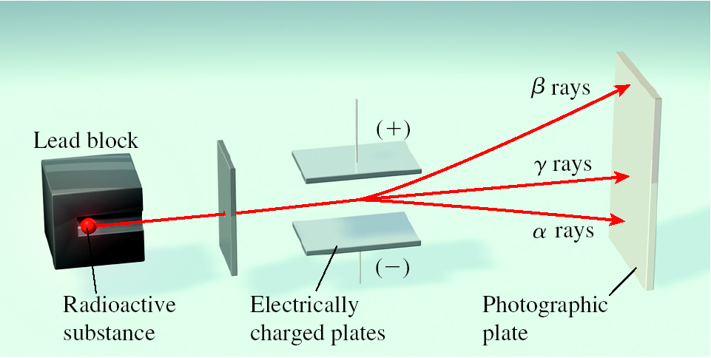
Radioactive, describes a substance that spontaneously emits radiation
Type of radioactivity
Alpha (α) - positively charged particles
Beta (β ) - electrons
Gamma (γ ) - no charge and are unaffected by external electric or magnetic fields.

Slide 19
The Nuclear Atom
1900’s - atoms consisted of positively charged matter with electrons scattered throughout (plum-pudding model by Thomson)
1910 - Rutherford performed “gold-foil” experiment.
Proposed a new model of the atom
Nucleus contained
Positive charges (later called protons)
Most of the mass of the atom

Slide 20
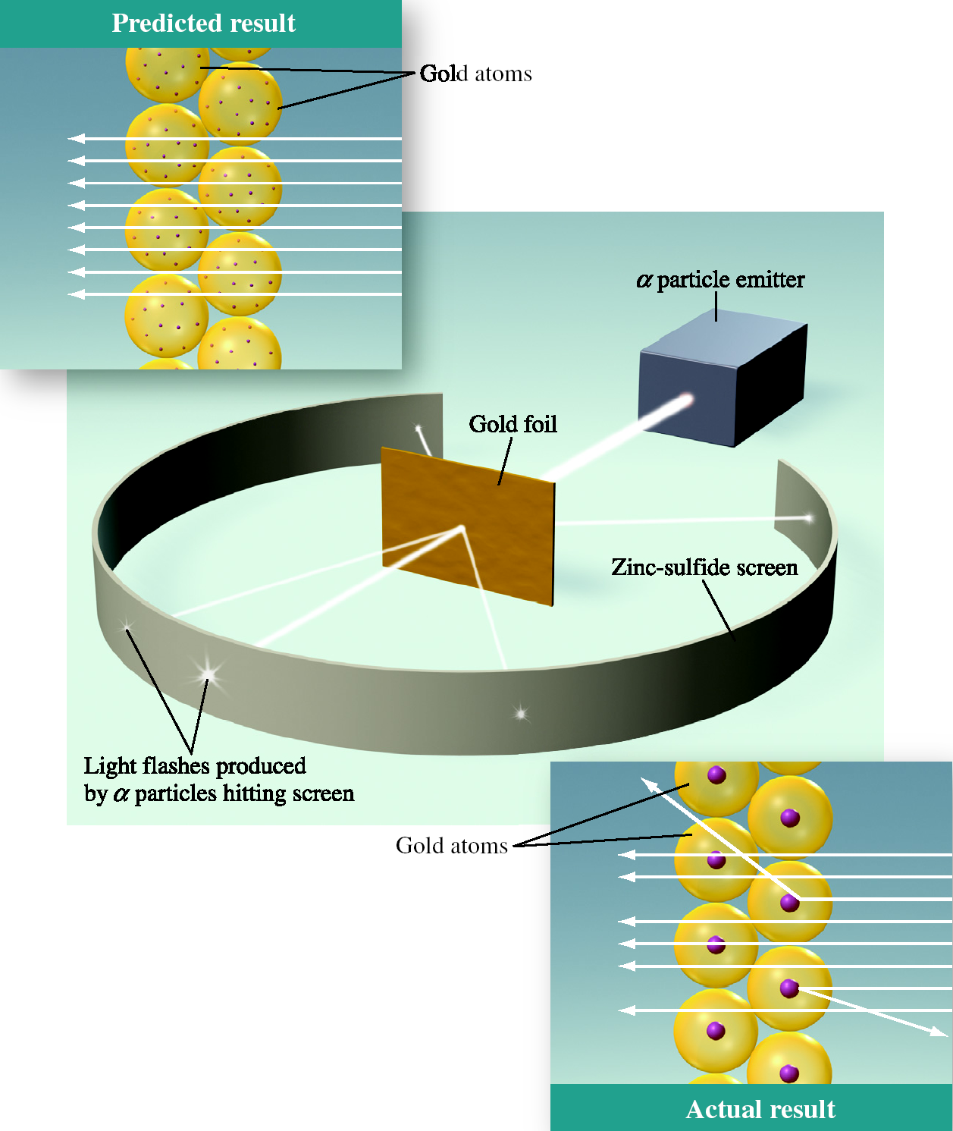
Rutherford’s Experiment

Slide 21
Rutherford’s model left one problem:
If H has a mass of 1
Then He should have a mass of 2
But its mass is 4!
1932 - James Chadwick
Discovered the neutron
Third subatomic particle
Neutral charge

Slide 22
2.3 Atomic Number, Mass Number and Isotopes
The chemical identity of an atom can be determined solely from its atomic number
Atomic number (Z) - number of protons in the nucleus of each atom of an element
Also indicates number of electrons in the atom—since atoms are neutral

Slide 23
Mass number (A) - total number of neutrons and protons present in the nucleus
Standard notation:

Slide 24
Isotopes
All atoms are not identical
(as had been proposed by Dalton)
Same atomic number (Z) but different mass numbers (A)
Isotopes of Hydrogen
Hydrogen (protium)
Deuterium
Tritium

Slide 25
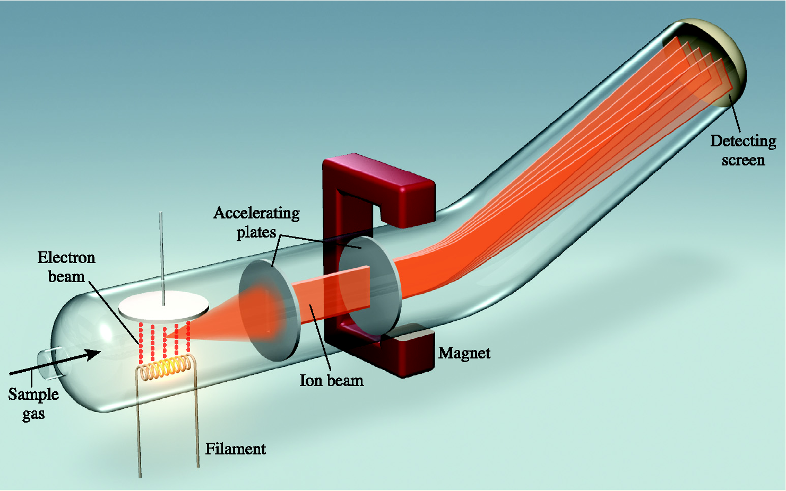
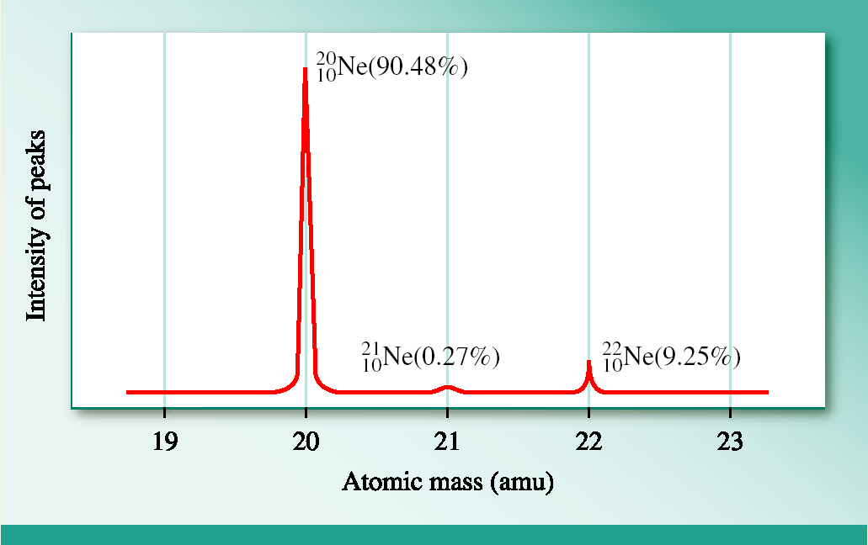
Mass Spectrometery
Sample In
Data Out

Slide 26
2.4 The Periodic Table
Periods - horizontal rows
Families (Groups) - vertical columns
Elements in the same family have similar chemical and physical properties
Arranged in order of increasing atomic number

Slide 27
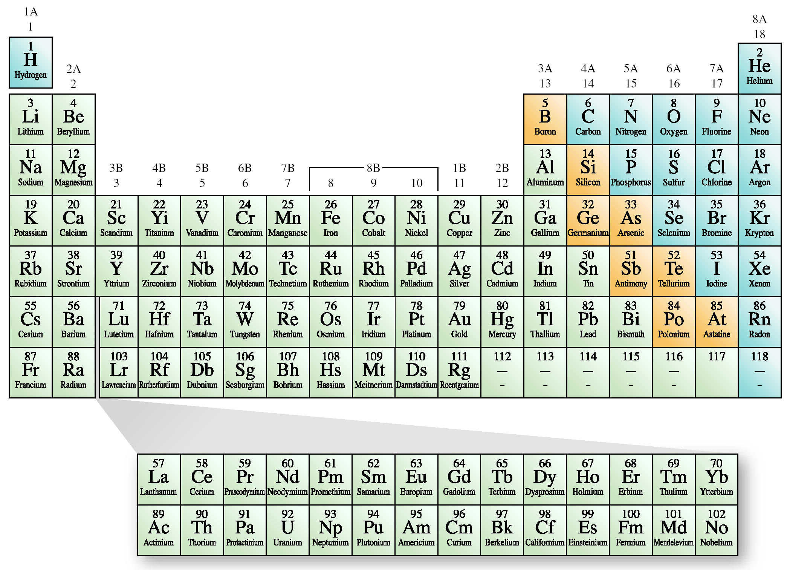
The Modern Periodic Table
Ti

Slide 28
Metals - good conductors of heat and electricity (majority of elements on the table, located to the left of the stair step)
Nonmetals - nonconductors (located in upper right-hand corner)
Metalloids - in between metals and nonmetals (those that lie along the separation line)

Slide 29
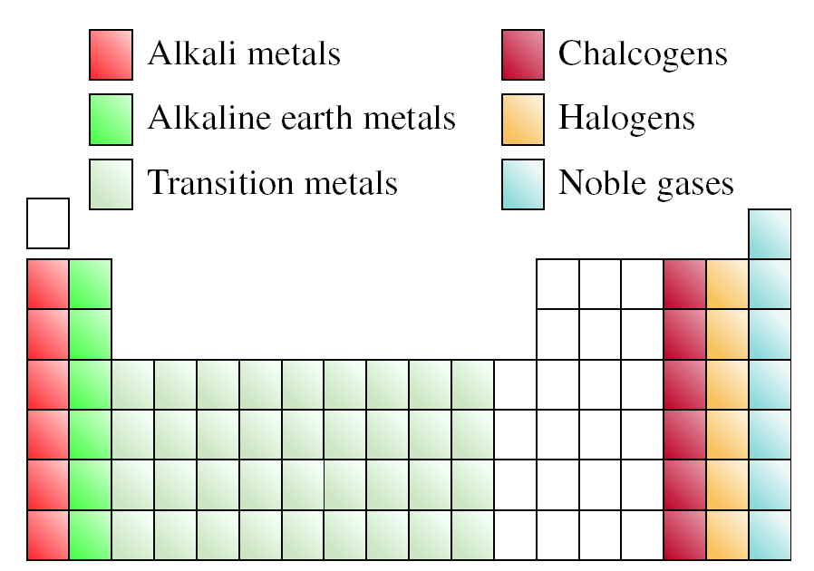
Groups (Families) on the Periodic Table

Slide 30
2.5 The Atomic Mass Scale and Average atomic Mass
Atomic mass is the mass of the atom in atomic mass units (amu)
Atomic mass unit is defined as a mass exactly equal to one-twelfth the mass of one carbon-12 atom
Carbon-12 (12 amu) provides the standard for measuring the atomic mass of the other elements

Slide 31
Why 1/12 the mass of Carbon-12? You might think that this would work with any particular isotope (e.g. 1/7 the mass of Lithium-7).
The problem is that there is a difference in the mass of the atom as a whole, and the sum of the masses of its individual protons, neutrons, and electrons.
When the particles bind together to form an atom, some of the mass is lost as “binding energy” according to:
E = mc²
Different atoms have differing amounts of binding energy, so one particular isotope had to be selected as the standard.

Slide 32
Average atomic mass
Masses on the periodic table are not whole numbers.
Mass spectrometer provides information about percentages of different isotopes of each element.
Periodic table mass is the weighted average of all of the isotopes of each element

Slide 33
Oxygen is the most abundant element both in
the Earth’s crust and in the human body. The
atomic masses of its three stable isotopes, ¹⁶O
(99.757%), ¹⁷O (0.038%), and ¹⁸O (0.205%),
are 15.9949 amu, 16.9999 amu, and 17.9999
amu, respectively. Calculate the average atomic
mass of oxygen using the relative abundances
given in parentheses.

Slide 34
Steps:
1. Convert each % into decimal abundance. (divide by 100)
2. Multiply mass of each isotope by its fractional abundance.
3. Add the contributions together.
(0.99757)(15.9949 amu) + (0.00038)(16.9999 amu) + (0.00205)(17.9999) = 15.999 amu.
*To four significant figures, this is the same as the mass given in the periodic table in the book: 16.00

Slide 35
The atomic masses of the two stable
isotopes of copper, ⁶³Cu (69.17%) and
⁶⁵Cu (30.83%), are 62.929599 amu and
64.927793 amu, respectively. Calculate
the average atomic mass of copper.
(0.6917)(62.929599 amu) + (0.3083)(64.927793 amu) + = 63.55 amu.

Slide 36
2.6 Molecules and Molecular Compounds
Molecule - combination of at least two atoms in a specific arrangement held together by chemical bonds
May be an element or a compound
H₂, hydrogen gas, is an element
H₂O, water, is a compound

Slide 37
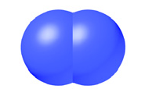
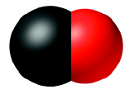
Diatomic molecules:
Homonuclear (2 of the same atoms)
Examples: H₂, N₂, O₂, F₂, Cl₂, Br₂, and I₂
Heteronuclear (2 different atoms)
Examples: CO and HCl

Slide 38
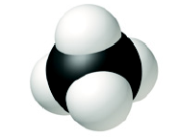
Polyatomic molecules:
Contain more than 2 atoms
Most molecules
May contain more than one element
Examples: ozone, O₃; white phosphorus, P₄; water, H₂O, and methane (CH₄)

Slide 39
Molecular formula - shows exact number of atoms of each element in a molecule
Subscripts indicate number of atoms of each element present in the formula.
Example: C₁₂H₂₂O₁₁

Slide 40
Allotrope - one of two or more distinct forms of an element
Examples: oxygen, O₂ and ozone, O₃; diamond and graphite (allotropic forms of carbon)
Structural formula - shows the general arrangement of atoms within the molecule.

Slide 41
Naming molecular compounds
Binary Molecular compounds
Composed of two nonmetals
Name the first element
Name the second element changing ending to “-ide”
Use prefixes to indicate number of atoms of each element

Slide 42
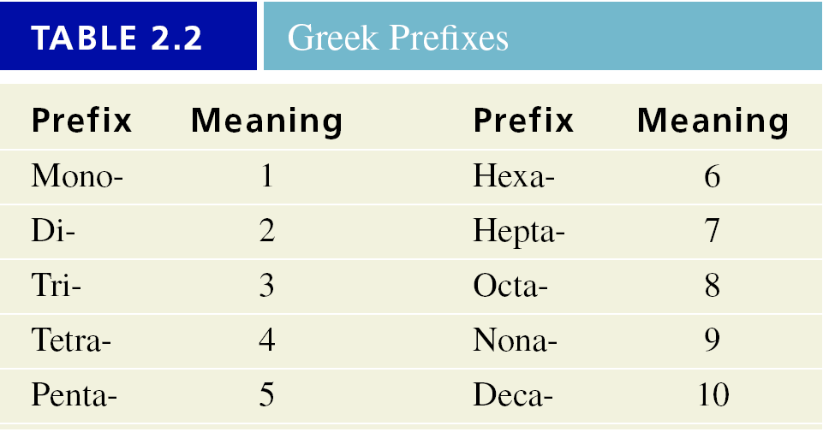

Slide 43
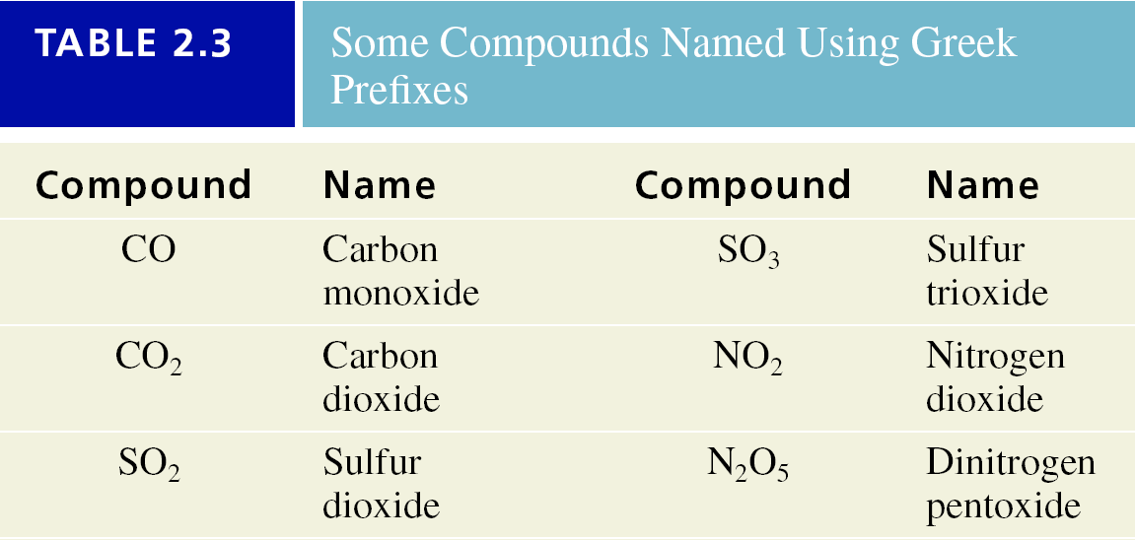

Slide 44
Name the following:
NO₂
nitrogen dioxide
N₂O₄
dinitrogen tetraoxide
Write formulas for the following:
Diphosphorus pentoxide
P₂O₅
Sulfur hexafluoride
SF₆

Slide 45
Common Names
B₂H₆ diborane
SiH₄ silane
NH₃ ammonia
PH₃ phosphine
H₂O water (vs. “dihydrogen monoxide)
H₂S hydrogen sulfide (vs. “dihydrogen sulfide”)

Slide 46
Acid - a substance that produces hydrogen ions (H⁺) when dissolved in water
Binary acids:
Many have 2 names
Pure substance
Aqueous solution
Example: HCl, hydrogen chloride, when dissolved in water it is called hydrochloric acid

Slide 47
Naming binary acids
Remove the “–gen” ending from hydrogen (leaving hydro–)
Change the “–ide” ending on the second element to “–ic”
Combine the two words and add the word “acid.”

Slide 48
Name the following:
HBr
hydrogen bromide hydrobromic acid
Write formulas for the following:
Hydrochloric acid
HCl(aq)
Hydrofluoric acid
HF(aq)

Slide 49
Organic compounds - contain carbon and hydrogen (sometimes with oxygen, nitrogen, sulfur and the halogens.)
Hydrocarbons - contain only carbon and hydrogen
Alkanes - simplest examples of hydrocarbons
Many derivatives of alkanes are derived by replacing a hydrogen with one of the functional groups.
Functional group determines chemical properties

Slide 50
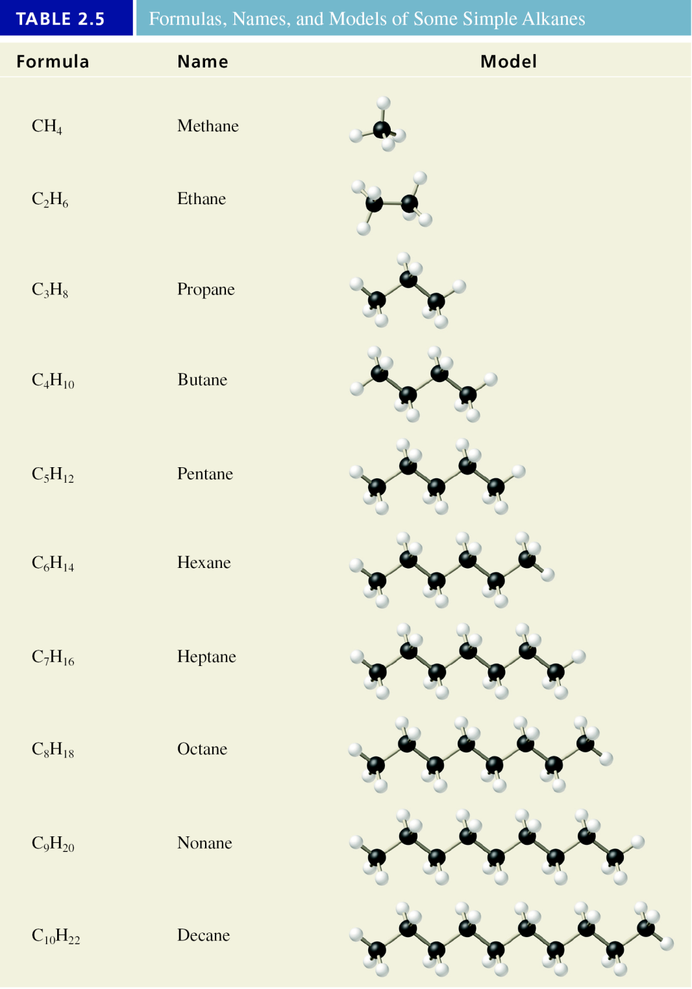

Slide 51
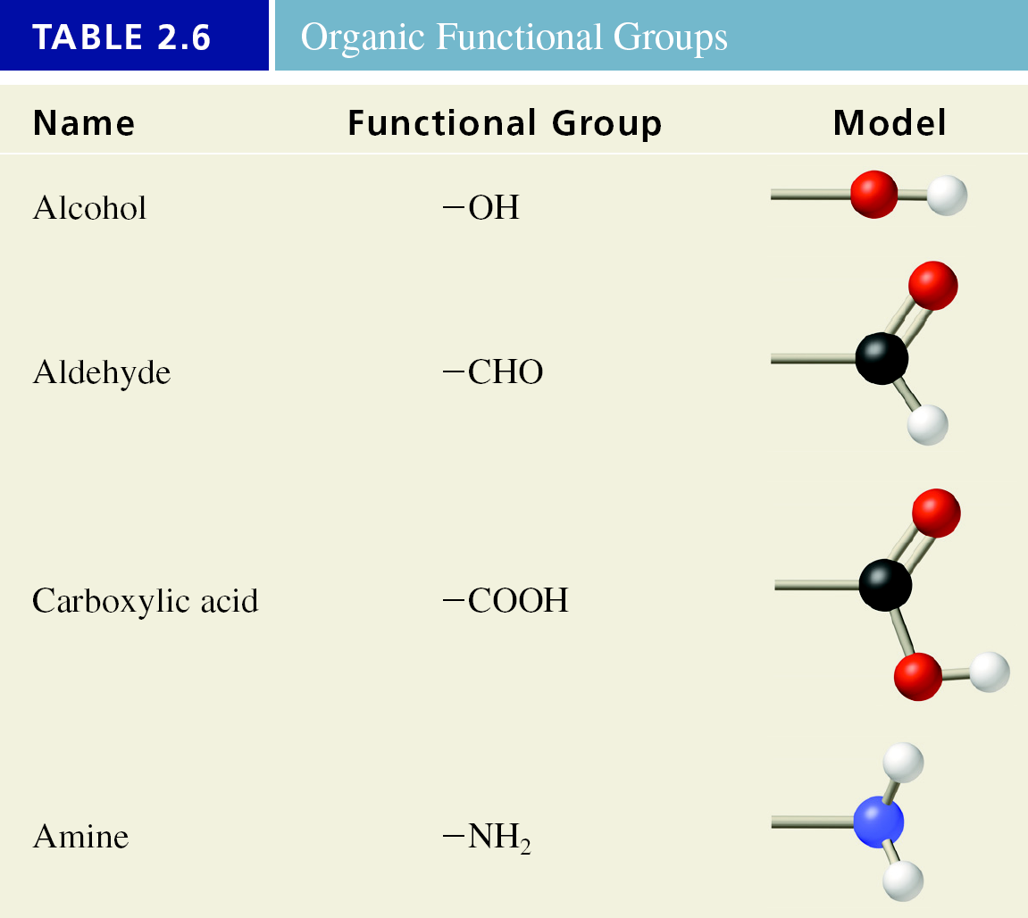

Slide 52
Empirical formulas reveal the elements present and in what whole-number ratio they are combined.
Molecular(explicit) Empirical(simplest)
H₂O₂ HO
N₂H₄ NH₂
H₂O H₂O

Slide 53
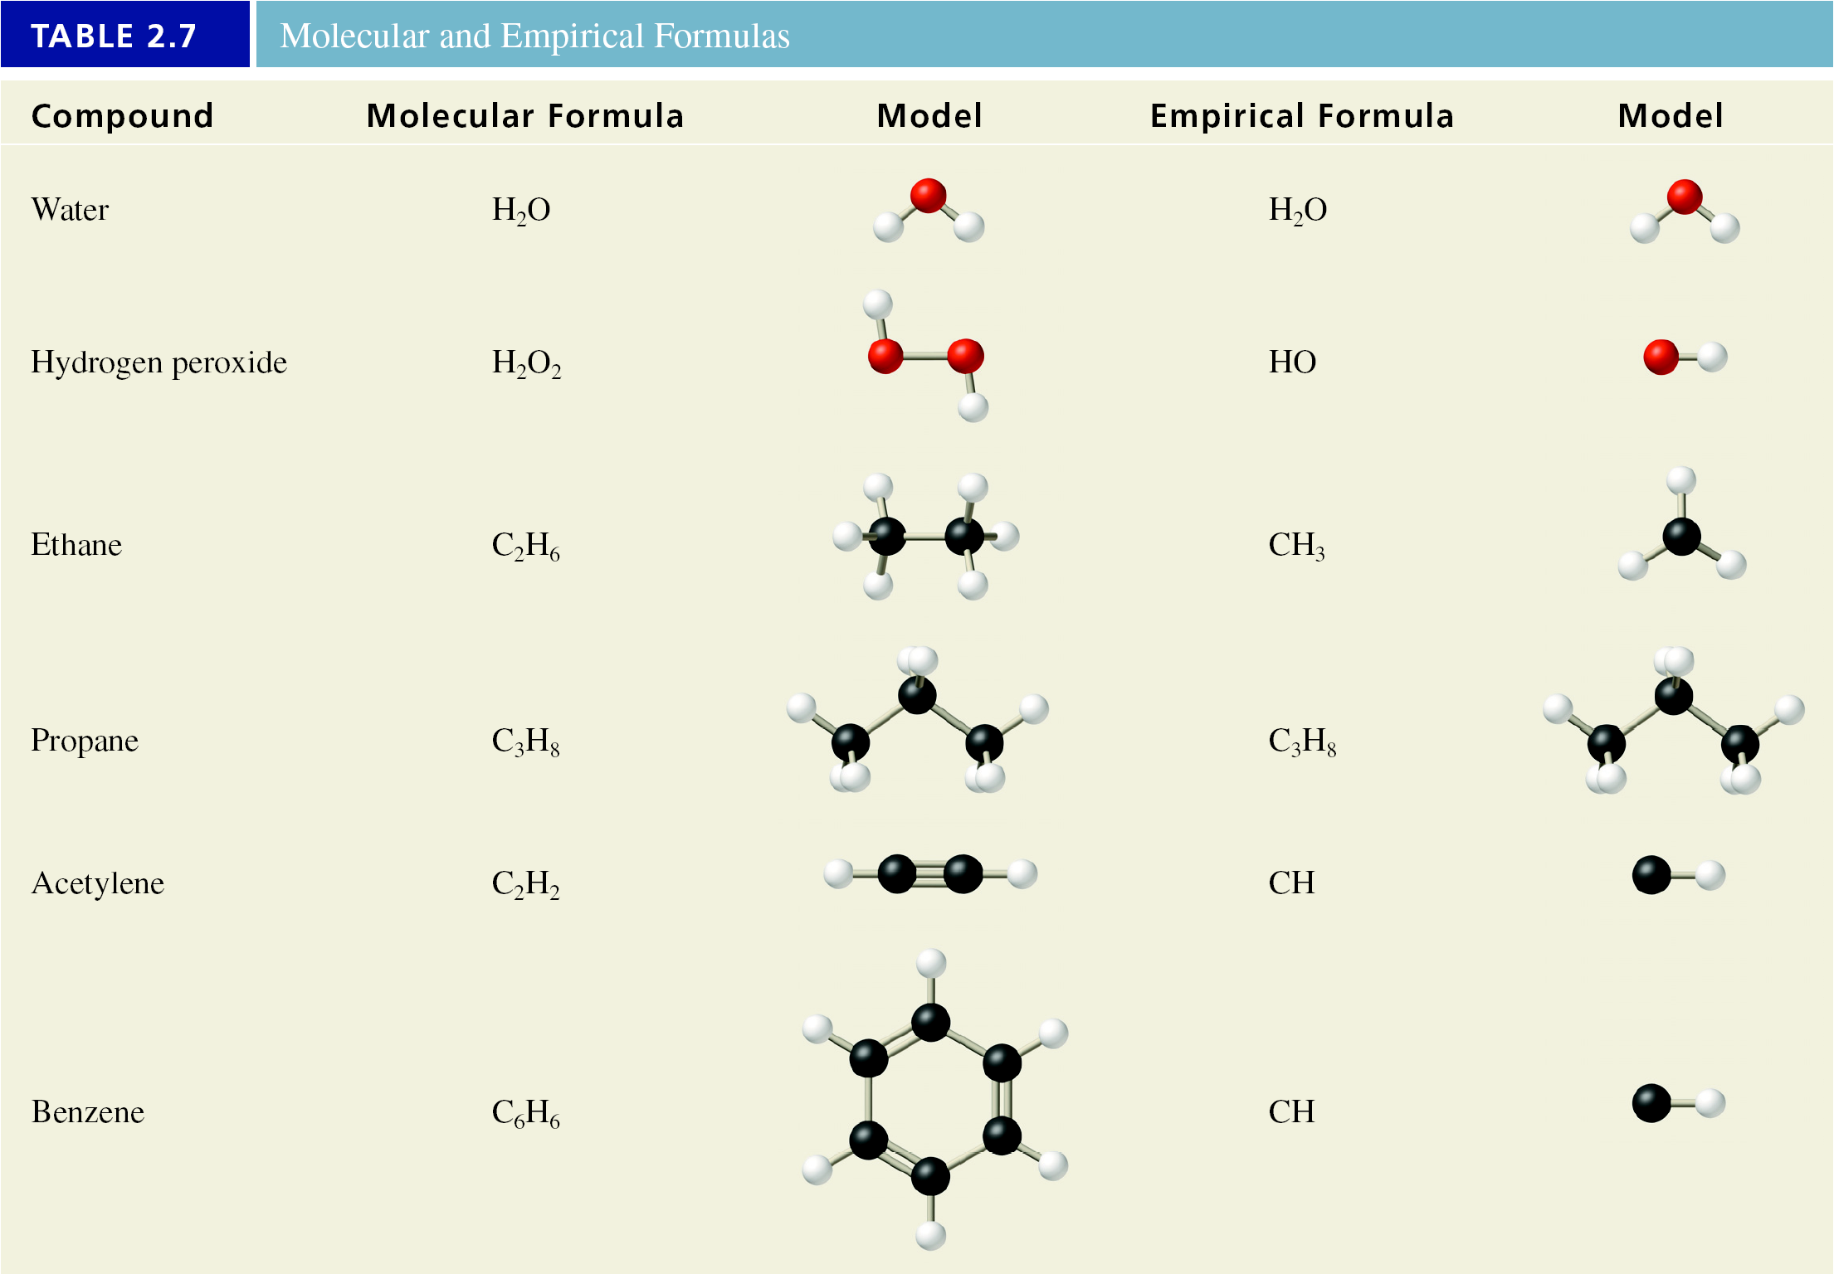

Slide 54
2.7 Ions and Ionic Compounds
Ion - an atom or group of atoms that has a net positive or negative charge
Monatomic ion - one atom with a positive or negative charge
Cation - ion with a net positive charge due to the loss of one or more electrons
Anion - ion with a net negative charge due the gain of one or more electrons

Slide 55
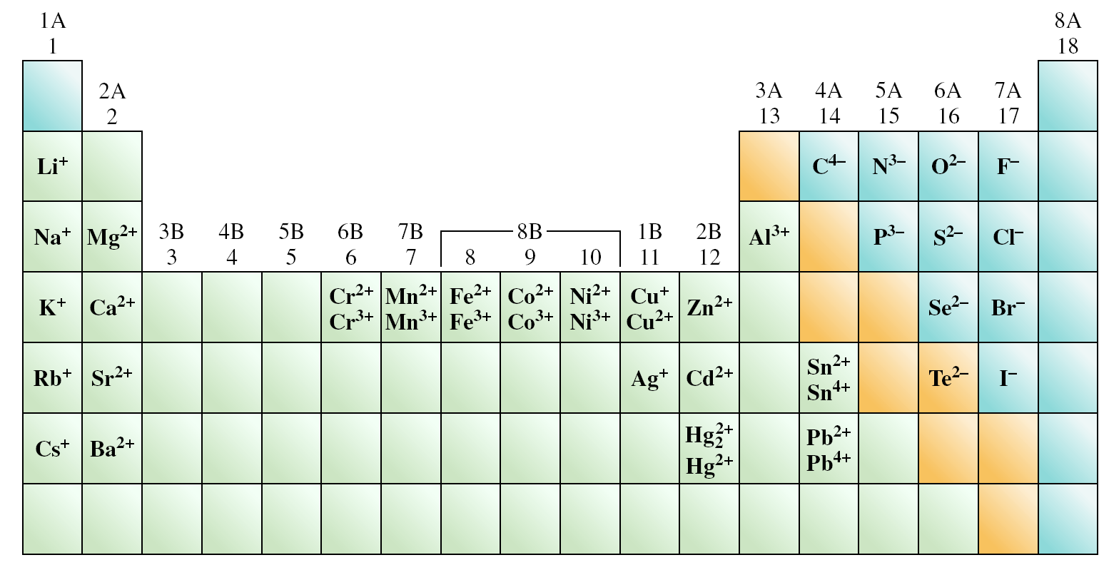
Common Monatomic Ions

Slide 56
Naming ions
Cations from A group metals
Name the element and add the word “ion”
Example: Na⁺, sodium ion
Cations from transition metals with some exceptions
Name element
Indicate charge of metal with Roman numeral
Add word “ion”
Example: Cu²⁺ ,copper(II) ion

Slide 57
Anions
Name the element and modify the ending to “-ide”
Example: Cl⁻, chloride
Polyatomic ions - ions that are a combination of two or more atoms
Notice similarities - number of oxygen atoms and endings for oxoanions
Nitrate, NO₃⁻ and nitrite, NO₂⁻

Slide 58
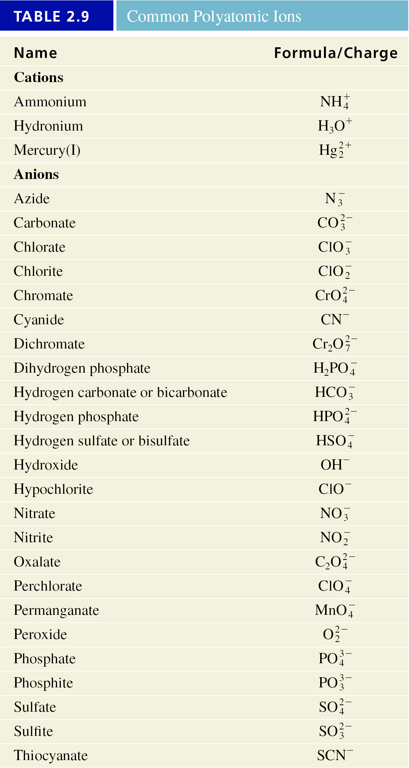

Slide 59
Ionic compounds - represented by empirical formulas
Compound formed is electrically neutral
Sum of the charges on the cation(s) and anion(s) in each formula unit must be zero
Examples:
Al³⁺ and O²⁻ Al₂O₃
Ca²⁺ and PO₄³⁻ Ca₃(PO₄)₂

Slide 60
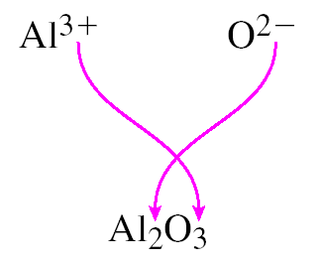
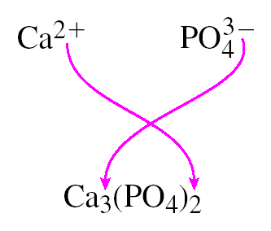

Slide 61
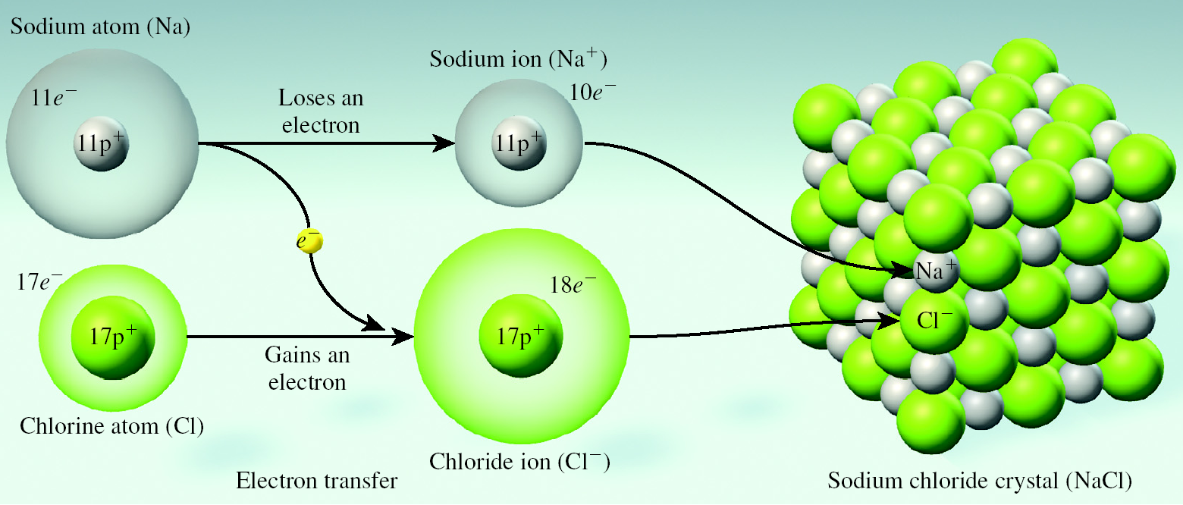
Formation of an Ionic Compound

Slide 62
Write empirical formulas for
Aluminum and bromide
AlBr₃
barium and phosphate
Ba₃(PO₄)₂
Magnesium and nitrate
Mg(NO₃)₂
Ammonium and sulfate
(NH₄)₂SO₄

Slide 63
Naming ionic compounds
Name the cation
Name the anion
Check the name of cation
If it is a A group metal you are finished
If it is a transition metal, with some exceptions, add the appropriate Roman numeral to indicate the positive ionic charge

Slide 64
Write names for the following:
KMnO₄
Sr₃(PO₄)₂
Co(NO₃)₂
FeSO₄

Slide 65
Write names for the following:
KMnO₄
potassium permanganate
Sr₃(PO₄)₂
strontium phosphate
Co(NO₃)₂
cobalt(II) nitrate
FeSO₄
iron(II) sulfate

Slide 66
Oxoacids
When writing formulas, add the number of H⁺ ions necessary to balance the corresponding oxoanion’s negative charge
Naming formulas
If the anion ends in “-ite” the acid ends with “-ous” acid
If the anion ends in “-ate” the acid ends in “-ic” acid

Slide 67
Name the following:
H₂SO₃
HClO
H₃PO₄
Write formulas for the following:
Perchloric acid
Nitric acid

Slide 68
Name the following:
H₂SO₃
sulfurous acid
HClO
hypochlorous acid
H₃PO₄
phosphoric acid
Write formulas for the following:
Perchloric acid
HClO₄
Nitric acid
HNO₃

Slide 69
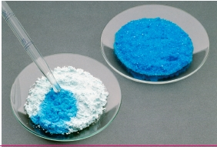
Hydrates - compounds that have a specific number of water molecules within their solid structure
Hydrated compounds may be heated to remove the water forming an anhydrous compound
Name the compound and add the word hydrate. Indicate the number of water molecules with a prefix on hydrate.
Example: CuSO₄ · 5 H₂O
Copper (II) sulfate pentahydrate

Slide 70
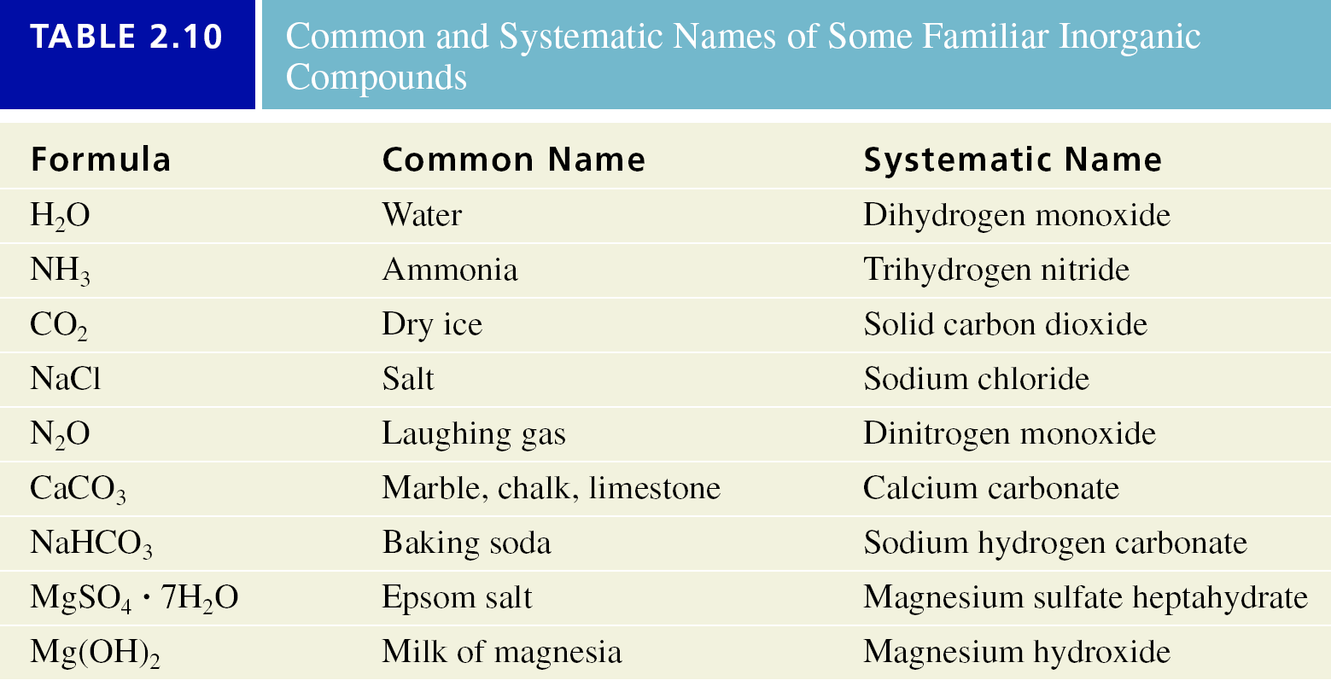

Slide 71
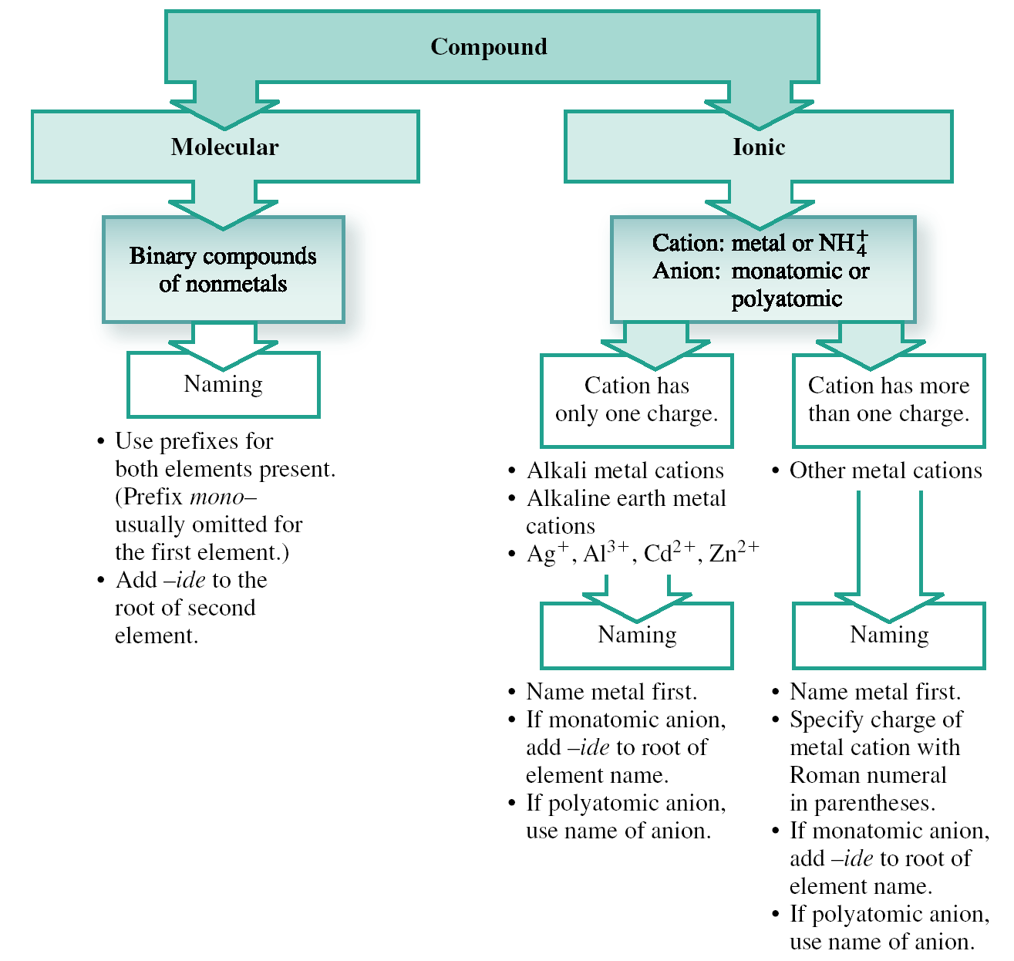

Slide 72
Key Points
Atomic theory - parts of the atom; theories; laws
Types of radiation
Atomic number and mass number
Isotopes
Periodic table; families and periods; metals, nonmetals and metalloids

Slide 73
Key Points
Average atomic mass
Naming and writing formulas for
Binary molecular compounds
Binary acids
Ionic compounds
Oxoacids
Hydrates

