Slide 2
Chapter 1 Chemistry: The Central Science
CHEM 101
Dr. Geoff Sametz
Fall 2009

Slide 3
What IS Chemistry?
Text: “The study of matter and the changes that matter undergoes”
Focus: how matter interacts at the atomic/molecular level

Slide 4
Why “The Central Science”?
Other scientific disciplines require an understanding of how matter behaves. Some examples:
Physics: electronic devices require an understanding of materials called semiconductors
Biology→Biochemistry→Organic Chemistry (the study of carbon-containing compounds)

Slide 5
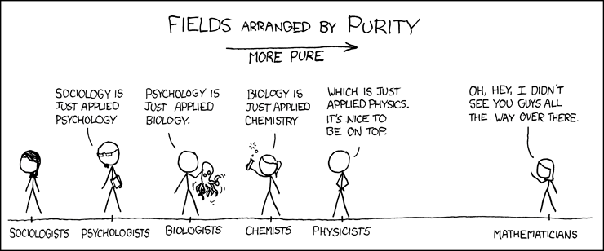

Slide 6
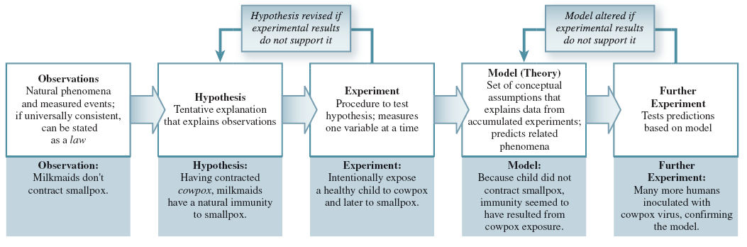
1.2 The Scientific Method
Notes:
The word “theory”, as used by scientists, actually indicates a model that is highly reliable…not speculative at all.

Slide 7
1.3 Classification of Matter
Matter is either classified as a substance or a mixture of substances.
Substance
Can be either an element or a compound
Has a definite (constant) composition and distinct properties
Examples: sodium chloride, water, oxygen

Slide 8
States of Matter
Solid
particles close together in orderly fashion
little freedom of motion
a solid sample does not conform to the shape of its container
Liquid
particles close together but not held rigidly in position
particles are free to move past one another
a liquid sample conforms to the shape of the part of the container it fills

Slide 9
Gas
particles randomly spread apart
particles have complete freedom of movement
a gas sample assumes both shape and volume of container.
States of matter can be inter-converted without changing chemical composition
solid → liquid → gas (add heat)
gas → liquid → solid (remove heat)

Slide 10
States of Matter

Slide 11
Physical vs. Chemical Change
In chemistry, we’re chiefly concerned with how atoms bond with each other.
A chemical change involves making or breaking chemical bonds to create new substances.
A physical change alters a substance without changing its chemical identity.
-e.g. crushing, melting, boiling.

Slide 12
Substances
Element: cannot be separated into simpler substances by chemical means.
Examples: iron, mercury, oxygen, and hydrogen
Compounds: two or more elements chemically combined in definite ratios
Cannot be separated by physical means
Examples: salt, water and carbon dioxide

Slide 13
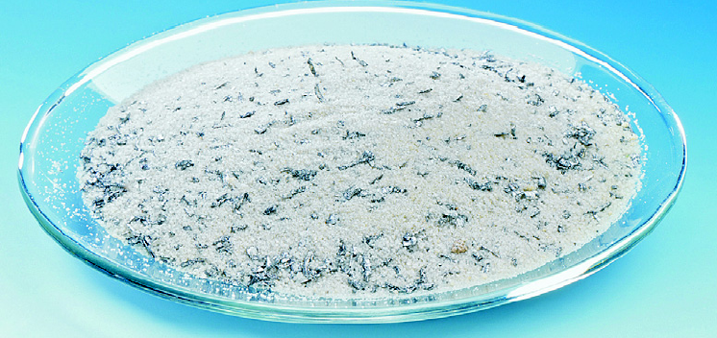
Mixtures
Mixture: physical combination of two or more substances
Substances retain distinct identities
No universal constant composition
Can be separated by physical means
Examples: sugar/iron; sugar/water

Slide 14
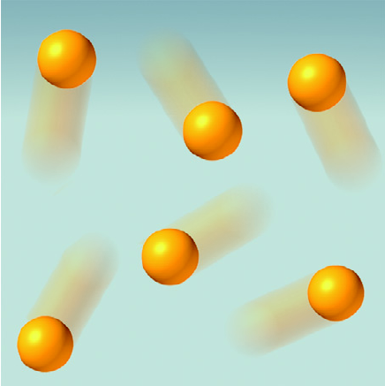
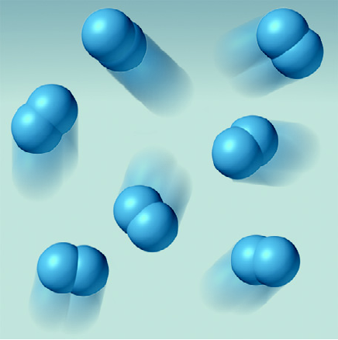
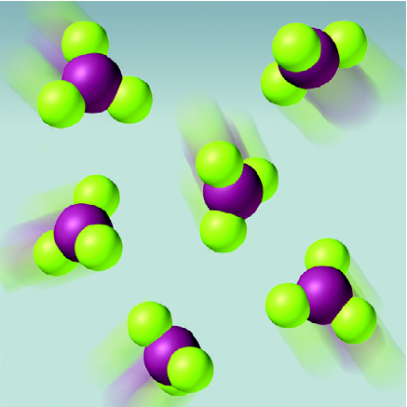
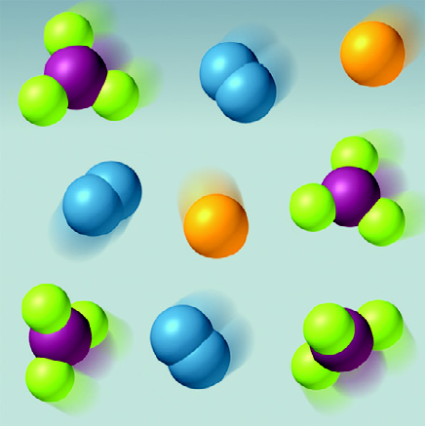
Molecular Comparison of Substances and Mixtures
Atoms of an element
Molecules of an element
Molecules of a compound
Mixture of two elements and a compound

Slide 15
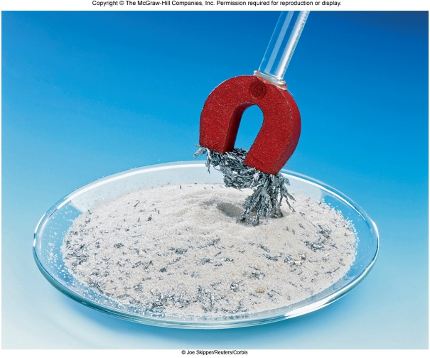
Types of Mixtures
Homogeneous: composition of the mixture is uniform throughout
Example: sugar dissolved in water
Heterogeneous: composition is not uniform throughout
Example: sugar mixed with iron filings

Slide 16
Classification of Matter

Slide 17
Classify the following
Aluminum foil
Baking soda
Milk
Air
Copper wire

Slide 18
Aluminum foil:
substance, element
Baking soda:
substance, compound
Milk:
mixture, homogeneous
Air:
mixture, homogeneous
Copper wire:
substance, element

Slide 19
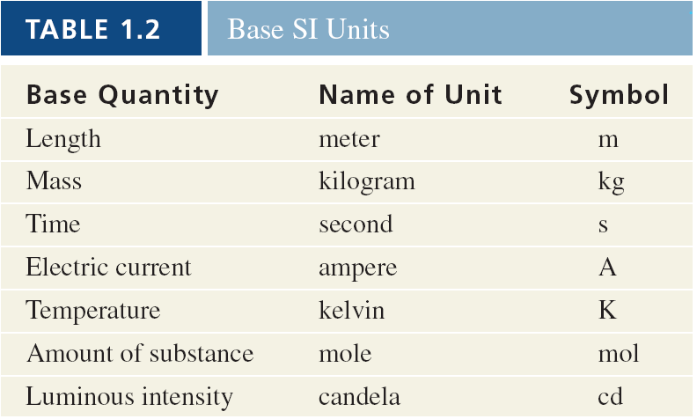
1.3 Scientific Measurement
Used to measure quantitative properties of matter
SI base units

Slide 20
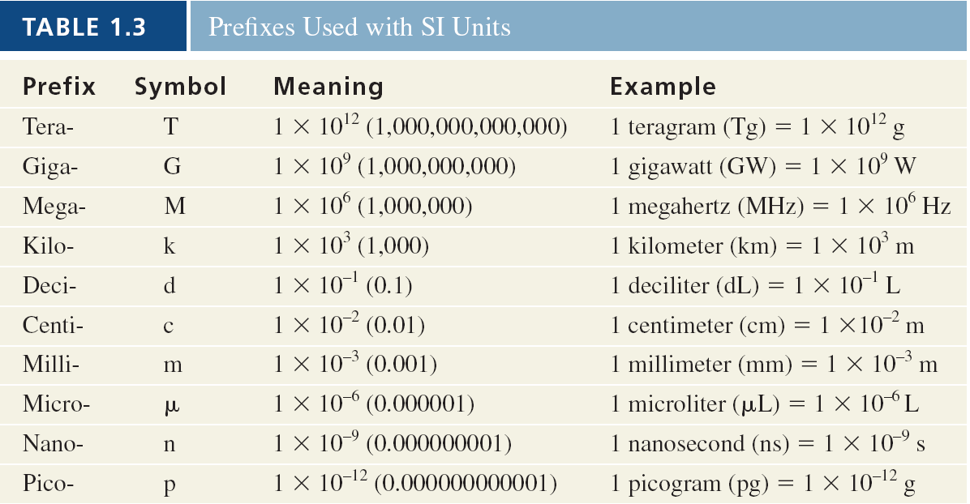
SI Prefixes

Slide 21
Mass: measure of the amount of matter
(weight refers to gravitational pull)
Temperature:
Celsius
Represented by °C
Based on freezing point of water as 0°C and boiling point of water as 100°C
Kelvin
Represented by K (no degree sign)
The absolute scale
Units of Celsius and Kelvin are equal in magnitude
Fahrenheit (the English system) (°F)

Slide 22
Equations for Temperature Conversions

Slide 23
Temperature Conversions
A clock on a local bank reported a
temperature reading of 28ºC. What is this
temperature on the Kelvin scale?

Slide 24
Practice
Convert the temperature reading on the
local bank (28°C) into the corresponding
Fahrenheit temperature.

Slide 25
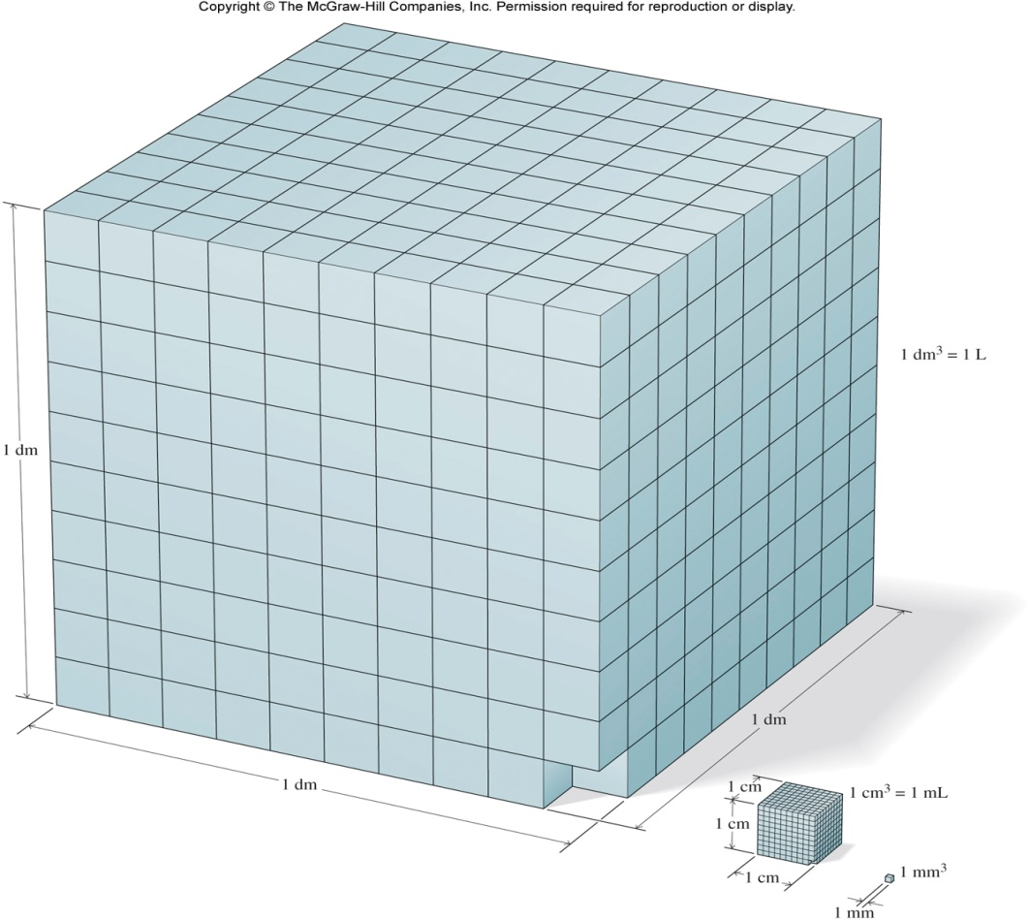
Volume: meter cubed (m³)
Derived unit
The unit liter (L) is more commonly used in the laboratory setting. It is equal to a decimeter cubed (dm³).

Slide 26
Density: Ratio of mass to volume
Formula:
d = density (g/mL)
m = mass (g)
V = volume (mL or cm³)
(*gas densities are usually expressed in g/L)

Slide 27
Practice
The density of a piece of copper wire is
8.96 g/cm³. Calculate the volume in cm³
of a piece of copper with a mass of 4.28 g.

Slide 28
1.4 Properties of Matter
Quantitative: expressed using numbers
Qualitative: expressed using properties
Physical properties: can be observed and measured without changing the substance
Examples: color, melting point, states of matter
Physical changes: the identity of the substance stays the same
Examples: changes of state (melting, freezing)

Slide 29
Chemical properties: must be determined by the chemical changes that are observed
Examples: flammability, acidity, corrosiveness, reactivity
Chemical changes: after a chemical change, the original substance no longer exists
Examples: combustion, digestion

Slide 30
Extensive property: depends on amount of matter
Examples: mass, length
Intensive property: does not depend on amount
Examples: density, temperature, color

Slide 31
1.5 Uncertainty in Measurement
Exact: numbers with defined values
Examples: counting numbers, conversion factors based on definitions
Inexact: numbers obtained by any method other than counting
Examples: measured values in the laboratory

Slide 32
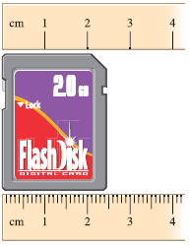
Significant figures
Used to express the uncertainty of inexact numbers obtained by measurement
The last digit in a measured value is an uncertain digit - an estimate

Slide 33
Guidelines for significant figures
Any non-zero digit is significant
Zeros between non-zero digits are significant
Zeros to the left of the first non-zero digit are not significant
Zeros to the right of the last non-zero digit are significant if decimal is present
Zeros to the right of the last non-zero digit are not significant if decimal is not present

Slide 34
Practice
Determine the number of significant figures in
each of the following.
345.5 cm
4 significant figures
0.0058 g
2 significant figures
1205 m
4 significant figures
250 mL
2 significant figures
250.00 mL
5 significant figures

Slide 35
Calculations with measured numbers
Addition and subtraction
Answer cannot have more digits to the right of the decimal than any of original numbers
Example:
102.50 two digits after decimal point
+ 0.231 three digits after decimal point
102.731 round to 102.73

Slide 36
Multiplication and division
Final answer contains the smallest number of significant figures
Example:
1.4 x 8.011 = 11.2154 round to 11
(Limited by 1.4 to two significant figures in answer)

Slide 37
Exact numbers
Do not limit answer because exact numbers have an infinite number of significant figures
Example:
A penny minted after 1982 has a mass of 2.5 g. If we have three such pennies, the total mass is
3 x 2.5 g = 7.5 g
In this case, 3 is an exact number and does not limit the number of significant figures in the result.

Slide 38
Multiple step calculations
It is best to retain at least one extra digit until the end of the calculation to minimize rounding error.
Rounding rules
If the number is less than 5 round “down”.
If the number is 5 or greater round “up”.

Slide 39
Practice
105.5 L + 10.65 L = 116.2 L
Calculator answer: 116.15 L
Round to: 116.2 L Answer to the tenth position
1.0267 cm x 2.508 cm x 12.599 cm = 32.44 cm³
Calculator answer: 32.4419664 cm³
Round to: 32.44 cm³ round to the smallest number of significant figures

Slide 40
Accuracy and precision
Two ways to gauge the quality of a set of measured numbers
Accuracy: how close a measurement is to the true or accepted value
Precision: how closely measurements of the same thing are to one another

Slide 41
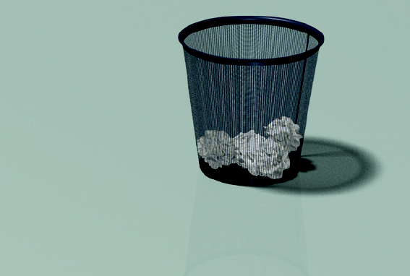
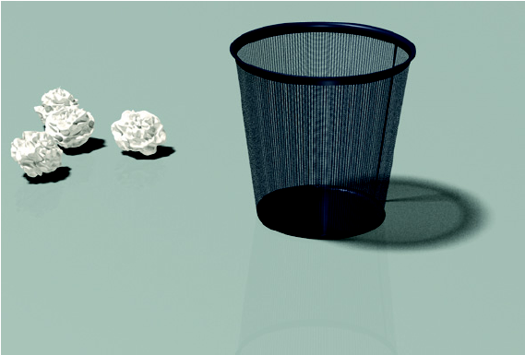
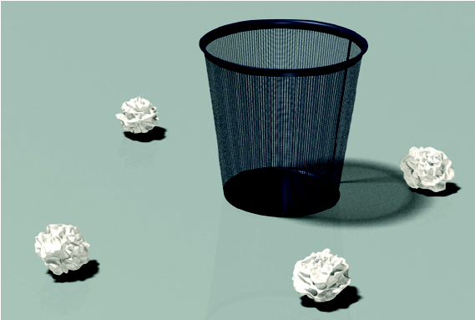
both accurate and precise
not accurate but precise
neither accurate nor precise

Slide 42
Describe accuracy and precision for each set
Student A Student B Student C
0.335 g 0.357 g 0.369 g
0.331 g 0.375 g 0.373 g
0.333 g 0.338 g 0.371 g
Average:
0.333 g 0.357 g 0.371 g
True mass is 0.370 grams

Slide 43
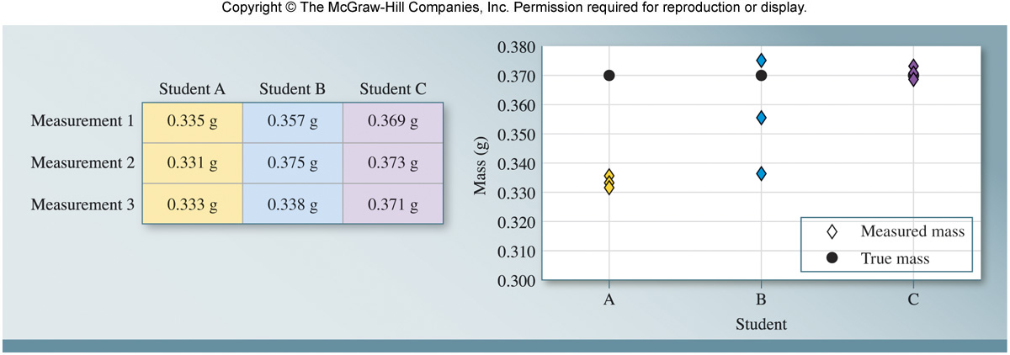
Student A’s results are precise but not accurate.
Student B’s results are neither precise nor accurate.
Student C’s results are both precise and accurate.

Slide 44
1.6 Using Units and Solving Problems
Conversion factor: a fraction in which the same quantity is expressed one way in the numerator and another way in the denominator
Example: by definition, 1 inch = 2.54 cm

Slide 45
Dimensional analysis: a problem solving method employing conversion factors to change one measure to another often called the “factor-label method”
Example: Convert 12.00 inches to meters
Conversion factors needed:
2.54 cm = 1 in and 100 cm = 1 meter
*Note that neither conversion factor limited the number of significant figures in the result because they both consist of exact numbers.

Slide 46
Notes on Problem Solving
Read carefully; find information given and what is asked for
Find appropriate equations, constants, conversion factors
Check for sign, units and significant figures
Check for reasonable answer

Slide 47
Practice
The Food and Drug Administration (FDA)
recommends that dietary sodium intake
be no more than 2400 mg per day. What
is this mass in pounds (lb), if 1 lb = 453.6 g?

Slide 48
Key Points
Scientific method
Classifying matter
SI conversions
Density
Temperature conversions
Physical vs chemical properties and changes
Precision vs accuracy
Dimensional analysis

