Slide 1
Lunch and Learn VLOOKUP & PivotTables
IT User Services
University of Delaware

Slide 2
Using VLOOKUP
VLOOKUP (Vertical Lookup) is a database type function.
Quickly looks up values in a vertical table of information (often using large amounts of data).
Allows you to combine data from two different sources.
Data can be retrieved from another worksheet or workbook.
Notes:
You will use the VLOOKUP to find matching values between the two spreadsheets (or workbooks) by looking VERTICALLY up and down the second sheet. Once it finds a match, you will instruct it to look to the value on the 2nd column over (in this case) and return it to the first spreadsheet.

Slide 3
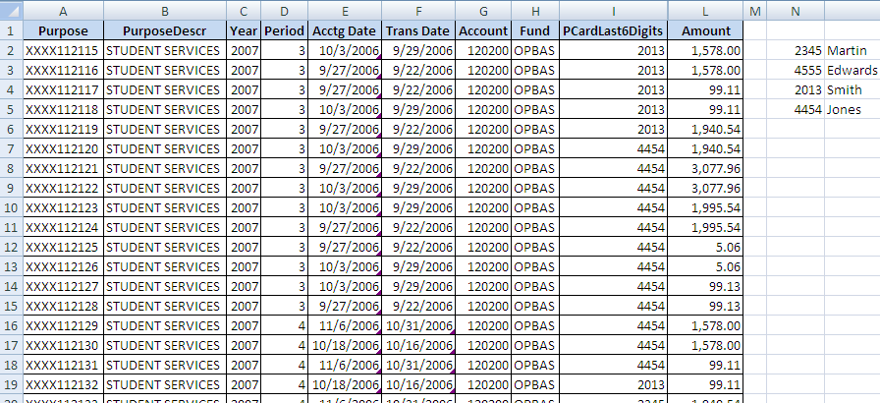
Using VLOOKUP
Notes:
In this example, the table array is in N2:O5.

Slide 4
VLOOKUP Syntax
=VLOOKUP(J2,$N$1:$O$4,2,FALSE)
To Find an Exact Match
J2 = Lookup value (last 4 digits of pro card)
$N$1:$O$4 = Table array (pro card # with employee name)
2 = Column index from table array with value to be returned
False = Tells Excel to return value if exact match is found
This function works differently based on the 4th parameter.
Notes:
Uses lookup value to search in the table array for an exact match.
Unless it finds an exact match it continues to look .
If no exact match then it returns #N/A

Slide 5
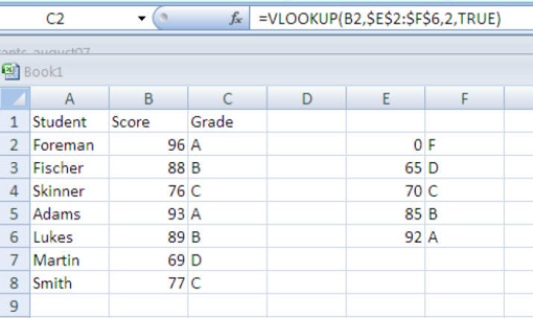
Using VLOOKUP
=VLOOKUP(B2,$E$2:$F$6,2,TRUE)
To Find the Closest Match
Search table array and looks for close match
Leave 4th parameter blank or enter TRUE
Table array must be sorted in ascending order
Notes:
If you are using the True argument, the values in the look up column should be sorted in ascending order.
Looks at table array, if lookup value is equal to current table array location, it returns matched value. If value is greater than, it looks at next table array location. If it’s less than, then it returns previous table array location otherwise it continues searching until the last value in the table array, then it returns that value.
Otherwise, you may get unexpected results. If you are using text values in your lookup column, avoid using leading or trailing spaces, as this also may produce unexpected results. However, if you use False as the final argument to your function (for an exact match), the lookup column does not have to be sorted.

Slide 6
Pivot Tables
Use a pivot table if you need to:
Work with large amounts of transactional data
Find relationships and groupings within data
Find a list of unique values for one field in data
Find trends using various time periods
Create subtotals that frequently include new additions
Organize your data into a format that’s easy to chart
* Bill Jelen, Mike Alexander. Pivot Table Data Crunching, 2007.

Slide 7
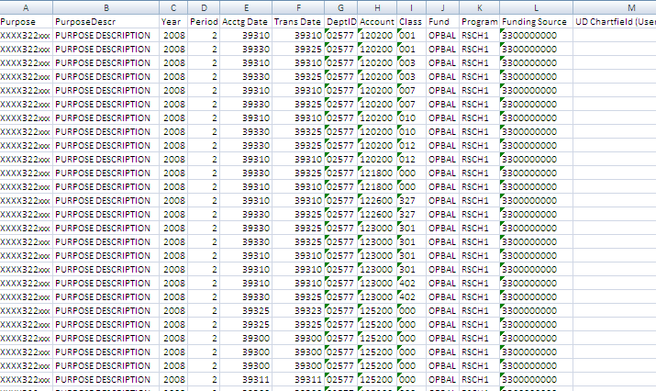
Pivot Tables
Allow you to quickly see numerical relationships
Often created from transactional data or raw data (like UD Financials)
Notes:
The screen shot on the left is the raw data from UD Financials. The view on the right shows a Pivot Table of Accounts and the subtotals for each account.

Slide 8
Pivot Tables
Rules:
No blank rows or columns are allowed
Each column must have a label
How to create:
Insert tab, PivotTable
Select fields
Notes:
Go to Excel worksheet for demo. Demo of previous slide.

Slide 9
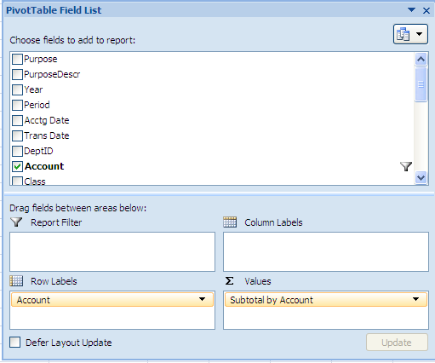
Pivot Table Anatomy
Values area – data fields you want to calculate
Row area – headings that go down the left side
Column area – heading across the top of the table, ideal for showing trends over time
Notes:
Describe each area.

Slide 10
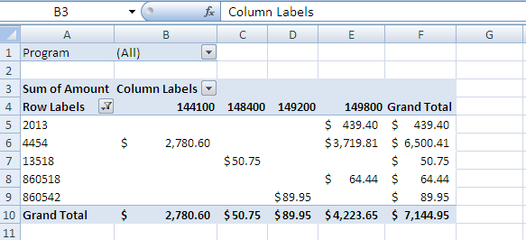
Pivot Table Anatomy
Report Filter area – optional area allowing filter of data items

Slide 11
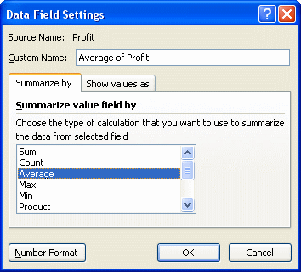
More Pivot Tables
Modifying PivotTable Calculations
Right-click Data field, select Summary option

Slide 12
More Pivot Tables
Refreshing a PivotTable
If you modify the original data the pivot table was based on, you must refresh it.
Notes:
Click the Refresh button in the Options ribbon. This will re-calculate the PivotTable with any data that may have changed.

Slide 13
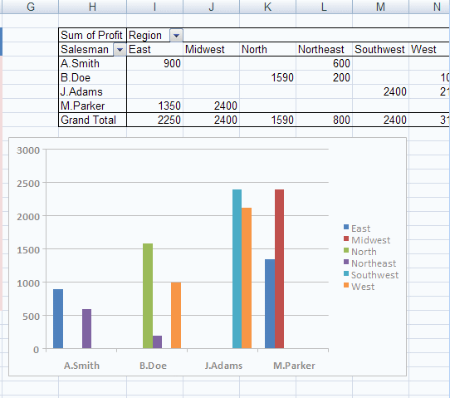
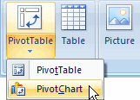
More Pivot Tables
Charting a PivotTable
PivotChart is a visual representation of the Pivot Table.
Notes:
Shows a graphical version of the data in the chart. Allows for at-a-glance representation of numerical data in a PivotTable. Create the chart by clicking a cell in the PivotTable, go to Options tab, choose Pivotchart. The slide shows Pivotchart from the Insert tab.

Slide 14
More Pivot Tables
Formatting a PivotTable
Use contextual Options & Design ribbons
Notes:
You can sort, filter, choose color schemes, etc. Describe the difference between the Options and Design tab under PivotTable Tools.

Slide 15
Other Pivot Table Uses
How Do I:
Sort date items in unique order?
Turn pivot table into hard data?
Show items with no data?
Create a separate pivot table for each field?
Avoid constantly redefining my pivot table data range?
Automate repetitive tasks?
Notes:
1-Type the label, the rest will automatically reorder
2-Copy and paste. Paste special, values for large data sets
3-If no data in a certain month, create a placeholder for label (helpful in charts)
4-Filter on a field, in table choose Options, PivotTable group, Options, show Report Filter pages
5-Name the range
6-Can use Macros, including with Pivot tables

Slide 16
Helpful Resources
Web sites:
www.udel.edu/learn
www.udel.edu/help
Reference materials:
Using Excel 2007, Bill Jelen, ISBN0-789703611-X
Pivot Table Data Crunching, Bill Jelen and Michael Alexander, ISBN-13:978-0-7897-3601-7

