Slide 1
Understanding Macros in Excel 2007
University of Delaware
Information Technology User Services

Slide 2
Macros
In this session you will learn how to:
Understand what a macro can accomplish
Set up developer tab and macro security
Plan a macro
Record & play macros
Notes:
VBA = Visual Basic for Applications

Slide 3
Macros
A macro is a small program designed to perform a number of tasks all at once.
Notes:
For example, instead of manually formatting a worksheet by hand, create one macro to do what you want to do, save the steps, and use the macro over and over. Macros are written (recorded) in Visual Basic.

Slide 4
Macro Planning
Think about how to break down the task into repeatable steps and determine what actions are needed to perform these steps in Excel.
Notes:
It is a good idea to plan out or even practice the sequence of actions for your macro before you record it. This will not only ensure that the actions lead to the expected outcome, but also helps you to avoid mistakes and unwanted actions in your macros. This is especially true for long macros that require several actions for the task.

Slide 5
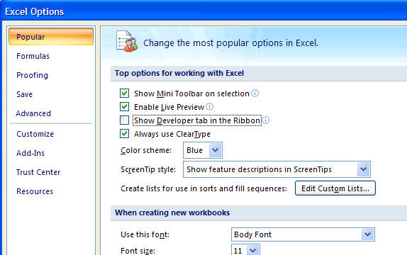
Developer Tab
Office button, click on Excel Options
☑ Show Developer tab in the ribbon
Notes:
Excel Options → click on box to Show Developer tab. Once you do this all macro commands will be found in the Developer tab.

Slide 6
Check Security Settings
Macro Security
Disable on certain conditions
Notes:
Click on Developer tab and click on Macro Security under the Code group to select Disable all macros with notification.

Slide 7
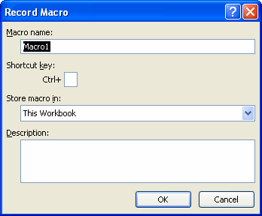
Macros
Recording Macros
Notes:
Developer tab, click Record Macro (Stop Recording) under Code group or you can use the shortcuts at the bottom of the worksheet.

Slide 8
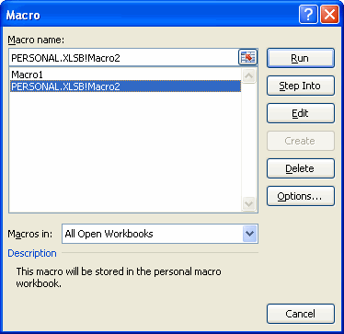
Macros
Playing a Macro
Select macro from list and click Run
Notes:
Click on Developer tab, click on Macros in Code group, choose macro under the Macro name: list, click Run
Go to Excel and demo.

Slide 9
More about Macros
More macro functionality is available, such as assigning a keystroke to a macro, making a relative reference macro, and deleting a macro.

Slide 10
Relative Macros
Record a Relative Reference Macro
Loosen cell restrictions; run on any cell range
Notes:
Click active cell, click Use Relative References, record macro.
Let’s say, for example, the active row is 1 and you create a relative reference macro that shades the range A1:I1 pink and changes some text. If you make the active row 3 and run the macro, the then range A3:I3 will be changed. If this were an absolute reference macro, the range A1:I1 will be changed no matter what the active row is when you run the macro.

Slide 11
Relative Macros
Running a Relative Reference Macro
Select active cell with relative data nearby, then run macro
Notes:
Imagine you have designed a relative macro to perform actions on cell A2:A7, with Cell A1 the active cell. You can run the macro anywhere and the same operations will be performed on the 6 cells immediately beneath the active cell.

Slide 12
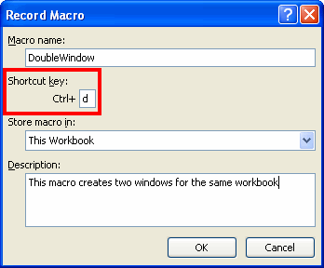
More about Macros
Assign Keystroke to a Macro
When recording macro, assign keystroke
Notes:
Think carefully about what key you want to assign as a short cut for a macro. Try to think of a shortcut that represents what the macro does, like Ctrl + s for a macro that formats subtotal rows.
Keep in mind that if the shortcut already had a task associated with it, the macro will now override the original purpose of the shortcut. For example, assigning Ctrl + N as a shortcut for a macro will disable Ctrl + N as a shortcut for opening a new workbook.

Slide 13
More about Macros
Deleting a Macro
Select macro from list and click Delete
Notes:
Click on Developer tab, click on Macros in Code group, choose macro under the Macro name: list, click Delete

Slide 14
More about Macros
Excel 2007 File Formats and Extensions
Excel Workbook (.xlsx) [Default]
Excel Macro-enabled Workbook (.xlsm)
Excel Template (.xltx)
Excel Macro-enabled Workbook Template (.xltm)
Excel Binary Workbook (.xlsb)
Excel Add-in (.xlam)
Notes:
Format Extension Annotations Excel Workbook .
.xlsx The default Excel 2007 workbook format. Functions as the primary replacement for the former binary .xls format, although it does not support Excel macros for security reasons.
.xlsm As Excel Workbook, but with macro support.
.xltx A template document that forms a basis for actual workbooks.
.xltm A template document that forms a basis for actual workbooks, with macro support. The replacement for the old .xlt format.
.xlsb As Excel Macro-enabled Workbook, but storing information in binary form rather than XML documents for opening and saving documents more quickly and efficiently. Intended especially for very large documents with tens of thousands of rows, and/or several hundreds of columns.
.xlam Excel add-in to add extra functionality and tools. Inherent macro support due to the file purpose.

Slide 15
Advanced Topics
Form controls provide a user-friendly visual way to interact with data in a workbook. You can apply formatting, perform calculations, and more with controls you are already familiar with.

Slide 16
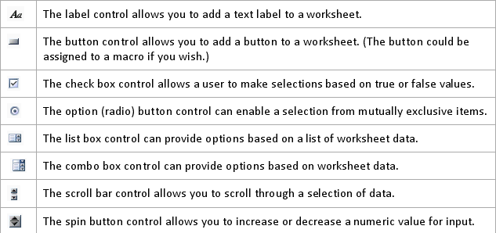
Form Controls
What is a Form Control?
GUI component that can be added to a worksheet
Notes:
GUI = Graphical User Interface. Many Windows components make use of these controls.

Slide 17
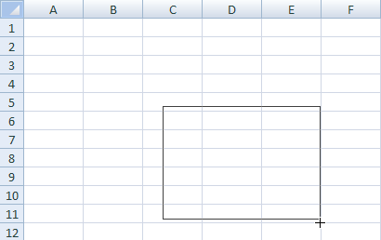
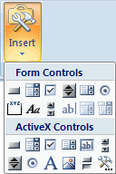
Form Controls
Adding a Control to a Worksheet
Insert and select control form
Notes:
Properties can then be modified for any object in the worksheet.

Slide 18
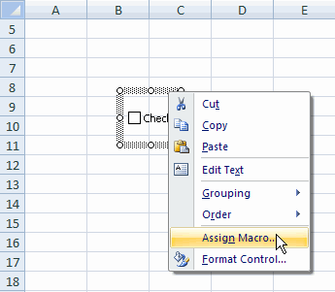
Form Controls
Assign a Macro to a Control
Right-click control, Assign Macro, record macro

Slide 19
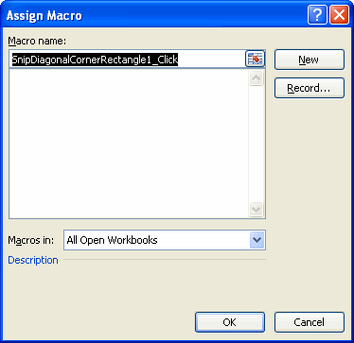
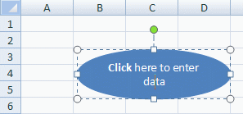
Forms & ActiveX Controls
Starting Using Form with Macro
Apply to a shape, assign to form
Notes:
Make the shape a starting button, or a special control to perform other actions.

Slide 20
Expert Topics
Using Visual Basic, you can create complex macros to perform many more actions and use it to copy macros from workbooks/templates.

Slide 21
VB & Macros
Opening the Visual Basic Editor
Notes:
Developer tab, click Visual Basic (VB) under Code group to open the VB Editor.

Slide 22
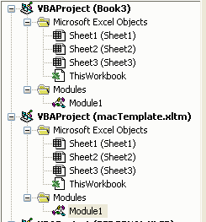
VB & Macros
Copy Macro from Workbook/Template
Open both worksheets, open VB editor, view Project Explorer, copy macro
Notes:
Module1 was copied from macTemplate to Book3.

Slide 23
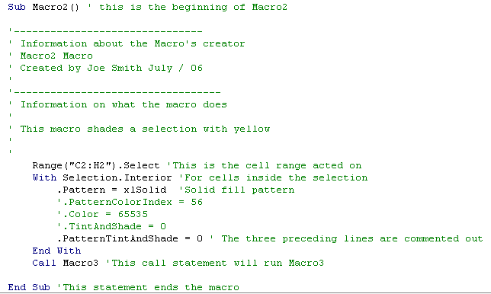
VB & Macros
Adding Comments to Code
Can be added nearly everywhere, describe your process
Notes:
Single apostrophe followed by text as your comment, everything after the single apostrophe is ‘commented out’ or ignored.

Slide 24
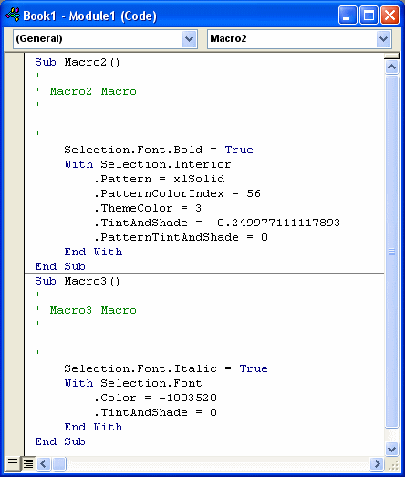
VB & Macros
Adding Code to your Macro
Record simple macro, open in editor, add code

Slide 25
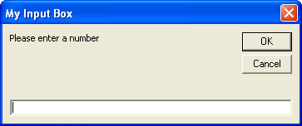
VB & Macros
Prompt for User Input
Request information from user

Slide 26
Resources
Web Sites:
http://www.udel.edu/learn
http://www.udel.edu/help

