Slide 1
Join the Conversation #VoicesOfUDel
April 6, 2015
Faculty Senate Meeting

Slide 2
Join the Conversation #VoicesOfUDel
April 6, 2015
Faculty Senate Meeting

Slide 3
About Us
Jawanza Keita, Communications Director
Anu Sivaraman, Assistant Professor of Marketing
Holly Norton, Social Media Manager

Slide 4
#VoicesOfUDel

Slide 5
#VoicesOfUDel

Slide 6
#VoicesOfUDel

Slide 7
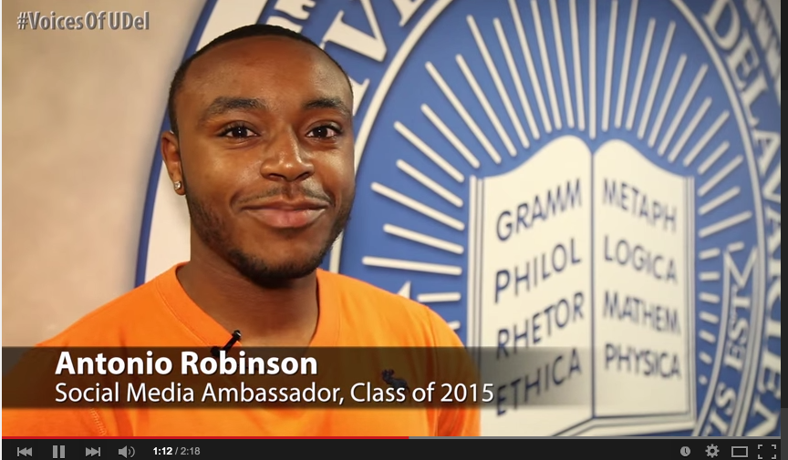
#VoicesOfUDel

Slide 8
#VoicesOfUDel
“What I’d love to see more of are real conversations between students, staff, faculty — everyone taking a further step to really get to know one another and acknowledge that their life experience can be totally different from one another.”
— Katie Connolly, Assistant Dean of Students

Slide 9
Partnership with WVUD: Campus Voices

Slide 10
#VoicesOfUDel Reach
Facebook: 110,000 people reached
YouTube: 6,455 views; up 48 % since February
Twitter: Hashtag used 285 times
Earned media
The News Journal
The Review

Slide 11
Call to Action

