Slide 1
Igs program updates

Slide 2
Student Updates
Undergraduate global survey
Results of 2450+ to guide global offerings
Study abroad fair February 25th 2-4pm
Drop in study abroad Wednesdays 1-4pm
Global internship opportunities
Growing alternate break programs

Slide 3
Faculty Updates
Fulbright informational sessions
February 27th 2-3pm; March 18th 9-10am
Developing your study abroad program
GLOBEX funding opportunities
Replaced scholars & travel awards
funding for high-impact projects

Slide 4
Salzburg Fellows
Dr. Martha Buell & Dr. Rena Hallam
Invited to “Designing a Social Compact for the 21st Century: Early Childhood Development and Education.”
Dr. Barret Michalec – “Developing a Shared Culture of Health: Enriching and Charting the Patient-Clinician Relationship.”
Dr. Michael O’Neal – “The Search for New Balance: America’s Changing Role in the World.”

Slide 5
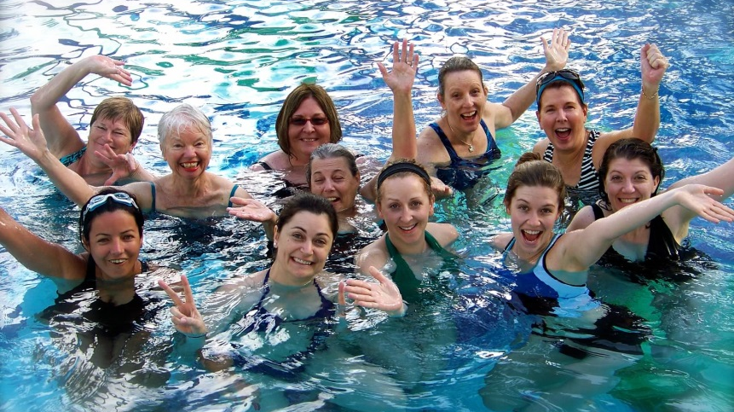
UD Travels
UD Wellness program –
Join the UD community February 3-7th, 2016 at the San Juan Marriott Resort & Stellaris Casino
Signature spring & summer programs –
Unique programming with faculty leaders

