Slide 1
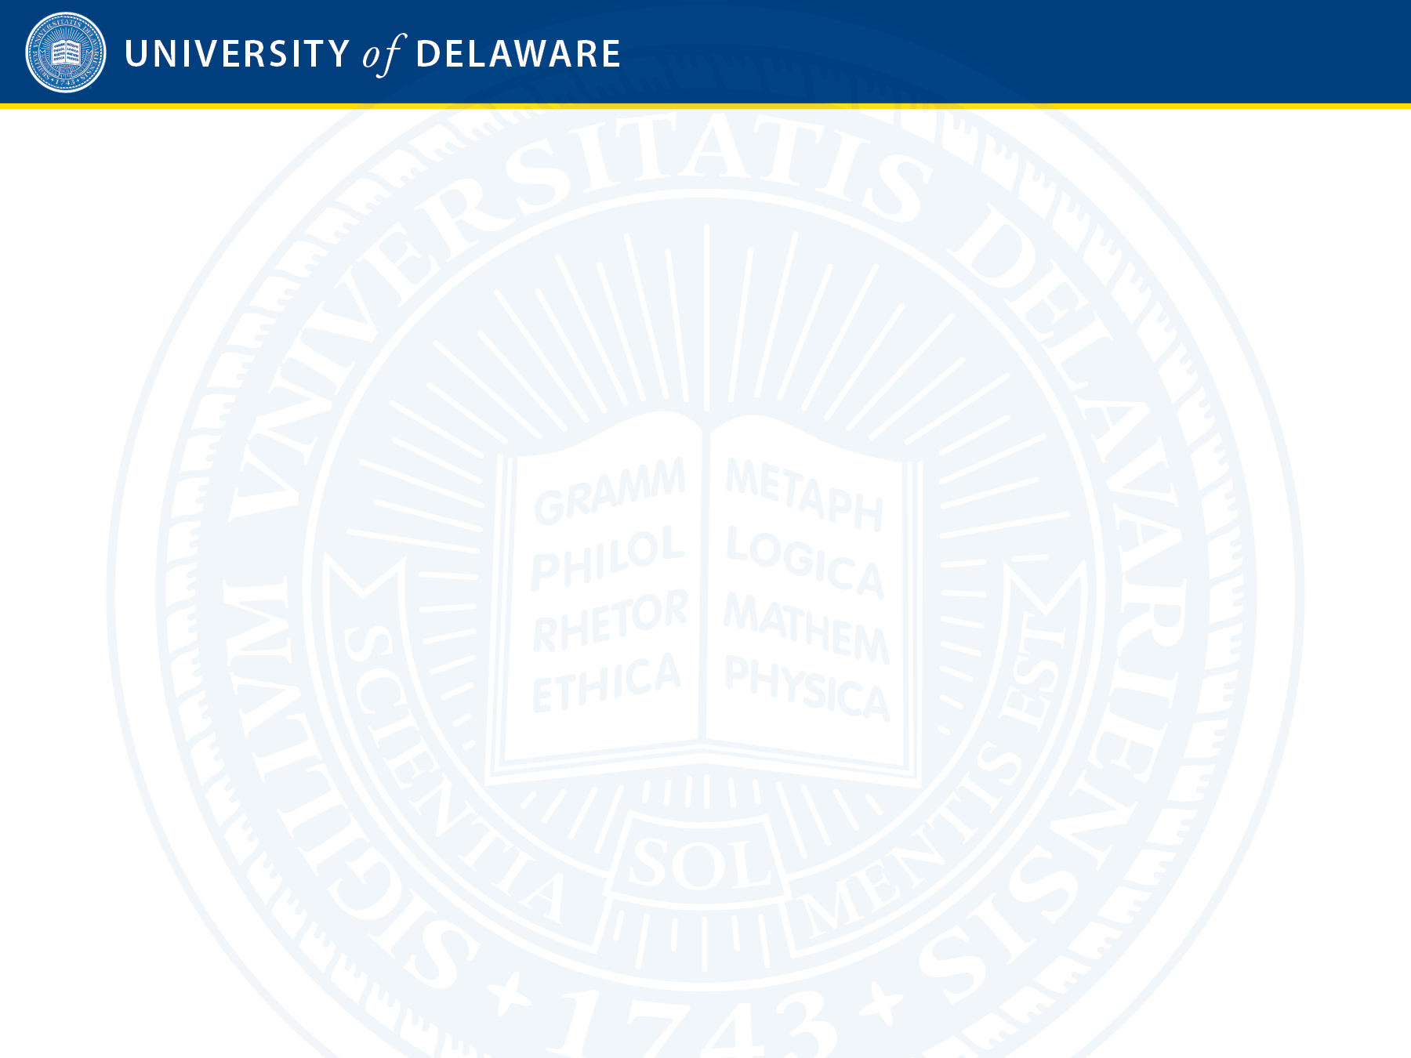
TDC Open Meeting of the
UD Faculty Senate
To Provide Information to the University Community Concerning the Data Center and Associated
Power Plant Planned for Construction on the
University of Delaware STAR Campus

Slide 2
UD Faculty Senate Executive Committee
Deni Galileo, President
Martha Buell, Vice President
Prasad Dhurjati, Secretary
Brian Hanson, COCAN Chair
John Jebb, Parliamentarian
Sheldon Pollack, Past-President
Fred Hofstetter, President-Elect
Karren Helsel-Spry, Senior Administrative Assistant to Senate President Deni Galileo

Slide 3
Purpose
The goal of this Open Meeting is twofold.
First is to inform the UD community about The Data Center (TDC) project. As you will see from the presentations being made today, the TDC project is large, innovative, and complex, with important environmental issues that need to be addressed.
The second purpose of the Open Meeting is to compile a list of concerns that the consultants and working groups need to take into account.

Slide 4
Program
Speaking today are four presenters who have been invited to address various aspects of the project.
Our first speaker is Dr. Charlie Riordan, who is UD's Vice Provost for Research. We have asked Charlie especially to address the history of The Data Center project.
Speaking second is Scott Douglass, UD's Executive Vice President and Treasurer.
Speaking third is TDC.
The fourth and final speaker on the formal part of today's agenda is Dr. John Morgan, Professor of Physics.

Slide 5
Rules
After the presentations have concluded, I will recognize individuals who wish to speak from the floor. To get in the queue to speak, you will get in line behind a microphone in the aisle.
The time limit is 2 minutes max, and all speakers need to be respectful as they present their views. Our parliamentarian, John Jebb, will time the speakers.
If called to order, you need to respect the gavel. That means you need to stop talking when your time expires, and we all need to be respectful as we listen to other people's views.
If time permits, individuals can speak more than once, but only after all those wanting to speak have had their first say. There is a two-minute time limit on all statements.
If you ask a question, you can remain at the microphone while your question is being answered, and if you think your question was not answered, you can ask one follow-up question on the same topic if you have not already exhausted your two-minute limit.
Karren Helsel-Spry will manage the microphone lines. In order to get in a microphone line, members of the UD Community will show their UD ID card to Karren. If time remains after the UD statements and questions conclude, members of the public will be permitted to get in the microphone line, following these same rules.
Those who speak should identify themselves by stating their name, title, and department or affiliation at the beginning of their statement.
As is standard operating procedure for Faculty Senate meetings, this open meeting is being recorded and will be published on the University's podcast feed at www.udel.edu/podcast.

