Slide 1
SOME IMPORTANT QUESTIONS FOR THE UD COMMUNITY
John D. Morgan III
Dept. of Physics and Astronomy

Slide 2
What is the purpose of The Data Centers’
248 MegaWatt Gas-Fired Power Plant?
Gene Kern, CEO of The Data Centers, at the 11-minute mark of Part 1 of the
Town Meeting in Newark on September 3, 2013, said:
“There’s been a lot of `facts’ put out there that are not accurate, and we’d like to correct that today. We’d like to make sure you understand completely what we’re doing, and how we’re doing it.”
Bruce Myatt, Executive VP and Chief Technology Officer of TDC, and
Bob Krizman, President of TDC, Zinc Whiskers (Sept./Oct. 2012), p. 16:
“Critical power generation with gas turbines, steam turbines, and absorption
chillers back up one another to power and cool the data center while the
owner sells excess power back to the grid.”
Bruce Myatt, Executive VP and Chief Technology Officer of TDC, and
Bob Krizman, President of TDC, Zinc Whiskers (Nov./Dec. 2012), p. 34:
“This results in excess power capacity during the winter months,
which creates opportunities to export substantial power to the grid
or turn down equipment.”

Slide 3
Letter from DEMEC to Gene Kern, CEO of TDC, dated December 17, 2012:
“We have been working with your team since July 2012 regarding this
project and the potential sale of 60 MW of power on an interruptible basis.”
Newark Post, April 28, 2013, article by Al Kemp
(‘STAR Campus Data Center Project Moves Forward’):
“The gas-fired power plant will produce twice as much energy as the
fiber-optic data center needs, leaving half the power available to flow
into the grid to be sold to the Delaware Municipal Electric Corporation,
a wholesale utility that powers Newark, New Castle, Middletown, Clayton, Smyrna, Dover, Milford, Lewes and Seaford.”
Gene Kern, CEO of TDC, at the 19 minute mark of Part 3 of the Town Meeting in Newark on Sept. 3, said:
“You gotta remember this is a data center facility, folks. It’s a data center.
It’s not a power plant. We’re not generating power and selling it to the grid.”
Which one of these contradictory statements is
“not accurate”?

Slide 4
Routes of New Large Natural Gas
Pipelines through Newark
Newark Post, April 28, 2013, article by Al Kemp
(‘STAR Campus Data Center Project Moves Forward’):
“In addition to water and electrical infrastructure upgrades, most of the
money [$7,500,000] would go toward 12 miles of new high-pressure
natural gas transmission pipelines from a pumping station in Parkesburg,
Pa., plus nine miles of much larger pipeline from a pumping station in Hockessin. New pumps would also be added at both sites.”
Through which neighborhoods will these pipelines pass?
To reach the STAR Campus, each pipeline will have to cross
both the C&O railroad line and the Amtrak railroad line.
Will these pipelines cross above or tunnel under these railway lines near the University of Delaware Campus?
Will there arise issues of safety due to heavy vibrations?

Slide 5
Noise Levels and the Decibel Scale
The decibel scale is logarithmic: A 10-fold decrease in the intensity of sound corresponds to a decrease by 10 in the number of decibels.
The intensity of sound emitted by a point source decreases as the inverse square of the distance from the source.
Hence doubling the distance from a point source reduces the intensity of sound by a factor of 2² = 4 and reduces the number of decibels by 10xlog₁₀ (4) ≈ 6.
Example:(52 decibels at your neighbor’s property line, from his radio 25 feet away)
Distance: 25 feet 50 feet 100 feet 200 feet 400 feet
Decibels: 52 46 40 34 28
Example:(52 decibels at TDC’s property line, from its gas turbines ¼-mile away)
Distance: ¼-mile ½-mile 1 mile 2 miles 4 miles
Decibels: 52 46 40 34 28

Slide 6
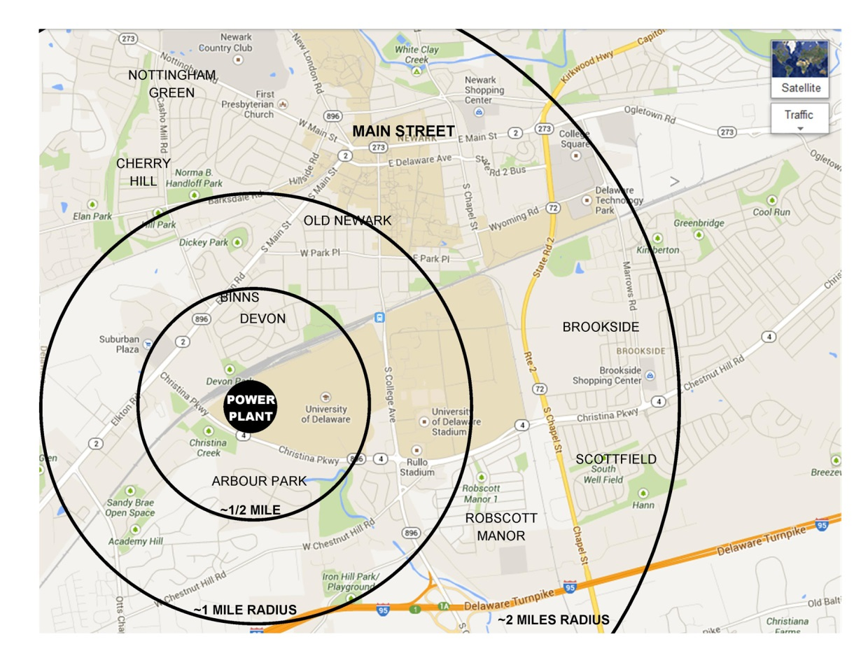
About 5,560 people live
within a 1-mile radius of
the power plant. Many
of them live within
a ½-mile, and some
within only a ¼-mile.
What will be the noise
levels in the nearby
residential areas and
on the STAR Campus and
the College of Agriculture?
And on our main campus?

Slide 7
Natural gas is mainly methane (CH₄).
The complete combustion of CH₄ is relatively clean:
CH₄ + 2O₂ → CO₂ + 2H₂O
Ideally, the only products would be the
safe gases carbon dioxide and water vapor.
However, at high temperatures some nitrogen (N₂)
in the air combines with oxygen (O₂) to make
NO (nitric oxide) and NO₂ (nitrogen dioxide),
which are harmful pollutants. Their levels can be reduced by ...

Slide 8
Selective Catalytic Reduction of NO_{x}
with Gaseous Ammonia (NH₃):
4NO + 4NH₃ + O₂ → 4N₂ + 6H₂O
2NO₂ + 4NH₃ + O₂ → 3N₂ + 6H₂O
NO + NO₂ + 2NH₃ → 2N₂ + 3H₂O
Will this NH₃ be stored on-site as “aqueous ammonia”, which TDC’s consultant Rick Beringer said is “a much safer way to store ammonia, than, for instance, anhydrous ammonia” at the 14-minute mark of Part 2 of the Town Meeting on Sept. 3?
Or will the less safe “anhydrous ammonia” be stored on-site, as is stated on p. 16 of TDC’s summary of the Q&A posted on its own website?
This discrepancy should be addressed by UD’s Working Group.

Slide 9
Production of CO₂
On p. 17 of The Data Centers’ summary of the Q&A on Sept. 3, it says
“Our facility (without CO₂ capture) is projected to produce
828 pounds of CO₂ per MW/h” [MegaWatt-hour].
Thus this 248 MW power plant is projected to produce
248 x 828 = 205,344 pounds of CO₂ per hour; i.e., about
205,344/2000 = 102 tons of CO₂ per hour, which is
24 x 102 = 2448 tons of CO₂ per day, which is
365 x 2448 = 893,520 tons of CO₂ per year.
In Academic Year 2007-8, the total `Category I’ direct emissions of CO₂ by the entire UD campus were less than
40,000 metric tons = 44,000 (English) tons of CO₂ per year.
Thus this power plant would increase UD’s `Category I’
direct emissions of CO₂ by about a factor of 20,
unless there will be efficient CO₂ capture.

Slide 10
How much CO₂ will be captured?
And after it’s captured, where will it go?
The Data Centers’ recent estimates of its rate of capture of CO₂ have varied from “45%” up to 90% or even “almost all the CO₂”.
On page 17 of The Data Centers’ summary of the Q&A it says:
“TDC will partner with an industrial gas firm [Air Liquide] that will operate the equipment that captures and cleans the CO₂ for other beneficial uses.”
Cole Bauer, VP for Site Engineering for TDC, said at the 29-minute mark of Part 1 of the Town Meeting on Sept. 3:
“They will be purifying it and liquifying it and then using it for the soda industry and other beverage industries that purchase CO₂.”
Is this claim realistic?
Across the whole USA, CO₂ usage in the beverage industry is about 2000 tons per day, about the same as the output of this power plant. Assuming that most of it will indeed be captured, how would so much CO₂ be transported across the whole USA?
Only 45% capture would increase UD’s Category I emissions of CO₂ 12-fold.
Even 90% capture would increase UD’s Category I emissions of CO₂ 3-fold.
Can UD urge others to reduce their carbon footprints if we sharply increase ours?

Slide 11
How much water vapor (H₂O) will be produced
by TDC’s natural gas-fired power plant?
Combustion of Methane (CH₄) produces
2 molecules of water vapor (H₂O: molecular mass 18)
for each molecule of carbon dioxide (CO₂: molecular mass 44).
Each day there will be produced about 2450 tons of CO₂
and about 2000 tons of H₂O.
Moreover, up to 3 million gallons of water from United Water will be used each day for steam generation and cooling.
That is 25 million pounds = 12,500 tons of water each day. Where will all this water go? Into the local atmosphere.
Minutes of the Delaware Infrastructure Investment Committee Public Meeting, April 25, 2013:
Robert Krizman, the President of TDC, “explained that they will be getting the water from United Water so there will be no discharge; it will evaporate.”

Slide 12
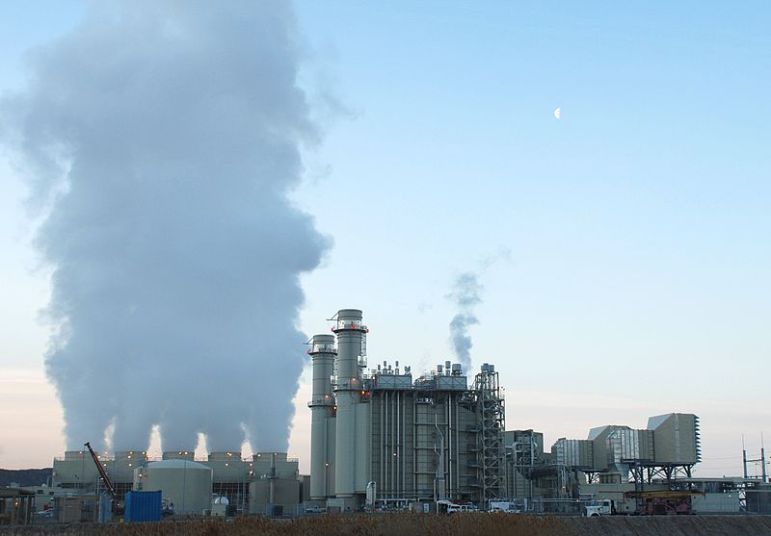
TDC’s 248 MegaWatt Natural Gas-Fired Power Plant would produce half the output of the 525 MegaWatt Natural Gas-Fired Lake Side Power Station in Utah (see below).
Do we want a cloud half this size permanently hovering over our campus?

