Slide 1
Commission on
Sexual Harassment
& Sexual Assault
Progress Report to the Faculty Senate
April 6, 2015
Michael Chajes, Commission Chair
Professor of Civil and Environmental Engineering

Slide 2
Commission formation
On November 3, 2014, the Faculty Senate voted to create a faculty-student-staff commission on sexual misconduct.

Slide 3
Commission membership
Robin Andreasen, Associate Professor of Linguistics and Cognitive Science
Sage Carson, Undergraduate Student
Chris Castillo, President of the Graduate Student Government
Michael Chajes, Professor of Civil and Environmental Engineering
Pam Cook, UNIDEL Professor of Mathematical Sciences and Associate Dean of Engineering
Ruth Fleury-Steiner, Associate Professor of Human Development and Family Studies
Susan Groff, Director Office of Equity and Inclusion/ Title IX Coordinator
Karren Helsel-Spry, Assistant to the Faculty Senate President
Helga Huntley, Research Assistant Professor of Marine Science and Policy
Matt Kinservik, Vice Provost for Faculty Affairs
Paul Laux, Professor of Finance
Ben Page-Gil, President of the Student Government Association
Claire Rasmussen, Associate Professor of Political Science and International Relations
Ismat Shah, Professor of Physics and Astronomy and Materials Science
Dawn Thompson, Vice President for Student Life
Kathleen Turkel, Assistant Professor of Women and Gender Studies
Miranda Wilson, Associate Professor of English
Angela Seguin, Program Coordinator, Student Wellness & Health Promotion (SOS, VAWA)

Slide 4
Commission charge
The commission was charged with making recommendations for the implementation of best practices for the prevention of sexual misconduct and for addressing misconduct allegations.
In fulfilling the charge, the commission is working in concert with Title IX Coordinator, Sue Groff and several Title IX committees.

Slide 5
Sexual misconduct
Sex Discrimination
Sexual Harassment
Sexual Assault
Domestic Violence
Dating Violence
Stalking

Slide 6
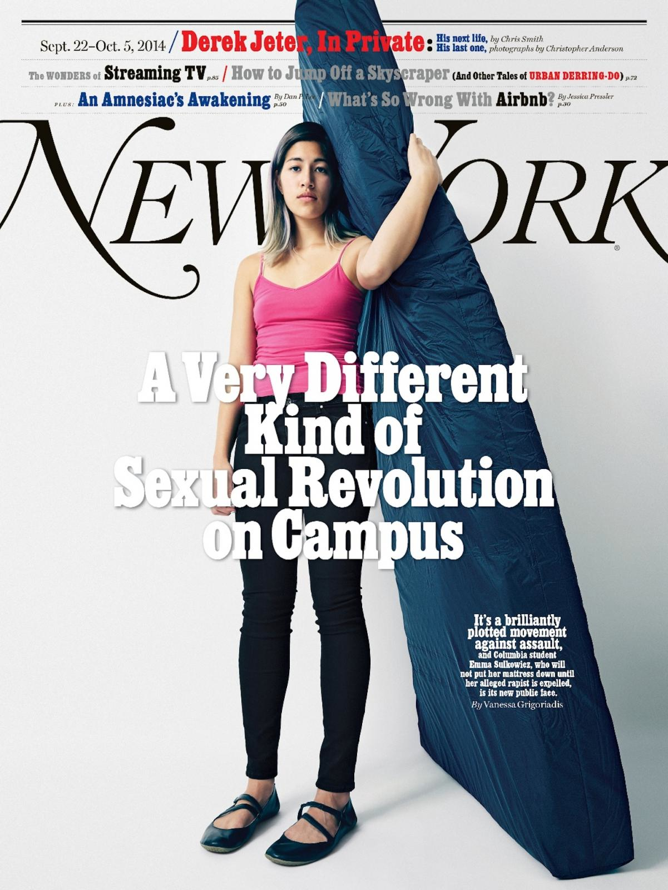
National issue

Slide 7
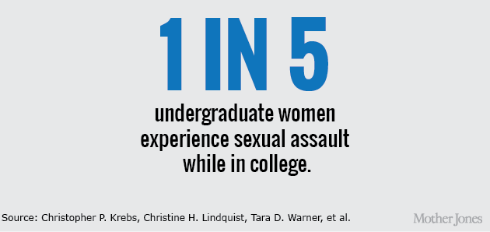
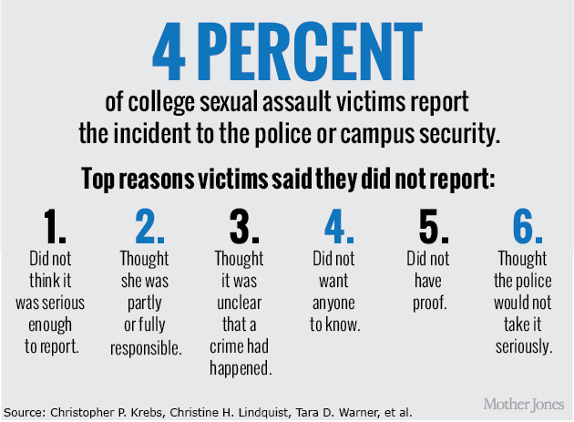
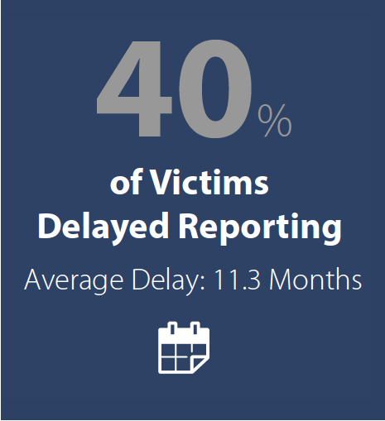
62%
of female college students reported being sexually harassed
United Educators. 2015
American Association of University Women, 2006
United Educators. 2015
Confronting Campus Sexual Assault: An Examination of Higher Education Claims, United Educators. 2015

Slide 8
Local issue

Slide 9
Local issue
Move in weekend at UD

Slide 10
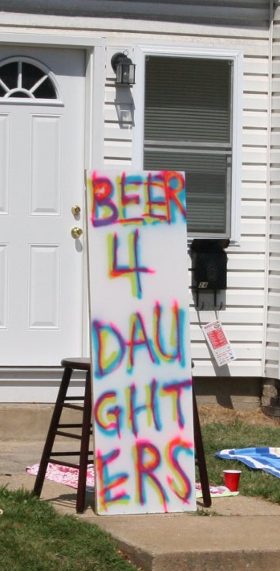
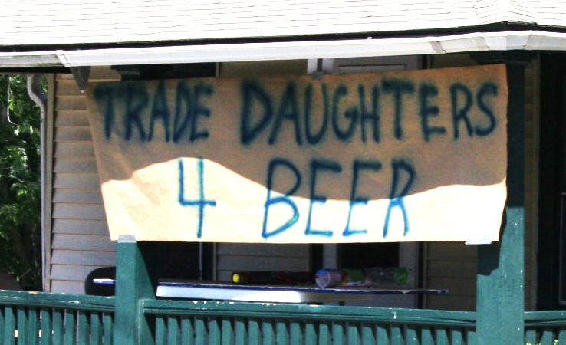
Local issue
Move in weekend at UD
Photos Courtesy of Angela Seguin
UD Coordinator, Sexual Offense Support

Slide 11
Commission subcommittees
The commission has three active subcommittees.
Education and prevention, chaired by Pam Cook, UNIDEL Professor of Mathematical Sciences and Associate Dean of Engineering
Policies and procedures, chaired by Miranda Wilson, Associate Professor of English
(3) Data collection, chaired by Ruth Fleury-Steiner, Associate Professor of Human Development and Family Studies

Slide 12
Progress to date
Gathering information
What have we learned?
What are we recommending?
Next steps

Slide 13
1. Gathering information (listening)
We have held weekly meetings since December, assembling information from literature, current events, open forums, focus groups, our website, and related campus events including:
Faculty senate open forum
Graduate student open forum
Undergraduate-only open forum
Staff forum (April)
Focus groups with ELI and ISFS, graduate studies, women faculty, LGBT caucus (upcoming), and more
Events such as The Hunting Ground (film and panel discussion), It Happened Here (film)
Campus surveys of students, faculty, and staff (forthcoming)

Slide 14
2. What have we learned?
Sexual misconduct is a significant concern among students, staff, and faculty
Excellent sexual offense support program (SOS) exists on campus (but it has a heavy reliance on volunteers)
Extent of the problem is not clear, good data is elusive
Campus-wide efforts related to education and outreach, training, prevention, and support services are not well coordinated or easily located
Understanding of policies & procedures is inadequate
Dedicated funding for existing and needed programs is insufficient (current funding relies heavily on grants)

Slide 15
2. What have we learned (cont.)?
In time of crisis, identifying help must be easy
Effective outcomes require leadership from top administration
Faculty engagement is critical
Comprehensive education for all UD constituents is needed
Delaware law regarding sexual misconduct is problematic
A campus culture shift is needed
Our focus should be on awareness and prevention of all forms of sexual misconduct, as well as on survivor support services

Slide 16
3. What are we recommending?
Big picture
Campus culture
Policies and procedures
Education and training
Survivor support
Data collection, assessment, and reporting
Outside partnerships

Slide 17
Big picture
Develop an implementation plan to address the sexual misconduct and monitor the results
Form a coherent organizational structure that has sufficient committed financial support
Create a dedicated, visible, and welcoming campus facility to house activities and support services related to gender and sexuality

Slide 18
Campus culture
Make a concerted effort to change the campus culture regarding sexual misconduct
Strong messaging from the upper administration
Host inspirational speakers and trainers like Jackson Katz (Mentors in Violence Prevention Project)
Create an engaging community for faculty, staff, and students
Increase faculty involvement in sexual misconduct awareness and prevention efforts and events

Slide 19
Policies and procedures
Assist the Title IX policy and communications committee in developing a comprehensive sexual misconduct policy
Definition of “responsible employee”
Mandatory reporting
Investigator model
Sanctioning and appeals
Consensual relationships
Ensure the integrity of due process in order to fully protect the rights of all parties involved
Achieve greater understanding of existing policies and procedures through faculty outreach

Slide 20
Education and training
Implement proven education, prevention, and support programs for all campus constituencies, and assess and monitor their effectiveness
2-Class FYS module needs to be continued and taken by all
Bystander intervention
Healthy relationships
Mentors in violence prevention (MVP)
Targeted peer education programs
Educate campus leadership including upper-level administrators, deans, and chairs
Develop train-the-trainer programs and use peer training and peer education as much as possible
Strive for greater faculty involvement in education and training programs

Slide 21
Survivor support
Create a simple, 3-digit emergency help hotline
Establish a cohort of confidential advisors
Expand on the successful volunteer-based sexual offense support (SOS) program
Ensure that all prevention and intervention efforts are focused on the well-being of survivors

Slide 22
Data collection, assessment, and reporting
Design and implement a comprehensive communication strategy
Conduct separate annual sexual misconduct surveys
undergraduate students
graduate students
faculty and staff
Widely disseminate the survey findings as well as other sexual misconduct data

Slide 23
Outside partnerships
Establish a partnership/MOU with Newark Police
Work with Delaware legislators to change Delaware law as it relates to sexual assault and provide input into newly proposed Delaware bill on “Safety on college campuses, sexual assault reporting”

Slide 24
4. Next steps
Continue the work of the commission
consider creating a standing faculty senate committee on sexual misconduct
Include commission/committee students and faculty on existing Title IX committees
Work with the Title IX committee on policy and communications to finalize a comprehensive policy for sexual misconduct
In conjunction with the Office of Institutional Research, conduct and analyze surveys of undergraduate students (April), and graduate students, faculty and staff (next fall)

Slide 25
4. Next steps (cont.)
Work to develop and implement a comprehensive implementation plan that is informed by the commission’s final recommendations
Work to create a dedicated, visible, and welcoming campus facility housing student, staff, and faculty activities and support services related to gender and sexuality (possibly as part of a broader umbrella)

Slide 26
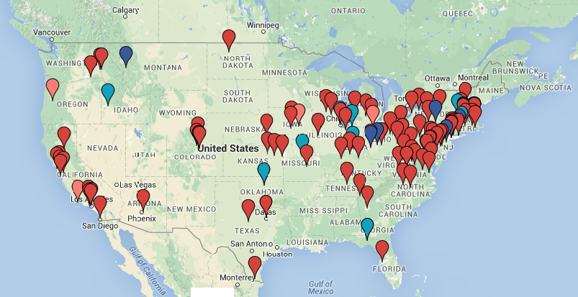
Questions and comments?
Over 100 Title IX complaints against universities are currently being investigated by the Office of Civil Rights (OCR)

