Slide 1
Sakai Pedagogy and Instructional Strategies
Selecting Sakai Tools
Based on How People Learn

Slide 2
Designing a Course with Sakai
Sakai uses a frameset that provides the student with a powerful set of tools in a left sidebar.
The key to creating a successful course with Sakai is designing the content so it can integrate seamlessly along the sidebar.
Sakai lets you, the course instructor, decide which tools will appear in the sidebar.
How do you make these decisions?
Log on to Sakai and show the default frameset.

Slide 4
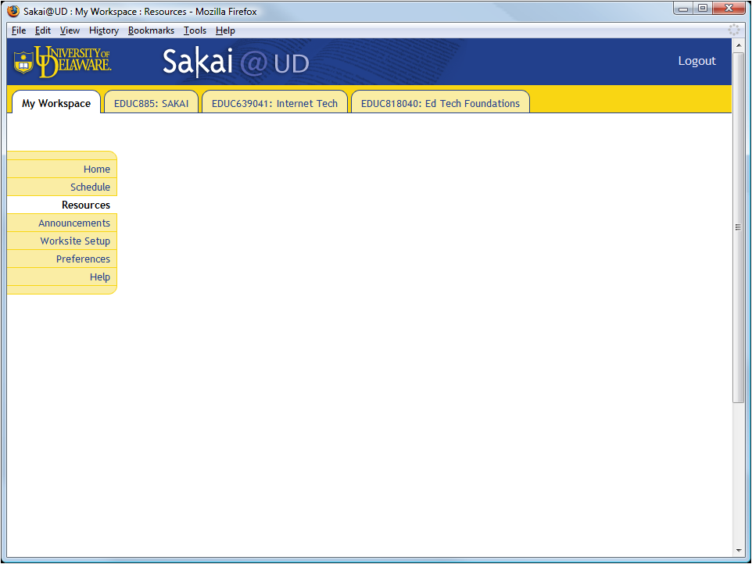

Slide 5
Frameworks for Framesets
The science of learning has evolved theoretical frameworks based on researched best practices that can inform the design of your Sakai frameset.
The design principles I will be presenting this morning are based on this research, which I will document as we move along.

Slide 6
How People Learn
How do you decide which Sakai tools to use?
You decide based on how people learn.
A landmark book from the National Research Council, How People Learn is freely available at www.nap.edu/openbook.php?isbn=0309070368.
It describes how effective learning environments are learner-centered, knowledge-centered, assessment-centered, and community-centered.
Sakai contains tools that support and align these four components for learning.

Slide 7
The Science of Learning
According to How People Learn (pp. 14-23), three guiding principles have emerged from the science of learning:
People learn by connecting new information to concepts already learned.
To learn how to reason, solve problems, and augment knowledge in a field of inquiry, people need to understand facts and ideas in the context of a conceptual framework that facilitates application to real-world problem solving.
People are motivated to learn when they can set their own goals, reflect on their progress, and feel in control of their learning.
From these principles, it follows that Sakai learning environments will be effective when instructional designs:
take into account the learner’s preexisting understandings and correct any faulty preconceptions in order to prevent future misunderstandings;
enable students to study multiple examples of the concept at work in order to learn it in depth in authentic contexts; and
include metacognitive supports that make visible the learner’s reflections and enable an instructor to provide scaffolding and guide revisions to improve student learning and reasoning.

Slide 8
Sakai Tool Selection
Learning principles guided my selection of the following Sakai tools to create a socially constructivist e-learning environment:
Home. Collapsible menus foster differentiated instruction.
Assignments. Engage and scaffold students in the zone.
Schedule. Visualize how the course unfolds.
Forums. Interact in a socially constructed discussion.
Wiki. Build communal knowledge.
Blogger. Submit reflective logs.
Podcasts. Get videos just-in-time.
Chat Room. Talk synchronously with classmates online.
Search. Find things in the course including chats with tags.
Roster. Identify your classmates.
Site Info. Create groups and give tools intuitive names.
Resources. Peruse file folders and follow Web links.
Tests. Survey students about their initial reactions to Sakai.
Gradebook. Provide second chances to enable students to succeed.
Help. Get answers to your questions about Sakai.
Demonstrate logon to show tool selection.

Slide 10
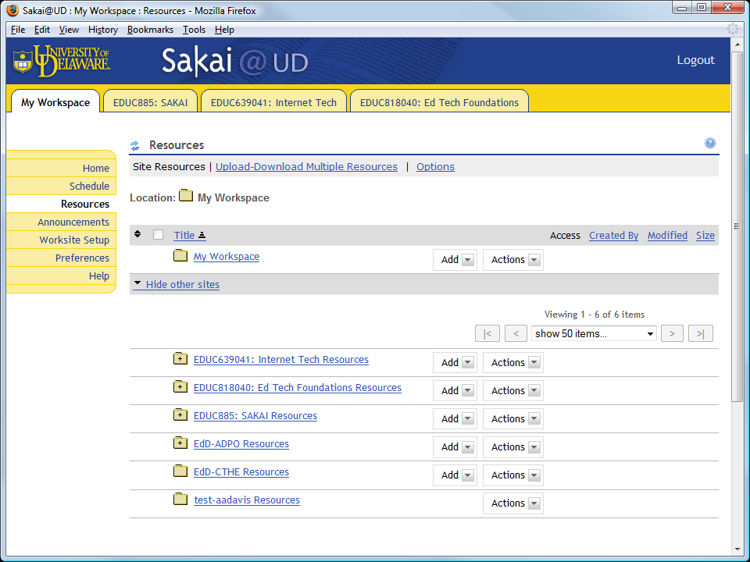

Slide 12
Sakai Web Design
Making Content Make Sense in the Context of the Sakai Frameset

Slide 13
Creating Your First Screen
What the student sees onscreen makes all the difference in an online course. The first screen especially must make sense. You need to make it as intuitive as you can.
Because Sakai uses a frameset, you are going to have its menu of tools in the left sidebar.
How do you design your content so it makes sense in the context of the Sakai sidebar?

Slide 15
Differentiated Instruction Powered by Dreamweaver and Ajax
Collapsible menus enable you to design your course content so students can locate material appropriate for their current level of achievement as well as learning style.
You can create collapsible menus using either
(1) Dreamweaver and Ajax; or
(2) MS Word and Adobe Acrobat.
I created my course content using our School of Education’s Dreamweaver template.
Collapsible menus powered by Ajax enable students to explore all of the course content at will.
Demonstrate home page design for differentiation (Firefox, Dreamweaver).

Slide 17
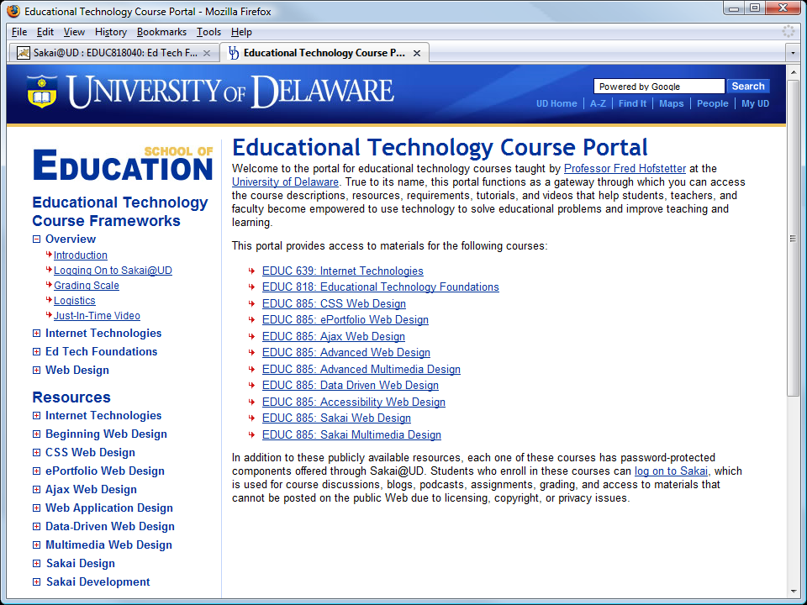

Slide 18
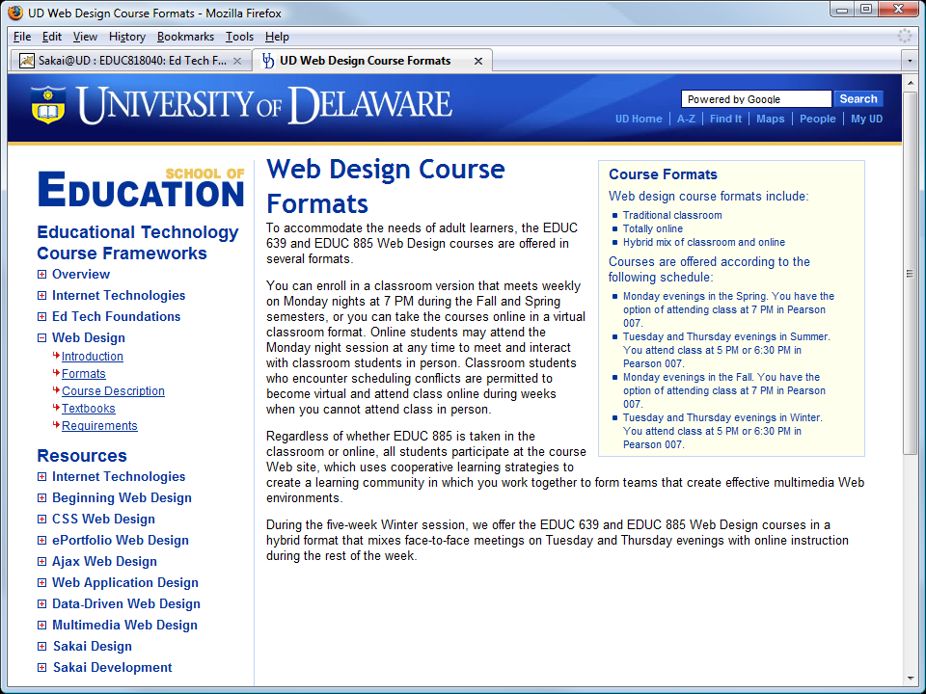

Slide 19
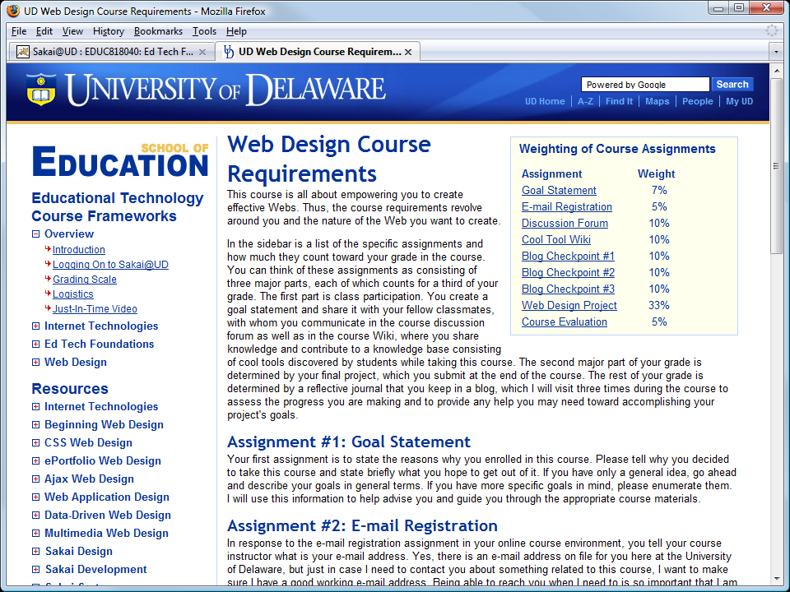

Slide 20
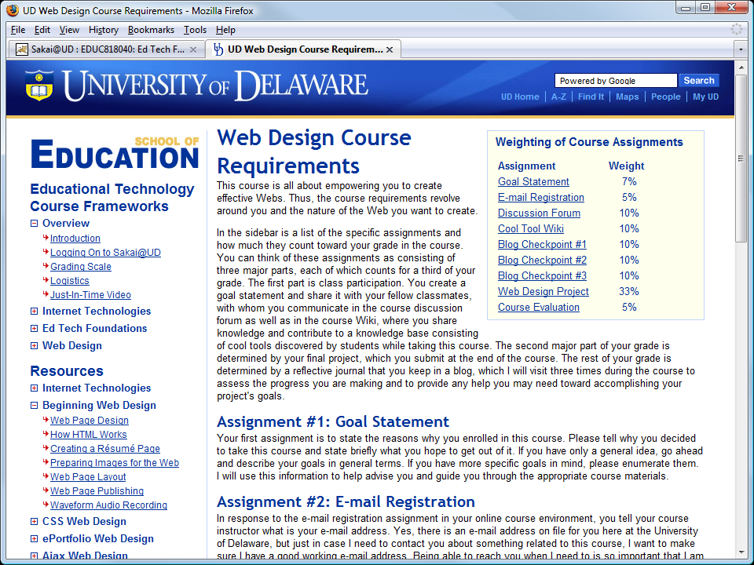

Slide 22
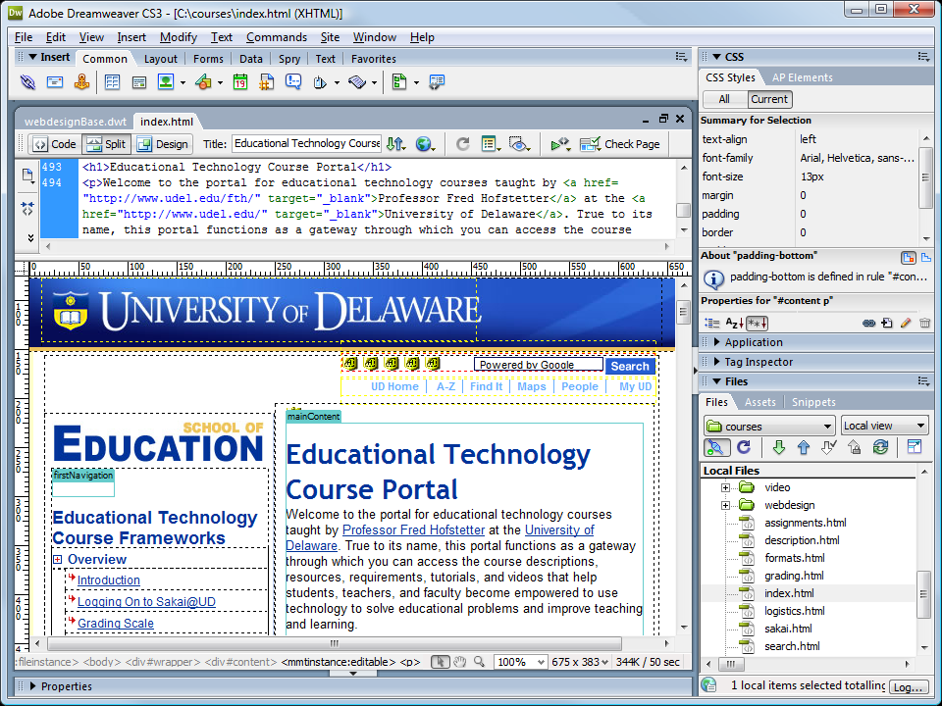

Slide 23
Differentiated Instruction Powered by MS Word and Acrobat
There is a simpler way to create Sakai content.
You can use MS Word.
Organize your course content using Word’s heading styles: H1 for chapter headings, H2 for section headings, H3 for subheads.
Then use the freely downloadable PDF add-in to convert your Word document into a PDF file.
Automatically, Acrobat creates bookmarks that enable students to navigate your course content through its headings.
Demonstrate collapsing menus created via MS Word for Acrobat.

Slide 25
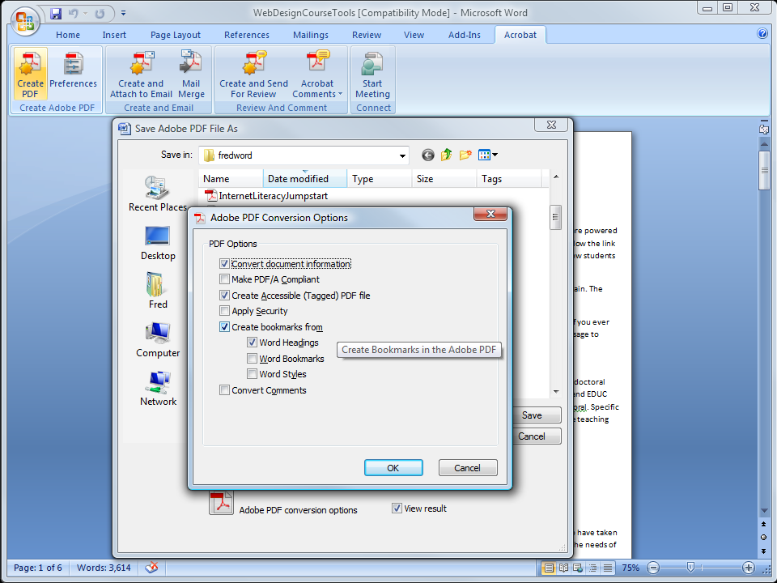

Slide 27
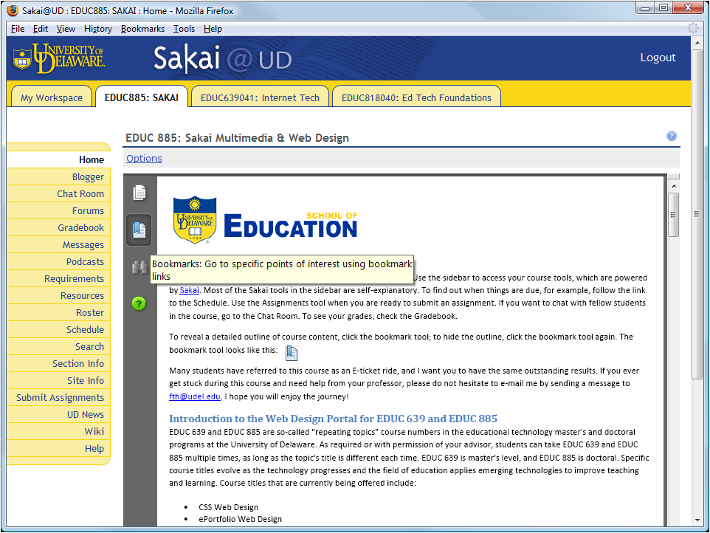

Slide 28
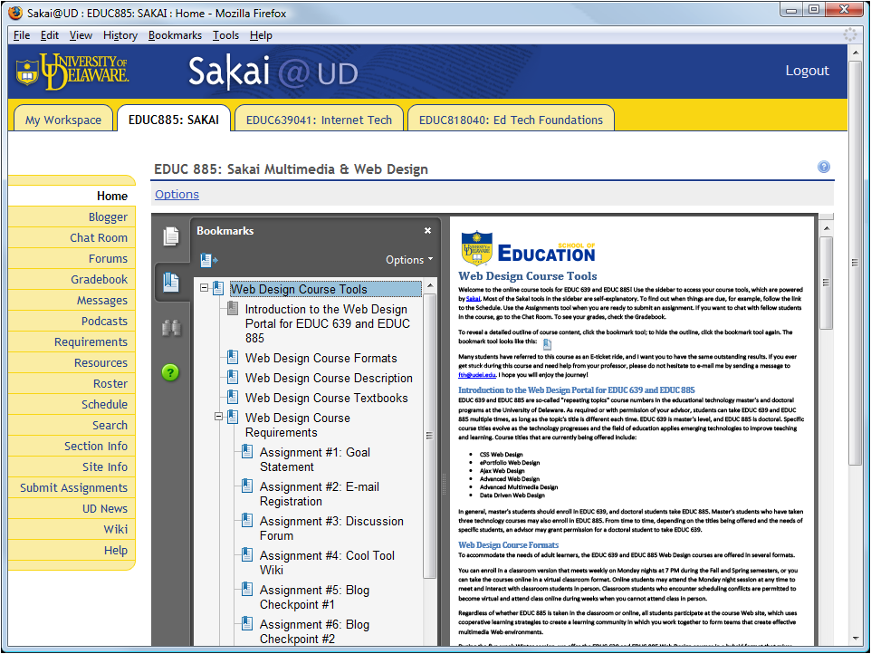

Slide 29
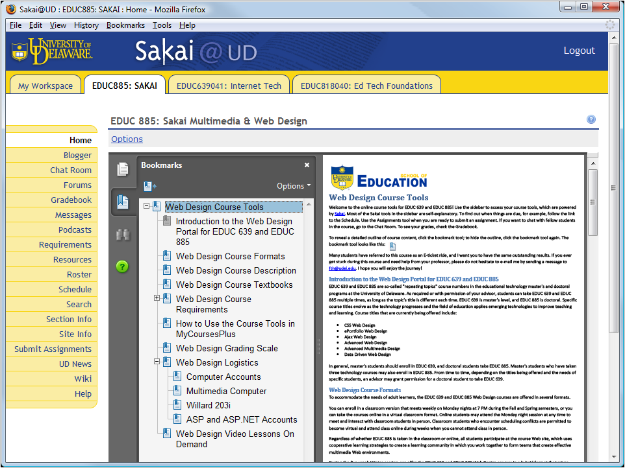

Slide 32
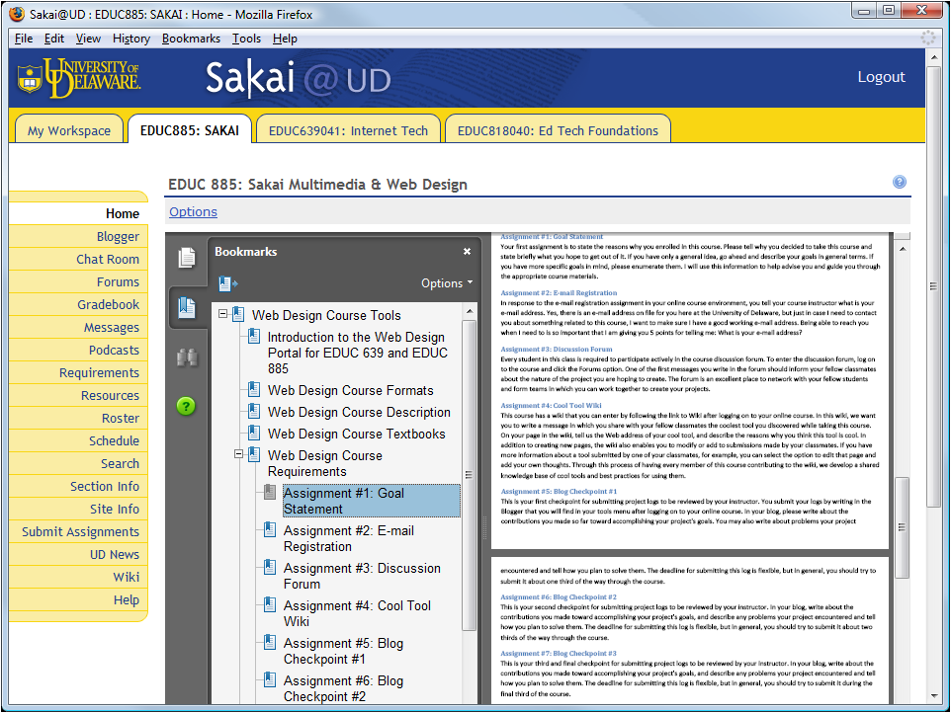

Slide 33
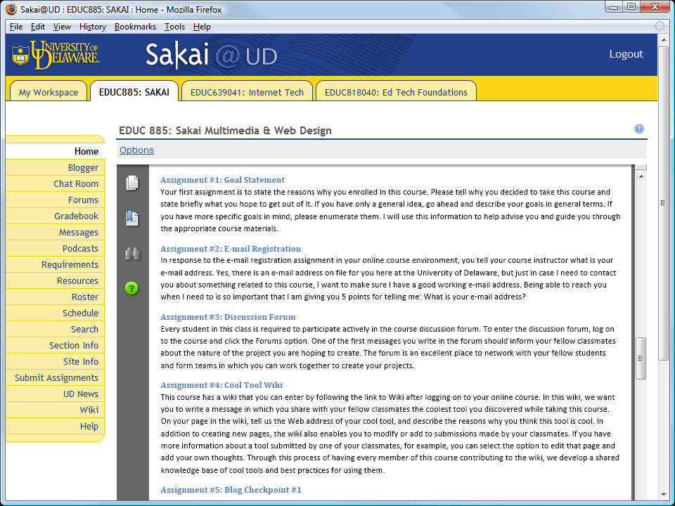

Slide 34
Engaging Students In the Zone
Sakai Supports Key Principles of Online Learning

Slide 35
Engaging Your Students Early
In online learning, it is important to engage students early in the course.
This creates a dynamic conversational framework that establishes an empathetic bond (Holmberg, 2003) among students and professor.
I create this bond by engaging students early in the course through assignments that get students accustomed to interacting with me.
Demonstrate e-mail assignment (Mike Albertson).

Slide 37
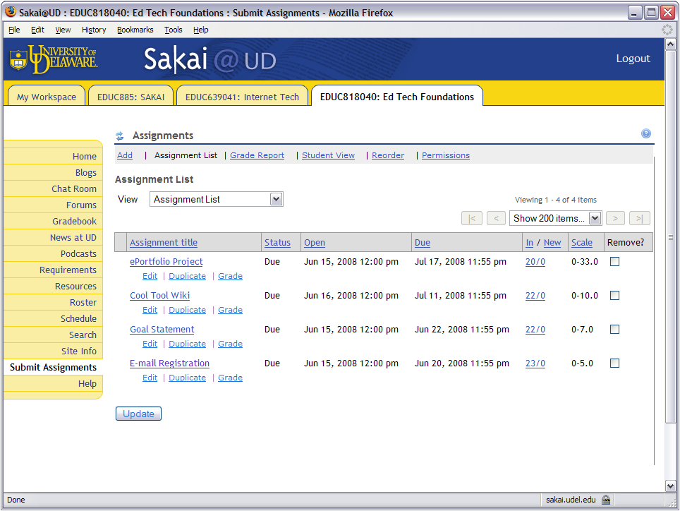

Slide 38
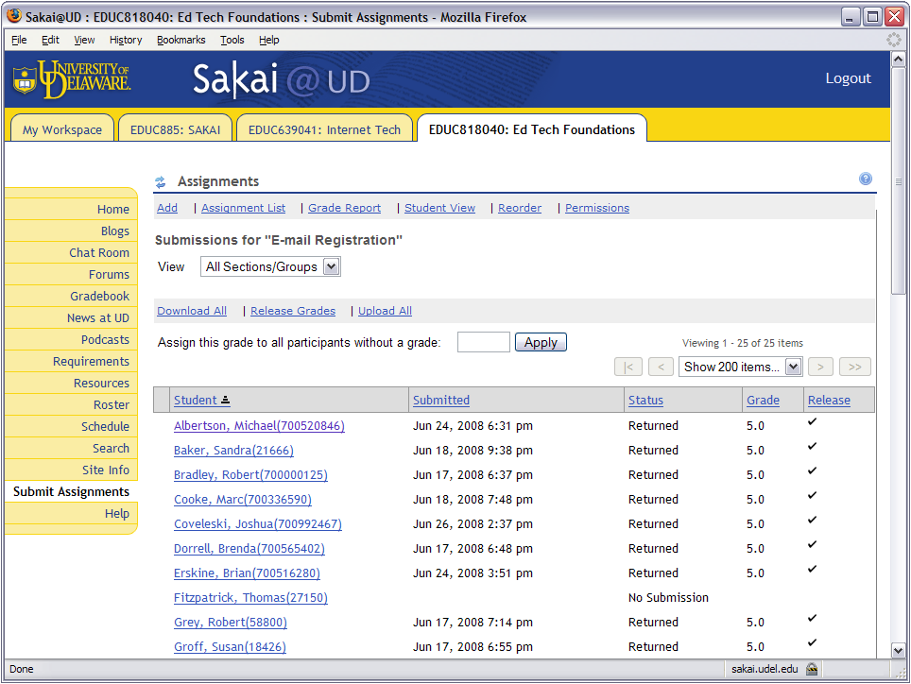

Slide 39
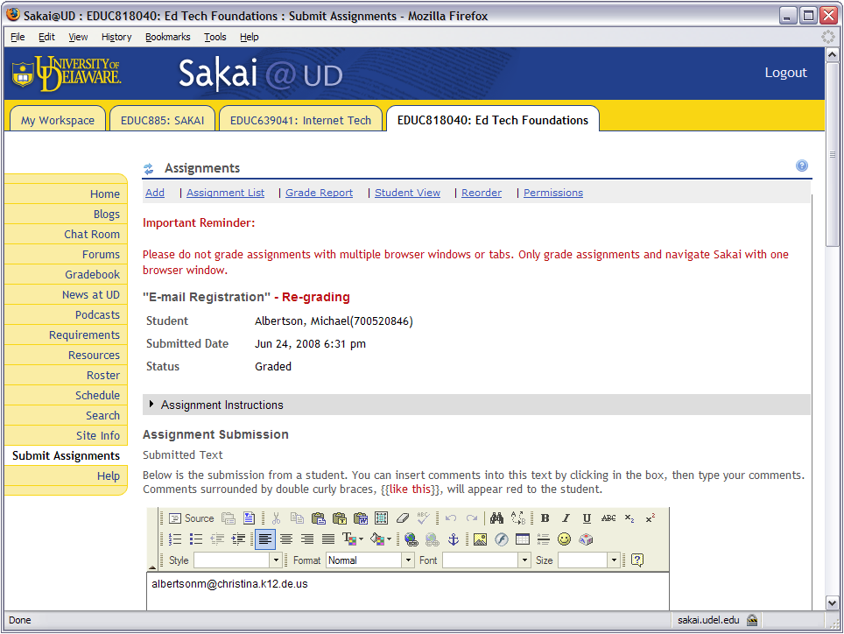

Slide 40
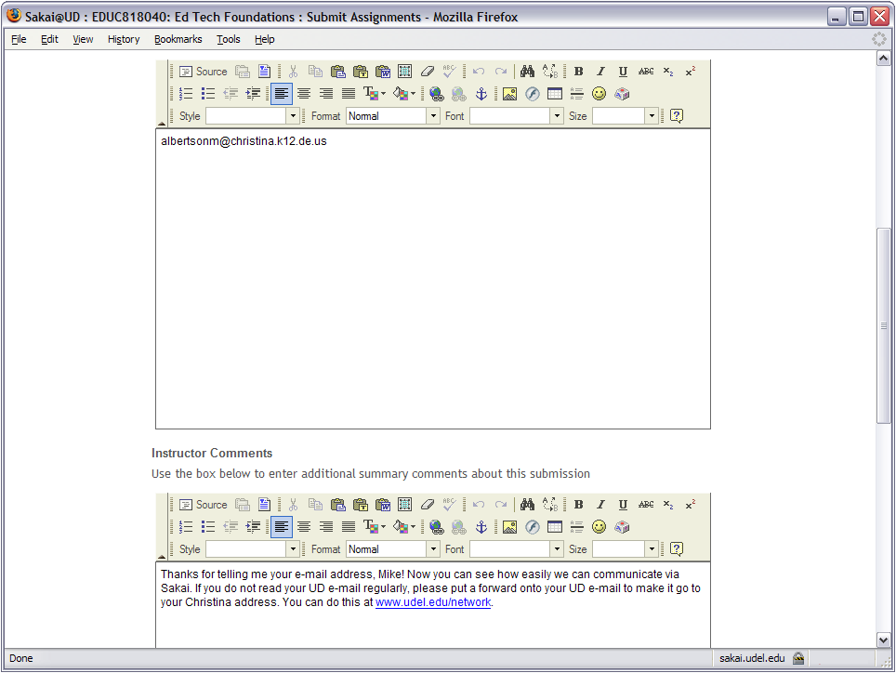

Slide 41
Constructing Goals
The innate human desire to develop competence is an important factor in motivating people to learn (National Research Council, 2000, p. 60).
In one of the early assignments, I work with my students to construct their goals, which are performance based.
Having students articulate their goals early in the course and hone them dialogically creates a bond that the professor later uses to scaffold students when they begin encountering difficulty.

Slide 42
Identifying the Zone
Later in the course, it is inevitable that the students will encounter difficulty, hopefully not with Sakai, but probably with more advanced course content.
When this happens, the students enter an educational space that the great Russian psychologist Vygotsky (1978, p. 86) called the Zone of Proximal Development; I simply call it the Zone.
It is in the Zone that you can use the Sakai coaching protocol to help students when they encounter difficulty.
Coaching students in their Zone is the most important principle of e-learning, and I was happy to discover that Sakai supports it extremely well.
Demonstrate goal scaffolding (Geoff Olive).

Slide 43
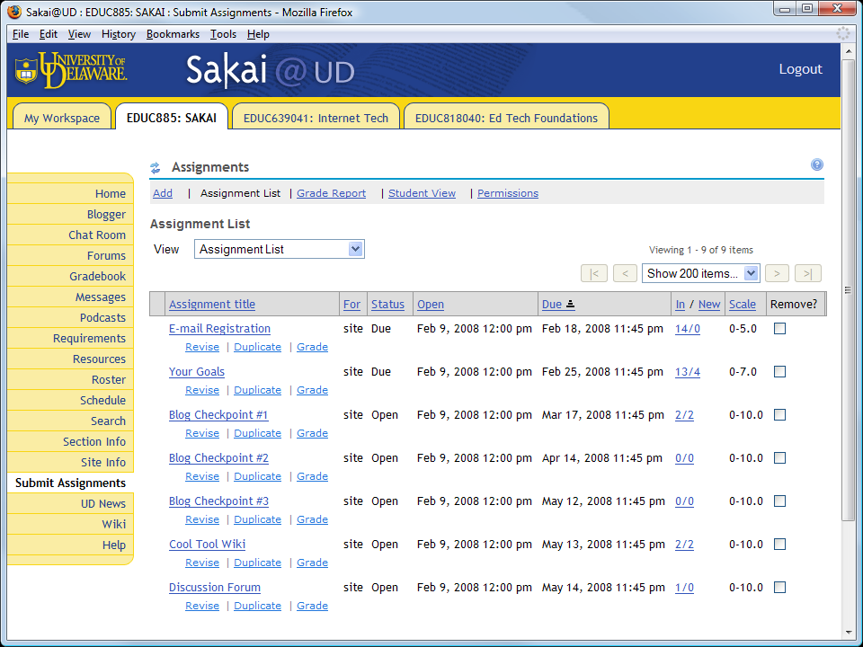

Slide 44
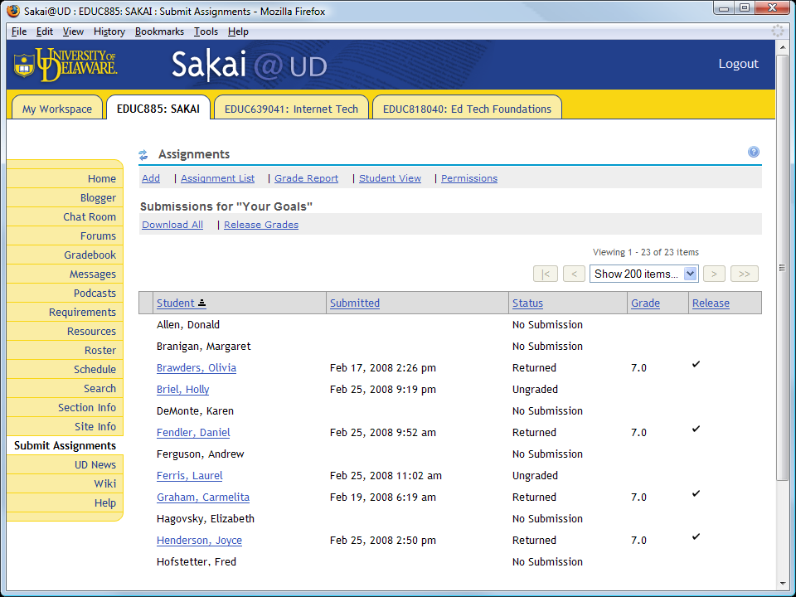

Slide 46
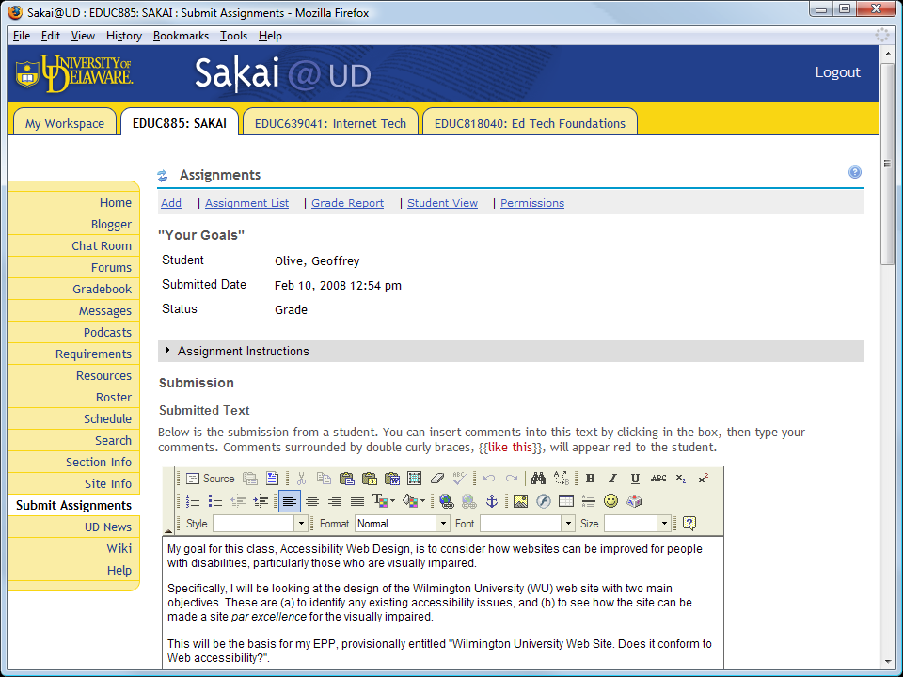

Slide 47
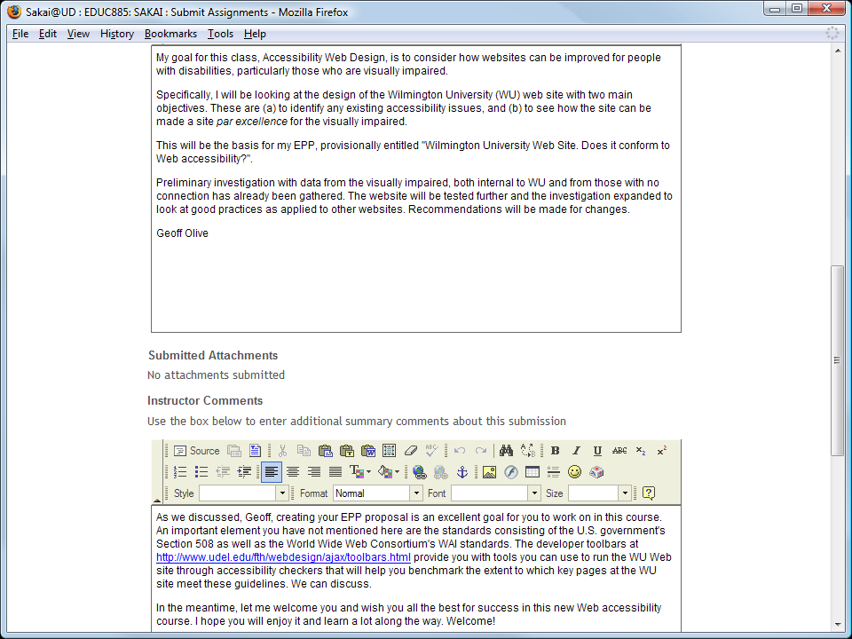

Slide 48
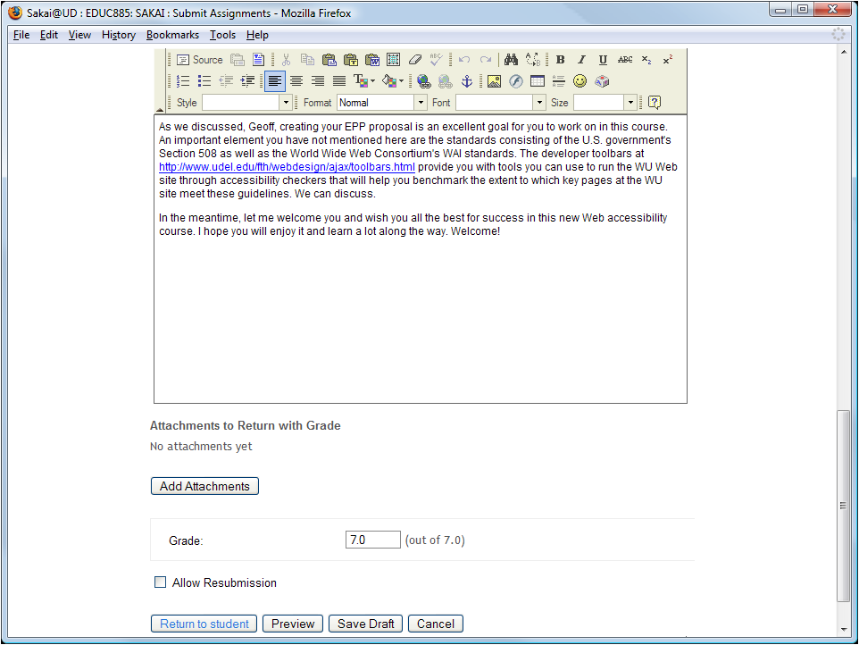

Slide 49
Multimedia Learning
How the Principles of Multimedia Learning Inform the Design of Course Content

Slide 50
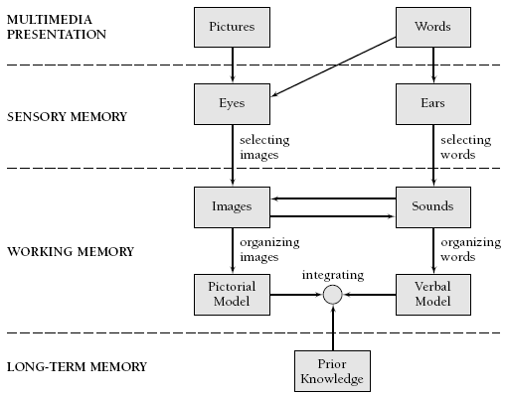
Multimedia Learning Theory
Richard Mayer’s (2001, p. 44) Cognitive Theory of Multimedia Learning

Slide 51
Multimedia Learning Principles
Principle | Effect on Learning
1. Multimedia | Deeper learning from words and pictures than words alone
2. Contiguity | Deeper learning from presenting words and pictures simultaneously rather than successively
3. Coherence | Deeper learning when extraneous words, sounds, or pictures are excluded rather than included
4. Modality | Deeper learning when words are presented as narration rather than as on-screen text
5. Redundancy | Deeper learning when words are presented as narration rather than as both narration and on-screen text
6. Personalization | Deeper learning when words are presented in conversational style rather than formal style
7. Segmentation | Deeper learning when complex lessons are presented in smaller parts
8. Pretraining | Deeper learning when key terms are explained in advance
Source: Clark & Mayer (2006, p. 386), summarized.

Slide 52
Multimedia Research Results
Cognitive Principle | Effect Size | Studies Showing This Effect
1. Multimedia | 1.50 | 9 of 9
2. Contiguity | 1.11 | 8 of 8
3. Coherence | 1.32 | 11 of 12
4. Modality | 0.97 | 21 of 21
5. Redundancy | 0.69 | 10 of 10
6. Personalization | 1.30 | 10 of 10
7. Segmentation | 0.98 | 3 of 3
8. Pretraining | 1.30 | 7 of 7
Clark & Mayer (2008, p. 383)

Slide 53
Just-In-Time Video
Key to my instructional strategy is just-in-time video that students can view to have my lectures onscreen just when you need them.
I create these videos with Camtasia Studio and follow Mayer’s principles to make them effective.
By balancing content across visual and auditory channels, I observe Mayer’s (2001) modality principle, and by organizing the videos into small clips, I follow the segmenting principle (Clark & Mayer, 2008, p. 183).
Demonstrate collapsible video menus.

Slide 54
Camtasia Workflow
Creating Just-In-Time Videos with Camtasia Studio

Slide 55
Camtasia Workflow
The next few slides step you through the process of creating an instructional video with Camtasia.
This is the process I have evolved over the past few years based on fairly extensive use of Camtasia.
I am always open to learning better ways of doing things, however, so if you know of a better way, please let me know!

Slide 56
Storyboard
You begin by planning your video sequence. Video professionals call this storyboarding.
I create my storyboards with PowerPoint.
Because the Camtasia player has a green skin, I created a PowerPoint theme based on that same shade of green.

Slide 57
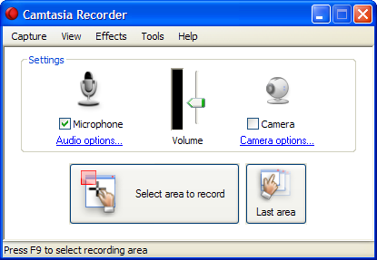
Record a Slide with Narration
Use Camtasia to make the PowerPoint window be what gets recorded.
It works best if you set the window to 1024 by 768.
Use the Camtasia Recorder to record the slide with your narration.
Make sure your microphone gain is turned way up, but not so high as to distort.

Slide 58
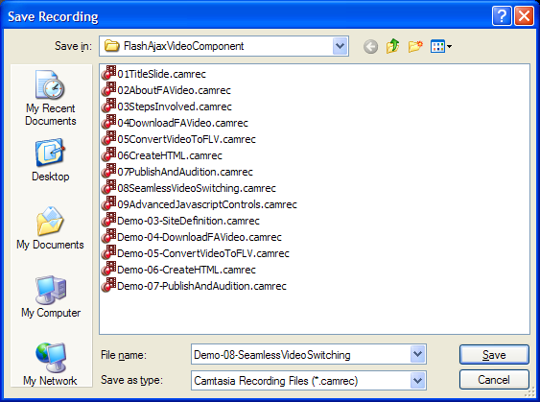
Review the Recorded Slide
After you record something, Camtasia provides a playback window that lets you review it.
You can delete the recording if you do not like it, or you can save it for future use.
When I save a clip, I begin the filename with a number, so the file manager will display my clips in sequence.

Slide 59
Record a Demo with Narration
Use Camtasia to make the demonstration window be what gets recorded.
It works best if you set the window to 1024 by 768.
Record the slide with your narration.
Save it.
Edit out any unwanted audio pauses or glitches.
Save it.

Slide 60
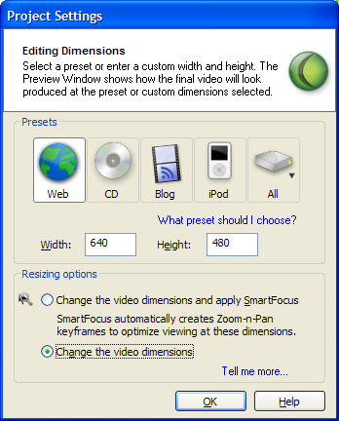
Insert Slides into Camtasia
When you begin editing your production, Camtasia will ask about your settings.
If you are producing for the Web, I recommend 640 x 480.
I do not recommend automatic Smart Focus because I find it more efficient creating the zooms by hand.

Slide 61
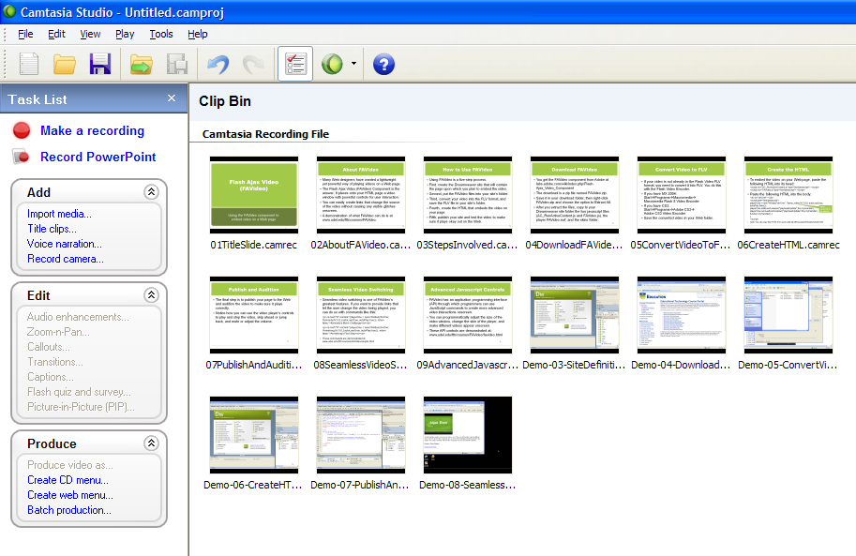
Using the Clip Bin
If you right-click the Clip Bin and choose Import Media, you can import all of the clips you created for use in this production.

Slide 62
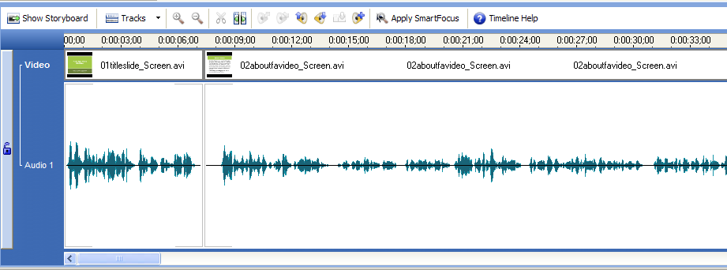
Delete Pauses and Glitches
On the timeline, you can delete all the pauses and glitches in your production. The timeline’s “zoom in” and “zoom out” features are very helpful here.

Slide 63
Add Transitions
The transitions I found to work best are:
The gradient wipe, which I put before each slide.
The wheel, which I put before each demonstration.

Slide 64
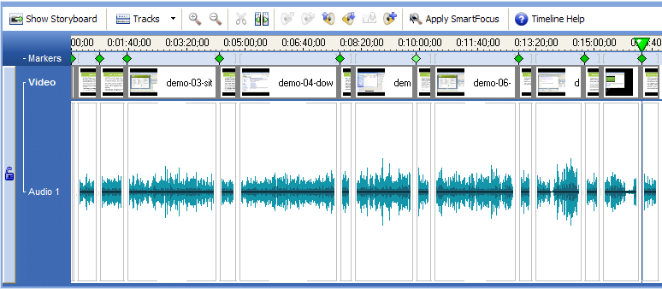
Create Markers
Markers create a sidebar that users can click to jump to different parts of your video.
Use markers when you have a complex, multi-part video.
If you are creating a simple screen recording, on the other hand, you will not need markers.

Slide 65
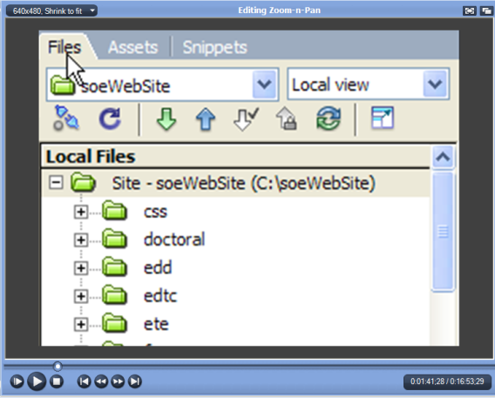
Create Pans and Zooms
Pans and Zooms enable you to focus on the part of the screen to which you want to draw the viewer’s attention.
Zooms are especially helpful when the text is small and you want to make it more readable.
It helps to pre-arrange the window positions to make any popout windows appear within the frame of the zoom you have onscreen.

Slide 66
Camtasia Zoom
As noted by Clark & Mayer (2008, p. 38), “our cognitive systems have limited capacity. Since there are too many sources of information competing for this limited capacity, the learner must select those that best match his or her goals.”
Through judicious use of Camtasia’s zoom feature, you can help learners attend to important parts of the lesson.

Slide 67
Sakai Podcasting
Reducing Transactional Distance by Reaching 21st Century Students On Their iPods

Slide 68
Sakai Podcasting
As identified by Michael Moore (1993), transactional distance is the psychological gap created by communication latency in distance learning environments.
For the younger generation of students who live on their cell phones and iPods, Sakai Podcasting is a powerful way of reducing transactional distance.
Throughout my course, as I make new videos and add them to the online collection, I announce the new titles via Sakai Podcasting.
Students do not need an iPod, but if they have one, their Sakai professor can be on it.

Slide 69
Podcasting Software
We create our Sakai podcasts with open-source software, including:
Audacity, which is freely downloadable from http://audacity.sourceforge.net;
Lame, an MP3 encoder that you download freely from http://audacity.sourceforge.net/download/lame; and
Sakai, in which you use the Podcasting tool to upload the recording to your course feed.
Students can subscribe to your course feed from iTunes or from the latest versions of Internet Explorer, Firefox, and Safari. Thus, you can tune in to the feed without necessarily having an iPod.

Slide 70
Scripting Your Narrative
It saves considerable time if you script your narrative prior to recording it.
Following Mayer’s personalization principle, avoid third person and instead use first and second person in your script.

Slide 71
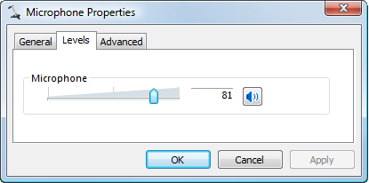
Recording Your Narrative
When you record your narrative, make sure your audio record level is turned way up, but not so high as to distort, and keep your mouth close to the mic to create presence.

Slide 72
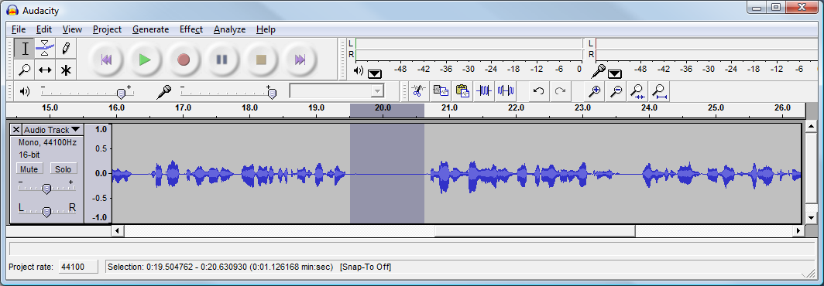
Delete Glitches
Audacity makes it easy to delete glitches.
Remove unwanted silence from the beginning and end of the clip; this is called trimming.

Slide 73
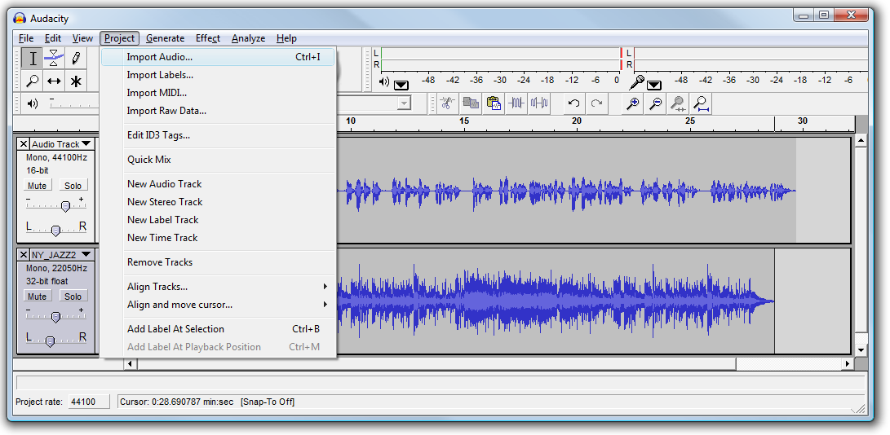
Mix In Some Music
Musical backgrounds add a professional quality to your podcast. Audacity makes it easy to import audio.

Slide 74
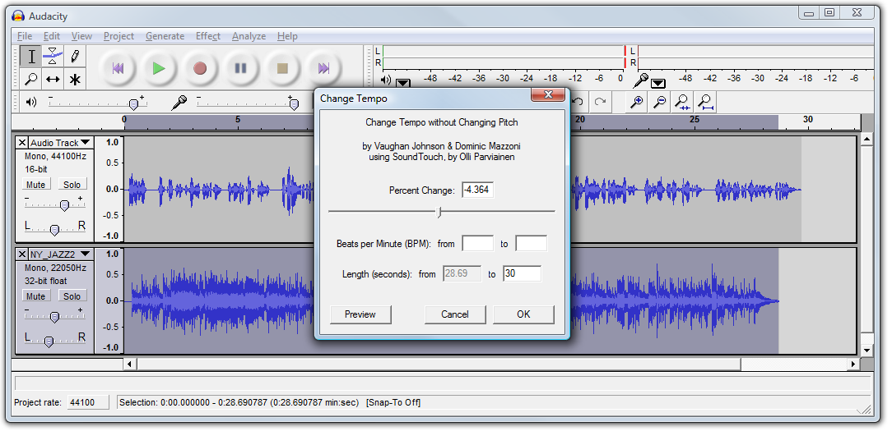
Adjust the Length
If the length of the music does not quite match that of your narration, you can use Audacity to lengthen or shorten the tracks without changing their pitch.

Slide 75
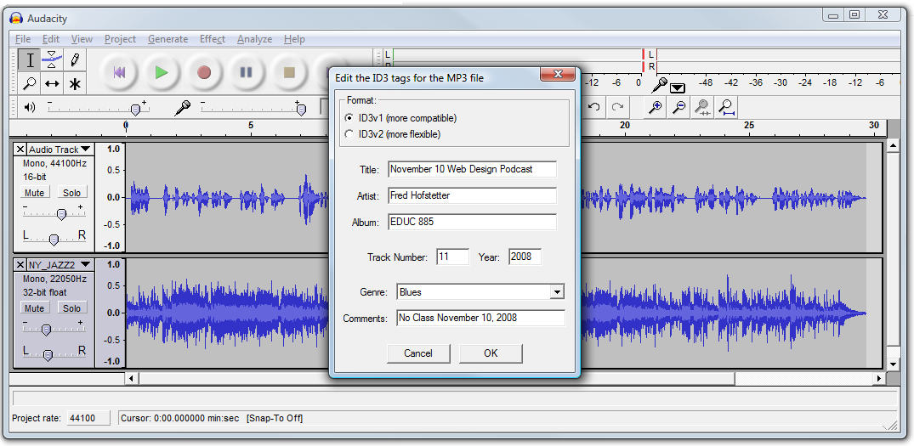
Export the MP3
You export the recording as an MP3 file, which is the format used in audio podcasting.

Slide 76
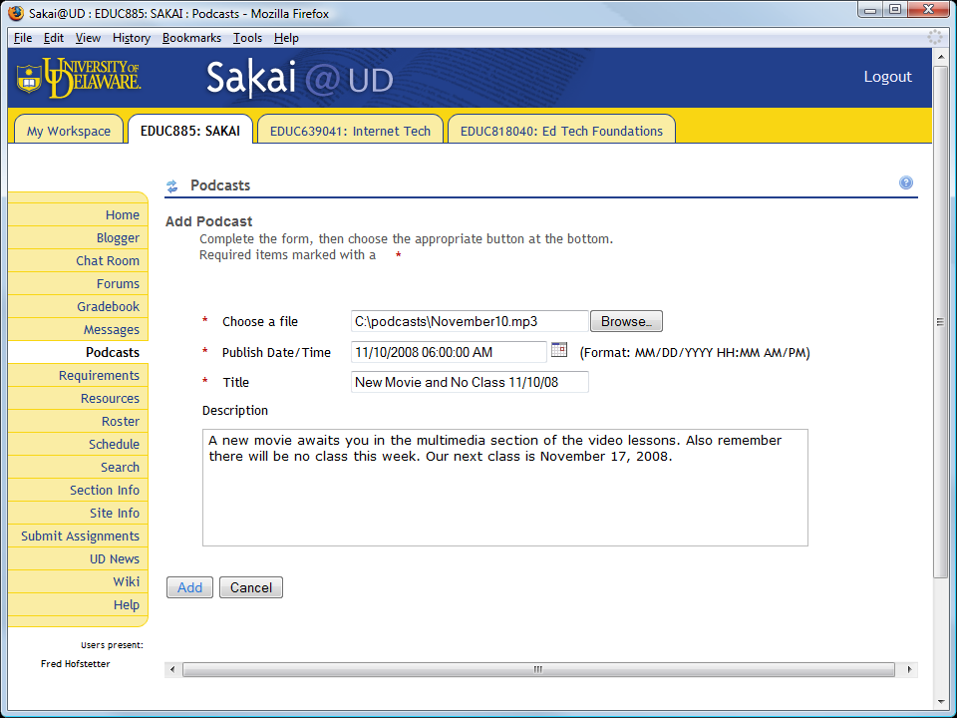
Use Sakai to Podcast the MP3
Sakai steps you through the process of uploading the MP3 file to your podcast.
Behind the scenes, Sakai creates the RSS file that defines your podcast.

Slide 77
Receiving a Sakai Podcast
Sakai tells you the address of the podcast here:
To tune in from iTunes, pull down the Advanced menu, and click Subscribe to Podcast:

Slide 78
Knowledge Building
Using Sakai’s Web 2.0 Tools to Create a Shared Knowledge Building Environment

Slide 79
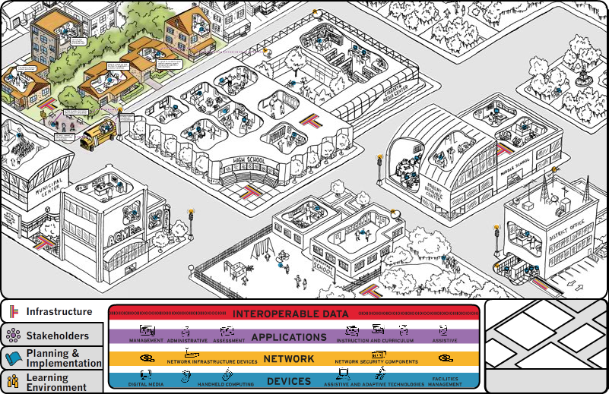
School 2.0
“In School 2.0, the learning ecosystem includes not just a school building, but also the combination of home, school, and community that collaborate to bring the wider world into day-to-day instruction and provide a rich array of learning opportunities.”
www.school2-0.org Office of Educational Technology, U.S. Department of Education

Slide 80
Collaboration Principle
Reflecting on his invention of the virtual high school (VHS) concept, Tinker (2005, p. 413) concluded that “Without collaboration, the social value of networking is lost and online courses become simply extensions of existing course formats.”
Riel (2005, p. 315-316) identified three overlapping ways in which online education should be community based: (1) collaborative learning in the context of a student cadre, (2) theoretical learning through community experiences, and (3) transformational learning in one’s community of practice.

Slide 81
Communal Knowledge Building
As Scardamalia and Bereiter (2006, p. 99) teach us, “People are not honored for what is in their minds but for the contributions they make to the organization’s or the community’s knowledge.”
Sakai’s Wiki tool is a powerful tool for communal knowledge building.
If it could be searched and tagged, the Sakai wiki would be even more powerful.

Slide 82
Sakai KBE Tools
Sakai contains several tools that can be used to form communities and build shared knowledge:
Forums provide multi-threaded asynchronous discussion space;
Blogs enable students to journal their activities, reflect on their progress, and, if enabled, let other students comment on their work.
Chat rooms let students meet synchronously, although the Sakai chats are perpetually ongoing, so you can participate in them asynchronously as well.
The Wiki lets participants create knowledge on pages that are communally shared, with an edit trail keeping track of who changed what when.

Slide 83
Forum Statistics
I like how the forum statistics enable you to see each student’s level of participation.
This is particularly helpful when forum participation is a requirement in the course.
You can even grade a message in a forum if you have created an assignment that requires participation in a forum.
I like how you can sort the forum statistics by column categories.
Demonstrate forum statistics.

Slide 84
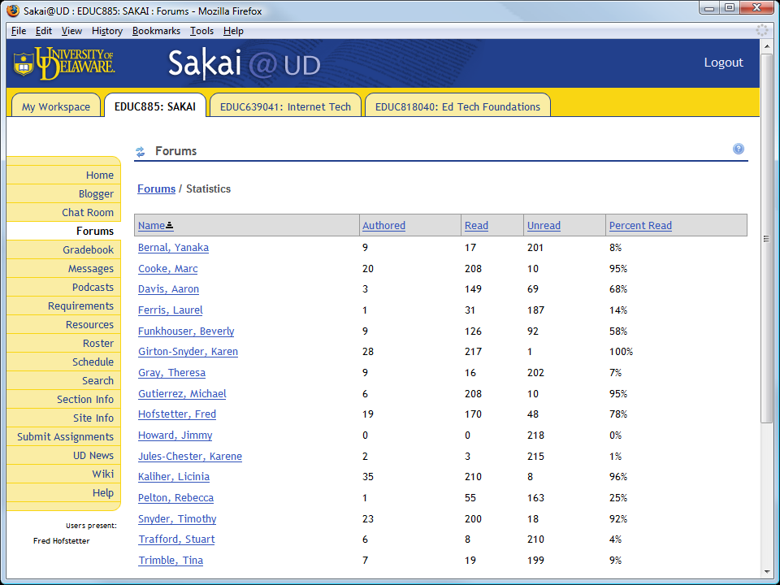

Slide 85
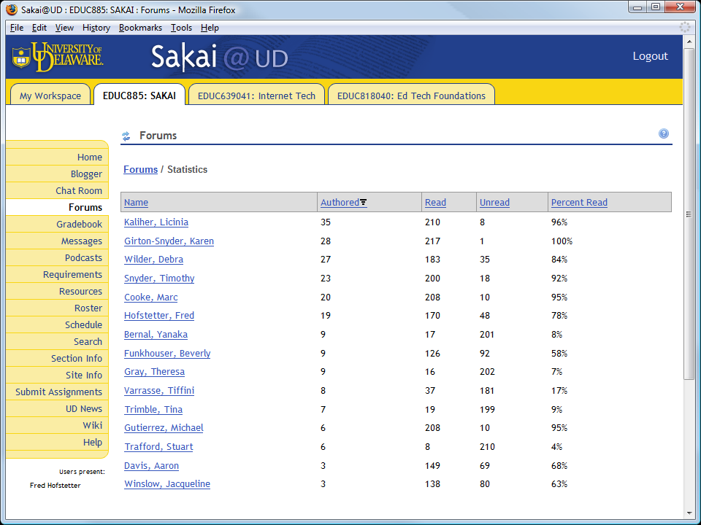

Slide 86
Wiki
Social opportunity is important in motivating people to learn (National Research Council, 2000, p. 61).
I used the Sakai Wiki to create a “cool tool” assignment in which I have the students (1) identify the tool they consider most useful and (2) write an essay explaining why they think it’s cool.
Through the Wiki, students explore each other’s tools and make discoveries richer than anything I could design on my own.
The Sakai Wiki addresses Romiszowski’s (2005, p. 337) criticism that in spite of what is known about creating knowledge building environments, IMS vendors have done little to build these kinds of cooperative learning protocols into their products.

Slide 87
Chat Room Searching
Students go into the chat room to add a synchronous dimension to their online course.
I like how the search tool includes chat room transcripts.
The tags let you explore other info related to what was found in the search.
Students like how the size of the tag represents how frequently it appears in the search results. This is powerful indeed for identifying themes in your course discussions.

Slide 88
Assessment
Sakai Supports Multiple Assessment Strategies

Slide 89
Multiple Assessment Strategies
When a course is online, it is especially important for students to have a clear picture of how they will be evaluated.
Sakai supports multiple forms of assessment that enable you to evaluate students on goal setting, individual performance, class participation, and performance outcomes.

Slide 90
Assessment Tools
The assignment tool provides for formative assessment by enabling faculty to provide feedback and give students a chance to resubmit their work and earn a higher grade.
The quizzing tool allows for self‐tests and feedback so students can self‐assess their learning.
The testing tools have both formative and summative assessment.
Blog Wow! is well-suited for gathering student self‐reflective data and faculty or peer feedback.
Sakai provides logs which enable faculty to know how long students work on tasks or which resources they access.

Slide 91
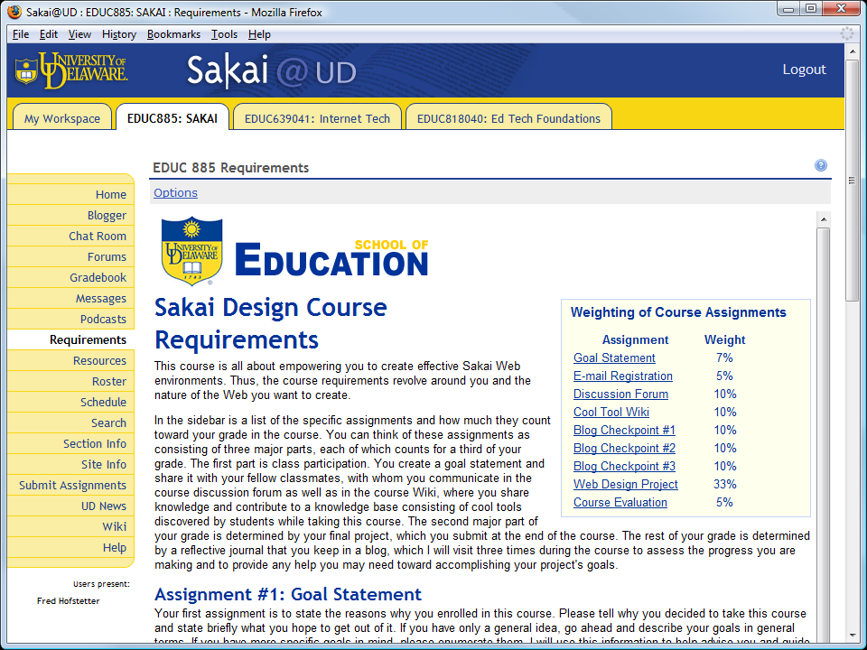
Course Requirements

Slide 92
Learning Outcomes
By the end of the course, each team must mount its portfolios and projects on the Web for their professor to review and grade. Each member of the team receives the grade awarded for the final project, which constitutes one third of the final grade.
Individually graded, on the other hand, are the blogs, in which each team member keeps track of their individual contributions toward accomplishing the project’s goals.
Thus, at the end of the course, I can assign final grades based on the overall quality of the final project as well as the role each student played.

Slide 93
Gradebook Strategy
Sakai lets you give students as many extra chances as you want. You can even markup the students’ answers.
You can set the date when assignments appear, when they must be answered, and when they will become unavailable. You can even restrict exams to specific IP addresses.
Instead of passing students on with mediocre grades, I use the Sakai scaffolding to help each student master the content and ace the course.

Slide 94
Blogger
In a meta-analysis of 122 studies of computer-supported collaborative learning, Lou, Abrami, and d’Apollonia (2001) found that group performance is not necessarily predictive of individual performance; I agree with this finding.
To assess each individual’s contribution to the group project, therefore, I require each student to write in the Sakai Blogger at three checkpoints equally spaced throughout the course.
Students like being able to see each other’s reports, and some of the students turn on the feature that lets classmates comment on each other’s blogs.
Demonstrate gradebook feedback (Blog Checkpoint #1).

Slide 95
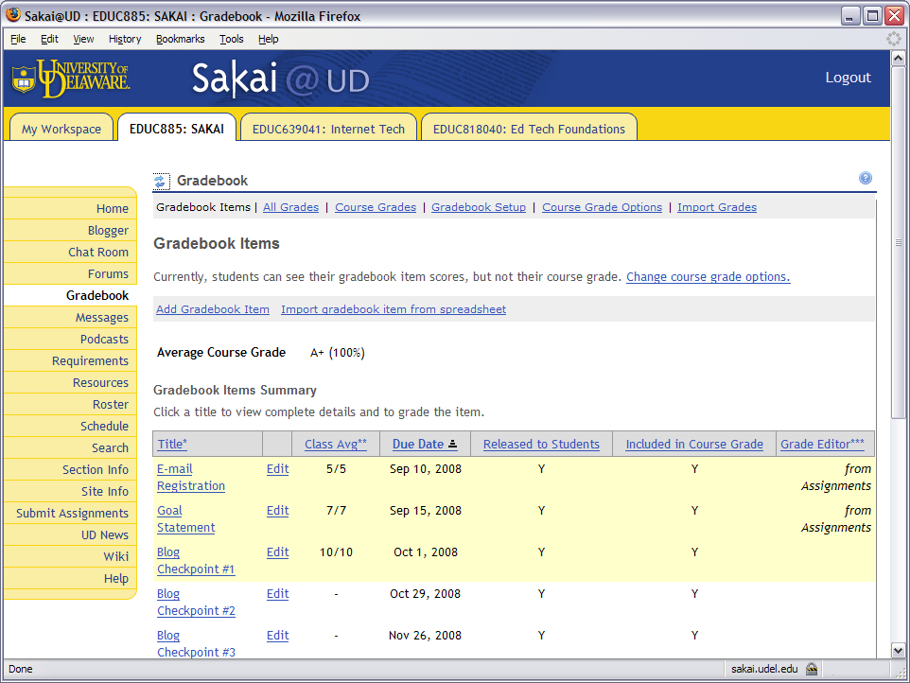

Slide 96
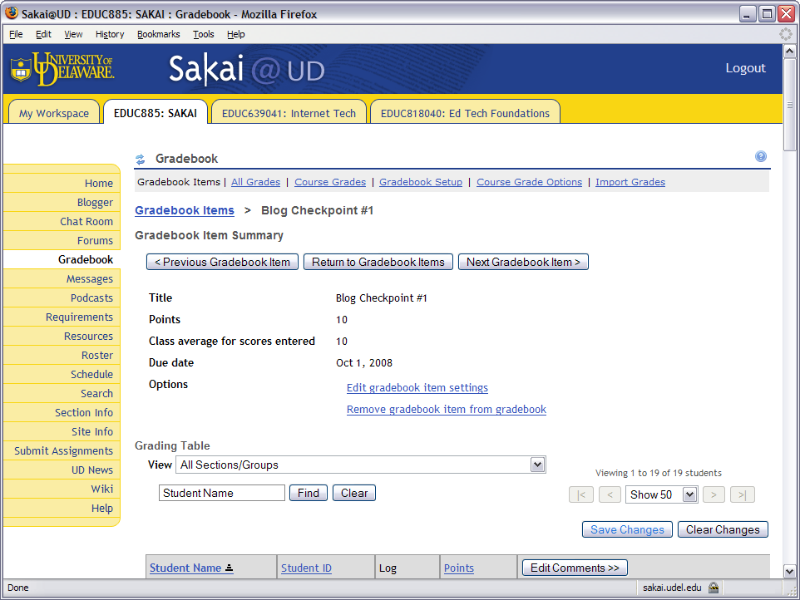

Slide 97
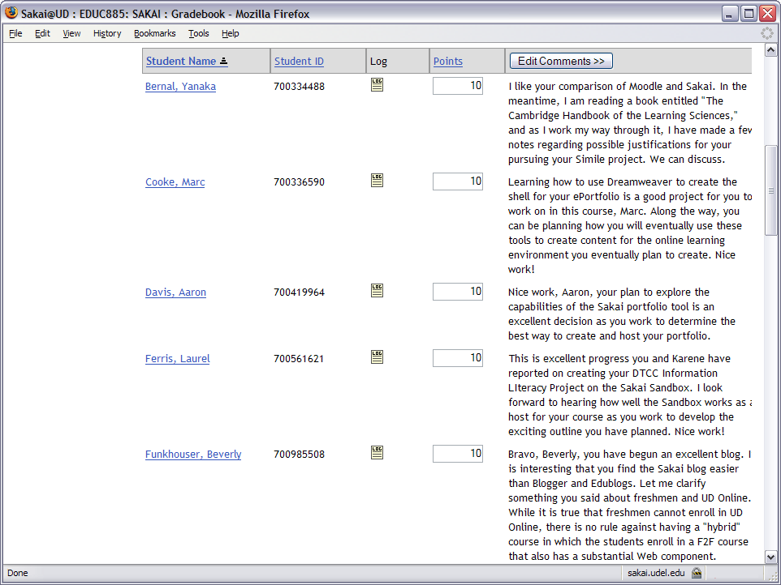

Slide 98
Metacognitive Assessment
Through the conversational assignment protocol that records the dialog between students and instructors, Sakai can make student thinking visible. By posing questions that make students reflect on whether their current level of understanding is adequate, the instructor can help students learn to be aware of the progress they are making toward understanding.
In my Web design courses, for example, students propose and negotiate the topics of their projects. Through an online consultation protocol, I help students formulate a project that not only satisfies their interests, but also meets national standards in their chosen career field. The dialog I have with my students is recorded in the Sakai database and can be viewed at any time on the course assignment page.
I encourage students to reflect on this dialog, think about their progress toward meeting the standards, and become actively involved in setting their learning priorities.

Slide 99
Course Evaluation Results
By following the principles of How People Learn, the Sakai course portal achieved the following results in Winter 2008, when my students completed a rigorous evaluation of the course administered independently through the University of Delaware course evaluation process:
In the doctoral course offering (n=14), on a scale of 1 to 5, the Instructor rating was a perfect 5.0 (excellent), and likewise, the overall evaluation of the course was 5.0 (excellent).
At the master’s level (n=12), the Instructor rating was 4.75, and the course rating was 4.67 (4 = very good, 5 = excellent).
I am grateful to the University of Delaware for adopting Sakai and making this work possible.

Slide 100
Survey Results
The following responses are typical of the feedback I received when I used the Sakai testing tool to administer a survey asking my students what they thought about Sakai.
MyCoursesPlus in my view is 10 times better than mycourses. It is more up to date with times and has many more features that were not present in MyCourses.
I am very pleased with the new structure for this course. The site is very organized and easy to navigate.
This new course management system is very similar to Serf. It is easy to navigate, fun to use, and has a lot of various options for the student to use.

Slide 101
Pedagogical Frameworks
How Leading Instructional Models Inform the Design of Sakai Learning Materials

Slide 102
Component Architecture
As we have seen, Sakai’s frameset requires the course author to choose and configure the tools to be used in the course.
Ferdig (2007, p. 52) refers to this kind of design framework as a component architecture.
In the scholarly literature are several instructional design models that can help faculty think about what components to include and how to use them.

Slide 103
Gagne’s Instructional Model
Gagne’s (2005) nine events of instruction inform the design of online learning in the Florida Virtual School and Spokane Virtual Learning (Johnston, 2007, p. 22):
Gaining Attention (Reception)
Informing Learners of the Objectives (Expectations)
Stimulating Recall of Prior Learning (Retrieval)
Presenting the Stimulus (Selective Perception)
Providing Learning Guidance (Semantic Encoding)
Eliciting Performance (Responding)
Providing Feedback (Reinforcement)
Assessing Performance (Retrieval)
Enhancing Retention and Transfer (Generalization)

Slide 104
Keller’s ARCS Model
Keller’s (1987) motivation model called ARCS reminds us of four principles important in motivating virtual learners (Johnston, 2007, p. 23):
Attention: | establishing and maintaining curiosity and learner arousal;
Relevance: | linking the learner situation to the needs and motives of the learner;
Confidence: | learners attribute positive learning experiences to their individual behavior;
Satisfaction: | learners develop the desire to pursue similar goals.

Slide 105
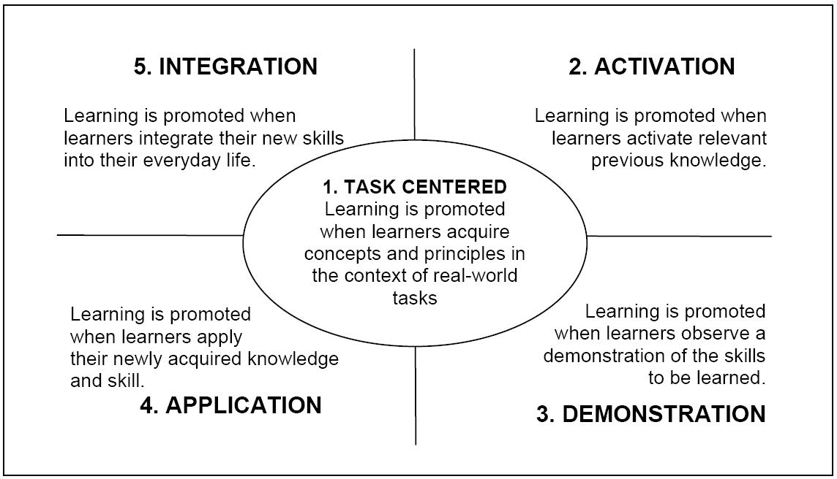
Merrill’s First Principles
Merrill (2007) http://cito.byuh.edu/merrill/text/papers/Task_Centered_Strategy.pdf

Slide 106
Andragogy
Adragogy is a theory of adult learning developed by Malcolm Knowles (1984).
Andragogy offers four design principles:
Adults need to know why they need to learn something.
Adults need to learn experientially.
Adults approach learning as problem-solving.
Adults learn best when the topic is of immediate value.

Slide 107
Articulation Principle
Sawyer (2006, p. 12) teaches that “articulation and learning go hand in hand, in a mutually reinforcing feedback loop. In many cases, learners don’t actually learn something until they start to articulate it. In other words, while thinking out loud, they learn more rapidly and deeply than studying quietly.”

Slide 108
Creativity in Learning
As we learn more about how people learn, creativity becomes more important as an instructional strategy.
In the recent revision of the ISTE standards, creativity replaced operations as the first standard.

Slide 109
Bloom’s Taxonomy
Creating is on top of Anderson & Krathwohl’s revision of Bloom’s taxonomy.
Benjamin Bloom (1984) | Anderson & Krathwohl (2001)
Evaluation | Creating Generating new ideas, products, or ways of viewing things
Synthesis | Evaluating Justifying a decision or course of action
Analysis | Analyzing Breaking information into parts to explore understandings and relationships
Application | Applying Using information in another familiar situation
Comprehension | Understanding Explaining ideas or concepts
Knowledge | Remembering Recalling information

Slide 110
Revised Taxonomy Table
The revised taxonomy table has a knowledge dimension and a cognitive process dimension. The instructional designer aligns objectives to assessment techniques by considering the kind of knowledge to be learned (knowledge dimension) and the process used to learn (cognitive process dimension).
The Knowledge Dimension | The Cognitive Process Dimension
 | Remembering | Understanding | Applying | Analyzing | Evaluating | Creating
Factual Knowledge
Conceptual Knowledge
Procedural Knowledge
Metacognitive Knowledge

Slide 111
Sakai Activity Theory
Sakai Tools
Curriculum
Assessment Lens
Subject
Outcome
Zone
Socialization
Standardization
Community
Instructor
Profession
Adapted from Engeström (1987, p. 78)

Slide 112
Design Tips
Jumpstarting Three Sakai Tools in Which Instructions Are Not Clear

Slide 113
Making Sakai Tools Intuitive
I created startup messages in three tools for which students may need help getting started. These three startups explain that:
In the Wiki, you must create a link in order to make a new page.
In the Blogger, you must click new in the menu bar to write a new entry in the Blog.
In the Forum, you must click the heading of the message to which you want to respond.

Slide 114
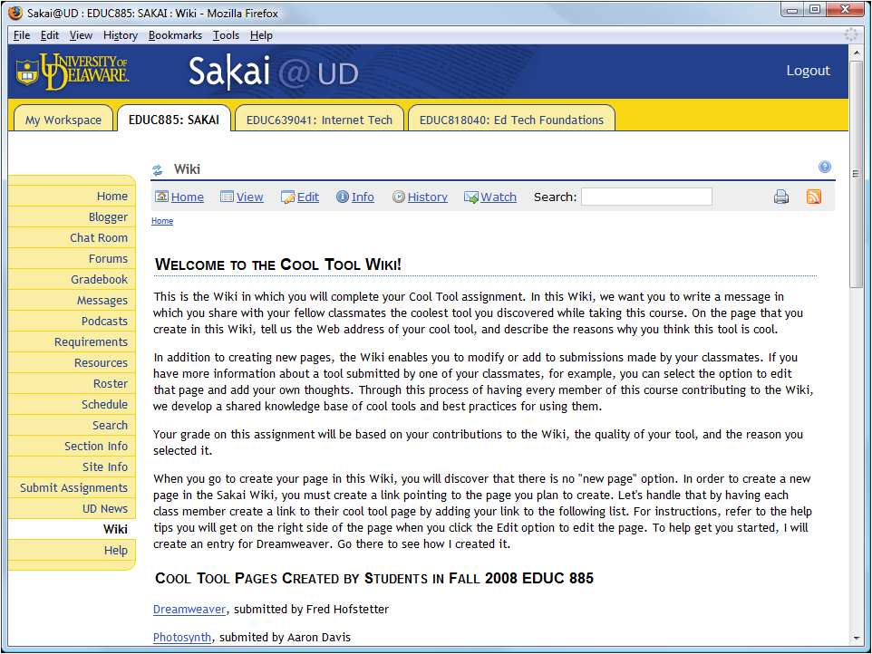
Jumpstarting the Wiki

Slide 115
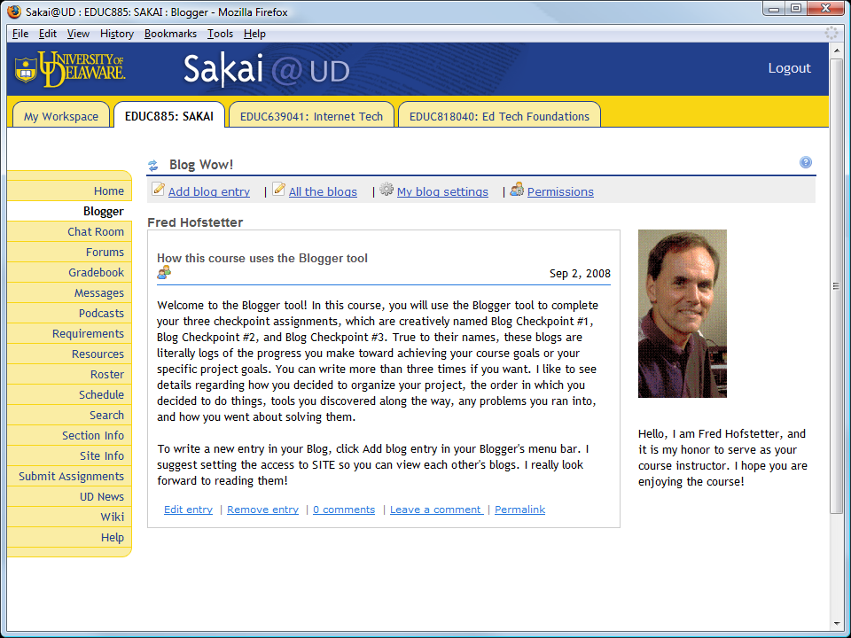
Jumpstarting the Blogger

Slide 116
Jumpstarting the Forum

Slide 117
Reflections on Sakai
Many Features to Like and a Few Pitfalls to Avoid

Slide 118
Automatic Notification
I like how the Announcements, Resources, and Syllabus tools can send email notifications to site participants when you add new items to the course. You can specify low or high priority.
In low priority, email notification will be subject to each participant's notification preferences.
In high priority, all site participants receive the notification.
To further reduce transactional distance, I would like to see this automatic notification feature added to the Sakai gradebook and assignment tools.

Slide 119
Forum Statistics
I like how the forum statistics enable you to see each student’s level of participation.
This is particularly helpful when forum participation is a requirement in the course.
You can even grade a message in a forum if you have created an assignment that requires participation in a forum.

Slide 120
Scheduling
Students like how the Sakai schedule tool enables you to visualize how the course unfolds.
I like how assignments appear automatically on the schedule.
I really like how the schedule updates when you change an assignment’s dates.
I found the schedule’s monthly view most useful because it pictures how the daily and weekly activities unfold.
Demonstrate the schedule’s monthly view.

Slide 122
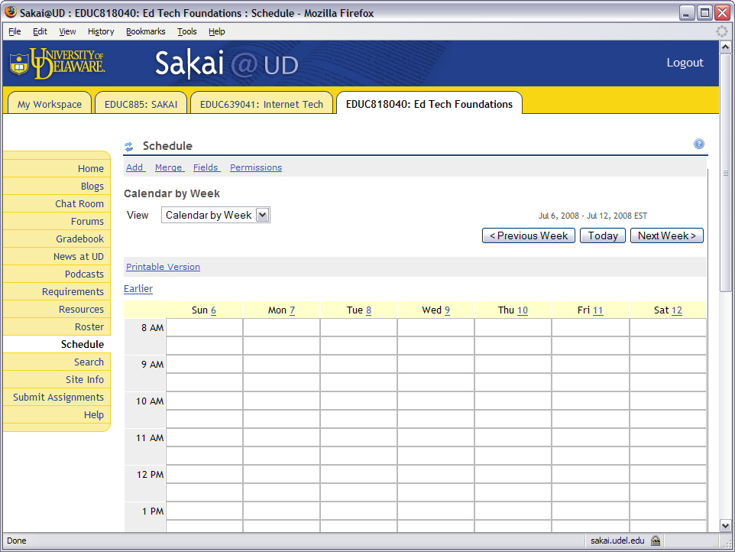

Slide 123
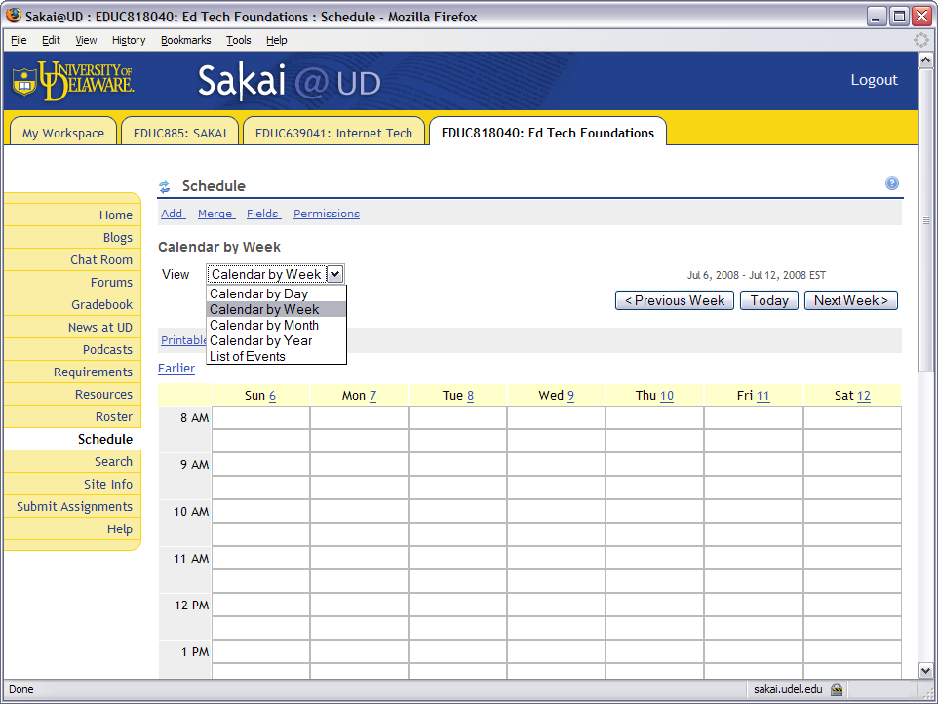

Slide 124
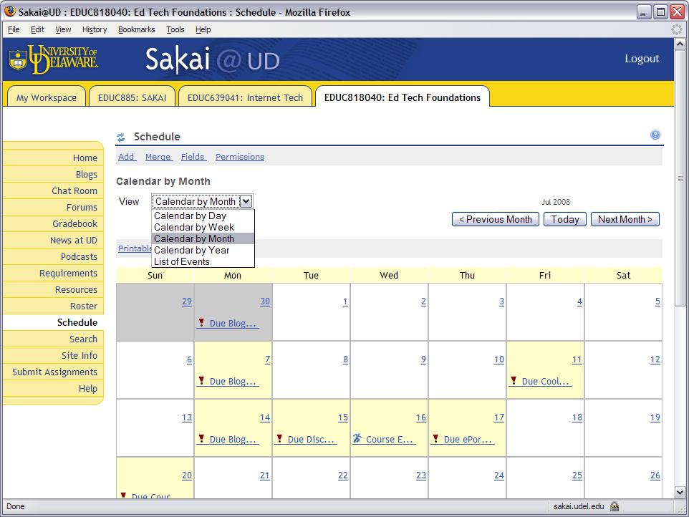

Slide 125
Grading
Students reported no problems answering my first assignments in Sakai.
Grading went smoothly and became more efficient when I figured out how to sort by submission status.
To see what needs to be graded, you choose Assignments (not Gradebook), click the In/New summary, then click Status to sort by submission status.

Slide 126
Sidebar Tooling
I like how the Page Order feature of the Site Info tool enables you to turn tools on or off and change the order in which the tools appear in your Sakai sidebar.

Slide 127
Blog and Wiki Wishes
As noted earlier, Sakai’s Blog and Wiki are powerful tools for communal knowledge building.
If the Wiki could be searched and tagged, however, it would be even more powerful, as would the blogger.
Tagging provides a mechanism for following discussion themes, which is one of the knowledge building requirements identified by Scardamalia and Bereiter (2006).

Slide 128
Pitfalls to Avoid
In the forums, do not permit students to create new topics. Let students create threads, but not topics. When you create a topic and configure the settings, you should consider leaving the long description blank because it only shows if the student clicks details.
Sakai@UD is a secured Web server that uses the https protocol. If you have http resources on an https page, you will get an annoying warning about mixing secure and non-secure items. To prevent this, either put everything into Sakai to make it all https, or create an external link from content not in the sidebar.
When using Sakai, all users need to avoid using the browser’s back button. Instead, use the Sakai buttons and breadcrumbs.
Chat room conversations reside in an archive that classmates can search and read. Make sure students realize the chats are not private.

Slide 129
Sakai Design Process In a Nutshell
On the home page, replace “worksite information” with the name of your course. Use the Site Info URL field to give the link of your first page to display. Make this be a page within your Sakai worksite in order to avoid the unwanted warning about mixing secure and non-secure items.
Use the Site Info tool to add tools to your course; I added assignments, schedule, forums, wiki, blogger, podcasts, chat room, search, and tests.
Create your course content. I did this with Dreamweaver; you can also create content with MS Word and use the PDF add-in to convert it into a PDF file that works beautifully in Sakai.
Adopt textbooks; I did this at safari.oreilly.com.
Create assignments and decide upon the weighting of your assignments. This works best if the weights add up to 100.
Decide when your assignments will become visible, due, and accepted.
Write a startup message in the forum explaining to click the heading of the message to which you want to respond.
Make the first message in your Wiki explain how to create a link to make a new page.
Front-end your blogger with a message explaining to click new in the menu bar to write a new entry in the Blog.
Record an audio or video message and use the Podcast tool to put it on your course feed.
Use the Test tool to create a survey for students to take over the first weekend and let you know how they are doing with Sakai.

Slide 130
References
Anderson, L.W., & Krathwohl (Eds.). (2001). A Taxonomy for Learning,Teaching, and Assessing: A Revision of Bloom's Taxonomy of Educational Objectives. New York: Longman.
Barab, S. Design-Based Research: A Methodological Toolkit for the Learning Scientist. In R.K. Sawyer (Ed.), The Cambridge Handbook of the Learning Sciences (pp. 153-169). New York: Cambridge University Press.
Bloom, B. (1984) Taxonomy of Educational Objectives. Boston, MA: Allyn and Bacon.
Clark, R.C., & Mayer, R.E. (2008). e-Learning and the Science of Instruction (2nd ed.). San Francisco, CA: Pfeiffer.
Confrey, J. (2006) The Evolution of Design Studies as Methodology. In R.K. Sawyer (Ed.), The Cambridge Handbook of the Learning Sciences (pp. 135-151). New York: Cambridge University Press.
Engeström, Y. (1987). Learning by expanding: An activity-theoretical approach to developmental research. Helsinki, Finland: Orienta-Konultit.
Ferdig, R.E. (2007). Teaching and Learning Literacy and Language Arts Online. In C. Cavanaugh and R. Blomeyer (Eds.), What Works in K-12 Online Learning. Washington, DC: ISTE.
Gagne, R., Wager, W., Golas, K., & Keller, J. (2005) Principles of Instructional Design. Belmont, CA: Wadsworth/Thomson Learning.

Slide 131
References
Haavind, S. (2000). Why Don’t Face-to-Face Teaching Strategies Work In the Virtual Classroom? @Concord, (4)3, 3-4. Retrieved 6 November 2008 from http://www.concord.org/publications/newsletter/2000fall/00fall.pdf.
Homberg, B. (2003). A Theory of Distance Education Based on Empathy. In M.G. Moore and W.G. Anderson (Eds.), Handbook of Distance Education (pp. 79-86). Mahwah, NJ: Lawrence Erlbaum.
Johnston, Sharon. (2007). Developing Quality Virtual Courses. In C. Cavanaugh and R. Blomeyer (Eds.), What Works in K-12 Online Learning. Washington, DC: ISTE.
Lou, Y., Abrami, P.C., & d’Apollonia, S. (2001). Small group and individual learning with technology: A meta-analysis. Review of Educational Research, 71, 449-521.
Mayer, R.E. (2001). Multimedia Learning. New York: Cambridge University Press.
Merrill, M.D. (2007). A Task-Centered Instructional Strategy. Journal of Research on Technology in Education, 40 (1), 33-50. http://cito.byuh.edu/merrill/text/papers/Task_Centered_Strategy.pdf.
Moore, M.G. (1993). Theory of Transactional Distance. In D. Keegan (Ed.), Theoretical Principles of Distance Education (pp. 22-38). London: Routledge.
National Research Council. (2000). How People Learn (expanded edition edited by J.D. Bransford, A.L. Brown, and R.R. Cocking). Washington, DC: National Academy Press.

Slide 132
References
Romiszowski, A.J. (2005). Online Learning: Are We on the Right Track? In G. Kearsley (Ed.), Online Learning: Personal Reflections on the Transformation of Education (pp. 321-349). Englewood Cliffs, NJ: Educational Technology Publications.
Sawyer, R.K. (2006) The New Science of Learning. In R.K. Sawyer (Ed.), The Cambridge Handbook of the Learning Sciences (pp. 1-16). New York: Cambridge University Press.
Sawyer, R.K. (2006) Analyzing Collaborative Discourse. In R.K. Sawyer (Ed.), The Cambridge Handbook of the Learning Sciences (pp. 187-204). New York: Cambridge University Press.
Scardamalia, M., & Bereiter, C. (2006) In Sawyer, R.K. The Cambridge Handbook of the Learning Sciences (pp. 97-115).
Vygotsky, L.S. (1978). Mind in Society: The Development of Higher Psychological Processes. Cambridge, MA: Harvard University Press.

Slide 133
Recommeded Books
Researched Best Practices of e-Learning

Slide 134
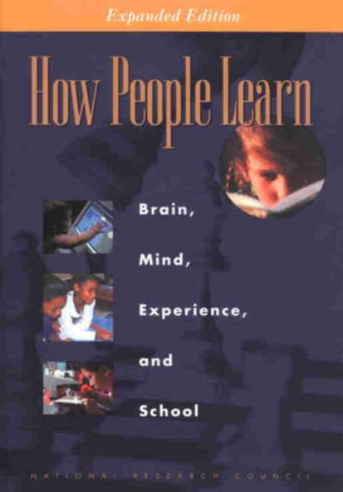
Recommended Books

Slide 135
Thanking User Services
I want to thank the University of Delaware’s IT-User Services for the fine service they are providing to faculty learning Sakai.
Janet DeVry manages the effort and encourages our participation in the Sakai community.
Nancy O’Laughlin facilitates our migration from WebCT to Sakai.
Karen Kral is invaluable in finding workarounds to temporary problems you may encounter.
John Hall is doing an excellent job of explaining technical details to faculty in our LMS forums.

