Slide 1
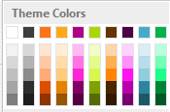

Using Office 365
Across All Your Devices
Fred T. Hofstetter
University of Delaware
Notes:
Slide purpose: Use this slide to welcome your guests and to set their expectations for the presentation.
Presentation purpose: This presentation is designed to help you introduce the new Office 365 Business to small businesses (~1-10 users). This is a SKU-specific deck so it starts with business pains, then goes into how Office 365 can solve those pains, and then goes into the new Business SKU.

Slide 2


Using Office 365
Across All Your Devices
Office where & when you need it
The best & latest version of Office
Built-in sharing & cloud storage
Notes:
Talk track
Now that you are familiar with in included in Office 365 Business, let’s drill down on why Office 365 Business is a better solution that buying traditional Office applications.
Office where and when you need it
Office 365 Business gives you the freedom to be productive wherever, whenever, using the familiar Office apps. With the ability to easily access, edit, and share your files from any device, you can get work done in the office and on the go, online or off.
The best & latest version of Office
Always have the best and lastest version of Office on your desktop and in the cloud. Don’t worry about being out of date with new features automatically synced to your desktop, tablets, and smart phones.
Built-in sharing & file storage
Work together easily and securely in real-time with built-in sharing and cloud storage in all your Office apps. With 1TB of storage, you can save files to the cloud, share files with the click of a button, and avoid the confusion of working on different versions of the same file.

Slide 3
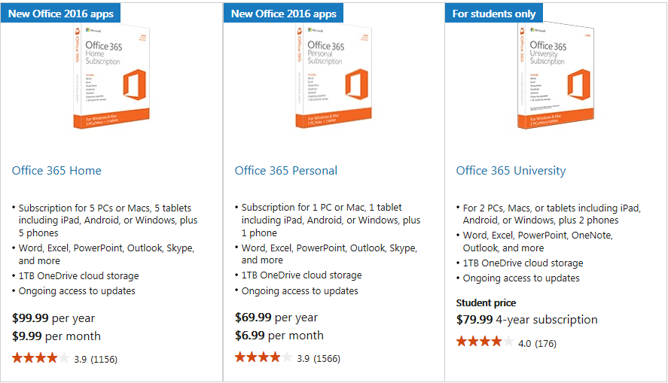

Slide 4
Using Office 365 Across All Your Devices
Full, installed Office applications on up to 5 PCs or Macs
Office for smartphones and Windows tablets and iPads®
Online versions of Office—Word, Excel, OneNote and more
1TB of OneDrive storage
Notes:
Slide purpose: Introduce Office 365 Business. Explain what is included in the plan. (note: the following slide helps explain the benefits of Office 365, so don’t feel pressured to tell that story on this slide).
Talk track
Office 365 Business is your familiar Office, but improved. It includes:
When we say “familiar office”, first of all, we mean the full, installable Office apps that you know and love – Word, PowerPoint, Excel, Outlook, etc. With Office 365 Business, you get the most up to date desktop Office apps you have always used, along with great new additional features and capabilities.
In addition to desktop apps, you also get Office apps on your tablet and smartphones for viewing and editing on the go.
And if you forget your laptop at home, or leave it at the Office and need to access or edit your files, you have Office Online which allows you to access, edit, and share your documents by simply logging into you Office Online account from any browser.\
Lastly, with Office 365 Business you get 1TB of OneDrive for Business online storage so you can safely and securely save your files online and share them with others.
This plan is easy to set up and manage, with a financially-backed SLA and 24/7 technical phone support for critical issues.
You may be familiar with Office. Office 365 Business is that same familiar Office with new features. But more importantly, Office 365 Business provides a few great new benefits [click to the next slide].
Note for presenter: Keep in mind that most people, when they hear “Office 365”, only hear “Office” and think “Word, PowerPoint, Excel”. And when they hear “cloud”, they think “browser based apps” only, thinking this is only a browser-based version of Office, similar to Google Apps. So it’s important to take your time and labor on these 2 points specifically. Transition from previous slide by saying, “We understand what technology you need to help you manage the business challenges you are facing. We are excited that there is a new offering in the market that has been designed specifically for you….”

Slide 5
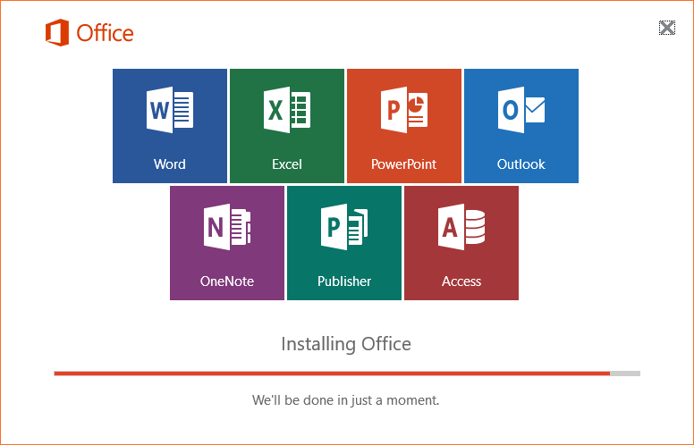
Install Office on Your Computer

Slide 6
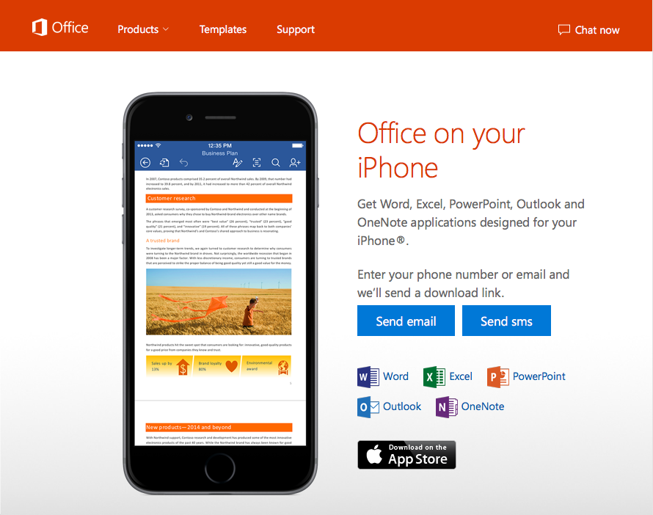
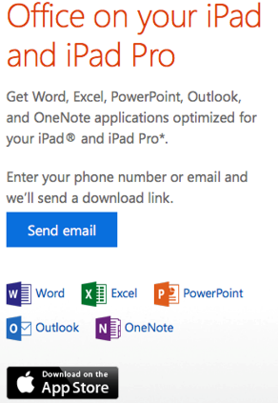
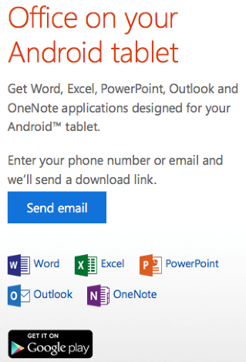
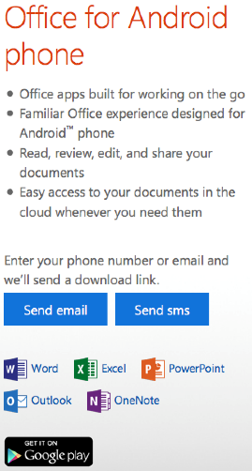
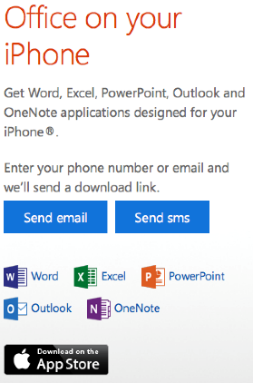
Install Apps on Your Mobile Devices

Slide 7
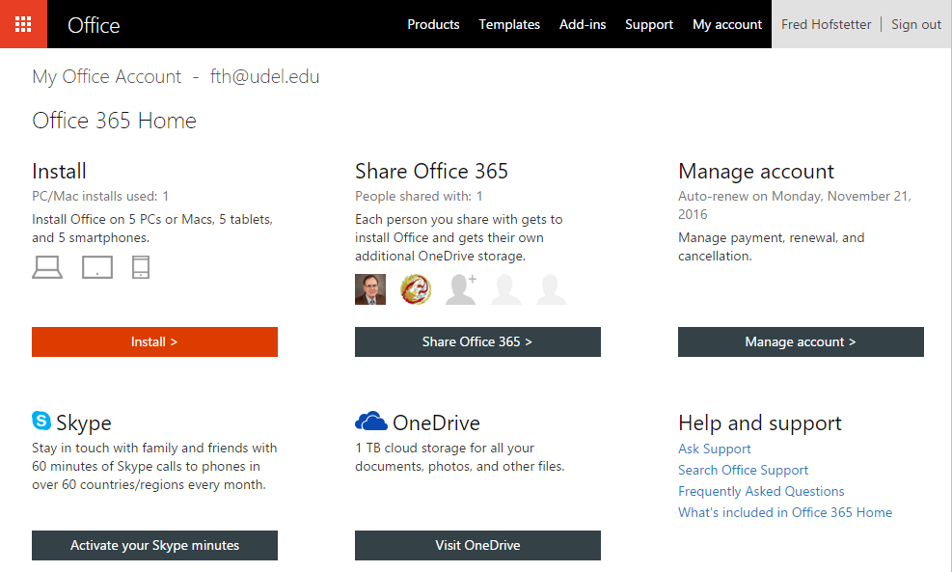
office.com/myaccount

Slide 8
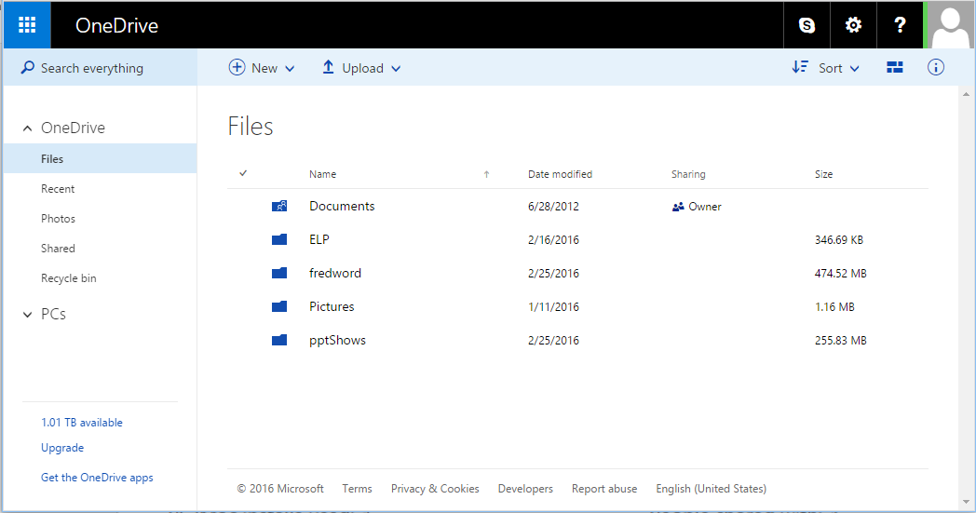
OneDrive

Slide 9
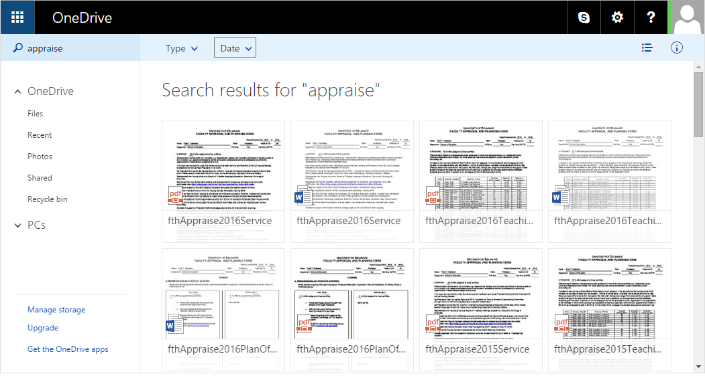
Quick Search

Slide 10
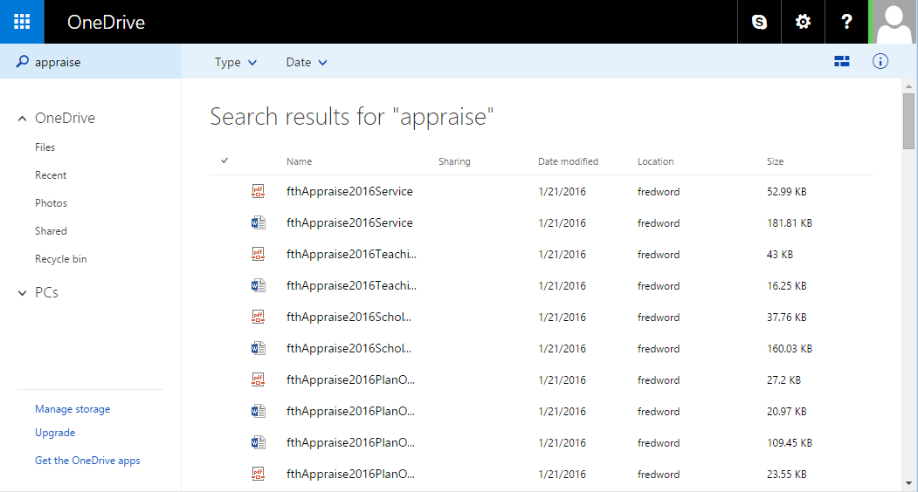
List Documents

Slide 11
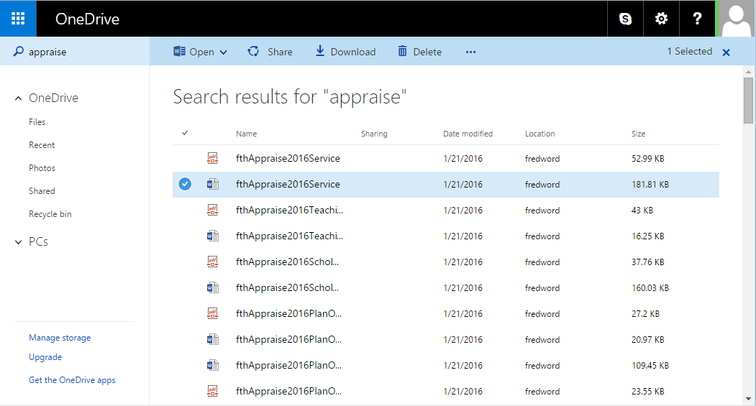
Select Documents

Slide 12
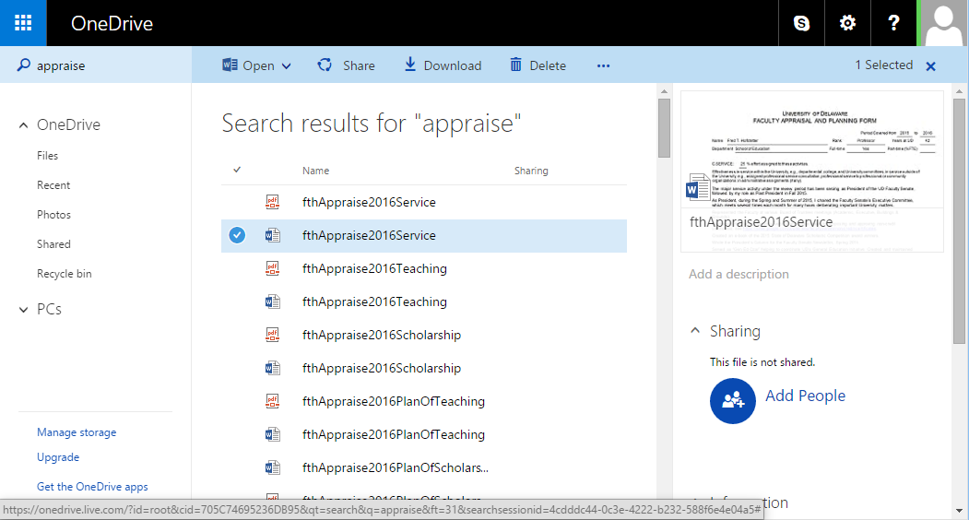
Share Documents

Slide 13
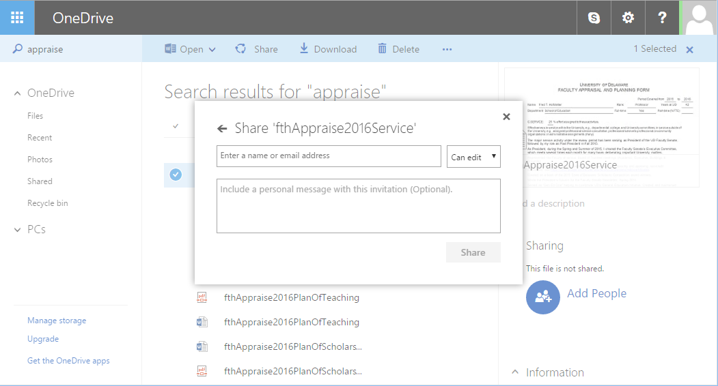
Add People

Slide 14
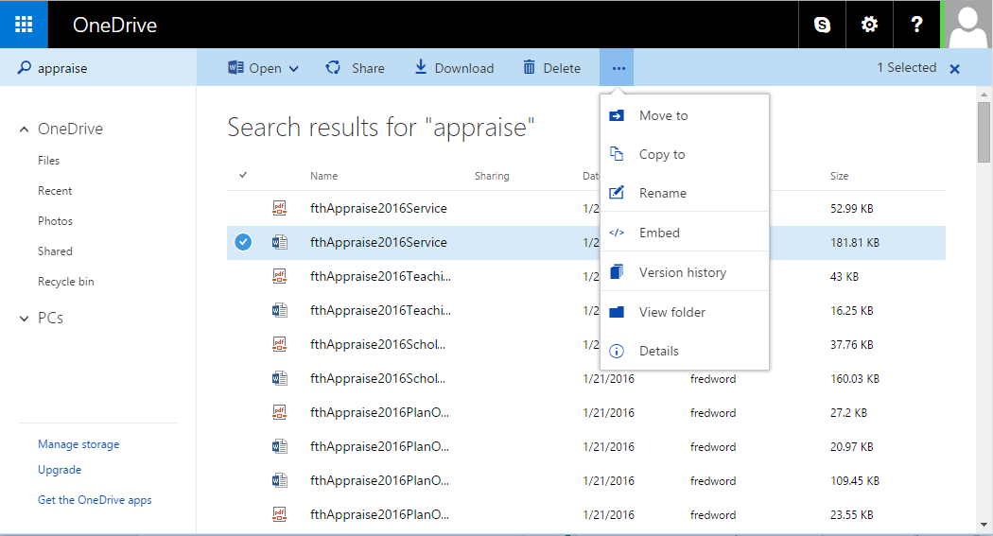
Manage Documents

Slide 15
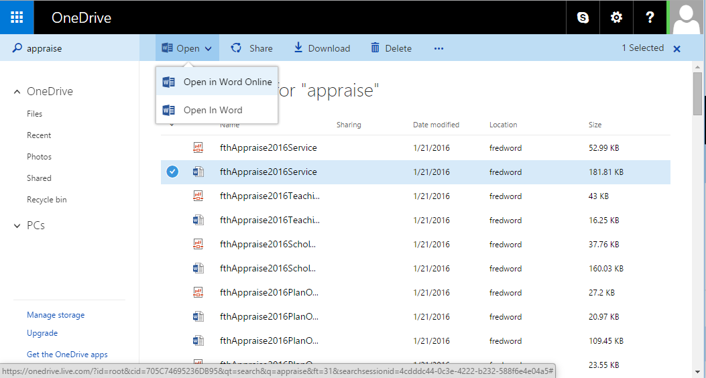
Open Documents

Slide 16
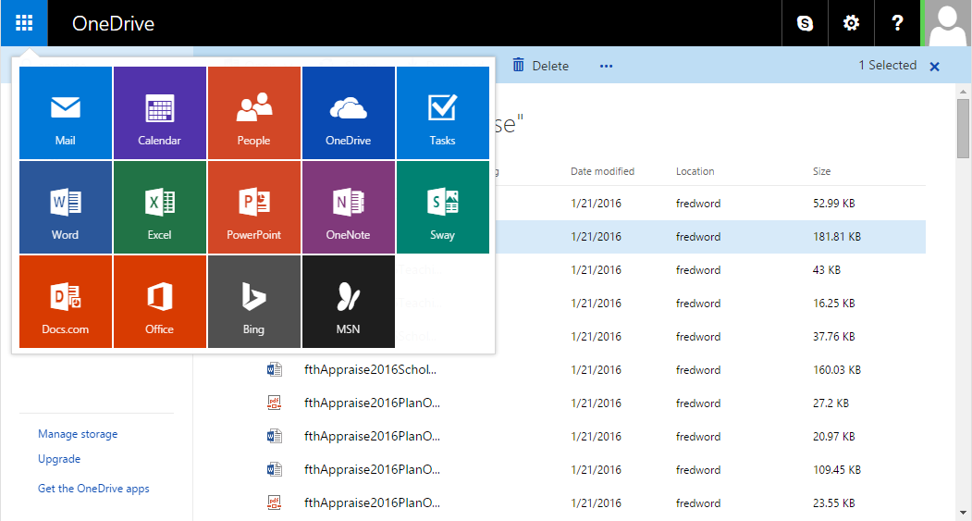
Office Online

Slide 17
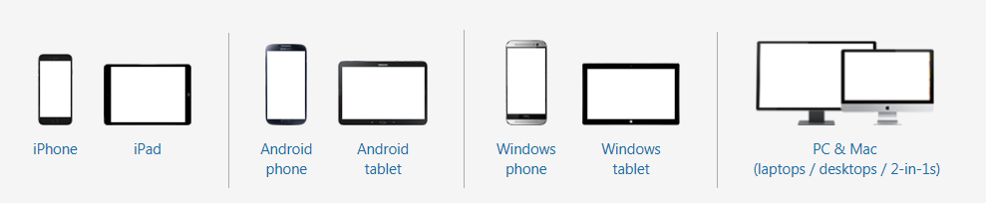
Devices

Slide 18
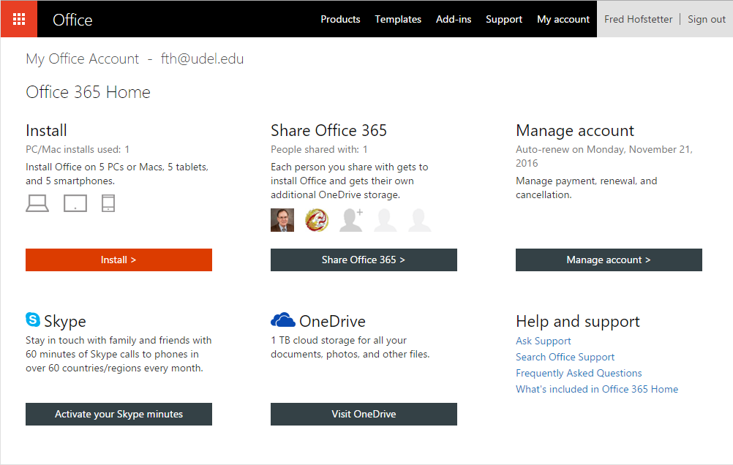
Office 365 Training via office.com/myaccount

Slide 19
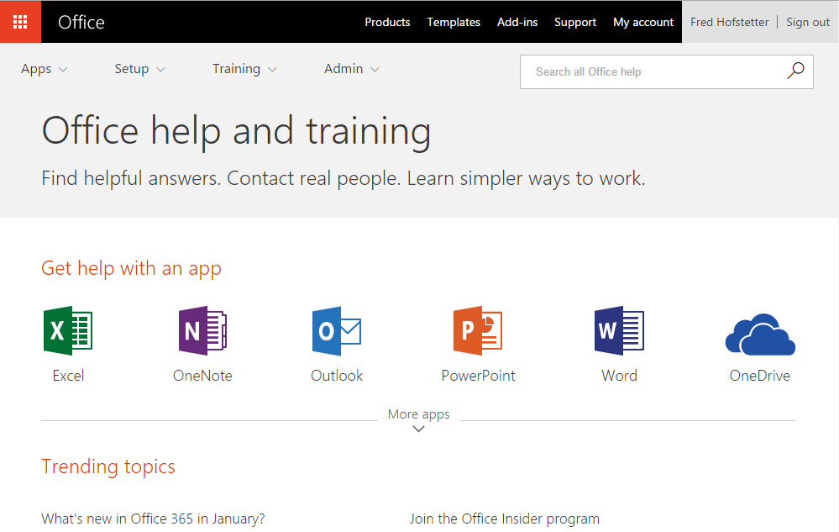
Support

Slide 20


Outlook is the best mail app I have ever found for my iOS devices. Outlook is also available for Android.
Before being called Outlook, this app was called Acompli, which was acquired by Microsoft in December 2014 and rebranded as Outlook Mobile in January 2015.
You can use the Outlook app with any IMAP-enabled email client; you do not need to use outlook.com.
On my iPhone and iPad, I configured Outlook for use with my googleapps@udel.edu gmail account.

Slide 21
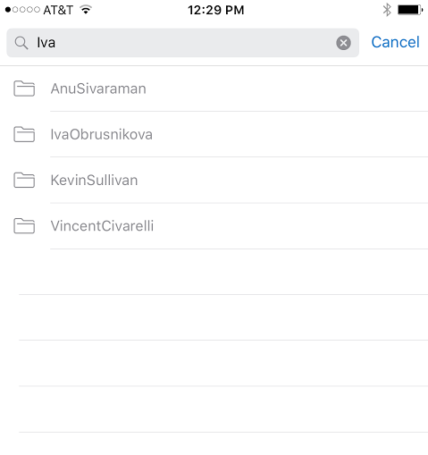
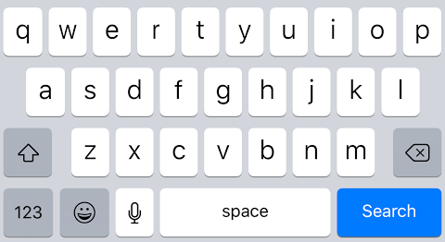
Workflow:
Filing Mail on Your Mobile Device
If you have hundreds of email folders, filing mail on a mobile device can be a daunting task.
Outlook Mobile solves this problem by letting you search for the folder you need.
Go to the message you want to file and follow these steps:
Any time you are reading mail, you
can tap the Search icon and search
for label:YourFolderName to bring
that folder’s contents onscreen.
Tap … and choose Move.
In the Search field, begin typing the name of the folder you want.
When the folder’s name appears, tap the folder you want.

Slide 22
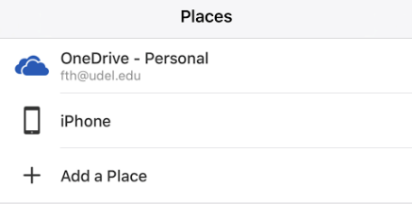
Workflow:
Using OneDrive as Your Backup Strategy
You can use OneDrive as your cloud-based backup from which you can copy any item into the file system on any one of your devices. This approach has several advantages:
    If you are going to be out of range of a network, you can work on the file offline without worrying about losing connectivity.
    It is faster to work on the file locally, especially if the file is large.
    When you are done working on the file, you can copy it back to the cloud.
    In this kind of a scenario, OneDrive is your cloud-based backup.
After you work on the file offline, you will want to save it into the cloud so you have an online backup that you
can access from any one of your devices.
If you do not see OneDrive as a Save
location, add OneDrive by choosing
the option to Add a Place.

Slide 23
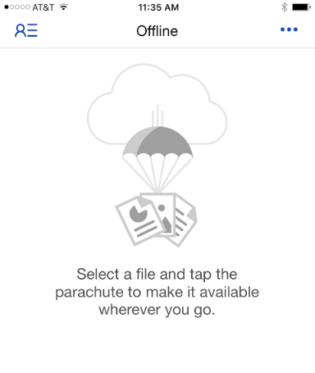

Workflow:
Marking a File for Offline Editing
You can use OneDrive to mark a file for Offline Editing.
When you do this, OneDrive makes a local copy of the file that will be there for you to work on offline.
The file automatically syncs back to the cloud the next time your device goes online.
To mark a file for offline editing,
follow these steps:
To reverse this process, repeat
these three steps.
Tap … and choose Select Items.
Select the files you want to work on offline.
Tap the parachute icon to put them offline.

Slide 24
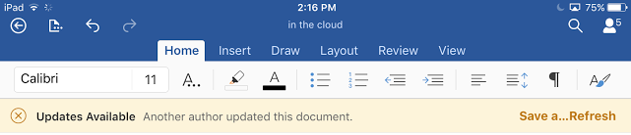
Workflow:
Sharing a Document Inside an App
File sharing is an important new feature of Office 365.
You can share files from OneDrive, or you can share a file from within an app via the app’s File menu.
If you share a file that you are working on in the cloud, users can collaborate in real time, and their contributions are flagged and color-coded to show who is writing what.
Use the Save-and-Refresh button to update the display.

Slide 25
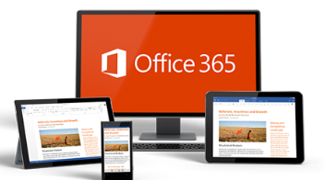
Office 365

