Slide 1
Open Source E-Learning In Graduate Education
Delivering Graduate Education
Based on How People Learn

Slide 2
What Is E-Learning?
E-learning is the use of electronic media to help people learn.
Graduate students like its flexibility and are well equipped due to the mass market popularity of computers, iPods, and cell phones.
Because of this widespread appeal, e-learning has become a multi-billion dollar industry, and some commercial enterprises charge a lot of money for it.
Thanks to the open source movement, however, some of the best software is free.

Slide 3
What Is Open Source?
Open Source is a licensing mechanism for sharing software freely among a user community that consorts to continually improve the software.
Open source products used in higher education include:
All of the tools I demonstrate this morning are freely available products of this Open Source movement.
Audacity | Moodle | PHP
Firefox | Sakai | Google Code
Java | Apache | Thunderbird
Linux | OpenOffice.org | Twitterizer
MySQL | Perl | Yahoo YUI

Slide 4
What Is a Hybrid Course?
A course that uses e-learning does not need to be taught 100% online.
Courses that mix face-to-face instruction with online learning are called hybrid.
Hybrid courses are popular because instructors establish a face-to-face connection with students who use e-learning to reduce the number of classroom sessions.
Imagine using fifty-fifty hybrid instruction to double the number of courses your classrooms can support.

Slide 5
How People Learn
E-Learning Works in Graduate Education Because It Supports How People Learn

Slide 6
How People Learn
E-Learning works in graduate education because the new Web 2.0 social networking technologies align with How People Learn.
The threefold purpose of this session is to:
Demonstrate how people learn through e-learning.
Explain why e-learning is a good administrative decision.
Hear testimonials from three contemporary graduate students in arts, humanities, and sciences.

Slide 7
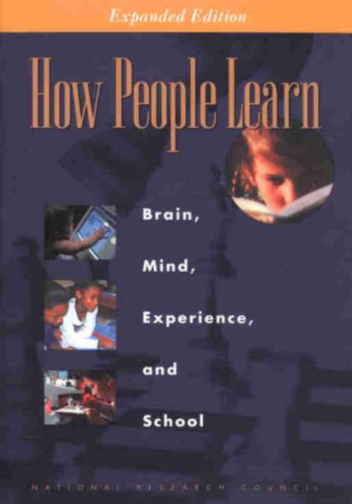
A landmark book from the National Research Council, How People Learn is freely available at www.nap.edu/openbook.php?isbn=0309070368.
It describes how effective learning environments are learner-centered, knowledge-centered, assessment-centered, and community-centered.
E-Learning works because the new Web 2.0 tools are dialogical and engaging; by making the student’s thinking visible, social networking protocols enable the professor to provide a higher quality of scaffolding that comes just when the student needs it.

Slide 8
Engaging Students In the Zone
Helping Students When They Encounter Difficulty

Slide 9
Engagement
Social networking makes it possible for the professor to engage students early in the course.
This creates a dynamic conversational framework that establishes an empathetic bond (Holmberg, 2003) among students and professor.
I create this bond by engaging students early in the course through some simple assignments that get students accustomed to interacting with me.
Demonstrate e-mail assignment with Mike Albertson.

Slide 12
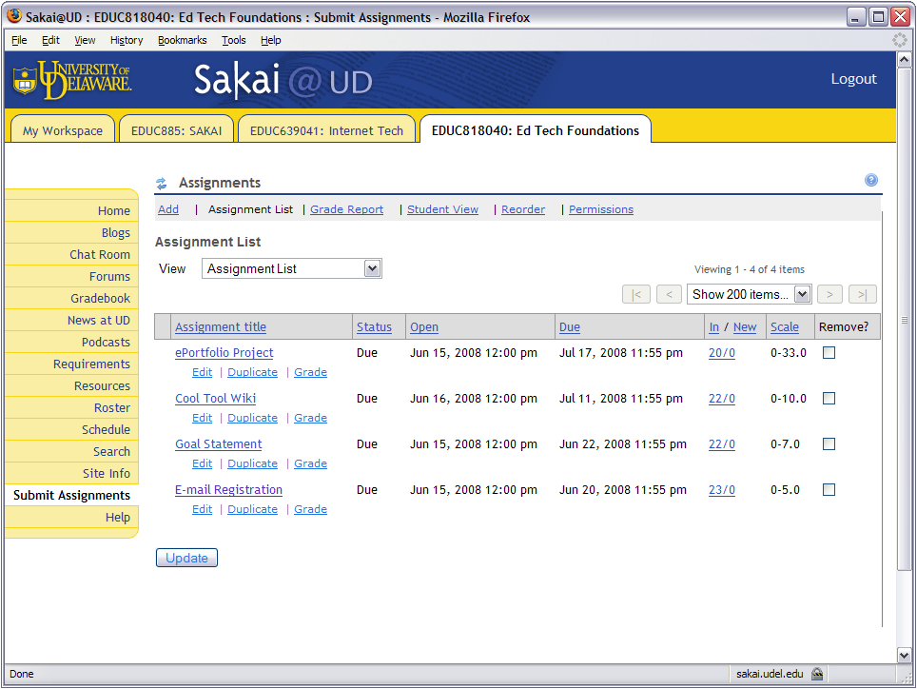

Slide 13
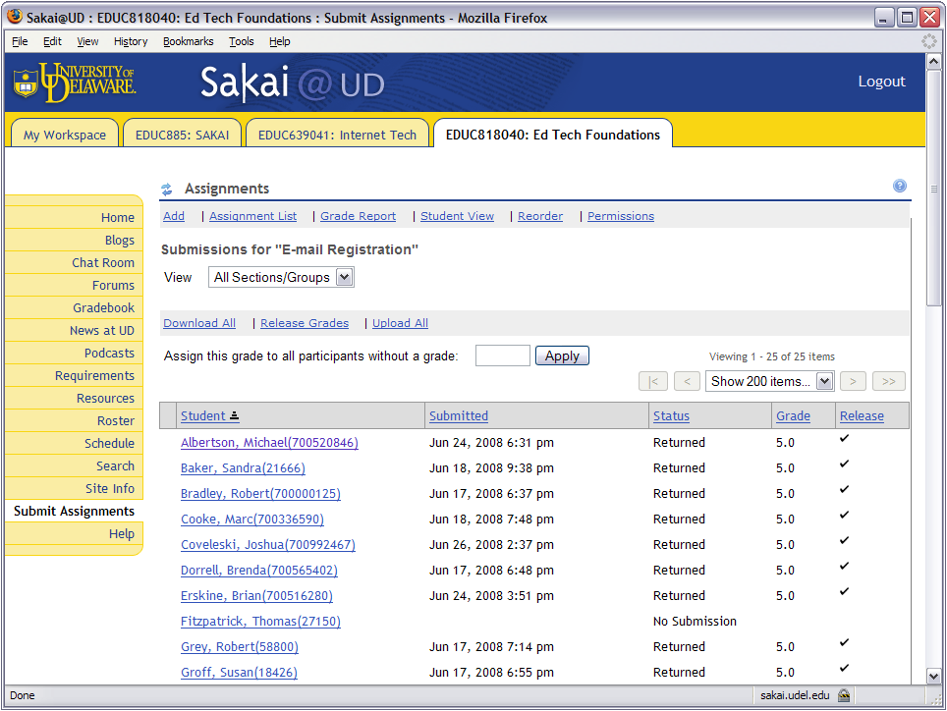

Slide 14
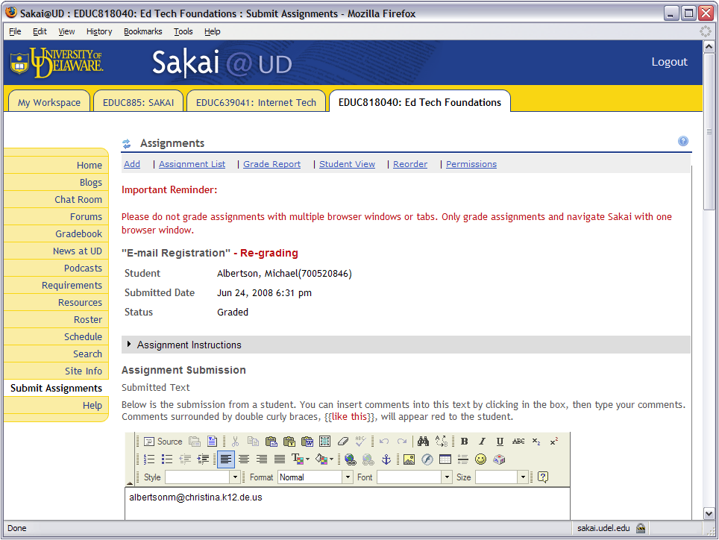

Slide 15
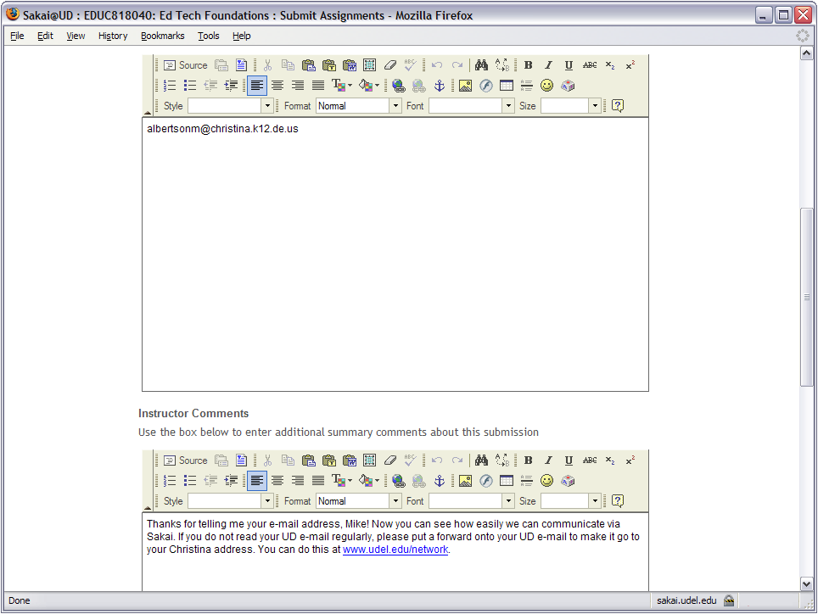

Slide 16
Learning in the Zone
Later in the course, it is inevitable that the students will encounter difficulty when they come to more advanced course content.
When this happens, the students enter an educational space that the great Russian psychologist Vygotsky (1978, p. 86) called the Zone of Proximal Development; I simply call it the Zone.
It is in the Zone that you can use the coaching protocol to help students when they encounter difficulty.
Demonstrate goal scaffolding (Geoff Olive).

Slide 17
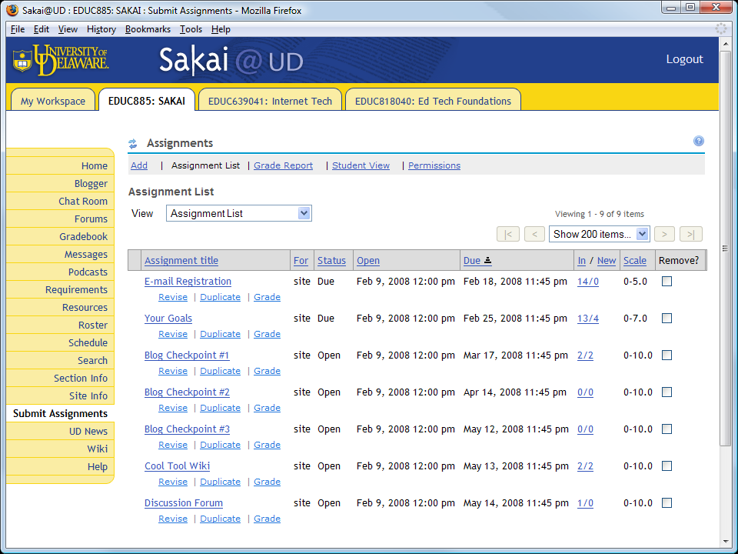

Slide 18
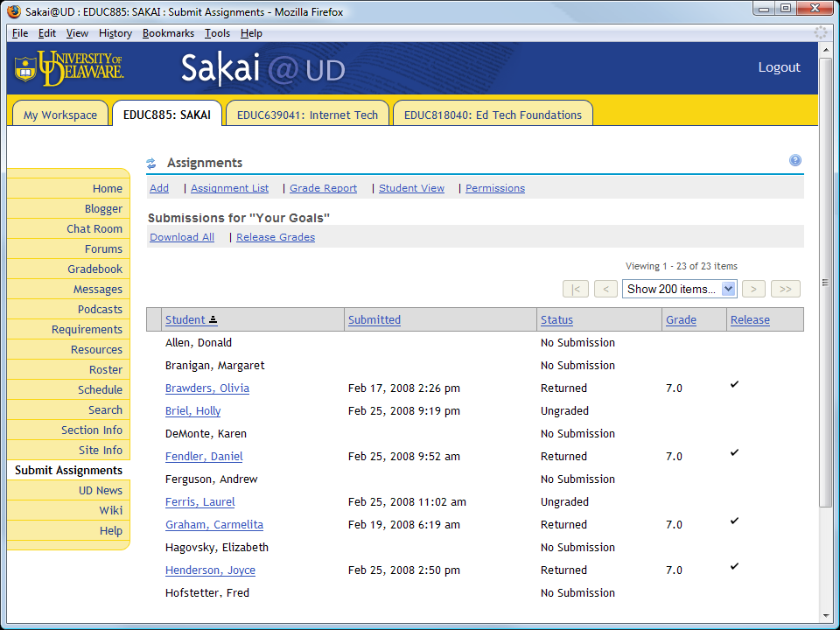

Slide 20
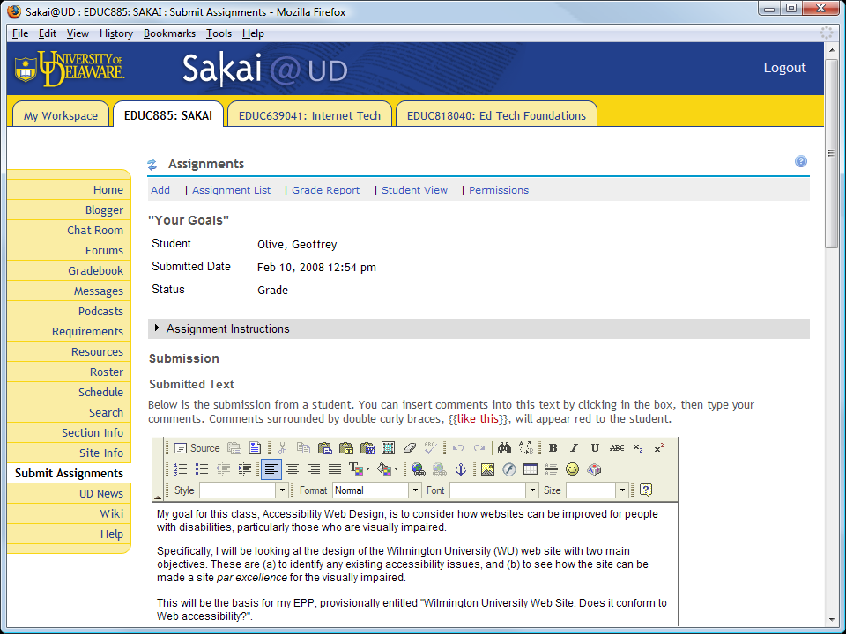

Slide 21
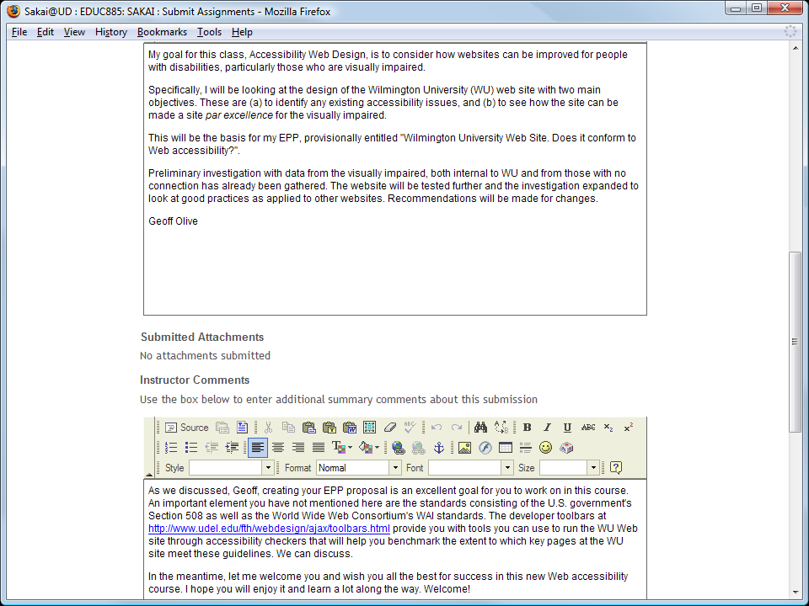

Slide 22
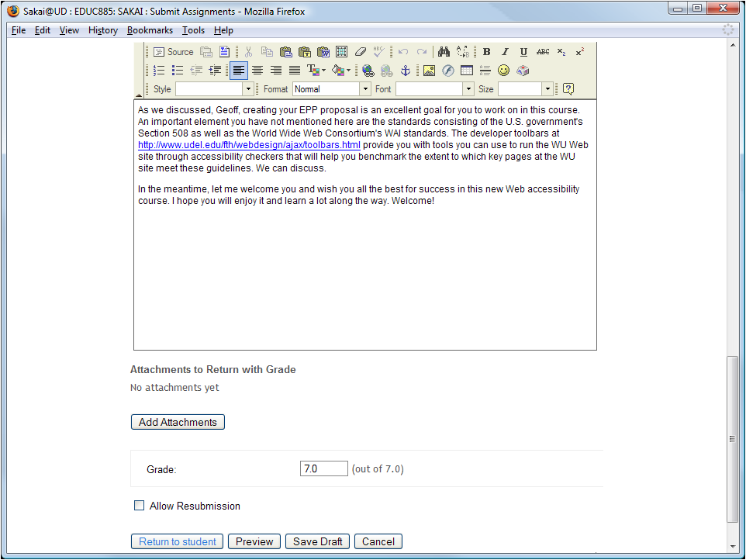

Slide 23
Reducing Transactional Distance
Reaching Millennial Students on their Cell Phones and iPods

Slide 24
Reducing Transactional Distance
As identified by Michael Moore (1993), transactional distance is the psychological gap created by communication latency in distance learning environments.
For the younger generation of students who live on their cell phones and iPods, Podcasting is a powerful way of reducing transactional distance.
Throughout my course, as I make new videos and add them to the online collection, I announce the new titles via Podcasting.
Students do not need an iPod, but if they have one, their professor can be on it.

Slide 25
Podcasting Software
We create our podcasts with open-source software, including:
Audacity, which is freely downloadable from http://audacity.sourceforge.net;
Lame, an MP3 encoder that you download freely from http://audacity.sourceforge.net/download/lame; and
Sakai, which has a Podcasting tool that uploads the recording to your course feed.
Students can subscribe to your course feed from iTunes or from the latest versions of Internet Explorer, Firefox, and Safari. Thus, you can tune in to the feed without necessarily having an iPod.

Slide 26
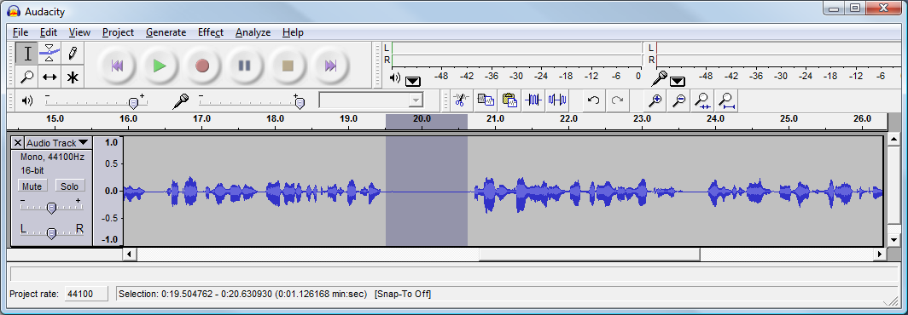
Delete Glitches
Audacity makes it easy to delete glitches.
Remove unwanted silence from the beginning and end of the clip; this is called trimming.

Slide 27
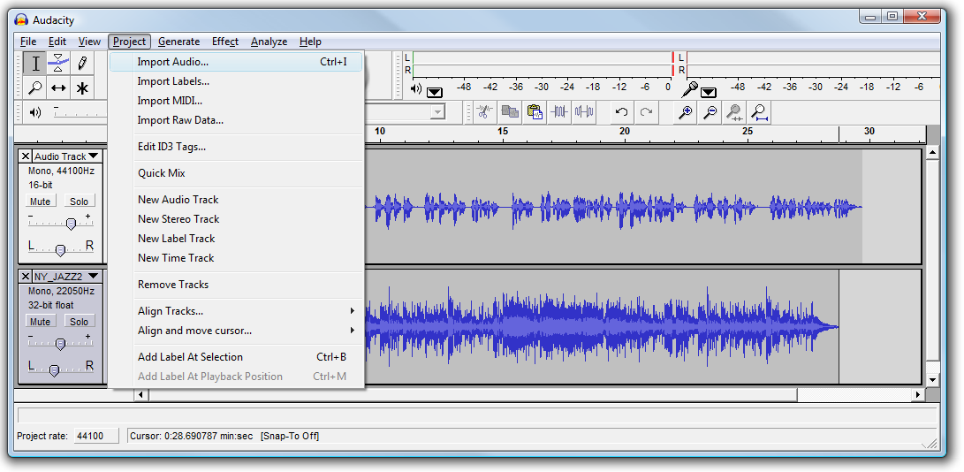
Mix In Some Music
Musical backgrounds add a professional quality to your podcast. Audacity makes it easy to import audio.

Slide 28
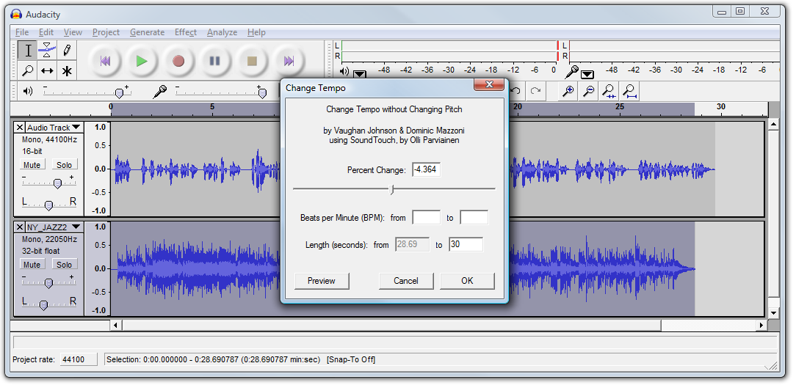
Adjust the Length
If the length of the music does not quite match that of your narration, you can use Audacity to lengthen or shorten the tracks without changing their pitch.

Slide 29
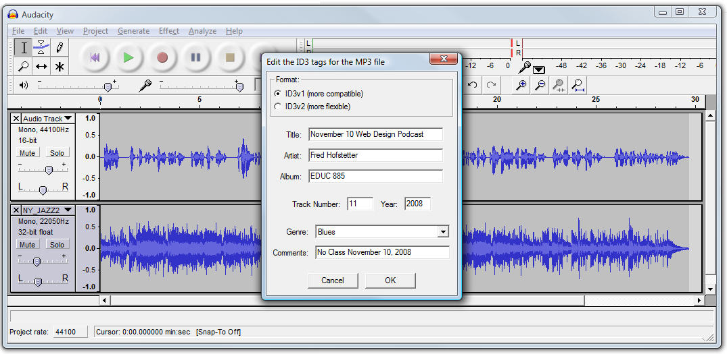
Export the MP3
You export the recording as an MP3 file, which is the format used in audio podcasting.

Slide 30
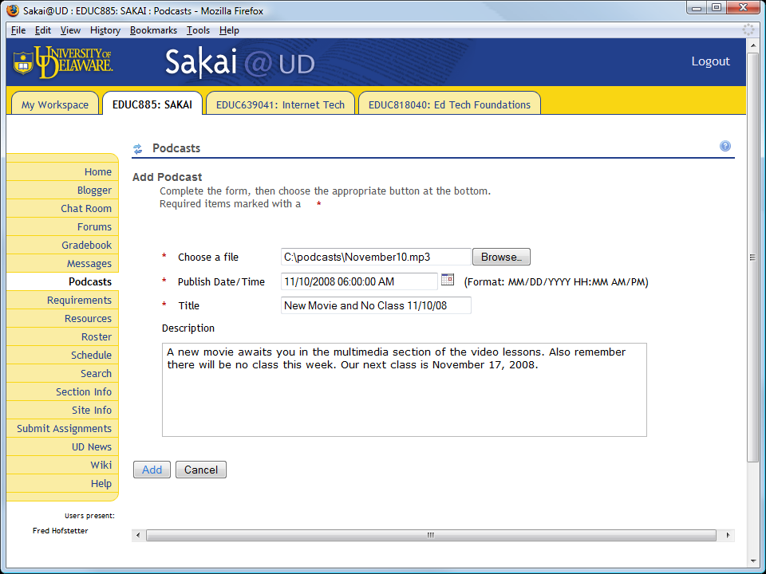
Podcasting the MP3
The podcast tool steps you through the process of uploading the MP3 file to your podcast.

Slide 31
Receiving a Podcast
The podcast has a Web address:
To tune in from iTunes, you subscribe to the podcast’s Web address:

Slide 32
Creating a Learning Community
Using Web 2.0 Tools to Create a Shared Knowledge Building Environment

Slide 33
Communal Knowledge Building
Collaboration tools enable you to form communities and build shared knowledge:
Forums provide multi-threaded asynchronous discussion space.
Blogs enable students to journal their activities, reflect on their progress, and, if enabled, let other students comment on their work.
Chat rooms let students meet synchronously.
The Wiki lets participants create knowledge on pages that are communally shared, with an edit trail keeping track of who changed what when.

Slide 34
Forum Statistics
I like how the forum statistics enable you to see each student’s level of participation.
This is particularly helpful when forum participation is a requirement in the course.
You can even grade a message in a forum if you have created an assignment that requires participation in a forum.
I like how you can sort the forum statistics by column categories.
Demonstrate forum statistics.

Slide 35
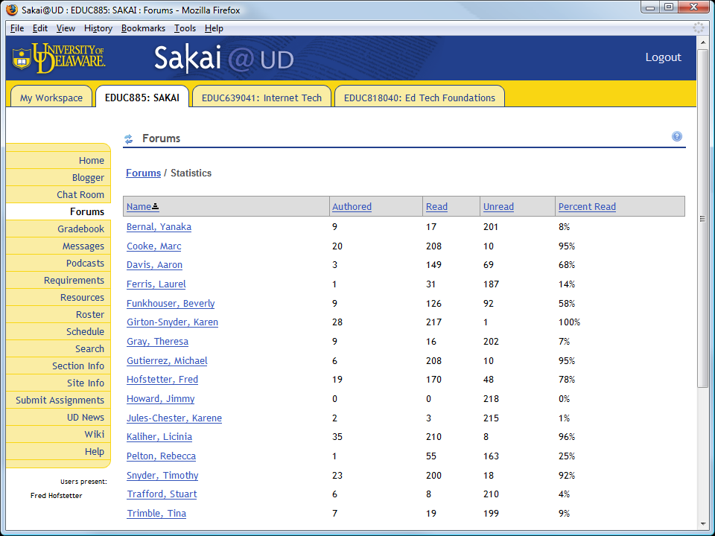

Slide 36
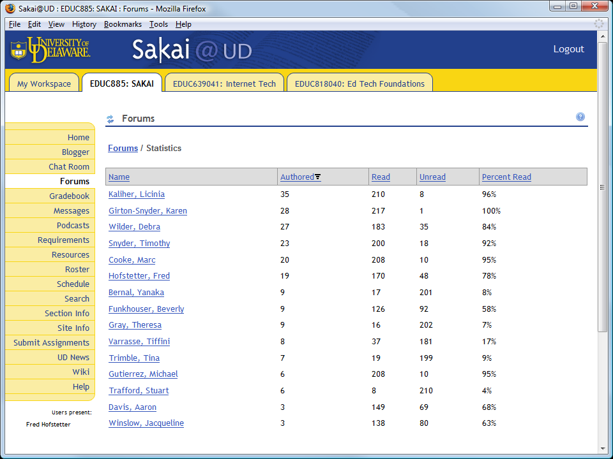

Slide 37
Gradebook Strategy
The gradebook lets you give students as many extra chances as you want. You can even markup the students’ answers.
You can set the date when assignments appear, when they must be answered, and when they will become unavailable. You can even restrict exams to specific IP addresses.
Instead of passing students on with mediocre grades, I use the scaffolding tool to help each student master the content and ace the course.

Slide 38
Course Evaluation Results
By following the principles of How People Learn, my teaching achieved the following results in Winter 2008, when my students completed a rigorous evaluation of the course administered independently through the University of Delaware course evaluation process:
In the doctoral course offering (n=14), on a scale of 1 to 5, the Instructor rating was a perfect 5.0 (excellent), and likewise, the overall evaluation of the course was 5.0 (excellent).
At the master’s level (n=12), the Instructor rating was 4.75, and the course rating was 4.67 (4 = very good, 5 = excellent).
I am grateful to the University of Delaware for making this work possible.

Slide 39
Recommeded Books
Researched Best Practices of e-Learning

Slide 40
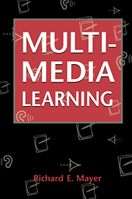
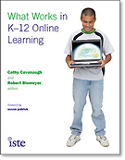
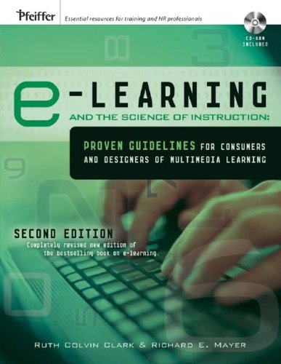
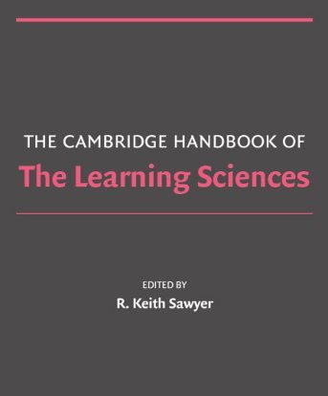
Recommended Books

Slide 41
References
Anderson, L.W., & Krathwohl (Eds.). (2001). A Taxonomy for Learning,Teaching, and Assessing: A Revision of Bloom's Taxonomy of Educational Objectives. New York: Longman.
Barab, S. Design-Based Research: A Methodological Toolkit for the Learning Scientist. In R.K. Sawyer (Ed.), The Cambridge Handbook of the Learning Sciences (pp. 153-169). New York: Cambridge University Press.
Bloom, B. (1984) Taxonomy of Educational Objectives. Boston, MA: Allyn and Bacon.
Clark, R.C., & Mayer, R.E. (2008). e-Learning and the Science of Instruction (2nd ed.). San Francisco, CA: Pfeiffer.
Confrey, J. (2006) The Evolution of Design Studies as Methodology. In R.K. Sawyer (Ed.), The Cambridge Handbook of the Learning Sciences (pp. 135-151). New York: Cambridge University Press.
Engeström, Y. (1987). Learning by expanding: An activity-theoretical approach to developmental research. Helsinki, Finland: Orienta-Konultit.
Ferdig, R.E. (2007). Teaching and Learning Literacy and Language Arts Online. In C. Cavanaugh and R. Blomeyer (Eds.), What Works in K-12 Online Learning. Washington, DC: ISTE.
Gagne, R., Wager, W., Golas, K., & Keller, J. (2005) Principles of Instructional Design. Belmont, CA: Wadsworth/Thomson Learning.

Slide 42
References
Haavind, S. (2000). Why Don’t Face-to-Face Teaching Strategies Work In the Virtual Classroom? @Concord, (4)3, 3-4. Retrieved 6 November 2008 from http://www.concord.org/publications/newsletter/2000fall/00fall.pdf.
Homberg, B. (2003). A Theory of Distance Education Based on Empathy. In M.G. Moore and W.G. Anderson (Eds.), Handbook of Distance Education (pp. 79-86). Mahwah, NJ: Lawrence Erlbaum.
Johnston, Sharon. (2007). Developing Quality Virtual Courses. In C. Cavanaugh and R. Blomeyer (Eds.), What Works in K-12 Online Learning. Washington, DC: ISTE.
Lou, Y., Abrami, P.C., & d’Apollonia, S. (2001). Small group and individual learning with technology: A meta-analysis. Review of Educational Research, 71, 449-521.
Mayer, R.E. (2001). Multimedia Learning. New York: Cambridge University Press.
Merrill, M.D. (2007). A Task-Centered Instructional Strategy. Journal of Research on Technology in Education, 40 (1), 33-50. http://cito.byuh.edu/merrill/text/papers/Task_Centered_Strategy.pdf.
Moore, M.G. (1993). Theory of Transactional Distance. In D. Keegan (Ed.), Theoretical Principles of Distance Education (pp. 22-38). London: Routledge.
National Research Council. (2000). How People Learn (expanded edition edited by J.D. Bransford, A.L. Brown, and R.R. Cocking). Washington, DC: National Academy Press.

Slide 43
References
Romiszowski, A.J. (2005). Online Learning: Are We on the Right Track? In G. Kearsley (Ed.), Online Learning: Personal Reflections on the Transformation of Education (pp. 321-349). Englewood Cliffs, NJ: Educational Technology Publications.
Sawyer, R.K. (2006) The New Science of Learning. In R.K. Sawyer (Ed.), The Cambridge Handbook of the Learning Sciences (pp. 1-16). New York: Cambridge University Press.
Sawyer, R.K. (2006) Analyzing Collaborative Discourse. In R.K. Sawyer (Ed.), The Cambridge Handbook of the Learning Sciences (pp. 187-204). New York: Cambridge University Press.
Scardamalia, M., & Bereiter, C. (2006) In Sawyer, R.K. The Cambridge Handbook of the Learning Sciences (pp. 97-115).
Vygotsky, L.S. (1978). Mind in Society: The Development of Higher Psychological Processes. Cambridge, MA: Harvard University Press.

