Slide 1
Principles of Multimedia Learning
How the Principles of Multimedia Learning Inform the Design of Effective Course Content

Slide 2
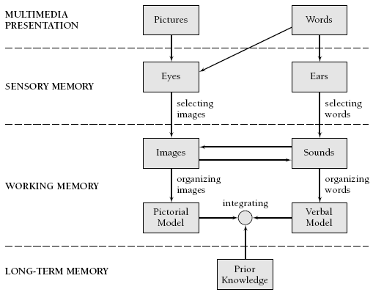
Multimedia Learning Theory
Richard Mayer’s (2001, p. 44) Cognitive Theory of Multimedia Learning

Slide 3
Multimedia Learning Principles
Principle | Effect on Learning
1. Multimedia | Deeper learning from words and pictures than words alone
2. Contiguity | Deeper learning from presenting words and pictures simultaneously rather than successively
3. Coherence | Deeper learning when extraneous words, sounds, or pictures are excluded rather than included
4. Modality | Deeper learning when words are presented as narration rather than as on-screen text
5. Redundancy | Deeper learning when words are presented as narration rather than as both narration and on-screen text
6. Personalization | Deeper learning when words are presented in conversational style rather than formal style
7. Segmentation | Deeper learning when complex lessons are presented in smaller parts
8. Pretraining | Deeper learning when key terms are explained in advance
Source: Clark & Mayer (2006, p. 386), summarized.

Slide 4
Multimedia Learning Principles
Principle | Effect on Learning
1. Multimedia | Deeper learning from words and pictures than words alone
2. Contiguity | Deeper learning from presenting words and pictures simultaneously rather than successively
3. Coherence | Deeper learning when extraneous words, sounds, or pictures are excluded rather than included
4. Modality | Deeper learning when words are presented as narration rather than as on-screen text
5. Redundancy | Deeper learning when words are presented as narration rather than as both narration and on-screen text
6. Personalization | Deeper learning when words are presented in conversational style rather than formal style
7. Segmentation | Deeper learning when complex lessons are presented in smaller parts
8. Pretraining | Deeper learning when key terms are explained in advance
Source: Clark & Mayer (2006, p. 386), summarized.

Slide 5
Multimedia Learning Principles
Principle | Effect on Learning
1. Multimedia | Deeper learning from words and pictures than words alone
2. Contiguity | Deeper learning from presenting words and pictures simultaneously rather than successively
3. Coherence | Deeper learning when extraneous words, sounds, or pictures are excluded rather than included
4. Modality | Deeper learning when words are presented as narration rather than as on-screen text
5. Redundancy | Deeper learning when words are presented as narration rather than as both narration and on-screen text
6. Personalization | Deeper learning when words are presented in conversational style rather than formal style
7. Segmentation | Deeper learning when complex lessons are presented in smaller parts
8. Pretraining | Deeper learning when key terms are explained in advance
Source: Clark & Mayer (2006, p. 386), summarized.

Slide 6
Multimedia Learning Principles
Principle | Effect on Learning
1. Multimedia | Deeper learning from words and pictures than words alone
2. Contiguity | Deeper learning from presenting words and pictures simultaneously rather than successively
3. Coherence | Deeper learning when extraneous words, sounds, or pictures are excluded rather than included
4. Modality | Deeper learning when words are presented as narration rather than as on-screen text
5. Redundancy | Deeper learning when words are presented as narration rather than as both narration and on-screen text
6. Personalization | Deeper learning when words are presented in conversational style rather than formal style
7. Segmentation | Deeper learning when complex lessons are presented in smaller parts
8. Pretraining | Deeper learning when key terms are explained in advance
Source: Clark & Mayer (2006, p. 386), summarized.

Slide 7
Multimedia Learning Principles
Principle | Effect on Learning
1. Multimedia | Deeper learning from words and pictures than words alone
2. Contiguity | Deeper learning from presenting words and pictures simultaneously rather than successively
3. Coherence | Deeper learning when extraneous words, sounds, or pictures are excluded rather than included
4. Modality | Deeper learning when words are presented as narration rather than as on-screen text
5. Redundancy | Deeper learning when words are presented as narration rather than as both narration and on-screen text
6. Personalization | Deeper learning when words are presented in conversational style rather than formal style
7. Segmentation | Deeper learning when complex lessons are presented in smaller parts
8. Pretraining | Deeper learning when key terms are explained in advance
Source: Clark & Mayer (2006, p. 386), summarized.

Slide 8
Multimedia Learning Principles
Principle | Effect on Learning
1. Multimedia | Deeper learning from words and pictures than words alone
2. Contiguity | Deeper learning from presenting words and pictures simultaneously rather than successively
3. Coherence | Deeper learning when extraneous words, sounds, or pictures are excluded rather than included
4. Modality | Deeper learning when words are presented as narration rather than as on-screen text
5. Redundancy | Deeper learning when words are presented as narration rather than as both narration and on-screen text
6. Personalization | Deeper learning when words are presented in conversational style rather than formal style
7. Segmentation | Deeper learning when complex lessons are presented in smaller parts
8. Pretraining | Deeper learning when key terms are explained in advance
Source: Clark & Mayer (2006, p. 386), summarized.

Slide 9
Multimedia Learning Principles
Principle | Effect on Learning
1. Multimedia | Deeper learning from words and pictures than words alone
2. Contiguity | Deeper learning from presenting words and pictures simultaneously rather than successively
3. Coherence | Deeper learning when extraneous words, sounds, or pictures are excluded rather than included
4. Modality | Deeper learning when words are presented as narration rather than as on-screen text
5. Redundancy | Deeper learning when words are presented as narration rather than as both narration and on-screen text
6. Personalization | Deeper learning when words are presented in conversational style rather than formal style
7. Segmentation | Deeper learning when complex lessons are presented in smaller parts
8. Pretraining | Deeper learning when key terms are explained in advance
Source: Clark & Mayer (2006, p. 386), summarized.

Slide 10
Multimedia Learning Principles
Principle | Effect on Learning
1. Multimedia | Deeper learning from words and pictures than words alone
2. Contiguity | Deeper learning from presenting words and pictures simultaneously rather than successively
3. Coherence | Deeper learning when extraneous words, sounds, or pictures are excluded rather than included
4. Modality | Deeper learning when words are presented as narration rather than as on-screen text
5. Redundancy | Deeper learning when words are presented as narration rather than as both narration and on-screen text
6. Personalization | Deeper learning when words are presented in conversational style rather than formal style
7. Segmentation | Deeper learning when complex lessons are presented in smaller parts
8. Pretraining | Deeper learning when key terms are explained in advance
Source: Clark & Mayer (2006, p. 386), summarized.

Slide 11
Multimedia Research Results
Cognitive Principle | Effect Size | Studies Showing This Effect
1. Multimedia | 1.50 | 9 of 9
2. Contiguity | 1.11 | 8 of 8
3. Coherence | 1.32 | 11 of 12
4. Modality | 0.97 | 21 of 21
5. Redundancy | 0.69 | 10 of 10
6. Personalization | 1.30 | 10 of 10
7. Segmentation | 0.98 | 3 of 3
8. Pretraining | 1.30 | 7 of 7
Clark & Mayer (2008, p. 383)

Slide 12
Personalization Principle
In terms of engaging learners, the most important principle identified by Mayer is the simplest, namely, the Personalization Principle.
“The personalization principle is that people learn better when the instructor uses conversational style rather than formal style. The rationale is that people try harder to make sense of the presented material (i.e., engage in the cognitive processes of organizing and integrating) when they feel they are in a social partnership with the instructor.” (Mayer, 2001, p. 394)
You achieve this by writing in first and second person.
Imagine improving results (es=1.30) so simply!

Slide 13
Multimedia Learning Hospital Example
Dr. Rahul G. Patwari applies the principles of multimedia learning to reading chest x-rays

Slide 14
Dr. Rahul G. Patwari, Assistant Professor, Rush University Medical Center https://www.youtube.com/watch?v=BcWSUnXz8kw

Slide 15
Zone of Proximal Development
Coaching Participants in Vygotsky’s Zone of Proximal Development

Slide 16
Identifying the Zone
When participants begin encountering difficulty, they enter an educational space that the great Russian psychologist Vygotsky called the Zone of Proximal Development; I simply call it the Zone.
It is in the Zone that you can use the coaching protocol in your LMS to help participants when they encounter difficulty.
Coaching participants in their Zone is the most important principle of e-learning, and I believe it is the most important feature of a Learning Management System.

Slide 17
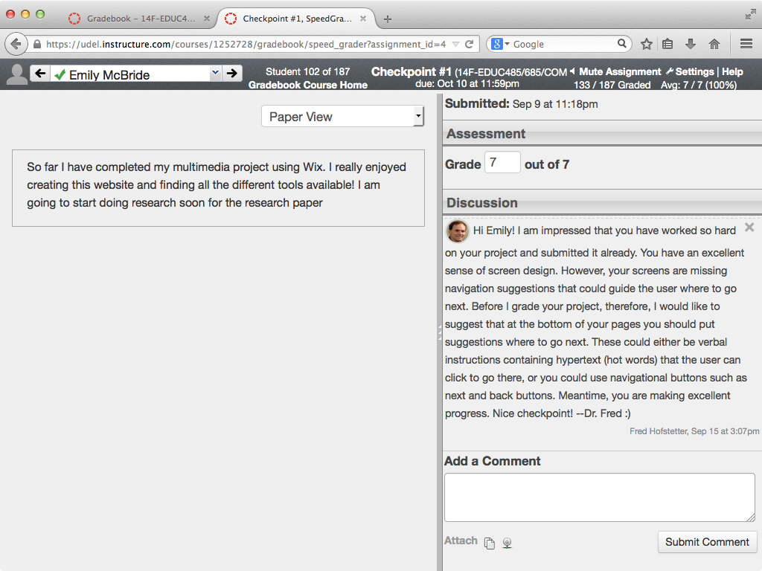

Slide 18
Recommended Books
Researched Best Practices of Multimedia Learning

Slide 19
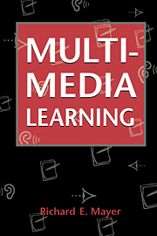
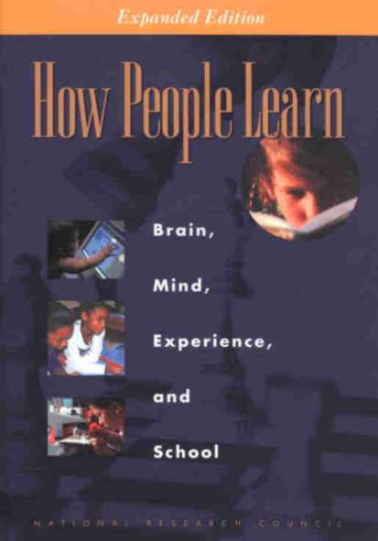
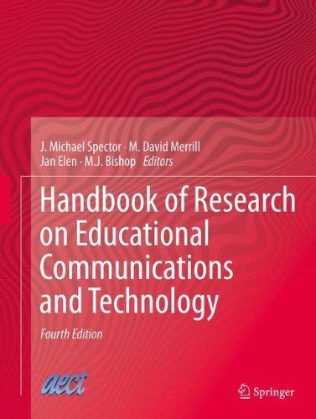
Recommended Books

