Slide 1
eLearning Face to Face
Using Web-based Videoconferencing to Extend the F2F Experience to Distance Learners

Slide 2
Impact
We shift the paradigm about what is online or not.
Instead of talking about “putting courses online” we enable students to "attend classes online" by logging on to the professor’s Adobe feed.
We incent faculty to do this by creating an RBB algorithm that rewards faculty for supporting students who attend face-to-face courses online.
UD increases its reach by enabling students to attend class anywhere there is Internet.

Slide 3
Feasibility
Creating this campus-wide initiative is feasible because Adobe Connect is flexible.
The faculty member can decide how much needs to be online or not.
The faculty member can decide whether to use an LMS or not.
The faculty member can record the Adobe Connect sessions for students to review after class.

Slide 4
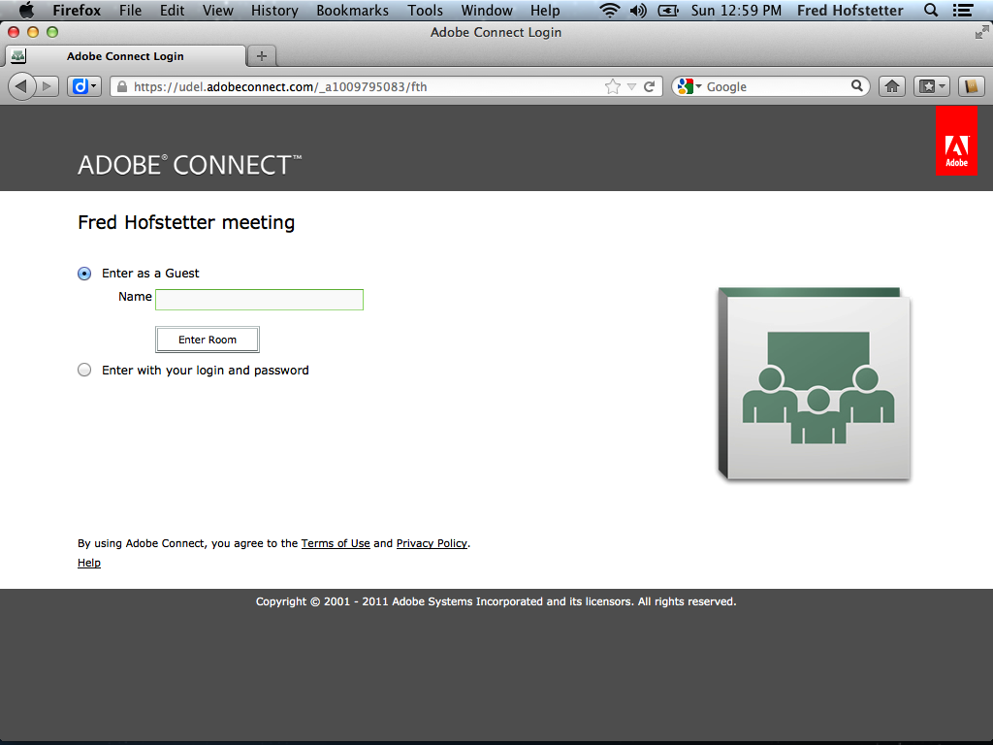

Slide 6
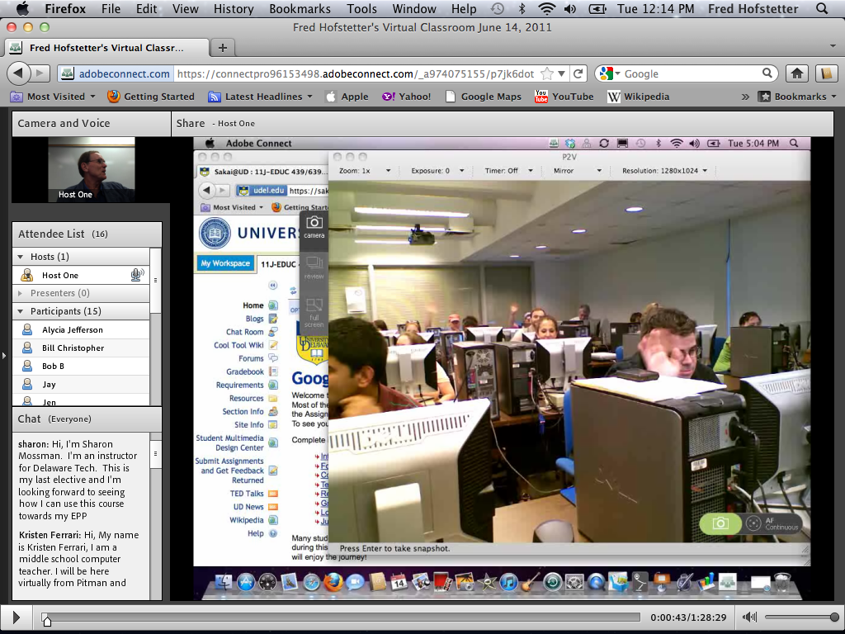

Slide 8
Channeling
In addition to the obvious advantages of saving gas and commuting time, Web-based videoconferencing opens up a new channel of communication that adds an innovative layer of interaction to the course.
Multiple students can ask questions at once, and students like how the chatroom queues their questions.
As one student put it, "Since we can chat, Fred has answered every single one of my questions even though he's on campus and I'm at home in my study. Chatting also makes me feel like I've gotten to know some of my classmates, even though we're not physically interacting."

Slide 9
Adobe Connect Mobile
Using Adobe Connect on iPad, iPhone, Android, and Blackberry Mobile Devices

Slide 10
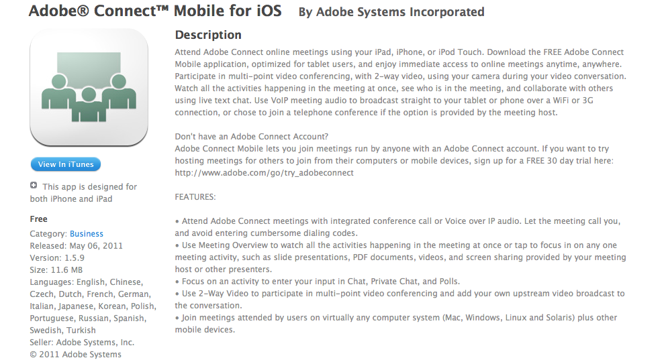
Adobe Connect Mobile

Slide 11
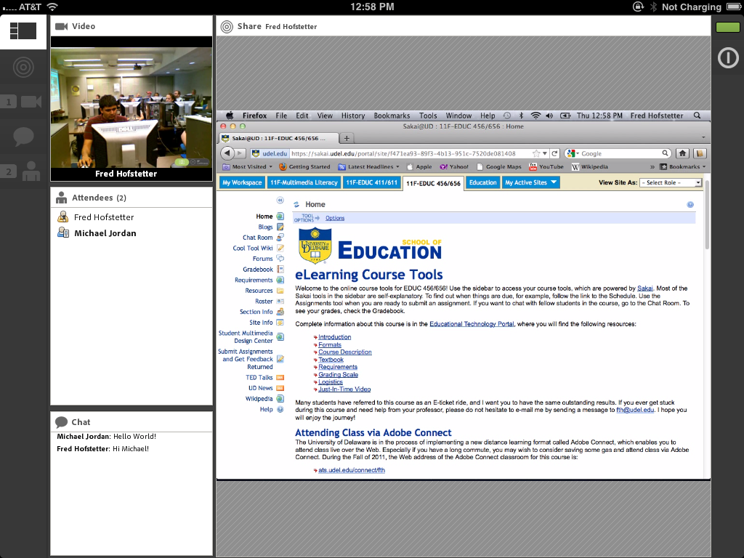

Slide 12
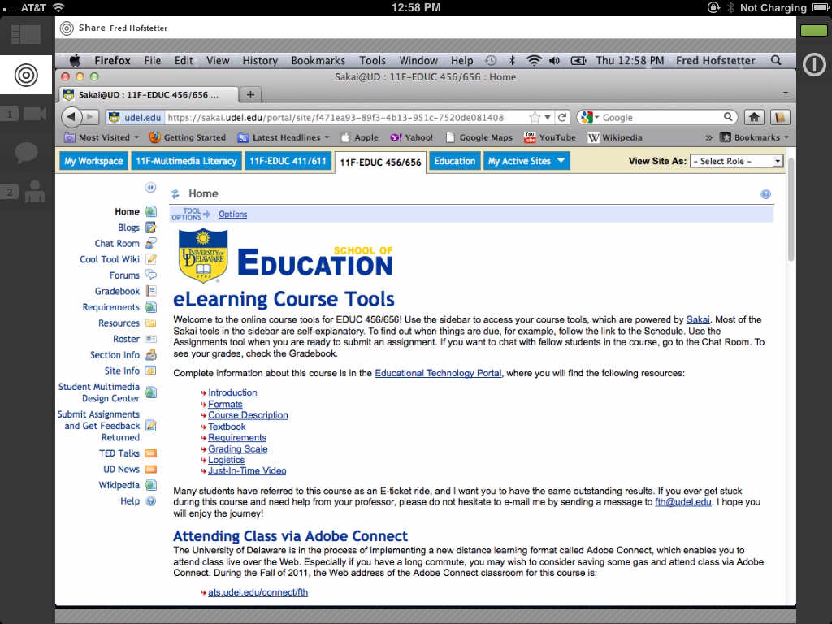

Slide 13
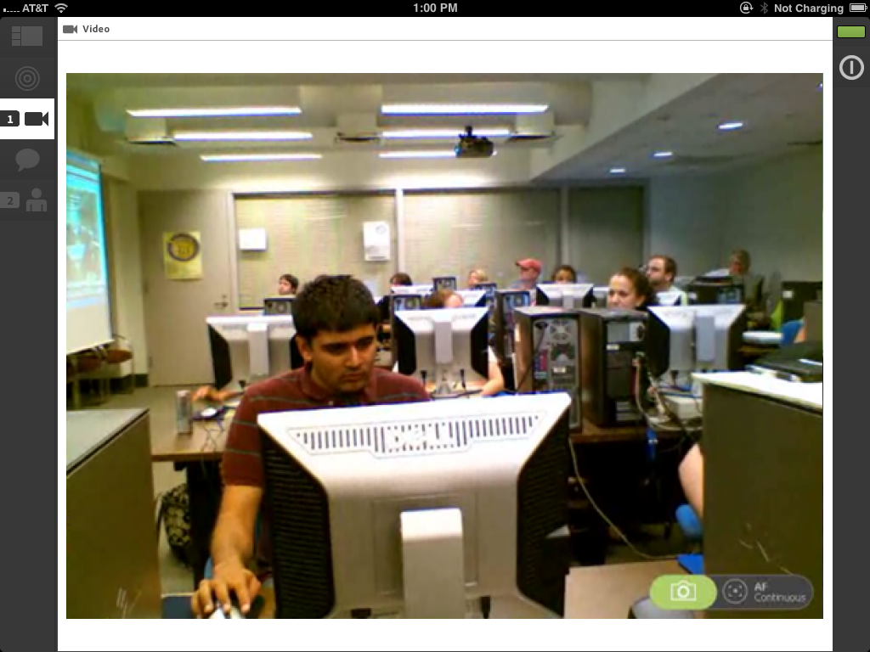

Slide 15
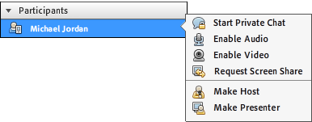
Engagement
Adobe Connect enables the instructor to pass control to any participant.
This enables participants to present what they are working on for all the students to see.
I use this feature for students to present their final projects on “Project Night” at the end of the course.

Slide 16
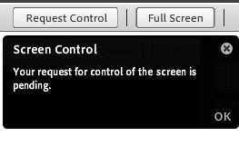
Requesting Control
The instructor can request control of the participant’s screen to help the student solve a troublesome problem.
When this happens, the participant sees everything the instructor is doing on the student’s computer.
At any time, the participant can revoke the instructor’s remote control.

