Slide 1
Engaging Students for Global Learning Online
Informing the Design of Online Learning By the Principles of How People Learn

Slide 2
Global Reach
Our Educational Technology Master's program has enrolled students from Saudi Arabia, Indonesia, Turkey, Europe, China, Japan, Taiwan, and India.
We use web-based supports to engage global students for optimum learning online.
This includes international students who come to reside here on campus, as well as students who log in to the classroom stream from anyplace in the world that has Internet access.

Slide 3
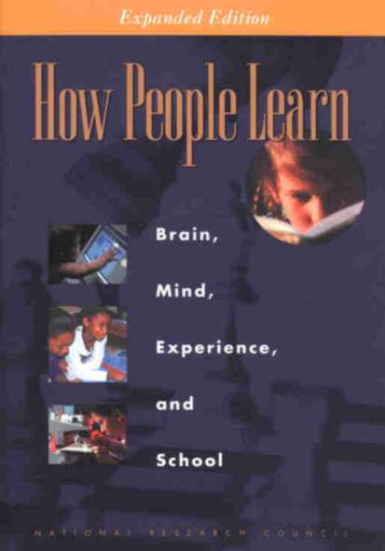
How People Learn
We inform our strategy by the principles of How People Learn, which is freely available at www.nap.edu/ openbook.php? isbn=0309070368.

Slide 4
Rules of Engagement
From this work by the National Research Council (2000, p. 18), we know that people are motivated to learn when they can:
Set their own goals;
Reflect on their progress; and
Feel in control of their learning.
The key to engaging students online is to apply these principles to your course design.

Slide 5
Engage Your Students Early in the Course
Key Principles of Online Learning

Slide 6
Engaging Your Students Early
In online learning, it is important to engage students early in the course.
This creates a dynamic conversational framework that establishes an empathetic bond (Holmberg, 2003) among students and professor.
I create this bond by engaging students early in the course through assignments that get students accustomed to interacting with me.

Slide 7
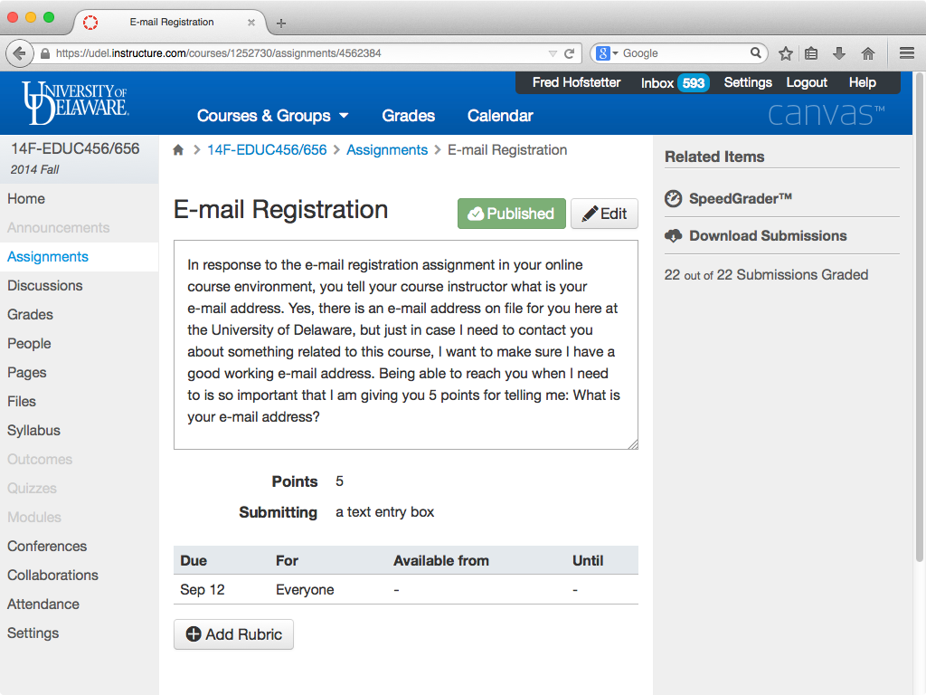

Slide 8
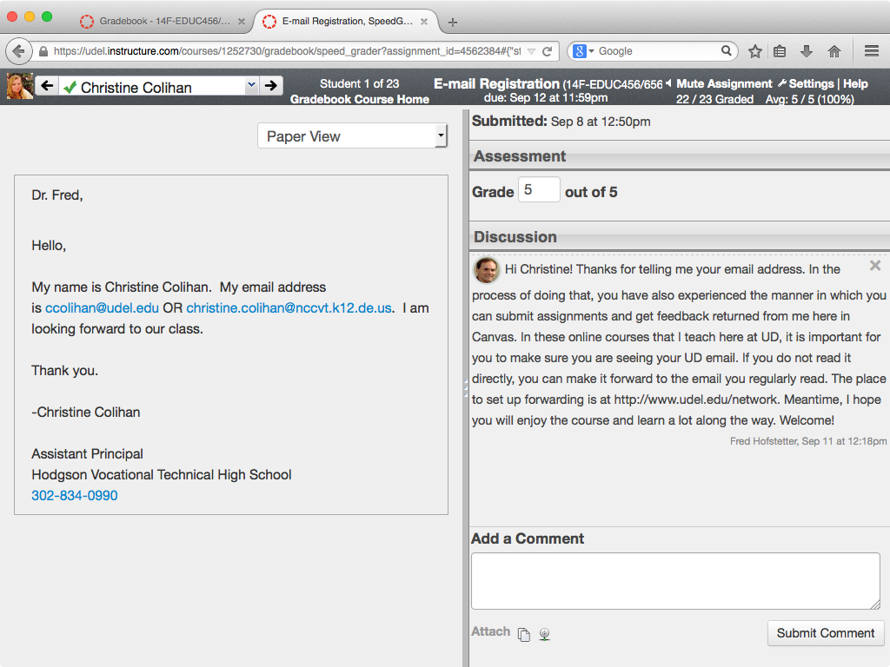

Slide 9
Constructing Goals
The innate human desire to develop competence is an important factor in motivating people to learn (National Research Council, 2000, p. 60).
In one of the early assignments, I work with my students to construct their goals, which are performance based.
Having students articulate their goals early in the course and hone them dialogically creates a bond that the professor later uses to scaffold students when they begin encountering difficulty.

Slide 10
Identifying the Zone
When students begin encountering difficulty, they enter an educational space that the great Russian psychologist Vygotsky (1978, p. 86) called the Zone of Proximal Development; I simply call it the Zone.
It is in the Zone that you can use the coaching protocol in your LMS to help students when they encounter difficulty.
Coaching students in their Zone is the most important principle of e-learning, and I believe it is the most important feature of a Learning Management System.

Slide 11
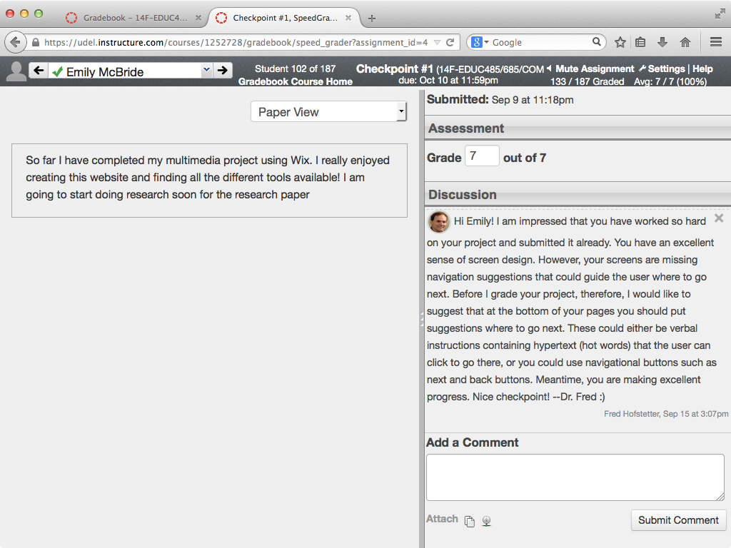

Slide 12
Follow the Principles of Multimedia Learning
How the Principles of Multimedia Learning Inform the Design of Engaging Course Content

Slide 13
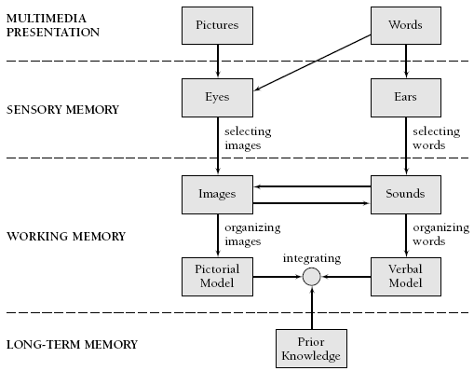
Multimedia Learning Theory
Richard Mayer’s (2001, p. 44) Cognitive Theory of Multimedia Learning

Slide 14
Multimedia Learning Principles
Principle | Effect on Learning
1. Multimedia | Deeper learning from words and pictures than words alone
2. Contiguity | Deeper learning from presenting words and pictures simultaneously rather than successively
3. Coherence | Deeper learning when extraneous words, sounds, or pictures are excluded rather than included
4. Modality | Deeper learning when words are presented as narration rather than as on-screen text
5. Redundancy | Deeper learning when words are presented as narration rather than as both narration and on-screen text
6. Personalization | Deeper learning when words are presented in conversational style rather than formal style
7. Segmentation | Deeper learning when complex lessons are presented in smaller parts
8. Pretraining | Deeper learning when key terms are explained in advance
Source: Clark & Mayer (2006, p. 386), summarized.

Slide 15
Multimedia Research Results
Cognitive Principle | Effect Size | Studies Showing This Effect
1. Multimedia | 1.50 | 9 of 9
2. Contiguity | 1.11 | 8 of 8
3. Coherence | 1.32 | 11 of 12
4. Modality | 0.97 | 21 of 21
5. Redundancy | 0.69 | 10 of 10
6. Personalization | 1.30 | 10 of 10
7. Segmentation | 0.98 | 3 of 3
8. Pretraining | 1.30 | 7 of 7
Clark & Mayer (2008, p. 383)

Slide 16
Personalization Principle
In terms of engaging learners, the most important principle identified by Mayer is the simplest, namely, the Personalization Principle.
“The personalization principle is that people learn better when the instructor uses conversational style rather than formal style. The rationale is that people try harder to make sense of the presented material (i.e., engage in the cognitive processes of organizing and integrating) when they feel they are in a social partnership with the instructor.” (Mayer, 2001, p. 394)
You achieve this by writing in first and second person.
Imagine improving results (es=1.30) so simply!

Slide 17
Create Learning Communities
Students form powerful learning communities in the Discussions

Slide 18
Discussions
Most learning management systems include an option to create Discussions in which students can read, respond, and create new topics.
Requiring students to participate in Discussions results in the formation of powerful learning communities.
Zhao and Kuh (2004, p. 124) found that “Participating in learning communities is uniformly and positively linked with student academic performance, engagement in educationally fruitful activities (such as academic integration, active and collaborative learning, and interaction with faculty members), gains associated with college attendance, and overall satisfaction with the college experience.”
As Manfra (2009) noted, these communities become so powerful that faculty find themselves learning from students.

Slide 19
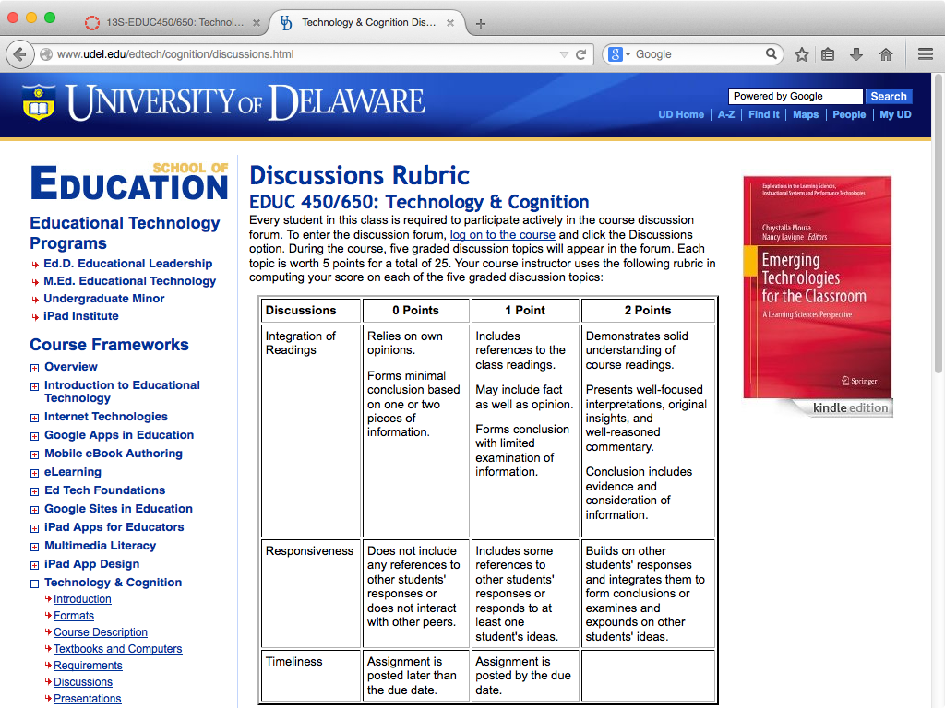

Slide 20
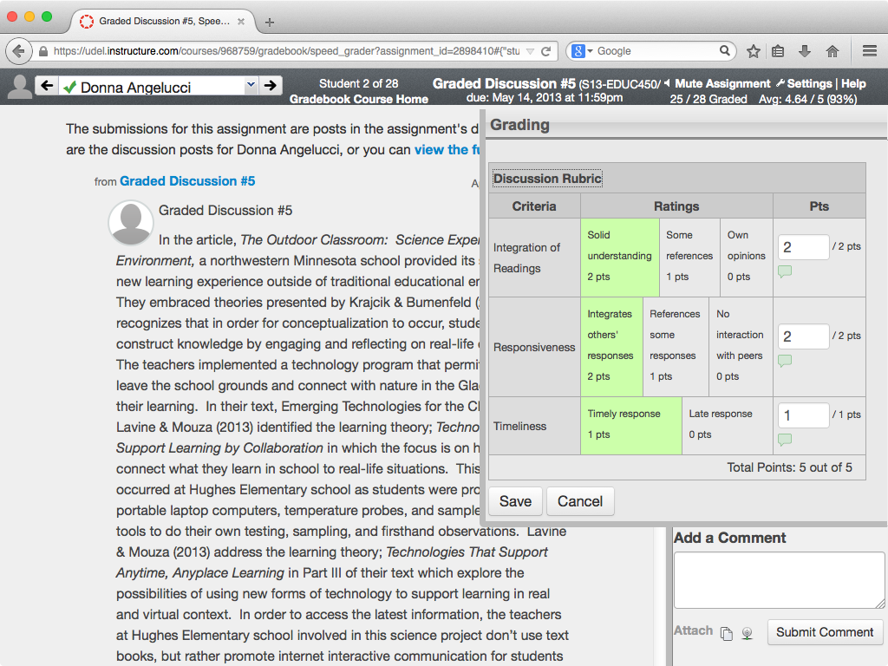

Slide 21
Negotiate Real-World Topics
Engaging Students in Authentic Contexts

Slide 22
Why Negotiate?
As Jonassen (2014, p. 282) found in assessing problem solving, “When students construct and elaborate their own cases, they are more deeply engaged in learning than when interpreting someone else’s cases.”
The time spent negotiating topics at the beginning of a course creates the foundation for deep engagement later in the course.
You can even design instruction into your feedbacks.

Slide 23
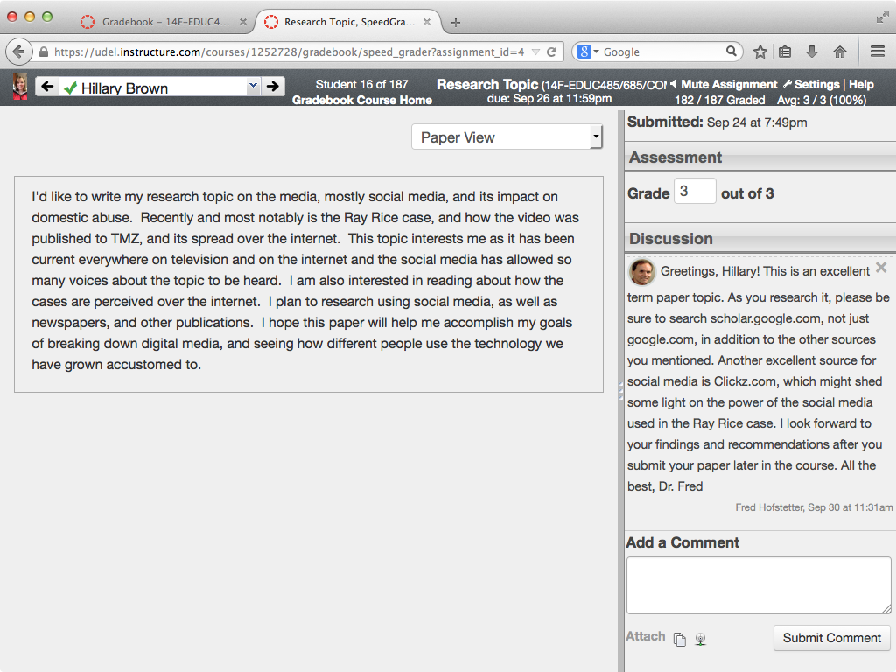
Negotiating Topics: Designed Instruction (Google & Clickz)

Slide 24
Make Students Blog
Engaging Students in their Zone by Making Thinking Visible

Slide 25
Checkpoints
Along the way, while students work on their projects, I have them blog about their progress.
By making thinking visible, blogs enable you to coach students in their zone.
Three times during the semester, I award students points for keeping their progress logs.
Because these are points at which I check in on each student, I call them checkpoints.

Slide 26
Feedback as Learning System
As we learn from Molloy and Boud (2014, p. 413), “A constructivist view on feedback encourages learners and educators to view feedback as a system of learning, rather than discreet episodes of educators ‘telling’ learners about their performance.”
When students “have frequent opportunities to engage in productive, dialogic exchanges with multiple others, they are more likely to see feedback as a tool for ‘them’ rather than as a destabilizing or debilitating act ‘done to them’ by those in authority.” (p. 422)

Slide 27
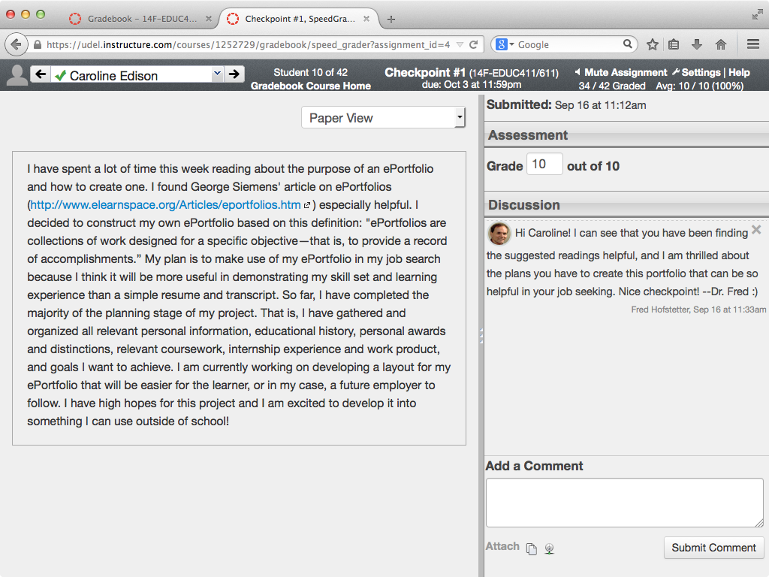
Checkpoint Feedback: Readings helpful

Slide 28
Save Your Feedbacks For Future Use
Feedback as Learning System

Slide 29
Thinking Patterns
Especially if your class is large, how will you have time to engage all your students if you must write this amount of dialogical feedback online?
In a large class with hundreds of students participating online, there will not be hundreds of thinking patterns.
Instead, as you grade the checkpoints, you will detect a relatively small number of patterns of student thinking in the course.
By preparing feedbacks to scaffold students at critical points in this thinking, you can be prepared to interact effectively by engaging each student in their zone.

Slide 30
Designing Online Feedbacks
You create a file in which you keep designed feedbacks.
Each time you write a new feedback, you put it into this file from which you can retrieve it on demand whenever another student encounters a similar problem.
I do this with MS Word in which I give each feedback’s title a “heading” style, which enables me to use the Navigation pane as an index into all my feedbacks.

Slide 31
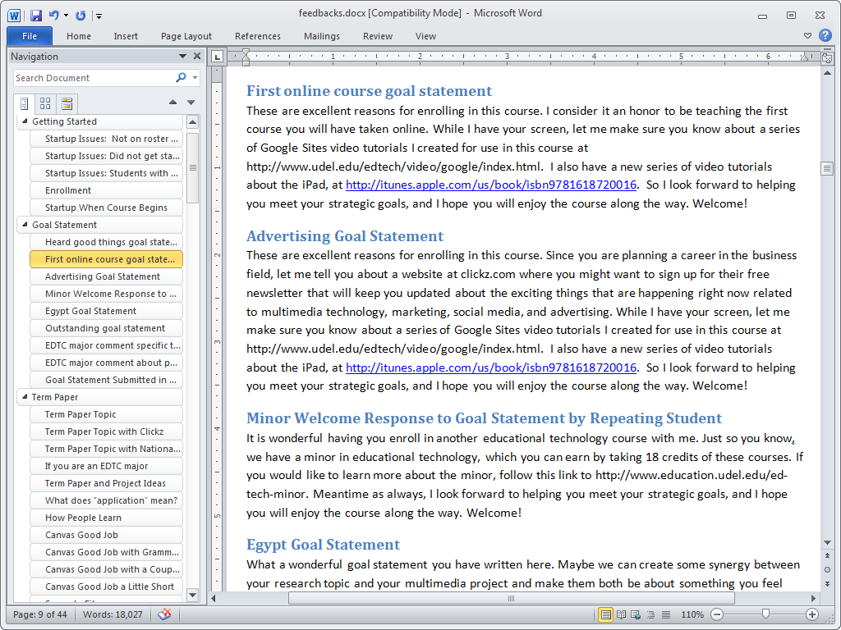

Slide 32
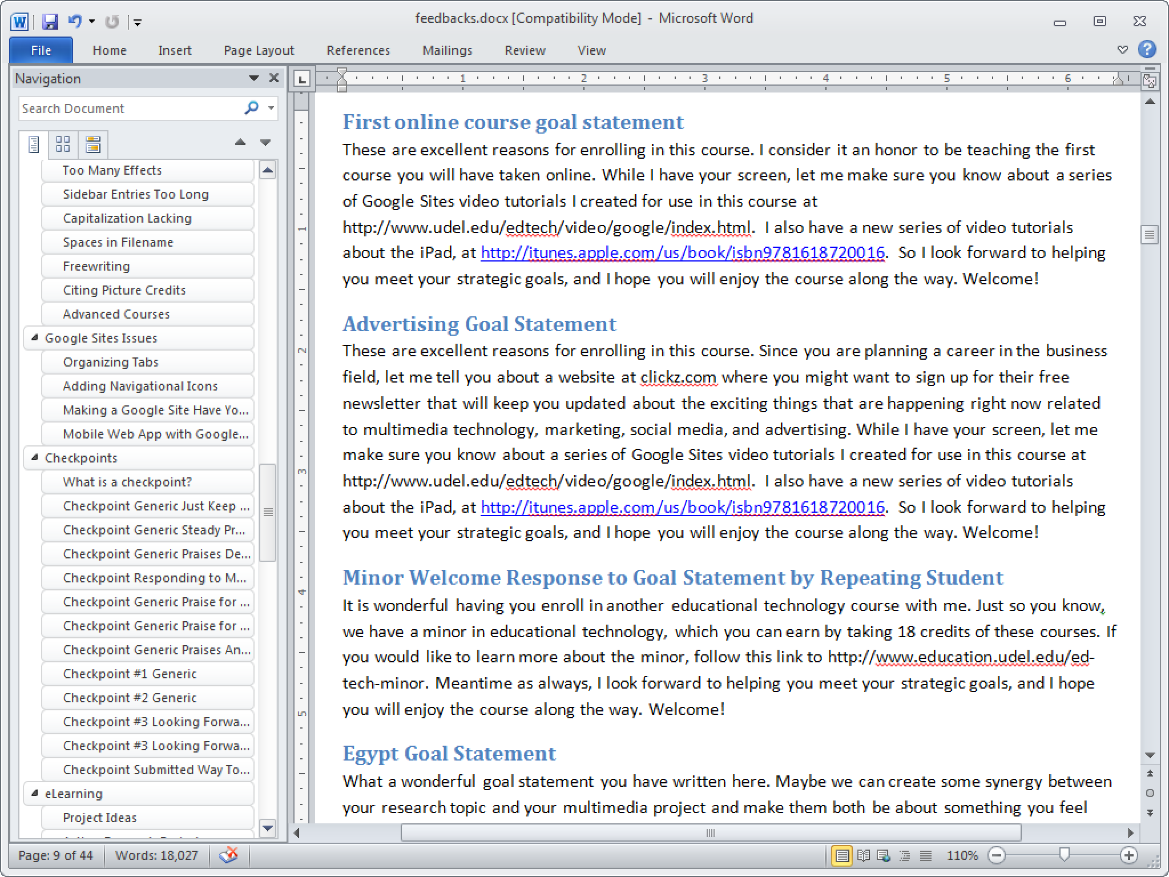

Slide 33
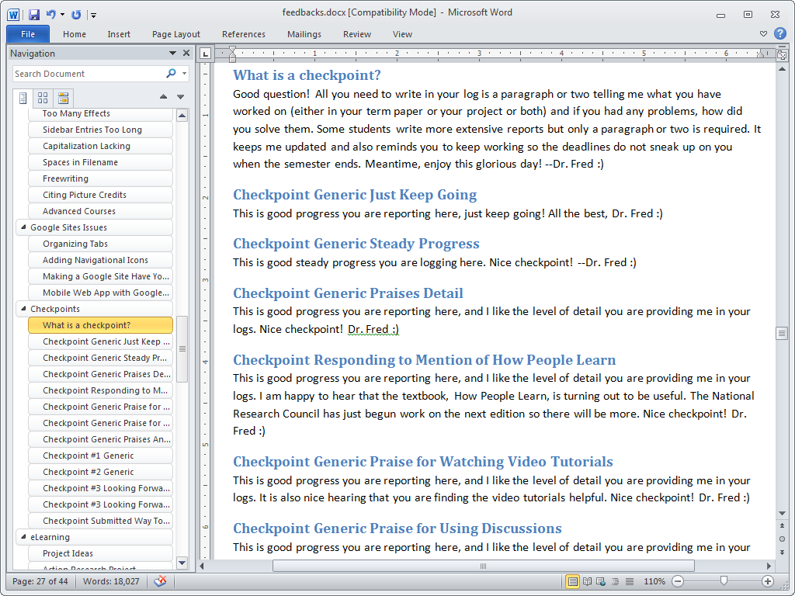

Slide 34
eLearning Face to Face
Using Web-based Videoconferencing to Extend the F2F Experience to Distance Learners

Slide 35
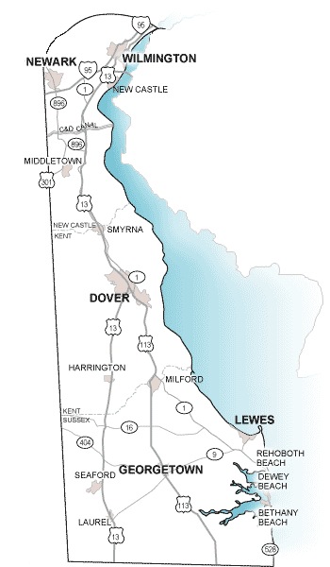
Delaware Logistics
Delaware is a long and narrow state that creates logistical issues for downstate students to attend classes on the University of Delaware's main campus located in northern Delaware.
To solve this problem, we use Web-based videoconferencing to extend the face-to-face experience to distance learners.

Slide 36
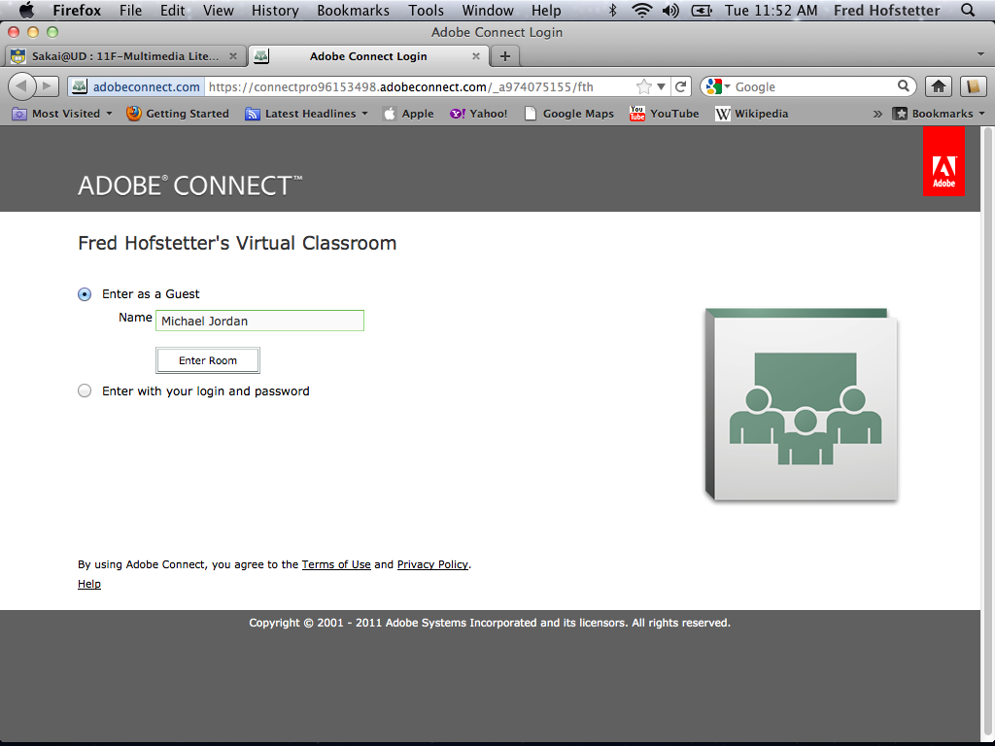

Slide 37
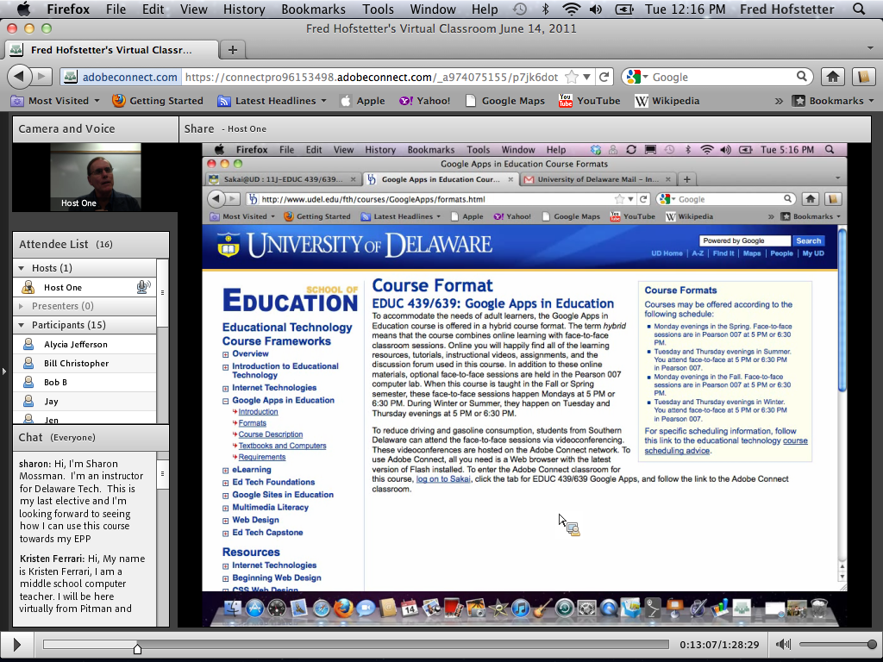

Slide 38
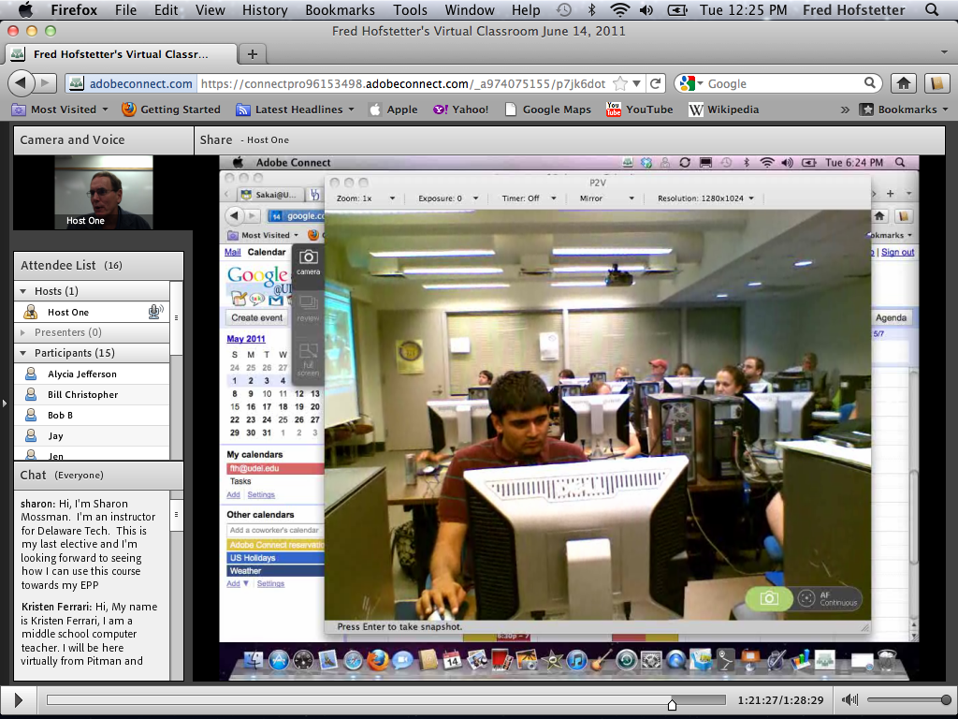

Slide 39
Impact
Adobe Connect has had a profound impact on the learning environment.
It creates a virtual classroom where students interact with me and each other to get help learning what they cannot master on their own.
By recording the classroom stream we use multimedia and the Internet to make all our teaching materials available 24/7 online.

Slide 40
eLearning Engagement Strategies
Putting Theory into Practice: Five eLearning Strategies for Engaging Students Online

Slide 41
Five Elements of Engagement
Discuss goals with each learner to create an empathetic bond at the beginning of the course.
Turn extrinsic motivation intrinsic by negotiating topics that students feel passionate about.
Make thinking visible through periodic checkpoints to provide effective scaffolding when students need help.
Form a learning community by using rubrics that encourage students to communicate meaningfully with peers and instructors in online discussion forums.
Design instruction into prepared feedbacks for coaching students in their zone.

Slide 42
Recommeded Books
Researched Best Practices of e-Learning

Slide 43
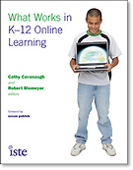
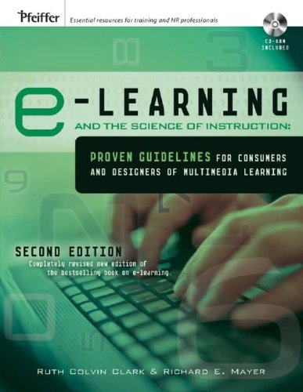
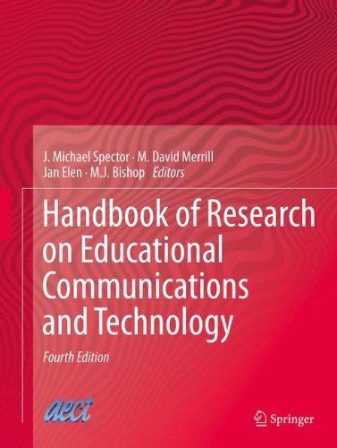
Recommended Books

Slide 44
References
Berardi, L. (2002). University faculty members' perceptions of student engagement: An interview study. Normal, IL: Illinois State University.
Clark, R.C., & Mayer, R.E. (2008). e-Learning and the Science of Instruction (2nd ed.). San Francisco, CA: Pfeiffer.
Holmberg, B. (2003). A Theory of Distance Education Based on Empathy. In M.G. Moore and W.G. Anderson (Eds.), Handbook of Distance Education (pp. 79-86). Mahwah, NJ: Lawrence Erlbaum.
Jonassen, D.H. (2014). Assessing Problem Solving. In Handbook of Research on Educational Communications and Technology (4th ed.). New York, NY: Springer New York, 269-288.
Kenny, G., Kenny, D., & Dumont, R. (1995). Mission and place: Strengthening learning and community through campus design. West Port, CT: Praeger Publishers.
Manfra, M. M. (2009). Critical inquiry in the social studies classroom: Portraits of critical teacher research. Theory and Research in Social Education, 37 (2), 298-316.
Mayer, R.E. (2001). Multimedia Learning. New York: Cambridge University Press.

Slide 45
References
Molloy, E.K. and Boud, D. (2014). Feedback Models for Learning, Teaching and Performance. In Handbook of research on educational communications and technology (4th ed., pp. 413-424). New York, N.Y.: Springer.
National Research Council. (2000). How People Learn (expanded edition edited by J.D. Bransford, A.L. Brown, and R.R. Cocking). Washington, DC: National Academy Press.
Romiszowski, A.J. (2005). Online Learning: Are We on the Right Track? In G. Kearsley (Ed.), Online Learning: Personal Reflections on the Transformation of Education (pp. 321-349). Englewood Cliffs, NJ: Educational Technology Publications.
Rule, A. (2006). The Components of Authentic Learning. Journal of Authentic Learning, 3(1), 1-110.
Scardamalia, M., & Bereiter, C. (2006) In Sawyer, R.K. The Cambridge Handbook of the Learning Sciences (pp. 97-115).
Vygotsky, L.S. (1978). Mind in Society: The Development of Higher Psychological Processes. Cambridge, MA: Harvard University Press.
Zhao, C. and G.D. Kuh. 2004. Adding Value: Learning Communities and Student Engagement. Research in Higher Education, Vol. 45, 115-138.

