Slide 1
Faculty Senate Meeting Gen Ed Report March 7, 2016 Welcome!

Slide 2
Gen Ed Overview
Today we report on the five Gen Ed Reform initiatives approved by the Faculty Senate on 11 May 2015. These initiatives are tracked at the Gen Ed Reform website, which you can access from the sidebar at facsen.udel.edu. Reported today are:
FYS Learning Outcomes: Avron Abraham, Chair, Ad Hoc Committee on the First Year Seminar
Core Course Pilot: Eric Rise, Chair, Ad Hoc Committee on the Core
Capstone Review Guidelines: Steve Hastings, Chair, Undergraduate Studies (UGS) Committee
Undergraduate Programs Review: Chris Knight, Chair, General Education Committee
Multicultural Course Review Guidelines and Certification Process: Emily Davis, Chair, Committee on Diversity and Inclusion; and Steve Hastings, UGS Chair

Slide 3
FYS Learning outcomes
Avron Abraham

Slide 4
FYS Guidelines and Learning Outcomes
In May 2015, the faculty senate approved specific topics for inclusion in all FYS courses thus ensuring that a committed portion of the FYS course time be allotted to common content.
Each of the topics listed are followed by a short list of objectives specific to the FYS. The FYS will introduce many of these topics to students, but it is understood that subsequent additional learning opportunities will occur through other general education requirements, including courses student must take as a requirement of their college and/or major, and out of the classroom learning experiences.

Slide 5
Ethics/Academic Honesty:
UD graduates should be able to explain the reasons behind the positions they hold on key ethical questions and to articulate the values that underlie their decisions.
Responsible use of Internet/Social Media:
Understanding how to responsibly use social media, other technologies, and develop a positive digital identity.
Academic Policies and Procedures:
Early in their academic careers at UD, students should be aware of the important policies and practices that will guide their progress and be familiar with those resources that will support their academic success.

Slide 6
Diversity:
The development of skills to work independently and collaboratively across a variety of cultural contexts and a spectrum of differences ensures that students will understand the limitations of a single perspective and the value of diverse perspectives and cultures in creative problem solving of major challenges.
Safety and Wellness:
Three sessions of the FYS course must be designated to student wellness and safety with a defined significant emphasis on alcohol and other substance education as well as sexual misconduct/violence prevention education. This will be accomplished through the teaching of bystander intervention theory and practice, taught by qualified, trained personnel or prevention staff.
Refer to the Gen Ed site for more information
Comments to Avron@udel.edu

Slide 7
Core course pilot
Eric Rise

Slide 8
Core Course Pilot
28 applications
6 courses will be offered in Fall 2016
Political Violence - Capitalism
Citizenship - Scientific Literacy
Climate Change - Technology and Change
Steps forward:
Evaluation of pilot courses
Possible phase 2 in the spring
Recommendation to Senate re: CORE requirement by May 2017
Notes:
The starting point for the discussion of curricular mapping is the 5 objectives of General Education. Our goal is to learn how our programs promote the development of these abilities.

Slide 9
Capstone Review Guidelines
Steve Hastings

Slide 10
Capstone Review Guidelines
The Process to Have a Capstone Course Approved Beginning August 2016 to be in Place by Fall 2017
The online Course Submission / Revision form will have a check box for Capstone Course; if that box is checked, the submitter will be linked to a form that includes the following message and questions:
Definition of a Capstone Experience (per the Faculty Senate, May 2015):
The Capstone Experience will require students to engage in explorations in which the outcomes are unknown, and/or to engage in self-assessment, reflection, and analysis that prepares them for future success. These experiences should occur during the senior year or near the end of the program of study and must have a set of learning goals that are well-communicated to students. These learning goals should support some or all of the Objectives of General Education as established by the Faculty Senate on November 3, 2014. In all possible regards, the Capstone Experience should be an expression of the totality of a student’s growth, development, and learning as an undergraduate. If the Capstone experience is primarily course based (vs. internship, research, etc.) it is recommended that wherever possible, the course include high impact practices such as service learning and problem based learning. Each capstone requirement will be a minimum of a one (1) credit, credit-bearing course. A Capstone Experience may be solely based within the discipline or be interdisciplinary in nature.
Please explain how this course will:
1a) Require students to engage in explorations in which the outcomes are unknown –
or
1b) Engage in self-assessment, reflection, and analysis that prepares them for future success
2) Explain how the learning goals support some or all of the Objectives of General Education as established by the Faculty Senate on November 3, 2014
Initially (Fall 2016), there will likely be an ad hoc sub-committee of UGS to review the submission.
Notes:
The starting point for the discussion of curricular mapping is the 5 objectives of General Education. Our goal is to learn how our programs promote the development of these abilities.

Slide 11
Curriculum Mapping
Christopher Knight

Slide 12
5 Objectives
General education at the University of Delaware prepares students who are able to:
Read critically, analyze arguments and information, and engage in constructive ideation.
Communicate effectively in writing, orally, and through creative expression.
Work collaboratively and independently within and across a variety of cultural contexts and a spectrum of differences.
Critically evaluate the ethical implications of what they say and do.
Reason quantitatively, computationally, and scientifically.
Notes:
The starting point for the discussion of curricular mapping is the 5 objectives of General Education. Our goal is to learn how our programs promote the development of these abilities.

Slide 13
Undergraduate Degree Program Review
The Faculty Senate Committee on General Education is charged to assist departments and programs administering undergraduate majors in ensuring full opportunity for all students to attain competency in the Objectives of General Education.
4. Provide clear examples and templates to all departments including curricular maps to aid in their internal reviews of how students are achieving the Objectives of General Education by May 1, 2016.
Notes:
The FS General Education Committee is charged to help all units to find, in their degree programs, where the students have the opportunity to attain competency in the objectives. Specifically, we are to provide departments with *curricular maps* to help in their internal reviews.

Slide 14
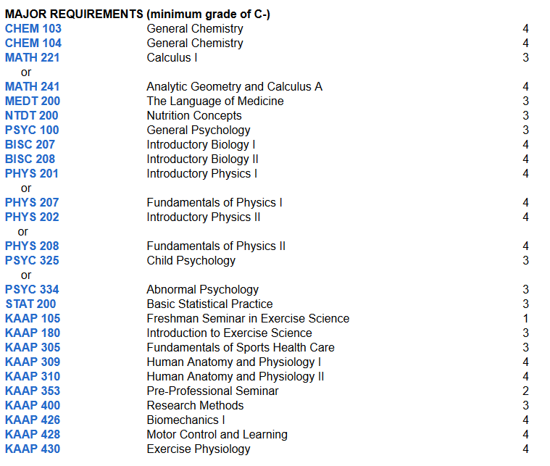
Notes:
Because our majors are made up of courses from across campus, we need to first develop a campus-wide registry of courses that are coded based on what objectives they emphasize. And this is where we need full faculty engagement.

Slide 15
Mapping Kit
Mapping Guide: A document containing instructions and written definitions of the Objectives.
Spreadsheet of objectives and courses for your unit.
Deadline: We request that each unit’s spreadsheet be turned into the Faculty Senate General Education Committee by sending it to CTAL-info@udel.edu before the start of Spring Break, March 25th, 2016. Because students enroll in courses from many different departments, we will not have a clear picture of how and where they fulfill General Education objectives until we have curriculum maps from all departments.
Notes:
We are providing materials to help all units with undergraduate degree programs to code the courses that they teach based on whether they emphasize any of the Gen Ed Objectives. I believe that our committee has been very thoughtful in developing a mapping process that balances *validity* and *effort*. We piloted the mapping process and refined it where we could. This can be a straightforward task that does not require much time.
We also suggest that this is not useless busywork being imposed on faculty. It is an important first step in a larger process that will provide departments, faculty and students with critical information that they couldn't otherwise get.
I know you are looking at the deadline. This does not allow much time and I am happy to address your questions after I give a brief outline of the mapping process.

Slide 16
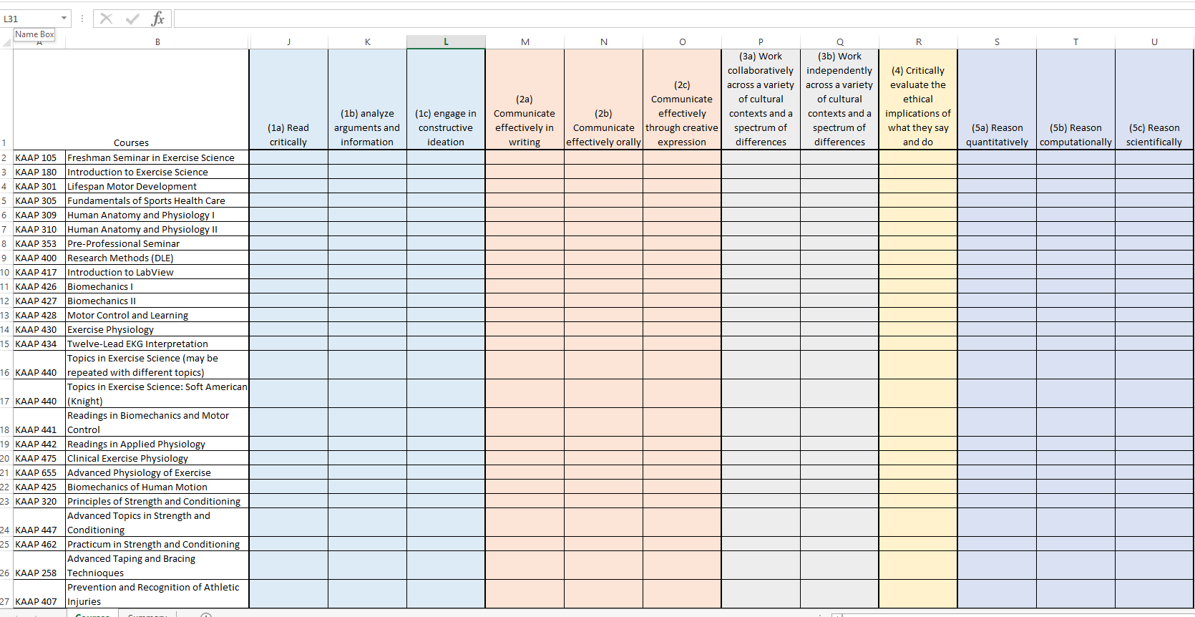
N - Score your course with an N for NOT APPLICABLE or no emphasis. Instructor will observe no student learning on this objective.*
M - Score your course with an M for MINOR emphasis of the course. Instructor will observe some student learning on this objective.
S - Score your course with an S for SIGNIFICANT or major emphasis of the course. Instructor will observe significant student learning on this objective.
Notes:
This is the excel spreadsheet that I received for my department. Columns contain each of the 12 GenEd Objectives. Rows contain the courses in your unit that were taught in the last two years.
These are the criteria that you will use to code the courses that you teach.
N for not applicable or no emphasis
M for minor emphasis
And S for significant or major emphasis of the learning objective
After coding your courses, you will submit this excel sheet to your Chair, who will send the department’s information in one file to CTAL. The Mapping Guide explains this in more detail, including a Frequently Asked Questions page that we will continue to update. CTAL is also excited to help your units with this process.

Slide 17
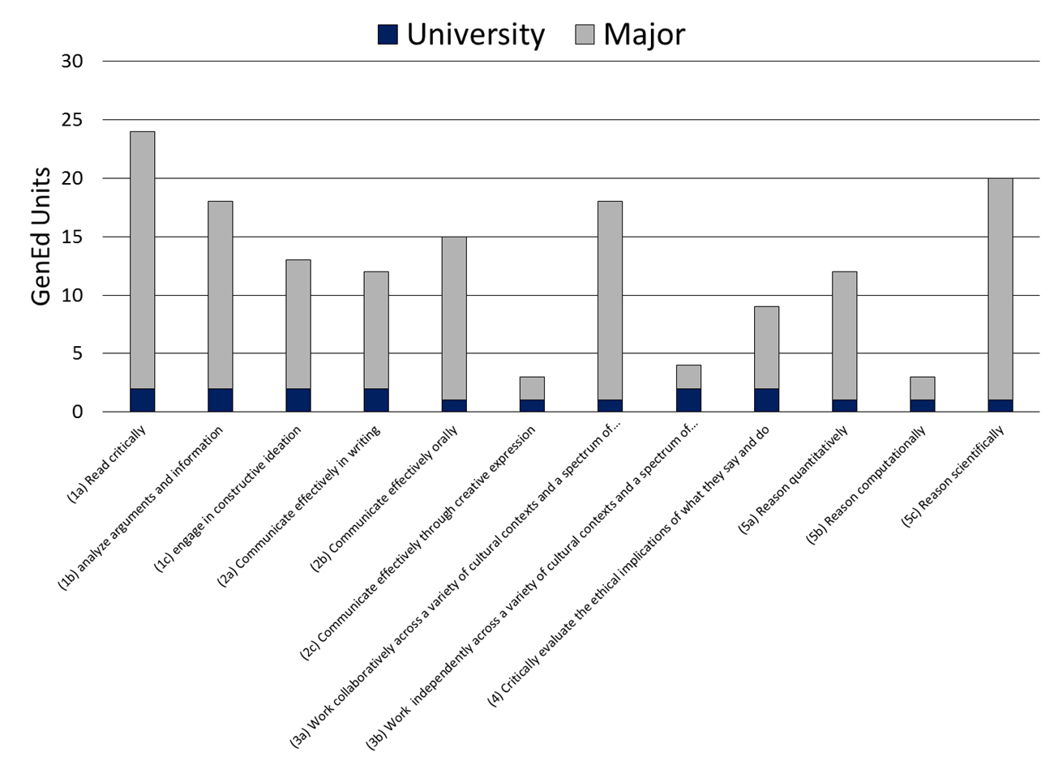
Course revisions
Program revisions
Advising
Reports
Departments
CTAL
Registrar
Notes:
Spreadsheet that are sent to CTAL are aggregated to make the university course registry. This will be given to the Office of the Registrar and reports will be created for departments.
Departments will then do a Gap Analysis to see if they need to make course or program revisions. The registry will also become a valuable tool for advising purposes.

Slide 18
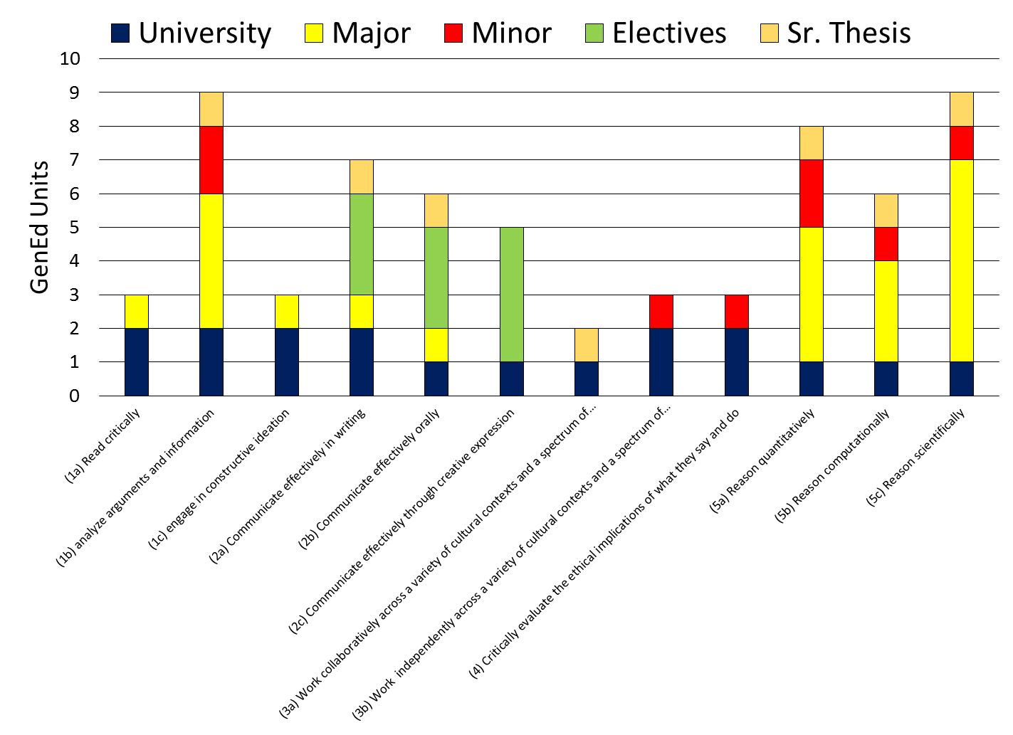
Notes:
One of the things we are very excited about is how the resulting course registry and advising software could be used to promote mote intentionality in the students course selections. This graph is an example of what a student’s skill development might look like after 4 years. They will be able to visualize their progress in each objective throughout their education and this graphic could also be a good marketing tool for the student.

Slide 19
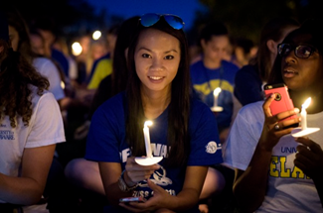
Thank you
For assistance or feedback on the process:
Chris Knight: caknight@udel.edu
CTAL: ctal-info@udel.edu
To graduate the aspirational citizen.
Notes:
I expect that you have questions about mapping and GenEd Reform overall. But first I want to thank the General Education Committee for their thoughtful development of this mapping process … and I want to especially thank the faculty in advance for finding time to enable our progress. There is never a good time for extra work but we hope that you can appreciate the importance and value of this undertaking.

Slide 20
Multicultural course guidelines
Emily Davis

Slide 21
Revised Multicultural Course Guidelines
Courses certified to meet the multicultural requirement must meet three of the following criteria:
1. Diversity Self-Awareness and Perspective Taking: Students can articulate their own individual identity in relation to key concepts such as race, ethnicity, gender, sexuality, language, social class, disability, national origin, and religious affiliation, and can also reflect on how their social position differs from, and impacts, their relationships in diverse environments. In other words, students will learn to locate themselves within larger structures of difference and understand how their own position shapes their identity and/or worldview, as well as how that identity and/or worldview may differ from others.
2. Cultural Difference: Students gain in-depth knowledge of the history, lived experience, artistic production, identity and/or worldview of one or more underrepresented groups in the West (i.e., the US, Great Britain, Europe, Canada, Australia, New Zealand) and/or of a non-Western culture (or cultures). Students can articulate particular aspects and experiences of these cultures as well as how they may be similar to or different than the students’ own.

Slide 22
3. Personal and Social Responsibility: Students analyze the ethical, social, and/or environmental consequences of policies, ideologies, or actions on marginalized communities/groups within the US or internationally. Based on this analysis, students identify a range of potential personal and civic responses to these issues. A service learning version of this course may allow students to directly take informed and responsible action to address these challenges.
4. Understanding Global Systems: Students gain and apply the tools to think systematically about how institutions, ideologies, rhetorics, and/or cultural representations shape a people’s culture and identity, which may include their role in perpetuating inequality, whether historically or in the present day.
*Faculty proposing to certify a course for the MCC must submit the following:
A course syllabus.
A list of each of the three criteria the course will satisfy along with copies of the assignment that satisfies each one (this could be a reading, project, essay, etc.)

Slide 23
Faculty Senate Meeting Gen Ed Report March 7, 2016 Thank You!

