Slide 1
Continuation of the May 4 Faculty Senate Meeting May 11, 2015 Welcome!

Slide 2
Agenda
VI. Presentation
Gen Ed Task Force Presentation with Points of Information Q&A John Pelesko, Gen Ed Task Force Chair
VII. Resolutions
First Year Seminar
Core Curriculum Proposal
Engagement and Exploration (E&E) Proposal
Capstone Requirement
Review of Undergraduate Degree Programs
Create a Minimum Required Syllabus for FYE/FYS
Align University Breadth Courses with Gen Ed Objectives
Align Multicultural Courses with Diversity Learning Rubric

Slide 3
Resolution M: First Year Seminar
Recommendation from the Faculty Senate Committee on General Education (Norm Wagner, Chair), with the support of UGS (Steve Hastings, chair) and Coordinating (Bob Opila, chair), for the request to approve a resolution concerning the First Year Experience at the University of Delaware (attachment) (task force report attachment)
WHEREAS, the faculty of the University of Delaware have affirmed the importance of a robust program of general education through their unanimous support of the November 3, 2014 “Resolution on General Education,” and
WHEREAS, the Task Force on General Education has reaffirmed the First Year Seminar as an important experience for students, and
WHEREAS, the Report to the Faculty, Administration, Trustees, and Students of the University of Delaware by An Evaluation Team representing the Middle States Commission on Higher Education prepared after an on-campus review on April 3-6, 2011, recommended that “…the university work to make the FYE a more integrated experience and expand a more uniform model across the university,” and
WHEREAS, a Periodic Review Report is due from the University of Delaware to the Middle States Commission on Higher Education in June 2016, be it therefore
RESOLVED, that the Faculty Senate directs the President of the Faculty Senate to proceed forthwith in appointing an “Ad Hoc Committee on the First Year Seminar,” subject to the charge and guidelines laid out in the attached document.

Slide 4
Attached Document for Resolution on the First Year Seminar Charge of the Ad Hoc Committee on the First Year Seminar
The Ad Hoc Committee on the First Year Seminar is formed to establish clear, detailed guidelines, which must be followed by any course designated as a “First Year Seminar,” effective September 1, 2016. The Ad Hoc Committee on the First Year Seminar is appointed by the President of the Faculty Senate, will consist of a minimum of one faculty representative from each college, one representative from the Office of the Provost, a minimum of one undergraduate student and four representatives from the Division of Student Life, and is to be charged by the President of the Faculty Senate with all due haste upon adoption of this resolution. The committee is further charged to:
Define a clear set of guidelines detailing all required components to be satisfied by any course designated as a “First Year Seminar.”
Diversity competency, sexual misconduct awareness and prevention, drug and alcohol use education and abuse prevention, responsible use of the internet and other social media, and ethics and academic honesty should be components within all First Year Seminars.
Make a recommendation to the Faculty Senate by September 1, 2016 as to a periodic review process designed to ensure that all “FYS” designated courses meet established guidelines.
Partner with the Office of Educational Assessment of the Center for Teaching and Assessment of Learning to develop an assessment plan for all FYS courses and a process for regular course assessment.
The committee will be dissolved by a vote of the Faculty Senate.

Slide 5
Resolution N: Core Curriculum Proposal
Recommendation from the Faculty Senate Committee on General Education (Norm Wagner, Chair), with the support of UGS (Steve Hastings, chair) and Coordinating (Bob Opila, chair), for the request to approve a resolution concerning core curriculum at the University of Delaware (attachment) (task force report attachment)
WHEREAS, the faculty of the University of Delaware have affirmed the importance of a robust program of general education through their unanimous support of the November 3, 2014 “Resolution on General Education,” and
WHEREAS, the Task Force on General Education has recommended the creation of a core curriculum as part of a new program on general education, and
WHEREAS, the faculty of the University of Delaware have expressed a desire to proceed prudently toward a core curriculum via a pilot and development phase, and
WHEREAS, the administration of the University of Delaware is willing to support said pilot and development phase, be it therefore
RESOLVED, that the faculty of the University of Delaware reaffirms the role of English 110 as an important component of the general education of all students, and be it further
RESOLVED, that the faculty of the University of Delaware endorses in principle the creation of a core curriculum of a minimum of one course and directs the President of the Faculty Senate to proceed forthwith in appointing an “Ad Hoc Committee on the Core,” subject to the charge and guidelines laid out in the attached document.

Slide 6
Attached Document for Resolution on a University of Delaware CORE Curriculum Charge of the Ad Hoc Committee on the Core
The Ad Hoc Committee on the Core is formed to assist in the process of developing and piloting a minimum of one core course that has the potential to become required of all University of Delaware students. The Ad Hoc Committee on the Core is appointed by the President of the Faculty Senate, will consist of a minimum of one faculty representative from each college, a minimum of one undergraduate student, and one representative from the Office of the Provost, and is to be charged by the President of the Faculty Senate with all due haste upon adoption of this resolution. The committee is charged to:
Support and work with the university administration to develop and pilot a minimum of one core course as generally described in the Report of the Task Force on General Education during AY2015/16. The first Core Pilot Course is to be offered in Fall 2016 and further, any Core Pilot Course will be counted as a UD Breadth course.
Provide regular and timely updates to the Faculty Senate General Education Committee and the Faculty Senate on the development, piloting, and assessment of these pilot courses.
Develop an assessment plan for the Core in conjunction with CTAL.
Make a recommendation to the Faculty Senate at the conclusion of an initial pilot as to whether or not to proceed with development of the core course(s) and the implementation of a core course(s) requirement.
Work with the university administration to develop a financial plan for said implementation. The committee will be dissolved by a vote of the Faculty Senate.

Slide 7
Resolution O: Engagement and Exploration (EE) Proposal
Recommendation from the Faculty Senate Committee on General Education (Norm Wagner, Chair) for the request to approve a resolution concerning an engagement and exploration requirement at the University of Delaware (attachment) (task force report attachment)
WHEREAS, the faculty of the University of Delaware have affirmed the importance of a robust program of general education through their unanimous support of the November 3, 2014 “Resolution on General Education,” and
WHEREAS, the Task Force on General Education has recommended a new university-level requirement replacing the current University Breadth Requirement and the current Multicultural Requirement, and
WHEREAS, the faculty of the University of Delaware have affirmed the importance of diversity and a strengthened Multicultural Requirement; the importance of curricular and co-curricular experiential learning; and the importance of faculty guidance of student’s curricular planning; be it therefore
RESOLVED, that for all students matriculating in academic year 2017 or later, the Engagement and Exploration Requirement, including a Multicultural Component, as defined in the attached document will be required for graduation and the existing University Breadth Requirement and existing Multicultural Requirement will be removed as requirements for graduation, and be it further
RESOLVED, that the Faculty Senate directs the President of the Faculty Senate to proceed forthwith in charging the Faculty Senate General Education Committee and the Faculty Senate Diversity and Affirmative Action Committee to oversee the implementation of the Engagement and Exploration Requirement subject to the charge and guidelines laid out in the attached document.

Slide 8
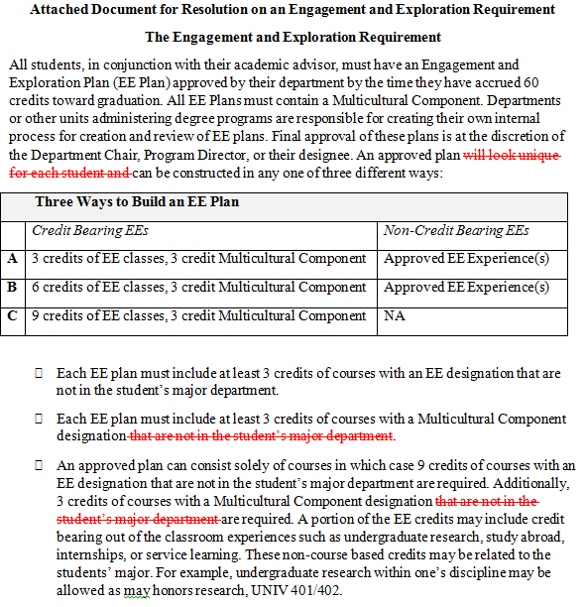

Slide 9
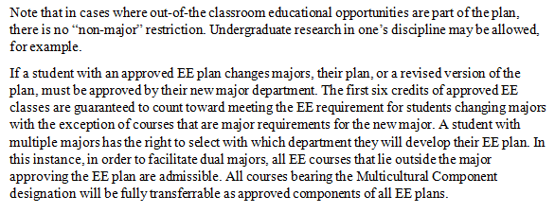

Slide 10
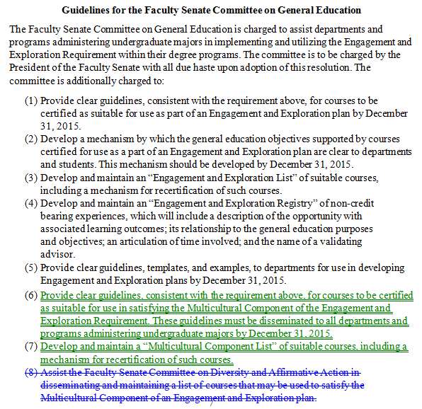

Slide 11
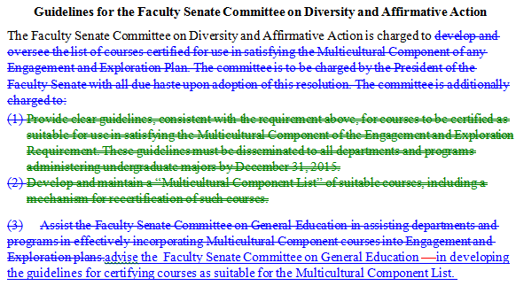

Slide 12
Attached Document for Resolution on an Engagement and Exploration Requirement The Engagement and Exploration Requirement
All students, in conjunction with their academic advisor, must have an Engagement and Exploration Plan (EE Plan) approved by their department by the time they have accrued 60 credits toward graduation. All EE Plans must contain a Multicultural Component. Departments or other units administering degree programs are responsible for creating their own internal process for creation and review of EE plans. Final approval of these plans is at the discretion of the Department Chair, Program Director, or their designee. An approved plan can be constructed in any one of three different ways:
Three Ways to Build an EE Plan
 | Credit Bearing EEs | Non-Credit Bearing EEs
A | 3 credits of EE classes, 3 credit Multicultural Component | Approved EE Experience(s)
B | 6 credits of EE classes, 3 credit Multicultural Component | Approved EE Experience(s)
C | 9 credits of EE classes, 3 credit Multicultural Component | NA

Slide 13
Each EE plan must include at least 3 credits of courses with an EE designation that are not in the student’s major department.
Each EE plan must include at least 3 credits of courses with a Multicultural Component designation.
An approved plan can consist solely of courses in which case 9 credits of courses with an EE designation that are not in the student’s major department are required. Additionally, 3 credits of courses with a Multicultural Component designation are required. A portion of the EE credits may include credit bearing out of the classroom experiences such as undergraduate research, study abroad, internships, or service learning. These non-course based credits may be related to the students’ major. For example, undergraduate research within one’s discipline may be allowed as may honors research, UNIV 401/402.
Departments are encouraged to work with their students to devise EE plans of 3 or 6 credits that include approved educational opportunities that take place outside of a traditional classroom.
Also included in the plan, may be significant, experiential, educational opportunities that take place outside of a traditional classroom which are not credit bearing such as student leadership roles, undergraduate research, internships, volunteer work, and athletics and recreational sports. Non-credit bearing experiences should be significant, must be assessed, and student involvement verified by an advisor.

Slide 14
Note that in cases where out-of-the classroom educational opportunities are part of the plan, there is no “non-major” restriction. Undergraduate research in one’s discipline may be allowed, for example.
If a student with an approved EE plan changes majors, their plan, or a revised version of the plan, must be approved by their new major department. The first six credits of approved EE classes are guaranteed to count toward meeting the EE requirement for students changing majors with the exception of courses that are major requirements for the new major. A student with multiple majors has the right to select with which department they will develop their EE plan. In this instance, in order to facilitate dual majors, all EE courses that lie outside the major approving the EE plan are admissible. All courses bearing the Multicultural Component designation will be fully transferrable as approved components of all EE plans.

Slide 15
Guidelines for the Faculty Senate Committee on General Education
The Faculty Senate Committee on General Education is charged to assist departments and programs administering undergraduate majors in implementing and utilizing the Engagement and Exploration Requirement within their degree programs. The committee is to be charged by the President of the Faculty Senate with all due haste upon adoption of this resolution. The committee is additionally charged to:
Provide clear guidelines, consistent with the requirement above, for courses to be certified as suitable for use as part of an Engagement and Exploration plan by December 31, 2015.
Develop a mechanism by which the general education objectives supported by courses certified for use as a part of an Engagement and Exploration plan are clear to departments and students. This mechanism should be developed by December 31, 2015.
Develop and maintain an “Engagement and Exploration List” of suitable courses, including a mechanism for recertification of such courses.
Develop and maintain an “Engagement and Exploration Registry” of non-credit bearing experiences, which will include a description of the opportunity with associated learning outcomes; its relationship to the general education purposes and objectives; an articulation of time involved; and the name of a validating advisor.
Provide clear guidelines, templates, and examples, to departments for use in developing Engagement and Exploration plans by December 31, 2015.
Provide clear guidelines, consistent with the requirement above, for courses to be certified as suitable for use in satisfying the Multicultural Component of the Engagement and Exploration Requirement. These guidelines must be disseminated to all departments and programs administering undergraduate majors by December 31, 2015.
Develop and maintain a “Multicultural Component List” of suitable courses, including a mechanism for recertification of such courses.

Slide 16
Guidelines for the Faculty Senate Committee on Diversity and Affirmative Action
The Faculty Senate Committee on Diversity and Affirmative Action is charged to advise the Faculty Senate Committee on General Education in developing the guidelines for certifying courses as suitable for the Multicultural Component List.

Slide 17
Resolution P: Capstone Requirement
Recommendation from the Faculty Senate Committee on General Education (Norm Wagner, Chair), with the support of UGS (Steve Hastings, chair) and Coordinating (Bob Opila, chair), for the request to approve a resolution concerning a capstone requirement at the University of Delaware (attachment) (task force report attachment)
WHEREAS, the faculty of the University of Delaware have affirmed the importance of a robust program of general education through their unanimous support of the November 3, 2014 “Resolution on General Education,” and
WHEREAS, the Task Force on General Education has recommended that a capstone experience be part of the education of every student at the university, and
WHEREAS, in its March 13, 2000 meeting the Faculty Senate “endorsed in principle…major components of the General Education Program,” including a “Capstone Experience which integrates the undergraduate experience such as a senior seminar, group project, or similar experience,” and
WHEREAS, the University of Delaware’s Periodic Review Report (2006) to the Middle States Commission on Higher Education stated that “Capstone experiences will be part of the education of all undergraduates by 2008,” be it therefore
RESOLVED, that the Faculty Senate directs each department or program responsible for administering undergraduate majors to include a capstone experience as a requirement for the major for all students matriculating in academic year 2017, and be it further
RESOLVED, that the Undergraduate Studies Committee of the Faculty Senate reviews and approves all proposed capstone experiences according to the guidelines laid out in the attached document.

Slide 18
Attached Document for Resolution on a Capstone Requirement Guidelines for the Review of the Capstone Experience
In reviewing and approving proposed Capstone Experiences for degree programs, the Undergraduate Studies Committee is directed to use the following criteria.
A Capstone Experience will require students to engage in explorations in which the outcomes are unknown, and/or to engage in self-assessment, reflection, and analysis that prepares them for future success. These experiences should occur during the senior year or near the end of the program of study and must have a set of learning goals that are well-communicated to students. These learning goals should support some or all of the Objectives of General Education as established by the Faculty Senate on November 3, 2014. In all possible regards, the Capstone Experience should be an expression of the totality of a student’s growth, development, and learning as an undergraduate. If the Capstone experience is primarily course based (vs. internship, research, etc.) it is recommended that wherever possible, the course include high impact practices such as service learning and problem based learning. Each capstone requirement will be a minimum of a one (1) credit, credit-bearing course. A Capstone Experience may be solely based within the discipline or be interdisciplinary in nature.
The committee should view the following as exemplars of successful capstone experiences:
(1) Honors Thesis/Senior Research
(2) Course-Based Research
(3) Professional Practicum and Internships
(4) Design Projects
(5) Programmatic ePortfolios
(6) Senior-level Seminars
(7) Field Experiences
(8) Appropriately defined classroom courses

Slide 19
Resolution Q: Review of Undergraduate Degree Programs
Recommendation from the Faculty Senate Committee on General Education (Norm Wagner, Chair), with the support of UGS (Steve Hastings, chair) and Coordinating (Bob Opila, chair), for the request to approve a resolution concerning a review of degree programs (attachment) (task force report attachment)
WHEREAS, the faculty of the University of Delaware have affirmed the importance of a robust program of general education through their unanimous support of the November 3, 2014 “Resolution on General Education,” and
WHEREAS, the Task Force on General Education has recommended a review of all degree programs to ensure all students attain competency in all five Objectives of General Education, and
WHEREAS, the new Objectives of General Education differ significantly from previous General Education Goals, be it therefore
RESOLVED, that the Faculty Senate directs the President of the Faculty Senate to proceed forthwith in charging the Faculty Senate Committee on General Education in partnership with the Faculty Senate Committee on Undergraduate Studies to oversee this review using the guidelines laid out in the attached document, and be it further
RESOLVED, that the Faculty Senate directs each department or program responsible for administering undergraduate majors to ensure that their degree programs, inclusive of major, college, and university requirements fully support student development in all Objectives of General Education by September 1, 2017, and be it further
RESOLVED, that an assessment mechanism for the General Education requirements be articulated.

Slide 20
Attached Document for Resolution on a Review of Degree Programs Guidelines for the Faculty Senate Committee on General Education
The Faculty Senate Committee on General Education is charged to assist departments and programs administering undergraduate majors in ensuring full opportunity for all students to attain competency in the Objectives of General Education. The committee is also responsible for conducting a review of all degree programs in this regard in partnership with the Faculty Senate Committee on Undergraduate Education. These committees are to be charged by the President of the Faculty Senate with all due haste upon adoption of this resolution. The committees are additionally charged to:
Support and work with programs and departments to ensure that all degree programs provide support for all students in attaining competency in all the Objectives of General Education.
Provide rubrics against which degree programs will be assessed, based on the AAC&U VALUE Rubrics, for each Objective of General Education or component of Objectives to all programs and departments by May 1, 2016.
Provide clear guidelines for review of student learning in all degree programs, with regard to the Objectives of General Education, to all programs and departments by May 1, 2016.
Provide clear examples and templates to all departments including curricular maps to aid in their internal reviews of how students are achieving the Objectives of General Education by May 1, 2016.
Provide timely and detailed feedback and guidance on the review of student learning within each degree program.

Slide 21
Resolution R: Create a Minimum Required Syllabus for FYE/FYS
Resolution from Past President Deni Galileo, co-sponsored by Senators Erica Selva, Brian Ackerman, Mary Ann McLane, Seth Shabo, Chris Williams, Martha Buell, Jeffrey Heinz, John Jebb, and John Courtright, to create a minimum syllabus for FYE/FYS.
WHEREAS, solving the problems of sexual harassment and alcohol and drug abuse are high priorities at the University of Delaware, and
WHEREAS, during the March 9 open hearing on sexual harassment and assault students identified undergraduate programs in which instruction is missing in these critically important areas, and
WHEREAS, it would be desirable to have such instruction required as part of a student’s First Year Experience or First Year Seminar (FYE/FYS) along with other needed instruction, be it therefore
RESOLVED, that every undergraduate student, within a year of entering the University, receives formal instruction about sexual conduct, alcohol and drug abuse, and be it further
RESOLVED, that the University Faculty Senate Committee on General Education shall work with the Committee on Undergraduate Studies to design and implement a process for creating a minimum syllabus that must be inserted into every First Year Experience/First Year Seminar to provide the abovementioned instruction, and be it further
RESOLVED, that this should occur during the 2015-2016 academic year.

Slide 22
Resolution S: Align University Breadth Courses with Gen Ed Objectives
Resolution from Past President Deni Galileo, co-sponsored by Senators Erica Selva, Brian Ackerman, Mary Ann McLane, Seth Shabo, Chris Williams, Martha Buell, Jeffrey Heinz, John Jebb, John Courtright, and Steve Eidelman, with the support of UGS (Steve Hastings, chair) and Coordinating (Bob Opila, chair), to align the University Breadth Courses with the five new UD General Education Objectives.
WHEREAS, the University Faculty Senate has approved five new general education objectives that replace the former ten goals of general education at UD, and
WHEREAS, it would be desirable for the University to align its undergraduate programs with the five new general education objectives, be it therefore
RESOLVED, that the University Faculty Senate Committee on General Education shall work with the Committee on Undergraduate Studies to design and implement a process for certifying existing and newly proposed University Breadth courses for their alignment with the five new general education objectives, and be it further
RESOLVED, that this should occur during the 2015-2016 academic year.

Slide 23
Resolution T: Align Multicultural Courses with Diversity Learning Rubric
Resolution from Past President Deni Galileo, co-sponsored by Senators Erica Selva, Brian Ackerman, Mary Ann McLane, Seth Shabo, Chris Williams, Martha Buell, Jeffrey Heinz, John Jebb, John Courtright, and Steve Eidelman, with the support of UGS (Steve Hastings, chair) and Coordinating (Bob Opila, chair), to align the Multicultural Courses with the Diversity Learning Rubric (attachment)
WHEREAS, multicultural courses should be recertified periodically to help ensure that they are meeting the diversity goals of the University, and
WHEREAS, the Center for the Study of Diversity has created a new rubric that is designed to assess diversity learning, be it therefore
RESOLVED, that the University Faculty Senate Committee on Diversity and Affirmative Action shall consider this new Diversity Learning Value Rubric and identify those dimensions appropriate for evaluating multicultural courses, and be it further
RESOLVED, that the University Faculty Senate Committee on Undergraduate Studies, with the involvement of the Committee on Diversity, shall design and implement a process for certifying existing and newly proposed University multicultural courses for their alignment with the abovementioned dimensions, and be it further
RESOLVED, that this should occur during the 2015-2016 academic year.

Slide 24
Agenda
XI. Introduction of New Business:
Such items as may come before the Senate. (No motion introduced under new business, except a motion to refer to committee, shall be acted upon until the next meeting of the Senate.)

Slide 25
Zide Motion Reaffirming Rights of Colleges and Departments
WHEREAS, the Faculty Senate of the University of Delaware is a representative body, but the needs of individual Colleges and Departments within the University vary; and
WHEREAS, the Bylaws of the Faculty Senate of the University of Delaware specifically reserve “Powers Delegated to the Several Colleges and Divisions” in Section XIV; and
WHEREAS, these functions explicitly include the powers “to seek the continual improvement of academic programs, standards, and achievements in the college; to take an active role in the guidance, planning and administration of the instructional, research, and service activities of the college; to serve as the official channel for the expression of college faculty opinion; to consider and make recommendations concerning (policies governing) appointments, leaves, sabbaticals, promotions, tenure, and dismissal of faculty members”; and
WHEREAS, the Bylaws state that “substantive changes [by the Senate] in such decisions [made by the Colleges] would be referred back to the colleges in question”; therefore, be it
RESOLVED, the Faculty Senate of the University of Delaware reaffirms its commitment to reserving for the Colleges these rights; and further, be it
RESOLVED, the Senate shall not unduly infringe on the rights of Colleges and Departments to make policies including, but not limited to, who is eligible for membership on College and Department Promotion and Tenure Committees, and further, be it
RESOLVED, the Faculty Senate shall, in accordance with its own bylaws, consult with the several Colleges before making policy changes that impact the way the Colleges conduct the delegated functions described above.

Slide 26
Zide Motion Requiring One Week Notice of Motions Prior to Voting
WHEREAS, The Constitution of the Faculty of the University of Delaware states, in Section IV, part 9, “The first item of business at any regular meeting of the Senate shall be the agenda. By approval of a majority of the senators present, items may be added to the agenda prepared by the Vice President, and the order in which the items are to be considered may be changed. As part of the agenda of each regular meeting, there shall be time allocated for new business. No motion introduced under new business, except a motion to refer to committee, shall be acted upon until the next meeting of the Senate”; and
WHEREAS, this does not unambiguously delineate whether business introduced as an amendment to the agenda can be acted on at that meeting; and
WHEREAS, Section IV, part 13 of said Constitution explicitly states, “Robert’s Rules of Order, Newly Revised, 1970, shall be followed by the Senate in the conduct of its business in all cases to which they are applicable and in which they are not inconsistent with this Constitution and any special rules of order the Senate may adopt”; and
WHEREAS, Robert’s Rules of Order explicitly states that a rule requiring notice of a motion cannot be suspended, “even by general consent or a unanimous vote”; and
WHEREAS, the Faculty Senate of the University of Delaware is intended to be a deliberative, representative body, and Senators are therefore encouraged to seek input from constituents, which requires some minimum amount of time; and
WHEREAS, Section IV, part 6 of the Constitution provides a path to call for special meetings of the Senate to address matters of such importance or gravity that waiting for the next regular meeting of the Senate is not practical or advisable; and
WHEREAS, the willingness of the Senators to hold such a meeting is a practical test of the importance of such business; therefore be it
RESOLVED, that the Faculty Senate of the University of Delaware shall not vote upon any motion at a regular meeting that was not introduced to the Senate at least one week prior to the meeting, such as through the agenda prepared by the Vice President.

