Slide 1
Faculty Senate Meeting February 9, 2015 Welcome!

Slide 2
Agenda
I. Adoption of the Agenda: February 9, 2015
II. Approval of the Minutes: January 12, 2015
III. Remarks: Provost Grasso
IV. Announcements: Senate President Fred Hofstetter

Slide 3
Announcements
The FWP policy has been revised as per the amendments made at the Special Faculty Senate Meeting on 12 January 2015.
The revision is linked to the committee’s charge at the Faculty Senate website as well as in the Faculty Handbook.
The revision contains the following gender-neutral edits.

Slide 4
Log of Gender Neutral FWP Policy Changes
I-B-1: All reference below to a Respondent's rights and obligations are subject to his/her the Respondent’s right to withdraw from the hearing procedures at any time.
I-B-3: Each Party has the right to be represented by an advisor of his or her their own choosing.
I-B-4: Each Party has the right to have an observer present of his or her their own choosing.
I-C-1-d: Each Party shall have the opportunity to be accompanied by his or her their advisor, and the Complainant, if he or she the Complainant is involved…
I-C-2-a-v: Each witness during his/her their testimony.
I-C-2-a-vi: The Complainant may, but is not required to, attend the entire hearing accompanied by an advisor or advocate of his or her the Complainant’s choosing.
I-C-2-b-ii: The Committee Chair or his/her their appointed representative shall serve as Chair of the Hearing.
I-C-2-b-v: Each witness shall be present in the hearing room only during the time of his/her their testimony…
I-C-5-d-i: …the witness notifies the Committee that he/she the witness is unable to appear…
I-C-5-g: …the failure of a witness who is a university employee to comply with section c above constitutes a violation of his/her their responsibilities…
I-C-6-a: Each Party is free to determine the degree to which his/her their advisor will conduct his/her their case…
II-B-2-e: With the approval of the Committee, a member of the Committee may serve as mediator in a complaint, but may not serve on the Hearing Panel, nor serve as an advisor or observer in the Complaint Hearing and must recuse him/herself self from all committee deliberations concerning this complaint.
II-B-2-h: …the Chair shall advise the Initiator(s) of her/his/their right to a Hearing under Section C.
II-C-1-c: Each Party shall have the opportunity to be accompanied by his or her their advisor, and the Complainant, if he or she the Complainant is involved…
II-C-2-a-ii: Advisors shall be employees of the University of Delaware as outlined in B-1-f above , except that, in any matter involving allegations of Sexual Misconduct, any Party and the Complainant shall be entitled to select as his or her their advisor any person regardless of whether such person is employed by the University of Delaware.
II-C-2-a-v: Each witness during his/her their testimony.
II-C-2-a-vi: The Complainant may, but is not required to, attend the entire hearing accompanied by an advisor or advocate of his or her the Complainant’s choosing.
II-C-2-b-ii: The Committee Chair or his/her their appointed representative shall serve as Chair of the Hearing.
II-C-2-b-vi: Each witness shall be present in the hearing room only during the time of his/her their testimony…
II-C-5-d-i: …the witness notifies the Committee that he/she the witness is unable to appear…
II-C-5-g: Unless excused according to d above, the failure of a witness who is a university employee to comply with section c above constitutes a violation of his/her the employee’s responsibilities as a member of the University community…
II-C-6-b: Each advisor shall act only as an advisor unless the Hearing Panel agrees to a Party's request that his/her the Party’s advisor undertake functions otherwise assigned to the Party…

Slide 5
Announcements
The Gen Ed Committee is hard at work on its plan for implementing the new Gen Ed objectives.
If the committee votes to hold an open hearing, we are reserving the following date, so please tentatively mark your calendars to reserve it: Monday, March 23, 4 PM in Gore 104

Slide 6
Announcements
UD is working to decide which vendor will supply our faculty activity tracking system.
Two alternatives are being considered:
Faculty 180 by Data 180
Activity Insight by Digital Measures
The selection committee is chaired by John Sawyer who wants to invite you to attend the faculty demonstration of Activity Insight being held in the UD Faculty Commons, room 116 Pearson Hall on Friday, February 13 from 11 am to noon.
In the Faculty Commons from 11 am until 1 pm on Monday, February 23, Data 180 will demonstrate Folio 180 and will answer questions about Faculty 180. Folio 180 is a product the assessment office is considering for student portfolios.

Slide 7
Announcements
The Commission on Sexual Harassment and Assault is planning to hold an Open Hearing on:
Monday, March 9, 4 PM in Gore 104
The hearing is entitled:
Open Forum on Sexual Harassment and Assault: An Invitation to the UD Community to Present Issues and Provide Suggestions

Slide 8
Agenda
V. Presentations:
Final Report of the 3-3-3 Committee on Administrative Searches Dean Nancy Targett, 3-3-3 Committee Chair
Student Use of Alcohol (rescheduled for March 2) Nancy Chase, Director of Student Wellness & Health Promotion
Updates at the Institute for Global Studies Amy Johnson, Deputy Director
Faculty Role in UD Fundraising Campaign Robin Wray, Campaign Director

Slide 9
VI. Consent Agenda
What is a Consent Agenda?
Robert’s Rules calls it a Consent Calendar:
“Legislatures, city, town, or county councils, or other assemblies which have a heavy work load including a large number of routine or noncontroversial matters may find a consent calendar a useful tool for disposing of such items of business…”
“The matters listed on it are taken up in order, unless objected to, in which case they are restored to the ordinary process by which they are placed in line for consideration on the regular agenda. The special rules of order establishing a consent calendar may provide that, when the matters on the calendar are called up, they may be considered in gross or without debate or amendment.”

Slide 10
Agenda
VII. Regular Agenda: A. Resolutions
1. Common Exams 2. Voting in the Faculty Senate 3. PSPR Deadline Extension for Bioinformatics MS 4. PSPR Deadline Extension for Bioinformatics PSM
VIII. Introduction of New Business:
Such items as may come before the Senate. (No motion introduced under new business, except a motion to refer to committee, shall be acted upon until the next meeting of the Senate.)

Slide 11
Resolution #1: Common Exams
Recommendation from the Committee on Undergraduate Studies (Steve Hastings, Chair) with the concurrence of the Coordinating Committee on Education (Bob Opila, Chair) for the request to revise the Faculty Handbook 3.1.4 Examinations and Tests (Attachment 1)
WHEREAS, the Faculty Handbook contains all appropriate policies approved by the Faculty Senate and University administration including policies governing final and common exam scheduling, and
WHEREAS, the current policy references an outdated printed exam schedule, and
WHEREAS, there is a need to create a policy to manage conflicts between laboratory classes and common examinations, be it therefore
RESOLVED, that the policy in the Faculty Handbook section 3.1.4 be modified to refer readers to the Registrar’s website for exam scheduling information, and be it further
RESOLVED, that if the conflict is with a laboratory and a common examination, the instructor administrating the common exam will provide an alternate examination option or will treat the student’s absence from the exam as excused.

Slide 12
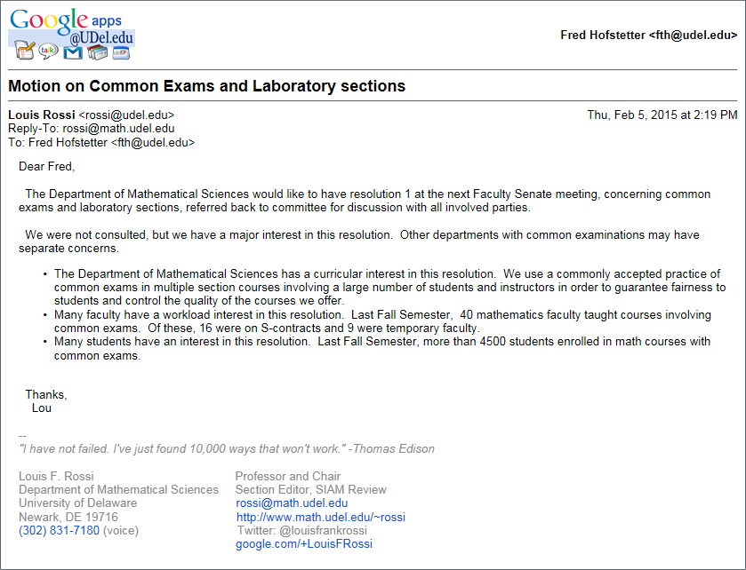

Slide 13
Resolution #2: Voting in the Faculty Senate
Recommendation from the Executive Committee (Fred Hofstetter, Chair) for the request to revise the Faculty Handbook Article 1.2 Section IV and V (Attachment 1)
WHEREAS, the current Bylaws of the Faculty Senate refer to decisions made by the votes of “those present”; and
WHEREAS, Robert’s Rules states, “Voting requirements based on the number of members present . . . are generally undesirable. Since an abstention in such cases has the same effect as a negative vote, these bases deny members the right to maintain a neutral position by abstaining;” be it therefore
RESOLVED, that in the Bylaws and Regulations of the University Faculty Senate, Article 1.2, Section V, the following sentence will be added . . . “Votes in the Senate for regular business are decided by a simple majority of those voting yes or no. For a motion to change the Bylaws, changes requiring two-thirds are decided by a two-thirds majority of those voting yes or no.” Be it further
RESOLVED, that in the Bylaws and Regulations of the University Faculty Senate, Article 1.2, Section IV, the word “present” (used twice, “of those present”) will be changed to voting yes or no (“of those voting yes or no”).

Slide 14
Resolution #3: PSPR Extension for Bioinformatics MS
Recommendation from the Graduate Studies Committee (Buz Swanik, Chair) with the concurrence of the Coordinating Committee on Education (Bob Opila, Chair) for the request for a two year extension of the Permanent Status Program Review (PSPR) of the MS in Bioinformatics & Computational Biology with a concentration in Computational Sciences and a Concentration in Life Sciences (attachment)
WHEREAS, the Master of Science (MS) in Bioinformatics & Computational Biology with a Concentration in Computational Sciences and a Concentration in Life Sciences is due for a Permanent Status Program Review (PSPR), and
WHEREAS, the program's enrollment has grown, with course directors and thesis faculty advisors from across five colleges, and
WHEREAS, the Center for Bioinformatics and Computational Biology and the College of Engineering are working to institutionalize the cross-college program coordination and resources needed for sustaining and expanding such an interdisciplinary program, be it therefore
RESOLVED, that the Faculty Senate recommends granting a two year extension for submitting the PSPR for the Master of Science in Bioinformatics & Computational Biology.

Slide 15
Resolution #4: PSPR Extension for Bioinformatics PSM
Recommendation from the Graduate Studies Committee (Buz Swanik, Chair) with the concurrence of the Coordinating Committee on Education (Bob Opila, Chair) for the request for a two year extension of the Permanent Status Program Review (PSPR) of the PSM degree in Bioinformatics with a concentration in Computational Sciences and a Concentration in Life Sciences (attachment)
WHEREAS, the Professional Science Master’s (PSM) in Bioinformatics with a concentration in Computational Sciences and a concentration in Life Sciences is due for a Permanent Status Program Review (PSPR), and
WHEREAS, the program's enrollment has waned, and
WHEREAS, the Center for Bioinformatics and Computational Biology and the College of Engineering are working to revamp the program with revised curriculum requirements and enhanced industry internships, and
WHEREAS, the PSPR is going to describe this transition and the plan for how it will take place, be it therefore
RESOLVED, that the Faculty Senate recommends granting a two year extension for submitting the PSPR for the Professional Science Master’s in Bioinformatics.

Slide 16
Agenda
VIII. Introduction of New Business:
Such items as may come before the Senate. (No motion introduced under new business, except a motion to refer to committee, shall be acted upon until the next meeting of the Senate.)

