Slide 1
Faculty Senate Meeting November 3, 2014 Welcome!

Slide 2
Memorial Tribute
Delivered by Prasad Dhurjati

Slide 3
Agenda
I. Adoption of the Agenda: November 3, 2014
II. Approval of the Minutes: October 6, 2014
III. Remarks: Vice Provost Matthew Kinservik
IV. Announcements: Senate President Fred Hofstetter

Slide 4
Announcements
Faculty Welfare and Privileges (FWP) policy changes are being formulated to bring the FWP policy into conformance with Title IX regulations.
The FWP committee has completed its policy draft, which is currently before the Executive Committee.
Prior to putting a resolution to make this policy change onto the December 1 Faculty Senate meeting agenda, the Executive Committee has decided to hold an Open Hearing.
The FWP Open Hearing will be held at 4 PM on Monday, November 10 in Gore 104; please mark your calendars.
FWP Chair John Courtright will moderate this open hearing.
Karren Helsel-Spry will send all faculty an announcement of the hearing with a link to these important FWP policy changes.
You are all invited to attend the Grand Opening of the UD Faculty Commons in 116 Pearson Hall on Thursday, November 13, 3-6 PM.

Slide 6
Announcements
The 3-3-3 Committee on Administrative Searches has completed its report.
Dean Nancy Targett, who chaired this committee, will present this report at the February 9 Faculty Senate meeting.
In the meantime, the report is being made available at the Provost’s website at http://provost.udel.edu/resources.

Slide 7
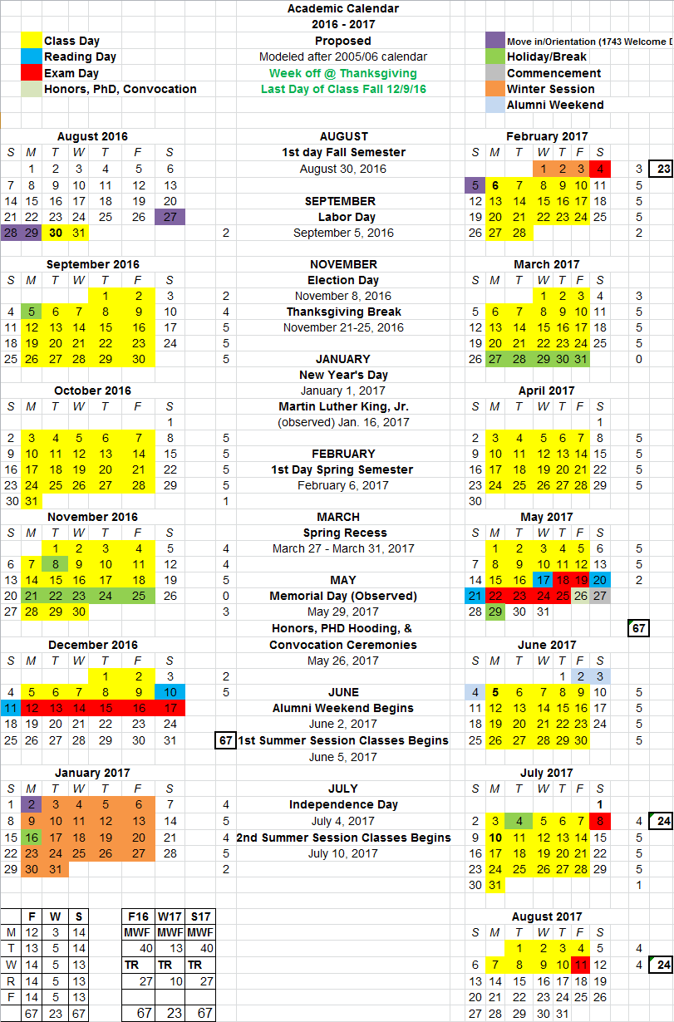
Announcements
According to its charge, after conferring with UGS and CGS, the Coordinating Committee has completed its review of the 2016-17 Academic Calendar.
There are 67 days of instruction in Fall 2016 and Spring 2017.
Winter 2017 has 23 days of instruction, and the two 5-week summer sessions have 24 days each.
There is a full week off during the Thanksgiving break.
Kudos to UGS for figuring out how to make exams end on December 17 instead of December 21 as originally proposed.

Slide 8
Agenda
V. Presentations: Acquisition of Surplus Military Equipment Pat Ogden, Chief of Police Skip Homiak, Executive Director of Campus and Public Safety Scott Douglass, Executive Vice President and Treasurer

Slide 9
Agenda
VI. Consent Agenda: None
VII. Regular Agenda: 1. Unfinished Business: None 2. New Business: a. Revising the Charge of the Graduate Studies Committee
b. General Education Resolution
c. MOOC Resolution
d. Forming a Commission on Sexual Harassment and Assault
VIII. Introduction of New Business:
Such items as may come before the Senate. (No motion introduced under new business, except a motion to refer to committee, shall be acted upon until the next meeting of the Senate.)

Slide 10
Graduate Studies Resolution
WHEREAS, the University of Delaware Faculty Senate Graduate Studies Committee shall receive and may stimulate and originate proposals for its development, and
WHEREAS, this committee shall have the power to act on and shall make recommendations to the Faculty Senate on matters of policy concerning graduate study, and
WHEREAS, the title for one of the ex officio members listed is Vice Provost for Academic Programs and Planning, and this position no longer exists, therefore, be it
RESOLVED, that the Vice Provost for Graduate and Professional Education, or their designee, shall serve on the committee as one of the ex officio members, and be it further
RESOLVED, that the charge of the Faculty Senate Committee on Graduate Studies shall be revised as in the redline document attached (redline attachment).

Slide 11
General Education Resolution
WHEREAS, the University of Delaware exists to cultivate learning, develop knowledge, and foster the free exchange of ideas, and
WHEREAS, a robust program of general education is an essential component of the cultivation of learning, the development of knowledge, and the fostering of a free exchange of ideas, and
WHEREAS, the overarching goal of general education at the University of Delaware is to set students along the path of possessing the characteristics of one who is both broadly and deeply educated, and
WHEREAS, in our April 2011 self-study prepared for the Middle States Commission on Higher Education, we noted that the current undergraduate general education goals, requirements, and assessment activities are under review with an eye toward streamlining the list of goals and taking action steps between now and 2015 to establish a coherent and integrative program of undergraduate education and university requirements, and
WHEREAS, this review has proceeded and culminated in the recommendations below, therefore, be it

Slide 12
General Education Resolution
RESOLVED, that the Faculty Senate adopts the following statement of purposes for the University of Delaware’s general education program:
We seek to prepare students who are:
Engaged citizens, involved in the world around them, and who understand the major challenges and debates of the day;
Aware of their intellectual strengths and interests and of their ethical values and commitments;
Capable of interpreting the arts and culture of contemporary and past societies; and
Equipped with the essential skills necessary to thrive in a rapidly evolving world including the ability to be a lifelong learner, creator, and innovator.
and be it further

Slide 13
General Education Resolution
RESOLVED, that to meet these purposes, the Faculty Senate adopts for all students the five objectives of general education set forth as follows:
General education at the University of Delaware prepares students who are able to:
Read critically, analyze arguments and information, and engage in constructive ideation.
Communicate effectively in writing, orally, and through creative expression.
Work collaboratively and independently within and across a variety of cultural contexts and a spectrum of differences.
Critically evaluate the ethical implications of what they say and do.
Reason quantitatively, computationally, and scientifically.
and be it further

Slide 14
General Education Resolution
RESOLVED, that to implement these objectives, the General Education Committee of the Faculty Senate will by 1 April 2015 submit an implementation plan aligned with the UD General Education Objectives; and be it further
RESOLVED, that the General Education Committee will develop an assessment plan whereby the University of Delaware can track student progress toward meeting the UD General Education Objectives; and be it further
RESOLVED, that an open hearing will be held during the early part of the Spring semester of 2015 to receive campus input regarding these plans.
(addendum attachment)

Slide 15
MOOC Resolution
WHEREAS, the Board of Trustees has assigned to the Faculty the responsibility of providing for the establishment of curricula and courses as well as for the establishment of a program of extra-curricular education; and
WHEREAS, the Faculty have established their Senate to exercise all the powers vested in the Faculty by the Board of Trustees and to determine the duties that it will delegate to faculty committees; and
WHEREAS, the Senate’s Coordinating Committee on Education is charged with reviewing the broad educational affairs of the University and for providing for the examination and preparation of educational proposals; and
WHEREAS, the University is now endorsing Massive Open Online Courses (MOOCs); and
WHEREAS, these courses are not currently approved by the Faculty through their Senate as are all other courses; therefore, be it
RESOLVED, that all MOOCs offered by the University of Delaware must be approved by the Senate’s Coordinating Committee on Education.

Slide 16
Sexual Harassment Resolution
Resolution to form a Commission to Review Current Policies and Procedures for Addressing Sexual Harassment and Assault Allegations (charge and membership attachment)
Authored by Michael Chajes, Professor of Civil and Environmental Engineering, and former Dean of the College of Engineering
Co-sponsored by the following Senators:
Brian Ackerman, Pscyhological and Brain Sciences
Wayne Batchis, Political Science and International Relations
Nicole Donofrio, Plant and Soil Sciences
Steven Eidelman, Human Development and Family Studies
Jeffrey Heinz, Linguistics and Cognitive Science
Tain-Jian Hsu, Civil and Environmental Engineering
Paul Laux, Finance (lead sponsor)
William Lewis, School of Education
Mark Parcells, Animal and Food Sciences
Herbert Tanner, Mechanical Engineering

Slide 17
Sexual Harassment Resolution
WHEREAS, sexual harassment and assault on college campuses is a nationwide problem, and
WHEREAS, the University of Delaware should strive to create a safe and supportive environment for all students, faculty, staff, and administrators and should provide an exemplary model for addressing sexual harassment and assault cases, therefore be it
RESOLVED, that a commission with representation from students, faculty, staff, and administrators will be formed by the Faculty Senate Executive Committee and given the task of making recommendations for the implementation of best practices regarding policies and procedures for addressing sexual harassment and assault allegations, and be it further
RESOLVED, that to achieve this goal the commission will work in concert with the Title IX Coordinator’s efforts to review current policies at the University of Delaware and elsewhere, ensure that the community is educated regarding current policies, broadly solicit recommendations for improving current policies, develop proposed policy changes, and hold hearings to obtain input on proposed policy changes, and be it further
RESOLVED, that the commission will develop recommendations for consideration by the full Faculty Senate no later than the April 2015 Faculty Senate meeting.

Slide 18
Agenda
VIII. Introduction of New Business:
Such items as may come before the Senate. (No motion introduced under new business, except a motion to refer to committee, shall be acted upon until the next meeting of the Senate.)

