Slide 1
Special Faculty Senate Meeting January 12, 2015 Happy New Year!

Slide 2
Agenda
I. Adoption of the Agenda: January 12, 2015
II. Approval of the Minutes: December 1, 2014
III. Remarks: Provost Grasso
IV. Announcements: Senate President Fred Hofstetter

Slide 3
Log of Changes to FWP Policy
As Deni Galileo requested at the end of the Faculty Senate meeting on 1 December 2014, I sent FWP chair John Courtright a log of the changes that had been made in the FWP policy document.
The definition of Complainant was modified. The old definition was "Complainant refers to the student, staff or faculty member who brought a sexual misconduct complaint against the Respondent." The new definition is "Complainant refers to the student, staff or faculty member who brought a sexual misconduct or other formal complaint of wrongdoing against the Respondent prompting the FWP proceeding." Where the old document said "if the matter involves allegations of Sexual Misconduct, the Complainant" the current version says simply "the Complainant".
At the end of the definition of sexual misconduct, the following sentence was added: "Nothing in this policy shall infringe upon First Amendment or academic freedom protections set forth in either the Faculty Handbook or in the Collective Bargaining Agreement between the University of Delaware and the American Association of University Professors."

Slide 4
Log of Changes to FWP Policy
In the revisions to the FWP Termination and Complaint Procedures that are before you today, the following additional changes have been made and voted on by the FWP committee:
Added to I-A-12 definition of Sexual Misconduct: “Speech appropriately related to curriculum, teaching, research, and scholarship is not sexual misconduct.”
In I-C-1-d-i: Changed "four weeks" to "20 days”
Added I-C-7-b: “Unless a majority of the Hearing Panel recommends that the accused faculty member be terminated, the accused faculty member shall not be terminated.”
Deleted the definition of Designated Dean (formerly section II-A-11)
Changed "Respondent" to "Initiator" in the definition of Complainant in section II-A-11.
Added to II-A-12 definition of Sexual Misconduct: “Speech appropriately related to curriculum, teaching, research, and scholarship is not sexual misconduct.”
Removed the vestigial mention of the Designated Dean in Section II-C-3-b-iii.
On page 1 where the document mistakenly referred to Section II-C, that referral was corrected to Section II-B.

Slide 5
Pending Amendments
During today’s Special Meeting, we must vote on the FWP resolution. During the debate, we are aware of five amendments that may be made as follows.
Past President Galileo has proposed, and the Executive Committee has endorsed, amending the resolved clauses to clarify that the Faculty Senate is "recommending" the termination changes in keeping with Section 3.2.5.2 of the BOT Bylaws, which give the faculty the privilege "To make recommendations to the President, for transmission to the Board, concerning the formation of policies governing appointments, promotions, tenure, dismissals, and salaries."
Senator Zide has drafted amendments that remove section I-C-7-b, require majority and minority reports to be signed in section I-C-7, and require the Provost to provide an explanation if the Provost’s decision contradicts the majority vote of the FWP hearing committee.
President Elect Opila may propose amending section 1-C-7-b.
In considering these possible changes and any other amendments that may come from the floor, Robert’s Rules will be in effect.

Slide 6
Galileo Amendment
WHEREAS, the Committee on Faculty Welfare and Privileges (FWP) Termination and Complaint Procedures (the “Procedures”) have not been edited and updated since 1999, and
WHEREAS, updates need to be made to the Procedures including the definition of the term Faculty to redefine who may file FWP complaints, and
WHEREAS, it is in the best interest of the University and its faculty to ensure that the Procedures conform to new requirements imposed by the U.S. Department of Education’s Office for Civil Rights (OCR) interpretation of Title IX, and
WHEREAS, the University needs to do all it can to reduce the incidence of sex discrimination and sexual harassment, and therefore, be it
WHEREAS, it is a privilege of the faculty to make recommendations concerning policies governing dismissals, therefore, be it
RESOLVED, that the FWP Committee’s Termination and Complaint Procedures (exclusive of Section I. Termination Procedures) shall be revised as in the red line document that is attached (Attachment 1), and be it further
RESOLVED, that the Faculty Senate recommends that the FWP Committee’s Termination Procedures (Section I.) be revised as in the red line document that is attached (Attachment 1).

Slide 7
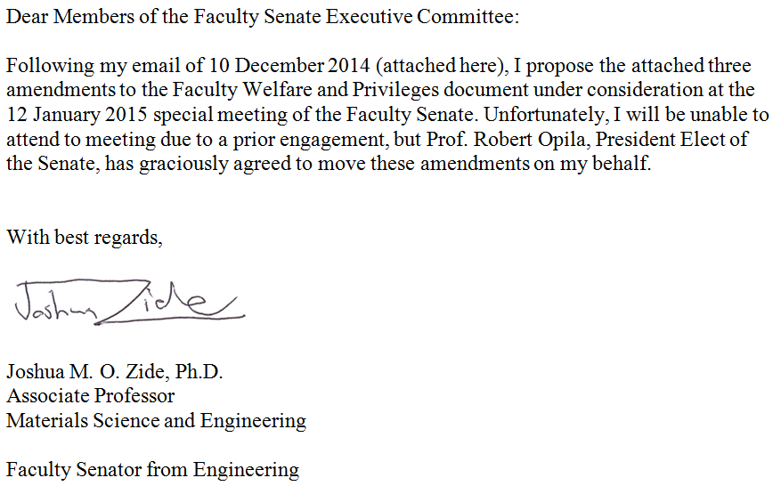
Zide Amendments

Slide 8
Zide Amendment #1
Whereas shared governance means that the Provost has some responsibilities, and
Whereas the Senate should not pass measures which contravene the principle of shared governance, and
Whereas the Faculty Handbook indicates that the Committee on Faculty Welfare and Privileges has advisory, rather than executive, role, and
Whereas those responsible for the final determination as to whether to terminate faculty appointments are subject to being named in lawsuits by either those who sue for wrongful termination or by the victims of misconduct, therefore, be it
Resolved that the proposed version of the Committee on Faculty Welfare and Privileges policy is amended to remove clause I-C-7-b, which currently reads, “Unless a majority of the Hearing Panel recommends that the accused faculty member be terminated, the accused faculty member shall not be terminated.”

Slide 9
Zide Amendment #2
Whereas the role of the Hearing Board is advisory to the Provost, and
Whereas the Provost benefits from having as much information as possible, and
Whereas majority and minority opinions are often both of value, and
Whereas vote counts or signatures are especially useful in advisory matters, therefore, be it
Resolved that the proposed version of the Committee on Faculty Welfare Privileges charge is amended to add the following clause to section 1-C-7, “Both the opinion of the majority (as described in 1-C-7-a) and a report of those in the minority (in the event the opinion is not unanimous) shall be provided to the Provost. These opinions should be signed by the concurring parties at the discretion of the members of the panel. In the event the panel chooses not to sign the opinions, the number of members supporting each position should be provided.”

Slide 10
Zide Amendment #3
Whereas the Provost makes the final decision in termination cases, and
Whereas the principle of shared governance means that the Provost should carefully consider the opinions of the Hearing Panel, and
Whereas the Faculty Welfare and Privileges Committee can reasonably expect the Provost to only overturn the ruling of a Duly Constituted Hearing Panel in exceptional circumstances, therefore, be it
Resolved that the proposed version of the Committee on Faculty Welfare and Privileges charge is amended to add the following clause to section 1-C-7, “If the Provost contravenes the majority opinion of the Hearing Panel, the Provost shall provide a written explanation to the Committee.”

Slide 11
Opila Amendment
Be it resolved that Section I-C-7-b shall read as follows: Within 21 days after receipt of the Report, which includes the recommendation, the Provost (or President) shall, in writing, either affirm the Report or refer it back to FWP with detailed objections and/or suggestions. If the Report is referred back, FWP shall review the Provost's (or President’s) response, taking into account any objections or suggestions therein. FWP submits a revised report within 21 days to the Provost (or President), who may affirm, modify, or reject it within 21 days. If the Report is rejected or modified, then the Provost (or President) shall provide a written statement to the Committee and both parties describing the substantive reason(s) for rejection or modification. The Provost's (or President’s) decision shall be final and conclusive, and the matter in question shall be deemed closed, unless either party requests an appeal to the Board of Trustees within 21 days after receipt of a written copy of the Provost's (or President’s) decision. The Board of Trustees may hear appeals at their discretion, and the Board's decision shall be final. [Note: The current proposed wording of I-C-7-b is “Unless a majority of the Hearing Panel recommends that the accused faculty member be terminated, the accused faculty member shall not be terminated.”]

Slide 12
Open Discussion Item
During the open discussion period on December 1, I failed to recognize an observer who had been raising his hand wanting to speak.
Before ending the discussion I should have recognized him because everyone else who had raised their hand had been given an opportunity to speak.
After discussing this, our agreement was that I would recognize him today, and now he has two minutes to speak.

Slide 13
Agenda
V. Consent Agenda: None
VI. Regular Agenda: 1. Unfinished Business: a. Revising the FWP Termination and Complaint Procedures
VII. Introduction of New Business:
Such items as may come before the Senate. (No motion introduced under new business, except a motion to refer to committee, shall be acted upon until the next meeting of the Senate.)

Slide 14
FWP Resolution
WHEREAS, the Committee on Faculty Welfare and Privileges (FWP) Termination and Complaint Procedures (the “Procedures”) have not been edited and updated since 1999, and
WHEREAS, updates need to be made to the Procedures including the definition of the term Faculty to redefine who may file FWP complaints, and
WHEREAS, it is in the best interest of the University and its faculty to ensure that the Procedures conform to new requirements imposed by the U.S. Department of Education’s Office for Civil Rights (OCR) interpretation of Title IX, and
WHEREAS, the University needs to do all it can to reduce the incidence of sex discrimination and sexual harassment, therefore, be it
RESOLVED, that the FWP Committee’s Termination and Complaint Procedures shall be revised as in the red line document that is attached (Attachment 1).

Slide 15
Galileo Amendment
WHEREAS, the Committee on Faculty Welfare and Privileges (FWP) Termination and Complaint Procedures (the “Procedures”) have not been edited and updated since 1999, and
WHEREAS, updates need to be made to the Procedures including the definition of the term Faculty to redefine who may file FWP complaints, and
WHEREAS, it is in the best interest of the University and its faculty to ensure that the Procedures conform to new requirements imposed by the U.S. Department of Education’s Office for Civil Rights (OCR) interpretation of Title IX, and
WHEREAS, the University needs to do all it can to reduce the incidence of sex discrimination and sexual harassment, and therefore, be it
WHEREAS, it is a privilege of the faculty to make recommendations concerning policies governing dismissals, therefore, be it
RESOLVED, that the FWP Committee’s Termination and Complaint Procedures (exclusive of Section I. Termination Procedures) shall be revised as in the red line document that is attached (Attachment 1), and be it further
RESOLVED, that the Faculty Senate recommends that the FWP Committee’s Termination Procedures (Section I.) be revised as in the red line document that is attached (Attachment 1).

Slide 16
Friendly Amendment from Senator Duker
Proposed friendly amendment to Regular Agenda, 1. Unfinished business Proposal a, Attachment 1 (Faculty Senate Jan. 12, 2015)
Rationale:
There are two references to an older version of the Faculty Handbook (with a different organizational system than the current one); this amendment will update these references to the current Faculty Handbook.
Current language in Attachment 1:
pg. 2 top line: "Handbook, III, N"
pg. 3 line 2: “Handbook, III, N"
Replace both instances with:
“Handbook, 4.1.15."

Slide 17
Opila Amendment
Be it resolved that Section I-C-7-b shall read as follows: Within 21 days after receipt of the Report, which includes the recommendation, the Provost (or President) shall, in writing, either affirm the Report or refer it back to FWP with detailed objections and/or suggestions. If the Report is referred back, FWP shall review the Provost's (or President’s) response, taking into account any objections or suggestions therein. FWP submits a revised report within 21 days to the Provost (or President), who may affirm, modify, or reject it within 21 days. If the Report is rejected or modified, then the Provost (or President) shall provide a written statement to the Committee and both parties describing the substantive reason(s) for rejection or modification. The Provost's (or President’s) decision shall be final and conclusive, and the matter in question shall be deemed closed, unless either party requests an appeal to the Board of Trustees within 21 days after receipt of a written copy of the Provost's (or President’s) decision. The Board of Trustees may hear appeals at their discretion, and the Board's decision shall be final. [Note: The current proposed wording of I-C-7-b is “Unless a majority of the Hearing Panel recommends that the accused faculty member be terminated, the accused faculty member shall not be terminated.”]

Slide 18
Zide Amendment #1
Whereas shared governance means that the Provost has some responsibilities, and
Whereas the Senate should not pass measures which contravene the principle of shared governance, and
Whereas the Faculty Handbook indicates that the Committee on Faculty Welfare and Privileges has advisory, rather than executive, role, and
Whereas those responsible for the final determination as to whether to terminate faculty appointments are subject to being named in lawsuits by either those who sue for wrongful termination or by the victims of misconduct, therefore, be it
Resolved that the proposed version of the Committee on Faculty Welfare and Privileges policy is amended to remove clause I-C-7-b, which currently reads, “Unless a majority of the Hearing Panel recommends that the accused faculty member be terminated, the accused faculty member shall not be terminated.”

Slide 19
Zide Amendment #2
Whereas the role of the Hearing Board is advisory to the Provost, and
Whereas the Provost benefits from having as much information as possible, and
Whereas majority and minority opinions are often both of value, and
Whereas vote counts or signatures are especially useful in advisory matters, therefore, be it
Resolved that the proposed version of the Committee on Faculty Welfare Privileges charge is amended to add the following clause to section 1-C-7, “Both the opinion of the majority (as described in 1-C-7-a) and a report of those in the minority (in the event the opinion is not unanimous) shall be provided to the Provost. These opinions should be signed by the concurring parties at the discretion of the members of the panel. In the event the panel chooses not to sign the opinions, the number of members supporting each position should be provided.”

Slide 20
Zide Amendment #3
Whereas the Provost makes the final decision in termination cases, and
Whereas the principle of shared governance means that the Provost should carefully consider the opinions of the Hearing Panel, and
Whereas the Faculty Welfare and Privileges Committee can reasonably expect the Provost to only overturn the ruling of a Duly Constituted Hearing Panel in exceptional circumstances, therefore, be it
Resolved that the proposed version of the Committee on Faculty Welfare and Privileges charge is amended to add the following clause to section 1-C-7, “If the Provost contravenes the majority opinion of the Hearing Panel, the Provost shall provide a written explanation to the Committee.”

Slide 21
Agenda
VII. Introduction of New Business:
Such items as may come before the Senate. (No motion introduced under new business, except a motion to refer to committee, shall be acted upon until the next meeting of the Senate.)

