Slide 1
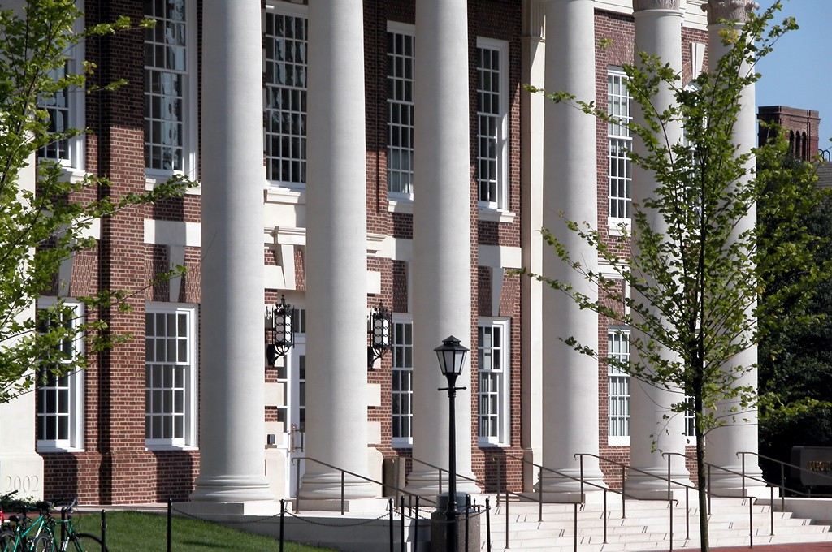
University of Delaware Cyber Security Initiative/UDCSI
Dr. Starnes E. Walker
Founding Director
April, 2015

Slide 2
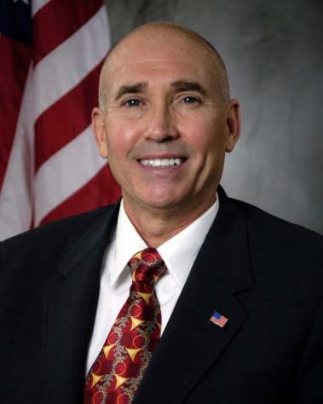
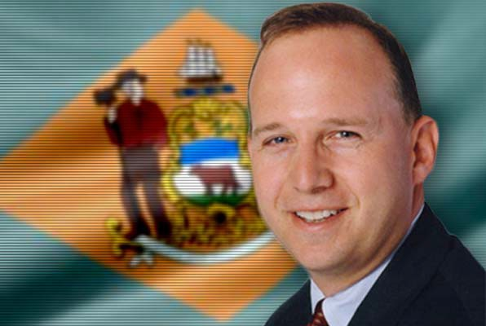
Cybersecurity Initiative
Starnes Walker, Director, Cybersecurity Initiative
Previously CTO-US Fleet Cyber‐CMD & U.S. 10 Fleet & Exec DIR-Office of Naval Research/Department of Navy, Defense Threat Reduction Agency-DoD—Senior Exec Service/SES Member Appointments
Director of Research, SES, U.S. Department of Homeland Security
Gov. Jack Markel, State of the State (1/23/14): Our institutions of higher education are positioning themselves to take a leadership role in this area and I am pleased to join with them to launch the Delaware Cyber Initiative.

Slide 3
UDCSI Overview
Key initiatives and programs spanning all 7 UD Colleges
Focus on training, education, and research addressing capability gaps for industry, small business & Government/Military UD partners

Slide 4
Cybersecurity Initiative
Goal — Establish a regional Cybersecurity coalition and UD Cybersecurity Initiative that capitalize on strategic advantages
  Geographic location
  Unique academic, government and private sector partnerships
Strategy — Develop high visibility research and education programs
Today’s Objective — Bring coalition partners together to guide program development and next steps

Slide 5
University of Delaware Cyber Security Initiative Advisory Council
RADM-Ret Jay M. Cohen, Principal-Chertoff Group (former Chief of Naval Research & DHS Under Secretary-S&T)
RADM-Ret Bill Leigher, Director-Advanced Solutions-Raytheon, (former Director-Information Dominance N2/N6 (Intelligence & Operations) of the OPNAV Staff supporting the Chief of Naval Operations & founding Deputy Commander U.S. Fleet Cyber Command/U.S. 10th Fleet)
Dr. Dale Klein, Associate Vice Chancellor for Research-The University of Texas System (former Assistant to the Secretary of Defense-Nuclear, Chemical, & Biological/directly reporting to the Secretary of Defense & Chairman-Nuclear Regulatory Commission)
Dr. Arden Bement, former Chief Global Affairs Officer & David A. Ross Distinguished Professor of Nuclear Engineering-Purdue University and former Director-National Science Foundation & Director-NIST
Stephen Kelly, Senior Vice President & President-Battelle National Security, Battelle Memorial Institute
Charles Palmer, CTO Security & Privacy & Member IBM Academy of Technology, IBM
Dr. Lane Arthur, Vice President-Information Protection & CIO, DuPont Pioneer
Cynthia Frick, Senior Vice President & Senior Architect Manager-Global Information Security, Bank of America
LTG-ret Guy Swan, Vice President-Association of U.S. Army, former Commander-Army North, Ft Sam Houston and Director-Operations/J3 U.S. Northern Command & NORAD
Maj Gen Tom Thomas (USAF-R), Commander-DE Air National Guard & Assistant to the Commander-U.S. Cyber Command & Director-NSA, (also Senior Vice President-Bank of America)
(Maj Gen-ret) Dr. Paul Nielson (former Commander-Air Force Research Laboratory), Director-Software Engineering Institute, Carnegie-Mellon University
David DeWalt, Chairman & CEO, FireEye, Inc.
Joseph Hammer, Managing Director-Information Technology & Services, Morgan Stanley
Thomas Quinn, Technology Controls Officer, JPMorgan Chase

Slide 7


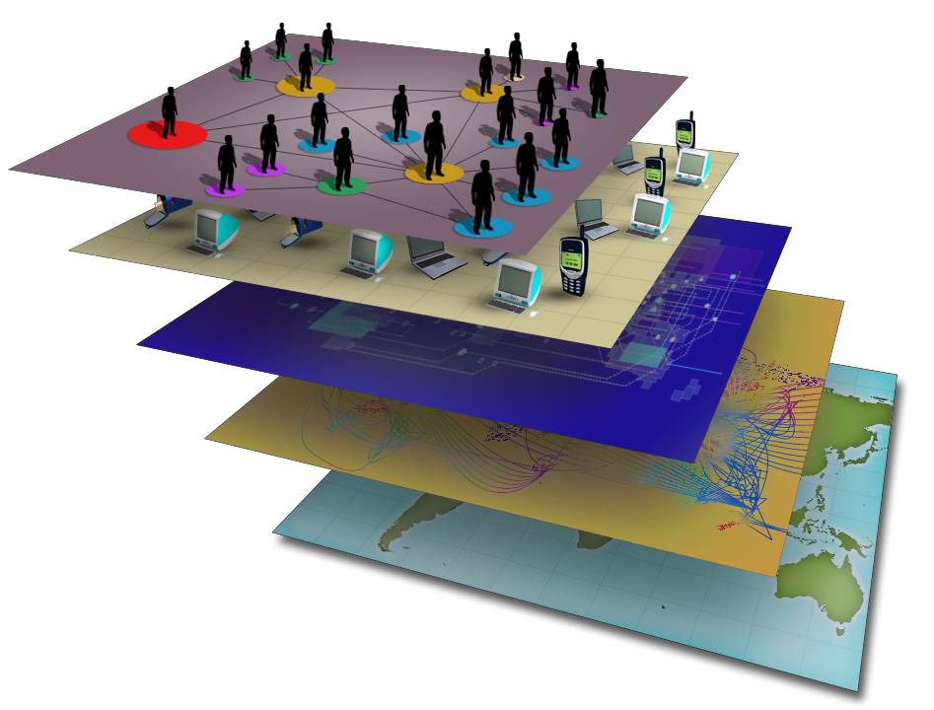


















The Cyber Environment
Cyberspace is where the Nation stores its treasure
(intellectual property) and its wealth (money)
Benefits:
National security
Economic
competiveness
Public safety
Civil liberties &
privacy
People
Cyber Identity
Information Layer
Physical Infrastructure
Geographic Layer

Slide 8














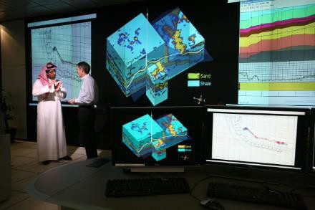



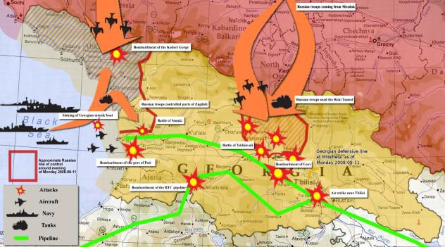

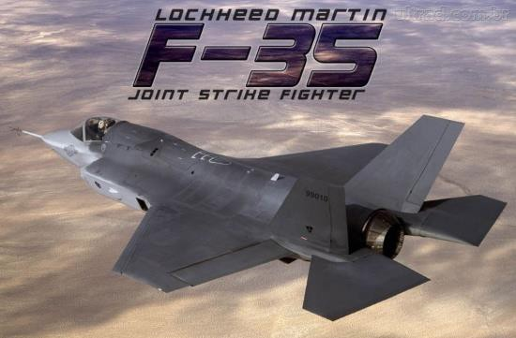

A Disturbing Trend
The Threat is Evolving

Slide 9










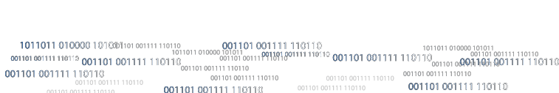








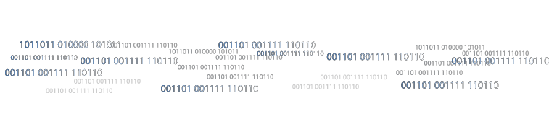

Nature of Cyberspace

Slide 10









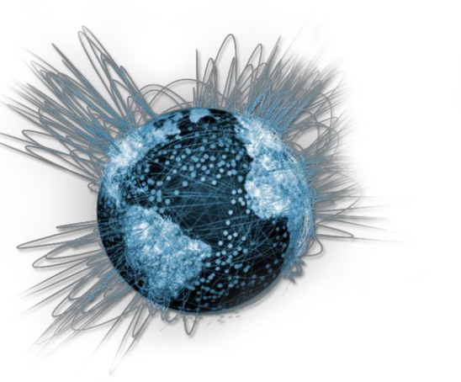





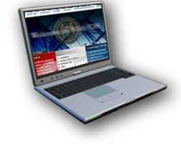

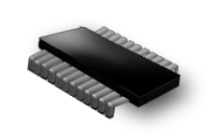
Exponential Rates
Library of Congress = 10 Terabytes
At best transmission line speed:
• 1998 = 16.5 days
• 2013 = .00008 seconds
5
Billion
634
Million
6.4
Billion
34%
2.3
Billion
2012
5.3
Billion
255
Million
28%
2010
10 Billion Mobile Devices Projected by 2016
(1.4 per person on the planet)
4
Billion
20%
187
Million
758
Million
2008
Facebook
Launch, 2004
Reaches1 Billion Users, 2012
2000
5%
740
Million
15.6
Million
42
Million
6

Slide 11
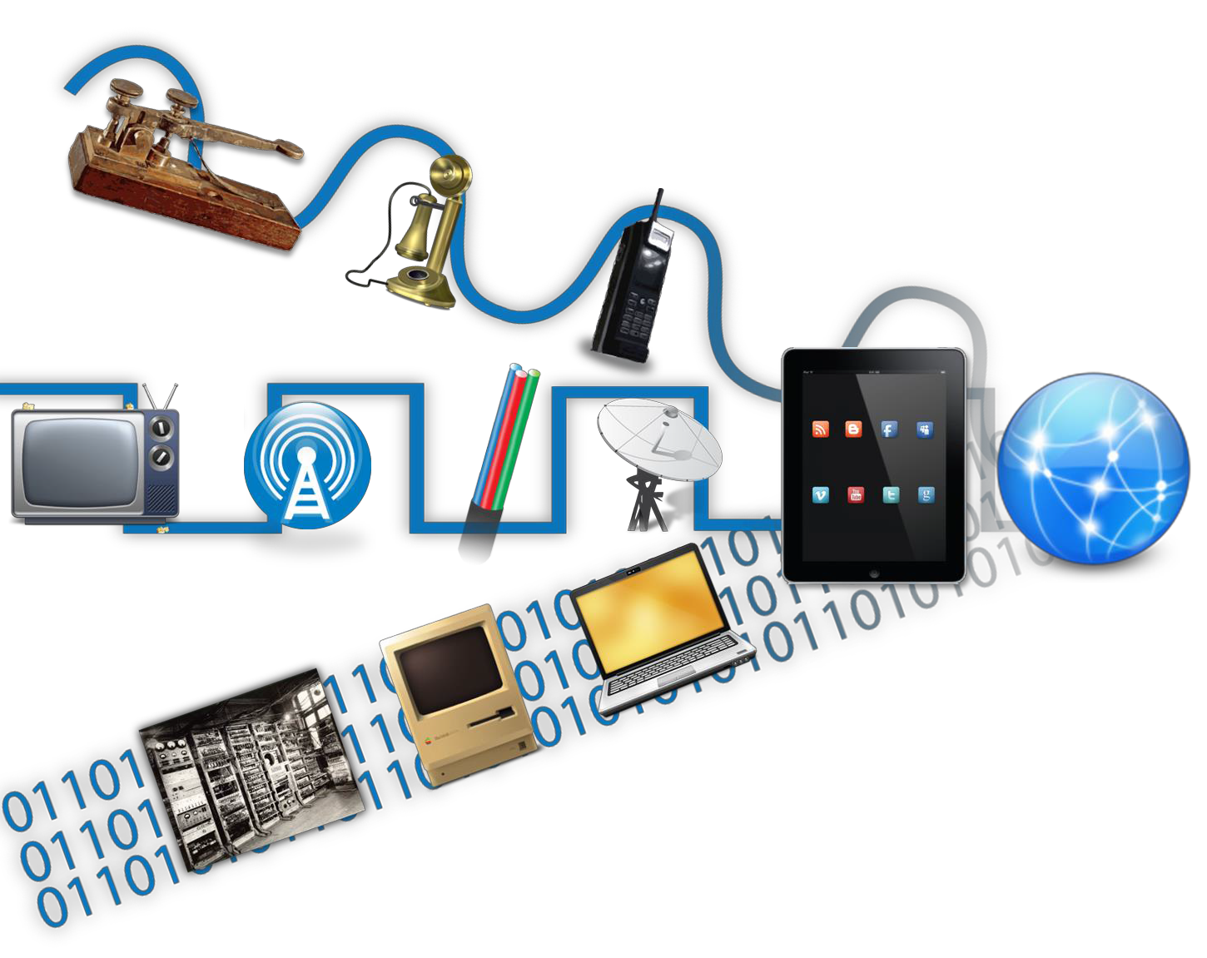




Convergence Opportunities
& Vulnerabilities
Opportunities
Vulnerabilities
An effective cyber attack against the right sector could be devastating to the US economy
Our adversaries are exploiting us; we must defend our networks
Gathering Information; planning cyber operations
Possible attribution of a cyber attack
Intelligence collection
& production more efficient & effective
Ability to maneuver in
cyberspace
Convergence means we all operate on the same network…

Slide 12














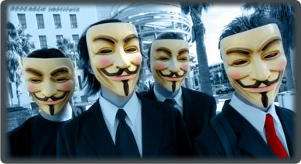




















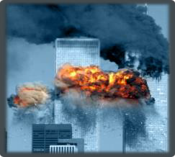









THREAT ACTORS
FOREIGN INTELLIGENCE
HACKTIVISTS
CRIMINAL
ELEMENTS
TERRORIST ACTS

Slide 13
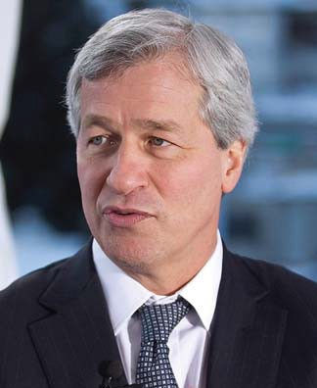
Cybersecurity Initiative
Each year, JPMorgan Chase spends approximately $200 million to protect ourselves from cyberwarfare and to make sure our data are safe and secure. This number will grow dramatically over the next three years. More than 600 employees across the firm are dedicated to the task. And this number likely will grow as well.
Jamie Dimon
JPMC Chairman & CEO April 10, 2013 Letter to Shareholders

Slide 14
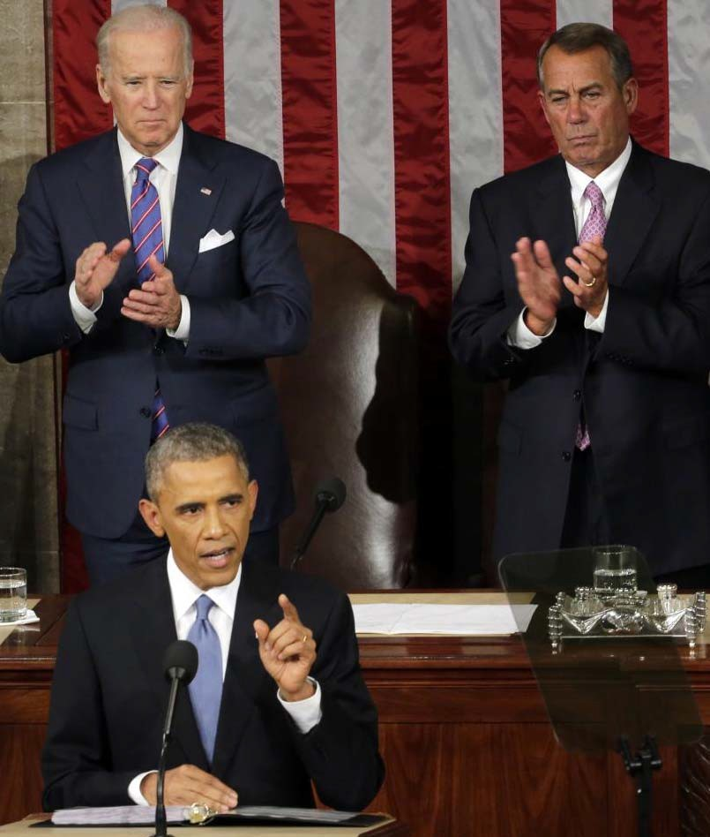
Cybersecurity Initiative
No foreign nation, no hacker, should be able to shut down our networks, steal our trade secrets, or invade the privacy of American families, especially our kids. So we’re making sure our government integrates intelligence to combat cyber threats, just as we have done to combat terrorism.
President Barack Obama
2015 State of the Union Address

Slide 15




Cybersecurity Initiative
Educational Programs
•Certificate Program
•Minor Degree
•Masters Degree
•4+1 Program
•2+2 Program
Partnerships
•Corporate & Government
•SAIC, JPMC, US Army (APG), DE
DTI, DE NG Network Warfare Squad.
•Academic
•Del Tech, Harford CC, DSU
Research
•Fundamental Research
•Network, Computer & Systems Security
•Information Assurance
•Cyber Defense and Offense
•Behavioral Analysis
•Classified Research
Outreach
•Student Internships
•Summer K‐12 Camps
•Bridge Programs
•Workshops & Seminars
•Business Cooperative Extension
Educational Programs
•Certificate Program
•Minor Degree
•Masters Degree
•4+1 Program
•2+2 Program
Partnerships
•Corporate & Government
•SAIC, JPMC, US Army (APG), DE
DTI, DE NG Network Warfare Squad.
•Academic
•Del Tech, Harford CC, DSU
Research
•Fundamental Research
•Network, Computer & Systems Security
•Information Assurance
•Cyber Defense and Offense
•Behavioral Analysis
•Classified Research
Outreach
•Student Internships
•Summer K‐12 Camps
•Bridge Programs
•Workshops & Seminars
•Business Cooperative Extension

Slide 16
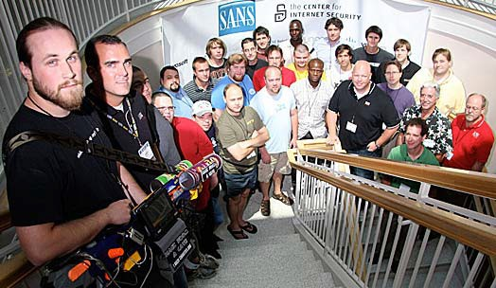
Cybersecurity Initiative
NSF Capacity Building Grant
Broad Coalition of Partners
  UD, Del Tech, Harford
  I2WD, SAIC, JPMC, DE
Capacity Building
  New Cybersecurity UD Faculty
  Pipeline of Graduates
Research Activities
  Information Assurance
  Cyber Defense and Offense
  Classified Research
Education Initiatives
  2+2, Minor, MS, 4+1 Degree Programs
  Internship, K‐12 Summer Outreach Activities

Slide 17
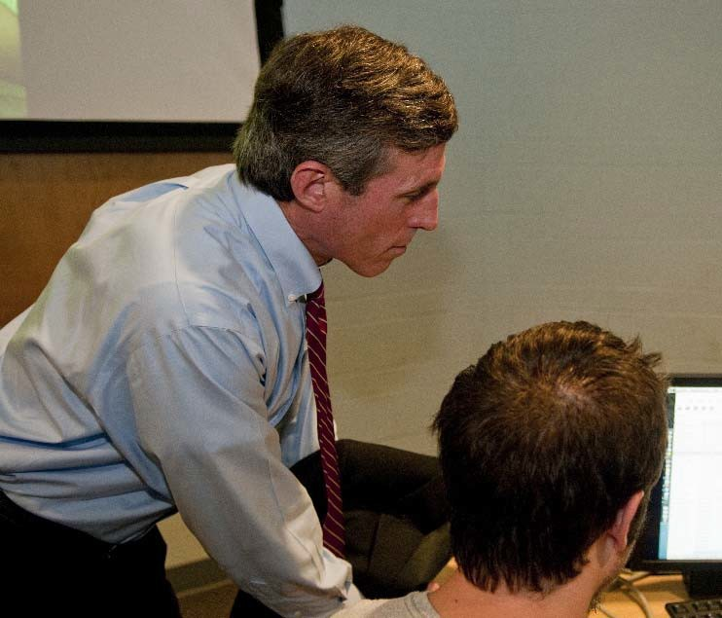
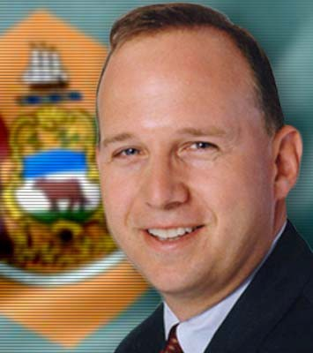
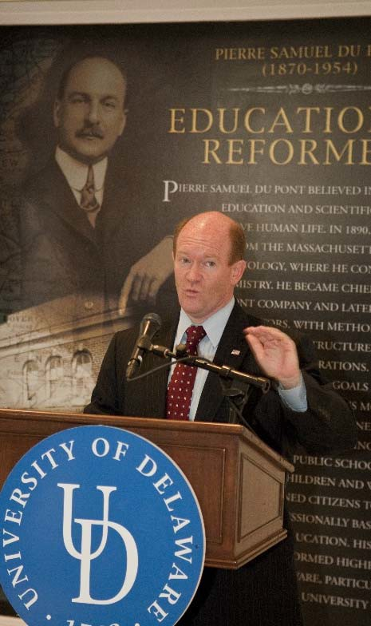
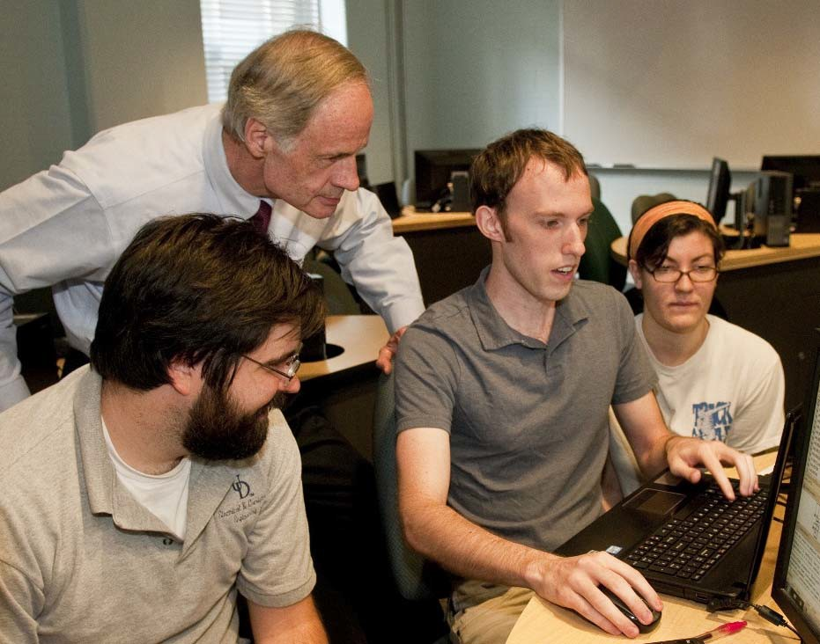
Cybersecurity Initiative
Gov. Jack Markel, State of the State (1/23/14): Our institutions of higher education are positioning themselves to take a leadership role in this area and I am pleased to join with them to launch the Delaware Cyber Initiative.
Senators Carper and Coons and Rep.
Carney at CSI kickoff press conference.

Slide 18
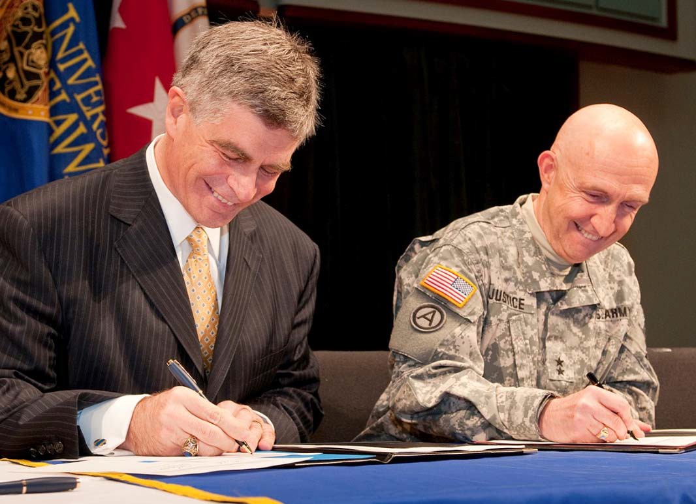
APG‐UD Partnership
Flexible Educational Programs
  On‐post courses, part‐time MS & PhD programs
    19 Courses on post and 71 APG employee enrollees to date
    Substantial tuition discount: 45% (~$800/credit)
  Workforce development, student interns
  Client driven senior design capstone projects
National Defense Research Focus
  Cyber security, high‐performance computing, sensing & systems, information processing
  UD‐RDECOM CRADA: ~30 SOWs
  Major contract participants
    NIST Cybersecurity FFRDC (MITRE, UM), TESS (BAH, DSCI), SSES NG (LEIDOS/SAIC), TIES (LEIDOS/SAIC, Praxis, EOIR), TAOSS (LEIDOS/SAIC)
Facilities & Classified Research
  STAR Campus Cybersecurity Institute — new construction
  Institutional ability to conduct classified research
  5+ faculty with clearances
Key Partnerships
  Financial industry (JPMC, BoA), DOD (APG, DE NG, ONR, AFSOR), Academia (UM‐CP/BC, Purdue, UT, Cornell, Harford, DTCC)

Slide 19
On‐Post Courses
APG On‐Post Courses Technical Concentrations
Computer Engineering
Information Assurance and Cybersecurity
Optics and Photonics RF Technologies Software Engineering
Communications and Signal Processing
Hi‐Performance Computing
Introduction to Cybersecurity
Optics
Advanced Electromagnetics
Software Process Management
Digital Signal Processing
Parallel Computer Architectures
Advanced Cybersecurity
Photonic Devices I
Computational Electromagnetics
Software Design
Wireless Communications
Computer Systems Design
System Hardening & Protection
Photonic Devices II
Antennae Theory
Software Requirements
Communications Theory I
Introduction to VLSI Design
Digital Forensics
Optical Properties of Materials
Microwave Design I
Software Testing and Maintenance
Communications Theory II
Pen Test and Reverse Engineering
Microwave Design II
Mobile Computing I
Image Processing
Secure Software Design
Advanced Magnetic Materials
Mobile Computing II
Random Signal Theory
Applied Cryptography
Radar Systems
Past, Current and Scheduled On‐Post Classes
Future On‐Post Classes

Slide 20
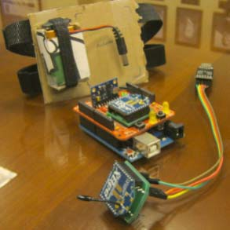
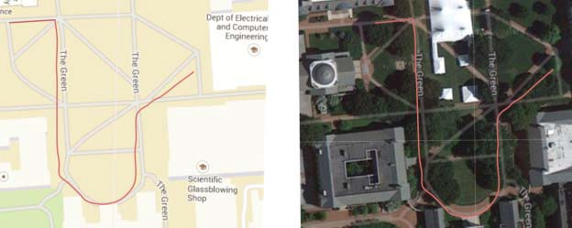
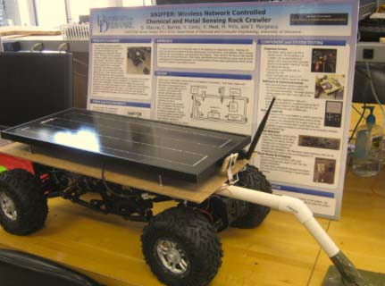
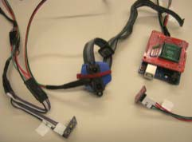
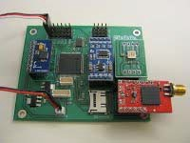
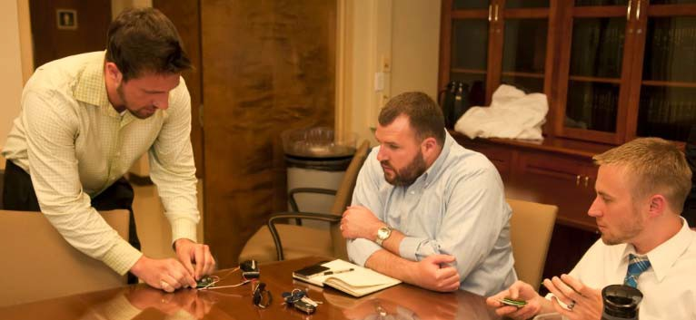
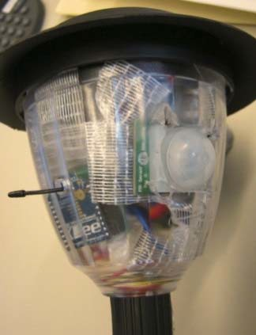
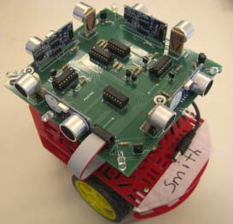
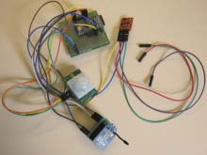
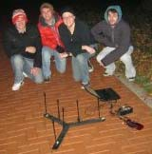
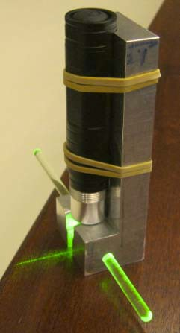
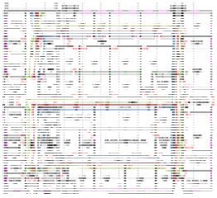
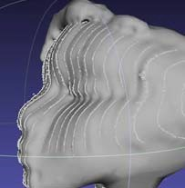

CERDEC Inspired
Senior Design Projects
Fall '14 ‐ Spring '15 AUTONOMOUS BREADCRUMBS THRIFTY POWER‐UP SCANNER
BREADCRUMBS
Adaptive Vehicle Autopilot Dead Reckoning System Energy Harvesting
Renewable Generation Battery Charging Pack 3D Scanner
INERTIA
Fall '13 ‐ Spring '14
TIGR TARGETER SNIFFER SKYRIM
INERTIA ARES
Tactical Ground Reporting System
Distributed Sensors Array to Distinguish Gunfire from other noises & pinpoint the Gunshot Outdoor Roaming Robot with detachable Chemical Sensor and metal detector (for ECBC) Mapping and Recording Compact Camera System based on Quadcopters
Stride Length Assisted Dead Reckoning System
Biometric Authentication ‐ provides secure access through advanced iris scanning software
SNIFFER
SENSORS
ICARUS
Fall '12 ‐ Spring '13
SKYNET SWAG WALL‐E SENSORS WSN RAM COMMAND
Collaborative Robotic Mapping
Determining Location and Direction by Sound Triangulation Robotic Building Mapping with Panoramic Imag
Sensor Net for Security
SKYNET
Hierarchical Wireless Sensor Network (WSN) for area monitoring and security Radio Assisted Mapping ‐ Establishing Team Member Location Using Radio Smartphone Application for the Command and Control of Unmanned Vehicles
Fall '11 ‐ Spring '12
STALKER SkEYE ICARUS AR
Design a robot that will use GPS coordinates to drive to a target, avoiding obstacles as it travels design and build a small UAV (unmanned aerial vehicle) and use it to collect a image map grid Create an flight control system for an Autonomous Unmanned Aerial Vehicle (UAV) Design of an Android application which will implement a markerless type of augmented reality
SCANNER
GUNSHOT
Spring '11
GUNSHOT
Gunfire Triangulation Via Sound
WALL‐E

Slide 21


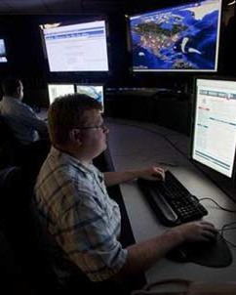

Cybersecurity Initiative
UD, State & Grant 5‐Year Investment: $10M
Building a Cybersecurity Institute to
UDCSI Leadership
•Director, Dr. Starnes Walker
•Deputy Director, Full Professor
•Primary Faculty Members (6‐10)
•Affiliated Faculty Members (20‐30)
•Research & Policy Fellows, Postdocs, Graduate Students, Undergraduate Students
•Entrepreneurs In Residence
Educate current and future Cybersecurity professionals
Develop the workforce and entrepreneurial activities critical to protecting regional infrastructure
Serve as a regional research, testing, and evaluation resource
Build a network of education, government, and private industry institutions jointly addressing Cybersecurity challenges
Institute Infrastructure — STAR Campus
Institute Office Suite
  Co‐Locate Primary Faculty, Students, Fellows, & Resident Collaborators
•Cybersecurity Range
•Real‐World Simulation Environment
•Defenses and Offenses Training & Testing
•Regional Resource — academic, state, and corporate simulation and training facility

Slide 22
Cybersecurity Initiative
Milestones
& Timeline
2016+
•Formally established Cybersecurity Institute
•Open new facilities, including Cybersecurity range
2015
•First Cybersecurity Minor Graduates
•Cybersecurity MS and 4+1 programs
•Cybersecurity workshop/Exec. training
•NSA/DHS National Center of Academic Excellence Certification
•Hire 1+ faculty member
•Internship program
•Corporate affiliates program
•Secure significant sponsored programs
2014
•Hired
•CSI Director, Walker
•CSI faculty, Wang
•Cybersecurity Minor
•2+ courses added
•Advisory Council
•Distinguished Lecture series
•Articulation agreements w/ DTCC
& Hartford
•Summer K‐12 programs begin
2013
•2 Cybersecurity courses added to curriculum
•Cybersecurity faculty search initiated — Tenure‐Track & Adjunct
2012
•NSF
Cybersecurity Capacity Building grant awarded

Slide 23

Cybersecurity Initiative
Cybersecurity Cooperative Extension
Cybersecurity Cooperative Extension
Business Community
State Government
Academic Institutions
Business Community
State Government
Academic Institutions
Small Business
Medium Business
Large Business
Department of Labor
Department of Safety & Homeland Security
Economic Development Office
Department of Technology and Information
University of Delaware
Delaware State University
Delaware Technical Community College
Wilmington University
Medium Business
Large Business
Department of Labor
Department of Safety & Homeland Security
Economic Development Office
Department of Technology and Information
University of Delaware
Delaware State University
Delaware Technical Community College
Wilmington University
Small Business
Shared Resources
•Best Practices
•Timely Sharing of Information
•Workshops
Student Activities
•Security Audits
•Internships
Community Outreach
•Information Dissemination
•Online eExtension
•K‐12 Programs
Shared Resources
•Best Practices
•Timely Sharing of Information
•Workshops
Student Activities
•Security Audits
•Internships
Community Outreach
•Information Dissemination
•Online eExtension
•K‐12 Programs

Slide 24
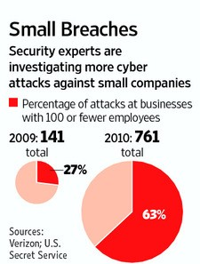
Cybersecurity Initiative

Slide 25







Cybersecurity Education Portfolio
Workshops
Executive Training
Contract Education
Ph.D. Programs
Elec. & Comp. Eng.
Comp. Sci.
Financial Services Analytics
Master’s Programs
2+2 Programs with DTCC & Harford CC
Cybersecurity Technology
Cybersecurity Policy*
Four‐Year Programs
Graduate Certificates
Elect. & Comp. Eng., Com. Sci., Mgt. Inf. Sci.
Cybersecurity Minor
Two‐Year Programs
Information Security & Assurance
4+1 Master’s Program
Research & Internships

Slide 26
Cybersecurity MS & Certificates
MS Degree Requirements: 10 courses (30 cr)
5 Fundamentals of Cybersecurity† courses
5 courses in an area of Concentration
Graduate Certificates can be earned in:
Fundamentals of Cybersecurity
Secure Software
Secure Systems
Security Analytics
Secure Business Systems
Certificate Requirements: 3 courses (9 cr) in Certificate Area. Fundamentals of Cybersecurity Certificate must be earned before Concentration Area Certificates.
Fundamentals of Cybersecurity
Secure Software
Secure Systems
Security Analytics
Security Management
Concentration Areas
†Courses available online

Slide 27









Strategic Partnership Vision
Electrical & Computer Engineering
Expand a strategic partnership focused across all domains of Financial Service Analytics
Value to JPMC
Engage & Recruit Top Students
– Average combined SAT score percentiles:
UD Freshmen: 80th
Engineering Freshmen: 89th
Engineering Honors Freshman: 97th
Business
•Domain Knowledge & Applications
Strategically Aligned Education and Research Programs
– Programs aligned with critical needs
Va lue to UD
Quality Placement of Students
Quantitative
•Statistical Learning, Modeling
& Algorithms
Technology
•Distributed & High Performance Hardware and Software Systems
– Interns & BS, MS, and PhD grads
Strategic Research Partnership with World‐Class Institution
– Real‐world problem identification, data collection & access, unique perspective collaborators
Financial Services Analytics

Slide 28
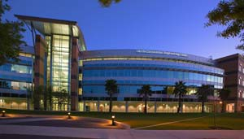
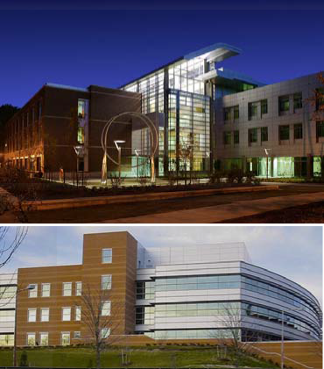
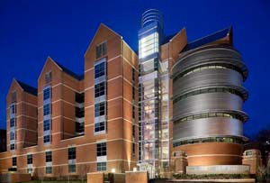
Broad Partnership Initiatives
Create Ta rgeted Clusters of Excellence
High Performance Computing & Big Data Center
  Focus Areas: optimize data flow, cloud computing, date warehousing, data mining
  Current faculty (5); Targeted growth: faculty (+2), research & stipend collaborative support
Financial Services Analytics
  Focus Areas: statistical modeling, machine learning
  Current faculty (4); Targeted growth: faculty (+3), research & stipend collaborative support
Cybersecurity Initiative
  Focus Areas: Identity management, risk assessment, Cyber defense/offense, Cybersecurity range
  Current faculty (3); Targeted growth: faculty (+3), research & stipend collaborative support
Software Engineering
  Focus Areas: requirements engineering, testing, process management
  Current faculty (3); Targeted growth: faculty (+2), research & stipend collaborative support
Expanded Ta rgeted Degree Programs
Financial Services Analytics PhD
Cybersecurity Minor & MS
4+1 Programs
Co‐Locate Ta rgeted Clusters & Collaborators —Modern Facilities
Critical ECE & CIS Centers, Programs & Laboratories
JPMC Innovation Center
  Visiting faculty, student interns, etc.
  Capstone projects engagement
  Targeted seminars
  Research Day, Senior Breakfast, etc., engagement

Slide 29




The CYBER time bomb
Annual cost of IP theft to US
companies: $250 Billion
Symantec estimate of costs due to global cyber crime: $388 Billion
Amount McAfee estimates was spent globally on remediation: $1 Trillion
Defense Industry: 97
Government Organizations: 98
Universities & Institutes: 576
Non-Defense Advanced Tech
Sector: 1230
1/28/2013 4:37 PM

Slide 30

Major Partnerships
Aberdeen Proving Ground (APG)/Cyber Security
NIST Cyber Security FFRDC
  Awarded to MITRE led team--UMD/UD/UT-Dallas, San Antonio/UC-San Diego, Berkeley/MIT
JPMorgan Chase, DuPont, IBM, General Electric, Raytheon, The Chertoff Group, Bank of America, Morgan Stanley, Battelle, U.S. Army
U.S. Universities
  UofTX System, Carnegie Mellon-SEI, Purdue-DHS Visual Analytics Center of Excellence
Department of Defense (ARL, ARO, ONR)
  Center for Composite Materials Centers of Excellence
Department of Energy (DOE)
  PNNL, NREL, INL, Catalysis Center for Energy Innovation
National Institute of Standards and Technology (NIST)
  National Center for Neutron Research
UD Institutes and Centers
  CB², CCM, CEEP, DBI, DENIN, DRI, DRC, and UDEI
International Universities
  Peking, Tsinghua, SWUFE, Xiamen, National Taiwan University, National University of Singapore, National University of Colombia, and the Technion

Slide 31
UD Cybersecurity Initiative
Electrical & Computer Engineering
Computer & Information Sciences
Sociology & Criminal Justice
Accounting & MIS
Mathematics
Business Administration
Economics
Corporate Affiliates
Academic Affiliates
Office of Economic Innovation & Partnerships
Research
Outreach
Education
Network, Computer & Systems Security
Certificate Program
Minor Degree
Masters Degree / 4+1
Community Building
Seminar Series
Research Exchanges
Summer Programs
Internships
Joint & Adjunct Faculty Positions
Faculty Development
Bridge Programs
2+2 Program
Information Assurance
Cyber Defense and Offense
Behavioral Analysis
Corporate Affiliates Program
Cybersecurity Cooperative Extension

Slide 32

Cybersecurity Initiative
Cybersecurity Cooperative Extension
State Government
Academic Institutions
University of Delaware
Delaware State University
Delaware Technical Community College
Wilmington University
Business Community
Department of Safety & Homeland Security
Department of Technology and Information
Small Business
Medium Business
Department of Labor
Economic Development Office
Large Business
Shared Resources
Best Practices
Timely Sharing of Information
Student Activities
Security Audits
Internships
Workshops
Community Outreach
Information Dissemination
K-12 Programs
Online eExtension

Slide 33
UDCSI SUMMARY
UDCSI spans Colleges at UD/Engineering, Business & Economics (financial analytics), Arts & Sciences, Earth/Ocean/Environment, & Health Sciences
Advancing undergraduate/graduate education and cutting-edge research
Building on quality and stature to address work force training & education
Historically strong bond between UD & Corporate America, Government & Military
Expanding strategic partnerships with University of Texas System, Purdue University’s DHS Visual Analytics Center, Carnegie Melon-Software Engineering Institute, & Intelligence & National Security Alliance
Establishing senior advisory board-industry executives, former Government/Military senior leadership, & academia

