Slide 1
eLearning Face to Face
Using Web-based Videoconferencing to Extend the F2F Experience to Distance Learners

Slide 2
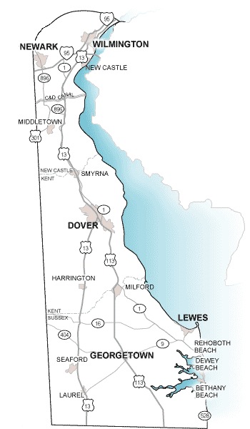
Delaware Logistics
Delaware is a long and narrow state that creates logistical issues for downstate students to attend classes on the University of Delaware's main campus located in northern Delaware.
To solve this problem, we are investigating the use of Web-based videoconferencing to extend the face-to-face experience to distance learners.

Slide 3
Web Conferencing Solutions
We began with a cloud-based collaboration service called Dimdim that provided real-time videoconferencing, chatroom, and screen sharing.
When Salesforce.com acquired Dimdim in January 2011, we switched to Adobe Connect, which currently hosts the videoconferencing, chatroom, and screen sharing aspects of the project reported here.

Slide 4
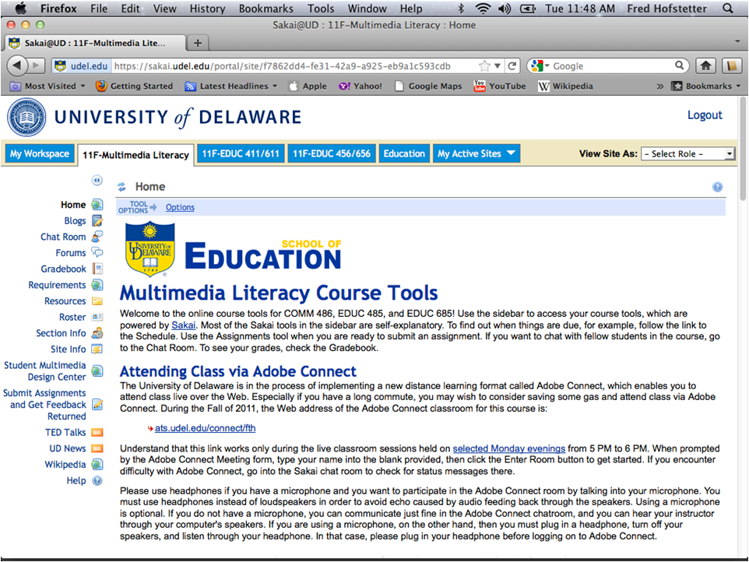

Slide 5
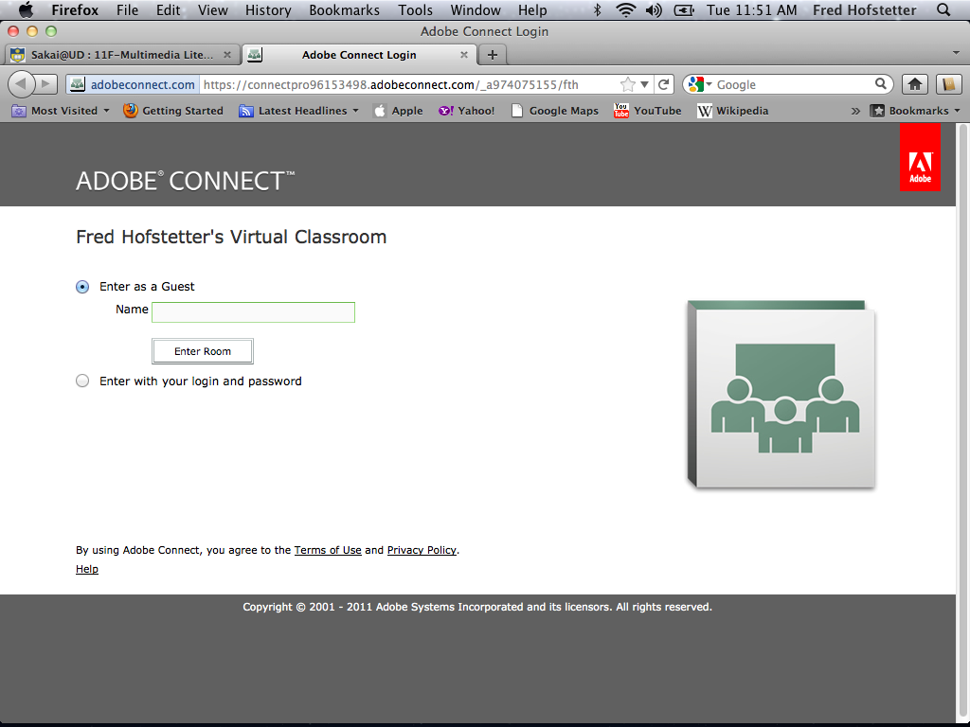

Slide 7
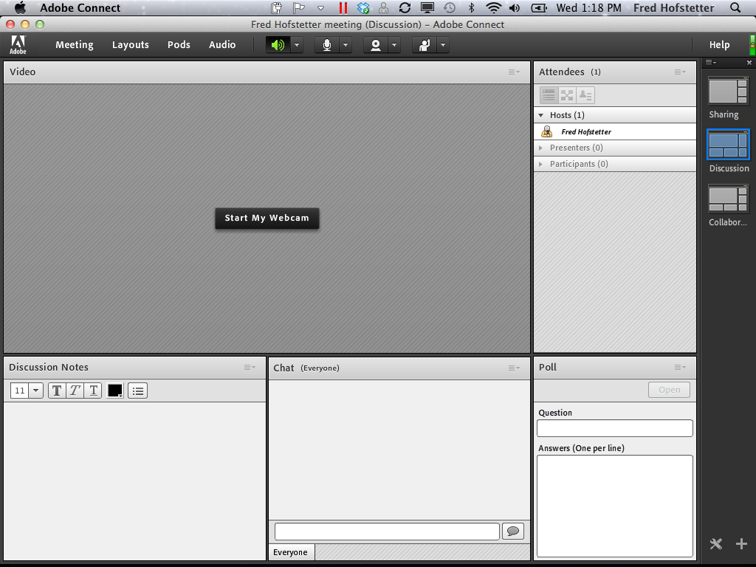

Slide 8
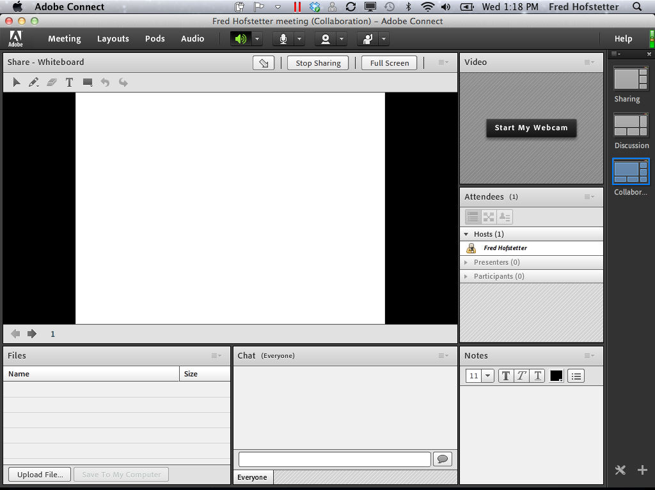

Slide 9
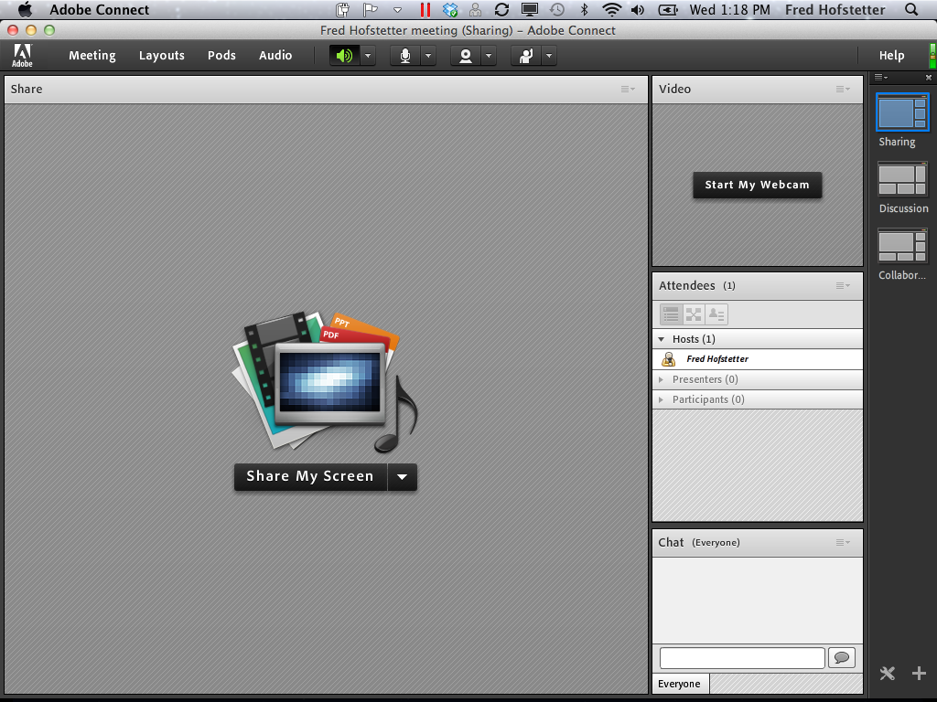

Slide 10
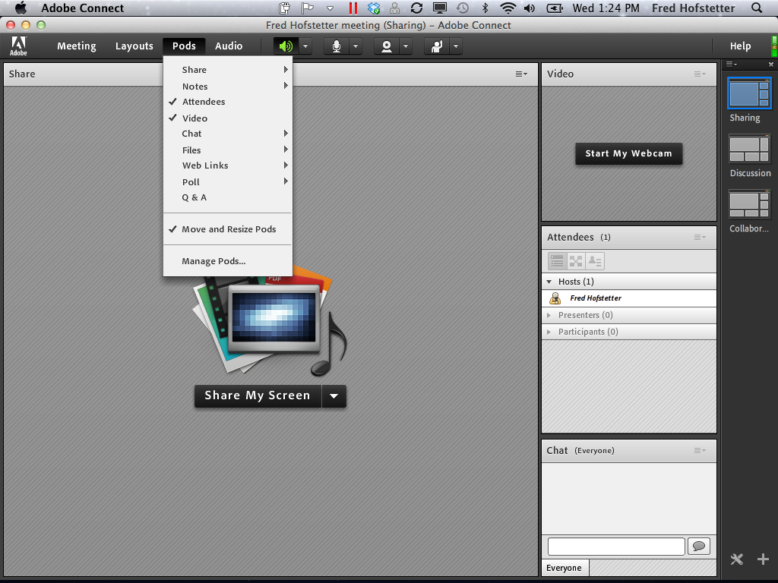

Slide 11
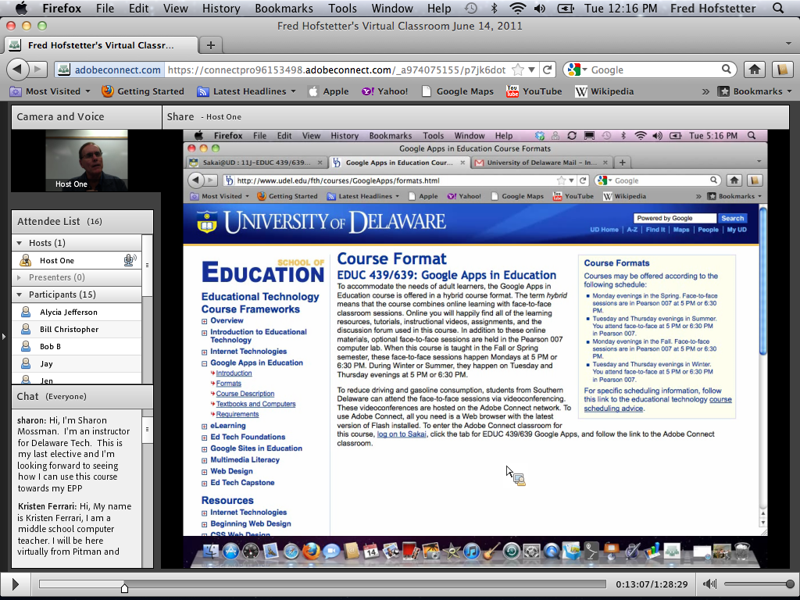

Slide 12
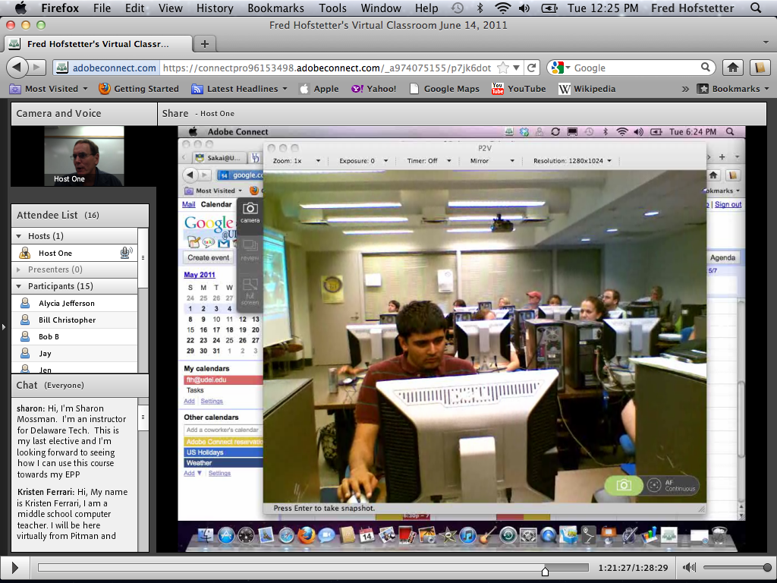

Slide 13
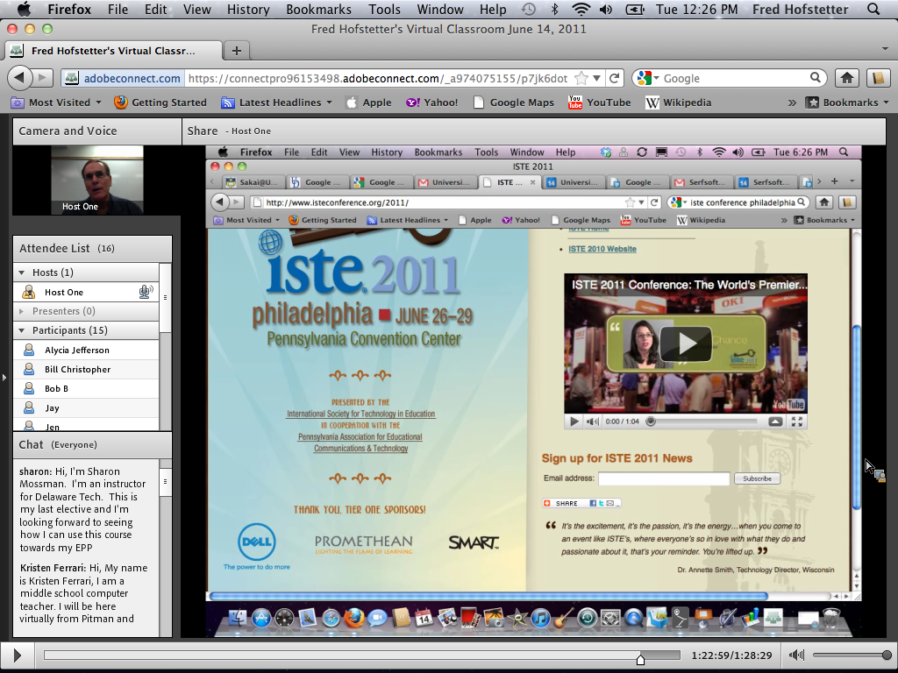

Slide 14
Methods
To gauge the effectiveness of this project, students have been journaling in an online discussion forum about their experiences with Dimdim and Adobe Connect.
We are conducting a thematic analysis of these journal entries, which are overwhelmingly positive.
We have also administered a survey to collect more sharply focused data regarding themes identified in the journals.

Slide 15
Channeling
In addition to the obvious advantages of saving gas and commuting time, Web-based videoconferencing opens up a new channel of communication that adds an innovative layer of interaction to the course.
Multiple students can ask questions at once, and students like how the chatroom queues their questions.
As one student put it, "Since we can chat, Fred has answered every single one of my questions even though he's on campus and I'm at home in my study. Chatting also makes me feel like I've gotten to know some of my classmates, even though we're not physically interacting."

Slide 16
Managing
Managing the chat enables the professor to decide when and how to work the student questions into the presentation, and the result is a classroom session that is more coherent and responsive to student needs.
In the meantime, students can carry on side conversations. The students perceive this as forming subgroups.
As one student said, "Having subgroups can ... differentiate learning ... because everyone is on a different part of the technology spectrum.“
As another student put it, "One added benefit is that, through chat, students can carry on side conversations without taking up class time."

Slide 17
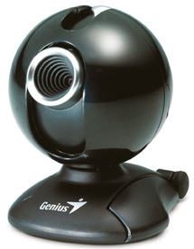
Who’s On Camera?
An interesting multimedia question arose regarding campus use of videoconferencing, namely, what should be on camera?
Many students maintain that it is the view of the instructor that makes them feel most present.
Others like a camera placement that provides a view of the class including both the professor and the students.
As one student said, "…that will really give remote users a feeling that they actually belong to the class."

Slide 18
The Mirror of Dimdim
We discovered an interesting multimedia solution when I brought a handheld mirror to class and held it in front of the laptop's built-in camera, which normally shows a head-shot of the professor.
When held up to the laptop's camera, the mirror makes the camera view the students attending class on campus.
Of course, a more advanced solution would be to use an external, repositionable camera to capture the classroom participants.
We got that working with a Point 2 View USB Camera.

Slide 19
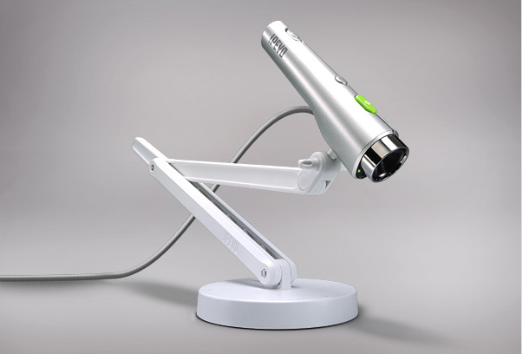
IPEVO Point 2 View

Slide 20
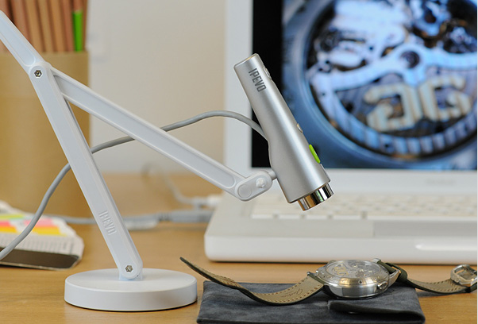
IPEVO Point 2 View

Slide 21
IPEVO Point 2 View

Slide 22
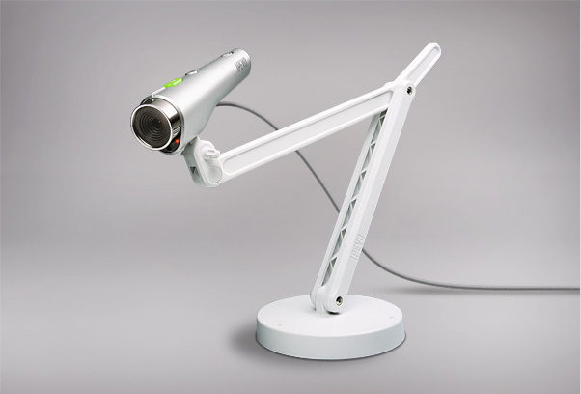
IPEVO Point 2 View

Slide 23
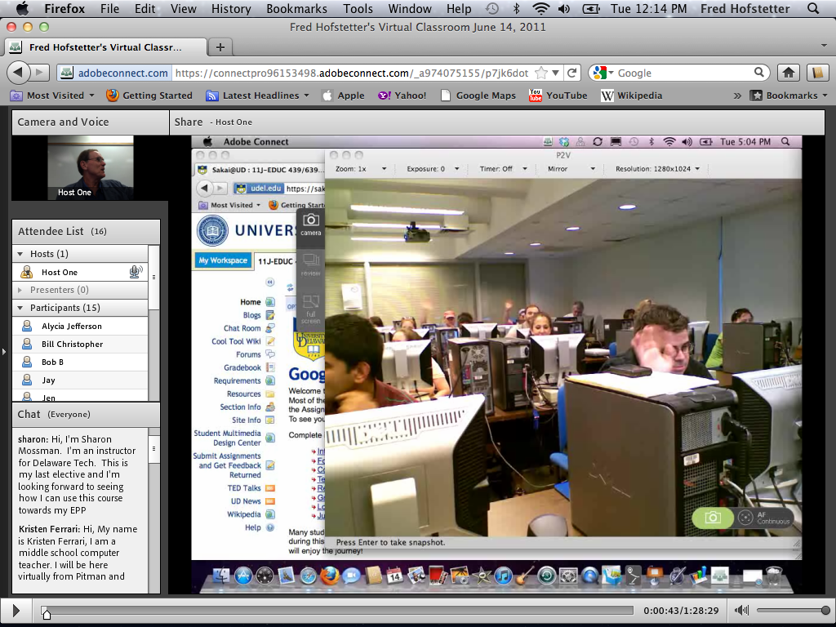

Slide 24
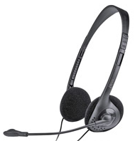
Student Microphones
Students like how Dimdim and Adobe Connect give the professor virtual microphones and a camera that can be assigned to different students during the class.
The students use game-style headset mikes that enable us to avoid the audio feedback than can otherwise occur if students use loudspeakers instead of headsets.

Slide 25
Zoom and Pan
Students especially like how they can adjust the zoom to make the shared screen larger or smaller.
As one student reported: "Just sat in on my first lecture from home. I could hear Dr. Hofstetter perfectly and it was also visually clear. If there was something I couldn't quite read in small print, I would simply adjust my zoom and then zoom back in if I wanted to write something on the chat wall."

Slide 26
Best Practices
Informed by this analysis, we are compiling best-practice guidelines for professors to use videoconferencing.
Still to be determined is whether using Dimdim or Adobe Connect successfully requires that the instructor have the technological skills of this particular professor, who is an educational technologist.
Our hope is that by identifying the specific skills instructors need, our best practice guidelines will enable most faculty to become facile with Web-based videoconferencing.

Slide 27
Guidelines
When sharing the instructor’s desktop, keep the chatroom visible so the instructor can see the conversations happening in chat.
If a wired Internet connection is available, turn off wireless to avoid connection issues that can occur if there is a weak wireless signal.
If you are using a microphone, you must plug in a headphone, turn off your speakers, and listen through your headphone in order to avoid echo caused by audio feeding back through the speakers.
Ask some of the students who are attending class locally to log on to the videoconference so they can alert the professor if any problems occur that the instructor is not aware of.

Slide 28
Adobe Connect Mobile
Using Adobe Connect on iPad, iPhone, Android, and Blackberry Mobile Devices

Slide 29
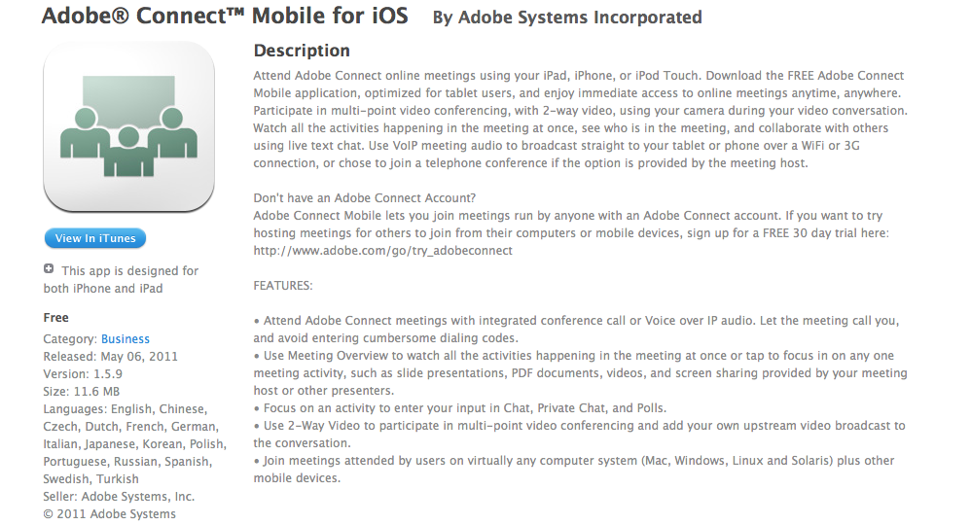
Adobe Connect Mobile

Slide 30
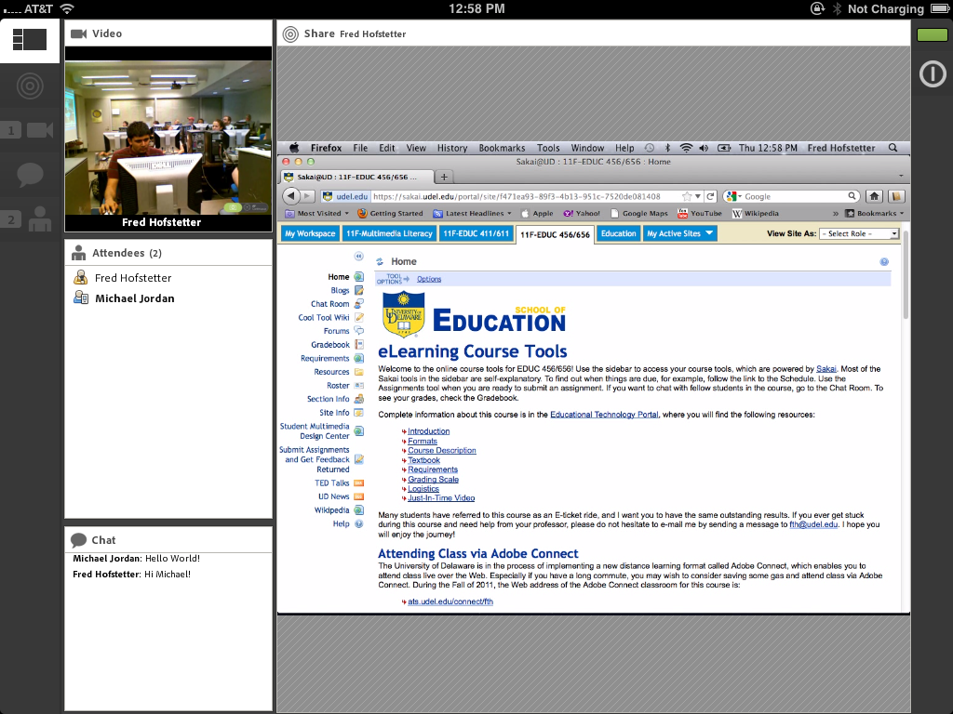

Slide 31
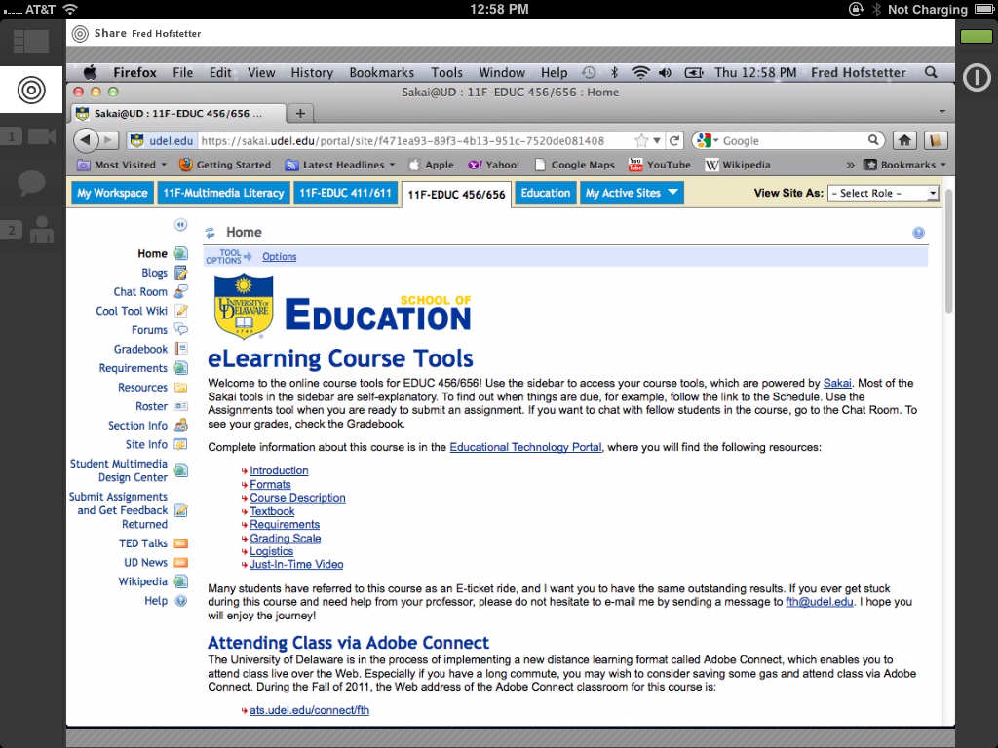

Slide 32
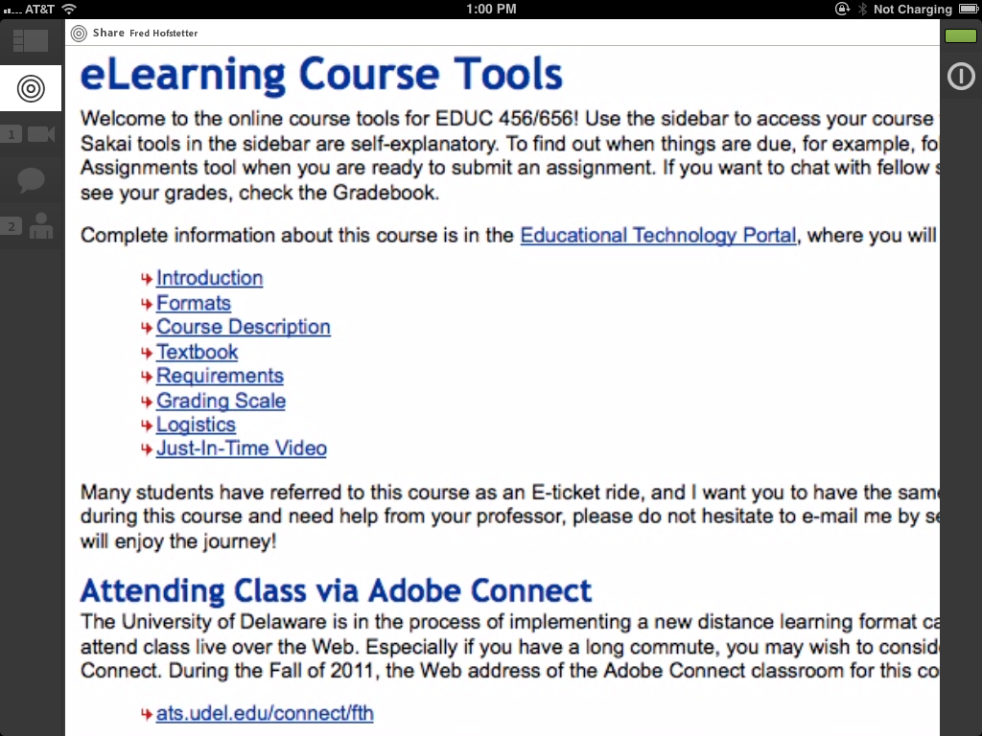

Slide 34
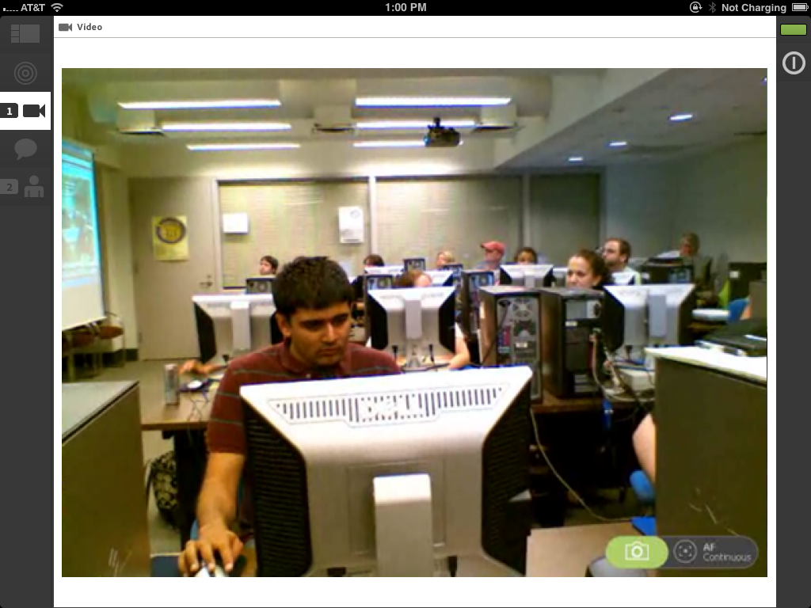

Slide 37
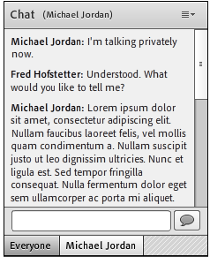
Private Chats
Private chats appear on tabs.
The instructor taps the tab of the chat in which you want to participate.

Slide 38
Impact
Adobe Connect has had a profound impact on the learning environment.
Instead of preparing lectures to deliver F2F as I did back in the 20th century, I use multimedia and the Internet to make all my teaching materials available 24/7 online.
Adobe Connect becomes the place where students interact with me and each other to get help learning what they cannot master on their own.

Slide 39
How People Learn
Reflecting on how Adobe Connect aligns with the Principles of How People Learn

Slide 40
How People Learn
How do you decide how to use Adobe Connect?
You decide based on how people learn.
A landmark book from the National Research Council, How People Learn is freely available at www.nap.edu/openbook.php?isbn=0309070368.
It describes how effective learning environments are learner-centered, knowledge-centered, assessment-centered, and community-centered.

Slide 41
The Science of Learning
According to How People Learn (pp. 14-23), three guiding principles have emerged from the science of learning:
People learn by connecting new information to concepts already learned.
To learn how to reason, solve problems, and augment knowledge in a field of inquiry, people need to understand facts and ideas in the context of a conceptual framework that facilitates application to real-world problem solving.
People are motivated to learn when they can set their own goals, reflect on their progress, and feel in control of their learning.
From these principles, it follows that eLearning environments will be effective when instructional designs:
take into account the learner’s preexisting understandings and correct any faulty preconceptions in order to prevent future misunderstandings;
enable students to study multiple examples of the concept at work in order to learn it in depth in authentic contexts; and
include metacognitive supports that make visible the learner’s reflections and enable an instructor to provide scaffolding and guide revisions to improve student learning and reasoning.

Slide 42
Making Thinking Visible
The chat window in Adobe Connect makes thinking visible.
When you record an Adobe Connect session, the chat window gets recorded along with it.
While viewing the recording, you can scroll the chat window independently from the video.
Studying this transcript enables you to reflect on the course and provide a better quality of scaffolding to your students.

Slide 43
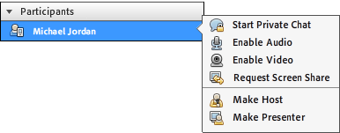
Engagement
Let me conclude with a word about engagement.
In addition to all the features demonstrated here today, Adobe Connect also enables the instructor to pass control to any participant.
This enables participants to become the presenter and demonstrate what they are working on for all of the participants to see.

Slide 44
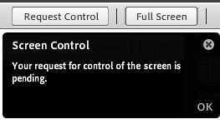
Requesting Control
The instructor can even request control of the participant’s screen to help the participant solve a troublesome problem.
When this happens, the participant sees everything the instructor is doing on the participant’s computer.
At any time, the participant can revoke the instructor’s remote control.

Slide 46
Educational Technology Portal
Using Ajax to Differentiate Instruction 24/7

Slide 47
Educational Technology Portal
All the non-confidential parts of these courses are at the Educational Technology portal at www.udel.edu/fth/courses.
Here students find all my course descriptions, syllabi, resources, and videos.
I use Ajax to create sliding menus from which the students can find any resource at any time.

Slide 48
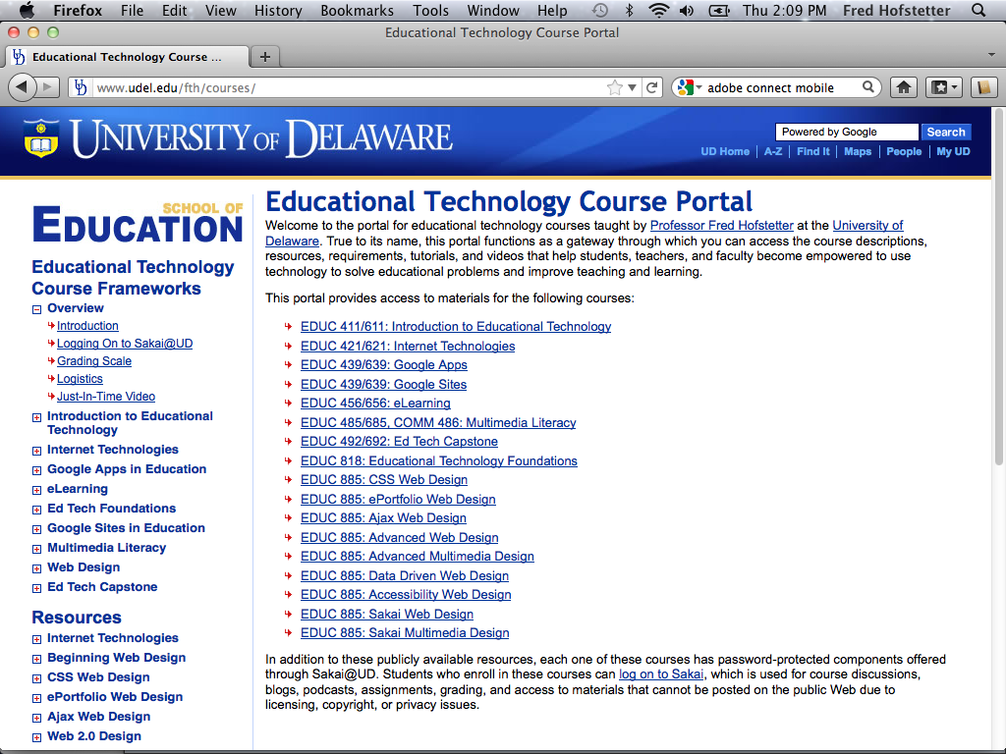

Slide 49
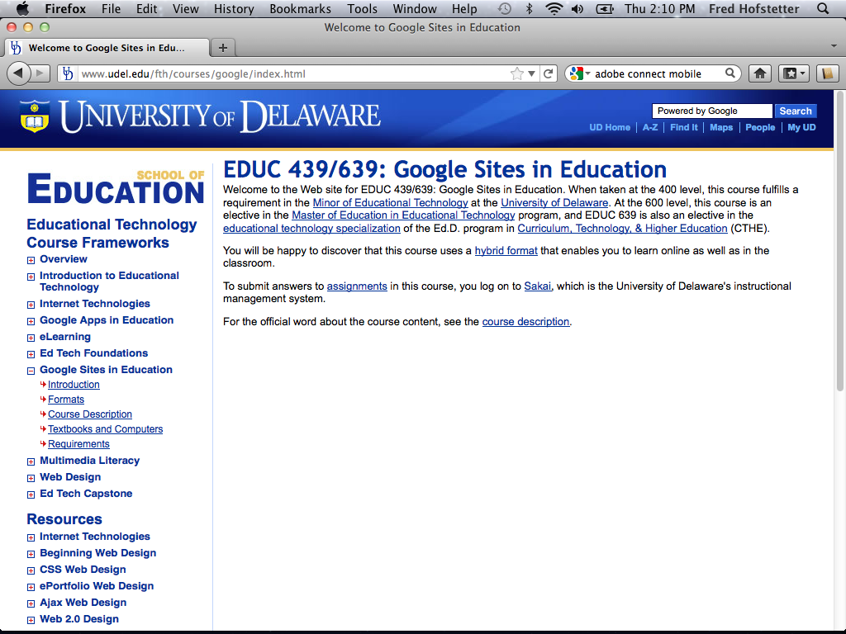

Slide 50
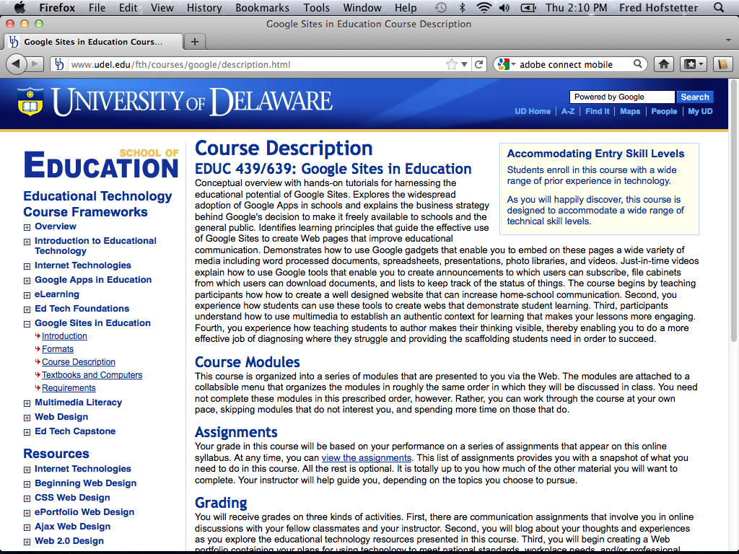

Slide 51
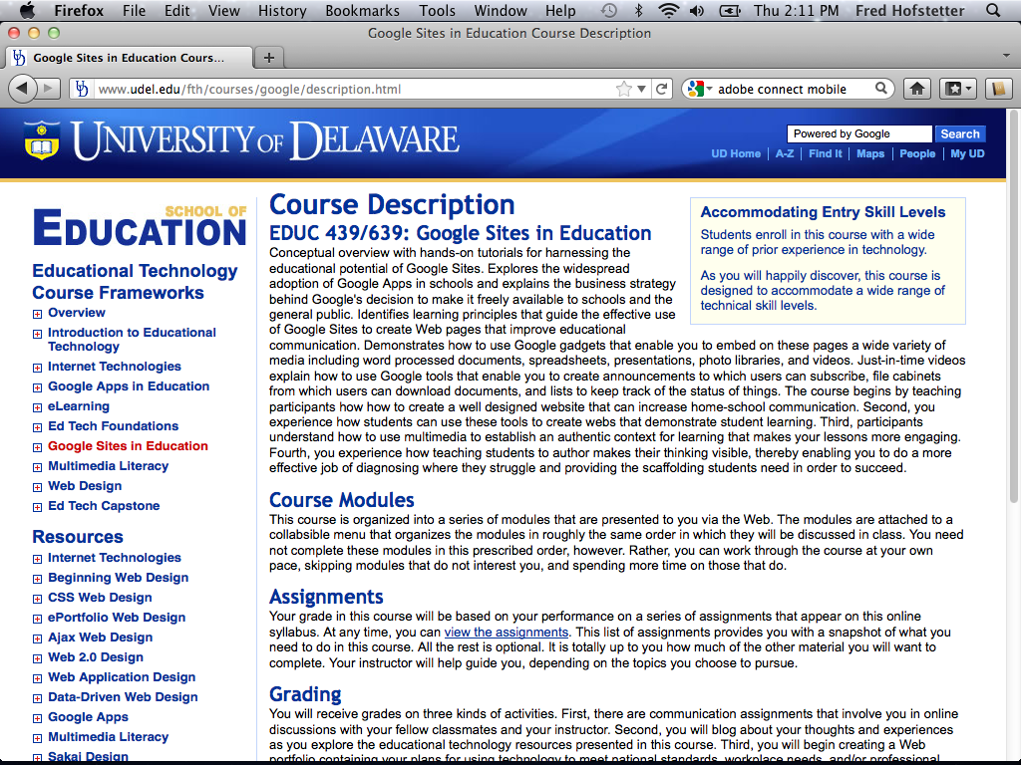

Slide 52
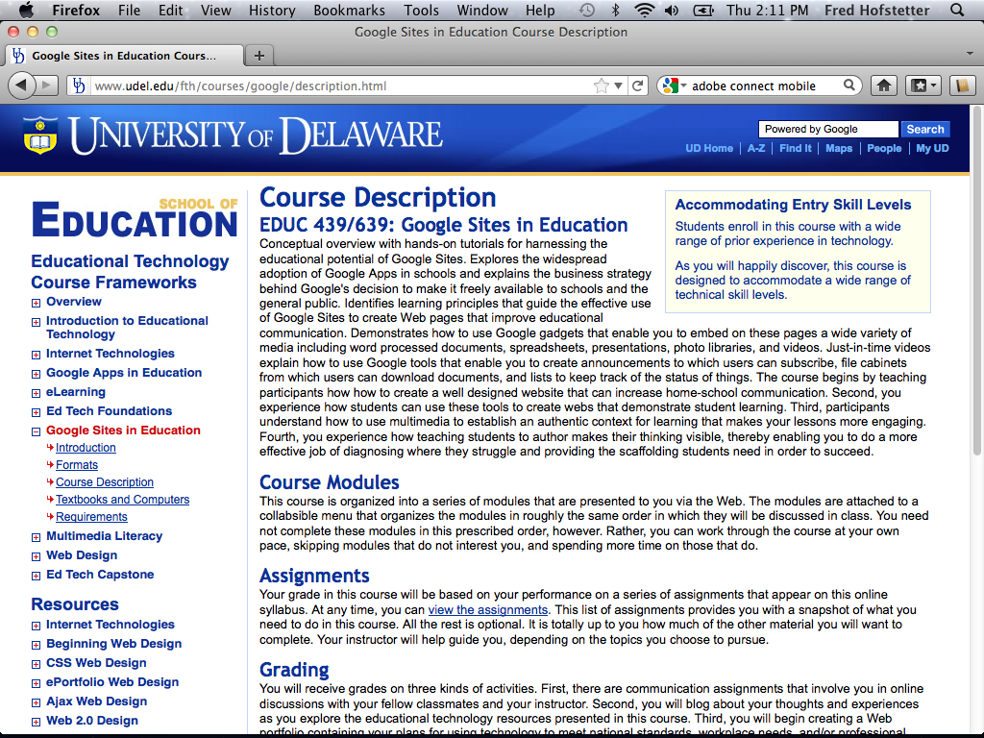

Slide 53
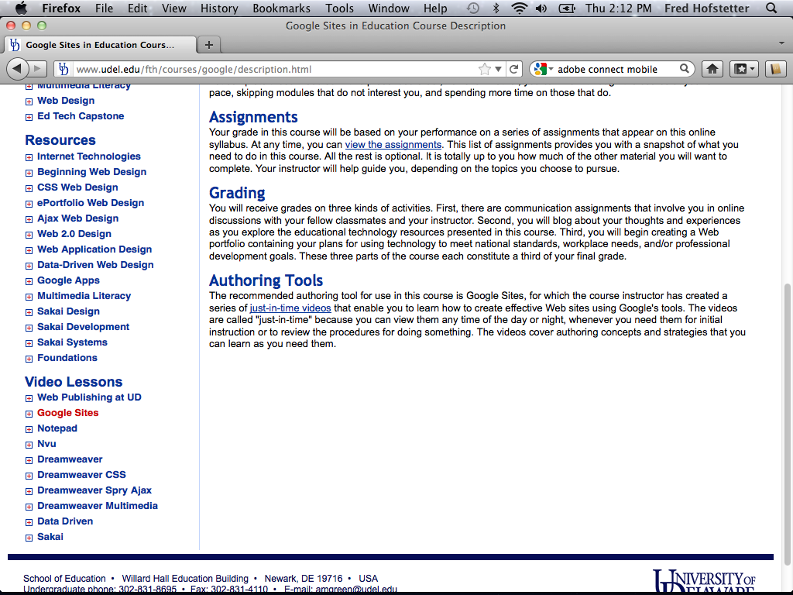

Slide 54
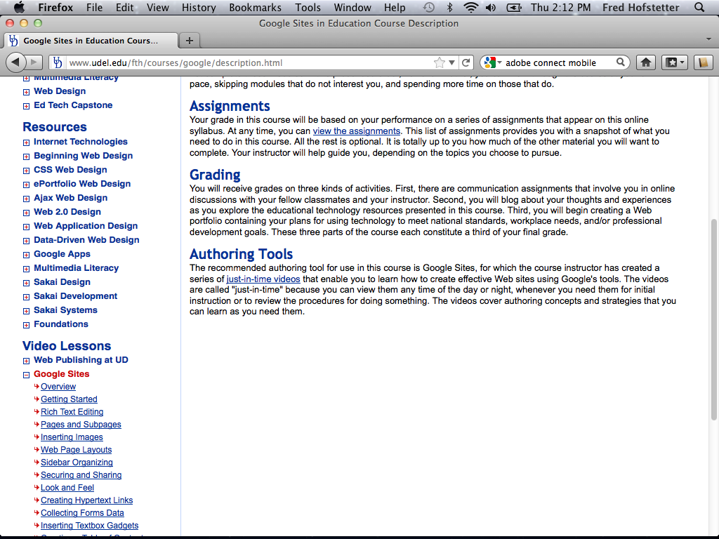

Slide 55
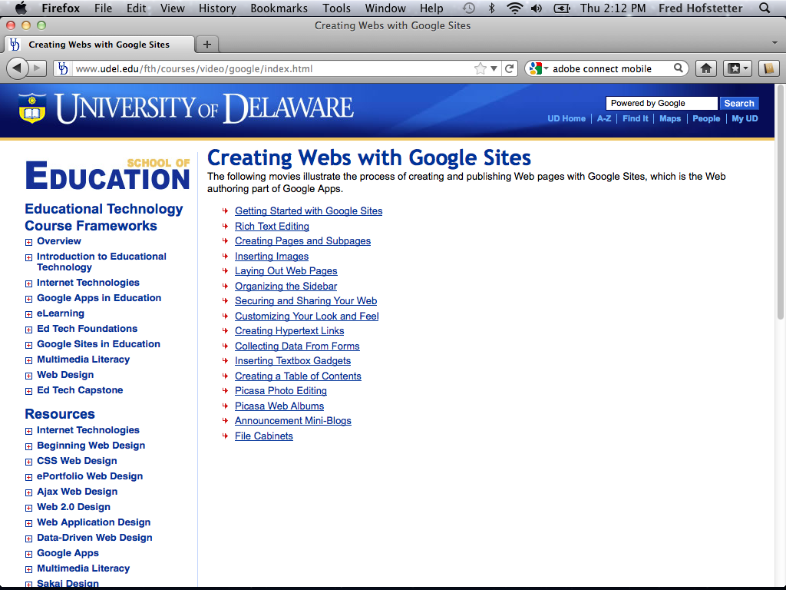

Slide 56
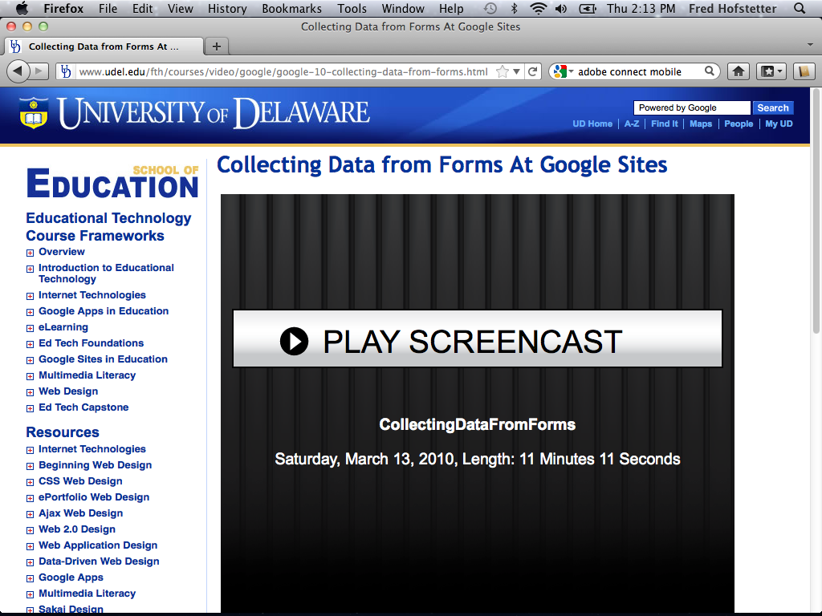

Slide 58
Multimedia Learning
How the Principles of Multimedia Learning Inform the Design of Course Content

Slide 59
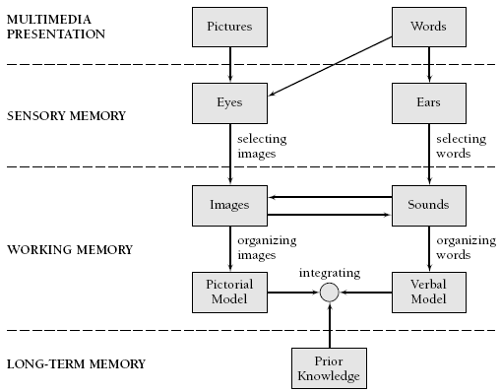
Multimedia Learning Theory
Richard Mayer’s (2001, p. 44) Cognitive Theory of Multimedia Learning

Slide 60
Multimedia Learning Principles
Principle | Effect on Learning
1. Multimedia | Deeper learning from words and pictures than words alone
2. Contiguity | Deeper learning from presenting words and pictures simultaneously rather than successively
3. Coherence | Deeper learning when extraneous words, sounds, or pictures are excluded rather than included
4. Modality | Deeper learning when words are presented as narration rather than as on-screen text
5. Redundancy | Deeper learning when words are presented as narration rather than as both narration and on-screen text
6. Personalization | Deeper learning when words are presented in conversational style rather than formal style
7. Segmentation | Deeper learning when complex lessons are presented in smaller parts
8. Pretraining | Deeper learning when key terms are explained in advance
Source: Clark & Mayer (2006, p. 386), summarized.

Slide 61
Multimedia Research Results
Cognitive Principle | Effect Size | Studies Showing This Effect
1. Multimedia | 1.50 | 9 of 9
2. Contiguity | 1.11 | 8 of 8
3. Coherence | 1.32 | 11 of 12
4. Modality | 0.97 | 21 of 21
5. Redundancy | 0.69 | 10 of 10
6. Personalization | 1.30 | 10 of 10
7. Segmentation | 0.98 | 3 of 3
8. Pretraining | 1.30 | 7 of 7
Clark & Mayer (2008, p. 383)

Slide 62
Just-In-Time Video
Key to my instructional strategy is just-in-time video that students can view to have my lectures onscreen just when you need them.
I create these videos with Camtasia Studio and follow Mayer’s principles to make them effective.
By balancing content across visual and auditory channels, I observe Mayer’s (2001) modality principle, and by organizing the videos into small clips, I follow the segmenting principle (Clark & Mayer, 2008, p. 183).

Slide 63
Camtasia Workflow
Creating Just-In-Time Videos with Camtasia Studio

Slide 64
Storyboard
You begin by planning your video sequence. Video professionals call this storyboarding.
I create my storyboards with PowerPoint.
Because the Camtasia player has a green skin, I created a PowerPoint theme based on that same shade of green.

Slide 65
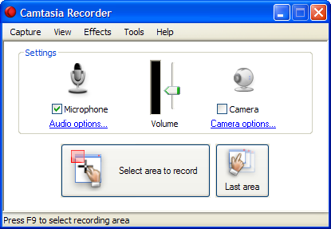
Record a Slide with Narration
Use Camtasia to make the PowerPoint window be what gets recorded.
It works best if you set the window to 1024 by 768.
Use the Camtasia Recorder to record the slide with your narration.
Make sure your microphone gain is turned way up, but not so high as to distort.

Slide 66
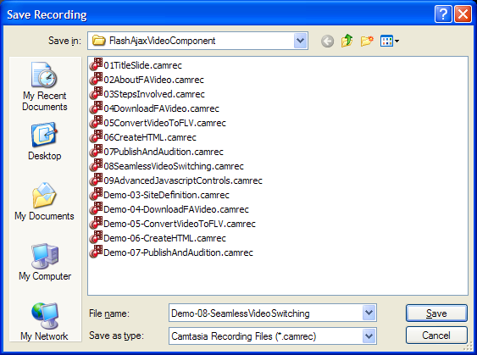
Review the Recorded Slide
After you record something, Camtasia provides a playback window that lets you review it.
You can delete the recording if you do not like it, or you can save it for future use.
When I save a clip, I begin the filename with a number, so the file manager will display my clips in sequence.

Slide 67
Record a Demo with Narration
Use Camtasia to make the demonstration window be what gets recorded.
It works best if you set the window to 1024 by 768.
Record the slide with your narration.
Save it.
Edit out any unwanted audio pauses or glitches.
Save it.

Slide 68
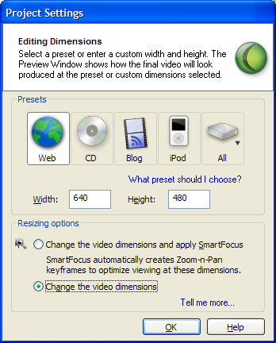
Insert Slides into Camtasia
When you begin editing your production, Camtasia will ask about your settings.
If you are producing for the Web, I recommend 640 x 480.
I do not recommend automatic Smart Focus because I find it more efficient creating the zooms by hand.

Slide 69
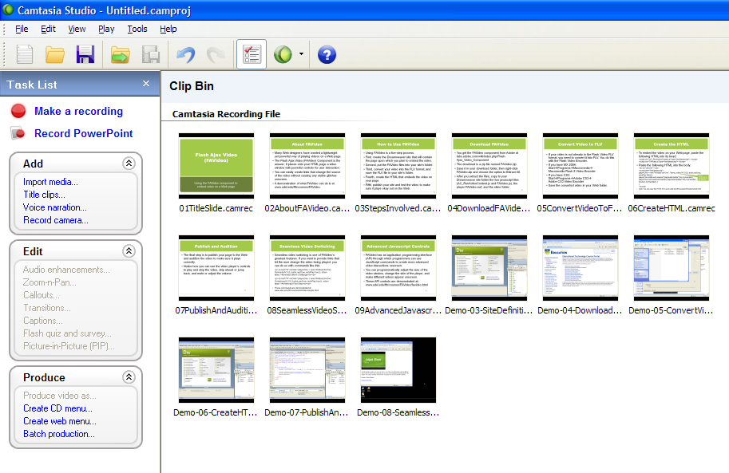
Using the Clip Bin
If you right-click the Clip Bin and choose Import Media, you can import all of the clips you created for use in this production.

Slide 70
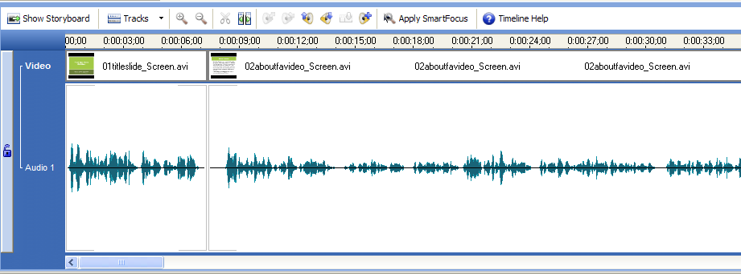
Delete Pauses and Glitches
On the timeline, you can delete all the pauses and glitches in your production. The timeline’s “zoom in” and “zoom out” features are very helpful here.

Slide 71
Add Transitions
The transitions I found to work best are:
The gradient wipe, which I put before each slide.
The wheel, which I put before each demonstration.

Slide 72
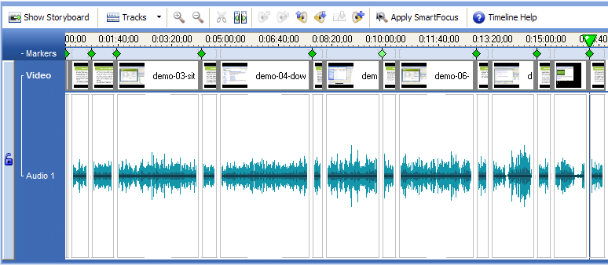
Create Markers
Markers create a sidebar that users can click to jump to different parts of your video.
Use markers when you have a complex, multi-part video.
If you are creating a simple screen recording, on the other hand, you will not need markers.

Slide 73
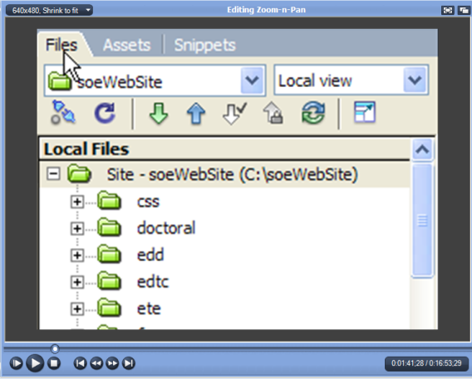
Create Pans and Zooms
Pans and Zooms enable you to focus on the part of the screen to which you want to draw the viewer’s attention.
Zooms are especially helpful when the text is small and you want to make it more readable.
It helps to pre-arrange the window positions to make any popout windows appear within the frame of the zoom you have onscreen.

Slide 74
Camtasia Zoom
As noted by Clark & Mayer (2008, p. 38), “our cognitive systems have limited capacity. Since there are too many sources of information competing for this limited capacity, the learner must select those that best match his or her goals.”
Through judicious use of Camtasia’s zoom feature, you can help learners attend to important parts of the lesson.

