Slide 1
Engaging Students for Optimum Learning Online
Informing the Design of Online Learning By the Principles of How People Learn

Slide 2
What Is Engagement?
As early as 1995, student engagement was "the latest buzzword in education circles." (Kenny et al., 1995, p. 37)
In an interview study of faculty perceptions of student engagement, Berardi (2002) suggested that faculty need to share a definition of student engagement.
How can we construct such a definition?
By studying the principles of How People Learn.

Slide 3
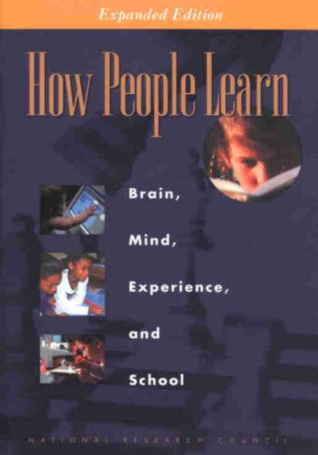
How People Learn
A landmark book from the National Research Council, How People Learn is freely available at www.nap.edu/ openbook.php? isbn=0309070368.

Slide 4
Rules of Engagement
From this work by the National Research Council (2000, p. 18), we know that people are motivated to learn when they can:
Set their own goals;
Reflect on their progress; and
Feel in control of their learning.
The key to engaging students online is to apply these principles to your course design.

Slide 5
Engage Your Students Early in the Course
Key Principles of Online Learning

Slide 6
Engaging Your Students Early
In online learning, it is important to engage students early in the course.
This creates a dynamic conversational framework that establishes an empathetic bond (Holmberg, 2003) among students and professor.
I create this bond by engaging students early in the course through assignments that get students accustomed to interacting with me.

Slide 7
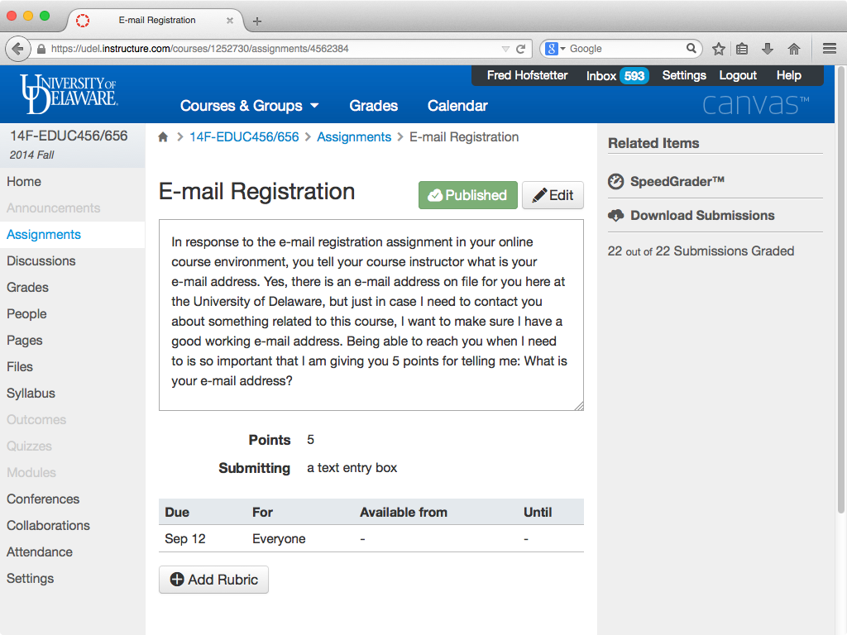

Slide 8
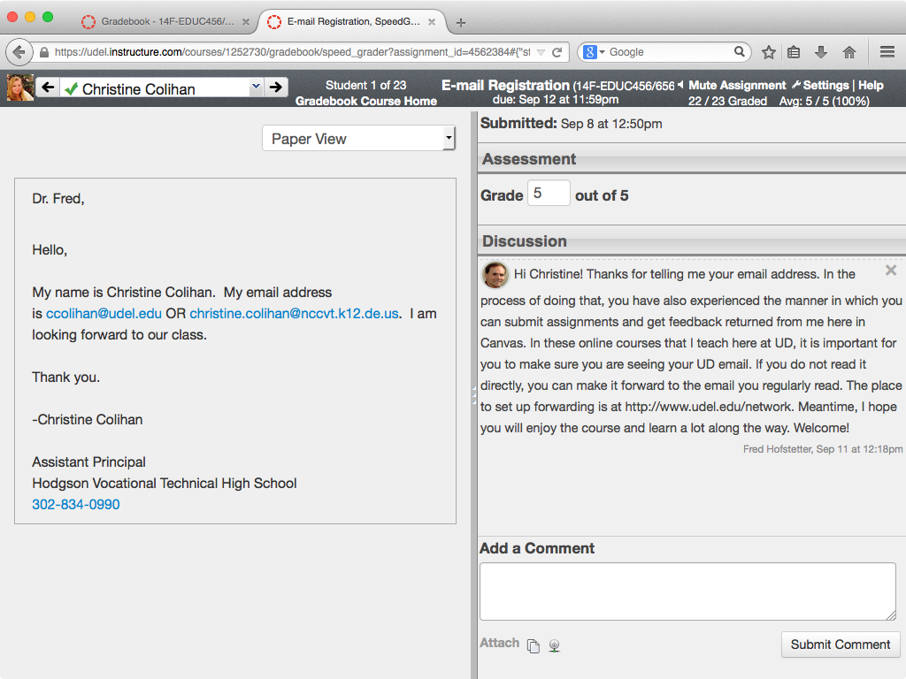

Slide 9
Constructing Goals
The innate human desire to develop competence is an important factor in motivating people to learn (National Research Council, 2000, p. 60).
In one of the early assignments, I work with my students to construct their goals, which are performance based.
Having students articulate their goals early in the course and hone them dialogically creates a bond that the professor later uses to scaffold students when they begin encountering difficulty.

Slide 10
Identifying the Zone
When students begin encountering difficulty, they enter an educational space that the great Russian psychologist Vygotsky (1978, p. 86) called the Zone of Proximal Development; I simply call it the Zone.
It is in the Zone that you can use the coaching protocol in your LMS to help students when they encounter difficulty.
Coaching students in their Zone is the most important principle of e-learning, and I believe it is the most important feature of a Learning Management System.

Slide 11
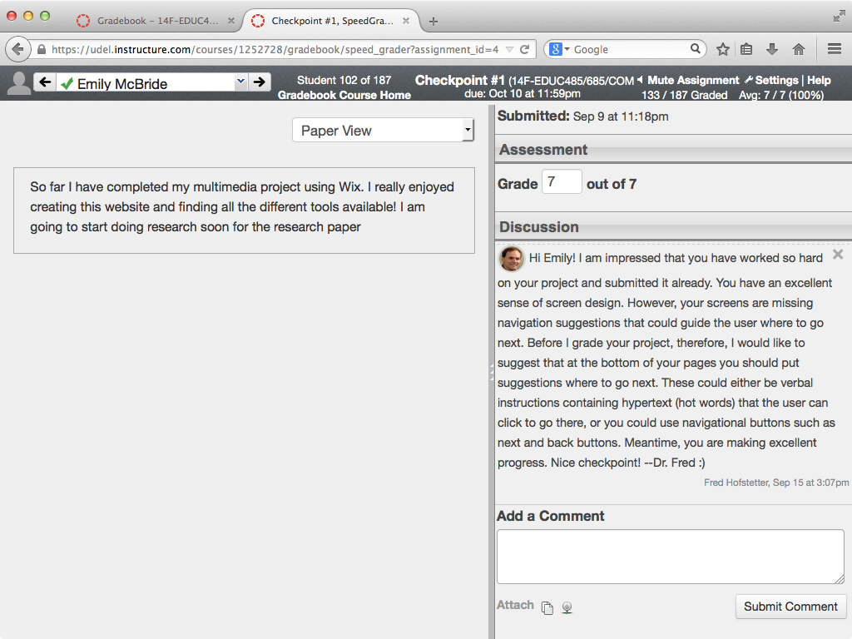

Slide 12
Follow the Principles of Multimedia Learning
How the Principles of Multimedia Learning Inform the Design of Engaging Course Content

Slide 13
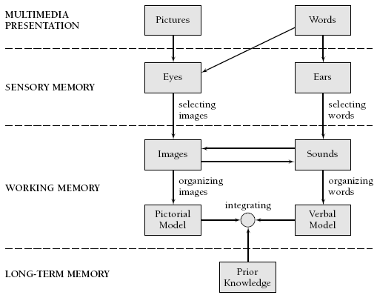
Multimedia Learning Theory
Richard Mayer’s (2001, p. 44) Cognitive Theory of Multimedia Learning

Slide 14
Multimedia Learning Principles
Principle | Effect on Learning
1. Multimedia | Deeper learning from words and pictures than words alone
2. Contiguity | Deeper learning from presenting words and pictures simultaneously rather than successively
3. Coherence | Deeper learning when extraneous words, sounds, or pictures are excluded rather than included
4. Modality | Deeper learning when words are presented as narration rather than as on-screen text
5. Redundancy | Deeper learning when words are presented as narration rather than as both narration and on-screen text
6. Personalization | Deeper learning when words are presented in conversational style rather than formal style
7. Segmentation | Deeper learning when complex lessons are presented in smaller parts
8. Pretraining | Deeper learning when key terms are explained in advance
Source: Clark & Mayer (2006, p. 386), summarized.

Slide 15
Multimedia Learning Principles
Principle | Effect on Learning
1. Multimedia | Deeper learning from words and pictures than words alone
2. Contiguity | Deeper learning from presenting words and pictures simultaneously rather than successively
3. Coherence | Deeper learning when extraneous words, sounds, or pictures are excluded rather than included
4. Modality | Deeper learning when words are presented as narration rather than as on-screen text
5. Redundancy | Deeper learning when words are presented as narration rather than as both narration and on-screen text
6. Personalization | Deeper learning when words are presented in conversational style rather than formal style
7. Segmentation | Deeper learning when complex lessons are presented in smaller parts
8. Pretraining | Deeper learning when key terms are explained in advance
Source: Clark & Mayer (2006, p. 386), summarized.

Slide 16
Multimedia Learning Principles
Principle | Effect on Learning
1. Multimedia | Deeper learning from words and pictures than words alone
2. Contiguity | Deeper learning from presenting words and pictures simultaneously rather than successively
3. Coherence | Deeper learning when extraneous words, sounds, or pictures are excluded rather than included
4. Modality | Deeper learning when words are presented as narration rather than as on-screen text
5. Redundancy | Deeper learning when words are presented as narration rather than as both narration and on-screen text
6. Personalization | Deeper learning when words are presented in conversational style rather than formal style
7. Segmentation | Deeper learning when complex lessons are presented in smaller parts
8. Pretraining | Deeper learning when key terms are explained in advance
Source: Clark & Mayer (2006, p. 386), summarized.

Slide 17
Multimedia Learning Principles
Principle | Effect on Learning
1. Multimedia | Deeper learning from words and pictures than words alone
2. Contiguity | Deeper learning from presenting words and pictures simultaneously rather than successively
3. Coherence | Deeper learning when extraneous words, sounds, or pictures are excluded rather than included
4. Modality | Deeper learning when words are presented as narration rather than as on-screen text
5. Redundancy | Deeper learning when words are presented as narration rather than as both narration and on-screen text
6. Personalization | Deeper learning when words are presented in conversational style rather than formal style
7. Segmentation | Deeper learning when complex lessons are presented in smaller parts
8. Pretraining | Deeper learning when key terms are explained in advance
Source: Clark & Mayer (2006, p. 386), summarized.

Slide 18
Multimedia Learning Principles
Principle | Effect on Learning
1. Multimedia | Deeper learning from words and pictures than words alone
2. Contiguity | Deeper learning from presenting words and pictures simultaneously rather than successively
3. Coherence | Deeper learning when extraneous words, sounds, or pictures are excluded rather than included
4. Modality | Deeper learning when words are presented as narration rather than as on-screen text
5. Redundancy | Deeper learning when words are presented as narration rather than as both narration and on-screen text
6. Personalization | Deeper learning when words are presented in conversational style rather than formal style
7. Segmentation | Deeper learning when complex lessons are presented in smaller parts
8. Pretraining | Deeper learning when key terms are explained in advance
Source: Clark & Mayer (2006, p. 386), summarized.

Slide 19
Multimedia Learning Principles
Principle | Effect on Learning
1. Multimedia | Deeper learning from words and pictures than words alone
2. Contiguity | Deeper learning from presenting words and pictures simultaneously rather than successively
3. Coherence | Deeper learning when extraneous words, sounds, or pictures are excluded rather than included
4. Modality | Deeper learning when words are presented as narration rather than as on-screen text
5. Redundancy | Deeper learning when words are presented as narration rather than as both narration and on-screen text
6. Personalization | Deeper learning when words are presented in conversational style rather than formal style
7. Segmentation | Deeper learning when complex lessons are presented in smaller parts
8. Pretraining | Deeper learning when key terms are explained in advance
Source: Clark & Mayer (2006, p. 386), summarized.

Slide 20
Multimedia Learning Principles
Principle | Effect on Learning
1. Multimedia | Deeper learning from words and pictures than words alone
2. Contiguity | Deeper learning from presenting words and pictures simultaneously rather than successively
3. Coherence | Deeper learning when extraneous words, sounds, or pictures are excluded rather than included
4. Modality | Deeper learning when words are presented as narration rather than as on-screen text
5. Redundancy | Deeper learning when words are presented as narration rather than as both narration and on-screen text
6. Personalization | Deeper learning when words are presented in conversational style rather than formal style
7. Segmentation | Deeper learning when complex lessons are presented in smaller parts
8. Pretraining | Deeper learning when key terms are explained in advance
Source: Clark & Mayer (2006, p. 386), summarized.

Slide 21
Multimedia Learning Principles
Principle | Effect on Learning
1. Multimedia | Deeper learning from words and pictures than words alone
2. Contiguity | Deeper learning from presenting words and pictures simultaneously rather than successively
3. Coherence | Deeper learning when extraneous words, sounds, or pictures are excluded rather than included
4. Modality | Deeper learning when words are presented as narration rather than as on-screen text
5. Redundancy | Deeper learning when words are presented as narration rather than as both narration and on-screen text
6. Personalization | Deeper learning when words are presented in conversational style rather than formal style
7. Segmentation | Deeper learning when complex lessons are presented in smaller parts
8. Pretraining | Deeper learning when key terms are explained in advance
Source: Clark & Mayer (2006, p. 386), summarized.

Slide 22
Multimedia Research Results
Cognitive Principle | Effect Size | Studies Showing This Effect
1. Multimedia | 1.50 | 9 of 9
2. Contiguity | 1.11 | 8 of 8
3. Coherence | 1.32 | 11 of 12
4. Modality | 0.97 | 21 of 21
5. Redundancy | 0.69 | 10 of 10
6. Personalization | 1.30 | 10 of 10
7. Segmentation | 0.98 | 3 of 3
8. Pretraining | 1.30 | 7 of 7
Clark & Mayer (2008, p. 383)

Slide 23
Personalization Principle
In terms of engaging learners, the most important principle identified by Mayer is the simplest, namely, the Personalization Principle.
“The personalization principle is that people learn better when the instructor uses conversational style rather than formal style. The rationale is that people try harder to make sense of the presented material (i.e., engage in the cognitive processes of organizing and integrating) when they feel they are in a social partnership with the instructor.” (Mayer, 2001, p. 394)
You achieve this by writing in first and second person.
Imagine improving results (es=1.30) so simply!

Slide 24
Create Learning Communities
Students form powerful learning communities in the Discussions

Slide 25
Discussions
Most learning management systems include an option to create Discussions in which students can read, respond, and create new topics.
Requiring students to participate in Discussions results in the formation of powerful learning communities.
Zhao and Kuh (2004, p. 124) found that “Participating in learning communities is uniformly and positively linked with student academic performance, engagement in educationally fruitful activities (such as academic integration, active and collaborative learning, and interaction with faculty members), gains associated with college attendance, and overall satisfaction with the college experience.”
As Manfra (2009) noted, these communities become so powerful that faculty find themselves learning from students.

Slide 26
Rubrics
When a colleague was bought out by a grant, I taught her course that used rubrics for discussions.
The rubrics required students to be timely, cite from assigned readings, and include references to other student responses.
Because I teach with a more relaxed style, I worried that such rigor would lower my teaching evaluations.
Instead, my ratings hit an all-time high.
Students valued the increase in engagement that the rubric encouraged.

Slide 27
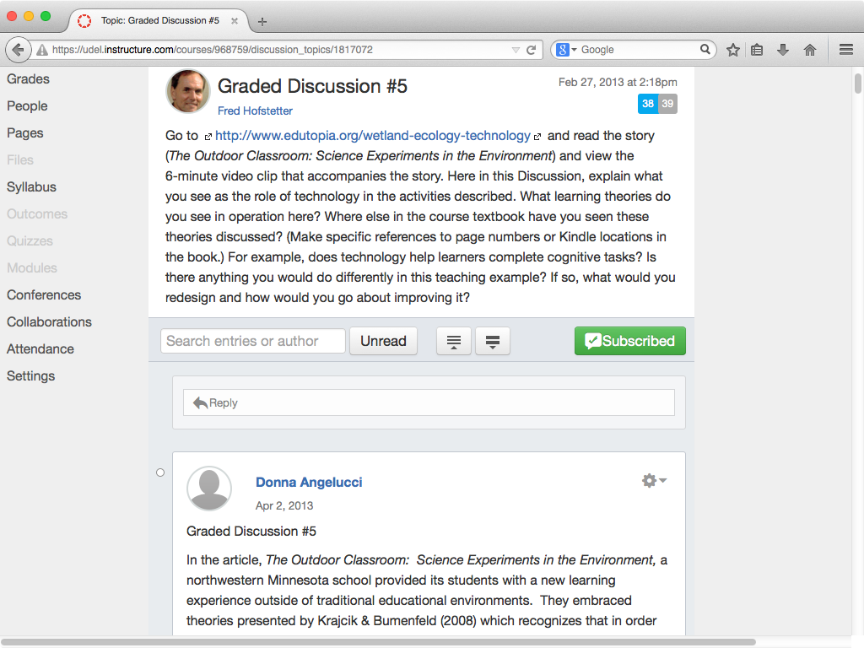

Slide 28
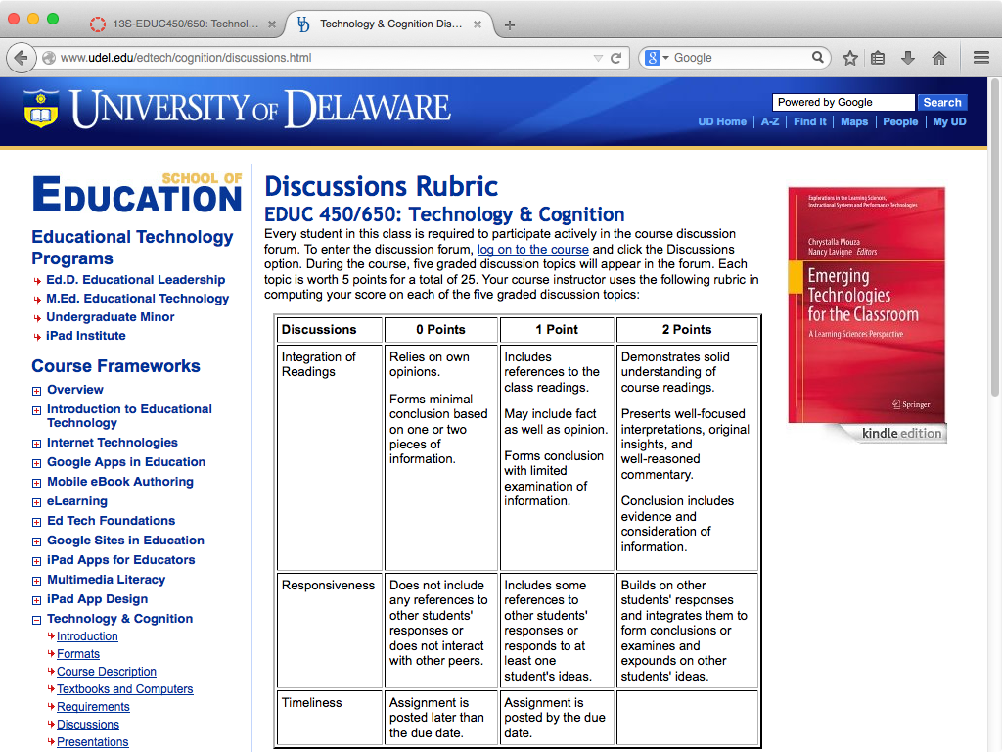

Slide 29
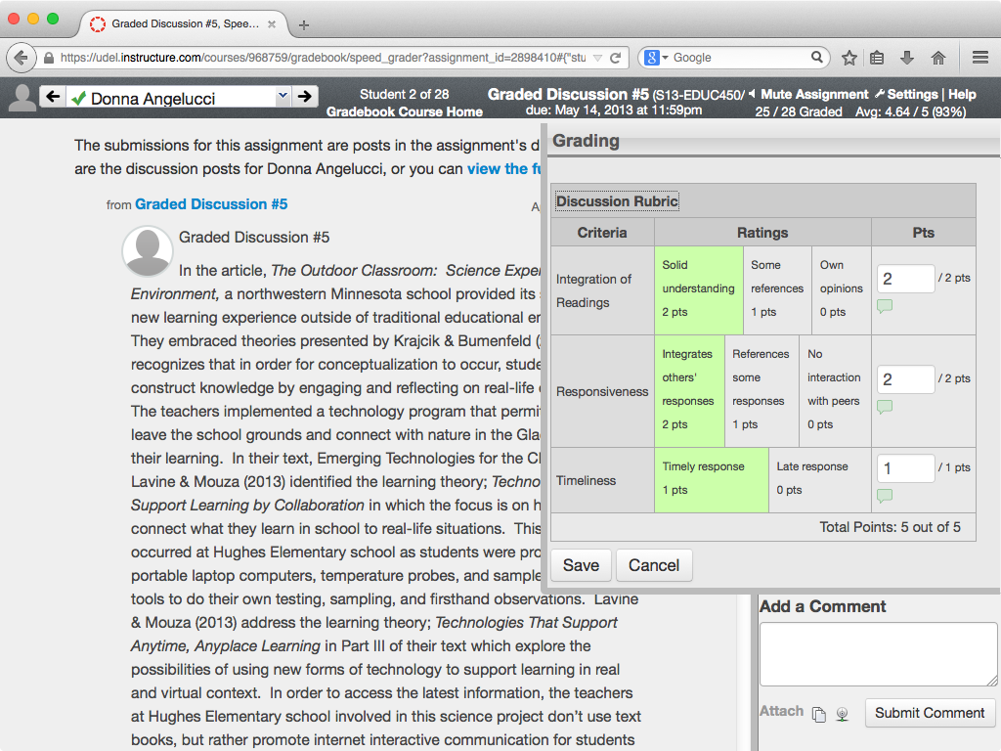

Slide 30
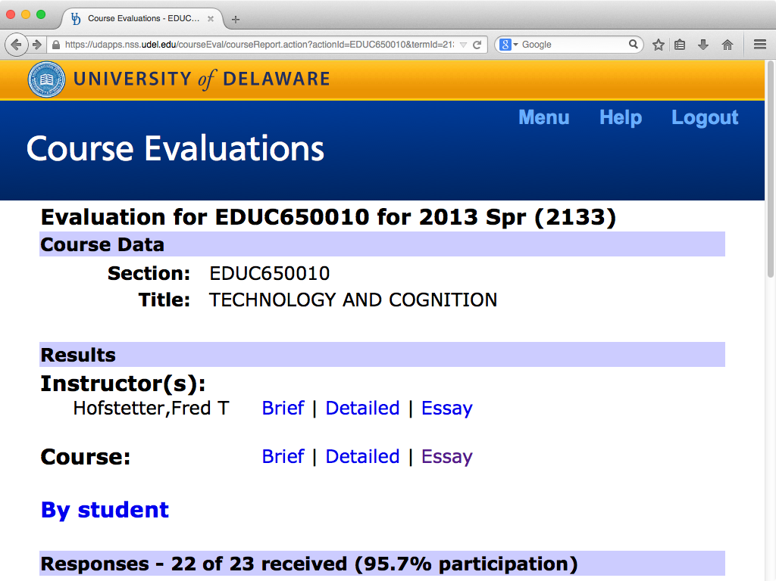

Slide 31
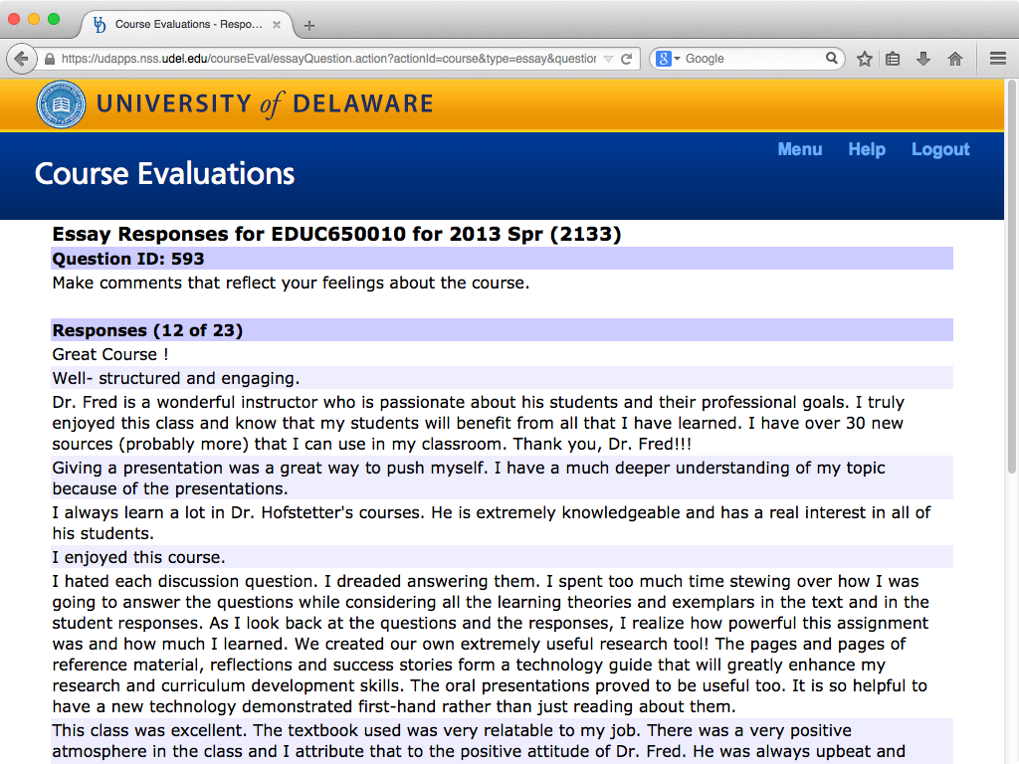

Slide 32
Student Evaluation Feedback
“I hated each discussion question. I dreaded answering them. I spent too much time stewing over how I was going to answer the questions while considering all the learning theories and exemplars in the text and in the student responses.”
“As I look back at the questions and the responses, I realize how powerful this assignment was and how much I learned. We created our own extremely useful research tool! The pages and pages of reference material, reflections and success stories form a technology guide that will greatly enhance my research and curriculum development skills.”

Slide 33
Negotiate Real-World Topics
Engaging Students in Authentic Contexts

Slide 34
Rule’s Model
In analyzing forty-five scholarly articles about authentic learning, Rule (2006, p. 2) identified the following four themes:
The activity involves real-world problems that mimic the work of professionals in the discipline with presentation of findings to audiences beyond the classroom.
Open-ended inquiry, thinking skills, and metacognition are addressed.
Students engage in discourse and social learning in a community of learners.
Students are empowered through choice to direct their own learning in relevant project work.

Slide 35
Why Negotiate?
As Jonassen (2014, p. 282) found in assessing problem solving, “When students construct and elaborate their own cases, they are more deeply engaged in learning than when interpreting someone else’s cases.”
The time spent negotiating topics at the beginning of a course creates the foundation for deep engagement later in the course.
You can even design instruction into your feedbacks.

Slide 36
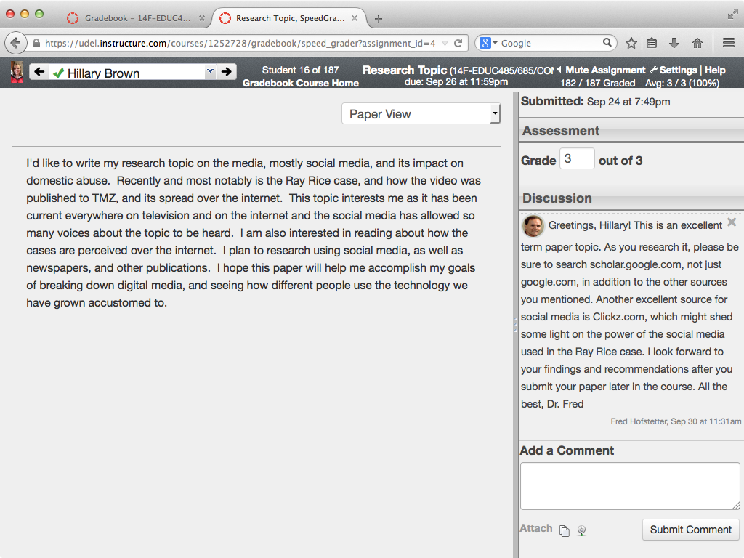
Negotiating Topics: Designed Instruction (Google & Clickz)

Slide 37
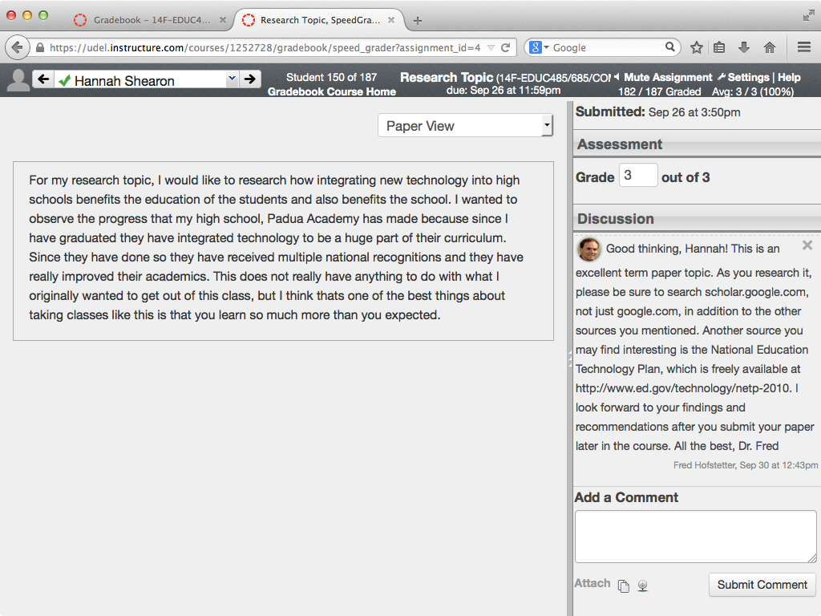
Negotiating Topics: Designed Instruction (National Plan)

Slide 38
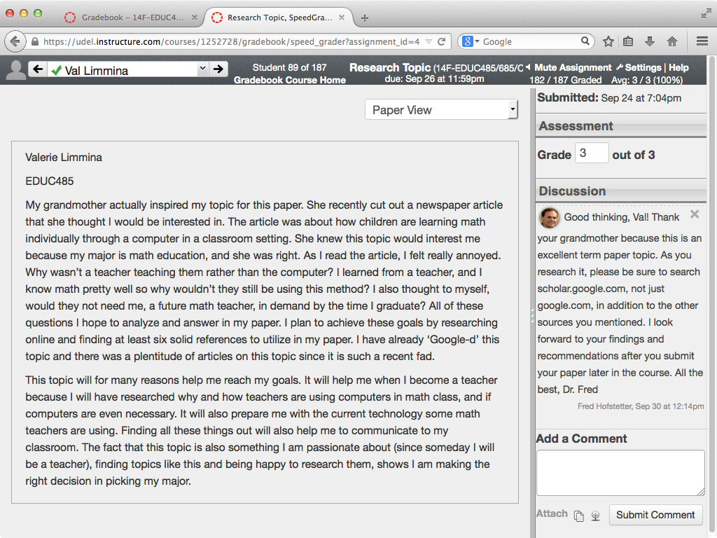
Negotiating Topics: Grandma Factor

Slide 39
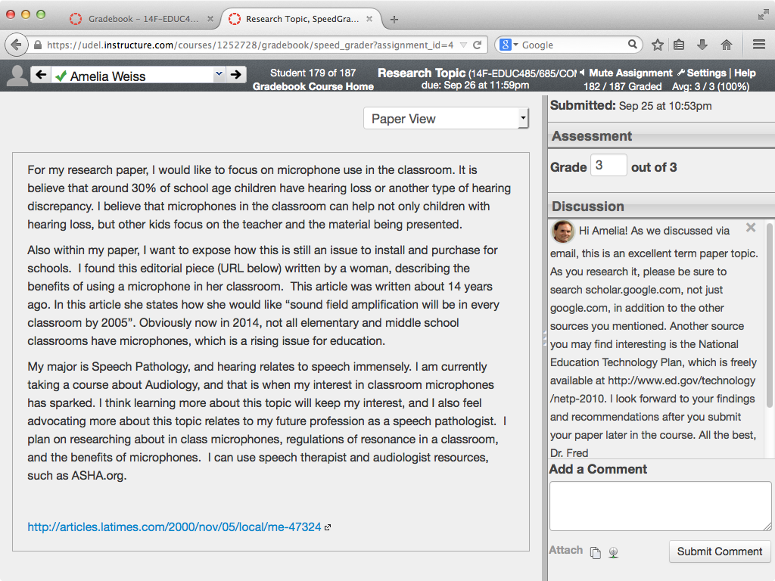
Negotiating Topics: Discussed via email

Slide 40
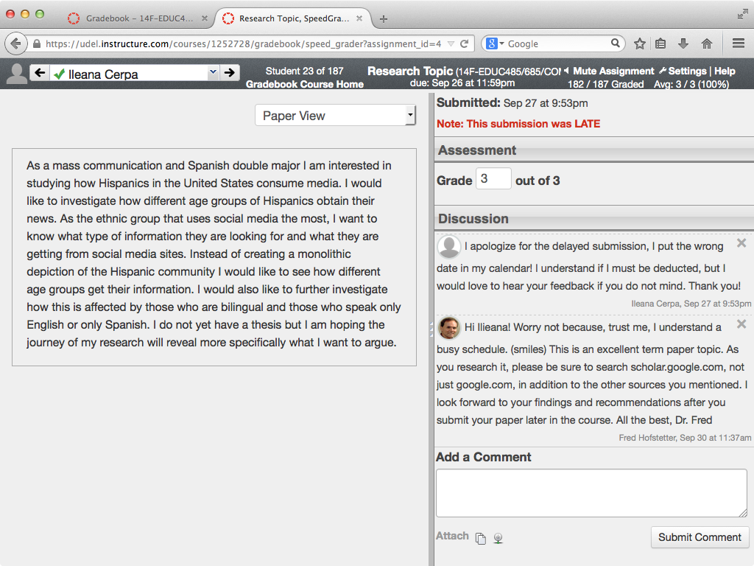
Negotiating Topics: Busy, not late…

Slide 41
Make Students Blog
Engaging Students in their Zone by Making Thinking Visible

Slide 42
Checkpoints
Along the way, while students work on their projects, I have them blog about their progress.
By making thinking visible, blogs enable you to coach students in their zone.
Three times during the semester, I award students points for keeping their progress logs.
Because these are points at which I check in on each student, I call them checkpoints.

Slide 43
Feedback as Learning System
As we learn from Molloy and Boud (2014, p. 413), “A constructivist view on feedback encourages learners and educators to view feedback as a system of learning, rather than discreet episodes of educators ‘telling’ learners about their performance.”
When students “have frequent opportunities to engage in productive, dialogic exchanges with multiple others, they are more likely to see feedback as a tool for ‘them’ rather than as a destabilizing or debilitating act ‘done to them’ by those in authority.” (p. 422)

Slide 44
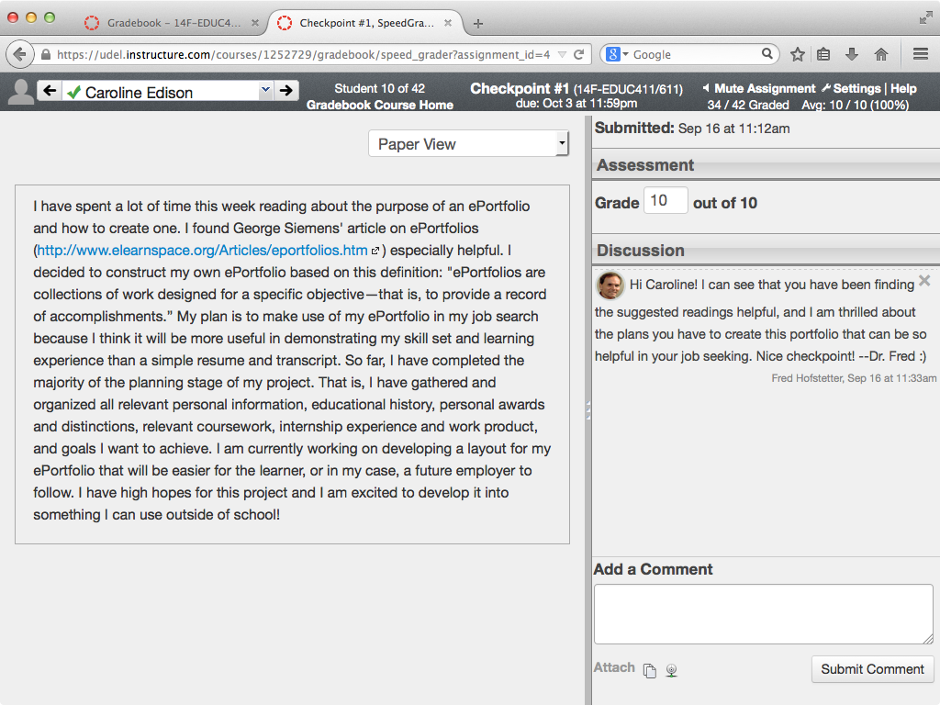
Checkpoint Feedback: Readings helpful

Slide 45
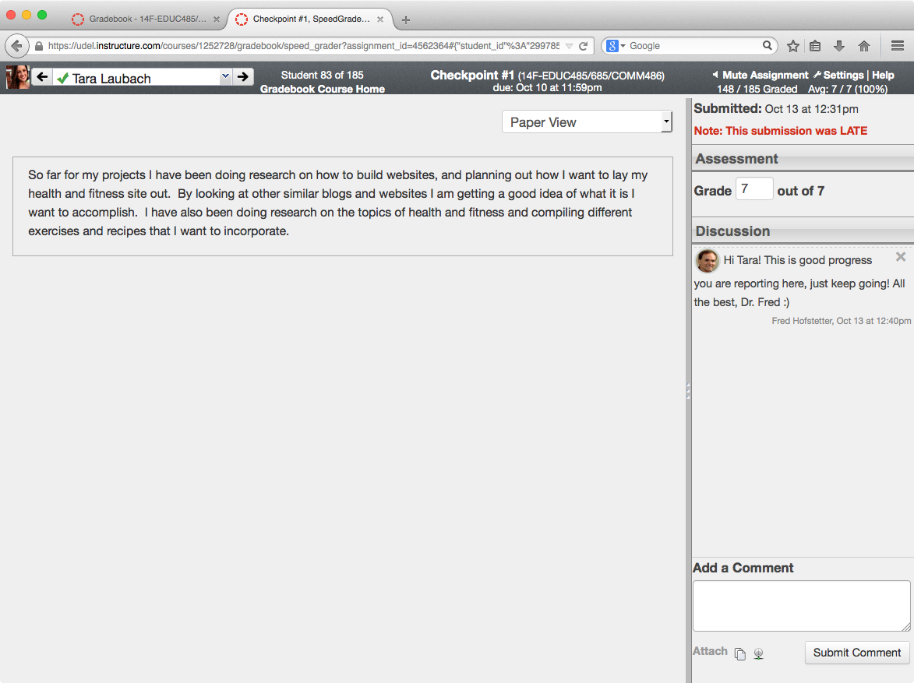
Checkpoint Feedback: Brief Prepared Reply

Slide 46
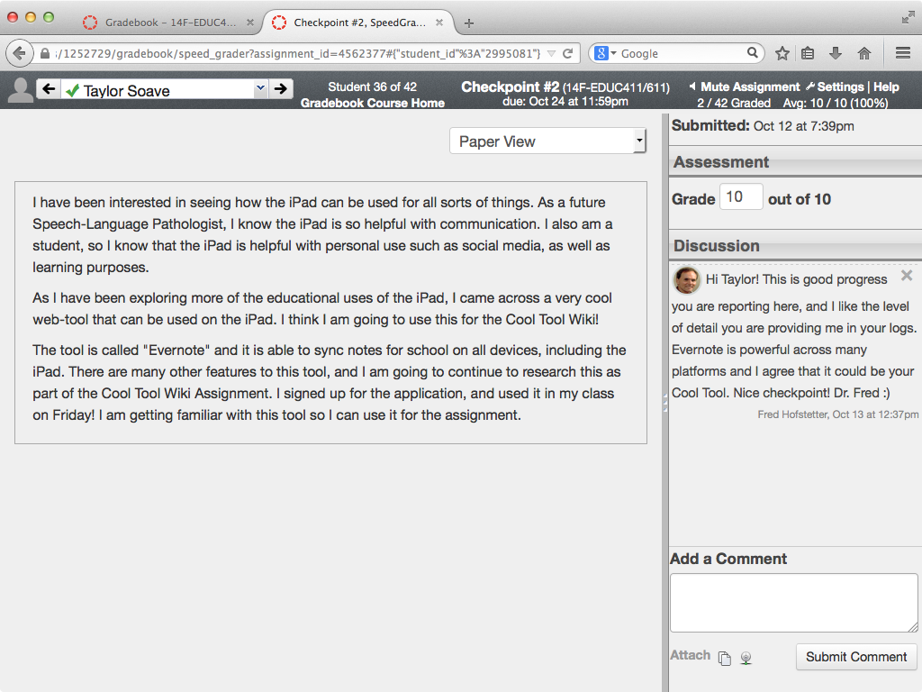
Checkpoint Feedback: Cool tool discovery

Slide 47
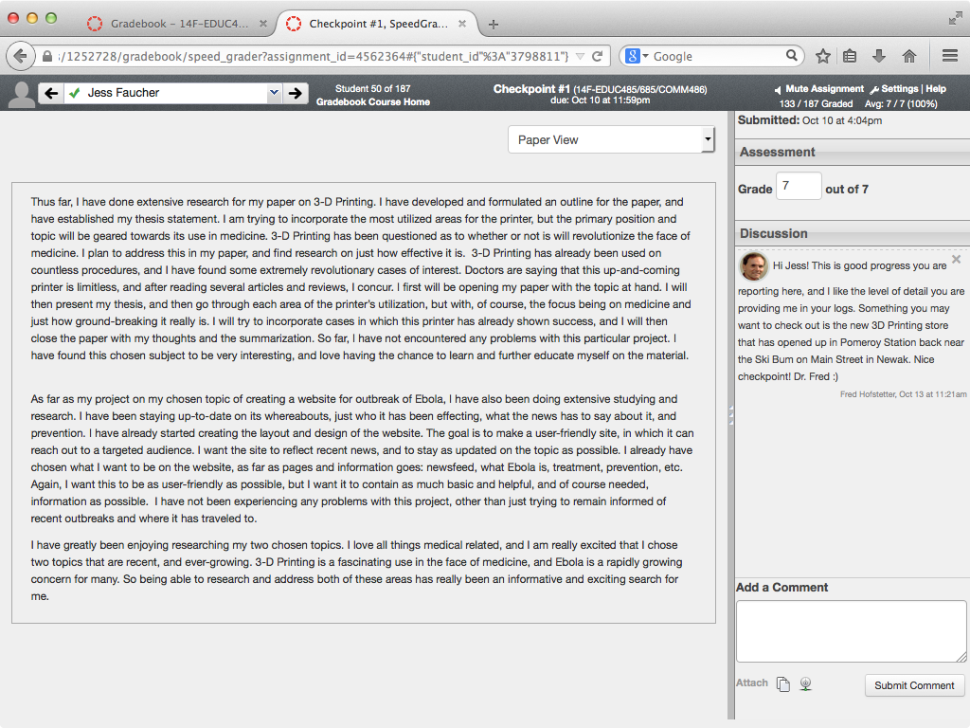
Checkpoint Feedback: Local 3D Printing Shop

Slide 48
Save Your Feedbacks For Future Use
Feedback as Learning System

Slide 49
Thinking Patterns
Especially if your class is large, how will you have time to engage all your students if you must write this amount of dialogical feedback online?
In a large class with hundreds of students participating online, there will not be hundreds of thinking patterns.
Instead, as you grade the checkpoints, you will detect a relatively small number of patterns of student thinking in the course.
By preparing feedbacks to scaffold students at critical points in this thinking, you can be prepared to interact effectively by engaging each student in their zone.

Slide 50
Designing Online Feedbacks
You create a file in which you keep designed feedbacks.
Each time you write a new feedback, you put it into this file from which you can retrieve it on demand whenever another student encounters a similar problem.
I do this with MS Word in which I give each feedback’s title a “heading” style, which enables me to use the Navigation pane as an index into all my feedbacks.

Slide 51
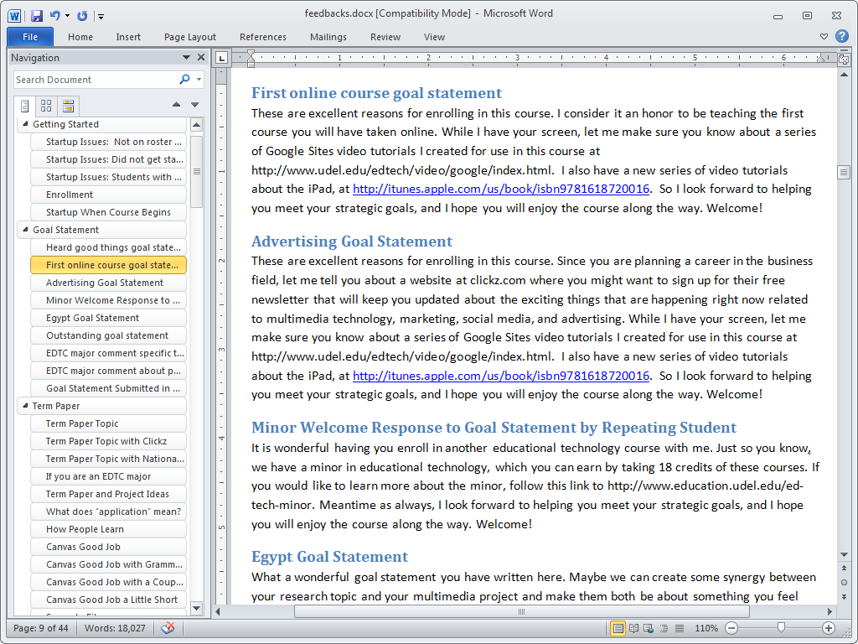

Slide 52
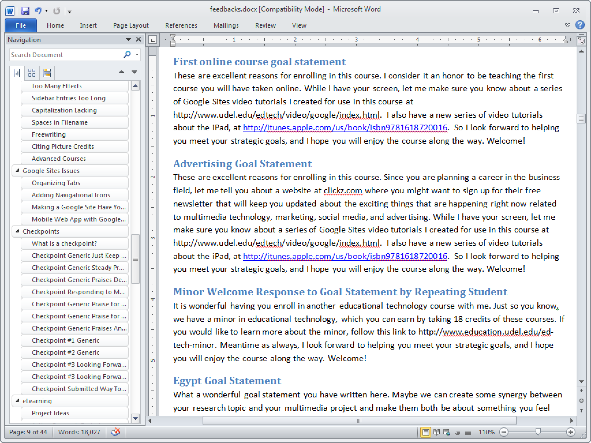

Slide 53
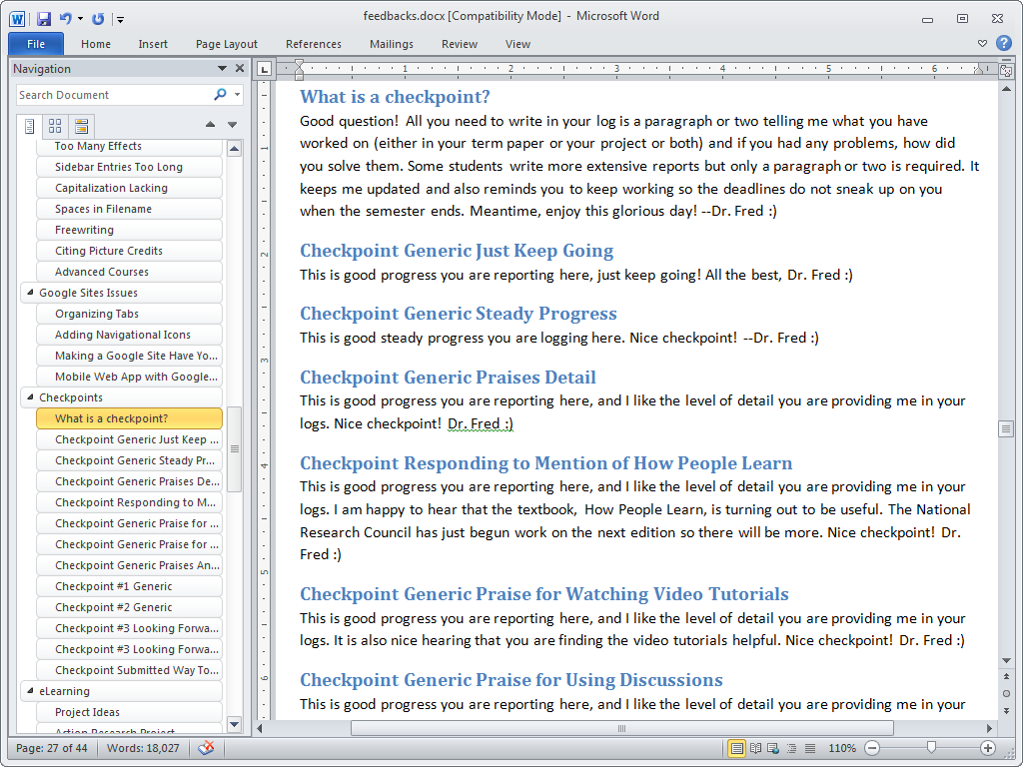

Slide 54
eLearning Engagement Template
Putting Theory into Practice: Five eLearning Strategies for Engaging Students Online

Slide 55
Five Elements of Engagement
Discuss goals with each learner to create an empathetic bond at the beginning of the course.
Turn extrinsic motivation intrinsic by negotiating topics that students feel passionate about.
Make thinking visible through periodic checkpoints to provide effective scaffolding when students need help.
Form a learning community by using rubrics that encourage students to communicate meaningfully with peers and instructors in online discussion forums.
Design instruction into prepared feedbacks for coaching students in their zone.

Slide 56
Applicability to Your LMS
Learning Management Systems are not created equal.
Many have blogs but some do not support blogging.
Some have wikis while others do not.
The challenge is, depending on your brand of LMS, how can you accomplish the five elements of online engagement?
Let us work through an example.

Slide 57
Engaging LMS Design
Principle | Sakai | Canvas | Blackboard
Discuss Goals | Assignment with Feedback and Resubmission | Assignment with Discussion in Sidebar
Negotiate Topics | Assignment with Feedback and Resubmission | Assignment with Discussion in Sidebar
Monitor Progress | Blogs | Checkpoints
Create Learning Community | Forums | Discussions
Coach in the Zone | Feedback and Resubmission | Sidebar Discussion

Slide 58
Engaging LMS Design
Principle | Sakai | Canvas | Blackboard
Discuss Goals | Assignment with Feedback and Resubmission | Assignment with Discussion in Sidebar
Negotiate Topics | Assignment with Feedback and Resubmission | Assignment with Discussion in Sidebar
Monitor Progress | Blogs | Checkpoints
Create Learning Community | Forums | Discussions
Coach in the Zone | Feedback and Resubmission | Sidebar Discussion

Slide 59
Engaging LMS Design
Principle | Sakai | Canvas | Blackboard
Discuss Goals | Assignment with Feedback and Resubmission | Assignment with Discussion in Sidebar
Negotiate Topics | Assignment with Feedback and Resubmission | Assignment with Discussion in Sidebar
Monitor Progress | Blogs | Checkpoints
Create Learning Community | Forums | Discussions
Coach in the Zone | Feedback and Resubmission | Sidebar Discussion

Slide 60
Engaging LMS Design
Principle | Sakai | Canvas | Blackboard
Discuss Goals | Assignment with Feedback and Resubmission | Assignment with Discussion in Sidebar
Negotiate Topics | Assignment with Feedback and Resubmission | Assignment with Discussion in Sidebar
Monitor Progress | Blogs | Checkpoints
Create Learning Community | Forums | Discussions
Coach in the Zone | Feedback and Resubmission | Sidebar Discussion

Slide 61
Engaging LMS Design
Principle | Sakai | Canvas | Blackboard
Discuss Goals | Assignment with Feedback and Resubmission | Assignment with Discussion in Sidebar
Negotiate Topics | Assignment with Feedback and Resubmission | Assignment with Discussion in Sidebar
Monitor Progress | Blogs | Checkpoints
Create Learning Community | Forums | Discussions
Coach in the Zone | Feedback and Resubmission | Sidebar Discussion

Slide 62
Engaging LMS Design
Principle | Sakai | Canvas | Blackboard
Discuss Goals | Assignment with Feedback and Resubmission | Assignment with Discussion in Sidebar
Negotiate Topics | Assignment with Feedback and Resubmission | Assignment with Discussion in Sidebar
Monitor Progress | Blogs | Checkpoints
Create Learning Community | Forums | Discussions
Coach in the Zone | Feedback and Resubmission | Sidebar Discussion

Slide 63
Engaging LMS Design
Principle | Sakai | Canvas | Blackboard
Discuss Goals | Assignment with Feedback and Resubmission | Assignment with Discussion in Sidebar
Negotiate Topics | Assignment with Feedback and Resubmission | Assignment with Discussion in Sidebar
Monitor Progress | Blogs | Checkpoints
Create Learning Community | Forums | Discussions
Coach in the Zone | Feedback and Resubmission | Sidebar Discussion

Slide 64
Engaging LMS Design
Principle | Sakai | Canvas | Blackboard
Discuss Goals | Assignment with Feedback and Resubmission | Assignment with Discussion in Sidebar
Negotiate Topics | Assignment with Feedback and Resubmission | Assignment with Discussion in Sidebar
Monitor Progress | Blogs | Checkpoints
Create Learning Community | Forums | Discussions
Coach in the Zone | Feedback and Resubmission | Sidebar Discussion

Slide 65
Engaging LMS Design
Principle | Sakai | Canvas | Blackboard
Discuss Goals | Assignment with Feedback and Resubmission | Assignment with Discussion in Sidebar
Negotiate Topics | Assignment with Feedback and Resubmission | Assignment with Discussion in Sidebar
Monitor Progress | Blogs | Checkpoints
Create Learning Community | Forums | Discussions
Coach in the Zone | Feedback and Resubmission | Sidebar Discussion

Slide 66
Recommeded Books
Researched Best Practices of e-Learning

Slide 67
Recommended Books

Slide 68
References
Berardi, L. (2002). University faculty members' perceptions of student engagement: An interview study. Normal, IL: Illinois State University.
Clark, R.C., & Mayer, R.E. (2008). e-Learning and the Science of Instruction (2nd ed.). San Francisco, CA: Pfeiffer.
Holmberg, B. (2003). A Theory of Distance Education Based on Empathy. In M.G. Moore and W.G. Anderson (Eds.), Handbook of Distance Education (pp. 79-86). Mahwah, NJ: Lawrence Erlbaum.
Jonassen, D.H. (2014). Assessing Problem Solving. In Handbook of Research on Educational Communications and Technology (4th ed.). New York, NY: Springer New York, 269-288.
Kenny, G., Kenny, D., & Dumont, R. (1995). Mission and place: Strengthening learning and community through campus design. West Port, CT: Praeger Publishers.
Manfra, M. M. (2009). Critical inquiry in the social studies classroom: Portraits of critical teacher research. Theory and Research in Social Education, 37 (2), 298-316.
Mayer, R.E. (2001). Multimedia Learning. New York: Cambridge University Press.

Slide 69
References
Molloy, E.K. and Boud, D. (2014). Feedback Models for Learning, Teaching and Performance. In Handbook of research on educational communications and technology (4th ed., pp. 413-424). New York, N.Y.: Springer.
National Research Council. (2000). How People Learn (expanded edition edited by J.D. Bransford, A.L. Brown, and R.R. Cocking). Washington, DC: National Academy Press.
Romiszowski, A.J. (2005). Online Learning: Are We on the Right Track? In G. Kearsley (Ed.), Online Learning: Personal Reflections on the Transformation of Education (pp. 321-349). Englewood Cliffs, NJ: Educational Technology Publications.
Rule, A. (2006). The Components of Authentic Learning. Journal of Authentic Learning, 3(1), 1-110.
Scardamalia, M., & Bereiter, C. (2006) In Sawyer, R.K. The Cambridge Handbook of the Learning Sciences (pp. 97-115).
Vygotsky, L.S. (1978). Mind in Society: The Development of Higher Psychological Processes. Cambridge, MA: Harvard University Press.
Zhao, C. and G.D. Kuh. 2004. Adding Value: Learning Communities and Student Engagement. Research in Higher Education, Vol. 45, 115-138.

