Slide 1
Alcohol Abuse Education, Prevention and Intervention
Presented to
Faculty Senate
February 9, 2015
By Nancy Chase, Director, Student Wellness and Health Promotion

Slide 2
Goals
Provide a framework for best practice in alcohol and other drug abuse prevention on the college campus
Review current data and key University alcohol and other drug education, prevention, and intervention initiatives
Notes:
I apologize to those who have already heard this presentation.
My hope is to skim the information on the slides and provide some time for discussion.

Slide 3
Public Health Approach:
Social Ecological Model
AOD use is influenced by multiple factors:
Individual factors (students)
Peer factors (other students)
Institutional factors
Community factors
Public policy
What many campuses focus on
Environmental
Management
Notes:
To understand best how we should look to managing this issue on the college campus, we take cues from the approaches used with the general society.
Alcohol and other drug abuse are categorized in our society as public health concerns, and in some cases, as epidemics.
Therefore the approach that is most often applied as an attempt to more effectively manage concerns of these proportions is through a public health approach which leverages the social ecological model.
When the factors that cause AOD abuse are analyzed, it is easy to see that they span well beyond the individual who chooses to use or abuse substances, and in fact are supported by theoretical research which clearly indicates that AOD abuse is supported by institutional factors, community factors and even poor public policy.
Early efforts to control AOD abuse in society and certainly on the college of university campus mainly focused on addressing individual causes of abuse or peer causes which support abuse. In other words, efforts that only addressed the students themselves, not the environment in which the students are living which indeed has been found to support abuse in some critical ways.

Slide 4
Effective prevention practice means establishing interventions in all spheres
Notes:
Because we can tie the causes of AOD abuse to many factors which span beyond the individual, it is important to recognize that the prevention of this type of abuse will require actions which also span the many spheres of human ecology. Analysis must be conducted and actions must be taken on every level (see spheres for titles) to assure a comprehensive, public health approach, to prevention.

Slide 5
Groundbreaking work in 2002, updated in 2007 by NIAAA
Notes:
In 2002 the National Institute on Alcohol Abuse and Alcoholism came out with a ground-breaking report directed at institutions of higher education. Since then, this Call to Action has been the leading guidance on how to approach AOD prevention within a college campus environment. The report was updated in 2007 and the findings of the 2002 report were found to remain sound with certain refinements, which have been included within the remainder of this presentation.
The report covers two things: a model to be adhered to: the 3 in 1 framework;
And the tiers of effectiveness which categorize prevention efforts by evidence, evidence in a non-campus environment, or logical and theoretical promise.

Slide 6
The 3-in-1 Framework
This adapts the social ecological model to be effective in a campus environment.
Simultaneously target:
Individuals, including at-risk or alcohol-dependent drinkers
The student body as a whole
College campus and the surrounding community
Notes:
The groundbreaking report shared a model for how to approach this work on the college campus. Essentially, the 3 in 1 framework that the report recommends distills the public health approach which I just shared into those three actions which will have the most effect in a campus environment.
The 3 in 1 approach tells us to simultaneously target the following three factors:
Individuals:
The risk for alcohol problems exists along a continuum. Targeting only those with identified problems misses students who drink heavily or misuse alcohol occasionally.
Targeting those with higher proven risk closes the gap.
Targeting change in the majority group results in larger, more significant outcomes.
2. The student body as a whole:
The key to affecting the behavior of the general student population is to address the factors that encourage high-risk drinking. These include:
Widespread availability of alcoholic beverages
Aggressive social and commercial promotion of alcohol
Large amounts of unstructured student time
Inconsistent publicity and enforcement of laws and campus policies
Student perceptions of heavy alcohol use as the norm.
3. The college campus and surrounding community:
When college drinking is reframed as a community as well as a college problem, campus and community leaders are more likely to come together to address it comprehensively. The joint activities that typically result help produce policy and enforcement reforms that, in turn, affect the total drinking environment. Campus and community alliances also improve relationships overall and enable key groups such as student affairs officers, residence life directors, local police, retail alcohol outlets, and the court system to work cooperatively in resolving issues involving students.

Slide 7
BASICS at UD
Skill training program administered by Student Wellness and Health Promotion
1) reduces alcohol and other drug consumption and its adverse consequences
2) promotes healthier choices regarding substance use
3) provides information, personalized feedback, and coping skills for risk reduction
Evidence-based practices of both personalized feedback and motivational interviewing
Required for students who violate the University’s alcohol and drug policies
Notes:
These sessions are scheduled at least one week apart from each other, and cannot be completed in the same week.
Personalized feedback is delivering accurate information about the nature of a person’s drinking habits, behaviors, choices and consequences.
Motivational Interviewing involves attention to natural language about change, with implications for how to have more effective conversations about it, particularly in contexts where one person is acting as a helping professional; for another.
MI is designed to find a constructive way through the challenges that often arise when a helper ventures into someone else’s motivation for change.
In particular, MI is about arranging conversations so that people talk themselves into change, based on their own values and interests. Attitudes are not only reflected in but are actively shaped by speech.
UD’s BASICS has three levels:
BASICS 1 consists of one 50-minute session which is a small-group experience followed by completion of an online questionnaire, and one 50-minute individual session in which personalized feedback is reviewed with a prevention specialist.
BASICS 2 consists of two 50-minute individual sessions with a prevention specialist, and still includes the completion of an online questionnaire during the first session. This second survey is only slightly modified from the BASICS 1 survey so that survey results and the personalized feedback which are generated from them can be compared to one another.
BASICS 3 involves four individual sessions, and includes the completion of the online questionnaire.

Slide 8
Campus Coalition on Alcohol and Other Drug Abuse Prevention
Engages faculty, staff and students from entire University community in the development of practices aimed at reducing risks associated with alcohol and other drug abuse
Provides oversight to ensure that institutional concerns about substance abuse are comprehensively addressed and that University efforts are evidence-based practices within the discipline of college health promotion
Notes:
Co-Chairs:
Dawn Thompson, Vice President for Student Life
Nancy Chase, Director, Student Wellness & Health Promotion
The formation of the coalition reflects the institution’s commitment to the safety and success of our students.
The members have been educated in best practices, have delved deeply into the available data about student behaviors, and have been informed about current UD campus prevention practices.
The next step is to determine a strategic plan.

Slide 9
Increased Enforcement and Joint Agency Policing
University and Newark police patrol together at high risk and high volume times.
Allows University police to assist at locales outside their jurisdictional lines (i.e., student and fraternity houses)
Results in faster University responses to developing situations
Extra joint agency teams in addition to University police patrol at high risk and high volume times.
Publicity of efforts and outcomes serves as a deterrent.
Notes:
When UD students are encountered, they are both arrested by city police (if applicable) and also written up by UD police and directly referred into the conduct system, which is more expedient and has more applicable educational sanctions than are provided through the City court process for our students.
These extra patrols are moved around by a dedicated shift sergeant who is aware of where the action is occurring. For instance, extra policing is available for night football games and on St. Patrick’s Day. And a visible police presence helps deter and/or contain behavior more effectively.
Publicity given in advance about extra patrols and also an overall increase in reporting about the outcomes of having consistent and expected enforcement acts as a deterrent in and of itself and often does not result in higher levels of intervention.

Slide 10
Data Sharing

Slide 11
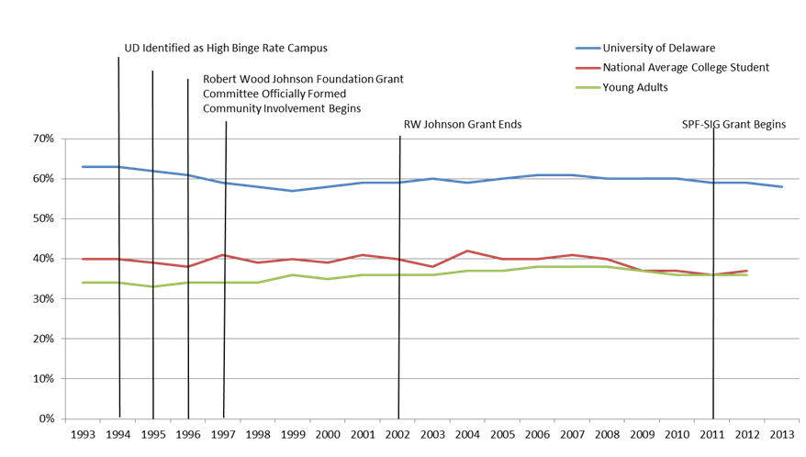
Trend line is based on a four-year rolling average. UD data from 1993, 1997-2003, and 2005 from the College Alcohol study. UD data beginning in 2008 from the College Risk Behaviors study. Non-UD data from the Monitoring the Future study, University of Michigan.
Notes:
This graph depicts our student data in reference to the national norms. This data reinforces the fact that we can’t just target individual behavior change and expect this level of risk to change.

Slide 12
Academic Consequences
Note: Percentages represent the number of drinkers who reported experiencing a particular consequence at any time in the past two weeks.

Slide 13
Negative Consequence for UD Students Associated with Drinking: CRBS 2012 and 2013

Slide 14
Opportunities for faculty engagement
Tier 1:
Challenging alcohol expectancies
Avoid glamorizing or normalizing alcohol or drug use
Avoid reinforcing the UD party school image
Avoid the use of alcohol around students
Hold students accountable
Reinforce the academic consequences of excessive alcohol or drug use
Add the factor of alcohol or drug use to discussions of professional ethics
Offering brief motivational enhancement interventions
Invite a guest lecturer for group motivational enhancement or other resiliency/skill-building programming
Give extra credit to students who volunteer to do BASICS or attend an awareness program

Slide 15
Opportunities for faculty engagement continued
Tier 1 continued:
Developing campus-community partnerships
Take a turn serving on the Campus Coalition or other related advisory board
Tier 2:
Increased publicity of and enforcement of laws and other policies adopted to reduce alcohol impairment
Know the Code of Conduct; take action when appropriate
Educate students about relevant aspects of the Code and about the Amnesty Protocol; reinforce UD expectations and standards
Class discussions about recent events (I’m Schmacked)
Curriculum infusion opportunities?
Research potential?

Slide 16
Opportunities for faculty engagement continued
Other ideas??

Slide 17
Thank you!

