Slide 1

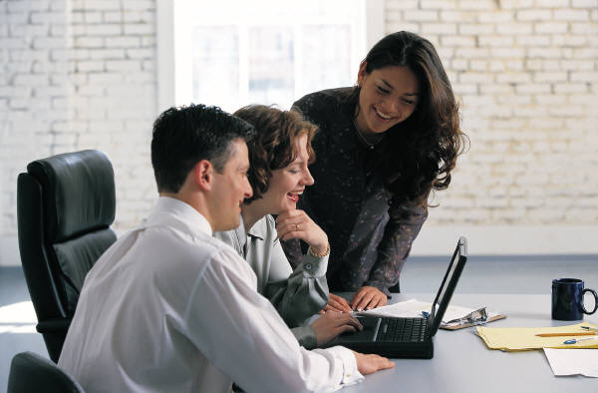
Online Spaces - Learning Places
Presented by Sallie Reissman
April 3, 2009

Slide 2
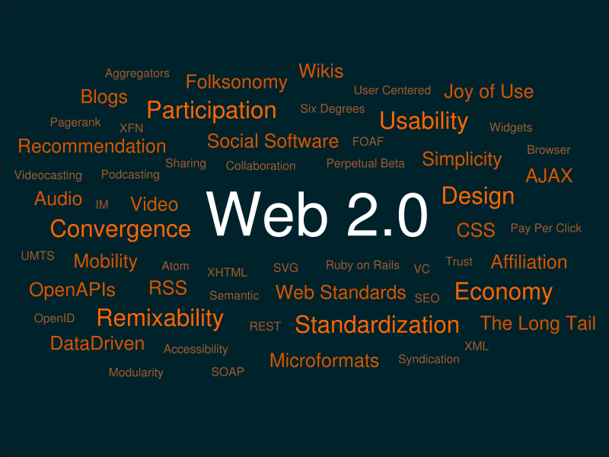
http://kosmar.de/archives/2005/11/11/the-huge-cloud-lens-bubble-map-web20/

Slide 3

Web 2.0
Users own and control the data
Climate of participation
Users add value as their needs evolve
User friendly interface
Connecting
Networking
Lifestreaming

Slide 4
Authentic Examples
Facebook – social networking
Twitter – micro blogging
Jing – screen capture
Skype - VoIP
Web Conferencing – online presentation

Slide 5
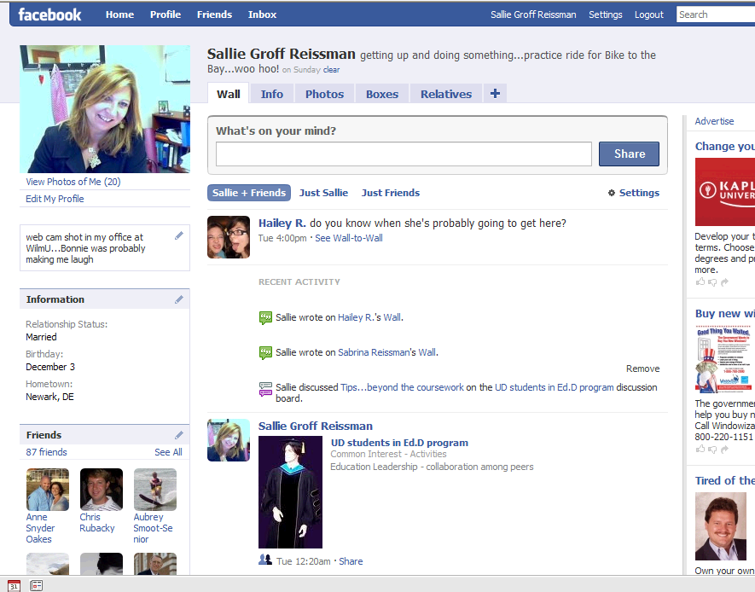

Slide 6
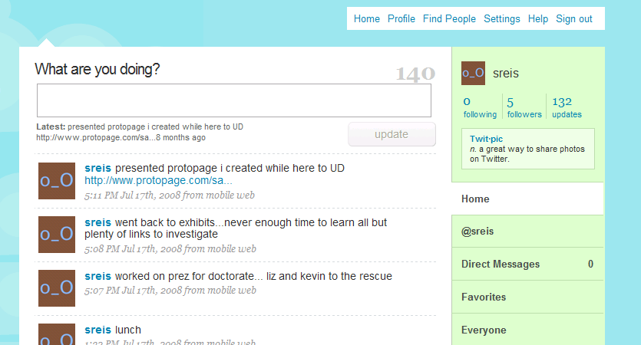

Slide 7
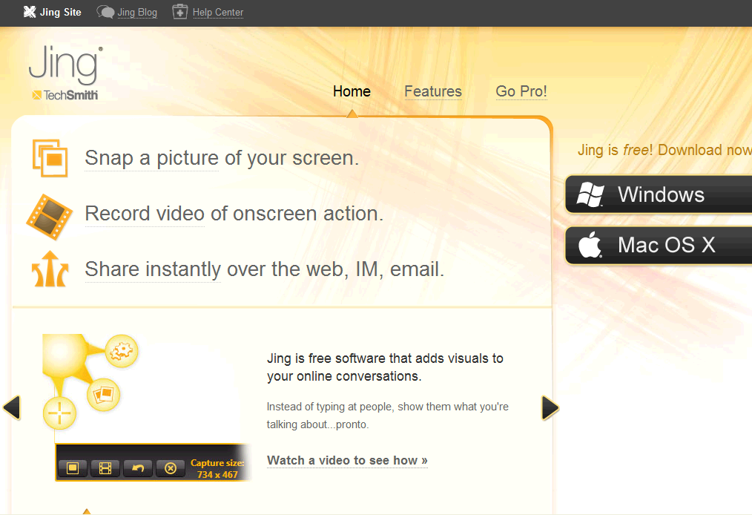

Slide 8
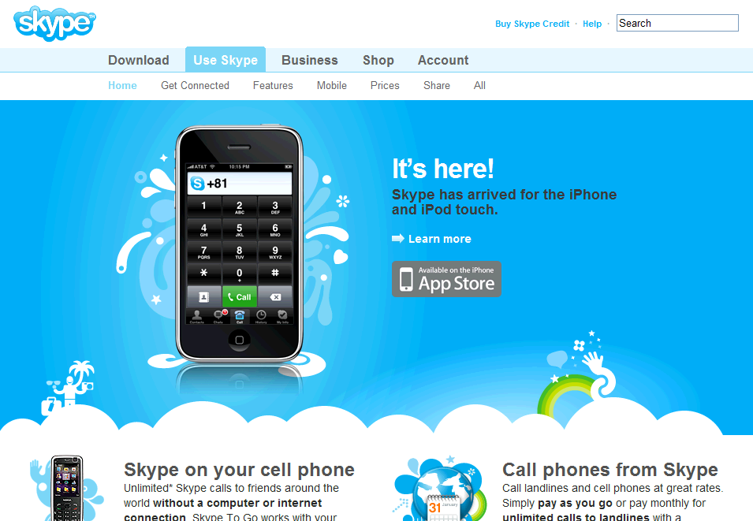

Slide 9
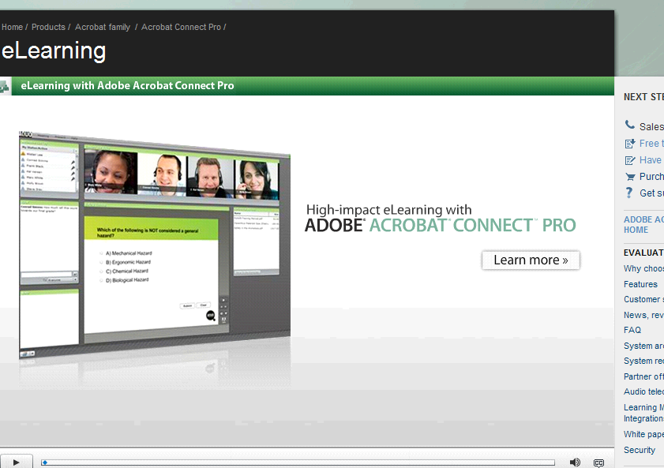
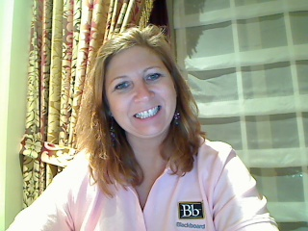

Slide 10


Questions?
sallie.a.reissman@wilmu.edu

