Slide 1
Donning and Doffing PPE

Slide 2
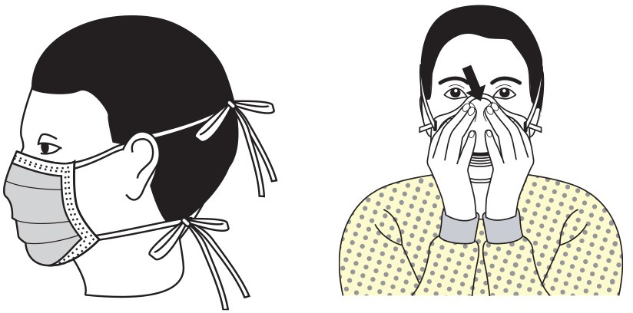
Donning and doffing of PPE
Donning and doffing is the practice of putting on and removing personal protective equipment.
Donning refers to putting on personal protective equipment.
Doffing refers to removing personal protective equipment.
Image: CDC

Slide 3


Donning a surgical or cloth mask
Wash hands with soap and water or apply hand sanitizer before donning a mask.
Place mask on face with ear loops over ears.
The mask should cover your nose and mouth with no gaps between the mask and your face.
Wash hands with soap and water or apply hand sanitizer.
Avoid touching the mask while wearing it.

Slide 4
Doffing a surgical or cloth mask
Wash hands with soap and water or apply hand sanitizer.
Use the ear loops to remove the mask avoiding touching the front of the mask or your face.
Wash hands with soap and water or apply hand sanitizer.
Note: If the mask was worn during an encounter with another person who displayed obvious signs of illness, discard the mask in the trash.

Slide 5
Reusing a surgical or cloth mask
If using a surgical or cloth mask and following social distancing practices, the likelihood of the mask being contaminated is very low.
Wash hands with soap and water or apply hand sanitizer.
Remove mask by holding the ear loops.
After removing surgical facemask, visually inspect for contamination, distortion in shape or form. Discard in trash if soiled, torn, or saturated. If not place in paper bag. For a cloth face mask, place in paper bag and launder.
Carefully store surgical mask in an unsealed bag labeled with your name on it.
Wash hands with soap and water or apply hand sanitizer.

Slide 6
Demonstration of surgical mask and cloth face cover donning and doffing procedures
https://www.youtube.com/watch?v=z-5RYKLYvaw

Slide 7
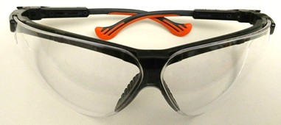
Procedures for donning safety glasses
Wash hands with soap and water or apply hand sanitizer before donning safety glasses.
Remove the safety glasses from package or storage container.
3. Place safety glasses directly on your face. Do not set the safety glasses on surfaces.
Image: ASU

Slide 8
Procedures for doffing safety glasses
Wash hands with soap and water or apply hand sanitizer. If wearing gloves, remove gloves before removing safety glasses.
Remove safety glasses. Avoid touching your eyes and face.
Clean safety glasses with soap and water solution. Let dry before storing them.
Place safety glasses in clean plastic container or Ziploc bag for reuse.

Slide 9
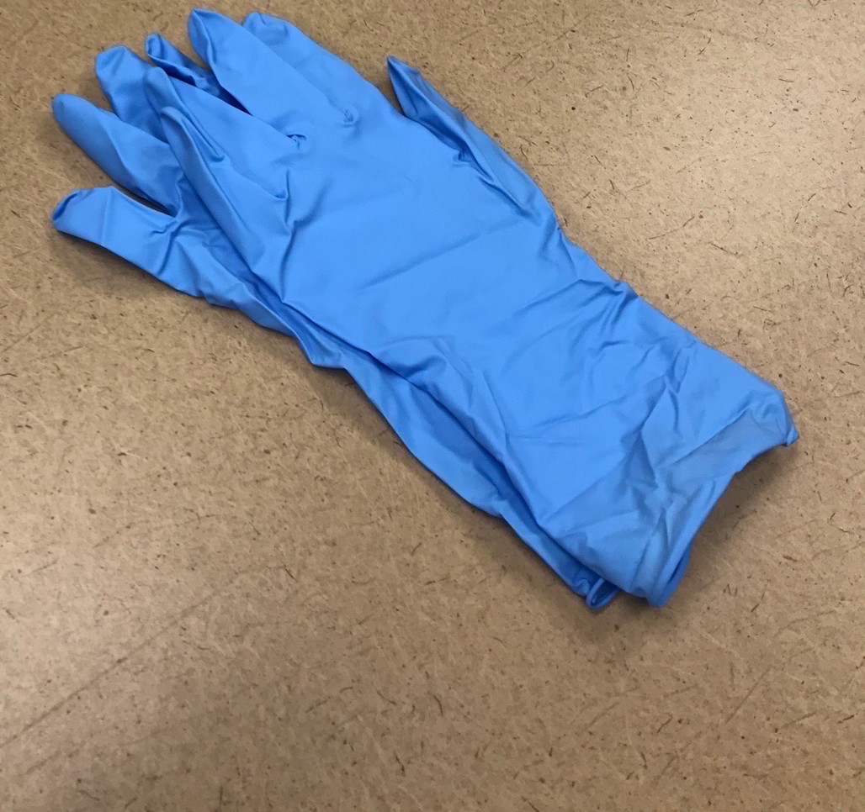
Procedures for donning gloves
Wash hands with soap and water or apply hand sanitizer before donning gloves.
Select properly sized gloves.
Don one glove per hand.
Inspect gloves for any tears or holes and replace gloves if any defects are detected.

Slide 10
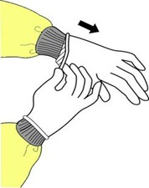
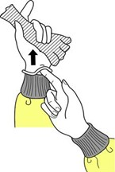
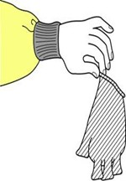
Procedures for doffing gloves
Grasp the outside edge near your wrist.
Peel away from your hand, turning the glove inside- out.
Hold in opposite gloved hand.
Slide ungloved finger under the wrist of the remaining glove.
Peel off from inside, creating a bag for both gloves.
Discard gloves in the garbage.
Image: CDC

Slide 11
Donning and Doffing Gloves Video
https://vimeo.com/232686970

Slide 12
Donning and Doffing Tyvek® Suit
https://www.youtube.com/watch?v=zLbvQcpfZyQ

