Slide 1
Advertising Using Mobile Apps
By Rachel Herrick

Slide 2
Table of Contents
History of Mobile Phones
Advertising using Applications
‘Appvertising’
iAds
Benefits
Remaining Issues
Conclusion

Slide 3
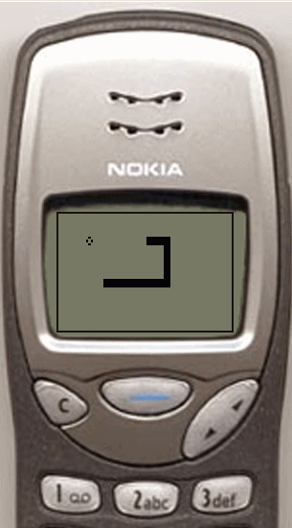
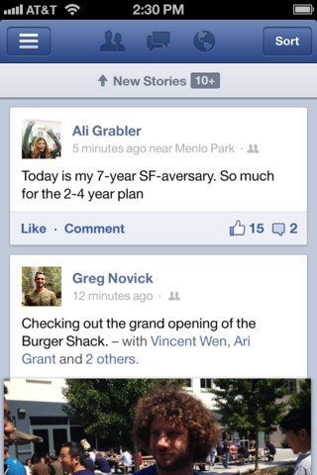
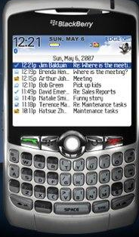
History
With the birth of the mobile phone came applications for both entertainment and functionality. As technology developed, these apps got more and more intricate and advanced.
2012
1998
2003

Slide 4
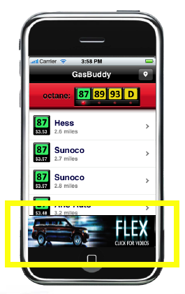
Advertising using Apps
Marketers are always looking for a way to expand and reach consumers
Mobile phones offered a new medium
Apps were a hot new technology
Banners on apps offered a new option
Banners could be put on any app for a time period

Slide 5
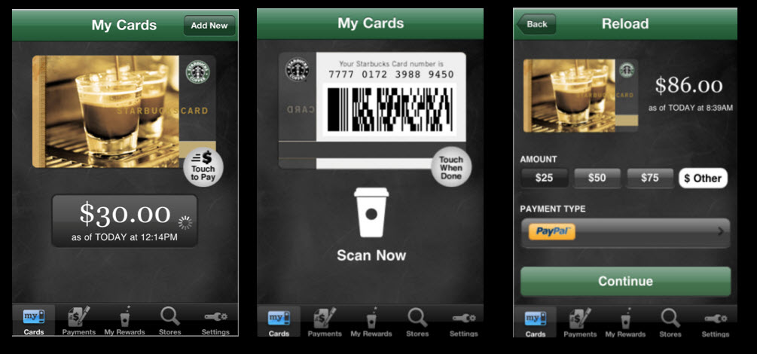
Appvertising
Term ‘appvertising’ was coined by Garrick Schmitt in 2010
Made up of:
ads served within apps
apps created by brands
apps sponsored by brands
Good advertising opportunity for business to build brand loyalty
Ex: Starbucks-customers earn points that load to the app whenever they make a purchase, these points lead to additional deals

Slide 6
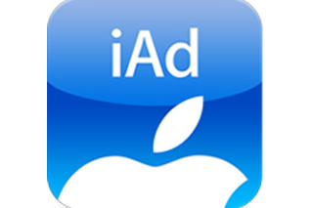
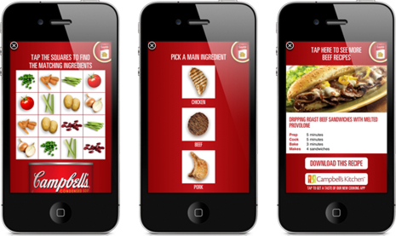
iAds
Created by Steve Jobs in 2010
Meant to resemble an interactive version of commercials to keep the consumer’s attention
Campbell’s iAds have been very successful
Offer recipes
Offer coupons
Offer an option to download an app for further recipes

Slide 7
Benefits
Deals and offers shown on similar apps or for the brand help to reach target markets
Mobile phone location services allows ads to be directed at consumers in nearby areas
Gives the consumer something to base their opinion of the brand off of
Reaches consumers on a more personal level

Slide 8
Remaining Issues
Small mobile phone screen sizes limit the advertisement and can make it difficult to read any fine print
Creating an app, iAd, or using a banner are very expensive
Apps have short run time and tend to get phased out by newer ones often

Slide 9
Conclusion
Mobile phones have come a very long way in the passed 15 years
With new technology come new opportunities for marketing and advertising
Using mobile phone applications has been the ‘new big thing’ to come to the advertising world
When do you think the new technological advancement will come out that will change advertising as we know it…AGAIN?!

