Slide 1
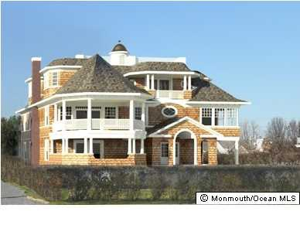
64 Ocean Ave Monmouth Beach, NJ, 07750
Start Here!

Slide 2
Facts & Figures
General Information
Layout
What You Need to Know
Drag your mouse
over what you want to see

Slide 3
General Information
Beds: 6
House size: 6,500 sq ft
Price: $2, 650,000
Property type: Single Family Home
Stories: 3
Baths: 5 full, 2 Half Bath
2 Car garage
Custom Style Waterfront Home from local architect James Montefort
What You Need to Know
Facts & Figures
Estimated Payment with a loan type of 30 year fixed:
20% down: $530,000
Interest Rate: 4.375%
Total estimated monthly payment for this scenario: $14,055
Updates as of July 2013:
-Granite kitchen counter tops
-Hardwood flooring refinished
-No basement
-No attic
Heat/Fuel: Natural Gas
Water Heater: Natural Gas
Heat/AC: 3+ Zoned AC & Heat
Ahead to Layout

Slide 4
Layout
First Floor
Second Floor
Third Floor
Dinging room, foyer, kitchen, study/bedroom, living room, porch, 1 full bath, 1 half bath
Front porch, foyer, 1 half bath, 1 full bath, living room, garage
3 Bedroom, 1 master bedroom balcony and master bath, 2 full bath, laundry room
Back to pinwheel!
Ahead to drawing board!

Slide 5
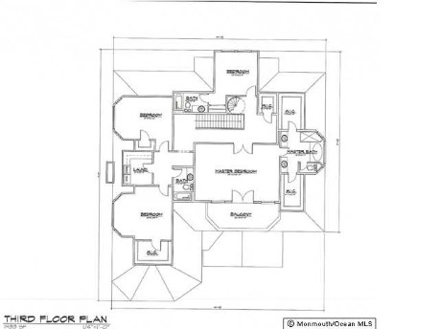
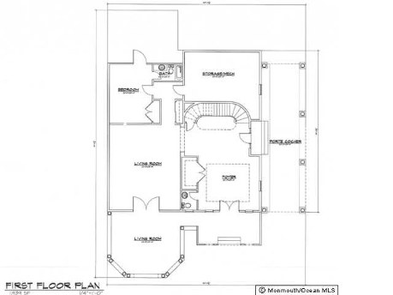
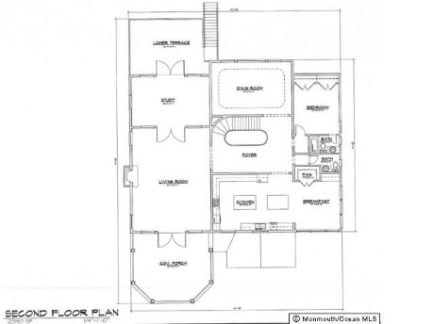
To do list
..find out more about the area!
Go to next open-house Oct. 11th @7pm!
Find out more
here!

Slide 6
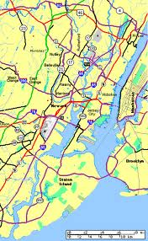
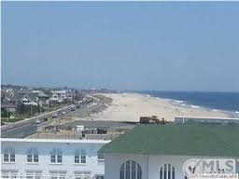
Community
Excellent Public Schools
Travel
Locals Only

Slide 7
Travel
Train
Long Branch to Penn Station
1.36 hrs
Ferry
Atlantic Highlands to Pier 11 or E. 35th St Manhattan
40min-1hr
Car
To Newark airport: 1hr
To JFK airport: 1.30hr
To Atlantic City: 1.45hr
Locals
School

Slide 8
Excellent Public Schools
K-4th
Monmouth Beach Elementary School, Monmouth Beach, New Jersey
5th-8th
Maple Place Middle School, Oceanport, New Jersey
9th-12th
Shore Regional High School, West Long Branch, New Jersey

Slide 9
Locals Only
Private membership at beach clubs
Contact your Realtor Here!
Pier village, shopping, great restaurants
Sandy Hook, river activities, Revolutionary War history
bike riding, fishing, tubing
library, nail salons, Milagro spa
golf clubs, sports bars, elite gyms
Monmouth University, where the movie Annie was filmed
Contact your realtor HERE!

Slide 10
Click on what you want to go back and review!
Home
General Information
Shore Homes Shirvanian Realty
35 Beach Road Monmouth Beach, NJ, 07750
Office: (732)-768-3545
Layout
Community

