Slide 1

Let’s Begin!
Click the picture that answers the question correctly

Slide 2


Which is an apple?

Slide 3

GREAT JOB!!
LET’S GO!

Slide 4
TRY AGAIN

Slide 5
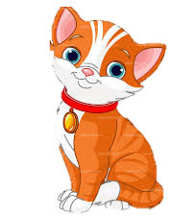

Which is the cat?

Slide 6
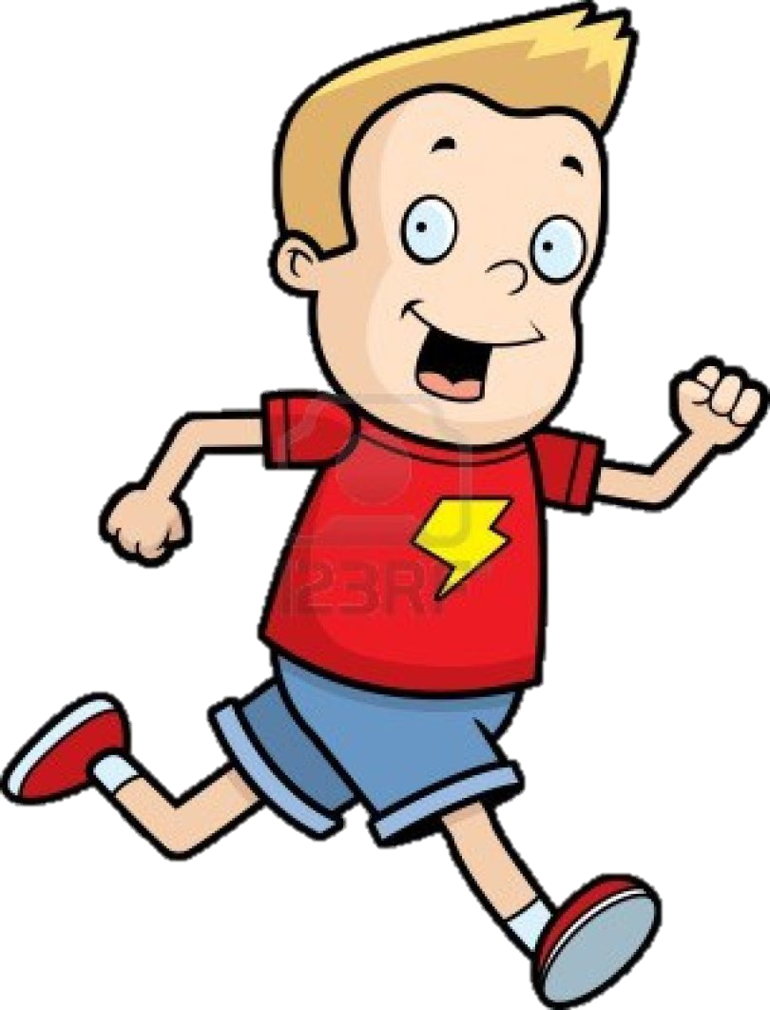
You did it!
NEXT

Slide 7
OOPS, TRY AGAIN

Slide 8


What picture is the boat?

Slide 9

You got it!
KEEP GOING

Slide 10
ONE MORE TRY!

Slide 11
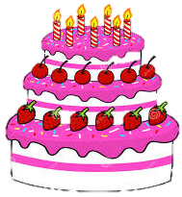
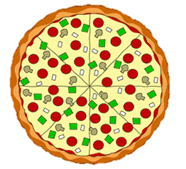
Which is the pizza?

Slide 12

That’s Right!
THIS WAY!

Slide 13
TRY AGAIN!

Slide 14
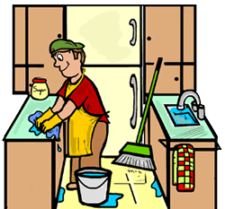
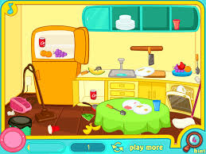
Which kitchen is clean?

Slide 15

Great Job!
Let’s try the next one!

Slide 16
Let’s try again!

Slide 17


Which is door is open?

Slide 18

You’re right!!
Keep Going!

Slide 19
Stop and Try Again!

Slide 20


Which pumpkin is bigger?

Slide 21
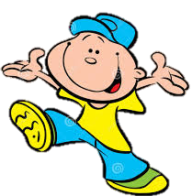
That’s Correct!
Time to Finish!

Slide 22
Try Again!

Slide 23
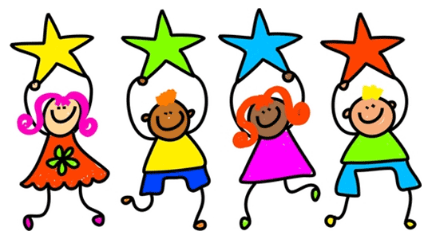
You are all Finished!
Great Job!

