Slide 1
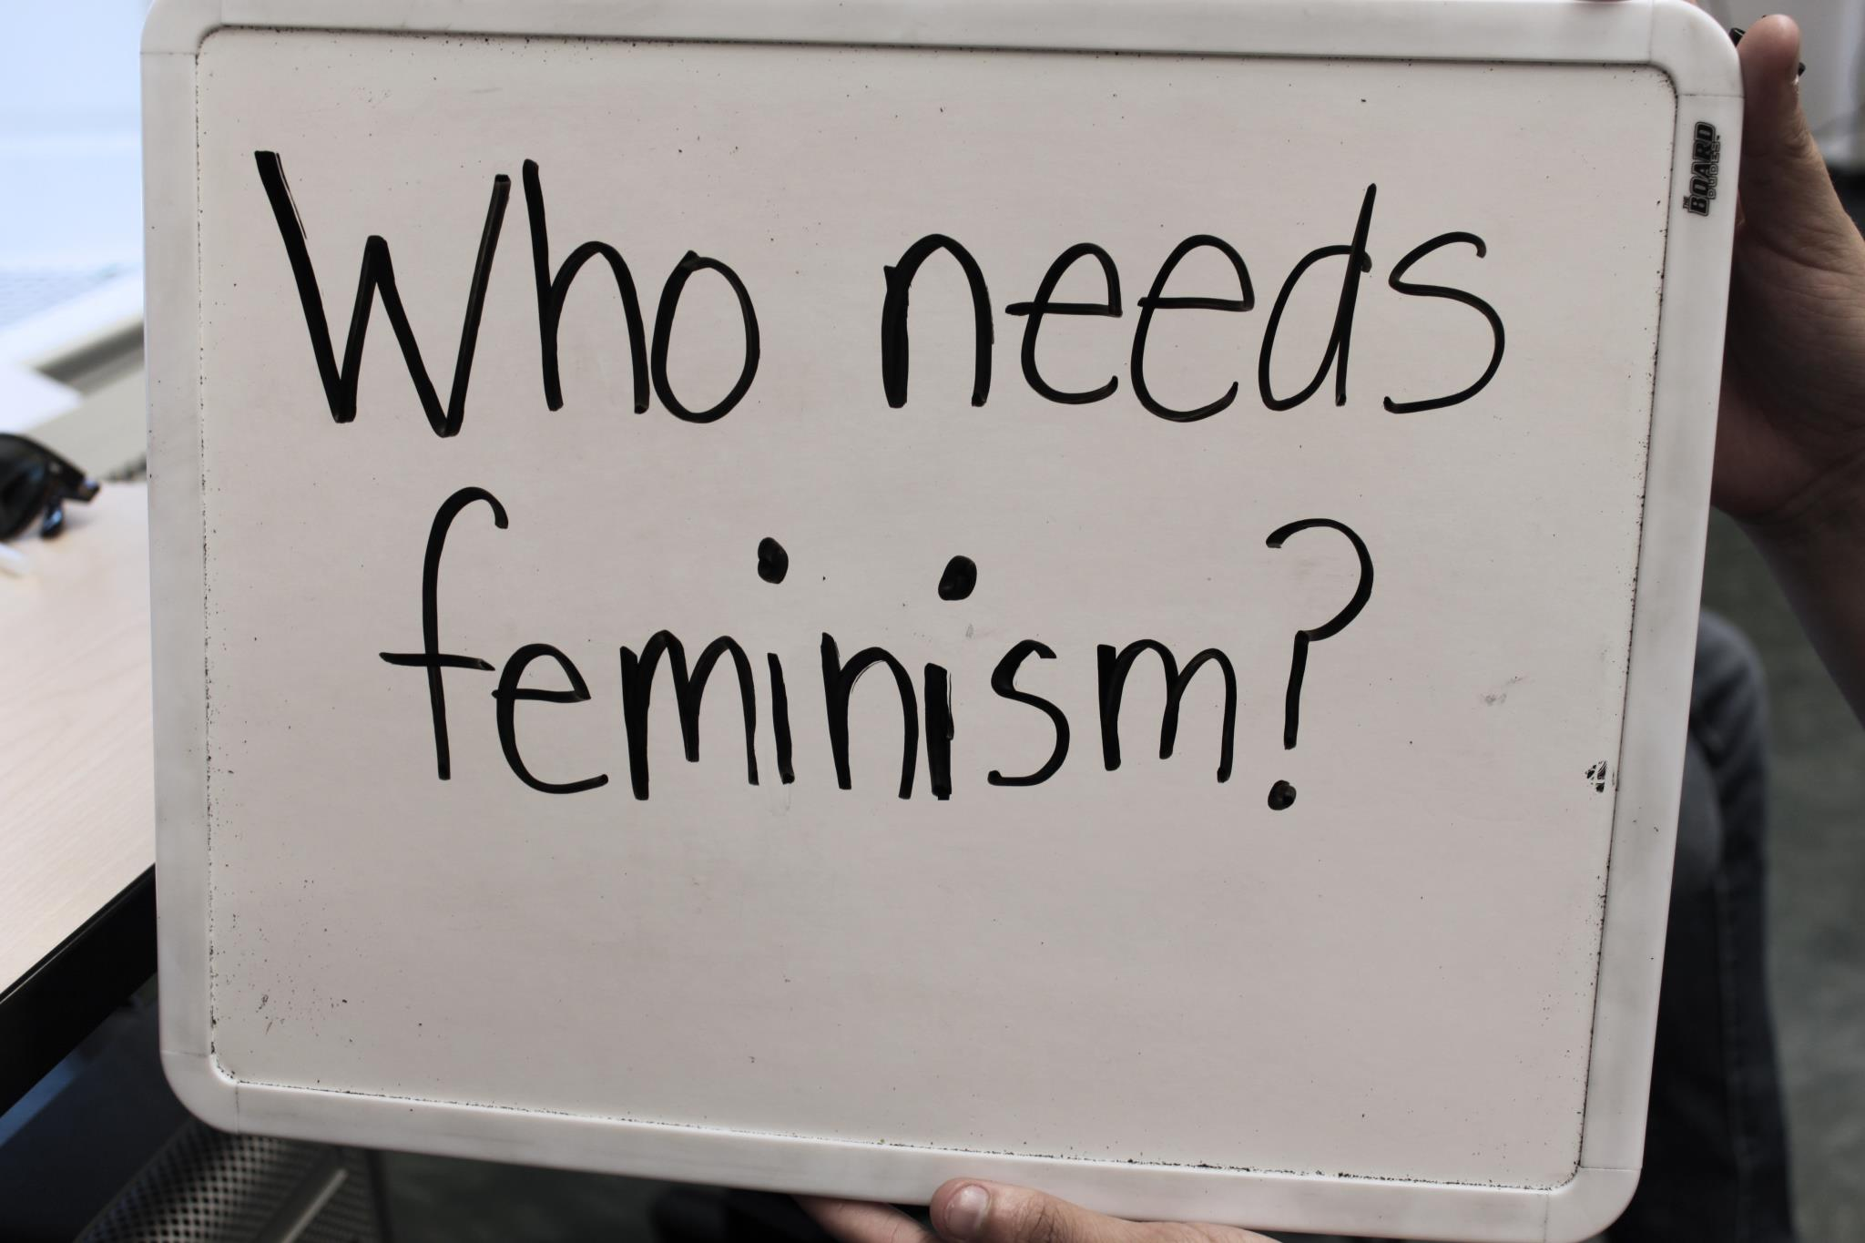




Feminist Social Media Resources
Click a picture to begin!

Slide 2
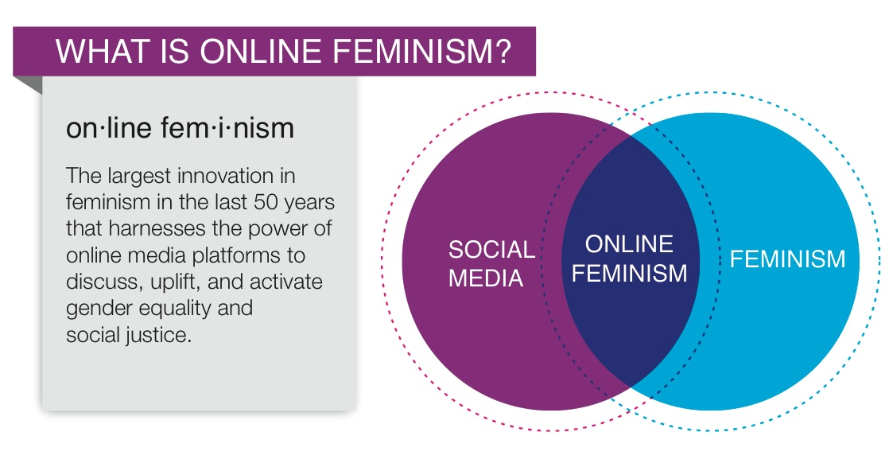

Social media and Feminism
Create a place where women are free to express thoughts and ideas
Social media has changed traditional methods of activism
Maximize visibility for feminist and feminist organizations
Home

Slide 3

Feminist Blogs
The oldest feminist blog
Feminist blog for mothers
The largest female blogging community
As of 2008, 36.2 million American women participate in “Blogosphere”
Home

Slide 4

Tumblr
A blogging site
Short form blogs (microblogging)
Microblog – smaller in actual size and aggregate file size
Users exchange small elements of content: short sentences, video links, individual images
Is This Feminist?
Lipstick Feminists
Upsetting Rape Culture
Home

Slide 5

Twitter
Microblogging service
Send and read messages of 140 characters or less
Feminist News
Feminist Campus
SlutWalk NYC
Home

Slide 6

Facebook
Users create profiles
Can join interest groups and “like” pages
Plays a huge role in online feminist activism
Crunk Feminist Collective
Love Consent
Home

Slide 7
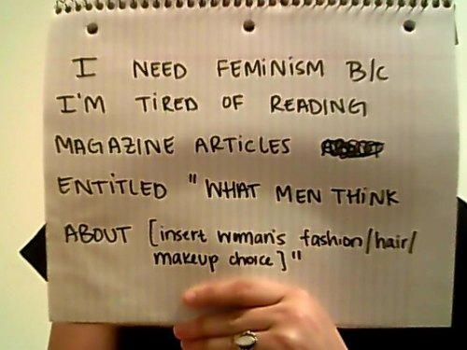
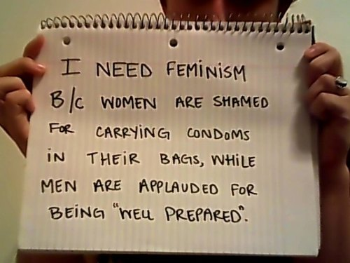
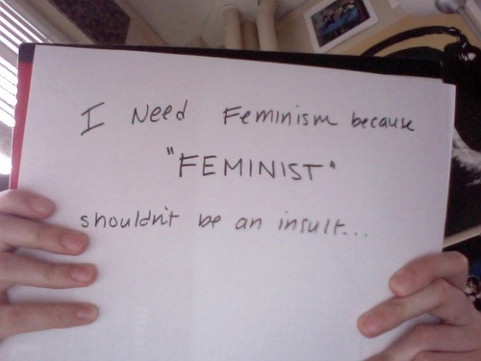
Who Needs Feminism?
Started at Duke University
Women students decided to fight back against misconceptions regarding feminism
Tumblr page
Who needs feminism is separate from the blog category because it has taken on a life of its own. It brings people of all races and genders together to understand why feminism is still important. is now ALL over the internet.
Home

Slide 8
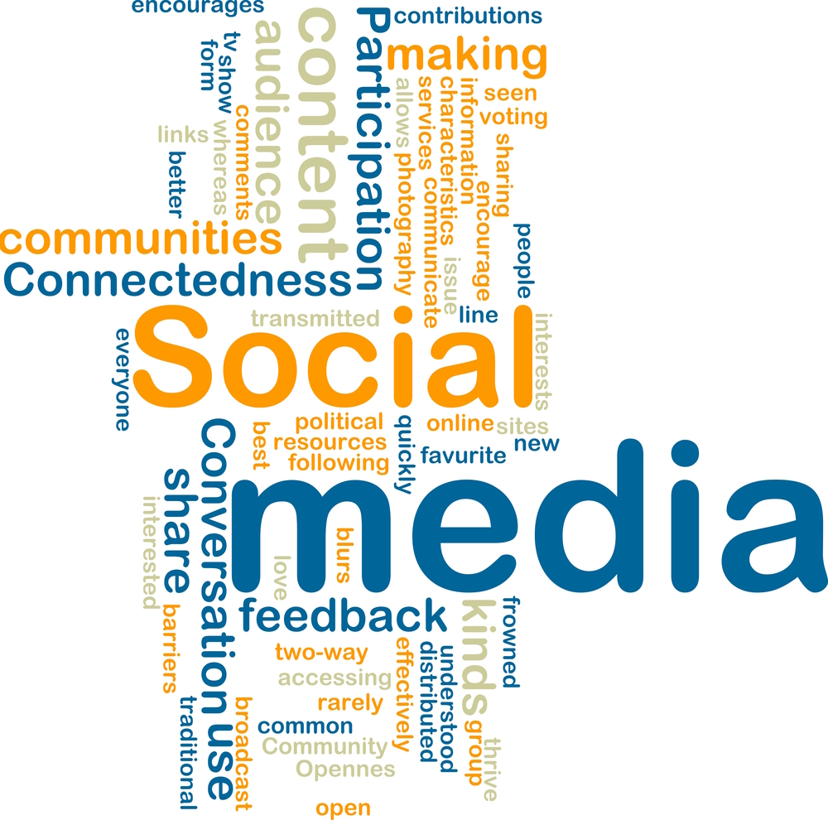
Conclusion
The interaction between feminism and social media has come a long way from the electronic magazines of the late 1990s/early 2000s. Facebook, Twitter, Tumblr, and other blog websites increase visibility of these causes to thousands of people and give people from all walks of life the opportunity to come together to discuss issues and ideas pertaining to feminism and women’s rights.

Slide 9
Bibliography
http://en.wikipedia.org/wiki/Facebook
http://en.wikipedia.org/wiki/Twitter
http://en.wikipedia.org/wiki/Tumblr
http://www.fem2pt0.com/2010/04/15/tweeting-feminists-exploring-feminism-and-social-media/
http://whoneedsfeminism.com/about.html

