Slide 1
A Guide to Mass transfer equations
By: Ahmed Al-Marjibi

Slide 2
X
This program is targeted toward junior chemical engineering student and students taking a heat and mass transfer class.

Slide 3
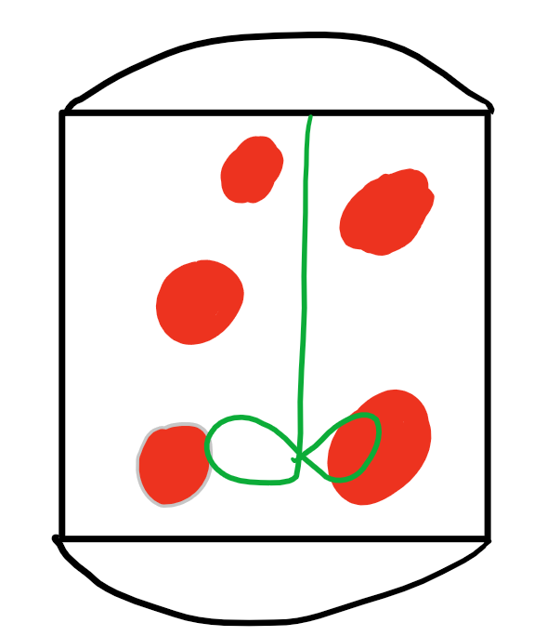
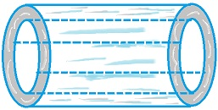
Choose contactor type
X
Tank
Tubular

Slide 4
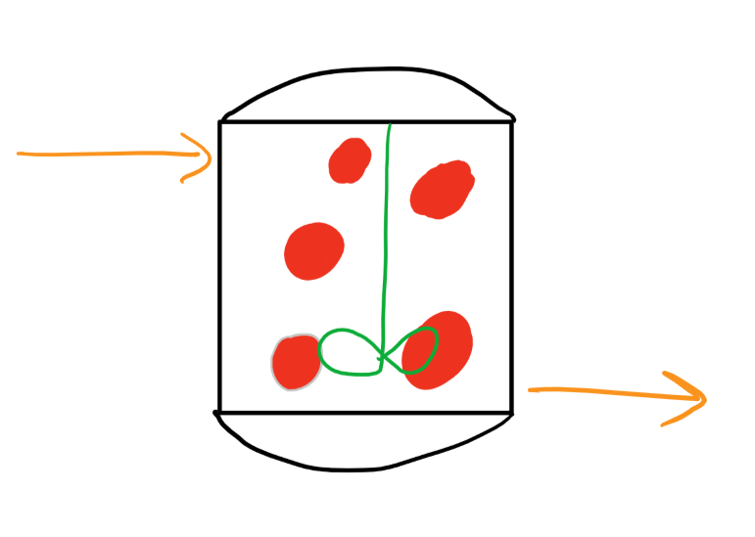
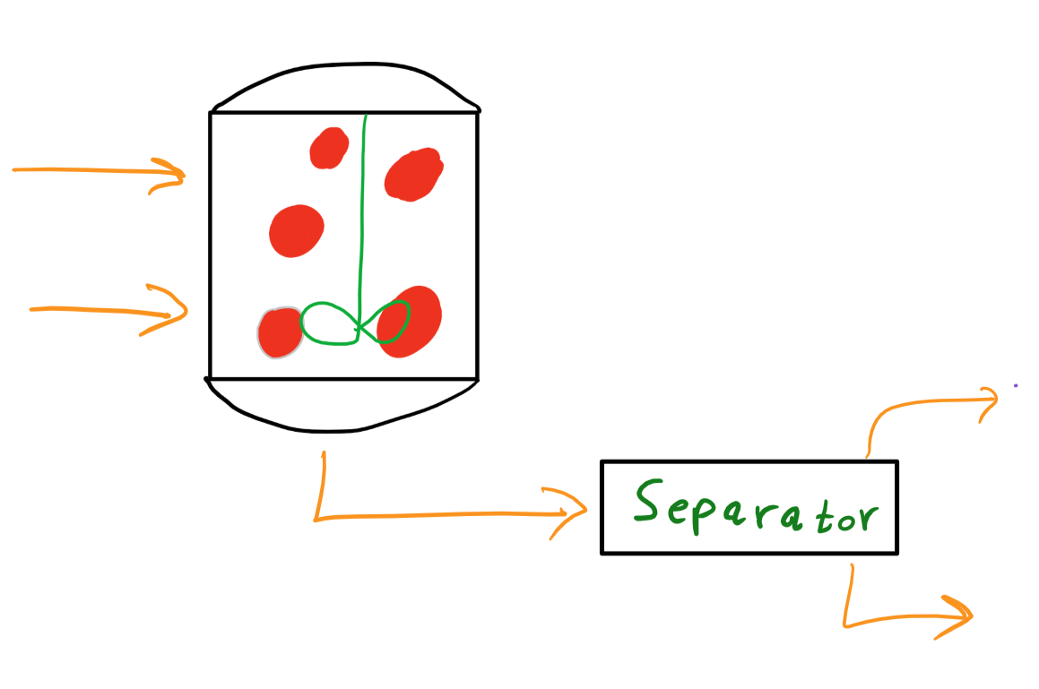
Choose one of the 3 main tank type mass contactors
X
Batch
Semi-Batch
Continuous
(Choose One)

Slide 5
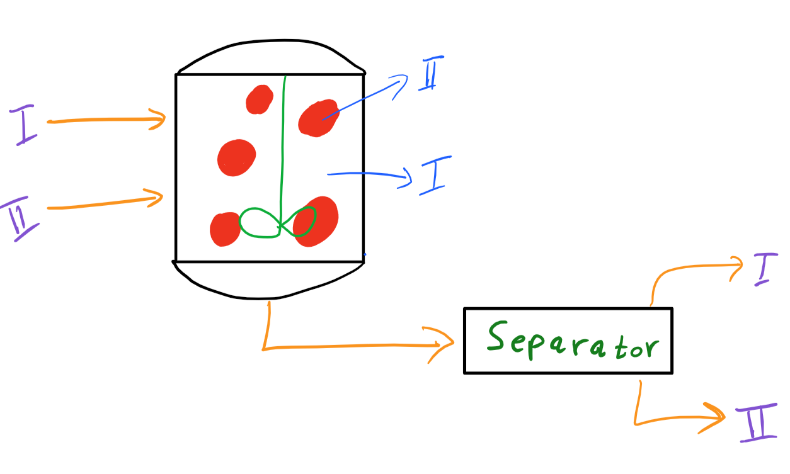



Tank type Continuous Contactor
X
(Choose one)
phase balance
$$C_{A}^{I}$$
$$C_{A}^{II}$$
$$V_{}^{II}$$
Back to tank type list

Slide 6

Tank type Continuous Contactor: Phase balance
X
$$0=q^{I}\left(C_{AF}^{I}−C_{A}^{I}\right)−k_{m}a(C_{A}^{I}−MC_{A}^{II})$$
$$0=q^{II}\left(C_{AF}^{II}−C_{A}^{II}\right)+k_{m}a(C_{A}^{I}−MC_{A}^{II})$$
Back

Slide 7
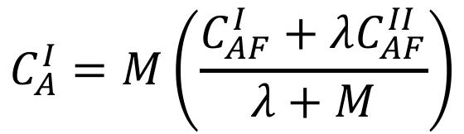

Tank type Continuous Contactor: $C_{A}^{I}$
X
$$C_{A}^{I}=M\left(\frac{C_{AF}^{I}+λC_{AF}^{II}}{λ+M}\right)$$
Back

Slide 8
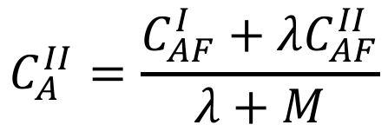

Tank type Continuous Contactor: $C_{A}^{II}$
X
$$C_{A}^{II}=\frac{C_{AF}^{I}+λC_{AF}^{II}}{λ+M}$$
Back

Slide 9


Tank type Continuous Contactor: $V_{}^{II}$
X
$$V_{}^{II}=\frac{ad}{6}$$
Back

Slide 10
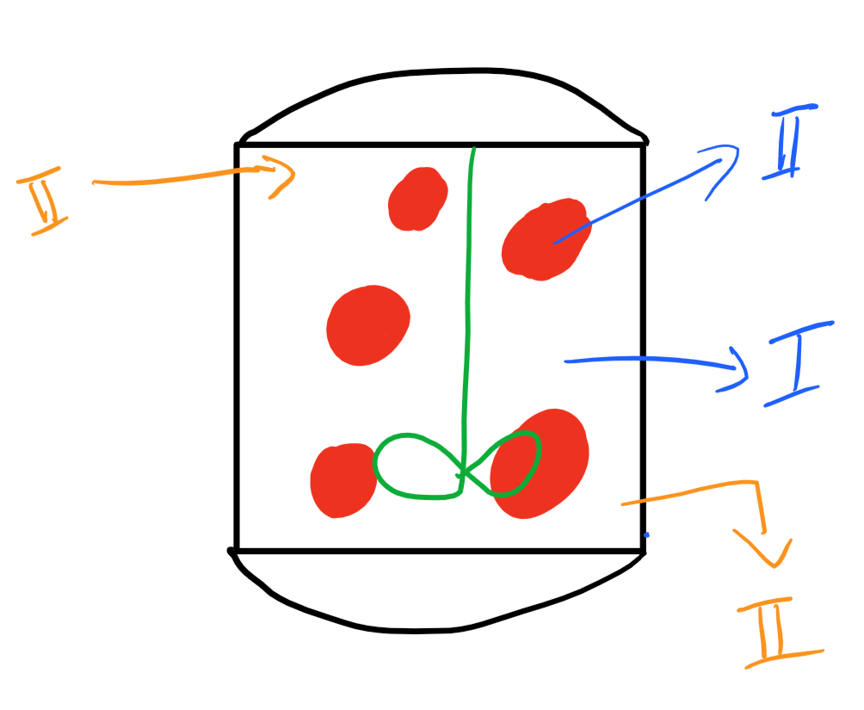
Tank type semi-Batch Contactor
X
(Choose one)
Overall phase balance
Phase I Energy balance
Phase II Energy balance
Back to tank type list

Slide 11
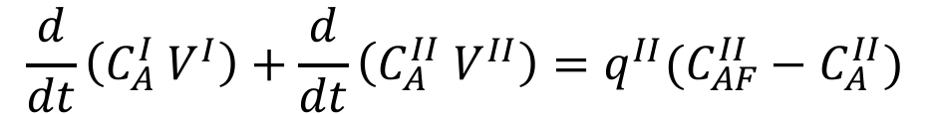
Tank type semi-Batch Contactor: overall phase balance
X
$$\frac{d}{dt}\left(C_{A}^{I} V^{I}\right)+\frac{d}{dt}\left(C_{A}^{II} V^{II}\right)=q^{II}(C_{AF}^{II}−C_{A}^{II})$$
Back

Slide 12
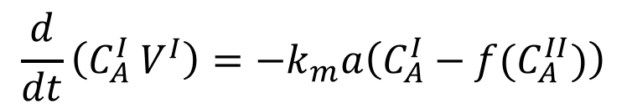
Tank type semi-Batch Contactor: Phase I energy balance
X
$$\frac{d}{dt}\left(C_{A}^{I} V^{I}\right)=−k_{m}a\left(C_{A}^{I}−f(C_{A}^{II})\right)$$
Back

Slide 13
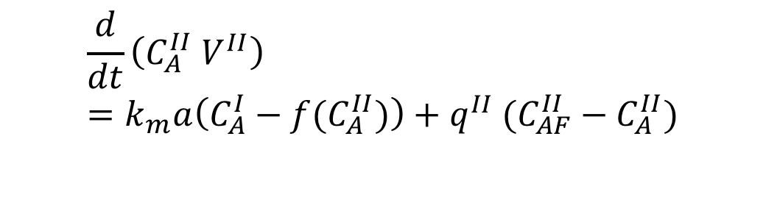
Tank type semi-Batch Contactor: Phase II energy balance
X
$$\frac{d}{dt}\left(C_{A}^{II} V^{II}\right)=k_{m}a\left(C_{A}^{I}−f(C_{A}^{II})\right)+q^{II} (C_{AF}^{II}−C_{A}^{II})$$
Back

Slide 14
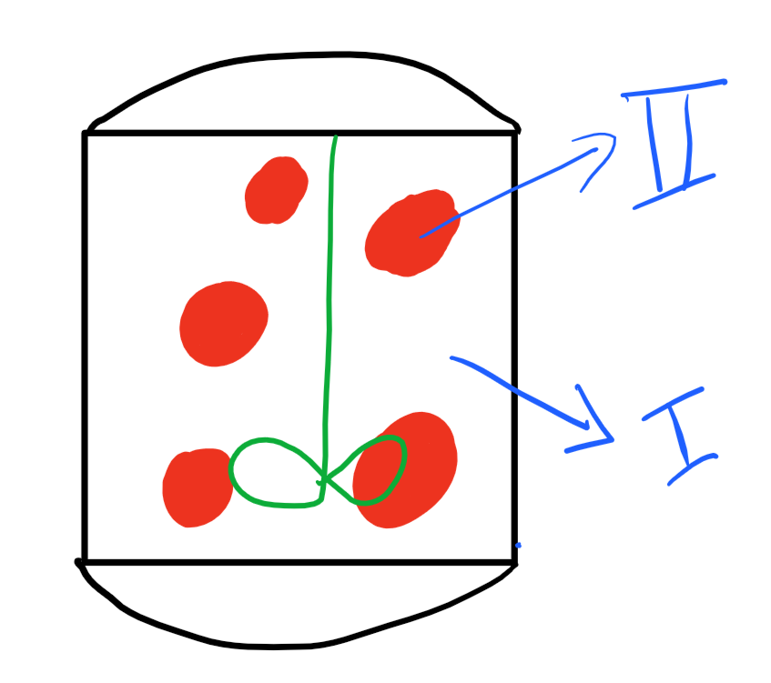



Tank type Batch Contactor
X
(Choose a variable)
phase balance
$$C_{A}^{I}$$
$$C_{A,eq}^{II}$$
$$V_{}^{II}$$
Back to tank type list

Slide 15
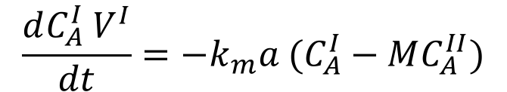
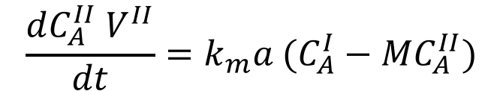
Tank type Batch Contactor: phase balance
X
$$\frac{dC_{A}^{I} V^{I}}{dt}=−k_{m}a (C_{A}^{I}−MC_{A}^{II})$$
$$\frac{dC_{A}^{II} V^{II}}{dt}=k_{m}a (C_{A}^{I}−MC_{A}^{II})$$
Back

Slide 16
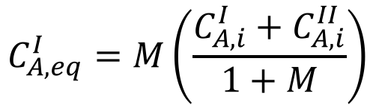
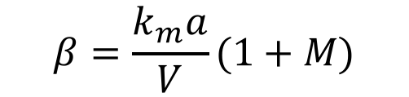

Tank type Batch Contactor: $C_{A}^{I}$
X
$$C_{A }^{I}\left(t\right)=C_{A,eq}^{I}−\left(C_{A,eq}^{I}−C_{A,i}^{I}\right)e^{−βt}$$
$$C_{A,eq}^{I}=M\left(\frac{C_{A,i}^{I}+C_{A,i}^{II}}{1+M}\right)$$
$$β=\frac{k_{m}a}{V}(1+M)$$
Back

Slide 17
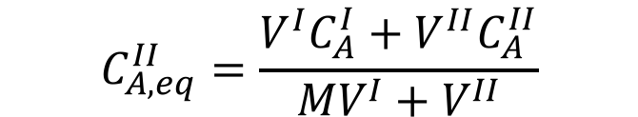

Tank type Batch Contactor: $C_{A,eq}^{II}$
X
$$C_{A,eq}^{II}=\frac{V^{I}C_{A}^{I}+V^{II}C_{A}^{II}}{MV^{I}+V^{II}}$$
Back

Slide 18
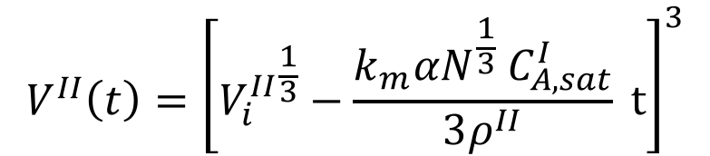

Tank type Batch Contactor: $V_{}^{II}$
X
$$V^{II}\left(t\right)={\left[{V_{i}^{II}}^{\frac{1}{3}}−\frac{k_{m}αN^{\frac{1}{3}} C_{A,sat}^{I}}{3ρ^{II}} t\right]}^{3}$$
Back

Slide 19
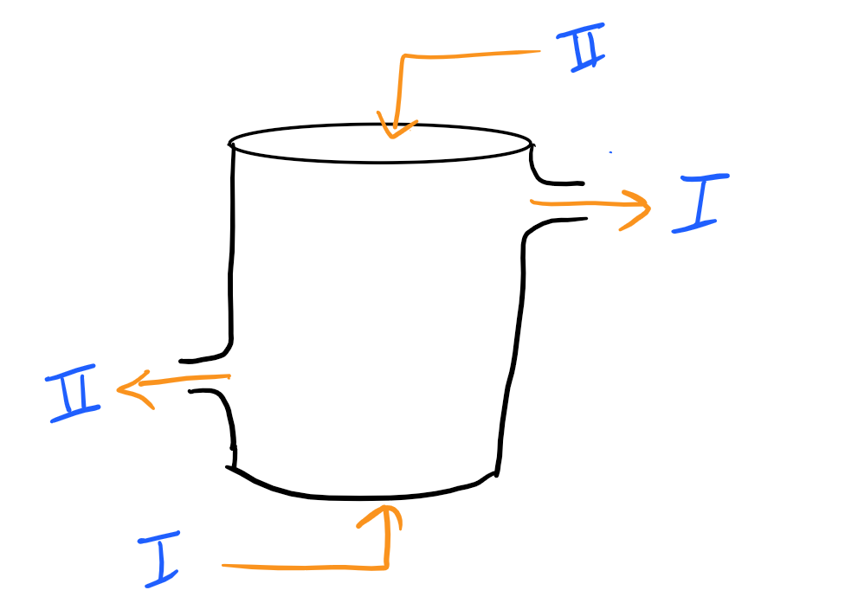
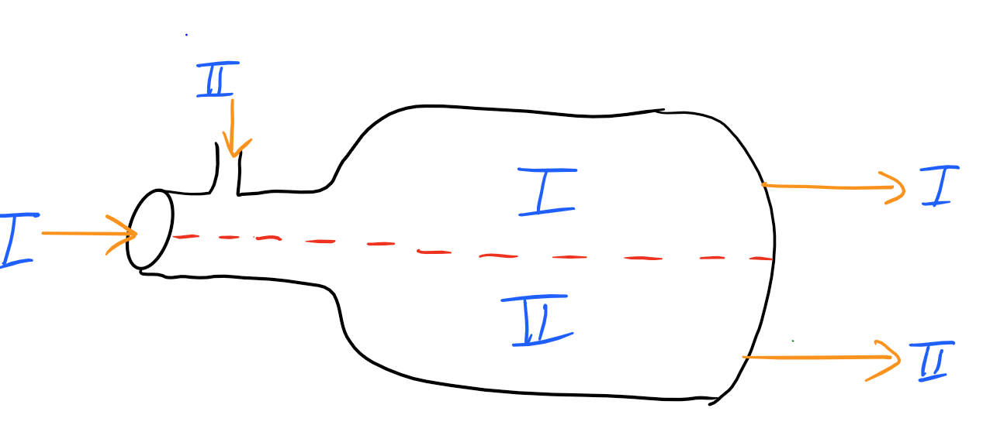
Choose one of the 2 main tubular type mass contactors
X
Co-Current
Counter-Current
(Choose One)

Slide 20

Counter-Current tubular type mass contactor
X
(Choose a variable)
phase balance
$$C_{A}^{I}$$
$$C_{A}^{II}$$
Back to tubular type list

Slide 21
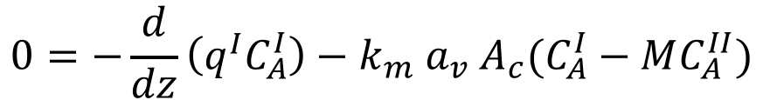
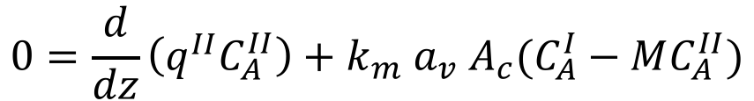
Counter-Current tubular type mass contactor: Phase Balance
X
$$0=−\frac{d}{dz}\left(q^{I}C_{A}^{I}\right)−k_{m} a_{v} A_{c}(C_{A}^{I}−MC_{A}^{II})$$
$$0=\frac{d}{dz}\left(q^{II}C_{A}^{II}\right)+k_{m} a_{v} A_{c}(C_{A}^{I}−MC_{A}^{II})$$
Back

Slide 22
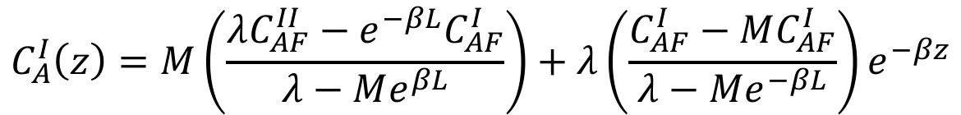
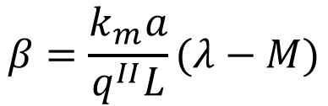

Counter-Current tubular type mass contactor:${ C}_{A}^{I}$
X
$$C_{A}^{I}\left(z\right)=M\left(\frac{λC_{AF}^{II}−e^{−βL}C_{AF}^{I}}{λ−Me^{βL}}\right)+λ\left(\frac{C_{AF}^{I}−MC_{AF}^{I}}{λ−Me^{−βL}}\right)e^{−βz}$$
$$β=\frac{k_{m}a}{q^{II}L}(λ−M)$$
Back

Slide 23
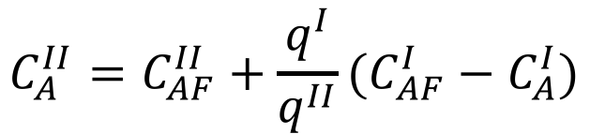

Counter-Current tubular type mass contactor:${ C}_{A}^{II}$
X
$$C_{A}^{II}={C_{AF}^{II}+\frac{q^{I}}{q^{II}}(C}_{AF}^{I}−C_{A}^{I})$$
Back

Slide 24

Co-Current tubular type mass contactors
X
(Choose a variable)
phase balance
$$C_{A}^{I}$$
$$C_{A}^{II}$$
$$C_{A,eq}^{I}, C_{A,eq}^{II}$$
Back to tubular type list

Slide 25
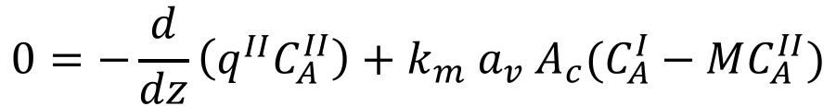
Co-Current tubular type mass contactors: phase balance
X
$$0=−\frac{d}{dz}\left(q^{I}C_{A}^{I}\right)−k_{m} a_{v} A_{c}(C_{A}^{I}−MC_{A}^{II})$$
$$0=−\frac{d}{dz}\left(q^{II}C_{A}^{II}\right)+k_{m} a_{v} A_{c}(C_{A}^{I}−MC_{A}^{II})$$
Back

Slide 26
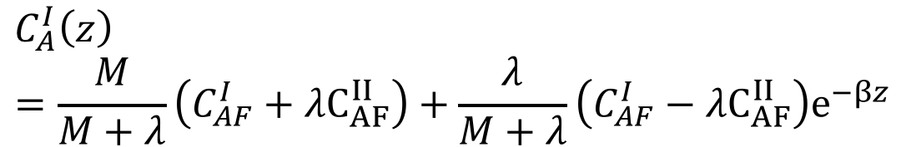
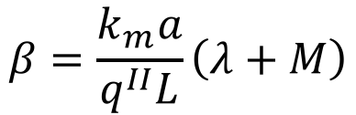

Co-Current tubular type mass contactors: $C_{A}^{I}$
X
$$C_{A}^{I}\left(z\right)=\frac{M}{M+λ}\left(C_{AF}^{I}+λC_{AF}^{II}\right)+\frac{λ}{M+λ}\left(C_{AF}^{I}−λC_{AF}^{II}\right)e^{−βz}$$
$$β=\frac{k_{m}a}{q^{II}L}\left(λ+M\right)$$
Back

Slide 27
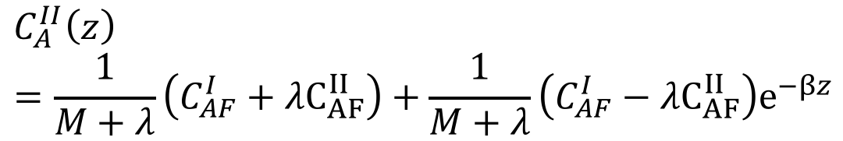

Co-Current tubular type mass contactors: $C_{A}^{II}$
X
$$C_{A}^{II}\left(z\right)=\frac{1}{M+λ}\left(C_{AF}^{I}+λC_{AF}^{II}\right)+\frac{1}{M+λ}\left(C_{AF}^{I}−λC_{AF}^{II}\right)e^{−βz}$$
$$β=\frac{k_{m}a}{q^{II}L}\left(λ+M\right)$$
Back

Slide 28

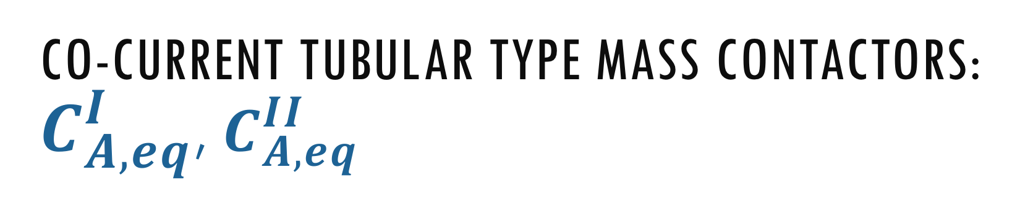
Co-Current tubular type mass contactors: $C_{A,eq}^{I}$, $C_{A,eq}^{II}$
X
$$C_{A,eq}^{II}=\frac{C_{A}^{I}+λC_{AF}^{II}}{λ+M}$$
$$C_{A,eq}^{I}=MC_{A,eq}^{II}$$
Back

Slide 29
Thank you for using the app
By: Ahmed Al-Marjibi

