Slide 1


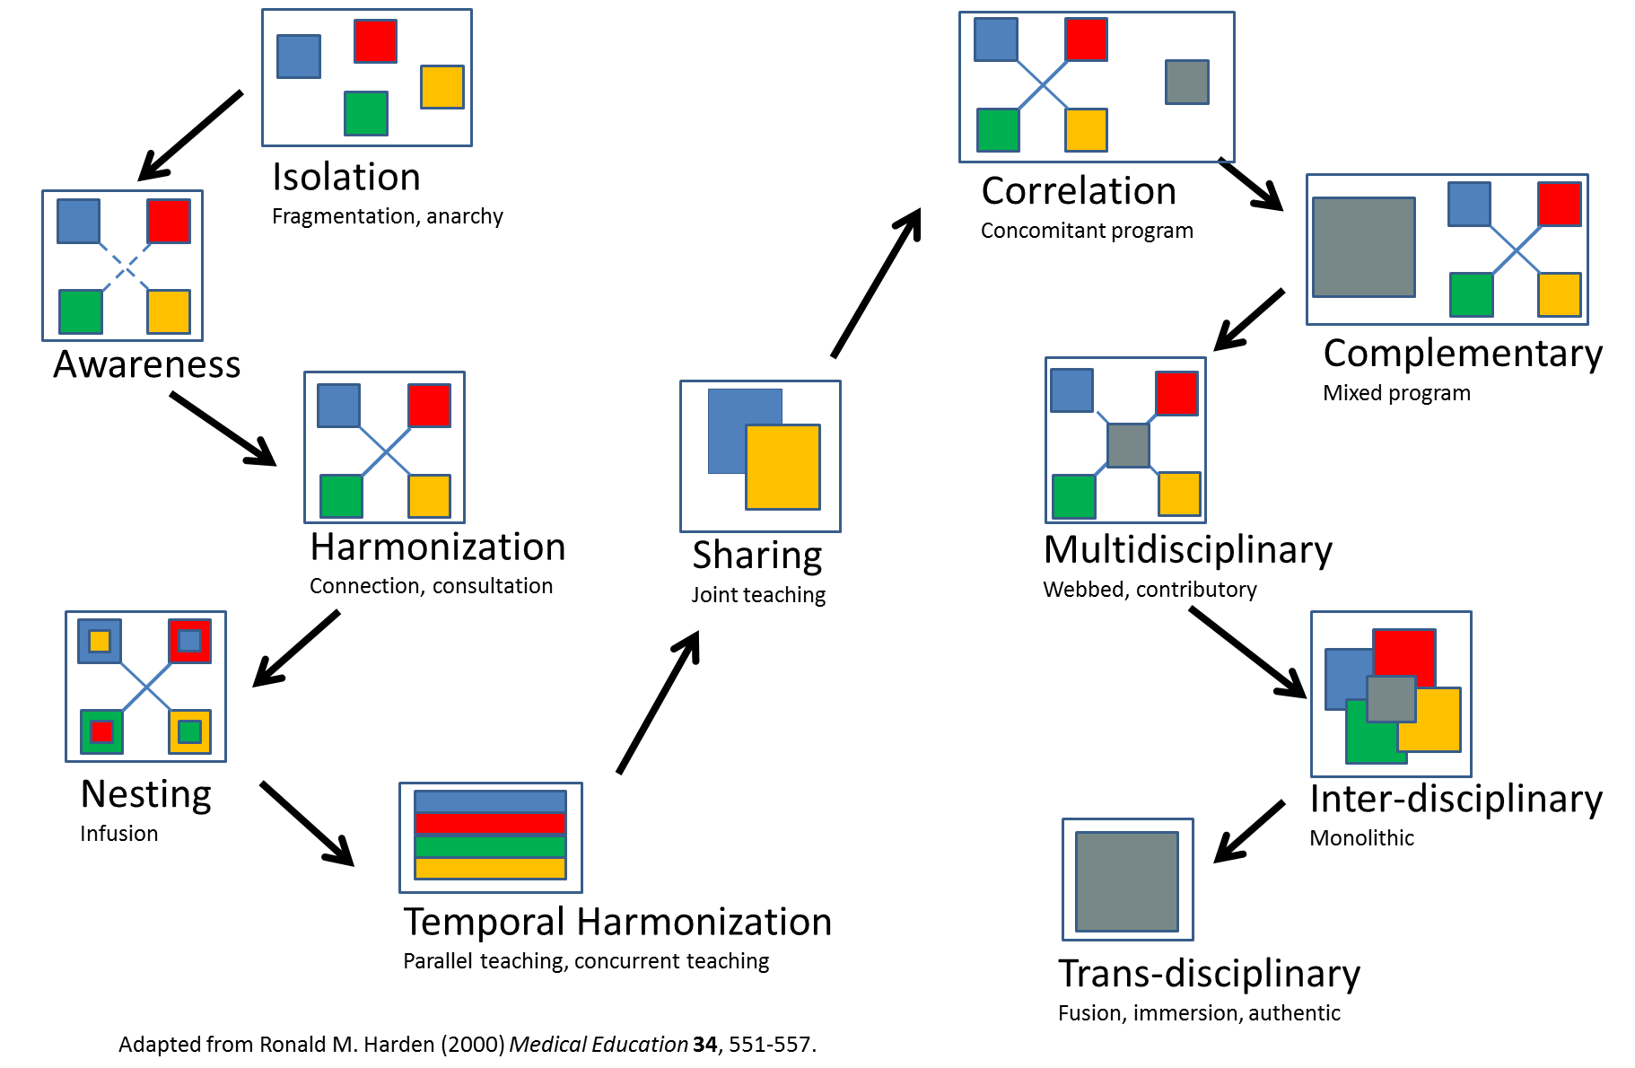
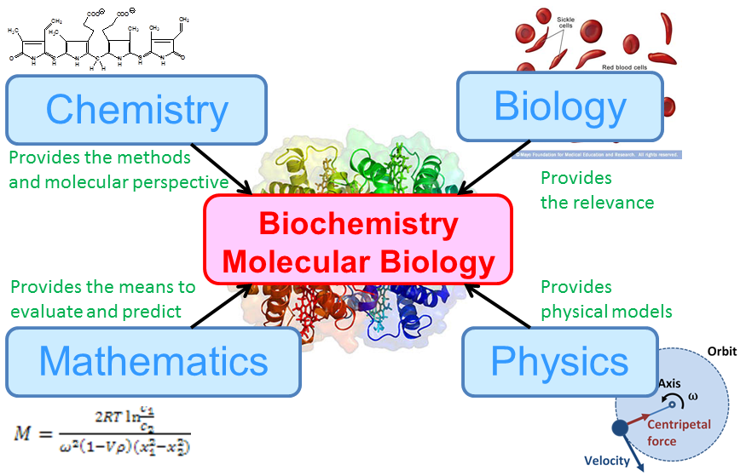
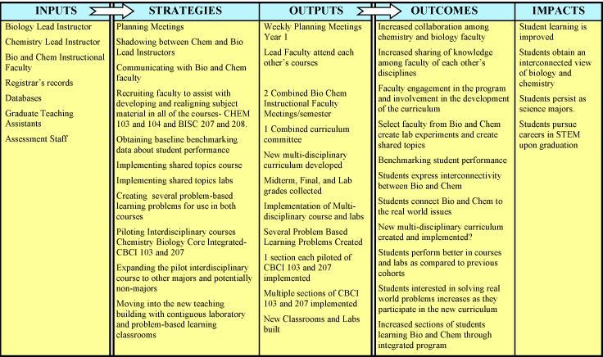
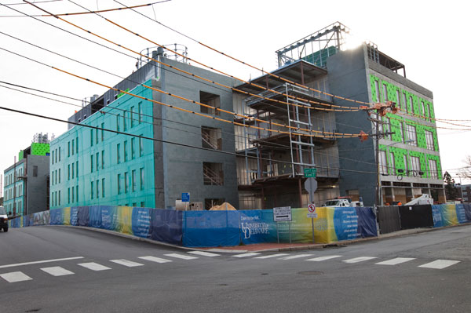
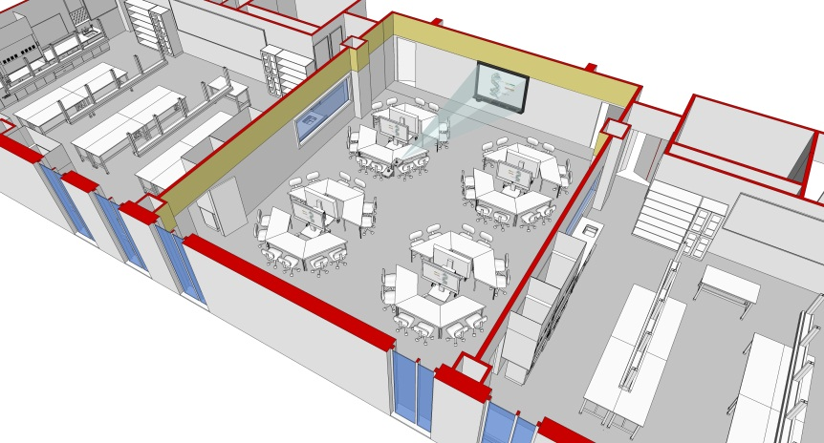
Confronting 500 Years of Separation:
Integrating
Introductory In
Instruction
Biology
&
Chemistry
“Biology cannot ignore chemistry
as much as I wish it could.”
John Maynard Smith, p. 48 in the New York Times Review 11/30/95
“The ultimate aim of the modern movement in biology is in fact to explain all biology in terms of physics and chemistry.”
Francis Crick quoted Science 264, 1782 (1994)
Hal White, Department of Chemistry and Biochemistry, Director
David Usher, Biological Science, Assistant Director
What does “Integration” Mean? How Far Can We Get?
500 years of separation represents the cumulative number of years faculty in biology and chemistry who teach introductory courses have been at the same institution without talking to each other about what they teach.
Introduction to Biochemistry –
An Introductory Interdisciplinary PBL Course
Based on Scientific Literature
The Problem - Observations on the
Biology-Chemistry Gap
The content of General Chemistry courses has changed little in the past 40⁺ years.
The content of General Biology courses has changed enormously in the past 40⁺ years.
Very little of General Chemistry deals with biology.
Much of the first semester of General Biology deals with the chemistry of life.
The chemistry taught in General Biology is disconnected from the chemistry in General Chemistry.
Chemistry instructors often have little expertise in biology or biochemistry.
The majority of students who take General Chemistry have majors in the life sciences.
Most biology majors take General Chemistry and General Biology concurrently.
Often biology majors like biology and dislike chemistry.
Students perceive that biology doesn’t require much math or chemistry.
Chemical techniques pervade research in the biological sciences.
A sizable proportion of the faculty in the Chemistry Departments have research programs dealing with biological problems.
A disproportionate number of prominent “biologists” were trained in the physical sciences.
Wouldn’t it benefit our students if we could help them see the connections between chemistry and biology?
Logic Model Assessment for UD Integration Initiative
Challenges:
Designing a Satisfactory Pre/Post Test
Dealing with Different Departmental and Disciplinary Cultures
Working Across Administrative Units
Accepting Faculty Independence, “Academic Freedom”
Acknowledging Faculty Breadth of Background
Preparing Graduate Teaching Assistants
Managing the Scale of the Enterprise
Defining the Extent of Integration
Integrating Laboratory, Lecture, or Both?
Moving Into a New Building September 2013.
Integration Initiatives:
Special program in chemistry and mathematics for at-risk freshmen Biology majors
Reciprocal biology-chemistry course observation by instructors
Monthly meetings of biology and chemistry introductory course instructors and interested faculty.
Development of active-learning laboratory activities with interdisciplinary elements.
Joint Graduate Teaching Assistant Preparation Course
Faculty attendance at regional and national education meetings
Pre-post testing in Introductory Biology
Benefits Realized:
Pre/Post Test – Concept Inventory Creation
Learning Community -Chemistry and Biological Science Faculty and Administrative Units
Assessment Conversations & Implementation
Revisions of Graduate Teaching Assistant Training
Creation of Common Language
Modifications to Course Calendar to Align Topics
Modifications to Lab Experiences to Increase Engagement
First Year Seminar Students Math Scores Year Increased
First Year Seminar Students Appear to Persist as STEM

