Slide 1
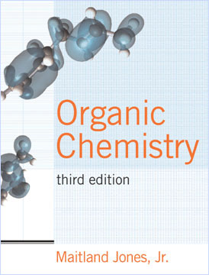
Ch 15
Norton Media Library
Chapter 15
Organic
Chemistry
Third Edition
Chapter 2
Constructing a
Government:
The Founding and
the Constitution
Maitland Jones, Jr.

Slide 2

Degree of Unsaturation
Degree of Unsaturation (or “Double Bond Equivalents”, DBE) is the number of π-bonds and/or rings present in a molecule
For the formula C_{C}H_{H}X_{X}N_{N}O_{O}, where X = halogen:

Slide 3
C₁H₄
Saturated alkanes (CH-only compounds) have the general formula:
C_{n}H_{2n+2}
C₂H₆
Note: it doesn’t matter how the atoms are configured:
C₃H₈
C₄H₁₀
C₄H₁₀

Slide 4
C_{n}H_{2n+2}
C_{n}H_{2n}
C_{n}H_{2n-2}
Two fewer hydrogens per double bond or ring!

Slide 5

Example: C₆H₁₀
Two double bonds
Two rings
One triple bonds
One double bond plus one ring
(or: missing 2 pairs of H from fully-saturated C₆H₁₄)

Slide 6
For each Carbon (valence =4) you add to a structure requires the addition of two more Hydrogens
Oxygen (valance = 2) can be added into a structure without changing the number of hydrogens
Each added nitrogen (valence =3) requires one additional hydrogen
X =
Each halogen (valance = 1), takes the place of a hydrogen

Slide 7
Example:
DBE = 3 – 5+1 + 1
2
DBE = 1
C₃H₅BrO
Example:
DBE = 4 – 7-1 + 1
2
DBE = 2
C₄H₇NO

Slide 8
Example:
C₃: saturated = 8H
5H+Br =“6H”
2H missing so 1DBE
DBE = 1
C₃H₅BrO
Example:
C₄N: Sat’d = 10+1 = 11H
4H missing so 2 DBE
DBE = 2
C₄H₇NO

Slide 9
Mass Spectrometry
Molecules are ionized and “shot” through a magnetic field
How far they’re deflected depends on the magnet’s strength, and the ion’s mass-to-charge (m/z) ratio

Slide 10
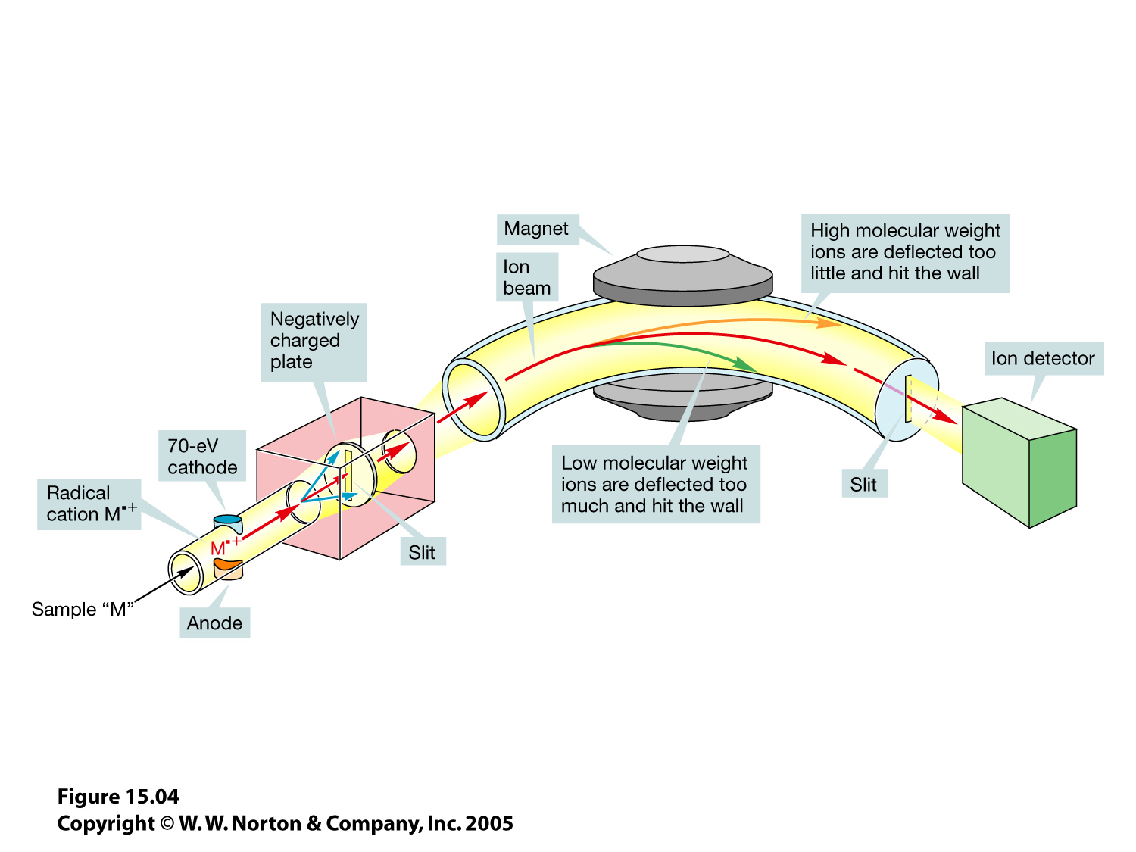
15.04.jpg

Slide 11
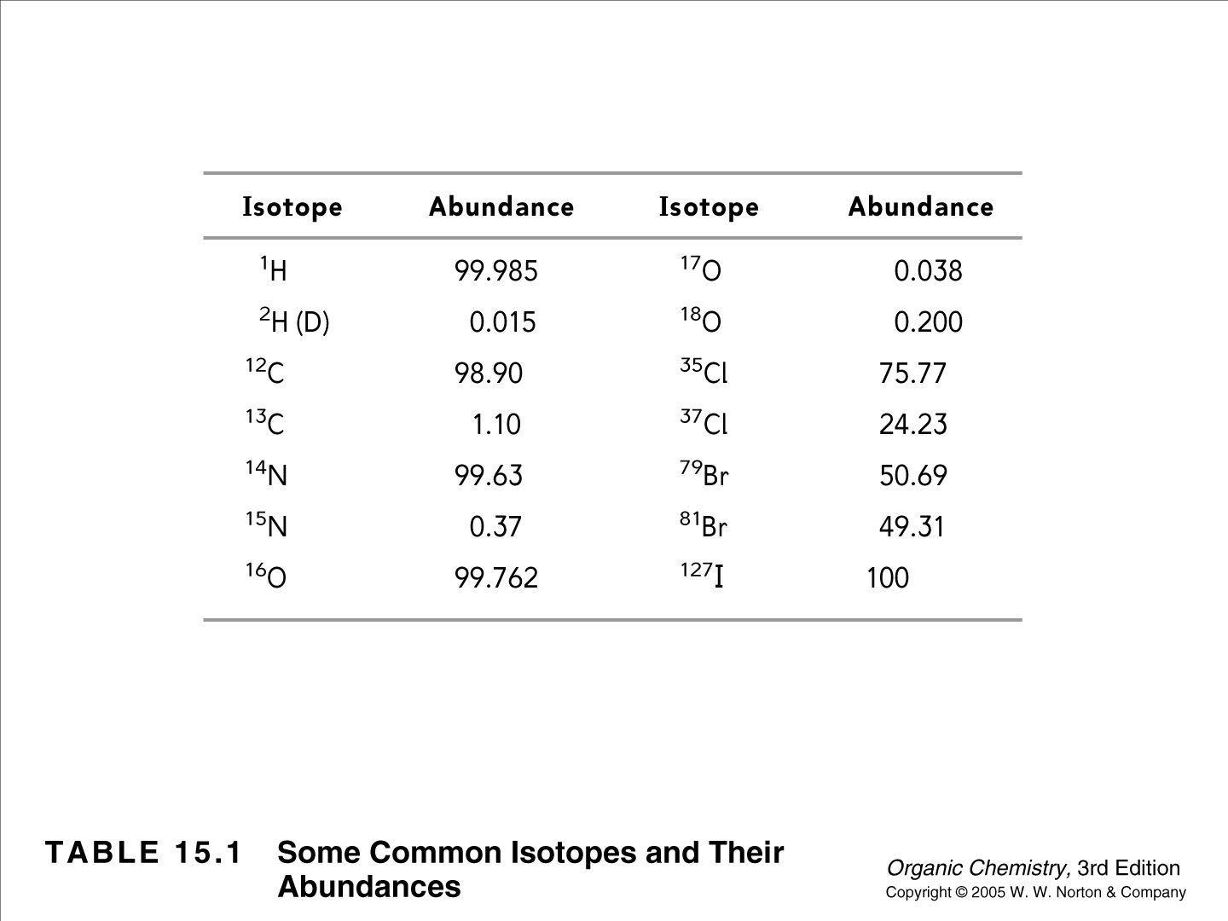
15.04.jpg
Notes:
Note: Cl gives two clear molecular ion peaks because there are two common isotopes.
M : (M+2) ~ 3:1
Similarly Br gives M : (M+2) ~ 1:1

Slide 12
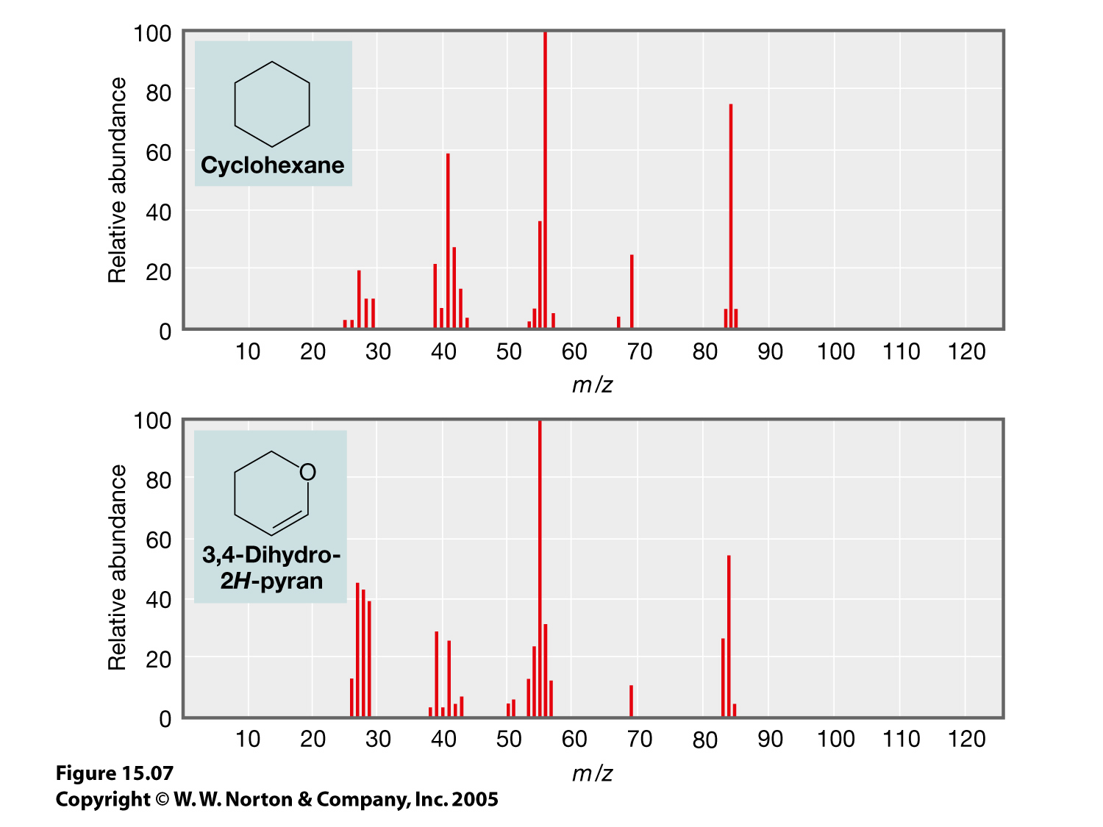
15.07.jpg
C₆H₁₂
MW 84.096
C₅H₈O
MW 84.059
High-Resolution MS can determine the exact molecular formula
Notes:
C6H12: 84.096
C5H8O: 84.059

Slide 13
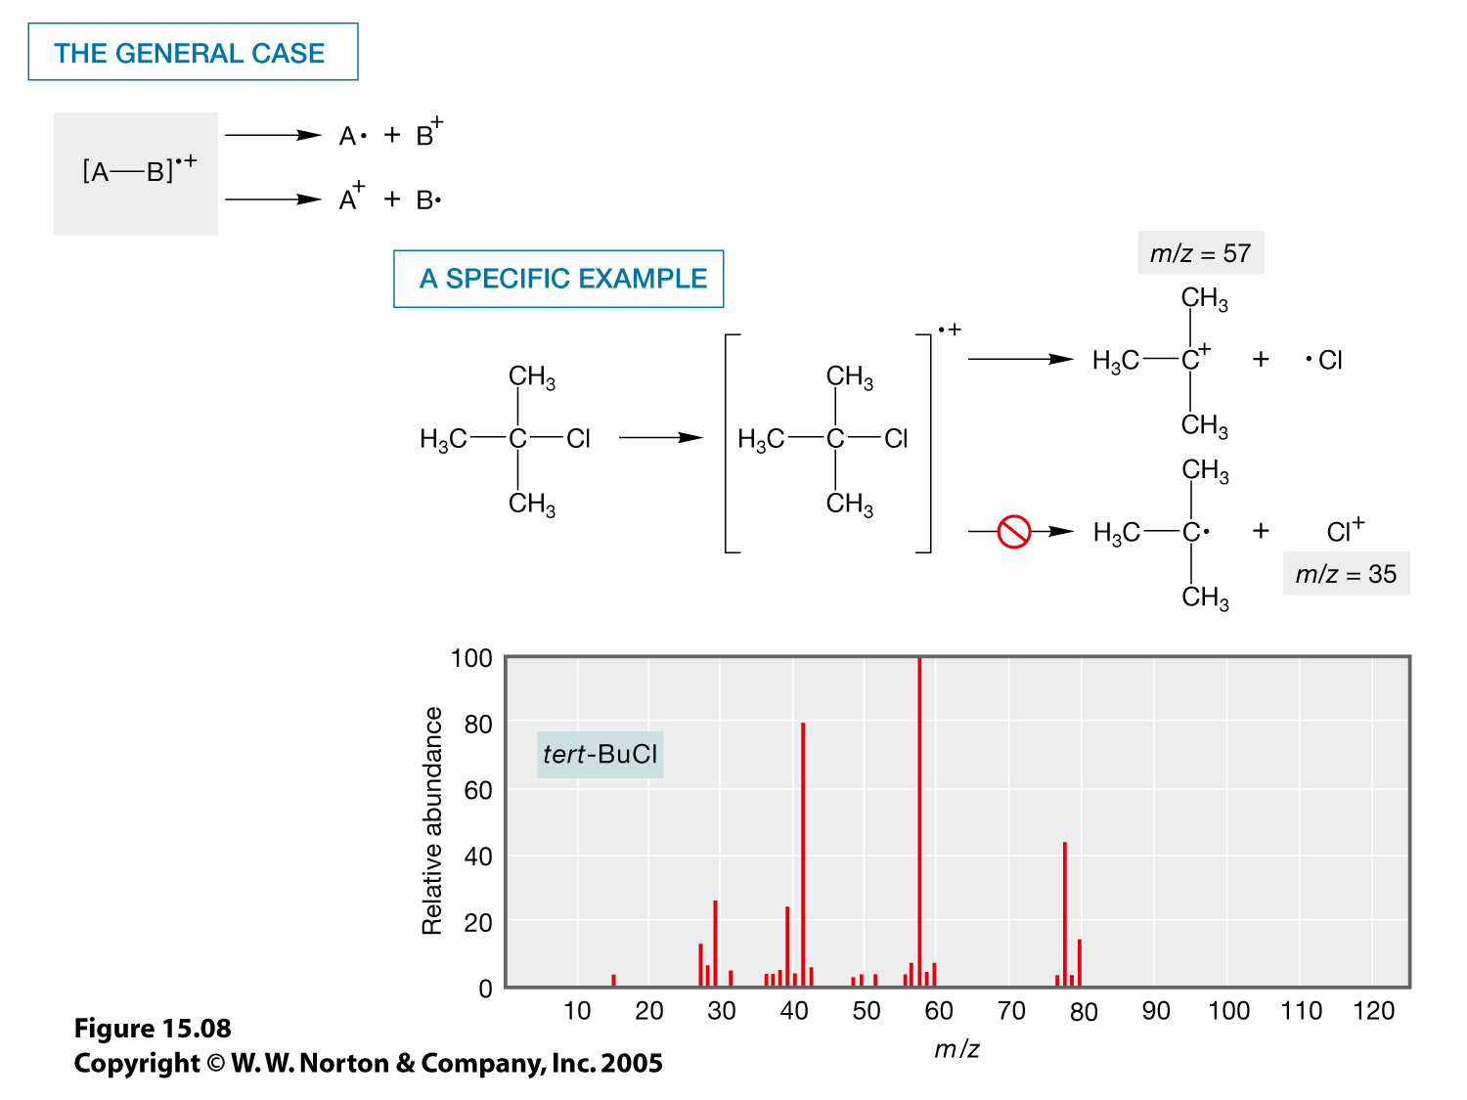
15.08.jpg
Notes:
Note the ca. 3:1 ratio of M : (M+2)

Slide 14
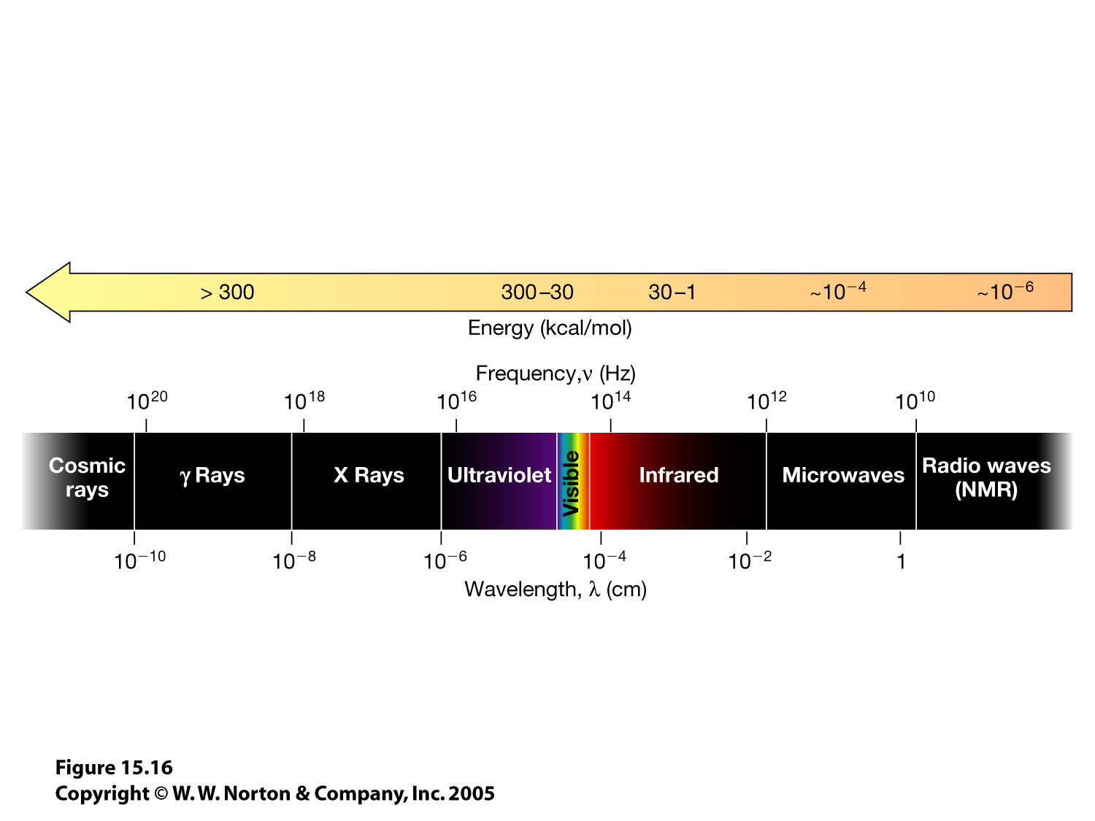
15.16.jpg

Slide 15
Infrared Spectroscopy
Bond lengths and bond angles are not constant. Molecular vibrations cause changes in bond lengths and angles to oscillate:
If a bond stretch causes a change in the size of the molecule’s dipole moment, then it is capable of absorbing infrared. Different types of bond stretches absorb at different frequencies.
IR can be used to identify functional groups in the molecule

Slide 16
Some Useful IR Stretching Frequencies
Bond | Frequency (cm⁻¹) | Intensity
O-H (alcohol) | 3650-3200 | Strong, broad
O-H (carboxylic acid) | 3300-2500 | Strong, very broad
N-H | 3500-3300 | Medium, broad
C-H | 3300-2700 | Medium
C≡N | 2260-2220 | Medium
C≡C | 2260-2100 | Medium to weak
C=O | 1780-1650 | Strong
C-O | 1250-1050 | strong

Slide 17
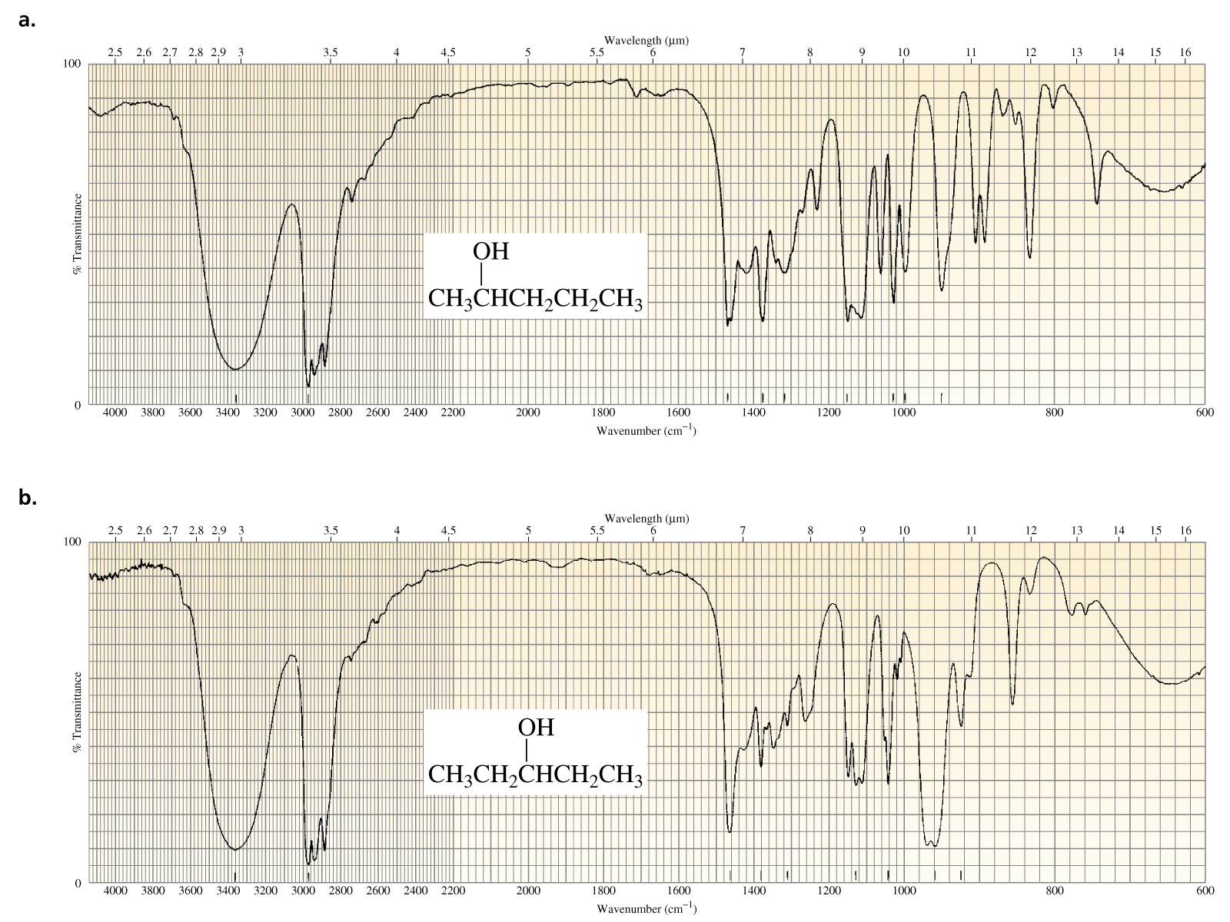
O-H stretch
The functional group region
The fingerprint region
Notes:
A typical IR spectrum measures % transmittance vs. frequency. Transmittence is a measure of what fraction of the IR light passes through the sample. As more is absorbed, the transmittance drops, suggesting there is something in the sample absorbing light at that frequency. So although we often refer to these absorbances as “peaks”, they look like “upside-down peaks” or “valleys”.
Frequency is expressed in reciprocal centimeters (1050-1200 cm⁻¹) for some odd reason. A typical spectrum spans from 4000 to 600 cm⁻¹.

Slide 18
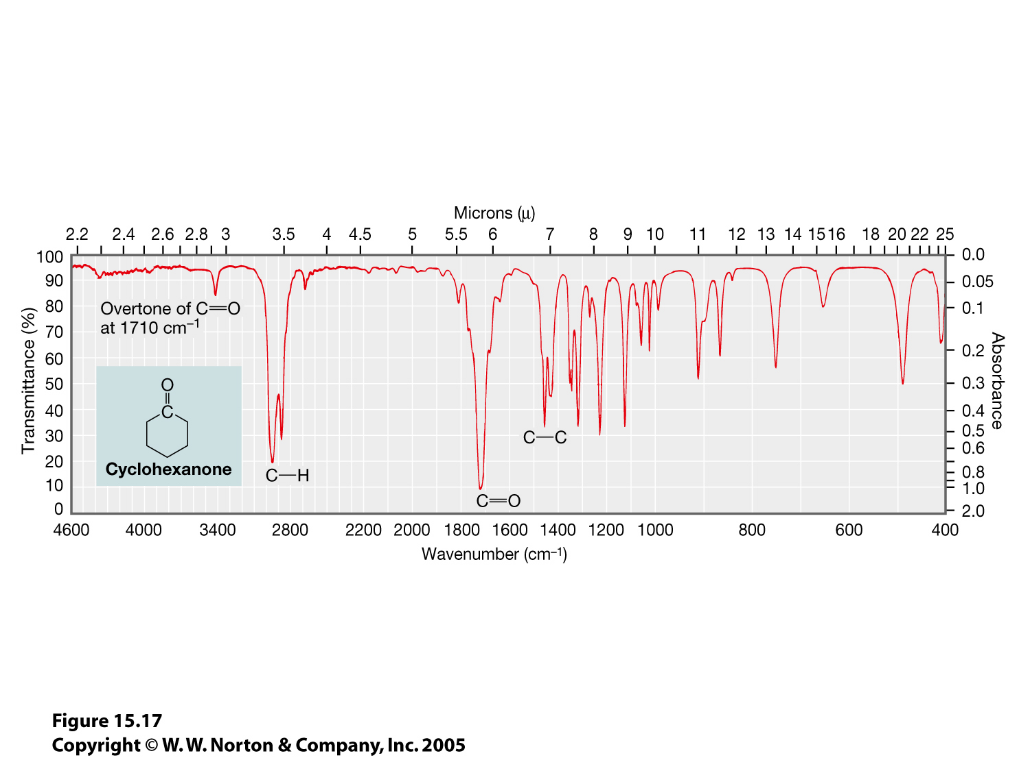
15.17.jpg
Carbonyls have very strong absorptions at ~1650-1780 cm⁻¹
Notes:
A typical IR spectrum measures % transmittance vs. frequency. Transmittence is a measure of what fraction of the IR light passes through the sample. As more is absorbed, the transmittance drops, suggesting there is something in the sample absorbing light at that frequency. So although we often refer to these absorbances as “peaks”, they look like “upside-down peaks” or “valleys”.
Frequency is expressed in reciprocal centimeters (1050-1200 cm⁻¹) for some odd reason. A typical spectrum spans from 4000 to 600 cm⁻¹.

Slide 19
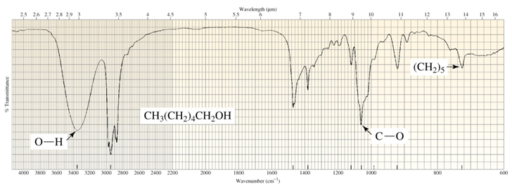
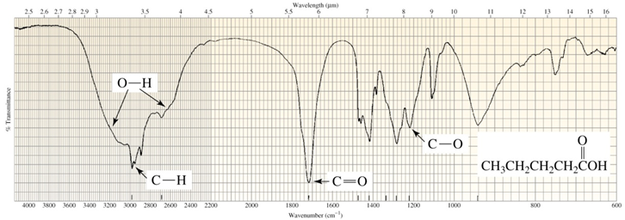
A carboxylic has a very broad O-H stretch (plus a C=O stretch)

Slide 20
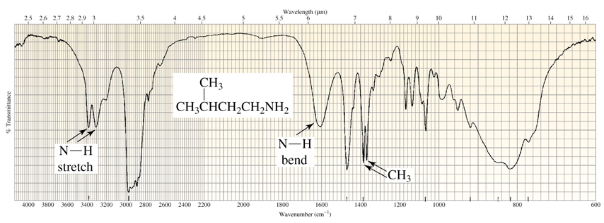
NH stretches are similar in frequency to –OH stretches, but usually weaker
An NH₂ group has a double peak

Slide 21
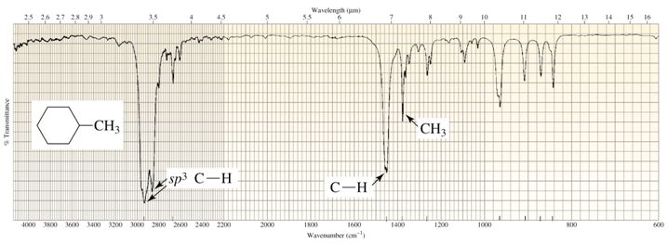
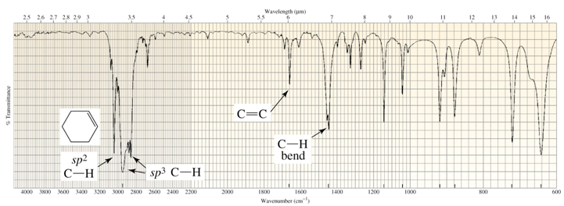
Absorption at ~ 3000 cm⁻¹ will practically always be seen (C-H stretch)
sp³ C-H <3000 cm⁻¹
sp² C-H >3000 cm⁻¹

Slide 22
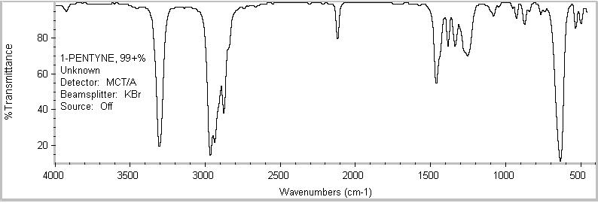
Absorption in the 2100-2300 cm-1 region is uncommon but significant—C≡C or C≡N. Alkynes aren’t very polar, so their C≡C stretches tend to be weak.
Terminal alkyne C-H stretches are higher frequency than sp²- or sp³-C-H stretches

Slide 23
Nuclear Magnetic Resonance (NMR) Spectroscopy
Some subatomic particles (e.g. : electrons, protons, some nuclei) have a property called “spin”
  ¹H, ¹³C: S = ½
  ²H : S = 1
Spin gives the particle a magnetic dipole moment

Slide 24
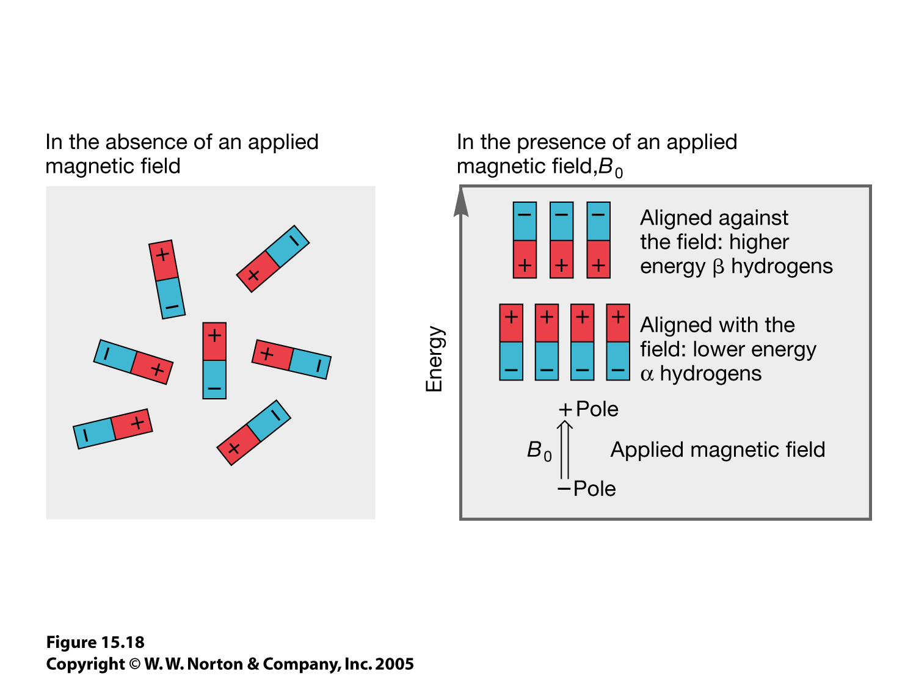
15.18.jpg

Slide 25
=
Energy
=
In the absence of a magnetic field, both spin states have equal energy

Slide 26
Stronger
Magnetic Field
No Field
Magnetic Field
β
β
Energy
α
α
β
}
Energy
hν
ΔΕ = hν
α
In a strong magnetic field, the energy level difference corresponds to the energy of radio waves

Slide 27
The frequency that a nucleus absorbs or emits radio waves depends on:
The type of nucleus
The strength of the magnet
For example, a “300-MHz NMR spectrometer” uses a 7-Tesla magnet, causing protons to absorb/emit radio waves at 300 MHz
Notes:
e.g. on a 300 MHz spectrometer, protons resonate at 300 MHz but 13-C at 75 MHz

Slide 28
How an NMR spectrometer works:
RF
transmitter
RF
Receiver
N
S
Note modern NMRs use superconducting magnets to attain very strong magnetic fields
+ -
Notes:
Transmitter: zaps all hydrogens at the same time with a broadband pulse
Receiver: “listens” to the hydrogens as they emit at their own frequencies.

Slide 29
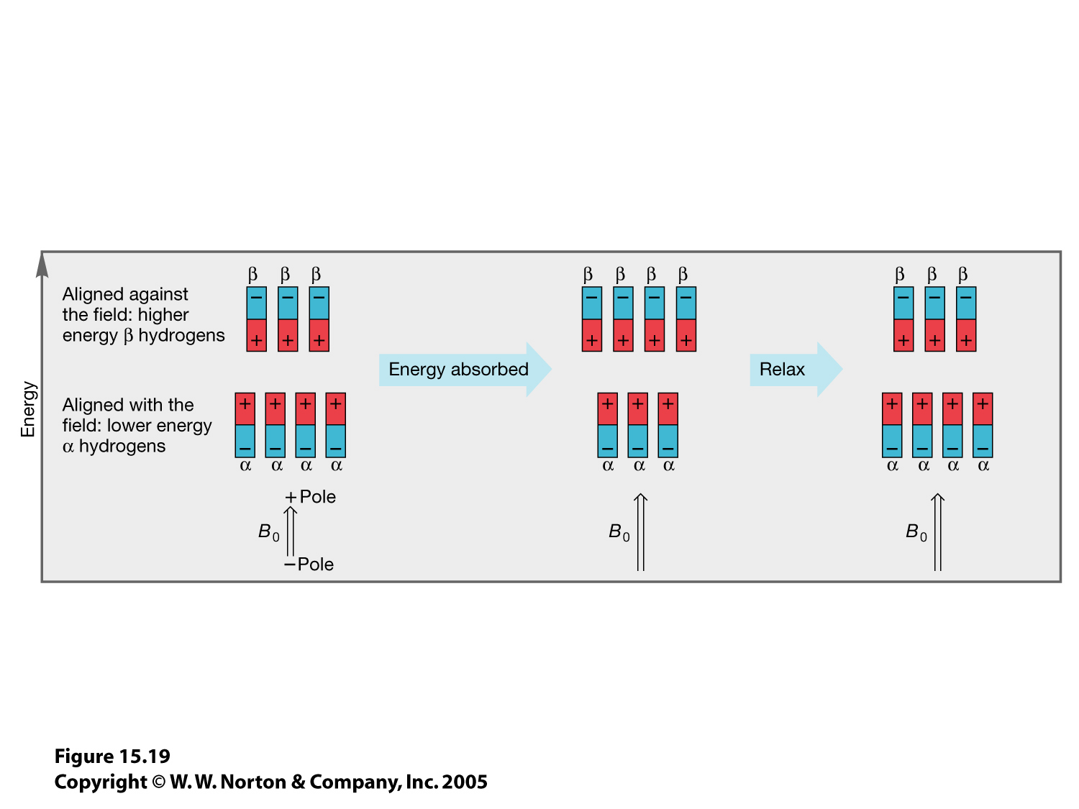
15.19.jpg

Slide 30
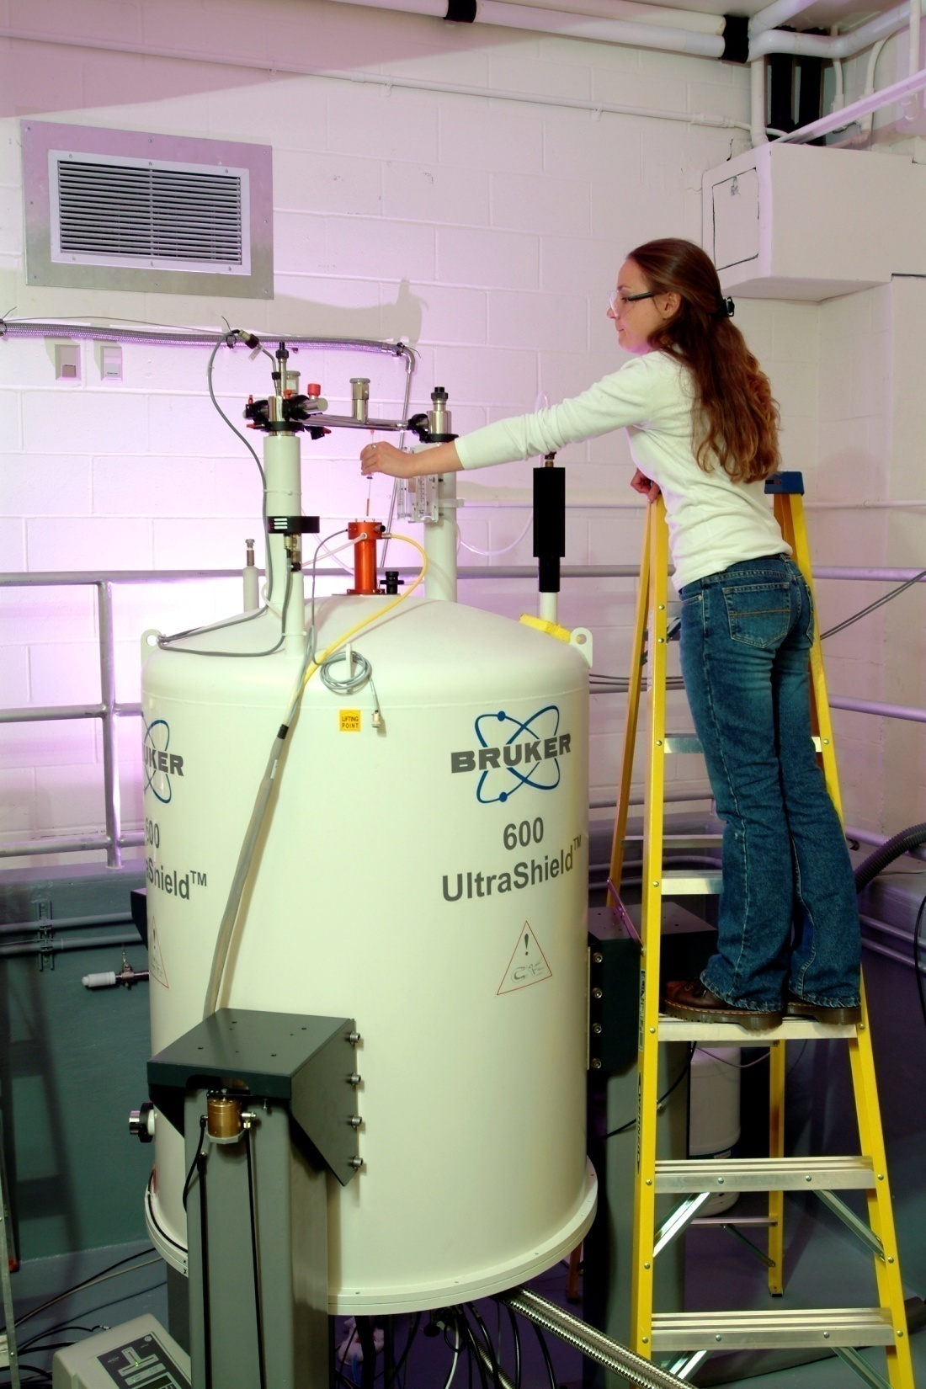
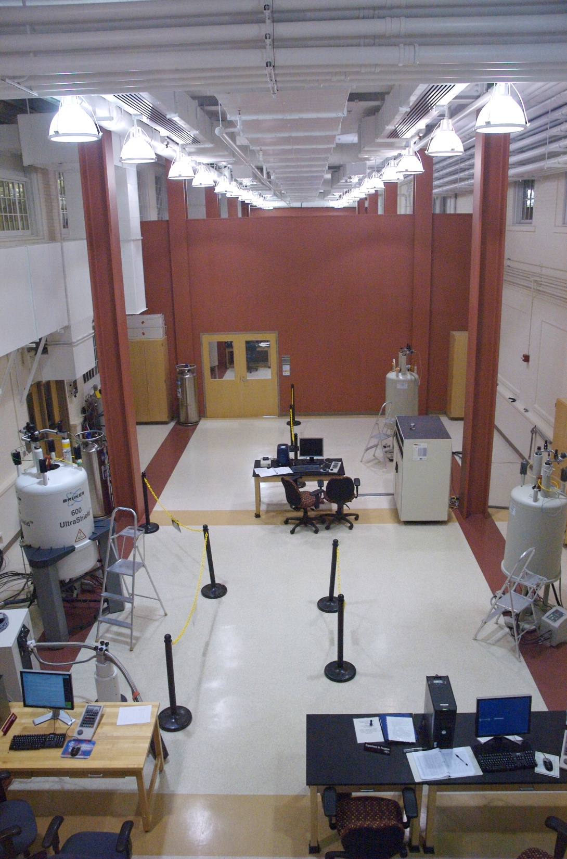
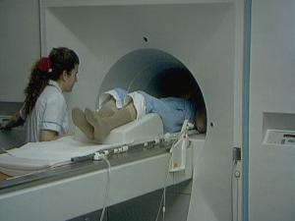

Slide 31
¹H (Proton) NMR
Hydrogen atoms are more than 99% ¹H.
¹H is particularly sensitive to NMR
Almost all organic compounds contain H
Can use size of peaks to determine # of H
Signal splitting provides extra information
Proton NMR has been developed into a very powerful analytical technique
Notes:
Last 2 bullets: integration and splitting in 13-C, on the other hand, is trickier.

Slide 32
The frequency that a nucleus absorbs or emits radio waves is also slightly altered by other features in the molecule.
The NMR spectrum is a plot of signal intensity versus frequency. However, different spectrometers use different magnets, and detect different frequencies
We use a standard scale that works across all spectrometers: “chemical shift” unit: δ (also “ppm” for “parts per million”)

Slide 33
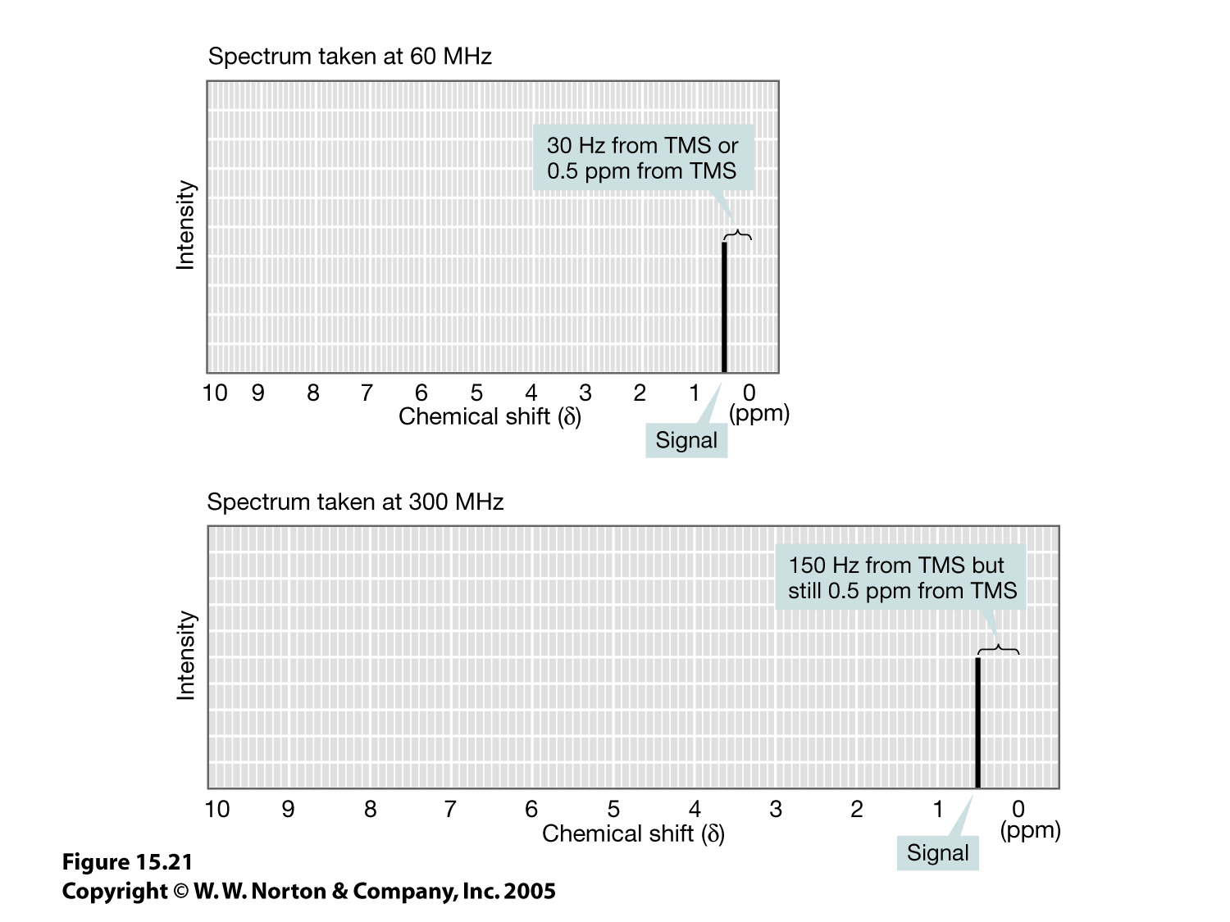
15.21.jpg
At 60 MHz,
1 ppm = 60 Hz
At 300 MHz,
1 ppm = 300 Hz

Slide 34
Tetramethylsilane {(CH₃)₄Si, TMS} is used as a reference for NMR spectra. Its chemical shift is defined as 0 ppm.
Most protons in organic compounds fall in the range of 1-12 ppm.
Typical locations of ¹H-NMR resonances
“downfield”
(higher frequency)
“upfield”
(lower frequency)
(X = O, Hal)
12
11
10
9
8
7
6
5
4
3
2
1
0
TMS
Notes:
Note the terms “downfield” and “upfield”. We use those terms frequently, even though most NMRs no longer vary the magnetic field strength. The next slide explains where this terminology comes from.

Slide 35
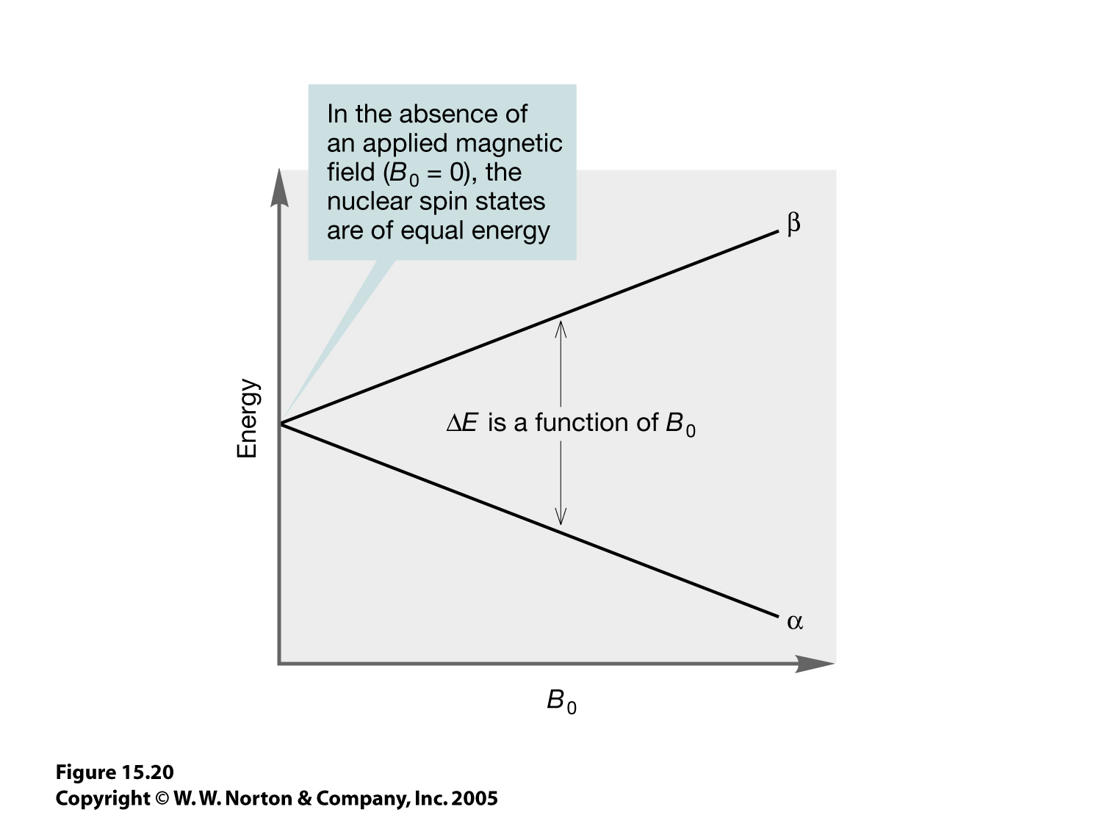
15.20.jpg
Old spectrometers used a single frequency of radio waves, and changed the strength of the magnet.
At lower field, ΔE is now at the spectrometer’s fixed frequency.
Modern spectrometers detect all frequencies simultaneously, but the terms “downfield” and “upfield” are still used.
A proton with a higher ΔE is “downfield” because the strength of the magnet has to be decreased in order
to absorb at the
spectrometer’s fixed
frequency.

Slide 36
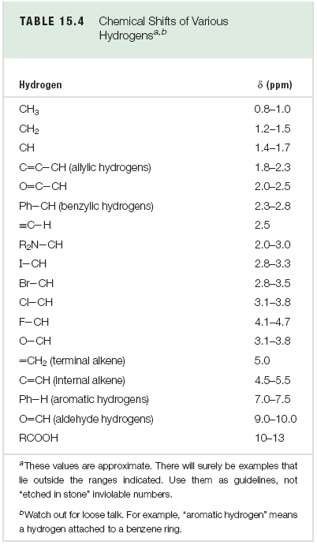
Notes:
Note these chemical shifts are expressed in ranges and are approximate. If more than one functional group is on the molecule, the net chemical shift will be even higher.

Slide 37
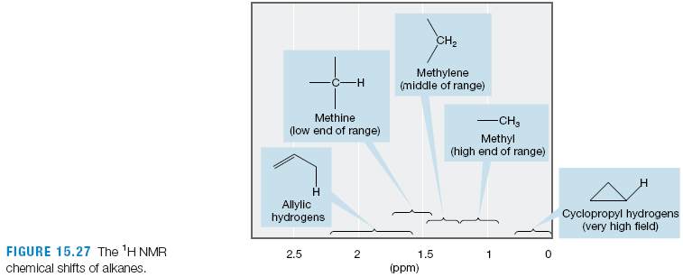
Alkanes: CH₃ ~ δ 0.8-1.0
CH₂ ~ δ 1.2-1.5
CH ~ δ 1.4-1.7

Slide 38
Note general trend in chemical
Shifts for methyl, methylene and methine
Notes:
This slide is just to show the general trend for CH₃X→RCH₂X→R₂CHX

Slide 39
Factors that Affect Chemical Shift
The electrons around a nucleus “shield” it from the full strength of the applied magnetic field
Electron-withdrawing groups “deshield” nearby nuclei, and shift their absorbance downfield (higher δ)

Slide 40
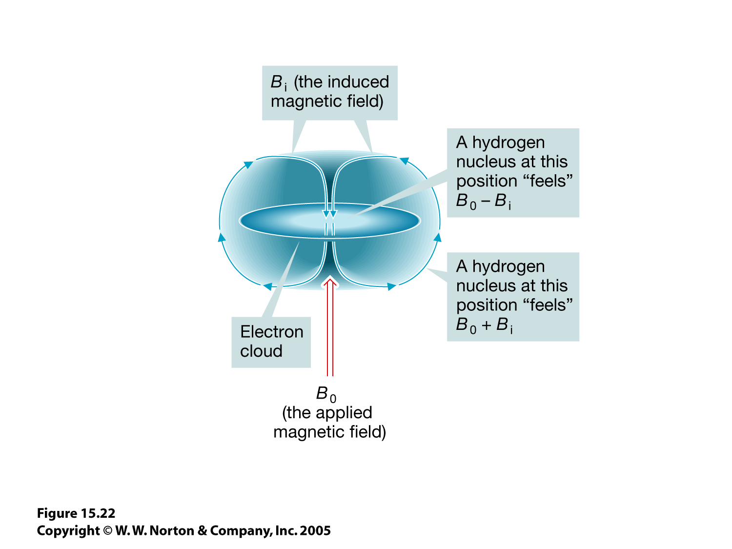
15.22.jpg
B₀ causes the electrons to circulate. This generates an induced magnetic field B_{i} at the nucleus, which opposes B₀.

Slide 41
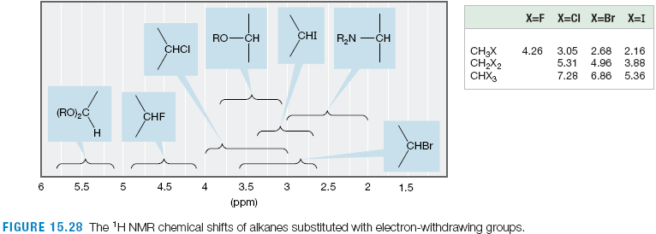
Electronegative atoms deshield protons, moving them downfield.
Especially note the typical shifts for protons next to O and Cl (~3-4 ppm)
Notes:
Also: note the additive effects when more than one electron-withdrawing group is present.

Slide 42
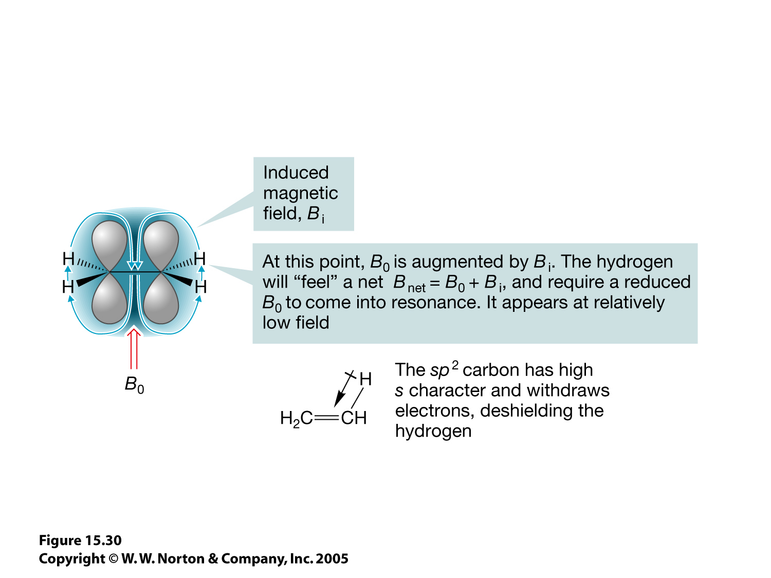
15.30.jpg
The circulation of p-electrons in a magnetic field produce particularly strong chemical-shift effects

Slide 43
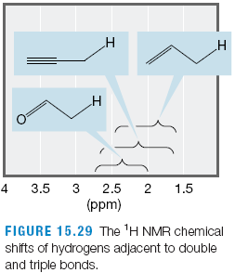
Allylic and propargylic hydrogens generally appear on either side of 2 ppm.
Hydrogens next to a carbonyl, or at a benzylic position, are generally in the 2-3 ppm range.

Slide 44
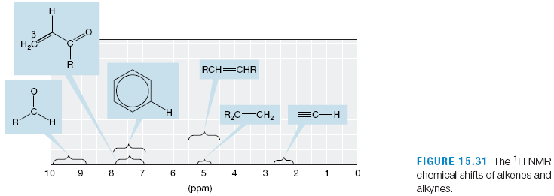
Vinylic hydrogens appear ~δ 4.5-6
Hydrogens on an aromatic ring appear ~δ 7-8
Aldehyde protons ~δ 9-10 ppm
Carboxylic acid shifts vary, but are typically ~δ 10-13

Slide 45
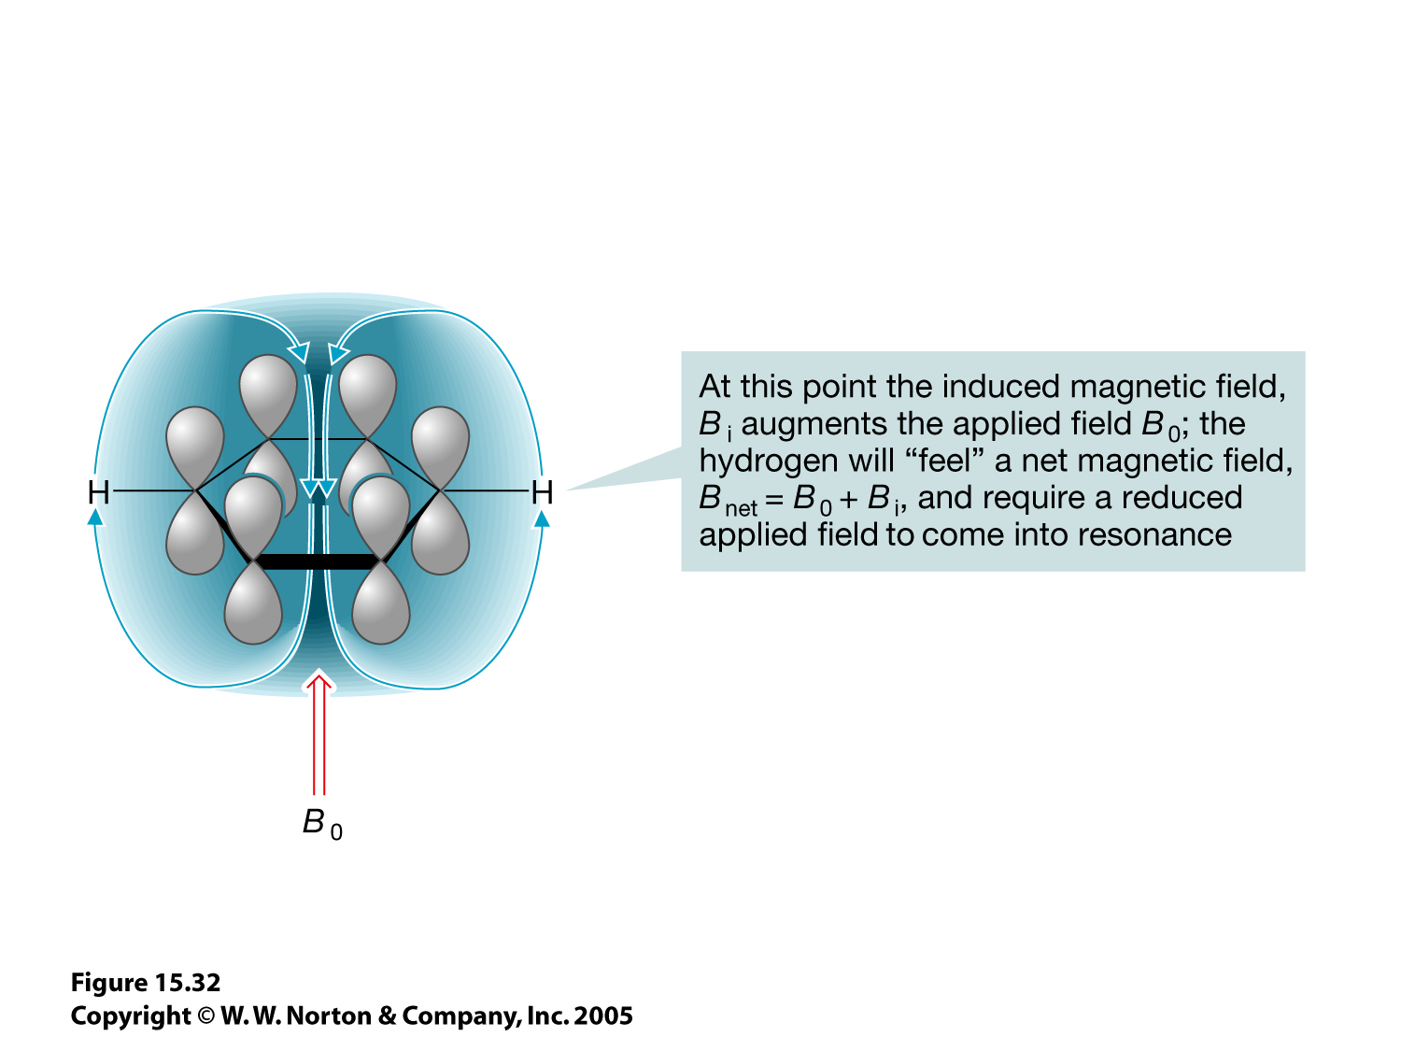
15.32.jpg
A magnetic field induces a “ring current” of π-electrons around an aromatic ring…
…resulting in a pronounced
downfield chemical shift
(~7-8 ppm)

Slide 46
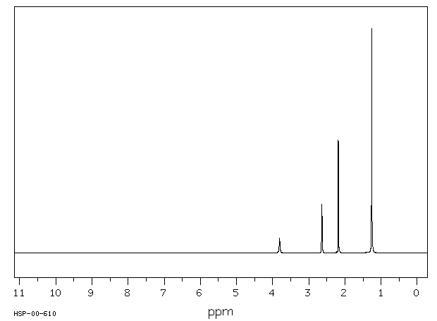
4
3
2
1

Slide 47
Protons that are interchangeable via bond rotation or symmetry have the same chemical shift and appear as one signal.

Slide 48
Integration of NMR Signals
The area under an NMR signal is proportional to the number of H that cause the signal.
Computers can “integrate” (calculate the
areas of) NMR signals, and allow ratios to be calculated.

Slide 49
6H
3H
2H
1H
1
2
3
4

Slide 50
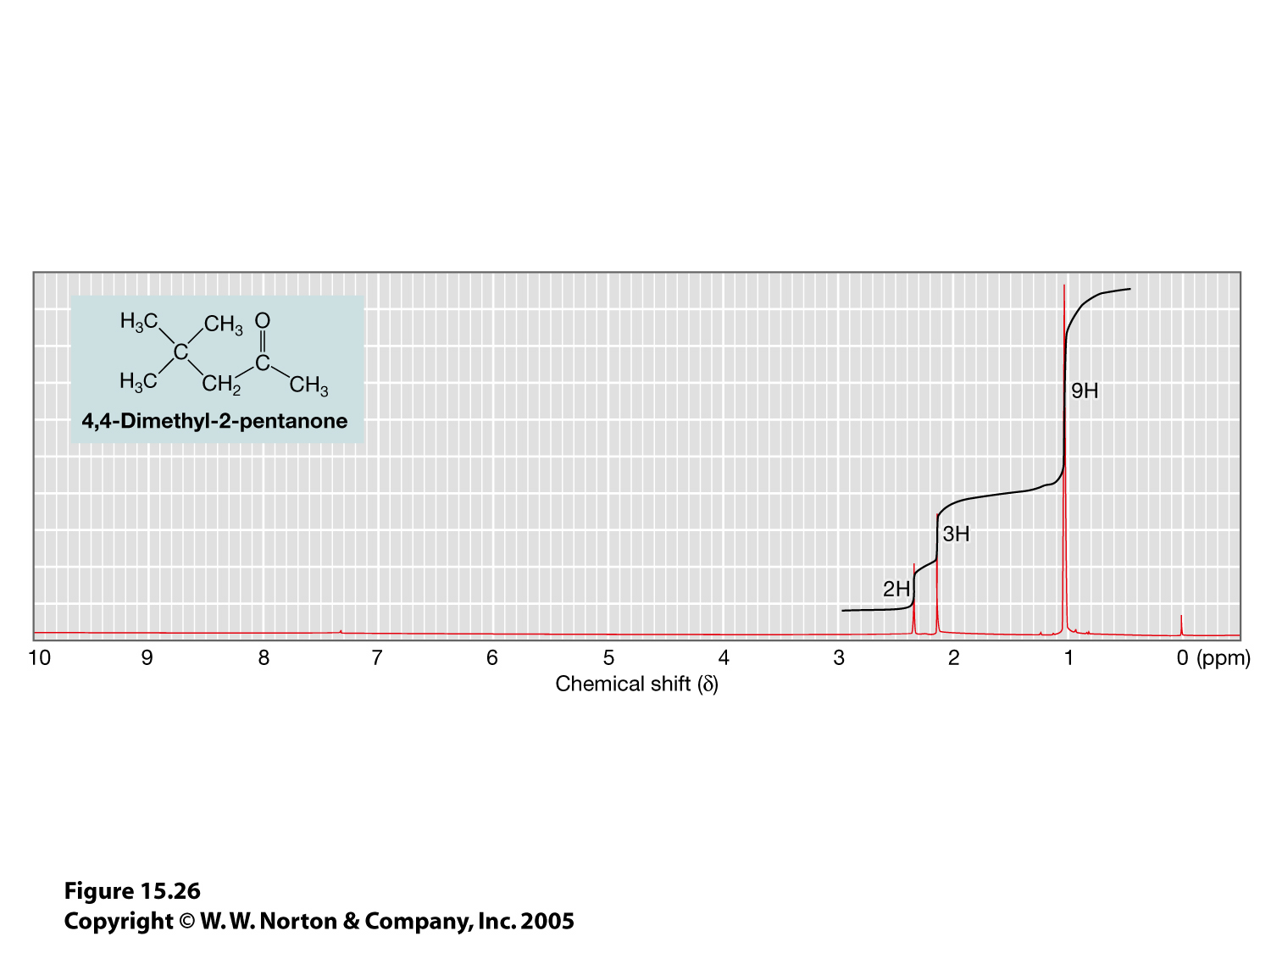
15.26.jpg
The “Old School” method of integration involved measuring the heights of computer-traced curves and calculating the ratio of heights

Slide 51
Spin-Spin Coupling
Protons in a magnetic field are almost equally divided between α- and β- spin states (i.e. +1/2, -1/2).
If two hydrogens are separated by 2-3 bonds, they feel each other’s magnetic spin—i.e. they are “spin-spin coupled”

Slide 52
+
B₋
B₀
B₊
50% chance H₂’s magnetic dipole adds to B₀
50% chance H₂’s magnetic dipole subtracts from B₀
H₁ feels 2 different net magnetic fields. Half of its signal appears slightly upfield, and half slightly downfield
—i.e. it’s split to a “doublet”

Slide 53
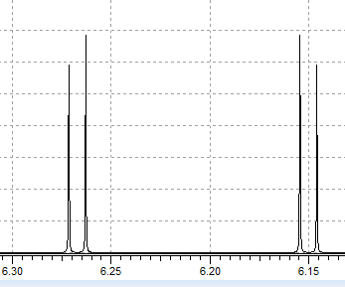
The size of couplings (J values) are expressed in Hz. The size of J in Hz is the same regardless of the strength of the magnetic field.
Coupled protons split each other to the same extent. Here, J_{AB} = J_{BA} = 3.4 Hz
H_{a}
3.4 Hz
H_{b}
3.4 Hz

Slide 54
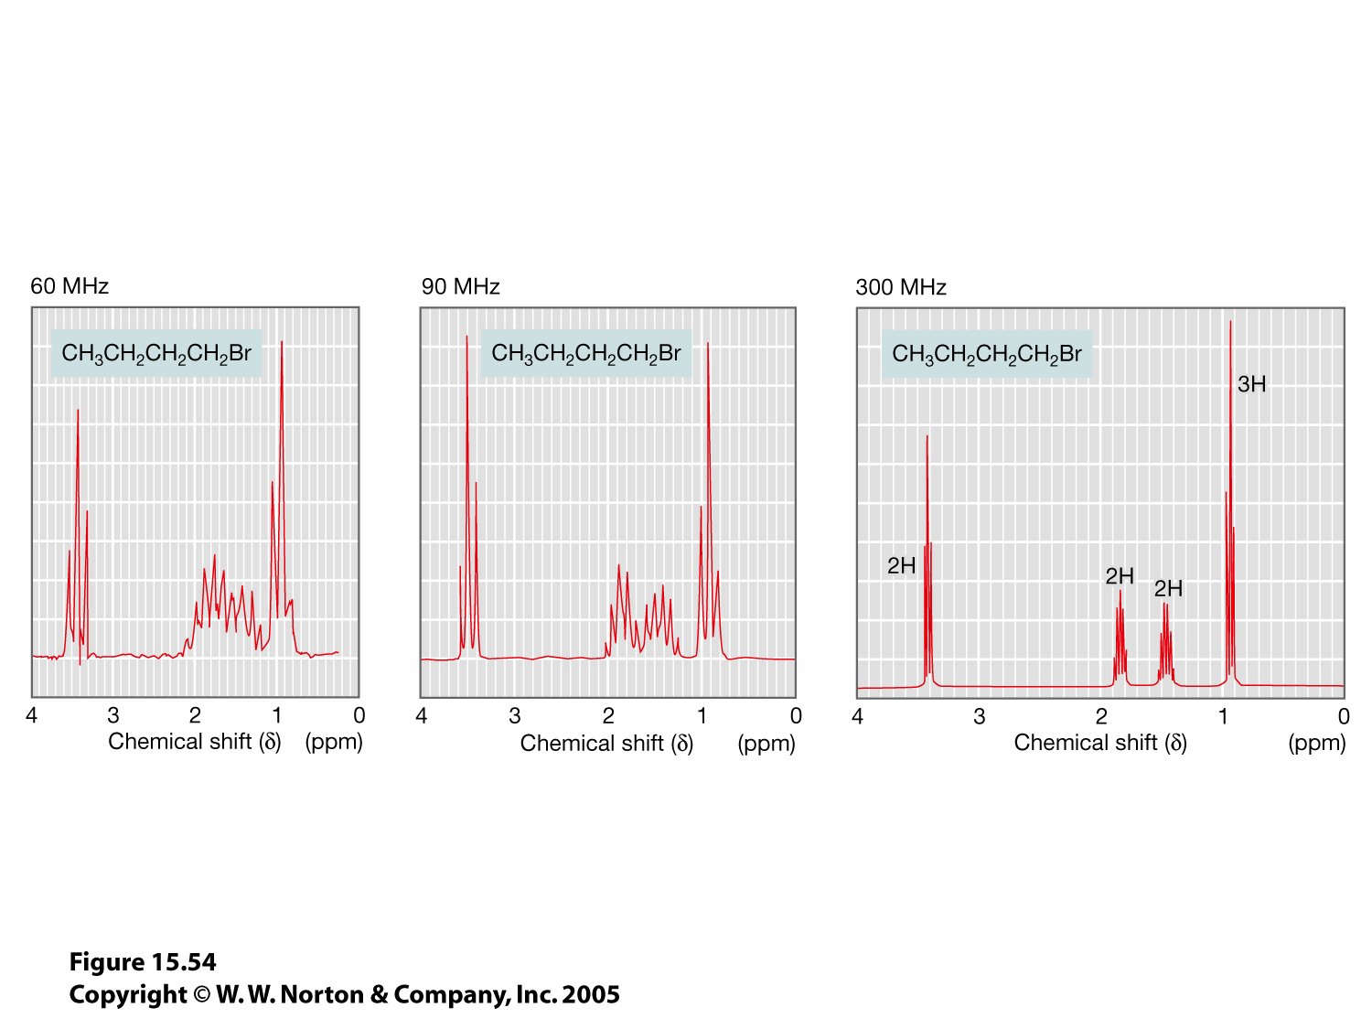
15.54.jpg
As the magnetic field increases, chemical shifts in Hz (not δ) increase, but J-splittings are constant.
Therefore, more powerful magnets give better resolution

Slide 55
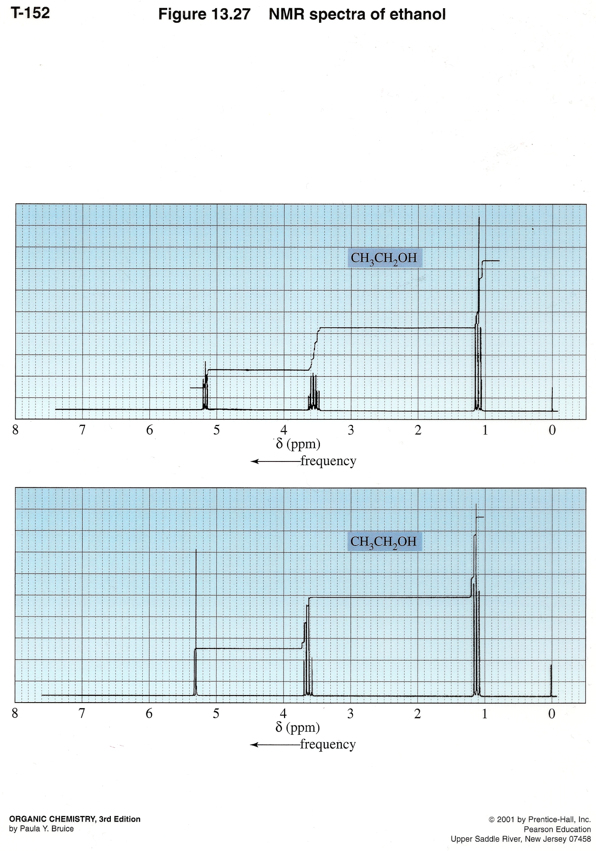
Only see coupling to OH/NH protons if acid/base is scrupulously avoided
Normally you see no coupling, and OH/NH signals appear as broad singlets
Notes:
Caption: Proton NMR spectrum of pure ethanol (a) and ethanol contaminated with a trace of acid (b).
Notes: In pure ethanol the alcohol hydrogen exchanges slowly enough that it couples with the adjacent methylene protons. If an alcohol is contaminated with a catalytic amount of acid the exchange speeds up to the point where the methylene protons show only an average interaction with the alcohol proton in various environments, and the alcohol proton likewise gives a signal corresponding to its average environment. No signal splitting is observed between an alcohol proton and neighboring protons in this circumstance.

Slide 56
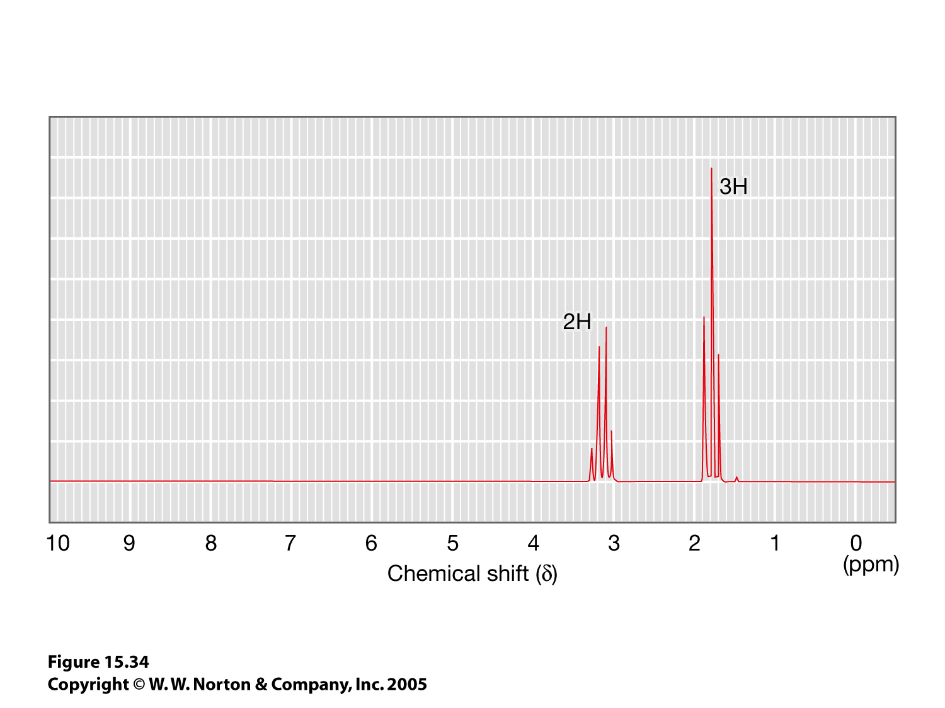
15.34.jpg
a
b
b
a

Slide 57
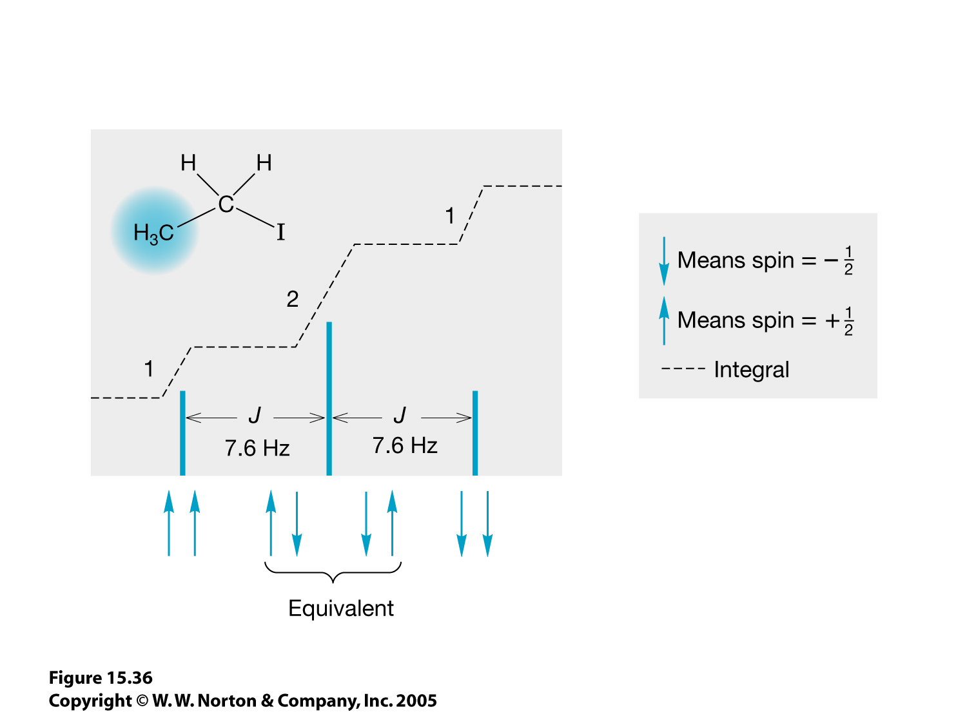
15.36.jpg
Compare this with the results of flipping a coin twice:
25% both tails
25% both heads
50% one head, one tail

Slide 58
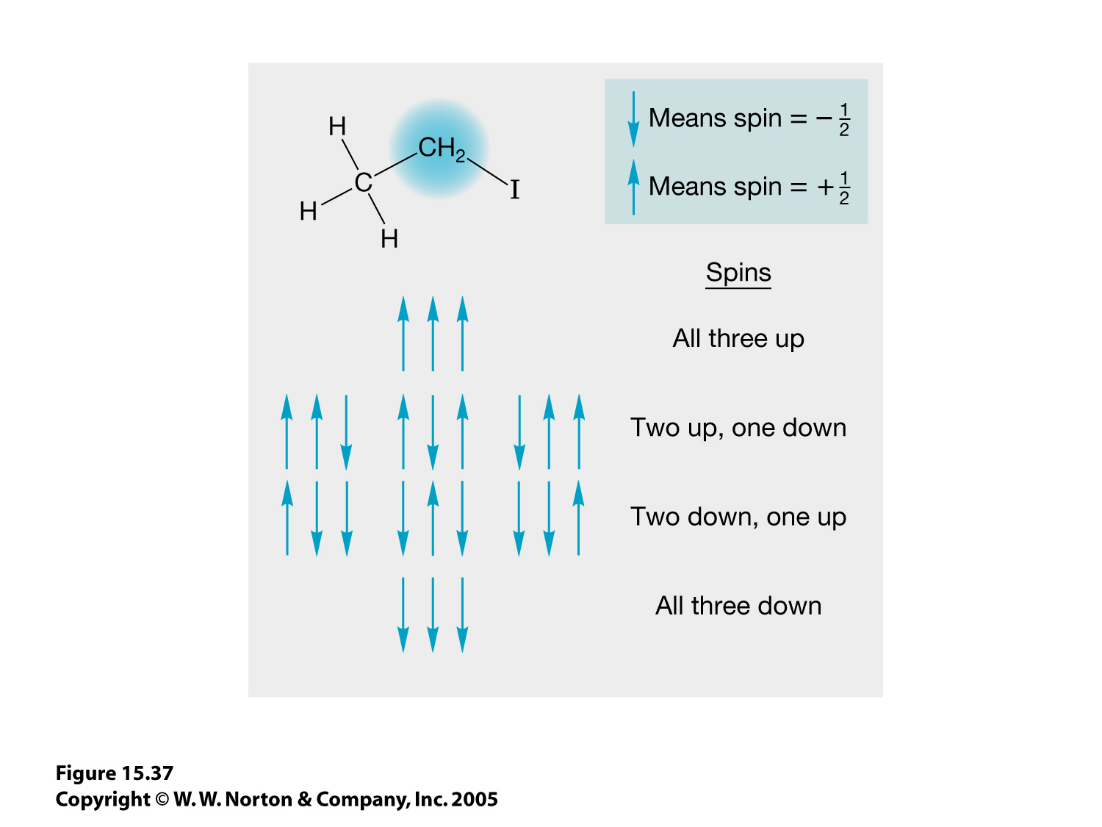
15.37.jpg

Slide 59
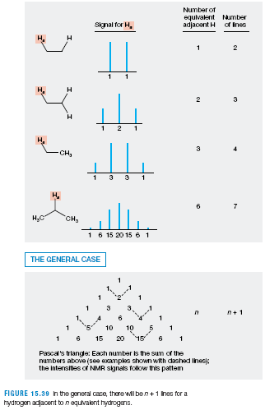
n+1 rule: the number of peaks in a proton’s signal = the number of neighboring protons (n) +1
This assumes that all Js are the same size. It generally holds true for simple acyclic alkyl groups.

Slide 60
15.34.jpg
C₂H₅I
b
a

Slide 61
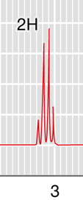
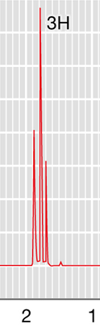
Analyzing the NMR Spectrum
Construct a table:
δ | Integration | Multiplicity | assignment
3.1 | 2H | q (quartet) | X-CH₂-CH₃ (I-CH₂-CH₃)
1.8 | 3H | t (triplet) | CH₃-CH₂

Slide 62
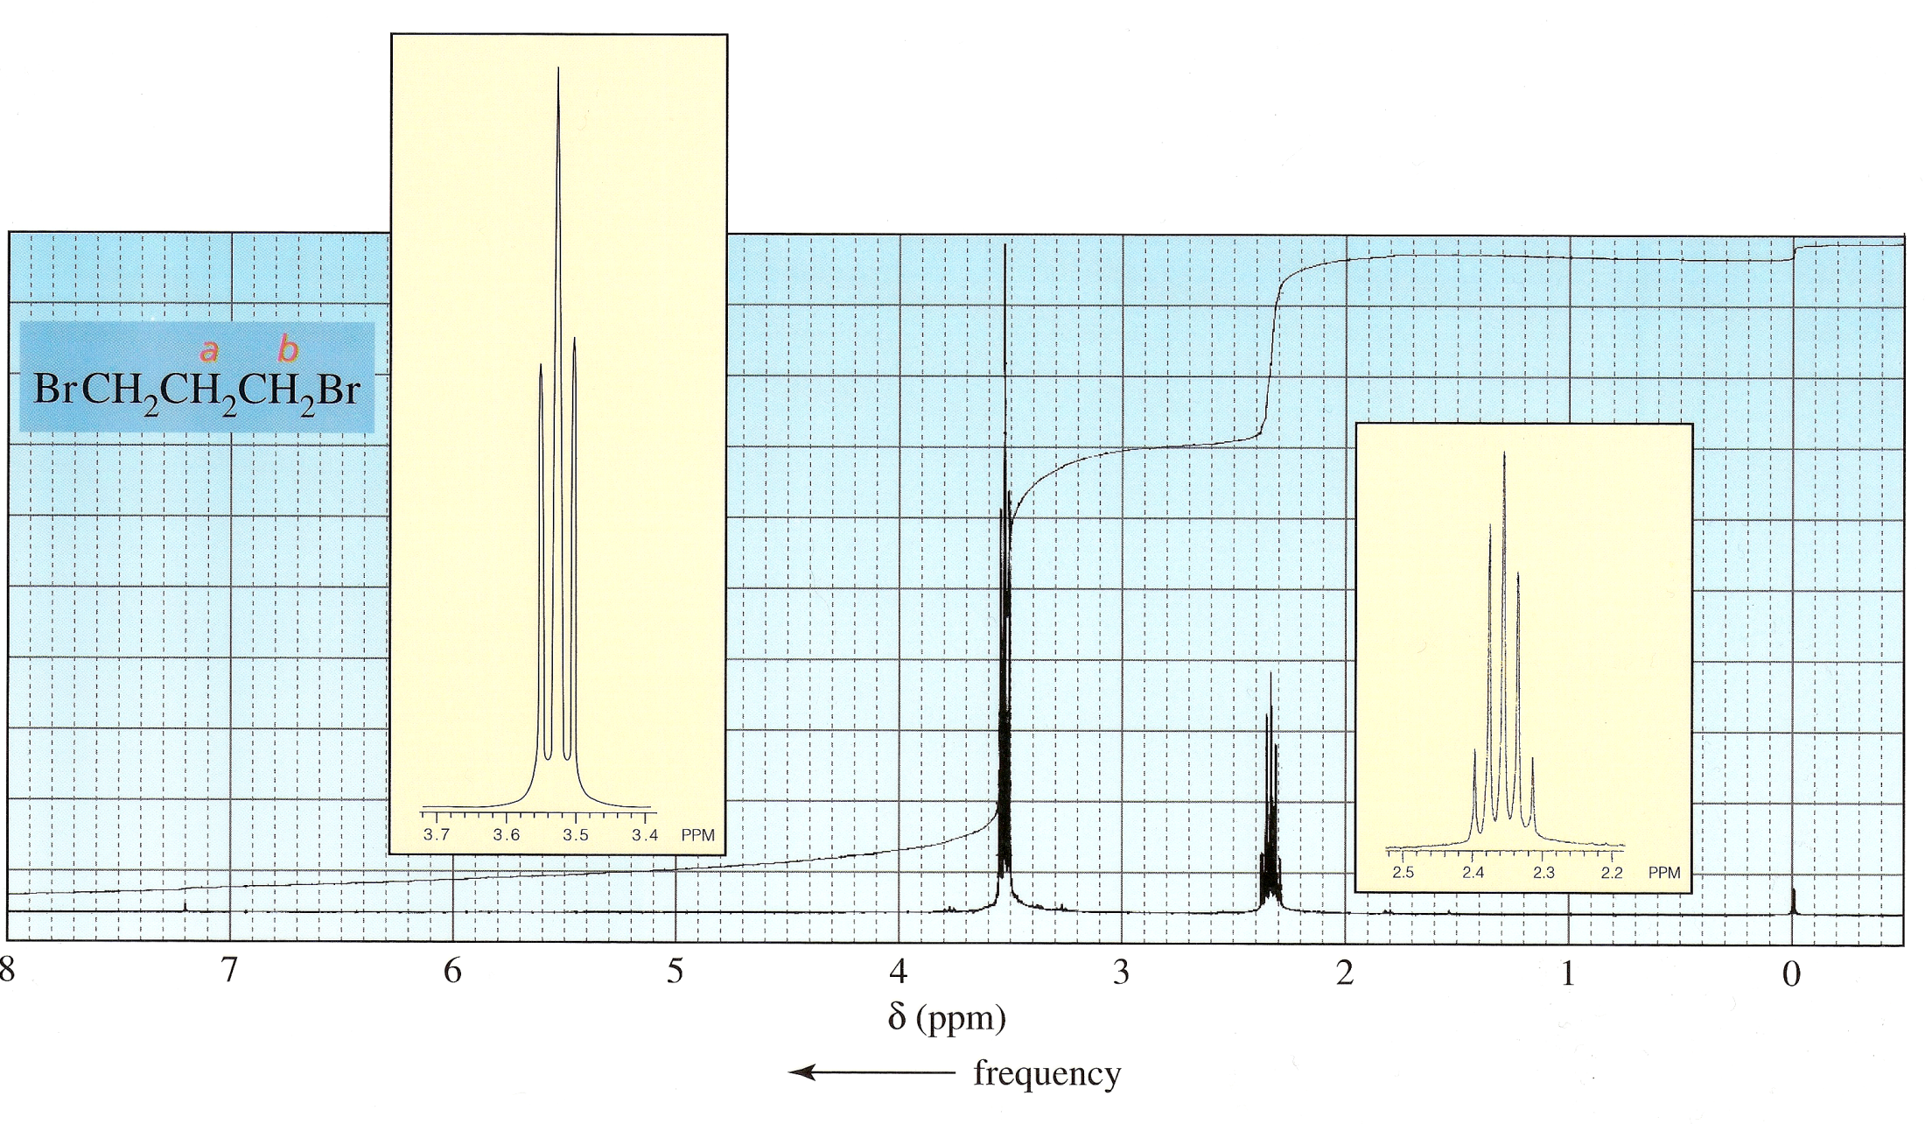
4H
C₃H₆Br₂
2H

Slide 63
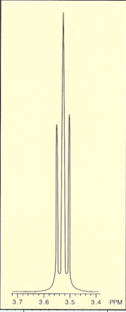
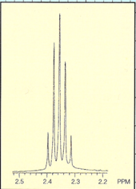
δ | Integration | Multiplicity | assignment
3.5 | 4H | t | X-CH₂-CH₂ (Br-CH₂-CH₂) ×2
2.3 | 2H | pentet | CH₂-CH₂-CH₂ or CH₃-CH₂-CH
Br-CH₂-CH₂-CH₂-Br

Slide 64
4H
2H
b
a

Slide 65
How to Solve Spectroscopy Problems
You’ll typically be given the molecular formula for the unknown compound, plus possibly IR and/or ¹³C data.
Calculate the DBE from the molecular formula. This can sometimes indicate the presence of functional groups not directly detectable by NMR (e.g. C=O)

Slide 66
Look at the IR data for functional groups. Evidence of C=O, C≡C or C≡N is particularly helpful because these groups aren’t directly detected by proton NMR.
The ¹³C spectrum can tell you how many different kinds of carbon are in the molecule, and their chemical shifts may provide additional insight. In particular, carbon signals above 150 ppm often indicate the presence of a carbonyl group.

Slide 67
Analyzing the NMR spectrum
Construct a table:
δ | Integration | Multiplicity | Assignment

Slide 68
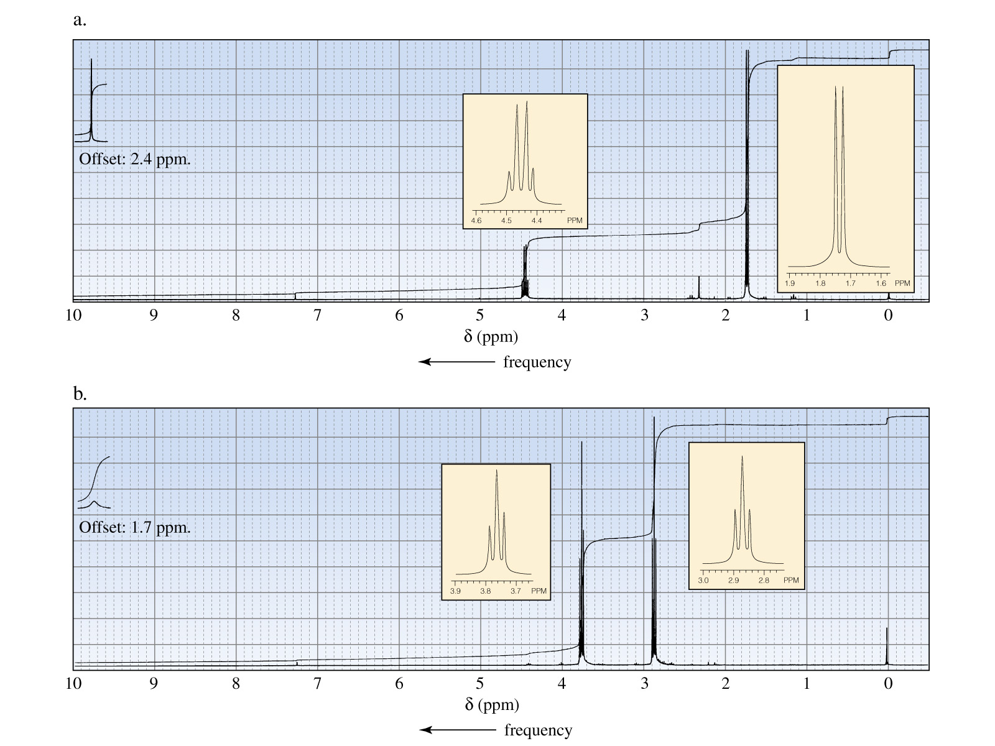
1H
3H
1H
~12.2 ppm
Both are C₃H₅ClO₂
2H
2H
1H
~11.5 ppm
Notes:
Notes: The first spectrum is of 2-chloropropanoic acid and the second is of 3-chloropropanoic acid. The first spectrum shows a deshielded methine proton signal split into a quartet by three methyl protons and a shielded methyl proton signal split into a doublet by one methine proton. The second spectrum shows two sets of methylene proton signals split into triplets caused by pairs of methylene protons splitting each other's signals.

Slide 69
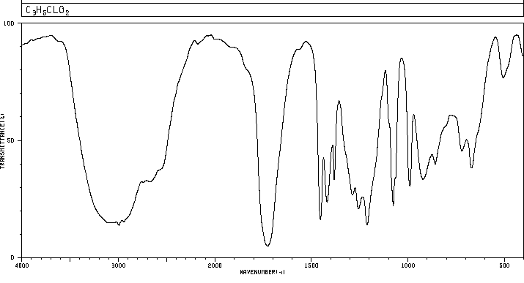
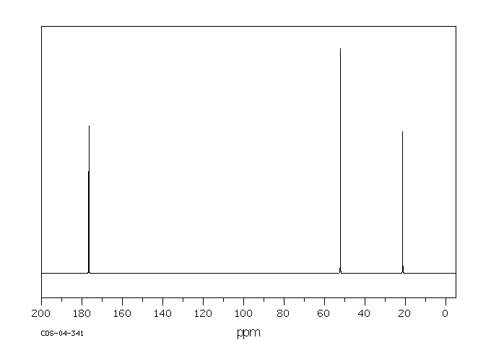
Broad stretch 3500-2100 cm⁻¹
Strong peak ~1730 cm⁻¹
Compound “a”
¹³C: ~δ 177, 52, 21

Slide 70
Compound “a” Analysis
DBE for C₃H₅ClO₂: 1
IR: 3500-2100 cm⁻¹ (v. broad OH stretch)
+1730 cm⁻¹ (carbonyl)
= carboxylic acid
¹³C NMR: -3 carbons
-177 ppm: carbonyl
-(52: next to EWG)
¹H NMR:
δ integration multiplicity assignment
12.2 1H br s CO₂H
4.4 1H q
1.7 3H d CH₃-CH
“br s” = “broad singlet”

Slide 71
DBE + IR + ¹³C NMR + ¹H NMR all indicate CO₂H—
C₂H₄Cl remain.
¹H NMR:
4.4 1H q
1.7 3H d CH₃-CH

Slide 72
1H
3H
1H
~12.2 ppm
Both are C₃H₅ClO₂
2H
2H
1H
~11.5 ppm
Notes:
Notes: The first spectrum is of 2-chloropropanoic acid and the second is of 3-chloropropanoic acid. The first spectrum shows a deshielded methine proton signal split into a quartet by three methyl protons and a shielded methyl proton signal split into a doublet by one methine proton. The second spectrum shows two sets of methylene proton signals split into triplets caused by pairs of methylene protons splitting each other's signals.

Slide 73
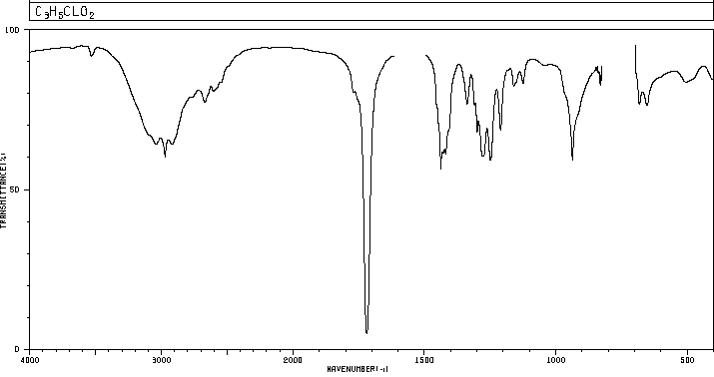
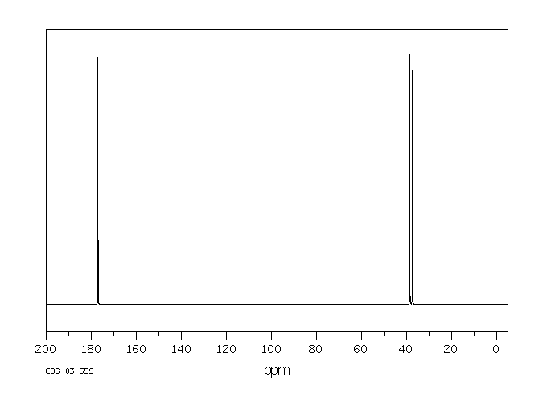
Broad stretch 3500-2100 cm⁻¹
Strong peak ~1720 cm⁻¹
¹³C: ~δ 177, 39, 37

Slide 74
Compound “b” Analysis
DBE for C₃H₅ClO₂: 1
IR: 3500-2100 cm⁻¹ (v. broad OH stretch)
+1720 cm⁻¹ (carbonyl)
= carboxylic acid
¹³C NMR: -3 carbons
-177 ppm: carbonyl
-(39,37: next to EWG)
¹H NMR:
δ integration multiplicity assignment
11.5 1H br s CO₂H
3.8 2H t
2.9 2H t

Slide 75
DBE + IR + ¹³C NMR + ¹H NMR all indicate CO₂H—
C₂H₄Cl remain.
¹H NMR:
3.8 2H t
2.9 2H t

Slide 76
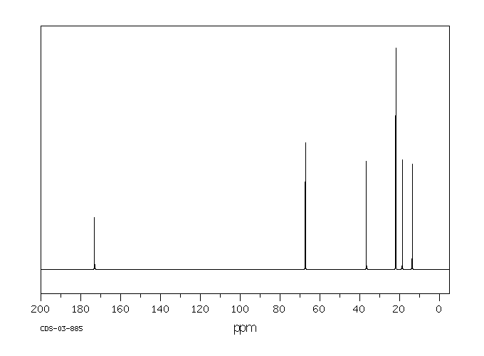
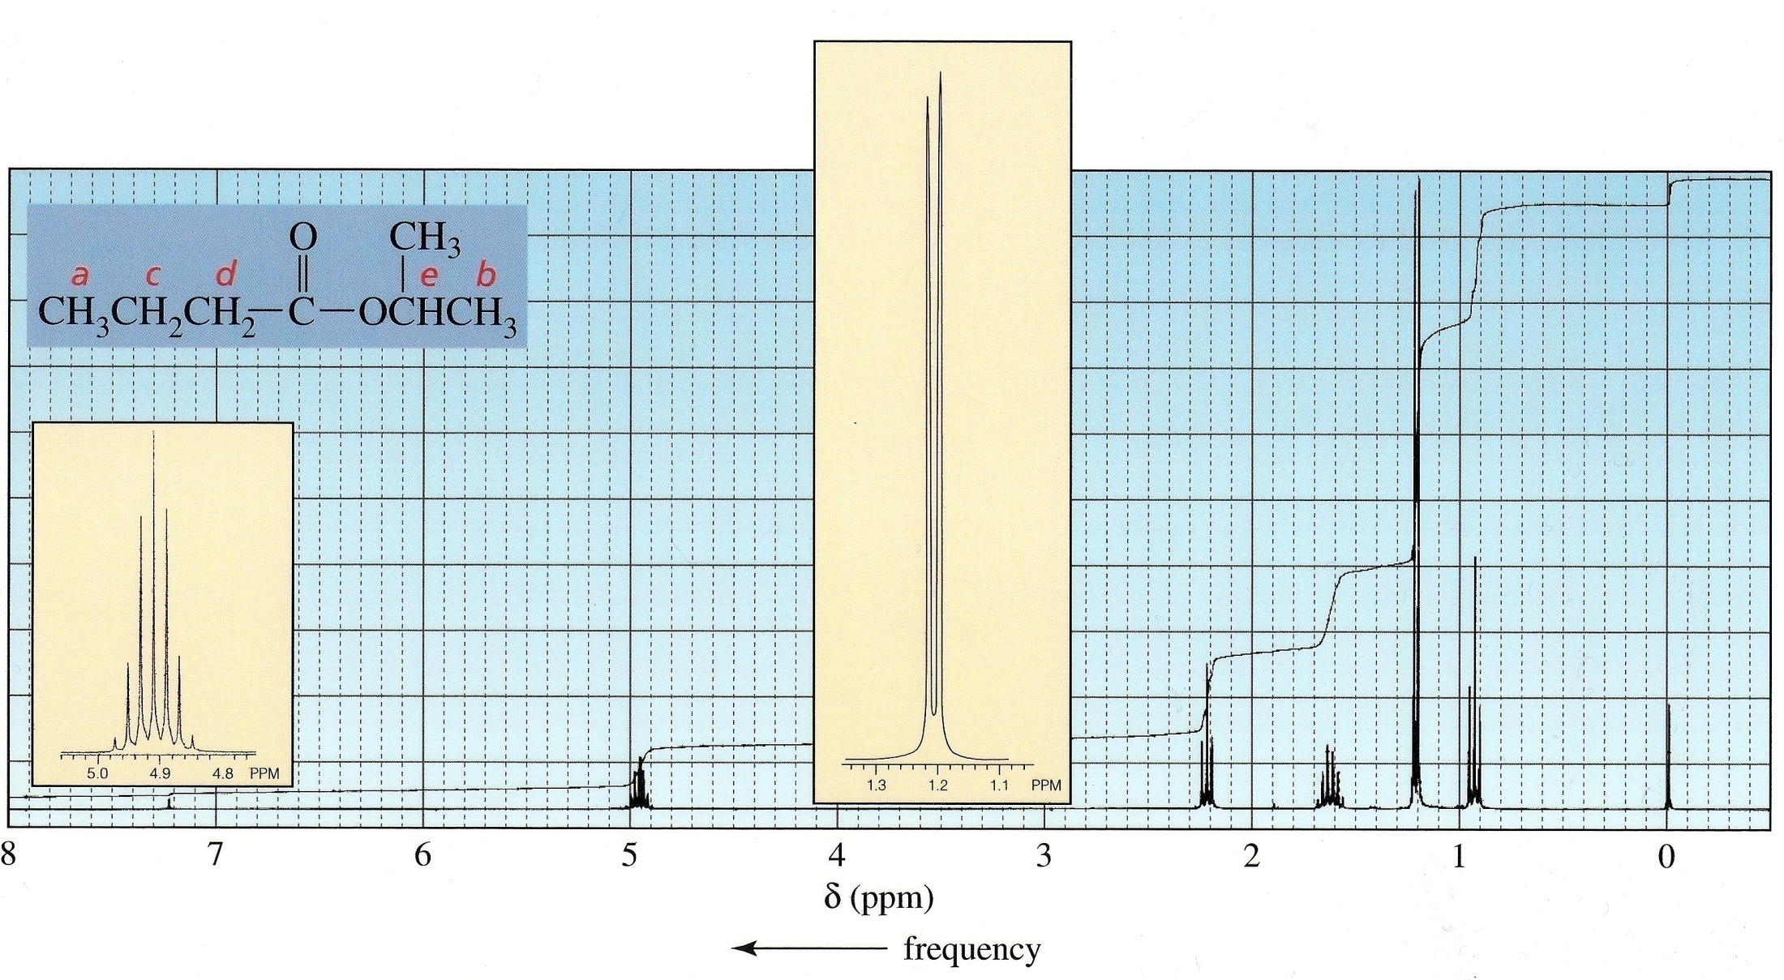

Chemical shifts for ¹³C NMR:
173
67
37
22
19
14
6H
C₇H₁₄O₂
3H
2H
2H
1H

Slide 77

1735 cm⁻¹
1190, 1110 cm⁻¹

Slide 78
DBE for C₇H₁₄O₂: 1
IR: 1735 cm⁻¹ (C=O)
+1190, 1110 cm⁻¹ (C-O)
¹³C NMR: -6 kinds of carbon
(but C₇, so hints at symmetry)
-173 ppm: carbonyl (suggests ester)
¹H NMR:
δ integration multiplicity assignment
4.9 1H septet
2.2 2H t
1.6 2H sextet CH₃-CH₂-CH₂

Slide 79
δ integration multiplicity assignment
1.2 6H d
0.9 3H t CH₃-CH₂
+
+
O
C₃H₇
(+O if you determined X=O)
C₄H₇O

Slide 80
The n+1 rule assumes that the J values between all neighboring protons is the same. This will be true if all the neighboring protons are the same by exchange or by symmetry.
The rule also holds relatively well for alkyl chains, particularly on less powerful spectrometers where slight differences in J couplings aren’t resolved.

Slide 81
When the coupling constants are different to different neighboring protons, more complex patterns result.
This is commonly seen in cyclic alkanes, alkenes, and substituted benzenes.

Slide 82

15.40.jpg

Slide 83

See: http://orgchem.colorado.edu/hndbksupport/nmrtheory/splittingcomplex.html
for a discussion of the NMR of styrene oxide.
M
A
X

Slide 84

15.42.jpg

Slide 85

Note Js are largest when the dihedral angle is 0° or 180°.

Slide 86

400 MHz
H1
H2
H3
H4
Notes:
Axial hydrogens are 180 degrees apart, so their Js are larger. Here, H1 has one axial neighbor, so it’s split into a wide doublet. H2 has two axial neighbors with the same J, so it’s split into a wide triplet. H3 has one axial and one equatorial neighbor, so it’s split into a doublet of doublets (coupling to the equatorial neighbour is smaller). H4 is equatorial and has small couplinc constants to its two neighbours and appears as a thin doublet of doublets.

Slide 87

15.44.jpg
Alkenes: J_{cis}< J_{trans}
Benzenes: J_{ortho}> J_{meta}

Slide 88

Alkyl benzenes usually have all the benzene hydrogens lumped together close to 7 ppm.
Notes:
Caption: Proton NMR spectrum of ethylbenzene.
Notes: The ethyl group shows a shielded triplet and a deshielded quartet and the different kinds of aromatic protons all split each other's signals and pack the resulting lines into the same chemical shift area, resulting in a complex pattern. In practice the splitting between protons meta and para to one another is often too small to be observable with low- or medium-field NMR spectrometers.

Slide 89

EDG or EWG on the benzene ring tend to create larger chemical shift differences between benzene hydrogens
In this spectrum, the meta-couplings are too small to be seen– c is a doublet, b is a triplet, and a is a doublet of doublets (2 different J_{ortho})
Notes:
Notes: The nitro group is powerfully electron withdrawing and its proximity to the various chemically different protons separates the signals of these protons from one another enough to see their signal multiplicities. The spectrometer used to generate this spectrum is not powerful enough to show mutual splitting of signals generated by protons substituted meta and para to one another, so the resulting spectrum is fairly simple. In order of increasing chemical shift a doublet of doublets followed by a triplet followed by a doublet is observed. These multiplets don't show the exact calculated relative intensities because multiplets generated by low- and medium-field instruments are asymmetric. As NMR field strengths increase the relative intensities of peaks in multiplets approaches theoretical values.

Slide 90

Two “doublets” in the aromatic region
is typical for a para-disubstituted benzene
Notes:
Notes: The molecular formula suggests four units of unsaturation, and the NMR spectrum shows that these can be accounted for by the presence of a benzene ring (lines near 7 ppm). The aromatic region shows two doublets, characteristic of a para-disubstituted aromatic compound. No O–H stretch is seen in the 3300–3400 cm–1 region of the IR, and a C–O stretch is seen at 1100 cm–1, suggesting an ether. The integration line in the NMR passes over two singlet signals, showing each signal to be caused by three protons, suggesting two methyl groups. One methyl group is in the right position to be attached to the benzene ring and the other is in the right position to be attached to an ether oxygen. The compound generating these spectra is para-methoxytoluene.

Slide 91

Here, the smaller
meta-couplings can be clearly seen.
On a poorer spectrometer, 4 and 7 would appear as doublets (one ortho- neighbour), and 5 and 6 as triplets (two ortho- neighbours).
Each signal is split into a fine doublet because each proton has one meta-coupling.

Slide 92
If two protons are coupled to each other, and their chemical shifts are close to each other, distortions start to appear and the signals no longer follow the basic “first-order” rules we’ve covered.
Such “second-order” spectra require special calculations to analyze properly, and are beyond the scope of this course.

Slide 93

15.48.jpg
The signals for two coupled hydrogens “lean” towards each other. The closer they are in chemical shift, the more pronounced the effect.

Slide 94

15.49.jpg
The closer the signals are to each other, the more extreme the distortion.

Slide 95

15.57.jpg
¹³C spectra are normally “decoupled”-
Every carbon appears as a singlet.

Slide 96


Slide 97
End Ch 15
This concludes the Norton Media Library
Slide Set for Chapter 15
Organic Chemistry
Third Edition
by
Maitland Jones, Jr.
W. W. Norton & Company
Independent and Employee-Owned

