Slide 1
Biochemical Examples of CHEM321/322 Concepts

Slide 2
Stereochemistry
Many biomolecules, including proteins, carbohydrates and DNA, are chiral.
A typical drug molecule acts by docking with a target biomolecule such as an enzyme or receptor. These drugs are often chiral, and the two enantiomers may differ greatly in efficacy.

Slide 3
Resolution of Naproxen
Naproxen is an NSAID (Non-Steroidal Anti-Inflammatory Drug).
The (+)-(S)-enantiomer of naproxen is the active isomer. It is synthesized as a racemate then resolved with an enantiopure amine base and sold as a single enantiomer.

Slide 4
NSAIDS act by inhibiting cyclooxygenase enzymes (COX). These enzymes convert arachidonic acid to prostaglandins, some of which are involved in inflammation.

Slide 5
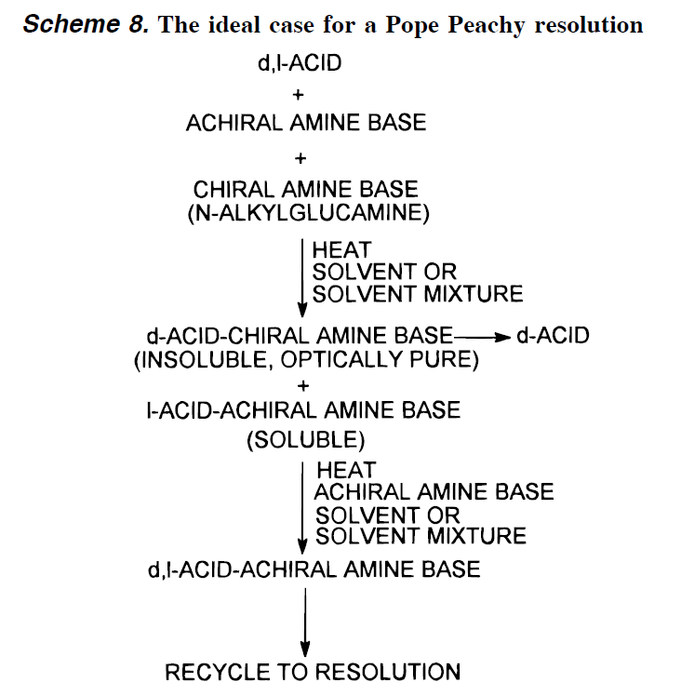
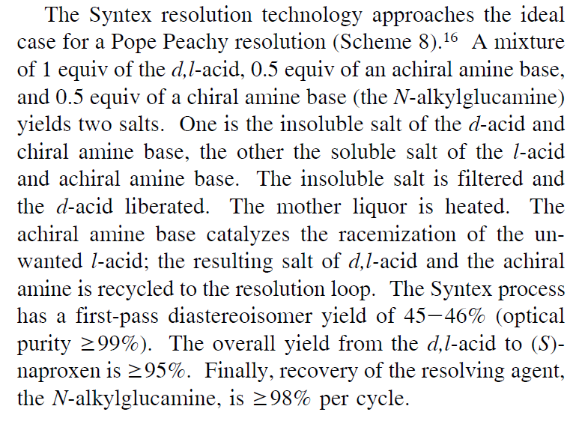

Slide 6
Epimerization
Epimers are stereoisomers that differ at only one stereocenter. Epimerization refers to a chemical process that interconverts epimers.
A stereocenter α- to a carbonyl can epimerize via the enol or enolate. e.g.:

Slide 7
Epimerization of Paclitaxel (Taxol™)
Paclitaxel, an inhibitor of mitosis, is used in chemotherapy
Epimerization via retro-Aldol:

Slide 8
Thalidomide
Was prescribed in 1957-62 for conditions that included insomnia and morning sickness in pregnant women.
The (R)- isomer gives the desired sedative effect.
The (S)- isomer is a teratogen.
Epimerization in the body is rapid, so an enantiopure drug would not prevent birth defects
Carl Zimmer, New York Times 3/15/2010.

Slide 9
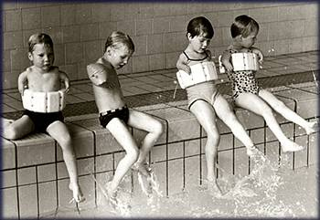
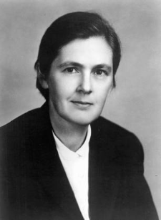
Thousands of babies worldwide, whose mothers had been prescribed thalidomide during pregnency, were born with severe deformities, particularly stunted and deformed limbs.
The insistence of pharmacologist Frances Oldham Kelsey for more safety data delayed approval of thalidomide in the U.S. In 1962, the teratogenic effects of thalidomide became widely know, and the drug maker withdrew its U.S. drug application.
http://pubs.acs.org/cen/coverstory/83/8325/8325thalidomide.html
http://www.flickr.com/photos/vivacomopuder/2531635433/

Slide 10


Slide 11
Amines and acids prefer acid-base chemistry

Slide 12
Formation of Peptide Bonds
Simply mixing carboxylic acids and amines together is generally not an effective way to make peptide bonds.
The ions that result from the acid/base reaction between the two components predominate and are inert to acylation-type reactions.

Slide 13
A Coupling Reagent; Couples Amines and Acids

Slide 14
Direct Treatment of Amino Acids with DCC leads to uncontrolled polymerization
“Real peptides” are of specific sequence.

Slide 15
Need protecting group
Now:

Slide 16

Purification of each reaction is a Pain!; Merifield’s Solid-supported synthesis

Slide 17
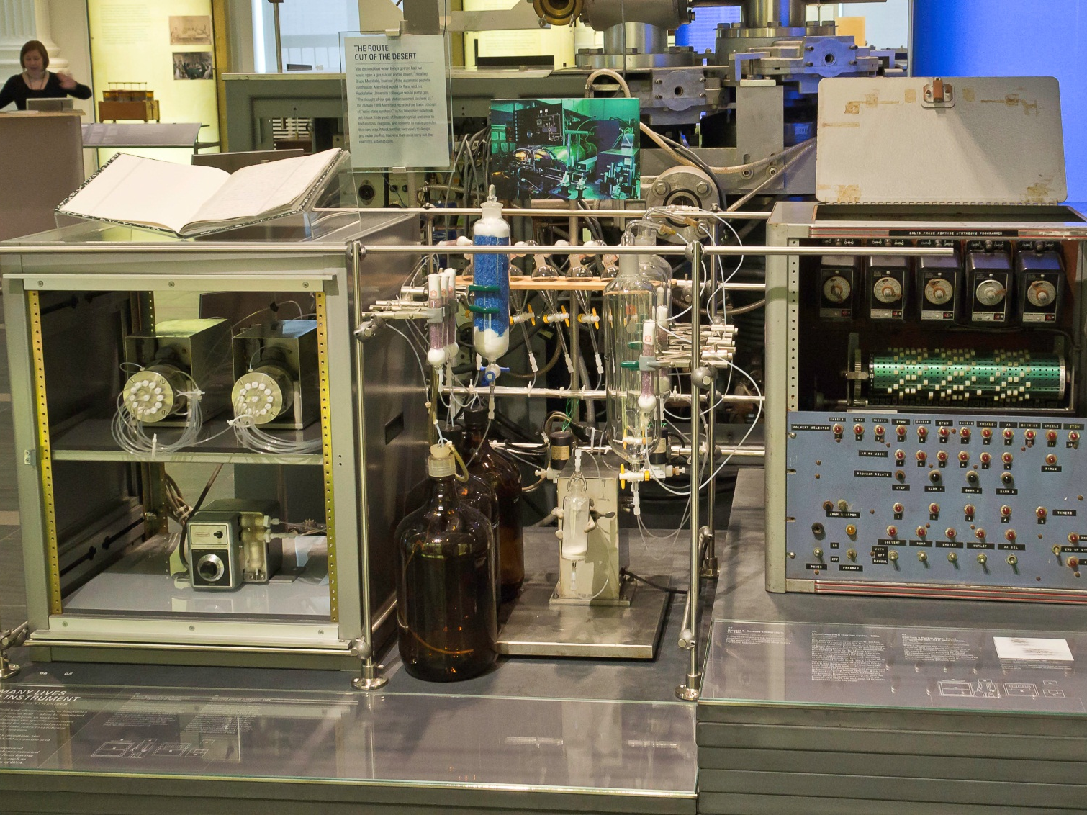
Merrifield automated peptide synthesizer ca. 1964
Chemical Heritage Museum, Philadelphia

Slide 18
How does nature make peptides/proteins?

Slide 19
How does nature make peptides/proteins?
-A-U-G - C-C-U - U-A-C - C-C-G - A-U-C-C-C-U-
mRNA
-A-U-G - C-C-U - U-A-C - C-C-G - A-U-C - C-C-U-

Slide 20
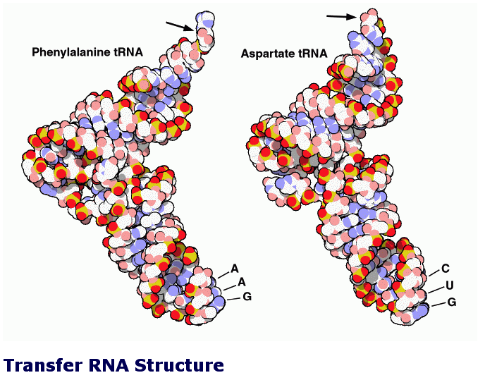
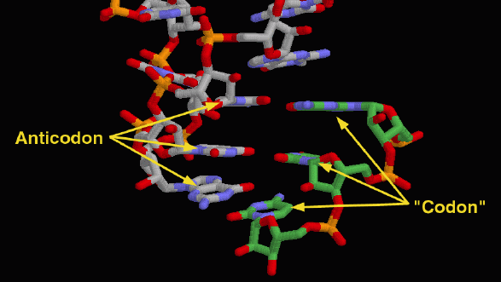
http://www.rcsb.org/pdb/

Slide 21
How does nature make How do you make acyl-tRNAs?

Slide 22
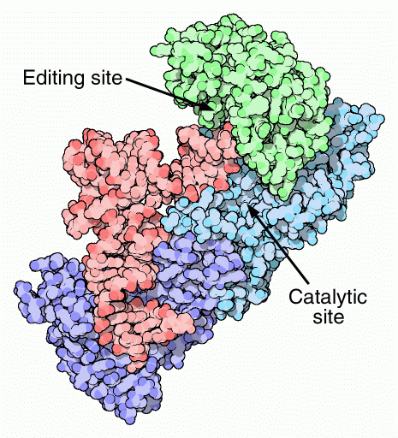
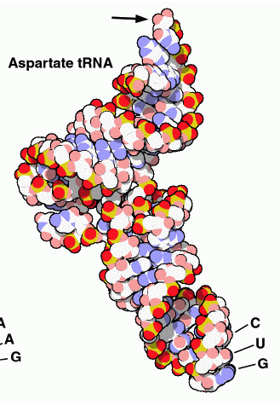

Slide 23
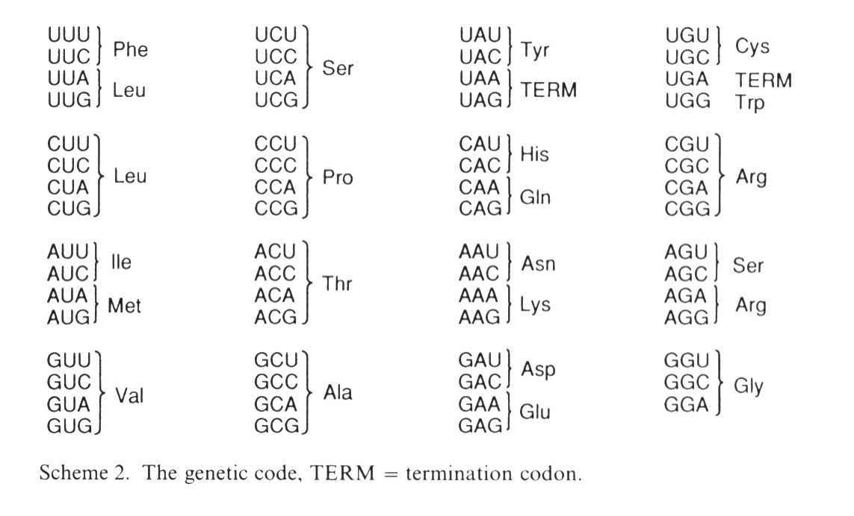

Slide 24
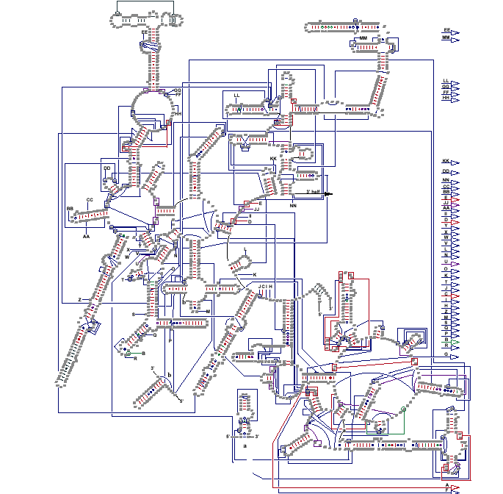
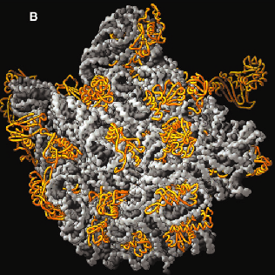
The Ribosome 3 RNA fragments + 31Proteins; IT’S BIG
2.6 million daltons!
Structure of the 5’ half of the large ribosomal subunit.
Grey = RNA
Gold = protein
Structure by T. Steitz and P. Moore (Yale)

Slide 25
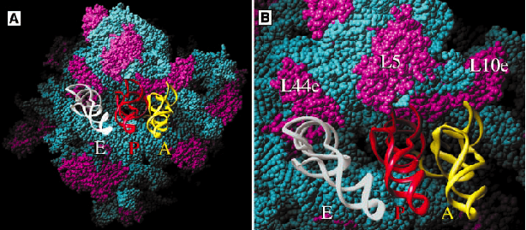
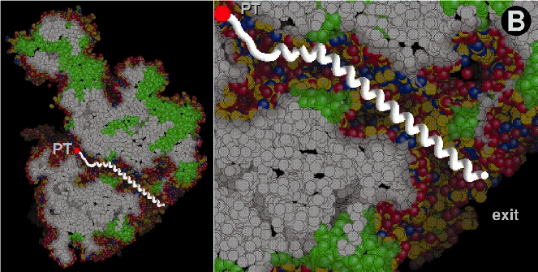
Three tRNAs in modeled in the core of the ribosome
The peptide tunnel
Exit ->

Slide 26
How do you break amide bonds?

Slide 27
Mechanism of Amide bond hydrolysis
Acid:
Base:

Slide 28
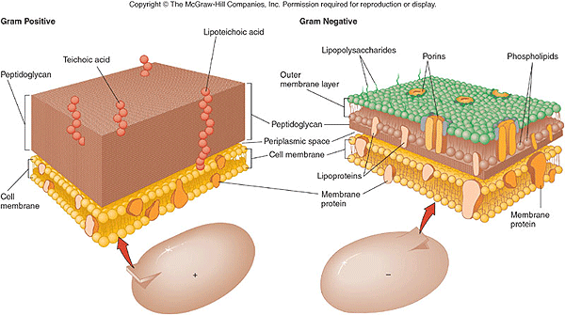
Beta Lactam Antibiotics
& Resistance
Bacteria are protected from osmotic stress by a strong heavily crosslinked peptidoglycan (protein+carbohydrate coating)
Bacteria need to be able to synthesize a strong cell wall in order to reproduce and survive.
Cool movie at: http://www.cellsalive.com/qtmovs/penpop_mov.htm

Slide 29
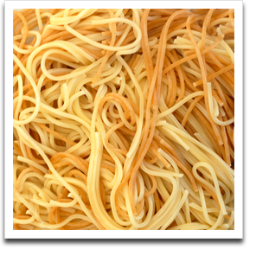
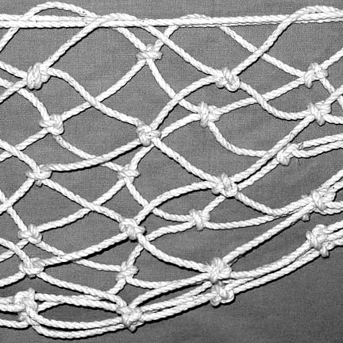
Crosslinking is needed for strength
transpeptidease
like spaghetti
like netting

Slide 30
A transpeptidease enzyme makes an unusual “isopeptide” from a lysine side chain to crosslink the pepdidoglycan.

Slide 32
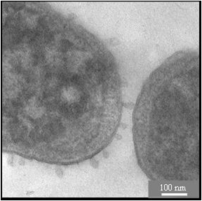
If you block the transpeptidease bacteria cant replicate and will burst.
Cool movie at: http://www.cellsalive.com/qtmovs/penpop_mov.htm

Slide 33
How beta-lactams work

Slide 34
The strained beta-lactam acts an an acylating agent of active site serine.

Slide 35
The bacterium fight back!

Slide 36
Betalactamase destroys betalactams

Slide 37
Build a better beta-lactam?

Slide 39
Another approach: cap the isopeptide chain
vancomycin
The natural product drug vancomycin caps the isopeptide

Slide 40
Vancomycin

Slide 41
Some bacterium have learned to modify their isopeptide to contain an ester linkage.
Vancomycin no longer binds the lactate containing isopeptide strong enough to block the transpeptidase.

Slide 42
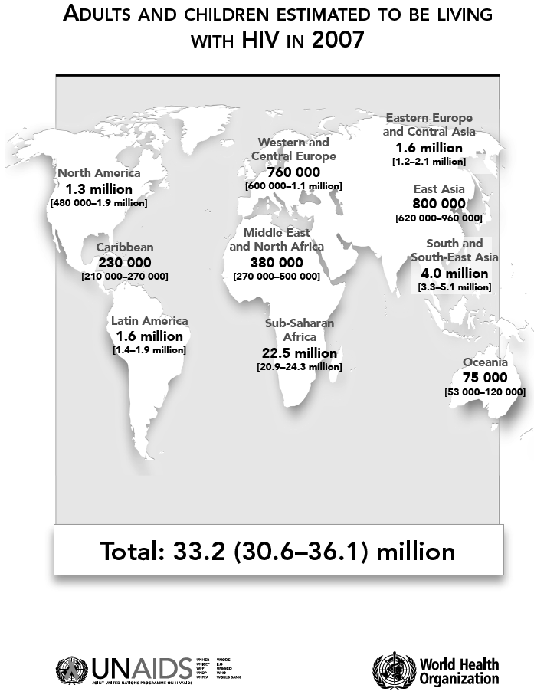
HIV
How to stop a killer

Slide 43
Designing Better anti-AIDS Drugs
HIV
R.T.
RNA
DNA
HIV protease
Functional Proteins

Slide 45
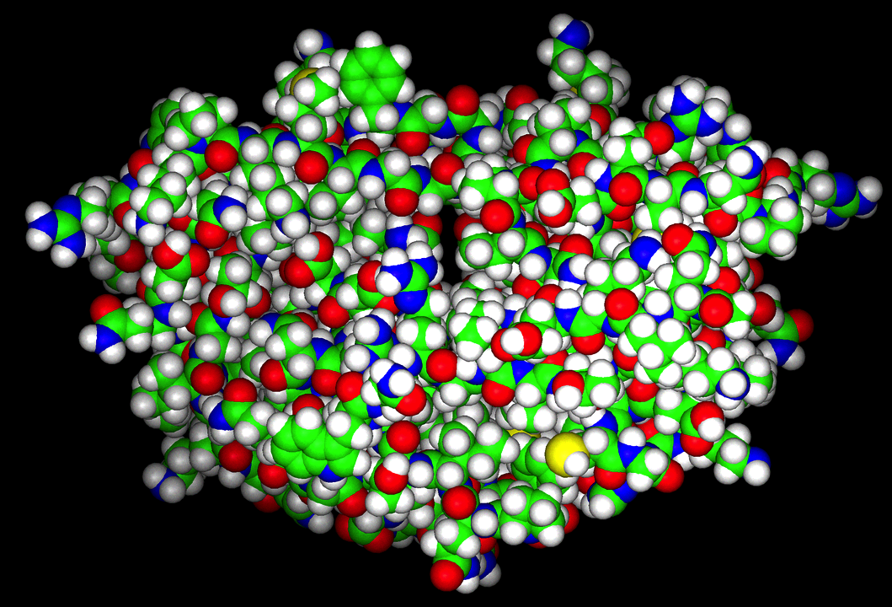

Slide 46
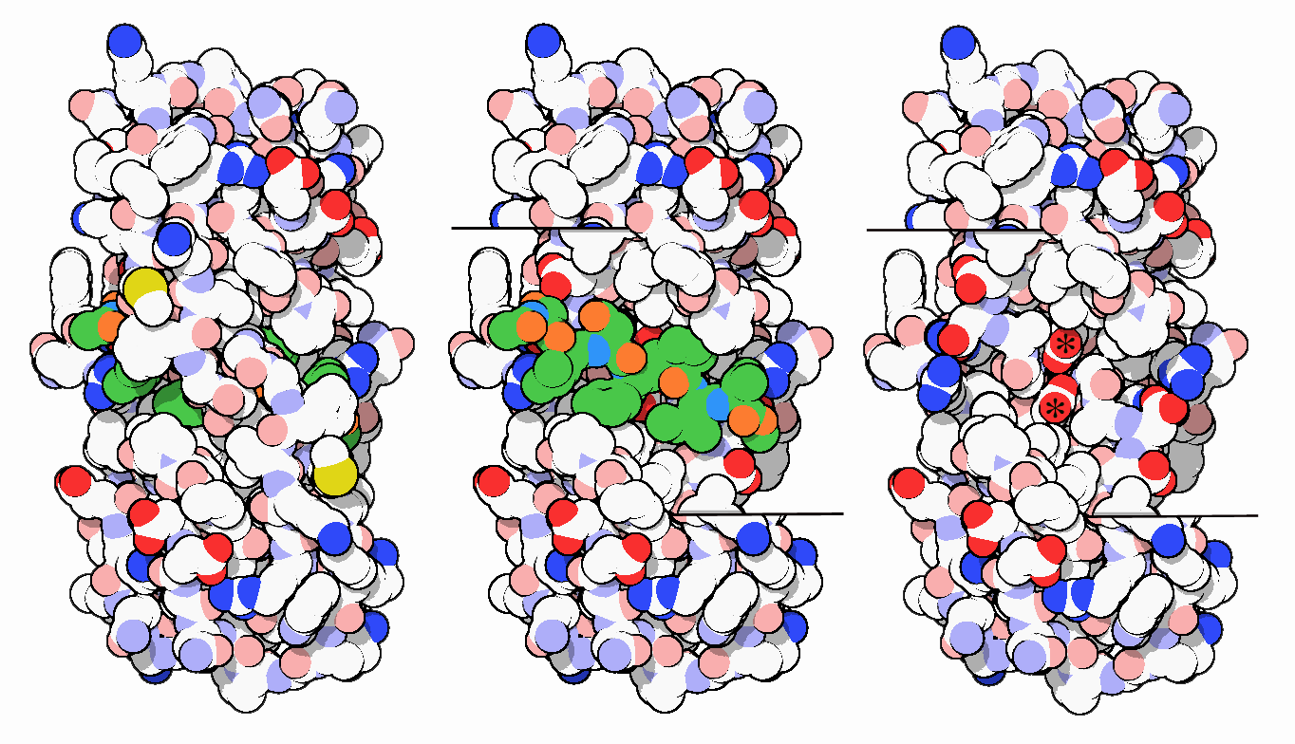
Another view at HIV protease
Top View Cross section with peptide Cross section

Slide 47
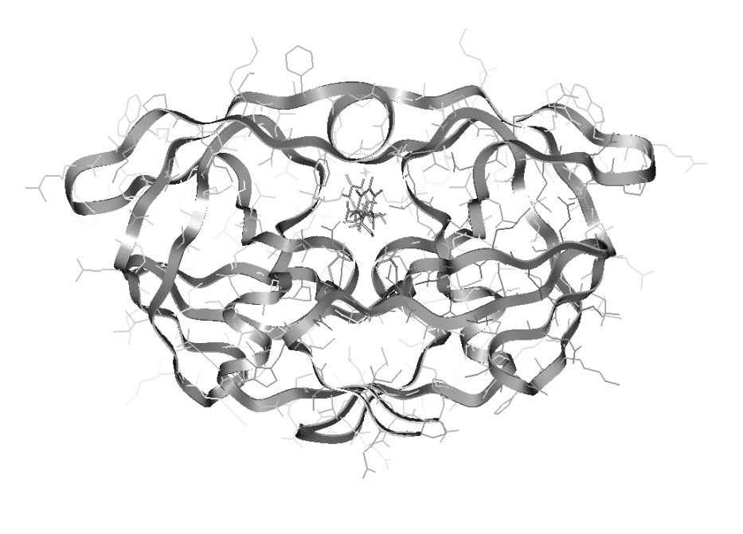
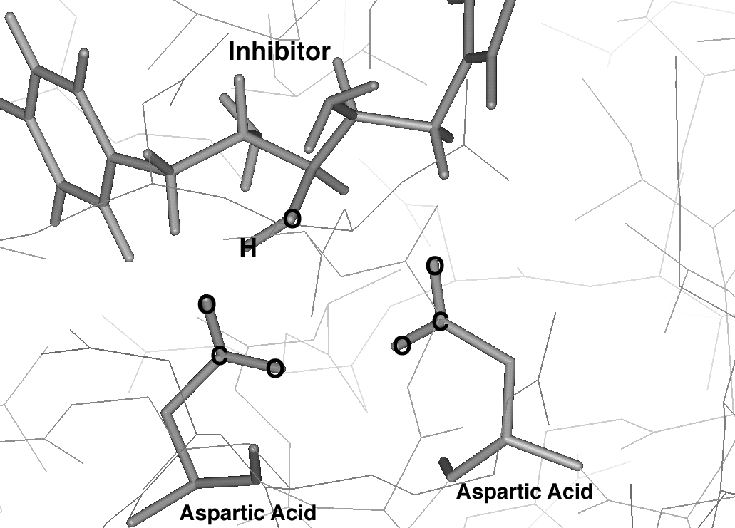
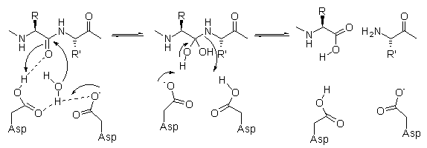
Note Tetrahedral Intermediate
From: www.dsch.units.it/~benedetti

Slide 48
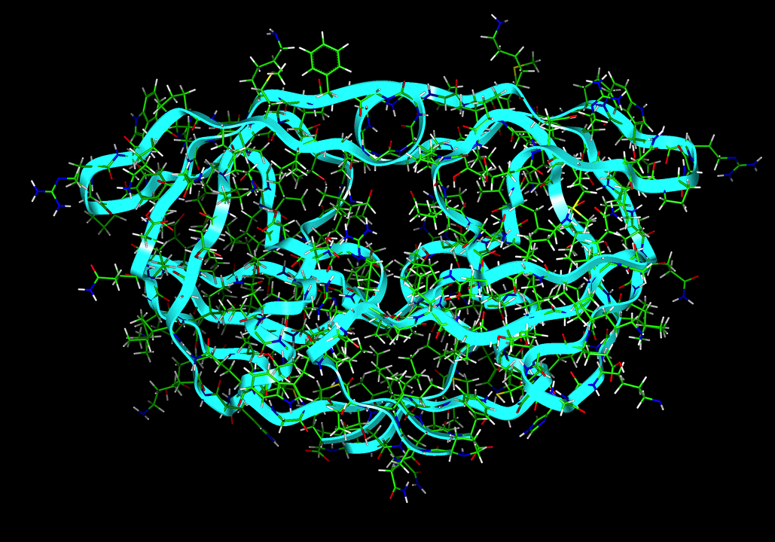
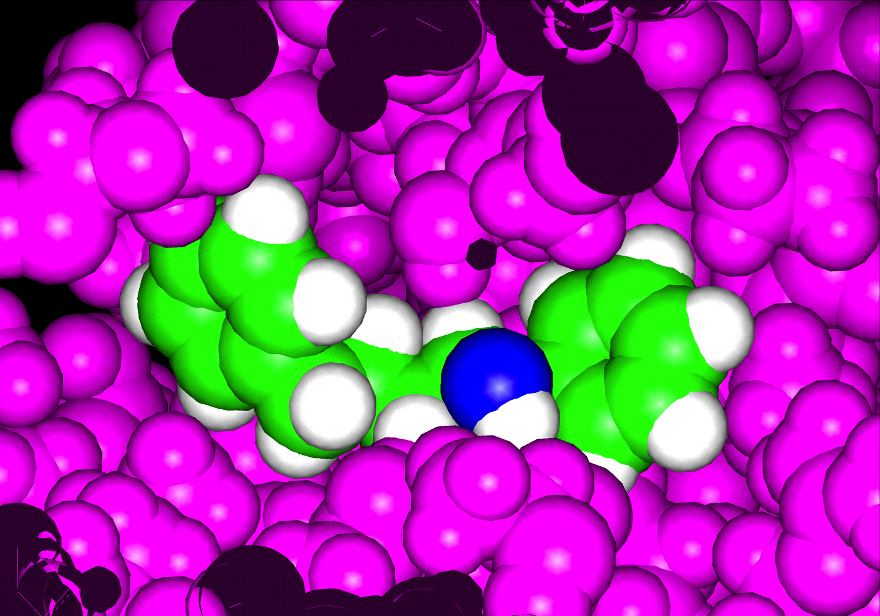
Mimics Tetrahedral Intermediate
Protease Inhibitor

Slide 50
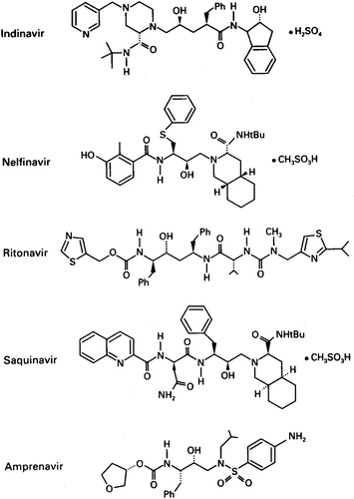
Several HIV proteases have been been developed
Annual Review of Pharmacology and Toxicology
Vol. 40: 649-674

Slide 51
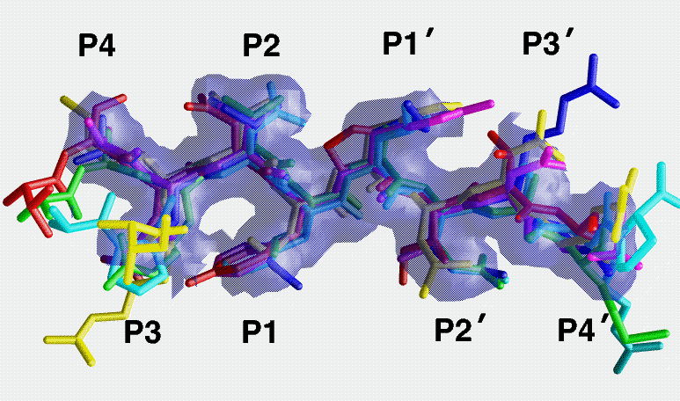
HIV resistance
Many strains are now known that have mutated their HIV protease specificity in response to protease inhibitors.
By identifying the common feature of these proteases, chemists are tying to develop new “universal” inhibitors.

Slide 52
Reversible vs. Irreversible Inhibition
The HIV protease inhibitors discussed earlier are reversible inhibitors. They mimic the shape of the substrate reaction’s transition state, but bind to the enzyme by weak intermolecular forces.

Slide 53
Reversible vs. Irreversible Inhibition
An inhibitor can also chemically react with its target and bind irreversibly via covalent bond formation. (“suicide inhibition”)

Slide 54
Acetylcholinesterase (AChE)
Acetylcholine is a neurotransmitter found at neuromuscular junctions.
After its release into the synapse, rapid hydrolysis of acetylcholine is critical for continued nerve function

Slide 55
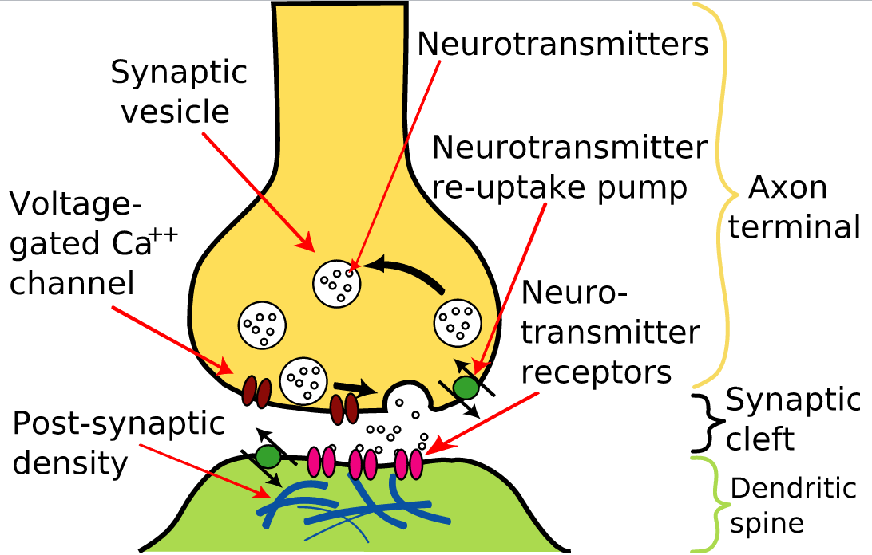
http://upload.wikimedia.org/wikipedia/commons/e/e0/Synapse_Illustration2_tweaked.svg

Slide 56
A neutral hydroxyl (e.g. Ser-OH) isn’t a very good nucleophile, but deprotonation would require a strong base
“Catalytic triad”: a glutamate (or aspartate) carboxylate hydrogen-bonds with a histidine’s imidazole group, which increases its basicity enough to assist with removal of serine’s hydroxyl proton.
The oxygen can then attack the substrate nucleophilically when the substrate binds to the active site.

Slide 57
Transesterification of acetylcholine in AChE active site

Slide 58
Organophosphorous Neurotoxins
Sarin and similar neurotoxins irreversibly inhibit AChE by reacting with Ser-OH

Slide 60
Oxidation/Reduction

Slide 61
Cannizzaro Reaction
An aldehyde acts as both oxidizing and reducing agent in a disproportionation reaction.
Mechanism features hydride (H:⁻) as a leaving group ?!?!?!?!?!?!?!?!

Slide 62
Cannizzaro Mechanism

Slide 63
NAD+/NADH

Slide 64
NADP+/NADPH

Slide 65
Anabolism: biosynthetic processes (“building”), e.g. synthesizing glucose from CO₂ and H₂O.
Catabolism: degradative processes (“destroying”), e.g. oxidizing glucose to CO₂ and H₂O.
Combined: Metabolism

Slide 66
NAD+ is generally used as an oxidizing agent in catabolism (e.g. citric acid cycle). The NADH produced is primarily used to produce ATP.
NADPH is primarily used as a reducing agent (hydride donor) in anabolic processes.
The phosphate “tag” on NADPH allows for independent regulation of levels of NAD⁺/NADH and NADP⁺/NADPH

Slide 67
Reduction of Carbonyls with NADPH
“Nature’s version of LAH”

Slide 68
HMG CoA Reductase is the Target of Statin Drugs
HMG CoA reductase catalyzes the rate-limiting step of cholesterol biosynthesis
Lipitor™ (atorvastatin) became the best-selling pharmaceutical in history in 2003.

Slide 69
Reduction of HMG CoA with NADPH
Reduction of a thioester (sulfur analogue of ester) with NADPH — similar to reduction of an ester with LAH
What is “SCoA”? Let’s look at the important thioester Acetyl CoA:

Slide 70
Acetyl CoA
CoA thioesters are common acyl transfer units.
Acetyl CoA is a common 2-carbon building block.

Slide 71
Nature Uses Claisen-Like Condensations
First step in HMG CoA synthesis:
Very similar to CHEM 322!

Slide 72
Nature Uses Aldol-Like Condensations

Slide 73
How Do You Get From

Slide 74
Mevalonate is converted to isopentenyl diphosphate (IPP) and dimethylallyl diphosphate (DMAPP):

Slide 75
IPP/DMAPP Are Nature’s Equivalent of Isoprene
Natural rubber (latex): polyisoprene

Slide 76
Synthesis of Cholesterol

Slide 79
Glycolysis

Slide 80
Activation of Glucose

Slide 81
Retro-Aldol to
Glyceraldehyde 3-Phosphate

Slide 82
Not Exactly “Retro-Aldol”
In plants and animals, fructose 1,6-biphosphate reacts at active site to form an imine (Schiff base):
(+) charge on N makes this “retro-aldol” mechanism more facile

Slide 83
DHAP/G3P Rapidly Interconvert Enzymatically

Slide 84
Triose phosphate isomerase catalyzes the interconversion of DHAP and G3P
Example of a “kinetically perfect” enzyme – rate-limiting step is diffusion

Slide 85
Fates of G3P/Pyruvate
Cool chemistry omitted!
(e.g. Vitamin B1)

Slide 86
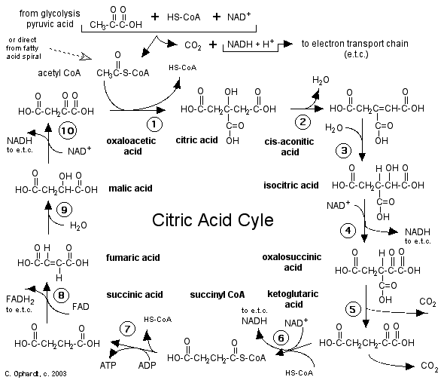
Citric Acid Cycle

Slide 87
Citric Acid Cycle
Aldol-type condensation
(using enol of acetyl CoA)

Slide 88
Citric Acid Cycle
dehydration of
aldol product
hydration
(Michael addition)

Slide 89
Citric Acid Cycle
oxidation to unstable
β-keto acid
decarboxylation

Slide 90
Citric Acid Cycle
similar interconversions of
carboxylic acid derivatives
as in Ch.
similar mechanism to
pyruvate -→ acetyl CoA
(vitamin B1)

Slide 91
Citric Acid Cycle
alcohol oxidation
hydration
(Michael)
dehydrogenation
(reverse of hydrogenation)

Slide 92
Fatty Acid Metabolism
See Section 19.10 of text!

