Slide 1
Environmental Applications of ESI FT-ICR Mass Spectrometry
Dissertation Defense
January 7, 2010
Oxidized Peptide and Metal Sulfide Clusters
Jeffrey M. Spraggins
University of Delaware
Department of Chemistry & Biochemistry
Advisor: Douglas Ridge, Ph.D.

Slide 2
Overview
ESI FT-ICR Mass Spectrometry
Oxidized Peptides
Metal Sulfide Clusters
• Johnston Group
• Dr. Laskin: PNNL
Luther Group
(Marine Studies)
• Energy-resolved SID
• Molecular Dynamics
• RRKM Theory
Molecular Capping Agents
Gas Phase
Ion-Molecule Reactions
Fragmentation
Mechanisms
Metal Sulfide Formation

Slide 3
Oxidized Peptides
ESI FT-ICR Mass Spectrometry
Jeffrey M. Spraggins, Julie A. Lloyd, Murray V. Johnston, Julia Laskin, Douglas P. Ridge J.Am. Soc. Mass Spec. (2009), Accepted for puplication.
Julie A. Lloyd, Jeffrey M. Spraggins, Murray V. Johnston, Julia Laskin, J. Am. Soc. Mass Spec. (2006), 17(9), 1289-1298

Slide 4
Oxidation Reaction
AngII + O
Tyr*
O₃
AngII
AngII + 3O
His*
(~143µM)
AngII + 4O
Tyr* and His*

Slide 5
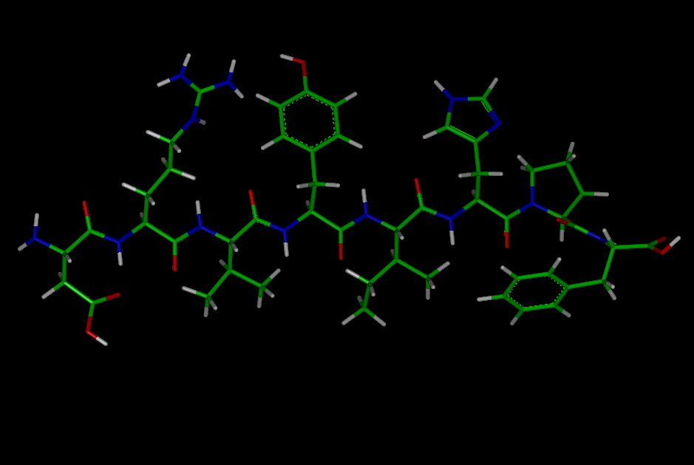
Asp-Arg-Val-Tyr-Ile-His-Pro-Phe

Slide 6
6 T FT-ICR MS: PNNL
Quad
6T Magnet
Bender
Lens 3
Lens 4
Lens 5
Lens 2
Deceleration
SAM
Lenses
Surface
Segmented
Lenses
Trapping
Plates
Lens 1
Accumulation Quadrupole
2 mTorr
Collisional
Quadrupole
20-50 mTorr
Resolving
Quadrupole
5×10⁻⁵ Torr
Ion
Source
Ion Funnel
0.6-0.8 Torr
Conductance Limit
Collimating Plate
Trapping Plates
Laskin J.; Denisov E. V.; Shukla A. K.; Barlow S. E.; Futrell J. H. Analytical chemistry 2002, 74, 3255-61.

Slide 7
AngII+3O
AngII
Intensity
AngII+4O
AngII+O
m/z
(b-d: 43eV SID Spectra)
m/z

Slide 8
Asp-Arg-Val-Tyr-Ile-His-Pro-Phe
y₇

Slide 9
Energy Resolved FECs: AngII
Relative Intensity
Collision Energy (eV)

Slide 10
Acidic Amino Acids
J. Laskin
J. Futrell
V. Wysocki
J. Beauchamp
Scheme Ia
Scheme Ib
y₇

Slide 11
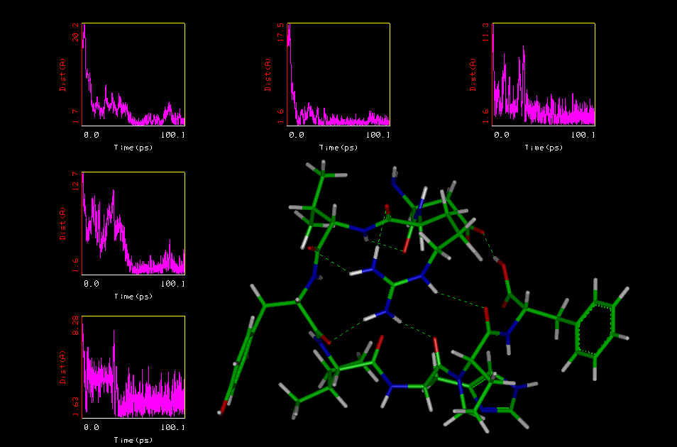
AngII: charge delocalization

Slide 12
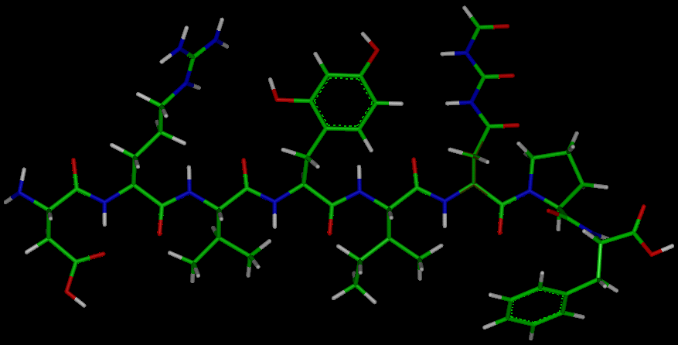
Asp-Arg-Val-Tyr(+O)-Ile-His(+3O)-Pro-Phe

Slide 13
Asp-Arg-Val-Tyr(+O)-Ile-His(+3O)-Pro-Phe
b₄+O

Slide 14
Energy Resolved FECs: AngII+O
Relative Intensity
Collision Energy (eV)

Slide 15
AngII+O
b₄ fragmentation pathway
Scheme II
b₄+O

Slide 16
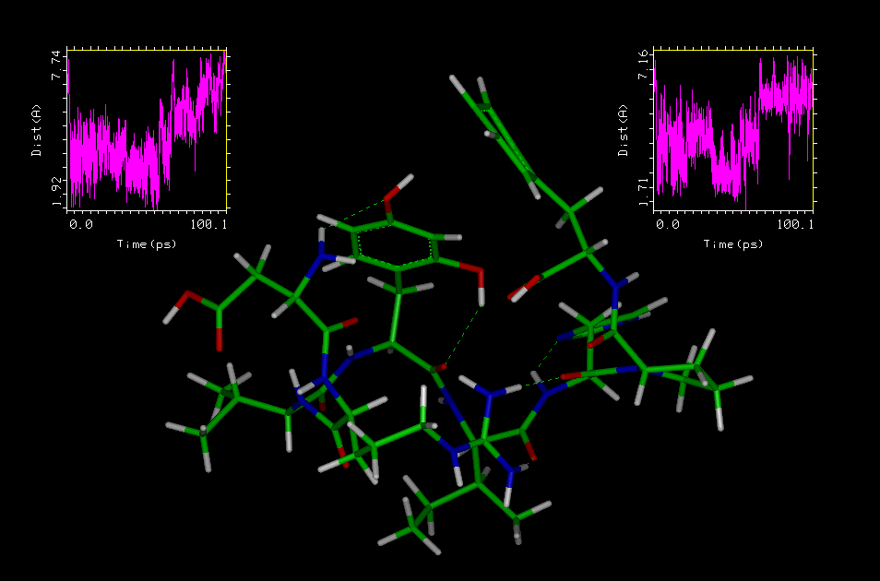
AngII+O: b₄ fragment

Slide 17
Acidic Amino Acids
J. Laskin
J. Futrell
V. Wysocki
J. Beauchamp
Scheme Ia
Scheme Ib

Slide 18
Asp-Arg-Val-Tyr(+O)-Ile-His(+3O)-Pro-Phe

Slide 19
Asp-Arg-Val-Tyr(+O)-Ile-His(+3O)-Pro-Phe
-45
-71
-88
b₅

Slide 20
AngII+3O
[MH+3O]⁺-45 & [MH+3O]⁺-71
Scheme III
[MH+3O]⁺-45
[MH+3O]⁺-71

Slide 21
AngII+3O
[MH+3O]⁺-88 & b₅ fragmentation pathway
Scheme IV
[MH+3O]⁺-88
b₅

Slide 22
Transition States
RRKM Theory
Relative Intensity
Collision Energy (eV)
[MH+nO]⁺ | DRVYIHPF | DRVY*IHPF | DRVYIH*PF | DRVY*IH*PF
M/Z | 1046 | 1062 | 1110 | 1126
E₀(eV) | 1.14 | 1.20 | 1.21 | 1.24
ΔS‡(cal/mol K) | -25.9 | -21.6 | -17.0 | -15.3
Relative E₀ | 0 | 0.06 | 0.07 | 0.11
A, s⁻¹ | 5.6x10⁷ | 4.8x10⁸ | 4.8x10⁹ | 1.2x10¹⁰
Log (A) | 7.7 | 8.7 | 9.7 | 10.1

Slide 23
Entropic Considerations
ΔS‡(cal/mol K)
-25.9
-21.6
-17.0
y₇ fragment
b₄+O fragment
[AngII+3O]-45
Side Chain
Backbone
Amide Bond

Slide 24
Conclusions
Unmodified Ang II
  Charge-remote selectivity towards y₇ fragment
M+O adduct FECs suggest that the b₄ pathway is a charge-remote process.
  C-term Tyr* - Backbone interaction leads to b₄ fragment ion.
M+3O product FECs show both charge-remote and charge-directed selective fragmentation channels are opened with the oxidation of the His residue.
  Loss of 45m/z and 71m/z driven by strong H-bonding within the His* side chain.
  His* is thought to compete with Arg for the lone proton leading to the b₅ and [MH+3O]⁺-88 charge-directed fragments.
RRKM results imply destabilization due to entropic effects.
  Consistent with proposed fragmentation mechanisms for oxidation products

Slide 25
The Big Picture
Structurally characterize peptide degradation by ozone exposure
Contribution to Fundamental MS/MS Literature
Understanding oxidized peptide fragmentation could benefit MS protein structural research
Method for increasing fragmentation sequence coverage for proteomic studies

Slide 26
Metal Sulfide Clusters
ESI FT-ICR Mass Spectrometry

Slide 27
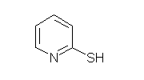
-
Project Goal
Dissolved Ions
-
+
+
• Metal Sulfide Precipitation
- Cluster Aggregation†
• Experimental Approach
- Capping Agents
- Ion-Molecule Reactions
Clusters
(Dissolved Polynuclear
Molecular Species)
1
Nanoparticles
(1-100nm)
10
∞
Solid state
material
† T. F. Rozan, M. E. Lassman, D. P. Ridge, G. W. Luther. Evidence for iron, copper and zinc complexation as multinuclear sulphide clusters in oxic rivers.
Nature, 2000, 406, 879-882.
Size (nm)

Slide 28
-
Project Goal
Dissolved Ions
-
+
+
Mass Spectrometry
Clusters
1
UV/VIS Spectroscopy
Nanoparticles
10
∞
Solid state
material
Size (nm)

Slide 29
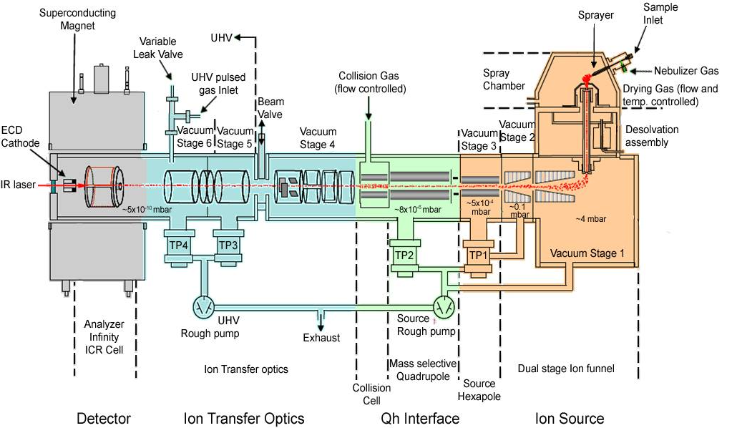
7T FT-ICR MS: UD

Slide 30
ESI of Metal Salt Solutions
Observed Nucleation Processes

Slide 31
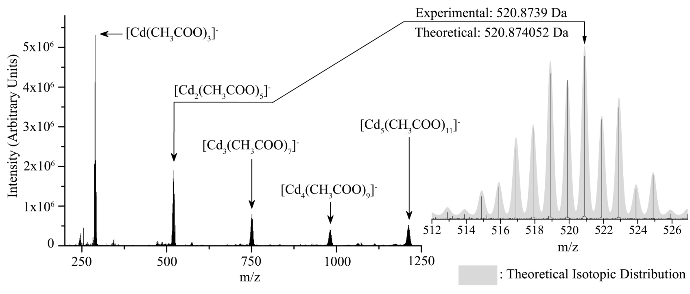
Salt Clusters Observed using ESI FT-ICR MS

Slide 32
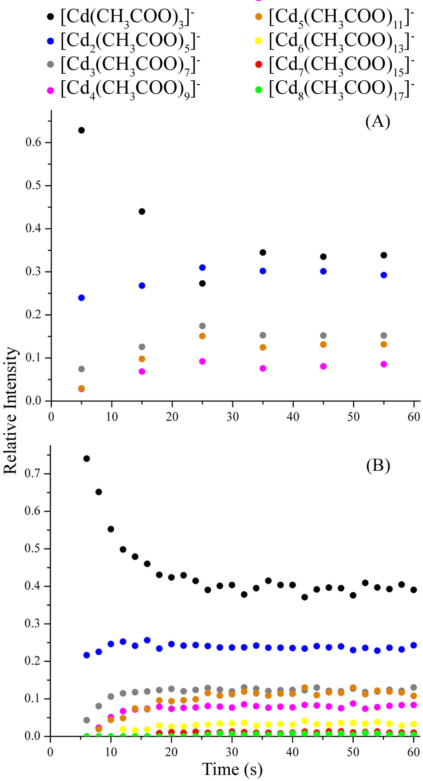
Signal Variance
Sampling was done using separate aliquots for each spectrum and
• [Cd(CH₃COO)₃]⁻
• [Cd₂(CH₃COO)₅]⁻
• [Cd₃(CH₃COO)₇]⁻
• [Cd₄(CH₃COO)₉]⁻
• [Cd₅(CH₃COO)₁₁]⁻
• [Cd₆(CH₃COO)₁₃]⁻
• [Cd₇(CH₃COO)₁₅]⁻
• [Cd₈(CH₃COO)₁₇]⁻
A single aliquot was continually injected as spectra were repeatedly taken.
0.3 mM cadmium acetate water/MeOH solution (1:1)

Slide 33
Important Points
Variance in signal over time suggests that clusters observed using ESI are forming in solution.
Results highlight processes taking place in low dielectric constant solvents
  Water/MeOH (ε=66†)
  Hydrothermal Fluids (ε=10-23‡)
†Akerlof, G. Dielectric Constant of some Organic Solvent-Water Mixtures at various Temperatures. J. Am. Chem. Soc. 1932, 54, 4125-4139.
‡Weingartner, H.; Franck, E. U. Supercritical Water as a Solvent. Angew Chem Int Ed Engl. 2005, 44, 2672-2692.

Slide 34
Making Metal Sulfide Clusters
Molecular Capping Agents

Slide 35
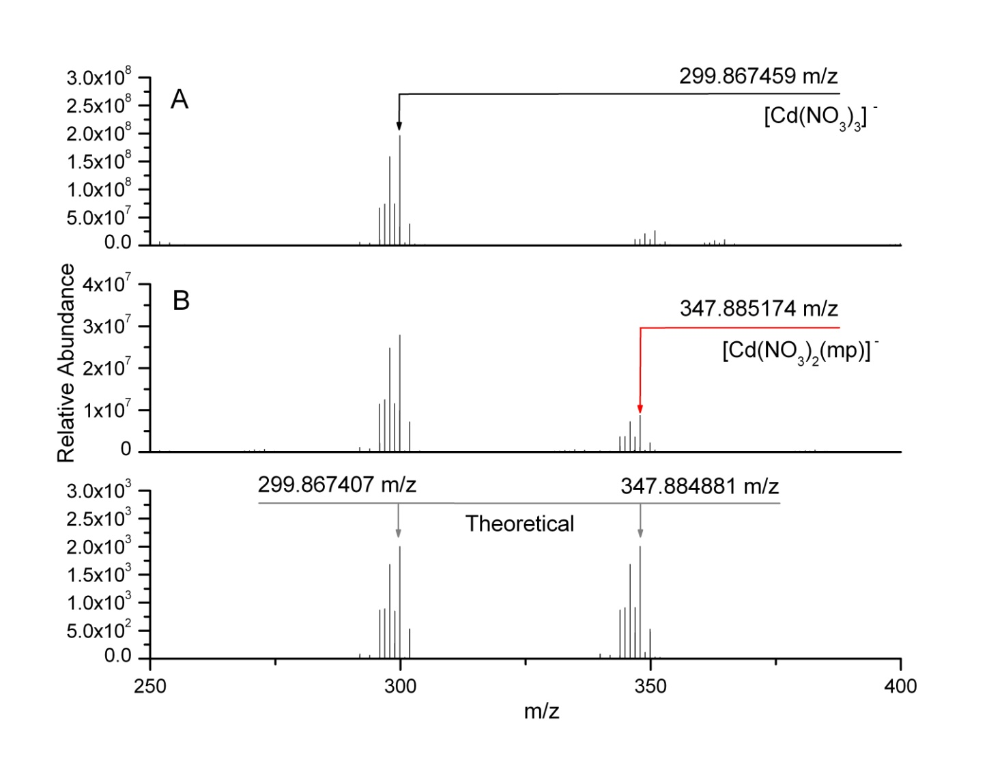
Solution Chemistry: Mononuclear Anions
3 mM aqueous solution of Cd(NO₃)₂•4H₂O diluted 50/50 with MeOH.
1.5 mM aqueous solution of Cd(NO₃)₂•4H₂O and 2-mercaptopyridine (1:1) diluted 50/50 with MeOH.
H₂S(g) bubbled through a 3 mM aqueous solution of Cd(NO₃)₂•4H₂O followed by addition of 2-mercaptopyridine (1:1), then diluted 50/50 with MeOH.

Slide 36
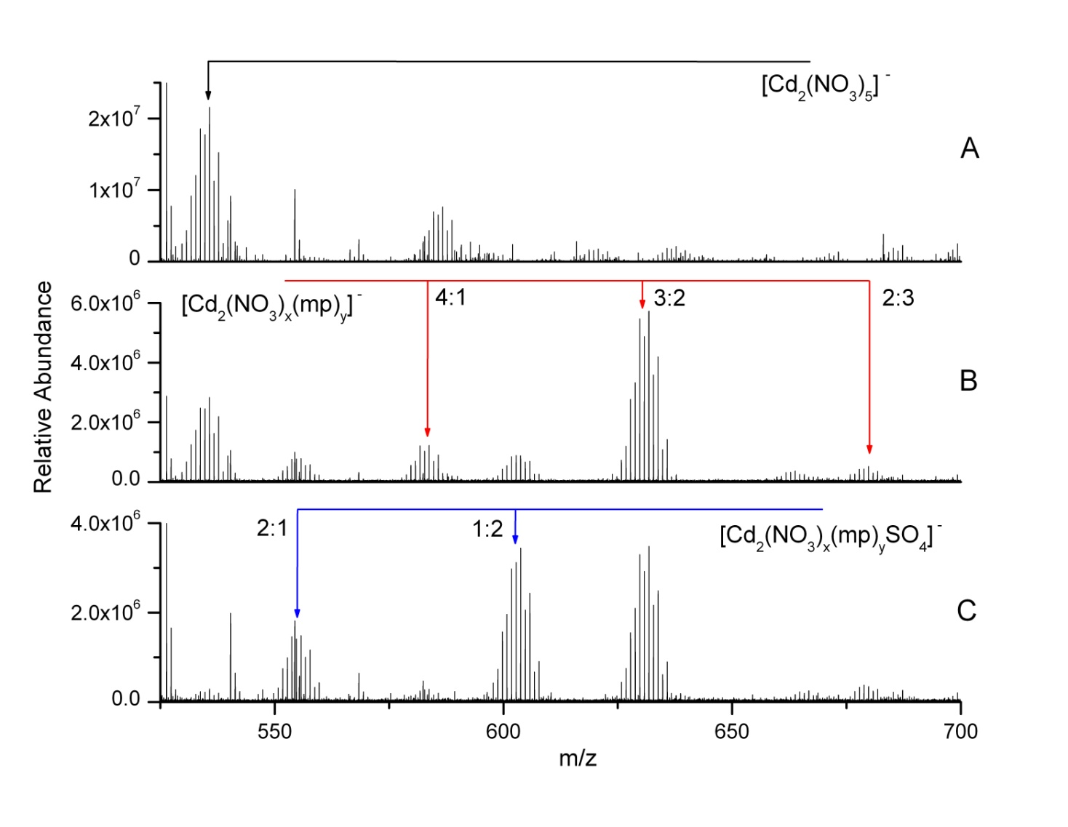
Solution Chemistry: Binuclear Anions
3 mM aqueous solution of Cd(NO₃)₂•4H₂O diluted 50/50 with MeOH.
1.5 mM aqueous solution of Cd(NO₃)₂•4H₂O and 2-mercaptopyridine (1:1) diluted 50/50 with MeOH.
H₂S(g) bubbled through a 3 mM aqueous solution of Cd(NO₃)₂•4H₂O followed by addition of 2-mercaptopyridine (1:1), then diluted 50/50 with MeOH.

Slide 37
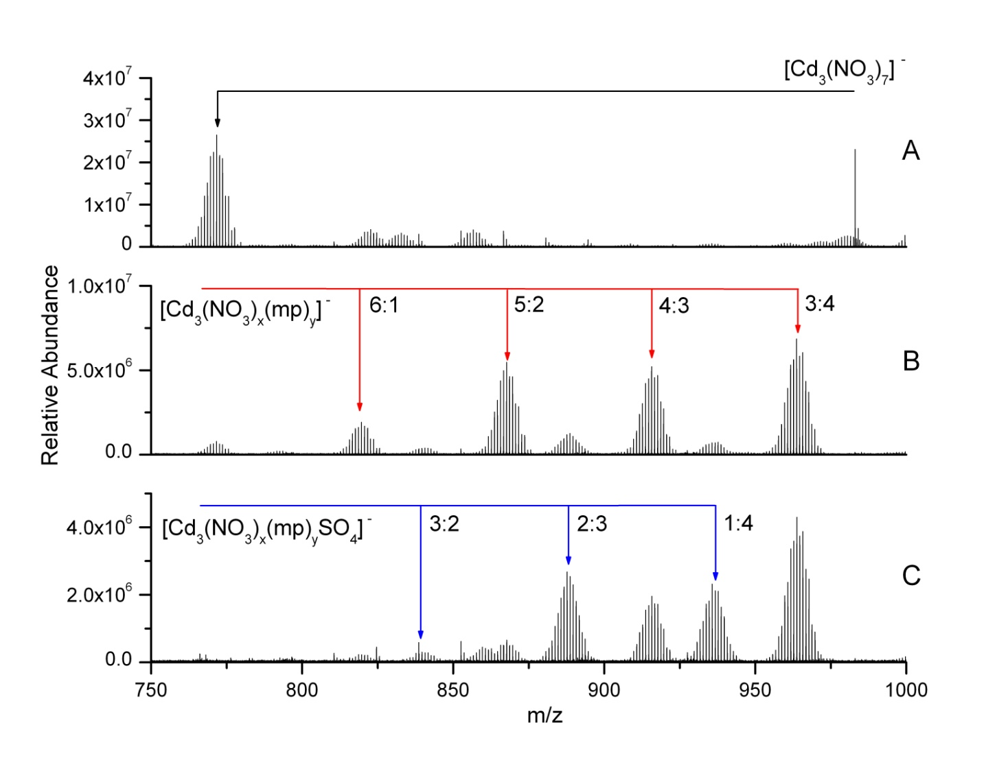
Solution Chemistry: Trinuclear Anions
3 mM aqueous solution of Cd(NO₃)₂•4H₂O diluted 50/50 with MeOH.
1.5 mM aqueous solution of Cd(NO₃)₂•4H₂O and 2-mercaptopyridine (1:1) diluted 50/50 with MeOH.
H₂S(g) bubbled through a 3 mM aqueous solution of Cd(NO₃)₂•4H₂O followed by addition of 2-mercaptopyridine (1:1), then diluted 50/50 with MeOH.

Slide 38
Important Points
Sulfidic clusters are observed when 2-mercaptopyridine is introduced.
Reactivity with H₂S is selective based on cluster size for [Cd_{x}(NO₃)_{2x+1}]⁻ species.
  Sampling a solution based process
  Gas phase ion-molecule reactions

Slide 39
Making Metal Sulfide Clusters
Gas Phase Ion-Molecule Reactions

Slide 40
Cadmium Salt Clusters
Reactive Clusters
[Cd(CH₃COO)₃]⁻
[Cd₂(CH₃COO)₅]⁻
[Cd₃(CH₃COO)₇]⁻
[Cd₄(CH₃COO)₉]⁻
[Cd₂(CH₃COO)₃]⁺
[Cd₃(CH₃COO)₅]⁺
[Cd₄(CH₃COO)₇]⁺
Non-Reactive Clusters
[Cd(NO₃)₃]⁻
[Cd_{x}Cl_{2x+1}]⁻
[Zn_{x}Cl_{2x+1}]⁻
[Cd₂(NO₃)₅]⁻
[Cd₃(NO₃)₇]⁻
[Cd₄(NO₃)₉]⁻
[CdNO₃(CH₃OH)]⁺
[CdNO₃(CH₃OH)(H₂O)]⁺
[CdCl(CH₃OH)]⁺
[Cd₂Cl₃(CH₃OH)]⁺
[ZnCl(CH₃OH)]⁺

Slide 41
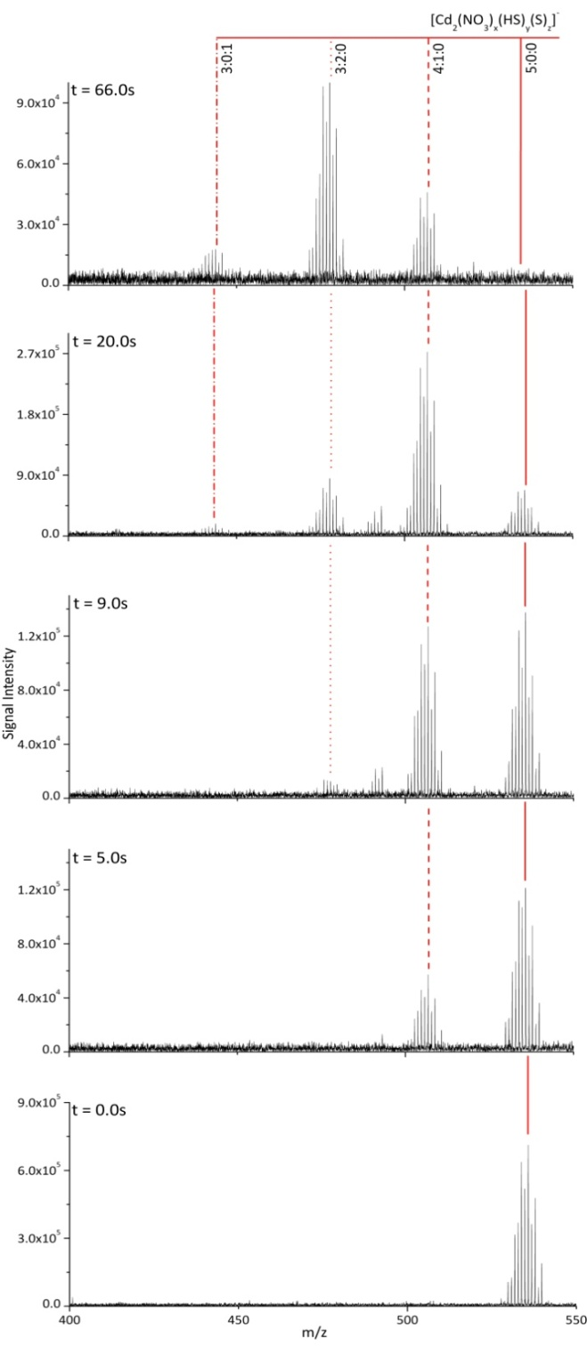
[Cd₂(NO₃)₅]⁻
{536 m/z}
H₂S
H₂S
-2HNO₃
-2HNO₃
[Cd₂S(NO₃)₃]⁻
[Cd₂SH(NO₃)₄]⁻
-HNO₃
{444 m/z}
{507 m/z}
H₂S
-2HNO₃
[Cd₂(SH)₂(NO₃)₃]⁻
{478 m/z}

Slide 42
Cd₂S₀
[Cd₂(NO₃)₅]⁻
{536 m/z}
H₂S
H₂S
-2HNO₃
-2HNO₃
Cd₂S₁
[Cd₂S(NO₃)₃]⁻
[Cd₂SH(NO₃)₄]⁻
-HNO₃
{444 m/z}
{507 m/z}
H₂S
-2HNO₃
Cd₂S₂
[Cd₂(SH)₂(NO₃)₃]⁻
{478 m/z}

Slide 43
d[S₀]
S₀
[Cd₂(NO₃)₅]⁻
= -k₁[S₀]
r = k[Cluster Family][H₂S]
dt
{536 m/z}
k₁
r = k[Cluster Family]
-CH₃COOH
H₂S
H₂S is in excess
  Pseudo First Order kinetics
d[S₁]
[Cd₂(NO₃)₄SH]⁻
= k₁[S₀] – k₂[S₂]
S₁
{507 m/z}
dt
[Cd₂S(NO₃)₃]⁻
{444 m/z}
k₂
-CH₃COOH
H₂S
Integrated Rate Equations
d[S₂]
[Cd₂(NO₃)₃(SH)₂]⁻
= k₂[S₁]
S₂
dt
{478 m/z}
[S₀]= [A]₀ e^{-k1t}
k₃ = 0
k₁
[S₁]=
[A]₀
(e^{-k1t} - e^{-k2t})
k₂-k₁
e^{-k1t}
e^{-k2t}
e^{-k3t}
[S₂]= k₁k₂
+
+
(k₂-k₁)(k₃-k₁)
(k₁-k₂)(k₃-k₂)
(k₁-k₃)(k₂-k₃)

Slide 44
[Cd₂(NO₃)₅]⁻ +H₂S (g)
4x10⁻⁹ torr
[Cd₂SH(NO₃)₄]⁻
[Cd₂S(NO₃)₃]⁻
[Cd₂(SH)₂(NO₃)₃]⁻

Slide 45
[Cd₂(NO₃)₅]⁻ +H₂S
[Cd₂S₀]⁻
k₁= 0.084 ± 0.004 s⁻¹
[Cd₂SH(NO₃)₄]⁻
[Cd₂S(NO₃)₃]⁻
[Cd₂(SH)₂(NO₃)₃]⁻
[Cd₂S₁]⁻
k₂= 0.019 ± 0.001s⁻¹
[Cd₂S₂]⁻
H₂S: 4x10⁻⁹ torr

Slide 46
Reaction Efficiency
[Cd₂S₀]⁻
k₁= 0.084 ± 0.004 s⁻¹
• Assume fastest RXN is collision rate limited
[Cd(NO₃)(CH₃OH)]⁺
k₁= 2.85 ± 0.27 s⁻¹
• Capture Collision Theory†
[Cd₂S₁]⁻
k₂= 0.019 ± 0.001s⁻¹
[Cd₂S₂]⁻
H₂S: 4x10⁻⁹ torr

Slide 47
Reaction Efficiency
[Cd₂S₀]⁻
k₁= 0.084 ± 0.004 s⁻¹
• Assume fastest RXN is collision rate limited
[Cd(NO₃)(CH₃OH)]⁺
k₁= 2.85 ± 0.27 s⁻¹
• Capture Collision Theory†
[Cd₂S₁]⁻
k₂= 0.019 ± 0.001s⁻¹
[Cd₂S₂]⁻
H₂S: 4x10⁻⁹ torr

Slide 48
Reaction Efficiency
[Cd₂S₀]⁻
k₁= 0.084 ± 0.004 s⁻¹
k₁/k_{c}= 0.031
• Assume fastest RXN is collision rate limited
[Cd(NO₃)(CH₃OH)]⁺
k₁= 2.85 ± 0.27 s⁻¹
• Capture Collision Theory†
[Cd₂S₁]⁻
k₂= 0.019 ± 0.001s⁻¹
k₂/k_{c}= 0.0069
[Cd₂S₂]⁻
H₂S: 4x10⁻⁹ torr

Slide 49
Anionic Cadmium Clusters
Reactant | P (10⁻⁹ torr) | ΔH (kcal/mol) | k₁/k_{c} | k₂/k_{c} | k₃/k_{c} | k₄/k_{c} | k₅/k_{c} | k₆/k_{c} | k₇/k_{c}
[Cd(CH₃COO)₃]⁻ | 4 | -6.236082 | 0.032 | 0.034 | 0.023
[Cd(CH₃COO)₃]⁻ | 9 | -6.236082 | 0.035 | 0.042 | 0.030
[Cd₂(CH₃COO)₅]⁻ | 4 |  | 0.018 | 0.015 | 0.010 | 0.0020
[Cd₂(CH₃COO)₅]⁻ | 9 |  | 0.019 | 0.015 | 0.0095 | 0.0034
[Cd₃(CH₃COO)₇]⁻ | 4 |  | 0.015 | 0.14 | 0.038 | 0.011 | 0.019 | 0.0073
[Cd₃(CH₃COO)₇]⁻ | 9 |  | 0.016 | 0.24 | 0.061 | 0.012 | 0.035 | 0.0082
[Cd₄(CH₃COO)₉]⁻ | 4 |  | 0.013 | 0.034(24) | 1.00* | 1.00* | 1.00* | 0.0079 | 0.0097(15)
[Cd₄(CH₃COO)₉]⁻ | 9 |  | 0.013 | 0.042(15) | 1.00* | 1.00* | 1.00* | 0.0080 | 0.015
[Cd(NO₃)₃]⁻ | 4 & 9 | 9.710921 | No RXN
[Cd₂(NO₃)₅]⁻ | 4 |  | 0.031 | 0.0069
[Cd₃(NO₃)₇]⁻ | 4 |  | 0.046 | 0.035 | 0.00090
[Cd₄(NO₃)₉]⁻ | 4 |  | 0.0094 | 0.0090 | 0.017
[CdCl₃]⁻ | 4 & 9 | 8.8245642 | No RXN
[Cd_{x}Cl_{2x+1}]⁻ | 4 & 9 |  | No RXN

Slide 50
Anionic Cadmium Clusters
Reactant | P (10⁻⁹ torr) | ΔH (kcal/mol) | k₁/k_{c} | k₂/k_{c} | k₃/k_{c} | k₄/k_{c} | k₅/k_{c} | k₆/k_{c} | k₇/k_{c}
[Cd(CH₃COO)₃]⁻ | 4 | -6.236082 | 0.032 | 0.034 | 0.023
[Cd(CH₃COO)₃]⁻ | 9 | -6.236082 | 0.035 | 0.042 | 0.030
[Cd₂(CH₃COO)₅]⁻ | 4 |  | 0.018 | 0.015 | 0.010 | 0.0020
[Cd₂(CH₃COO)₅]⁻ | 9 |  | 0.019 | 0.015 | 0.0095 | 0.0034
[Cd₃(CH₃COO)₇]⁻ | 4 |  | 0.015 | 0.14 | 0.038 | 0.011 | 0.019 | 0.0073
[Cd₃(CH₃COO)₇]⁻ | 9 |  | 0.016 | 0.24 | 0.061 | 0.012 | 0.035 | 0.0082
[Cd₄(CH₃COO)₉]⁻ | 4 |  | 0.013 | 0.034(24) | 1.00* | 1.00* | 1.00* | 0.0079 | 0.0097(15)
[Cd₄(CH₃COO)₉]⁻ | 9 |  | 0.013 | 0.042(15) | 1.00* | 1.00* | 1.00* | 0.0080 | 0.015
Most Anionic Metal Cluster reactions
are < 5% efficient.
[Cd(NO₃)₃]⁻ | 4 & 9 | 9.710921 | No RXN
[Cd₂(NO₃)₅]⁻ | 4 |  | 0.031 | 0.0069
[Cd₃(NO₃)₇]⁻ | 4 |  | 0.046 | 0.035 | 0.00090
[Cd₄(NO₃)₉]⁻ | 4 |  | 0.0094 | 0.0090 | 0.017
[CdCl₃]⁻ | 4 & 9 | 8.8245642 | No RXN
[Cd_{x}Cl_{2x+1}]⁻ | 4 & 9 |  | No RXN

Slide 51
Anionic Cadmium Clusters
Reactant | P (10⁻⁹ torr) | ΔH (kcal/mol) | k₁/k_{c} | k₂/k_{c} | k₃/k_{c} | k₄/k_{c} | k₅/k_{c} | k₆/k_{c} | k₇/k_{c}
[Cd(CH₃COO)₃]⁻ | 4 | -6.236082 | 0.032 | 0.034 | 0.023
[Cd(CH₃COO)₃]⁻ | 9 | -6.236082 | 0.035 | 0.042 | 0.030
[Cd₂(CH₃COO)₅]⁻ | 4 |  | 0.018 | 0.015 | 0.010 | 0.0020
[Cd₂(CH₃COO)₅]⁻ | 9 |  | 0.019 | 0.015 | 0.0095 | 0.0034
[Cd₃(CH₃COO)₇]⁻ | 4 |  | 0.015 | 0.14 | 0.038 | 0.011 | 0.019 | 0.0073
[Cd₃(CH₃COO)₇]⁻ | 9 |  | 0.016 | 0.24 | 0.061 | 0.012 | 0.035 | 0.0082
[Cd₄(CH₃COO)₉]⁻ | 4 |  | 0.013 | 0.034(24) | 1.00* | 1.00* | 1.00* | 0.0079 | 0.0097(15)
[Cd₄(CH₃COO)₉]⁻ | 9 |  | 0.013 | 0.042(15) | 1.00* | 1.00* | 1.00* | 0.0080 | 0.015
The Exception…
[Cd(NO₃)₃]⁻ | 4 & 9 | 9.710921 | No RXN
[Cd₂(NO₃)₅]⁻ | 4 |  | 0.031 | 0.0069
[Cd₃(NO₃)₇]⁻ | 4 |  | 0.046 | 0.035 | 0.00090
[Cd₄(NO₃)₉]⁻ | 4 |  | 0.0094 | 0.0090 | 0.017
[CdCl₃]⁻ | 4 & 9 | 8.8245642 | No RXN
[Cd_{x}Cl_{2x+1}]⁻ | 4 & 9 |  | No RXN

Slide 52
[Cd₄(CH₃COO)₉]⁻
H₂S
H₂S
-CH₃COOH
{980 m/z}
-2CH₃COOH
[Cd₄(CH₃COO)₇S]⁻
-CH₃COOH
[Cd₄(CH₃COO)₈SH]⁻
{894 m/z}
{954 m/z}
H₂S
H₂S
-CH₃COOH
-CH₃COOH
[Cd₄(CH₃COO)₄S₂]⁻
[Cd₄(CH₃COO)₆S(SH)]⁻
-CH₃COOH
[Cd₄(CH₃COO)₇(SH)₂]⁻
{808 m/z}
-CH₃COOH
{868 m/z}
{928 m/z}
H₂S
H₂S
H₂S
-CH₃COOH
-CH₃COOH
-CH₃COOH
[Cd₄(CH₃COO)₃S₃]⁻
[Cd₄(CH₃COO)₄S₂(SH)]⁻
[Cd₄(CH₃COO)₅S(SH)₂]⁻
-CH₃COOH
[Cd₄(CH₃COO)₆(SH)₃]⁻
{722 m/z}
-CH₃COOH
{782 m/z}
-CH₃COOH
{842 m/z}
{902 m/z}
H₂S
H₂S
H₂S
H₂S
-CH₃COOH
-CH₃COOH
-CH₃COOH
-CH₃COOH
[Cd₄(CH₃COO)₂S₃(SH)]⁻
[Cd₄(CH₃COO)₃S₂(SH)₂]⁻
[Cd₄(CH₃COO)₄S(SH)₃]⁻
[Cd₄(CH₃COO)₅(SH)₄]⁻
{696 m/z}
-CH₃COOH
{756 m/z}
-CH₃COOH
{816 m/z}
-CH₃COOH
{876 m/z}
H₂S
H₂S
H₂S
H₂S
-CH₃COOH
-CH₃COOH
-CH₃COOH
-CH₃COOH
[Cd₄(CH₃COO)S₃(SH)₂]⁻
[Cd₄(CH₃COO)₂S₂(SH)₃]⁻
[Cd₄(CH₃COO)₃S(SH)₄]⁻
[Cd₄(CH₃COO)₄(SH)₅]⁻
{670 m/z}
-CH₃COOH
{730 m/z}
-CH₃COOH
{790 m/z}
-CH₃COOH
{850 m/z}
H₂S
H₂S
H₂S
H₂S
-CH₃COOH
-CH₃COOH
-CH₃COOH
-CH₃COOH
[Cd₄S₃(SH)₃]⁻
-CH₃COOH
[Cd₄(CH₃COO)S₂(SH)₄]⁻
[Cd₄(CH₃COO)₂S(SH)₅]⁻
[Cd₄(CH₃COO)₃(SH)₆]⁻
{644 m/z}
{704 m/z}
-CH₃COOH
{764 m/z}
-CH₃COOH
{824 m/z}
H₂S
H₂S
H₂S
-CH₃COOH
-CH₃COOH
-CH₃COOH
[Cd₄S(SH)₅]⁻
-CH₃COOH
[Cd₄(CH₃COO)S(SH)₆]⁻
-CH₃COOH
[Cd₄(CH₃COO)₂(SH)₇]⁻
{678 m/z}
{738 m/z}
{798 m/z}
H₂S
H₂S
-CH₃COOH
-CH₃COOH
[Cd₄S(SH)₇]⁻
[Cd₄(CH₃COO)(SH)₈]⁻
{712 m/z}
-CH₃COOH
{772 m/z}

Slide 53
[Cd₄S₀]⁻
k₁/k_{c}= 0.013
[Cd₄(CH₃COO)₉]⁻ +H₂S (g)
k₁/k_{c}= 0.013
9x10⁻⁹ torr
[Cd₄S(CH₃COO)₉]⁻
[Cd₄S₂(SH)₃(CH₃COO)₂]⁻
[Cd₄S₂(SH)₄(CH₃COO)]⁻
[Cd₄S₃(SH)₃]⁻
[Cd₄S₁]⁻
k₂/k_{c}= 0.043
k₂/k_{c}= 0.034
[Cd₄S₂]⁻
k₃/k_{c}= 1.0*
k₃/k_{c}= 1.0*
[Cd₄S₃]⁻
k₄/k_{c}= 1.0*
[Cd₄S₂(SH)₅]⁻
k₄/k_{c}= 1.0*
4x10⁻⁹ torr
[Cd₄S₄]⁻
k₅/k_{c}= 1.0*
k₅/k_{c}= 1.0*
[Cd₄S₅]⁻
k₆/k_{c}= 0.0080
k₆/k_{c}= 0.0079
[Cd₄S₆]⁻
k₇/k_{c}= 0.015
k₇/k_{c}= 0.0097
[Cd₄S₇]⁻

Slide 54
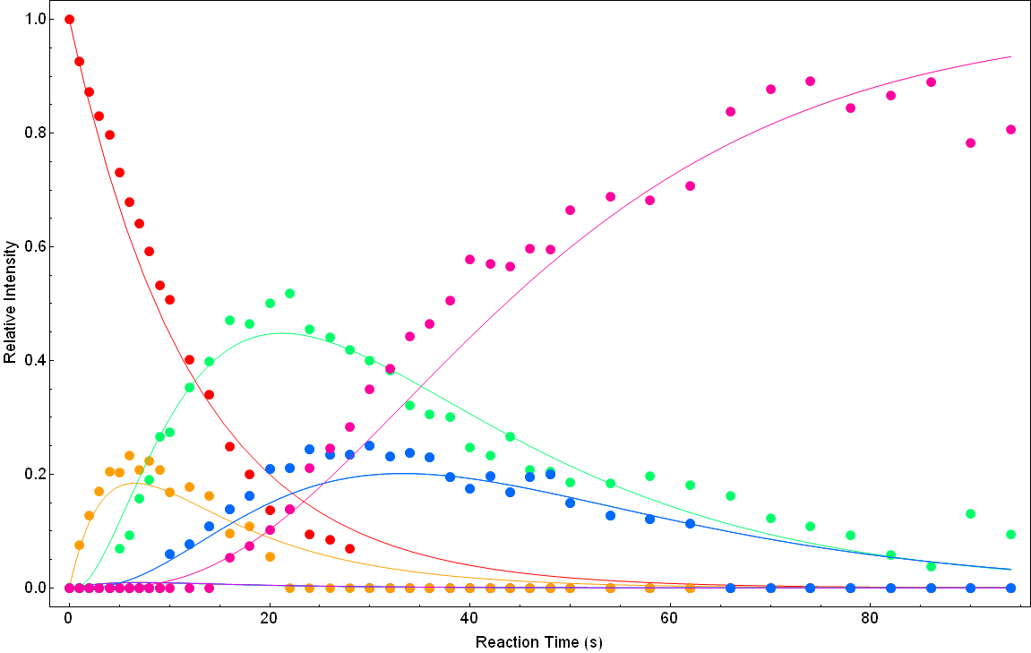
[Cd₄(CH₃COO)₉]⁻ +H₂S (g)
9x10⁻⁹ torr
[Cd₄S(CH₃COO)₉]⁻
[Cd₄S₂(SH)₃(CH₃COO)₂]⁻
[Cd₄S₂(SH)₄(CH₃COO)]⁻
[Cd₄S₃(SH)₃]⁻
[Cd₄S₂(SH)₅]⁻

Slide 55
Anionic Cadmium Clusters
Reactant | P (10⁻⁹ torr) | ΔH (kcal/mol) | k₁/k_{c} | k₂/k_{c} | k₃/k_{c} | k₄/k_{c} | k₅/k_{c} | k₆/k_{c} | k₇/k_{c}
[Cd(CH₃COO)₃]⁻ | 4 | -6.236 | 0.032 | 0.034 | 0.023
[Cd(CH₃COO)₃]⁻ | 9 | -6.236 | 0.035 | 0.042 | 0.030
[Cd₂(CH₃COO)₅]⁻ | 4 |  | 0.018 | 0.015 | 0.010 | 0.0020
[Cd₂(CH₃COO)₅]⁻ | 9 |  | 0.019 | 0.015 | 0.0095 | 0.0034
[Cd₃(CH₃COO)₇]⁻ | 4 |  | 0.015 | 0.14 | 0.038 | 0.011 | 0.019 | 0.0073
[Cd₃(CH₃COO)₇]⁻ | 9 |  | 0.016 | 0.24 | 0.061 | 0.012 | 0.035 | 0.0082
[Cd₄(CH₃COO)₉]⁻ | 4 |  | 0.013 | 0.034(24) | 1.00* | 1.00* | 1.00* | 0.0079 | 0.0097(15)
[Cd₄(CH₃COO)₉]⁻ | 9 |  | 0.013 | 0.042(15) | 1.00* | 1.00* | 1.00* | 0.0080 | 0.015
Calculated reaction enthalpies are
consistent with observed reactivity.
[Cd(NO₃)₃]⁻ | 4 & 9 | 9.711 | No RXN
[Cd₂(NO₃)₅]⁻ | 4 |  | 0.031 | 0.0069
[Cd₃(NO₃)₇]⁻ | 4 |  | 0.046 | 0.035 | 0.00090
[Cd₄(NO₃)₉]⁻ | 4 |  | 0.0094 | 0.0090 | 0.017
[CdCl₃]⁻ | 4 & 9 | 8.825 | No RXN
[Cd_{x}Cl_{2x+1}]⁻ | 4 & 9 |  | No RXN

Slide 56
Cationic Metal Sulfide Clusters

Slide 57
[Cd₄(CH₃COO)₇]⁺
+
H₂S
SH⁻ Substitution
CH₃COOH Elimination
H₂S Addition

Slide 58
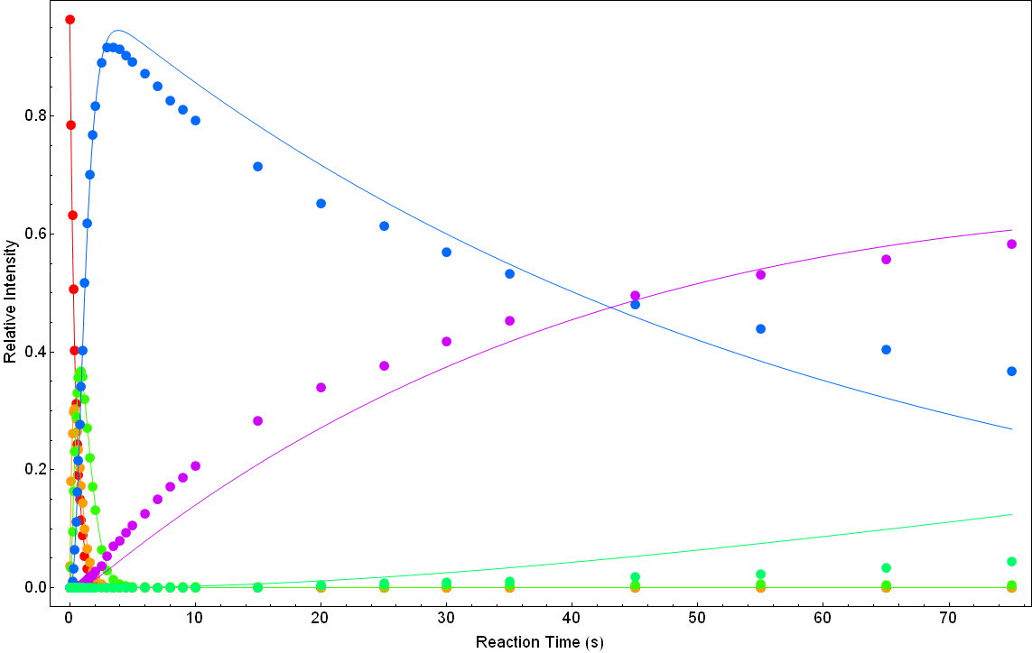
[Cd₄(CH₃COO)₇]⁺+H₂S (g)
9x10⁻⁹ torr
[Cd₄SH(CH₃COO)₆]⁺
[Cd₄(SH)₂(CH₃COO)₅]⁺
[Cd₄S(SH)(CH₃COO)₄]⁺
[Cd₄SH(CH₃COO)₆(H₂S)]⁺
[Cd₄(SH)₃(CH₃COO)₄]⁺
[Cd₄S(SH)₂(CH₃COO)₃]⁺
[Cd₄(SH)₂(CH₃COO)₅(H₂S)]⁺
[Cd₄(SH)₄(CH₃COO)₃]⁺
[Cd₄S(SH)₃(CH₃COO)₂]⁺
[Cd₄(SH)₃(CH₃COO)₄(H₂S)]⁺
[Cd₄S(SH)₄(CH₃COO)]⁺
[Cd₄S(SH)₃(CH₃COO)₂(H₂S)]⁺

Slide 59
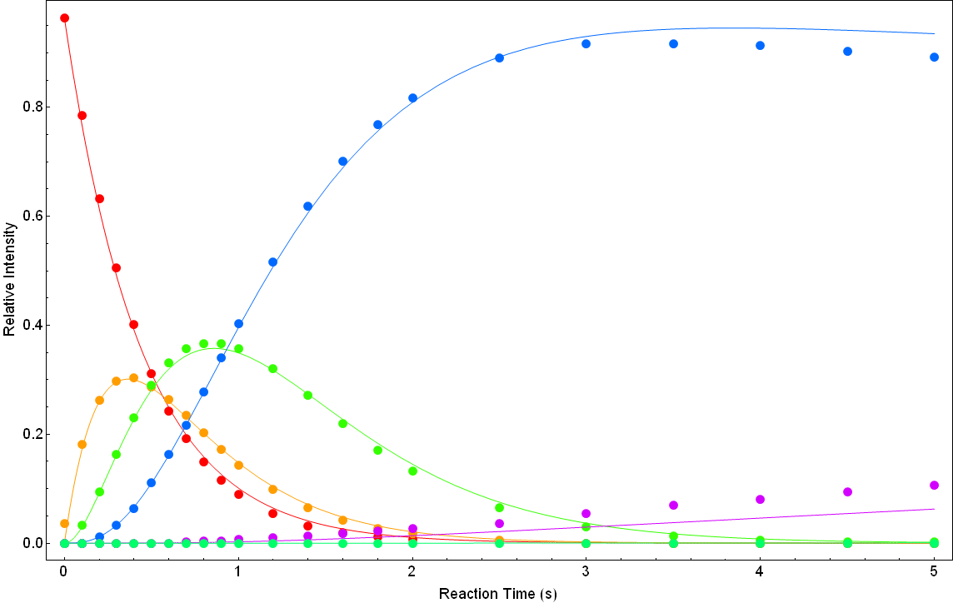
[Cd₄(CH₃COO)₇]⁺+H₂S (g)
9x10⁻⁹ torr
[Cd₄(SH)₃(CH₃COO)₄]⁺
[Cd₄S(SH)₂(CH₃COO)₃]⁺
[Cd₄(SH)₂(CH₃COO)₅(H₂S)]⁺
[Cd₄SH(CH₃COO)₆]⁺
[Cd₄(SH)₂(CH₃COO)₅]⁺
[Cd₄S(SH)(CH₃COO)₄]⁺
[Cd₄SH(CH₃COO)₆(H₂S)]⁺
[Cd₄(SH)₄(CH₃COO)₃]⁺
[Cd₄S(SH)₃(CH₃COO)₂]⁺
[Cd₄(SH)₃(CH₃COO)₄(H₂S)]⁺
[Cd₄S(SH)₄(CH₃COO)]⁺
[Cd₄S(SH)₃(CH₃COO)₂(H₂S)]⁺

Slide 60
Cationic Cadmium Clusters
Reactant | P (10⁻⁹ torr) | ΔH (kcal/mol) | k₁/k_{c} | k₂/k_{c} | k₃/k_{c} | k₄/k_{c} | k₅/k_{c}
[Cd(CH₃COO)]⁺ |  | -3.759 | Not Obs
[Cd₂(CH₃COO)₃]⁺ | 4 |  | 0.77 | 0.0033 | 0.0045
[Cd₃(CH₃COO)₅]⁺ | 4 |  | 0.923 | 0.0722 | 0.0045 | 0.0013
[Cd₃(CH₃COO)₅]⁺ | 9 |  | 0.88 | 0.073 | 0.0062 | 0.0066
[Cd₄(CH₃COO)₇]⁺ | 9 |  | 0.37 | 0.54 | 0.28 | 0.0029 | 0.0016
[Cd(NO₃)]⁺ |  | -17.442 | Not Obs
[Cd(NO₃)(CH₃OH)]⁺ | 4 |  | 1.00
[Cd(NO₃)(CH₃OH)(H₂O)]⁺ | 4 |  | 0.61
[CdOH]⁺ |  | -27.183 | Not Obs
[CdOH(CH₃OH)]⁺ | 4 |  | 0.77
[CdCl]⁺ |  | -11.163 | Not Obs
[CdCl(CH₃OH)]⁺ | 4 |  | 0.16 | 0.0062
[ZnCl]⁺ |  | -11.903 | Not Obs
[ZnCl(CH₃OH)]⁺ | 4 |  | 0.037

Slide 61
Cationic Cadmium Clusters
Reactant | P (10⁻⁹ torr) | ΔH (kcal/mol) | k₁/k_{c} | k₂/k_{c} | k₃/k_{c} | k₄/k_{c} | k₅/k_{c}
[Cd(CH₃COO)]⁺ |  | -3.759478 | Not Obs
[Cd₂(CH₃COO)₃]⁺ | 4 |  | 0.77 | 0.0033 | 0.0045
[Cd₃(CH₃COO)₅]⁺ | 4 |  | 0.923 | 0.0722 | 0.0045 | 0.0013
[Cd₃(CH₃COO)₅]⁺ | 9 |  | 0.88 | 0.073 | 0.0062 | 0.0066
[Cd₄(CH₃COO)₇]⁺ | 9 |  | 0.37 | 0.54 | 0.28 | 0.0029 | 0.0016
Cationic Metal Clusters show much higher
reaction efficiencies.
[Cd(NO₃)]⁺ |  | -17.441937 | Not Obs
[Cd(NO₃)(CH₃OH)]⁺ | 4 |  | 1.00
[Cd(NO₃)(CH₃OH)(H₂O)]⁺ | 4 |  | 0.61
[CdOH]⁺ |  | -27.182772 | Not Obs
[CdOH(CH₃OH)]⁺ | 4 |  | 0.77
[CdCl]⁺ |  | -11.162765 | Not Obs
[CdCl(CH₃OH)]⁺ | 4 |  | 0.16 | 0.0062
[ZnCl]⁺ |  | -11.902944 | Not Obs
[ZnCl(CH₃OH)]⁺ | 4 |  | 0.037

Slide 62
Cationic Cadmium Clusters
Reactant | P (10⁻⁹ torr) | ΔH (kcal/mol) | k₁/k_{c} | k₂/k_{c} | k₃/k_{c} | k₄/k_{c} | k₅/k_{c}
[Cd(CH₃COO)]⁺ |  | -3.759 | Not Obs
[Cd₂(CH₃COO)₃]⁺ | 4 |  | 0.77 | 0.0033 | 0.0045
[Cd₃(CH₃COO)₅]⁺ | 4 |  | 0.923 | 0.0722 | 0.0045 | 0.0013
[Cd₃(CH₃COO)₅]⁺ | 9 |  | 0.88 | 0.073 | 0.0062 | 0.0066
[Cd₄(CH₃COO)₇]⁺ | 9 |  | 0.37 | 0.54 | 0.28 | 0.0029 | 0.0016
[Cd(NO₃)]⁺ |  | -17.442 | Not Obs
[Cd(NO₃)(CH₃OH)]⁺ | 4 |  | 1.00
[Cd(NO₃)(CH₃OH)(H₂O)]⁺ | 4 |  | 0.61
[CdOH]⁺ |  | -27.183 | Not Obs
[CdOH(CH₃OH)]⁺ | 4 |  | 0.77
[CdCl]⁺ |  | -11.163 | Not Obs
[CdCl(CH₃OH)]⁺ | 4 |  | 0.16 | 0.0062
[ZnCl]⁺ |  | -11.903 | Not Obs
[ZnCl(CH₃OH)]⁺ | 4 |  | 0.037

Slide 63
Cationic Cadmium Clusters
Reactant | P (10⁻⁹ torr) | ΔH (kcal/mol) | k₁/k_{c} | k₂/k_{c} | k₃/k_{c} | k₄/k_{c} | k₅/k_{c}
[Cd(CH₃COO)]⁺ |  | -3.759478 | Not Obs
[Cd₂(CH₃COO)₃]⁺ | 4 |  | 0.77 | 0.0033 | 0.0045
[Cd₃(CH₃COO)₅]⁺ | 4 |  | 0.923 | 0.0722 | 0.0045 | 0.0013
[Cd₃(CH₃COO)₅]⁺ | 9 |  | 0.88 | 0.073 | 0.0062 | 0.0066
[Cd₄(CH₃COO)₇]⁺ | 9 |  | 0.37 | 0.54 | 0.28 | 0.0029 | 0.0016
[Cd(NO₃)]⁺ |  | -17.441937 | Not Obs
[Cd(NO₃)(CH₃OH)]⁺ | 4 |  | 1.00
[Cd(NO₃)(CH₃OH)(H₂O)]⁺ | 4 |  | 0.61
Reaction rates vary significantly with successive
sulfide addition.
[CdOH]⁺ |  | -27.182772 | Not Obs
[CdOH(CH₃OH)]⁺ | 4 |  | 0.77
[CdCl]⁺ |  | -11.162765 | Not Obs
[CdCl(CH₃OH)]⁺ | 4 |  | 0.16 | 0.0062
[ZnCl]⁺ |  | -11.902944 | Not Obs
[ZnCl(CH₃OH)]⁺ | 4 |  | 0.037

Slide 64
Cationic Cadmium Clusters
Reactant | P (10⁻⁹ torr) | ΔH (kcal/mol) | k₁/k_{c} | k₂/k_{c} | k₃/k_{c} | k₄/k_{c} | k₅/k_{c}
[Cd(CH₃COO)]⁺ |  | -3.759478 | Not Obs
[Cd₂(CH₃COO)₃]⁺ | 4 |  | 0.77 | 0.0033 | 0.0045
[Cd₃(CH₃COO)₅]⁺ | 4 |  | 0.923 | 0.0722 | 0.0045 | 0.0013
[Cd₃(CH₃COO)₅]⁺ | 9 |  | 0.88 | 0.073 | 0.0062 | 0.0066
[Cd₄(CH₃COO)₇]⁺ | 9 |  | 0.37 | 0.54 | 0.28 | 0.0029 | 0.0016
NO₃ > OH > Cl
[Cd(NO₃)]⁺ |  | -17.441937 | Not Obs
[Cd(NO₃)(CH₃OH)]⁺ | 4 |  | 1.00
[Cd(NO₃)(CH₃OH)(H₂O)]⁺ | 4 |  | 0.61
[CdOH]⁺ |  | -27.182772 | Not Obs
[CdOH(CH₃OH)]⁺ | 4 |  | 0.77
[CdCl]⁺ |  | -11.162765 | Not Obs
[CdCl(CH₃OH)]⁺ | 4 |  | 0.16 | 0.0062
[ZnCl]⁺ |  | -11.902944 | Not Obs
[ZnCl(CH₃OH)]⁺ | 4 |  | 0.037

Slide 65
Cationic Cadmium Clusters
Reactant | P (10⁻⁹ torr) | ΔH (kcal/mol) | k₁/k_{c} | k₂/k_{c} | k₃/k_{c} | k₄/k_{c} | k₅/k_{c}
[Cd(CH₃COO)]⁺ |  | -3.759478 | Not Obs
[Cd₂(CH₃COO)₃]⁺ | 4 |  | 0.77 | 0.0033 | 0.0045
[Cd₃(CH₃COO)₅]⁺ | 4 |  | 0.923 | 0.0722 | 0.0045 | 0.0013
[Cd₃(CH₃COO)₅]⁺ | 9 |  | 0.88 | 0.073 | 0.0062 | 0.0066
[Cd₄(CH₃COO)₇]⁺ | 9 |  | 0.37 | 0.54 | 0.28 | 0.0029 | 0.0016
Calculated reaction enthalpy is
consistent with observed reactivity.
[Cd(NO₃)]⁺ |  | -17.441937 | Not Obs
[Cd(NO₃)(CH₃OH)]⁺ | 4 |  | 1.00
[Cd(NO₃)(CH₃OH)(H₂O)]⁺ | 4 |  | 0.61
[CdOH]⁺ |  | -27.182772 | Not Obs
[CdOH(CH₃OH)]⁺ | 4 |  | 0.77
[CdCl]⁺ |  | -11.162765 | Not Obs
[CdCl(CH₃OH)]⁺ | 4 |  | 0.16 | 0.0062
[ZnCl]⁺ |  | -11.902944 | Not Obs
[ZnCl(CH₃OH)]⁺ | 4 |  | 0.037

Slide 66
Conclusions
ESI of salt solutions show variation of cluster size vs. time.
  Data suggests that both % methanol and concentration play a role.
Solution experiments show successive substitutions of mp for NO₃
  Treatment with H₂S leads to replacement of (NO₃)₂ with SO₄ for larger clusters.
Gas phase ion-molecule reactions between metal salt clusters and H₂S result in the formation of a variety of metal sulfide species.
  Cationic clusters display < 5% reaction efficiency with the exception of [Cd₄(CH₃COO)₉]⁻
  Anionic metal clusters show higher initial reaction efficiencies which decreases significantly with successive SH⁻ substitution.
  DFT calculations are consistent with gas phase reactivity (Kaitlin Papson).
Similarities between gas and condensed phases highlighted by salt nucleation in binary solvents, spectator solvent molecules, and similarities in [Cd_{x}(NO₃)_{2x+1}]⁻ reactivity.

Slide 67
Dissolved Ions
-
-
Project Goal
+
+
Mass Spectrometry
Clusters
1
Size (nm)
Nanoparticles
Spectroscopy
10
∞
Solid state material

Slide 68
The Big Picture
Elucidation of initial steps for metal sulfide formation
Gas phase ion-molecule reactions as models for aqueous metal sulfide reactions
The Next Step: high pressure source-side reactions.
  Structural characterization
  Surface deposition

Slide 69
Tying it all together….
The technique: FT-ICR MS
Understanding environmental chemical processes
  Atmospheric: Biomolecules
  Aquatic: Inorganic clusters
Analytical Chemistry
  Mass Spectrometry

Slide 70
Acknowledgements
Dr. Ridge
Our Research Group
  Kaitlin Papson
  Nick Zeringo
  Una Kim
  Scott Robinson
Collaborators
  George Luther
    Kate Mullaugh
  Murray Johnston
    Julie Lloyd
  Julia Laskin (PNNL)
Funding
  UD GK-12
  NSF
  Delaware EPSCoR
  UD IGERT

Slide 71
Environmental Perspective
Evidence of Salt Nucleation at Hydrothermal Sites
  Salt deposits†
  gyser-like brine discharges†
  ‘salt diapirs‡’ (dī· ə· pîr)
    Buoyant/Mobile salt layer piercing the brittle overlying rock
†Hovland, M.; Rueslatten, H. G.; Johnsen, H. K.; Kvamme, B.; Kuznetsova, T. Salt Formation Associated with Sub-Surface Boiling and Supercritical Water. Mar. Pet. Geol. 2006, 23, 855-869.
‡Hovland, M.; Fichler, C.; Rueslatten, H.; Johnsen, H. K. Deep-Rooted Piercement Structures in Deep Sedimentary Basins - Manifestations of Supercritical Water Generation at Depth? J. Geochem. Explor. 2006, 89, 157-160.

Slide 72
B
+
FT-ICR MS

Slide 73
B
X
qB
f =
2πm
+
+
+
FT-ICR MS

Slide 74
B
X
+
_
+
FT-ICR MS

Slide 75
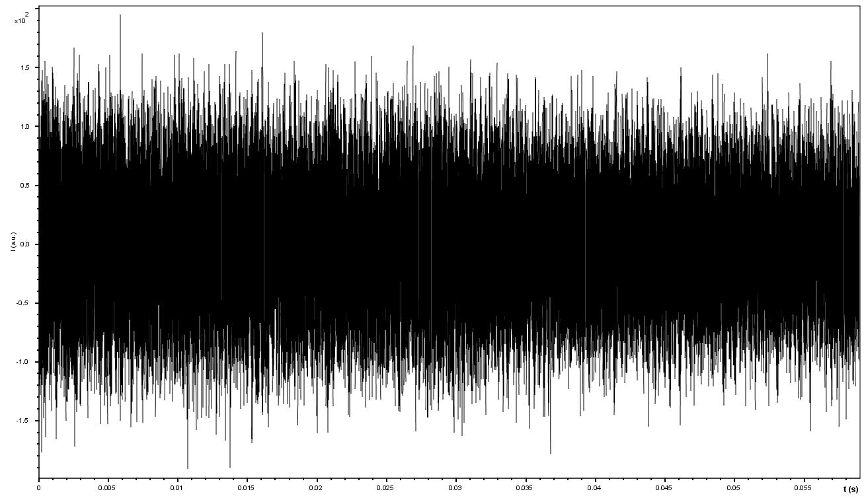
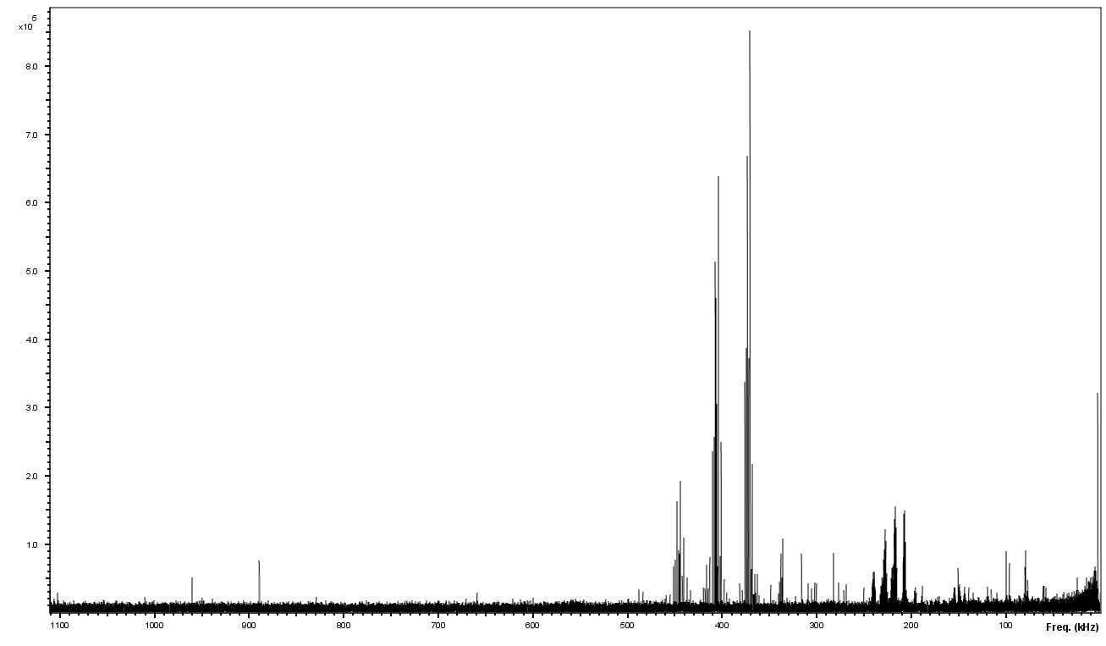
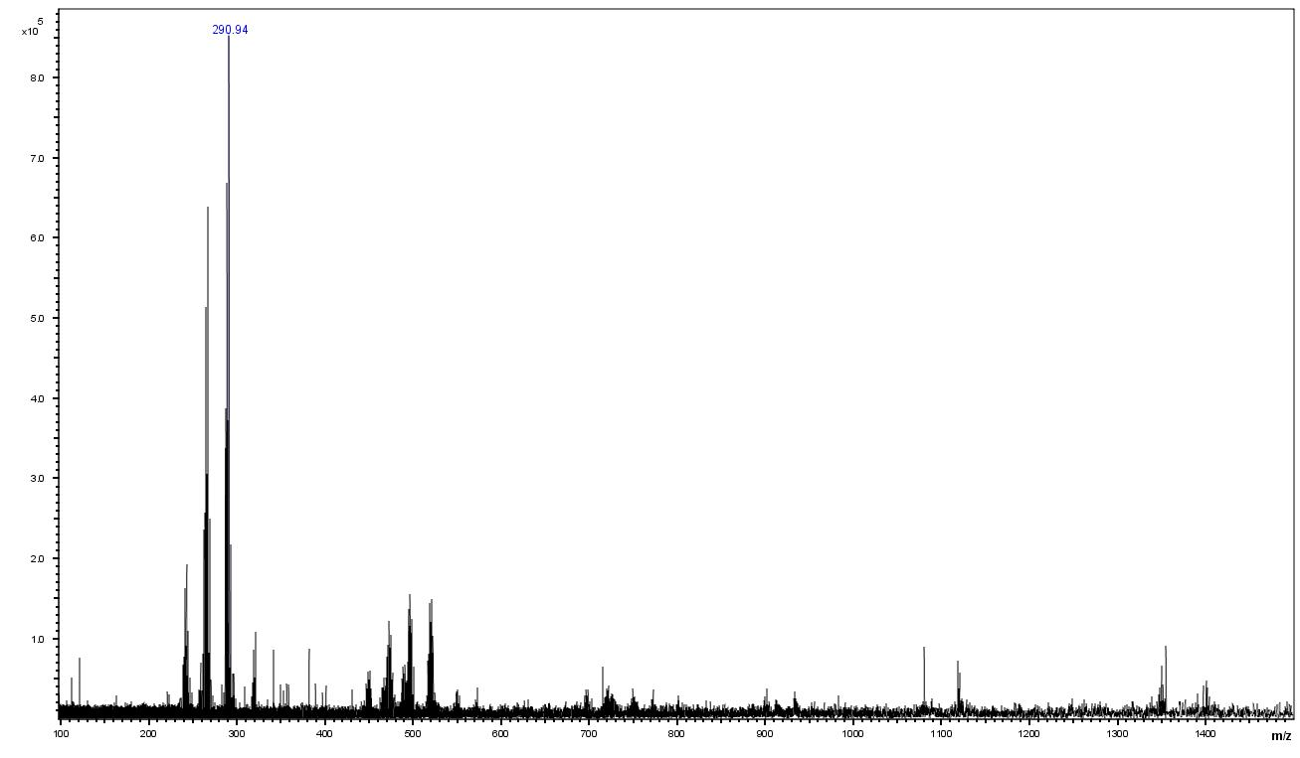
Why we care? Past Research
The Instrument Making Clusters
Gas Phase Moving Forward
Fourier Transform
qB
f =
2πm

Slide 76
Energy Resolved FECs: AngII+3O
Relative Intensity
Collision Energy (eV)

Slide 77
Asp-Arg-Val-Tyr(+O)-Ile-His(+3O)-Pro-Phe
-45
-71

Slide 78
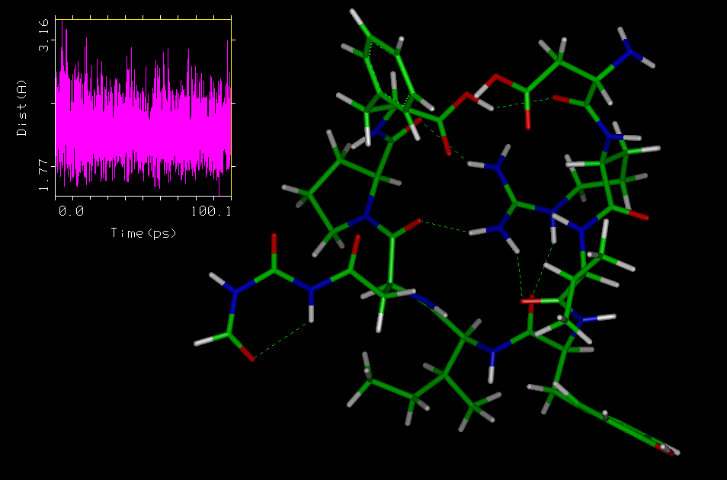
[AngII+3O]-45

Slide 79
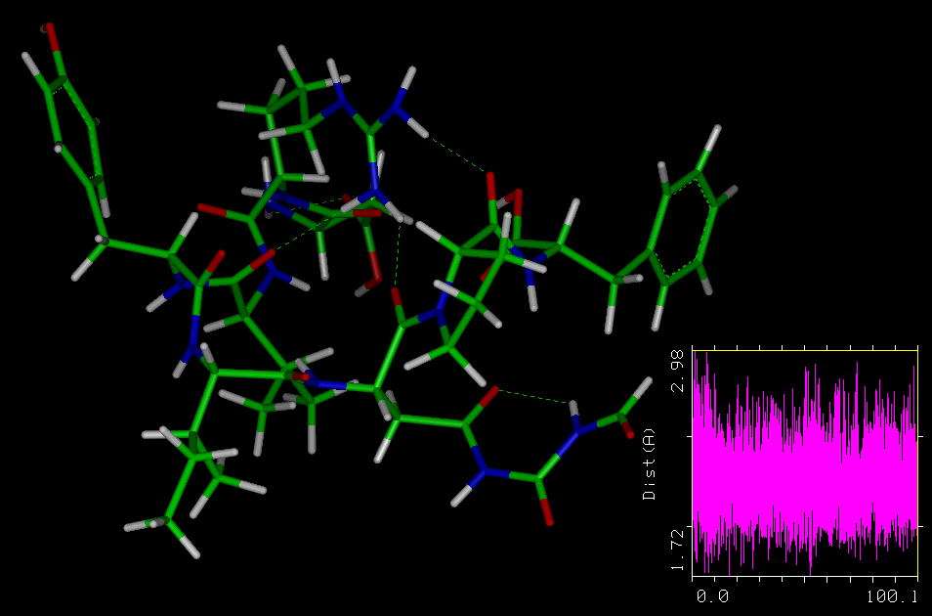
[AngII+3O]-71

Slide 80
Asp-Arg-Val-Tyr(+O)-Ile-His(+3O)-Pro-Phe
-88
b₅

Slide 81
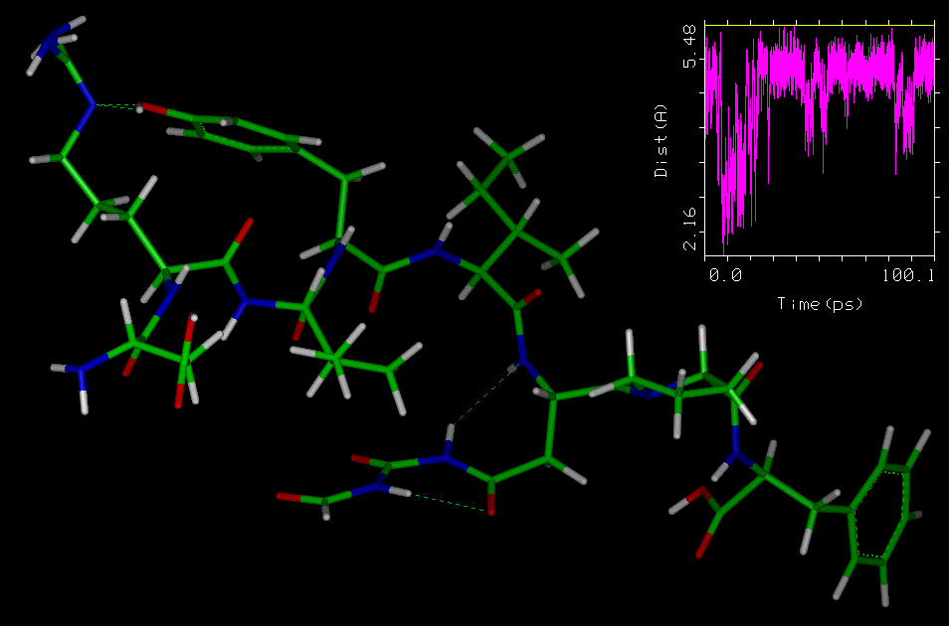
AngII+3O: b₅ fragment

Slide 82
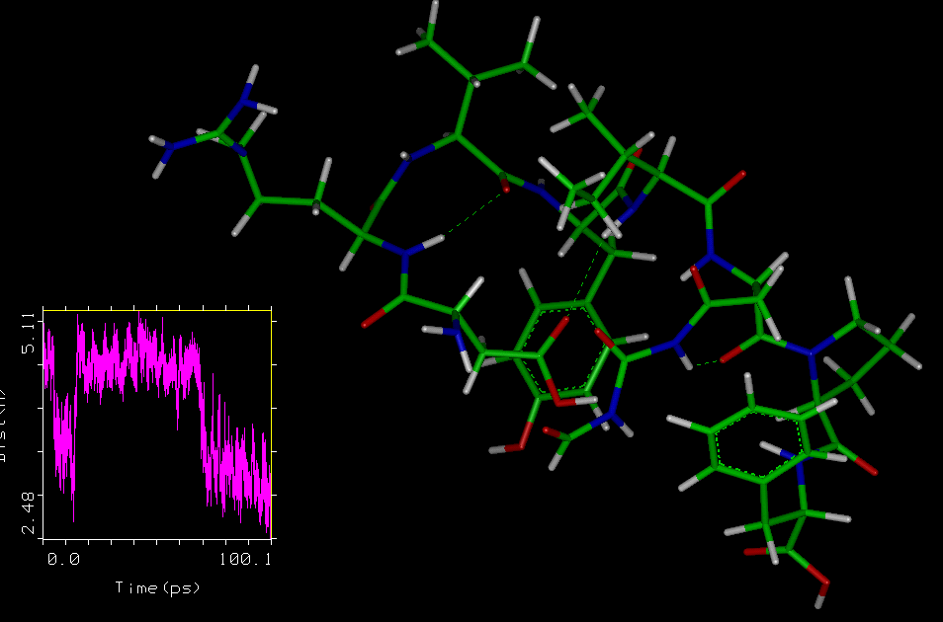
[AngII+3O]⁺-88 fragment

Slide 83
[AngII+3O]⁺-88 fragment

Slide 84
RRKM Modeling: Dr. Julia Laskin
TST: Arrhenius Equation
Energy Deposition
Survival Curves
Frequencies
Activation energy
Activation Entropy
RRKM
Frequencies
E₀ & ΔS‡
[MH+nO]⁺ | DRVYIHPF | DRVY*IHPF | DRVYIH*PF | DRVY*IH*PF
M/Z | 1046 | 1062 | 1110 | 1126
E₀(eV) | 1.14 | 1.20 | 1.21 | 1.24
ΔS‡(cal/mol K) | -25.9 | -21.6 | -17.0 | -15.3
Relative E₀ | 0 | 0.06 | 0.07 | 0.11
A, s⁻¹ | 5.6x10⁷ | 4.8x10⁸ | 4.8x10⁹ | 1.2x10¹⁰
Log (A) | 7.7 | 8.7 | 9.7 | 10.1

Slide 85
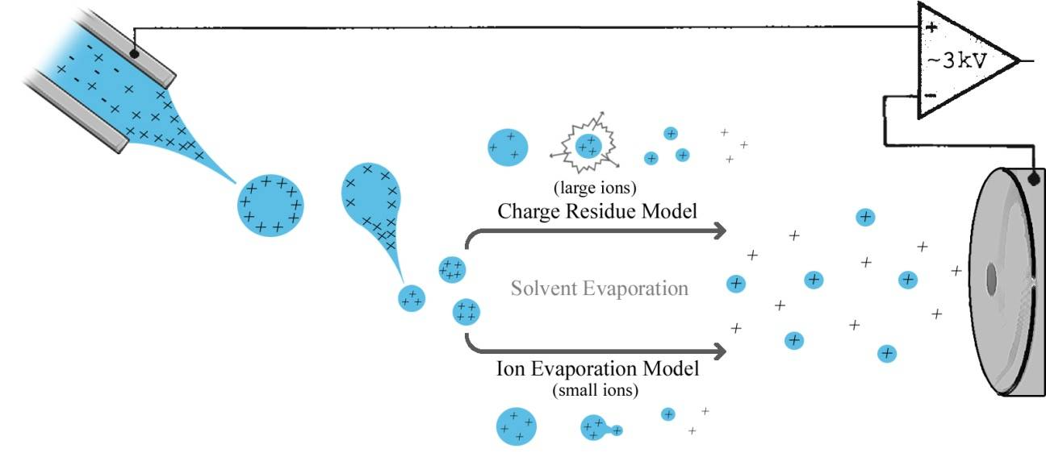
Electrospray Mechanism

Slide 86
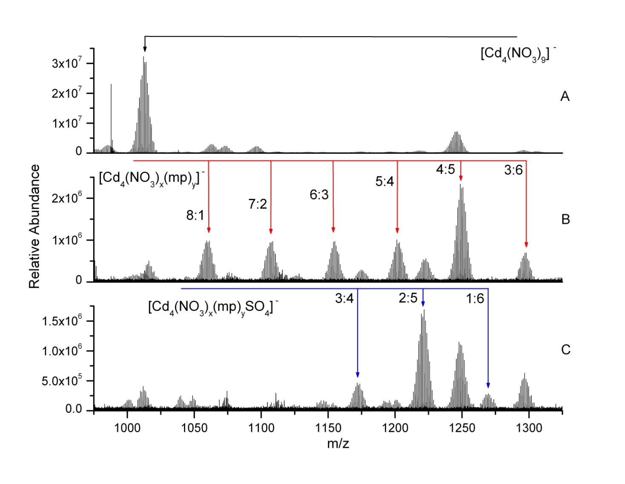
Solution Chemistry: Tetranuclear Anions
3 mM aqueous solution of Cd(NO₃)₂•4H₂O diluted 50/50 with MeOH.
1.5 mM aqueous solution of Cd(NO₃)₂•4H₂O and 2-mercaptopyridine (1:1) diluted 50/50 with MeOH.
H₂S(g) bubbled through a 3 mM aqueous solution of Cd(NO₃)₂•4H₂O followed by addition of 2-mercaptopyridine (1:1), then diluted 50/50 with MeOH.

Slide 87
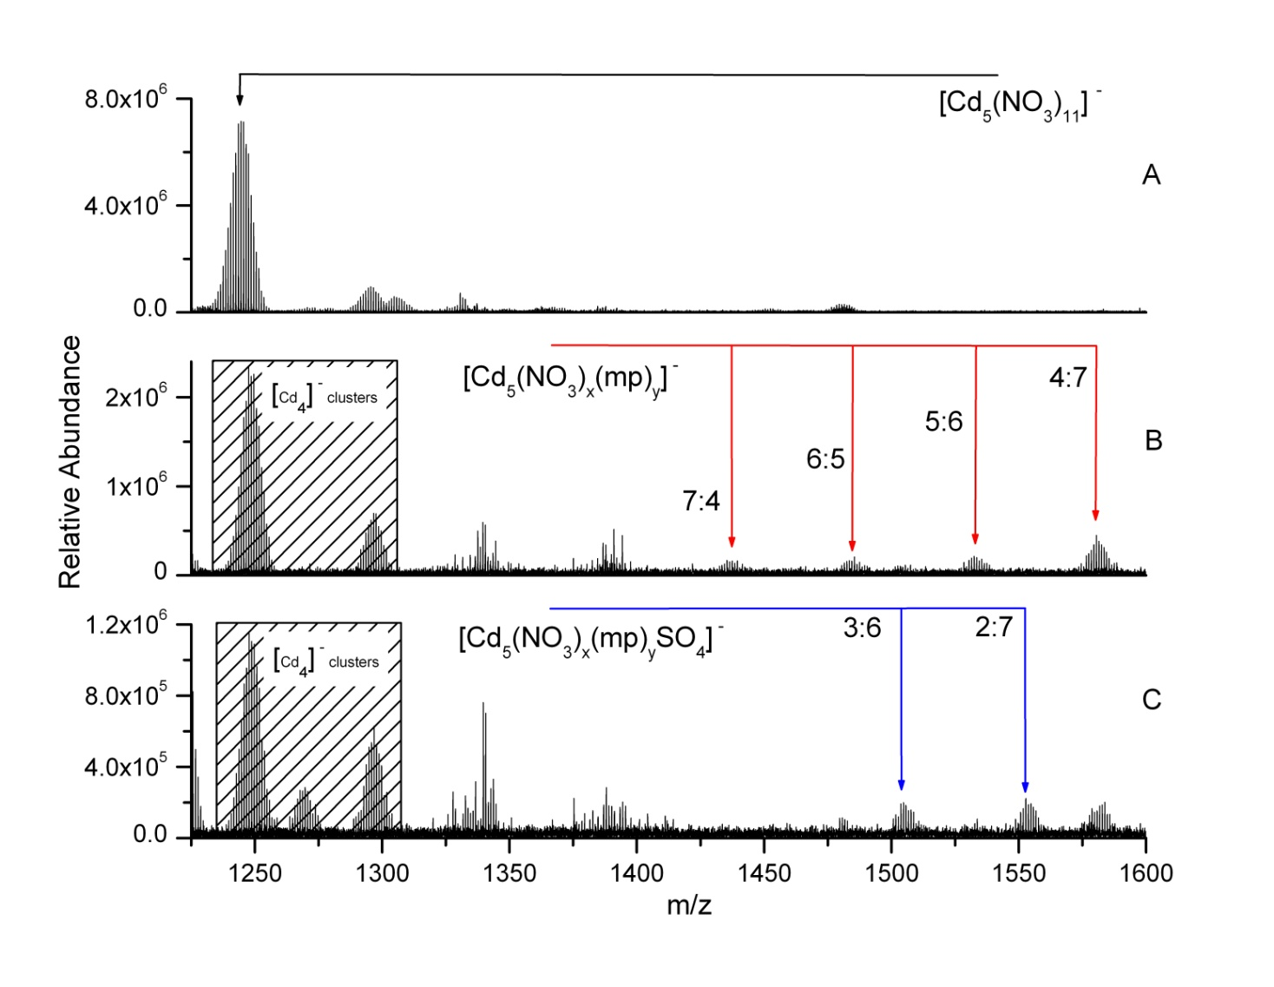
Solution Chemistry: Pentanuclear Anions
3 mM aqueous solution of Cd(NO₃)₂•4H₂O diluted 50/50 with MeOH.
1.5 mM aqueous solution of Cd(NO₃)₂•4H₂O and 2-mercaptopyridine (1:1) diluted 50/50 with MeOH.
H₂S(g) bubbled through a 3 mM aqueous solution of Cd(NO₃)₂•4H₂O followed by addition of 2-mercaptopyridine (1:1), then diluted 50/50 with MeOH.

Slide 88
Bimolecular Rate Constants
[Cd(NO₃)(CH₃OH)]⁺
Determine [H₂S]
  Assume fasted measured k is collision rate limited.
  Capture Collision Theory
k₁= 2.85 ± 0.27 s⁻¹
4x10⁻⁹ Torr
µ_{D}’ dipole moment
(0.97 D)
α' volume polarizability (3.67 Å³)
τ = 2.49
µ’ reduced mass (29.193 Da)
Theoretical collision rate

Slide 89
Bimolecular Rate Constants
[Cd(NO₃)(CH₃OH)]⁺
Determine [H₂S]
  Assume fasted measured k is collision rate limited.
  Capture Collision Theory
k₁= 2.85 ± 0.27 s⁻¹
4x10⁻⁹ Torr
Theoretical collision rate
[H₂S] = 2.34x10⁹ molecules cm⁻³
[H₂S] = 6.62x10⁻⁸ Torr
Slowest reaction observed
Fastest
Slowest

Slide 90
Reaction Efficiency
[Cd(NO₃)(CH₃OH)]⁺
Fastest
Slowest

