Slide 1
Enantioselective Total Synthesis of (-)-Strychnine
Steven D. Knight, Larry E. Overman, and Garry Pairaudeau
J. Am. Chem. Soc. 1993, 115, 9293-9294
Bryan Klebon
February 21, 2012

Slide 2
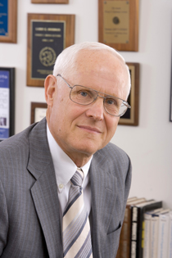
Larry Overman
Born in Chicago, 1943
B.A. Earlham College 1965
Ph.D. University of Wisconsin-Madison 1969
  Worked for Howard Whitlock, Jr.
Postdoc at Columbia with Ronald Breslow 1969-1971
Joined faculty at UC Irvine 1971
Overman Rearrangement 1974
His first use of aza-Cope-Mannich Reaction for synthesis of Gephyrotoxin in 1979

Slide 3
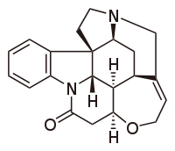
Strychnine
Plant Alkaloid
First isolated 1818 from Strychnos ignatii
Structure determined in 1946 by Sir Robert Robinson
First synthesis in 1954 by Woodward
Second synthesis wasn’t until 1992 by Magnus
Overman’s synthetic route was the first asymmetric route to (-)strychnine
  Key step: aza-Cope-Manninch reaction

Slide 4
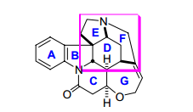
Synthetic rationale
An aza-Cope-Mannich reaction could be used to generate the quaternary carbon of rings B, D, and E.

Slide 5
Synthesis of the aza-Cope-Mannich substrate
1) MeOCOCl,
pyridine, CH₂Cl₂
NaCNBH₃, TiCl₄
2) NaH, 1% Pd₂(dba)₃
96%
88%
DCC, CuCl
91%
CrO₃, H₂SO₄,
acetone
1) DIBAL
Jones oxidation
2) TIPSCl,
tetramethylguanidine
97%
85%

Slide 6
Synthesis of the aza-Cope-Mannich substrate
1) L-selectride,
PhNTf₂
+
2) Me₆Sn₂,
10%Pd(PPh₃)₄
80%
80%
2.5% Pd₂dba₃,
22% Ph₃As, CO
NR₂
1) t-BuOOH,
Triton-B
2) Ph₃P=CH₂,
TBAF
Wittig Reaction
84%

Slide 7
Synthesis of the aza-Cope-Mannich substrate
1) MsCl i-Pr₂NEt
2) NH₂COCF₃, NaH
83%
1) NaH
2) KOH, EtOH/H₂O
62%

Slide 8
Aza-Cope-Mannich Reaction
98%
New quaternary
center formed

Slide 9
More rings…
1) LDA, NCCO₂Me
2) HCl, MeOH
70%
1) Zn dust, H₂SO₄
80%
NaOMe
epimerization
85%

Slide 10
More rings…
i-Bu₂AlH
76%
CH₂(CO₂H)₂, Ac₂O
65%

Slide 11
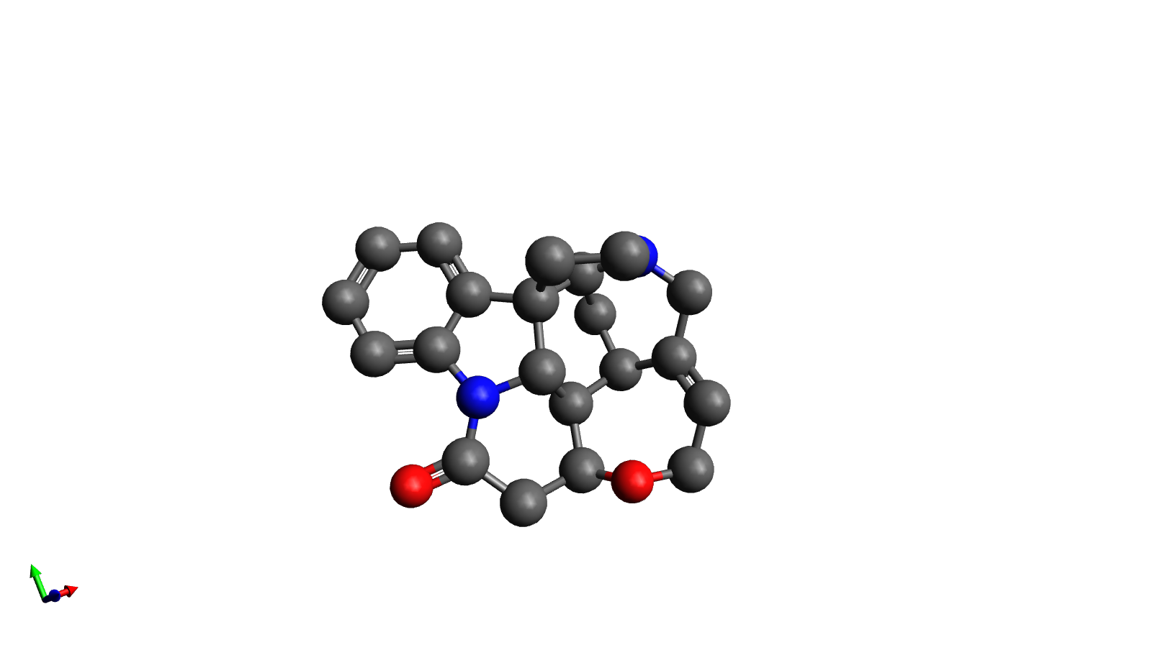
The Final product
E
F
A
B
D
G
C
First asymetric synthesis of (-)-strychnine
3% yield in 20 steps
Several orders of magnitude more efficient than previous syntheses
Demonstrates usefulness of aza-Cope-Mannich reaction for alkaloid synthesis

