Slide 1
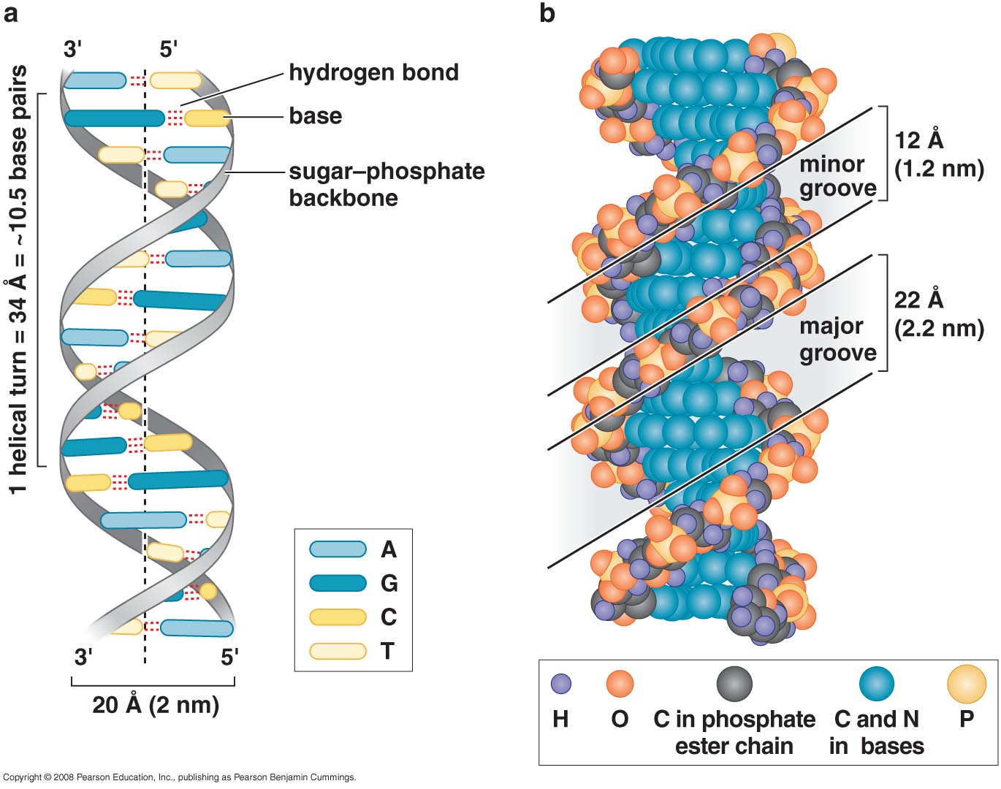
DNA STRUCTURE
DNA is composed of polynucleotide chains
The helical structure of DNA

Slide 2
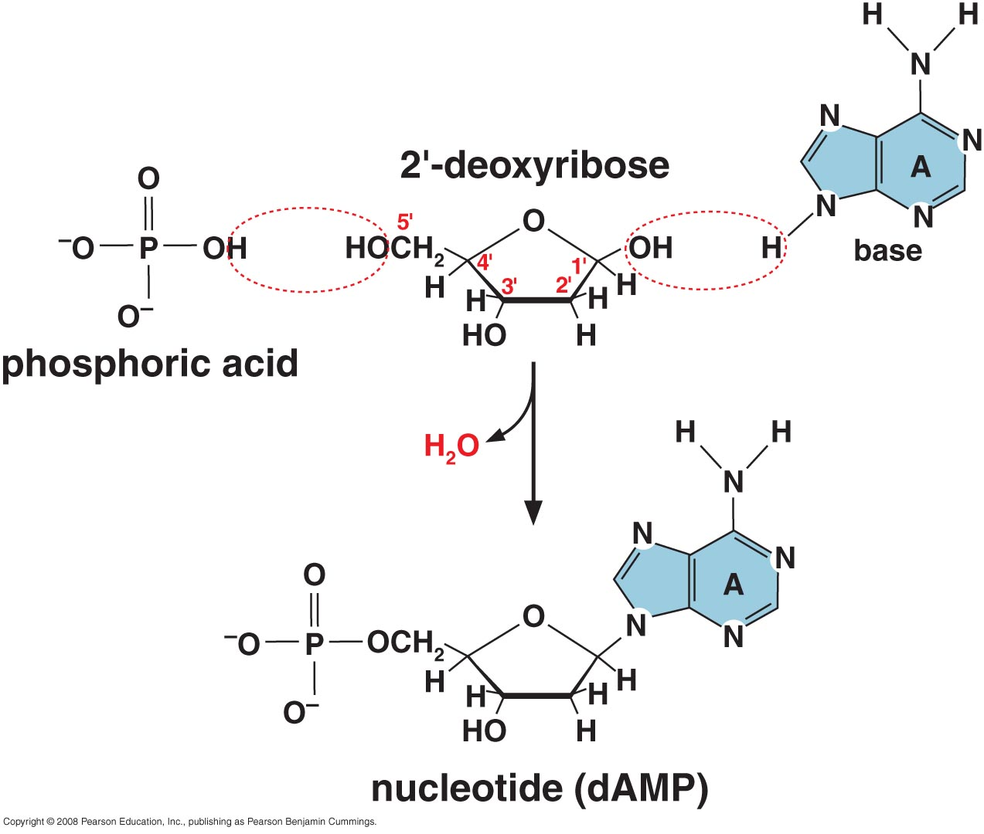
Formation of Nucleotides

Slide 3
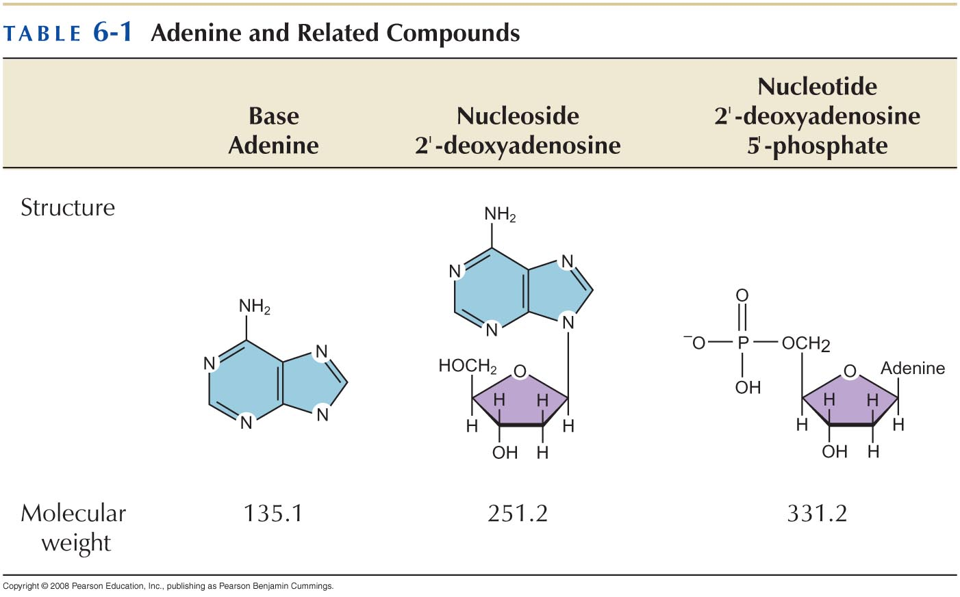

Slide 4
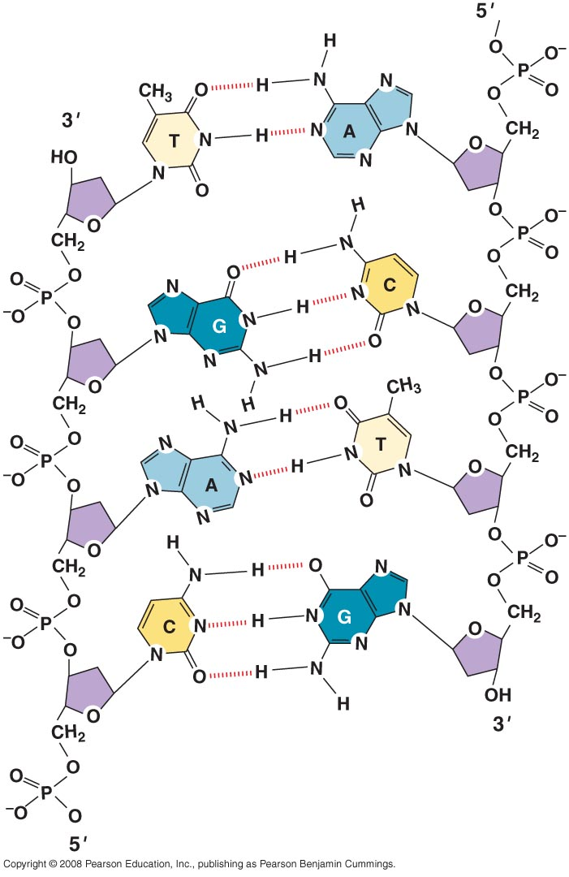
Structure of polynucleotide polymer

Slide 5
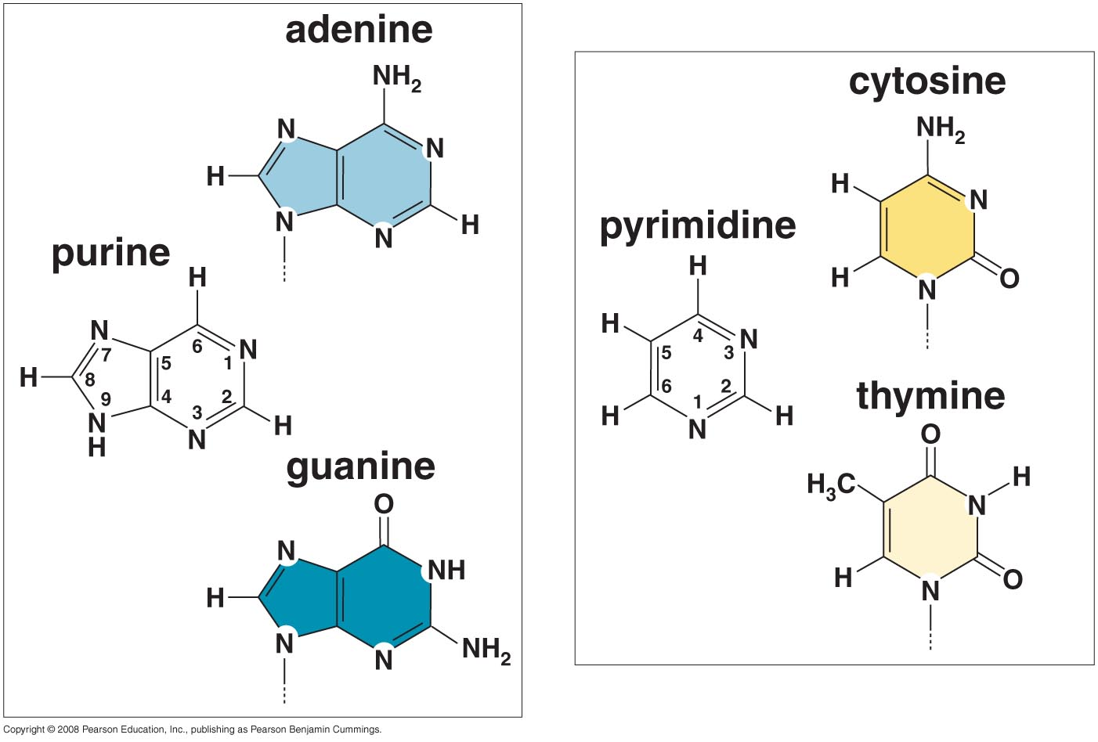
Each base has its preferred tautomeric form
Purine and Pyrimidine

Slide 6
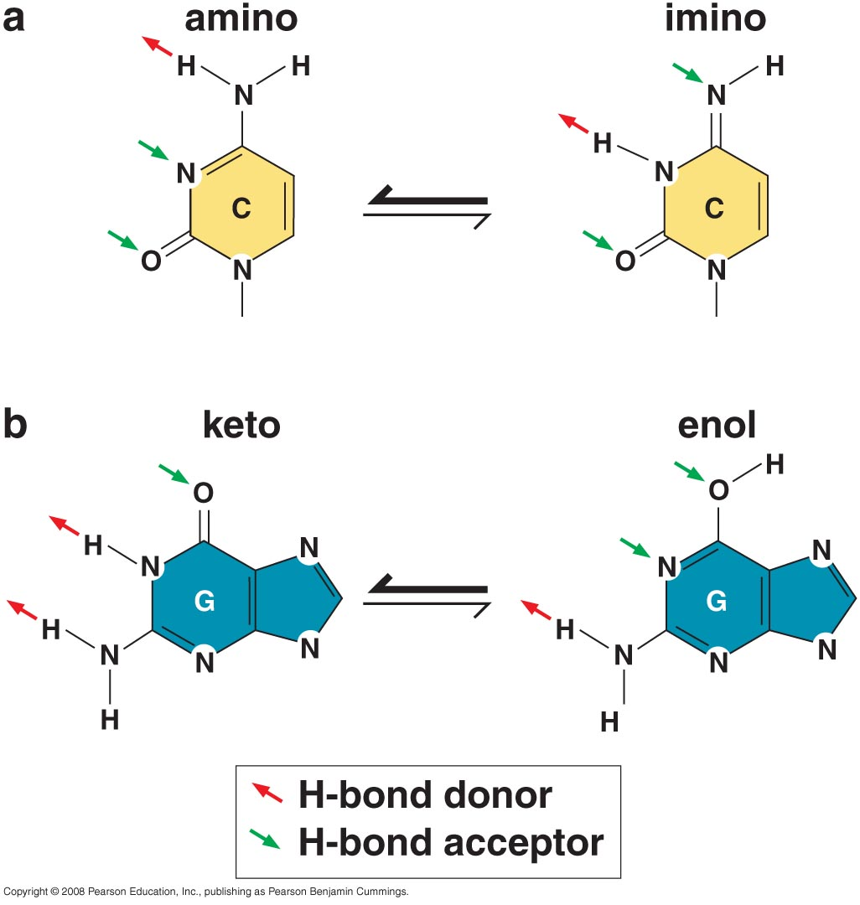
Base tautomers; are frequent sources of errors during DNA synthesis

Slide 7
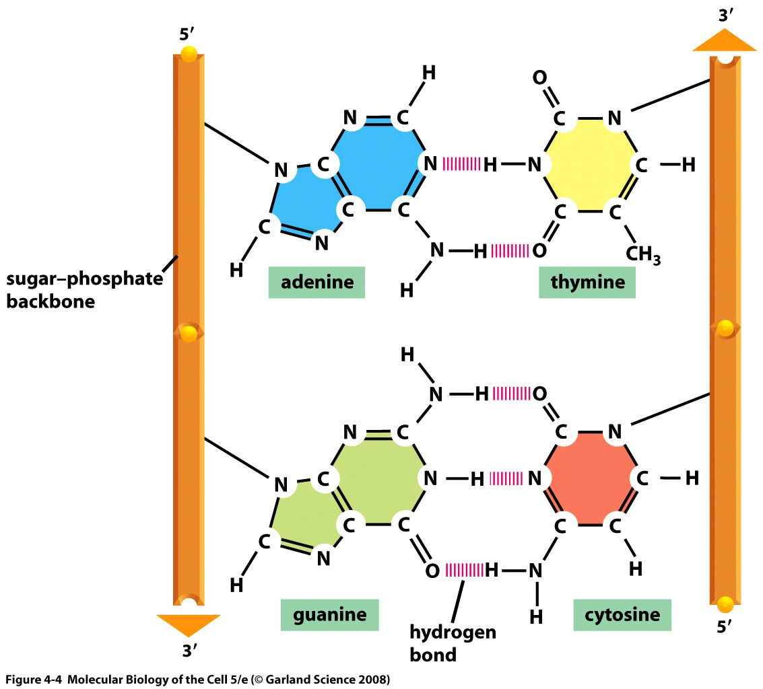
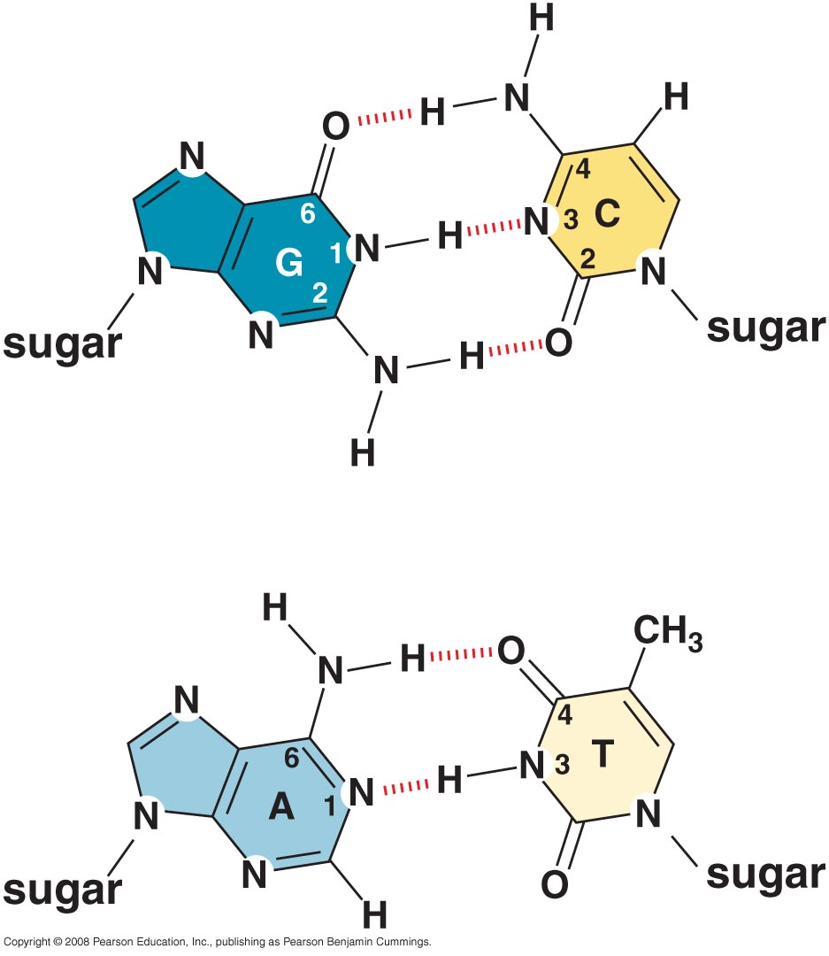
The two strands of the double helix are held together by base pairing in an anti-parallel orientation
A:T & G:C base pairs

Slide 8
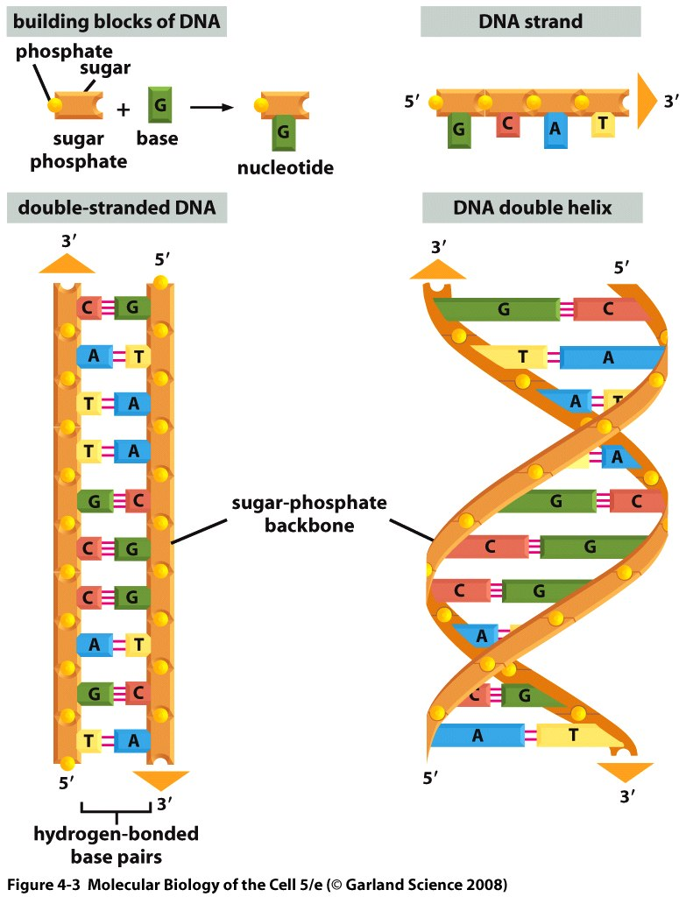
The two chains of the double helix have complementary sequences

Slide 9
What is a complementary sequence?
5’ATCGG, TGCAA, CCGCG, TAAGT 3’
5’ TAGCC, ACGTT, GGCGC, ATTCA 3’
(2) 5’ TGAAT, GCGCC, AACGT, GGCTA 3’
(3) 5’ ACTTA, CGCGG, TTGCA, CCGAT 3’

Slide 10
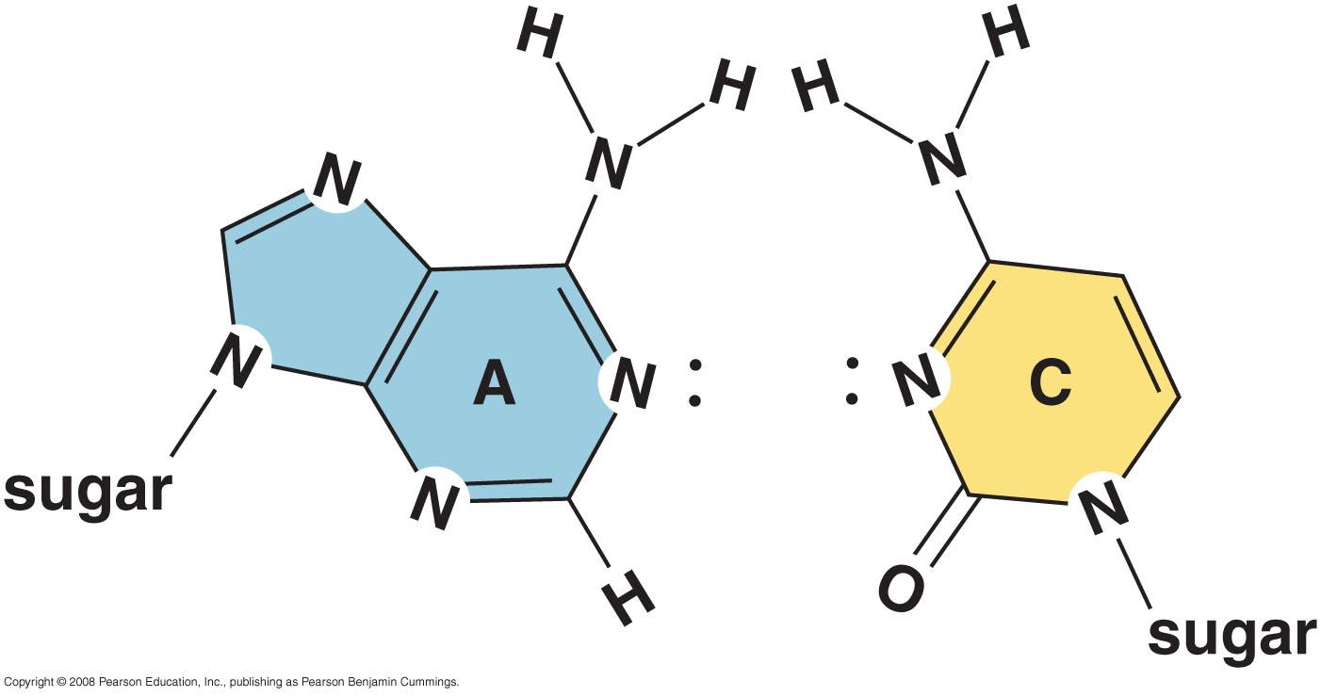
Hydrogen bonding is important for specificity of base pairing
A:C incompatibility

Slide 11
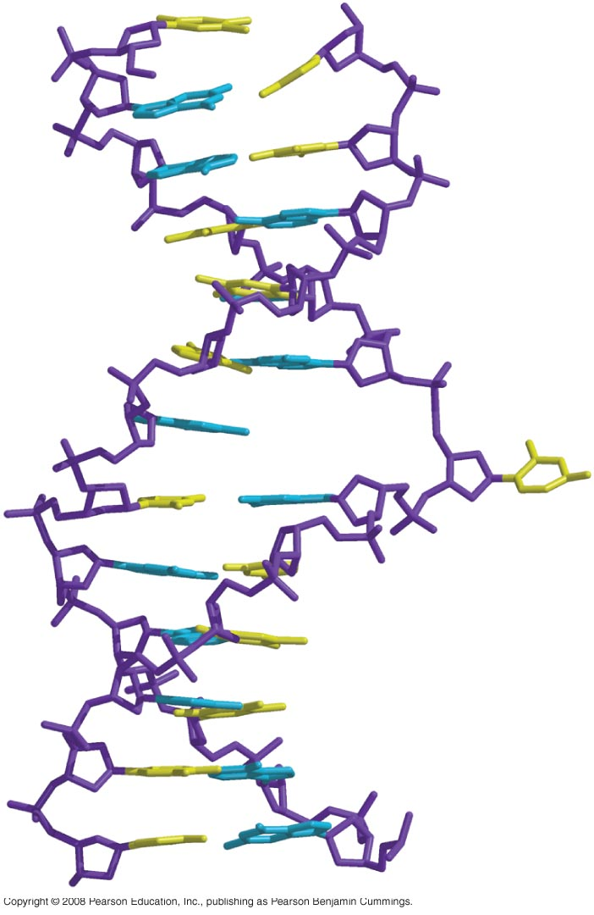
Base can flip out from the double helix

Slide 12
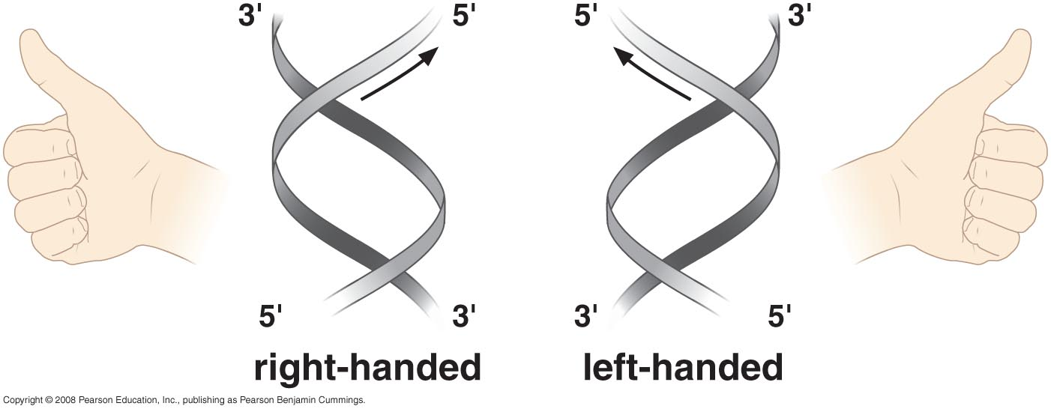
DNA is usually a right-handed double helix

Slide 13
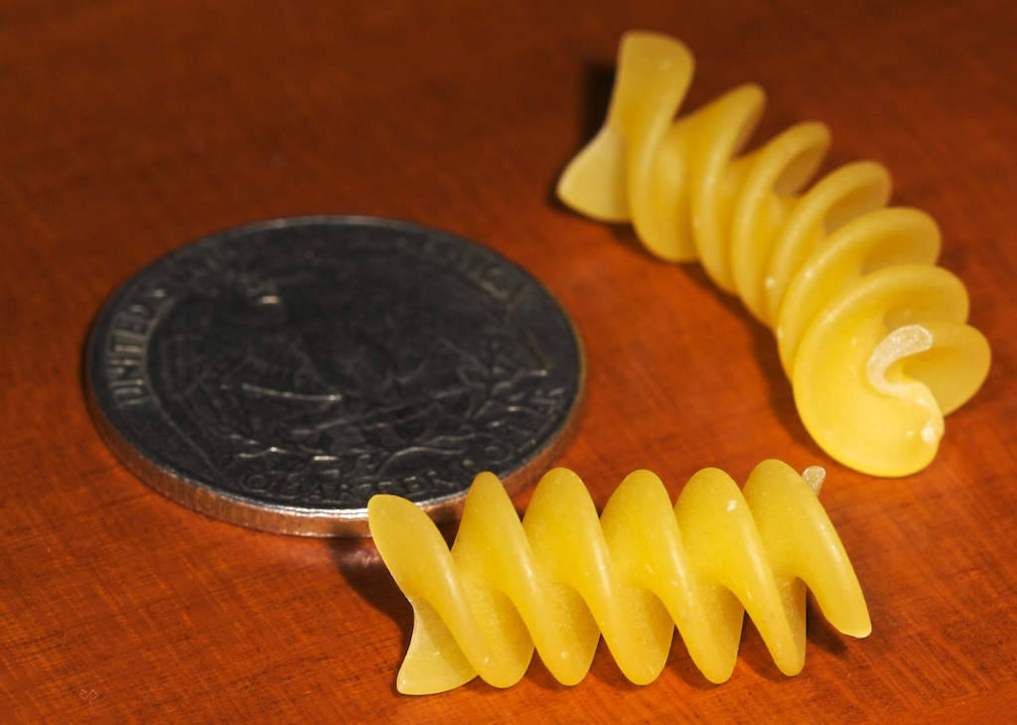
Rotini

Slide 14
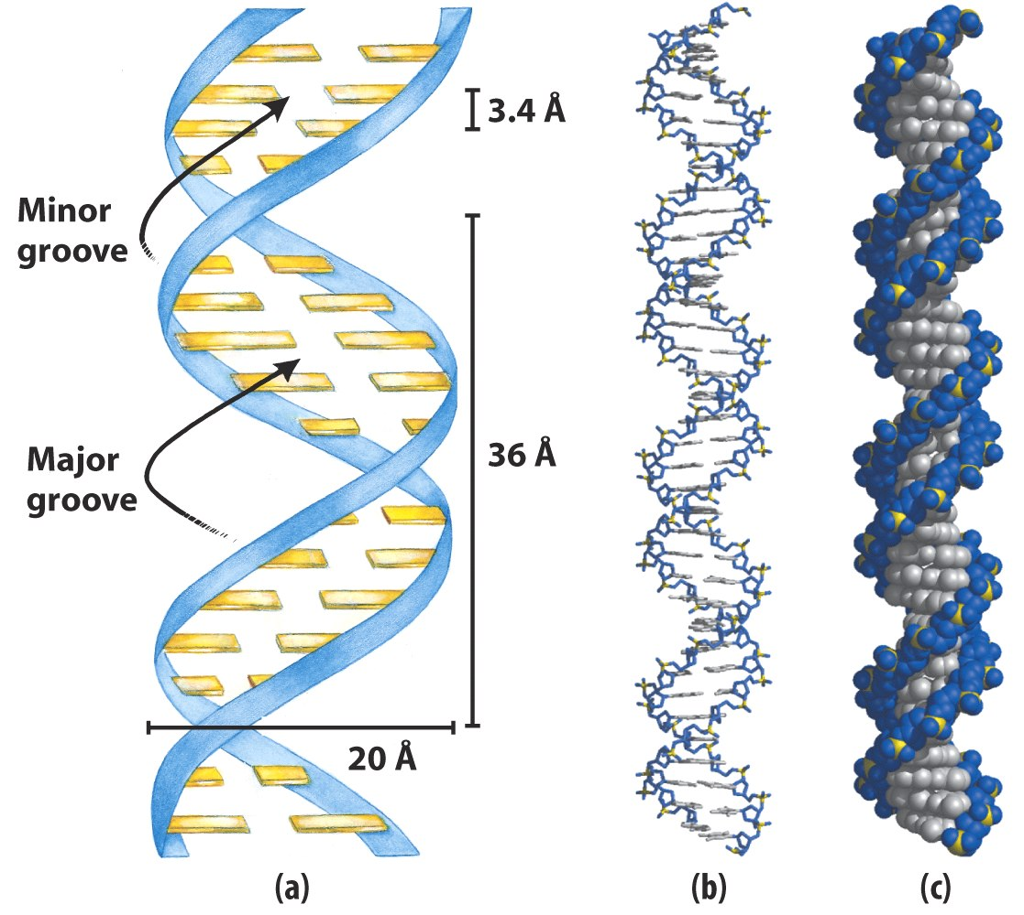
The double helix has minor and major grooves

Slide 15
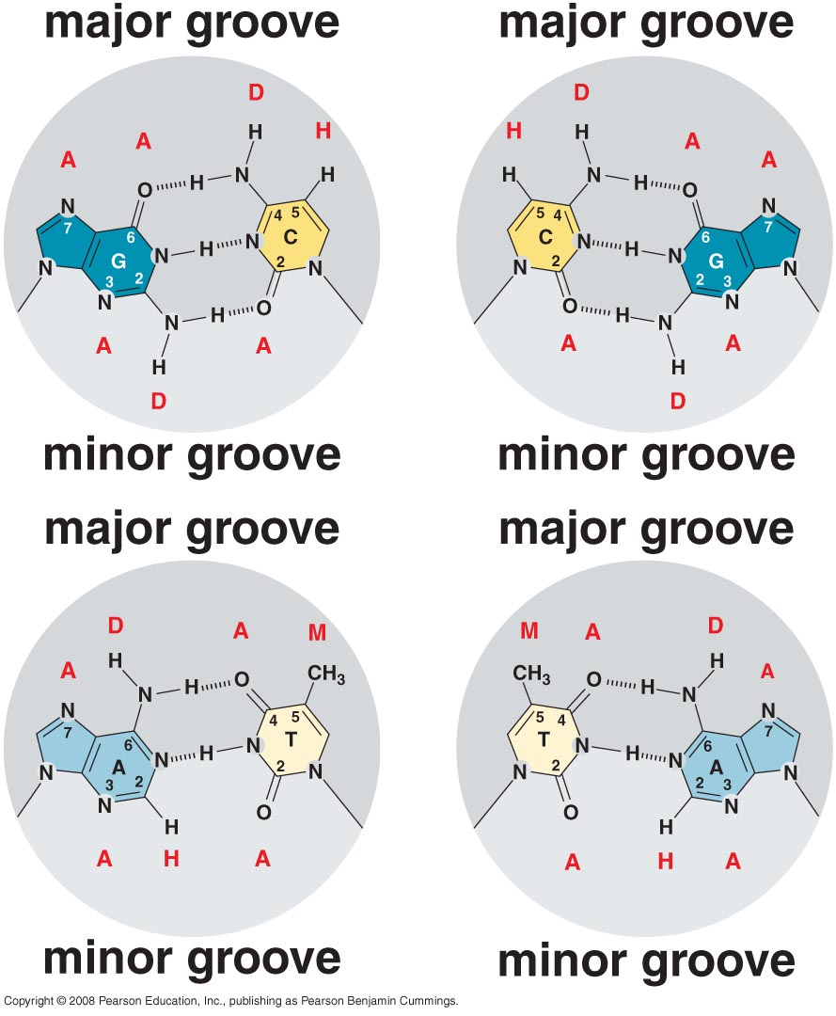
The major groove is rich in chemical information

Slide 16
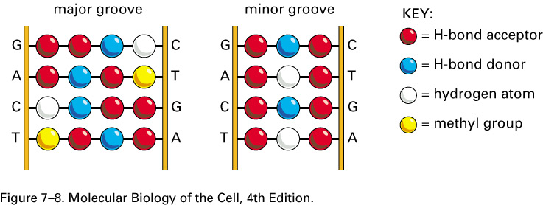
A DNA recognition code.
The edge of each base pair, seen here looking directly at the major or minor groove, contains a distinctive pattern of hydrogen bond donors, hydrogen bond acceptors, and methyl groups. From the major groove, each of the four base-pair configurations projects a unique pattern of features. From the minor groove, however, the patterns are similar for G–C and C–G as well as for A–T and T–A.

Slide 17
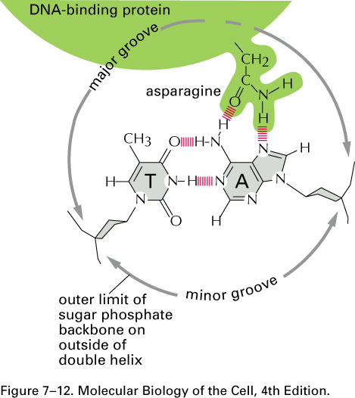
The binding of a gene regulatory protein to the major groove of DNA.
Only a single contact is shown. Typically, the protein-DNA interface would consist of 10 to 20 such contacts, involving different amino acids, each contributing to the strength of the protein–DNA interaction.

Slide 18
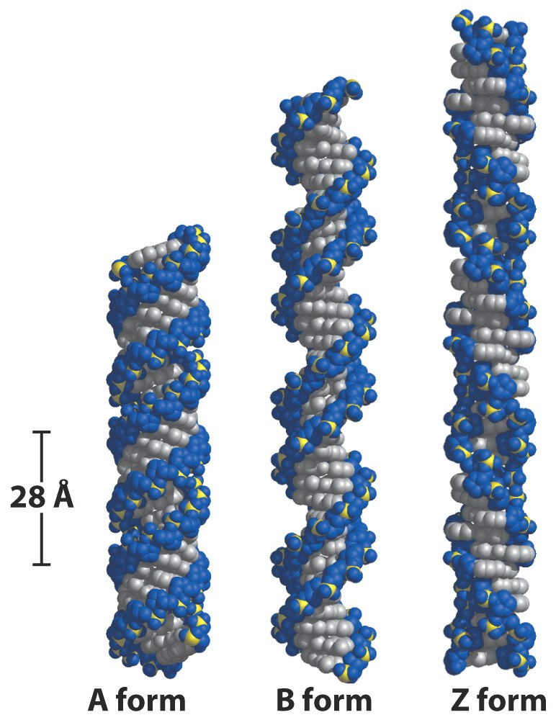
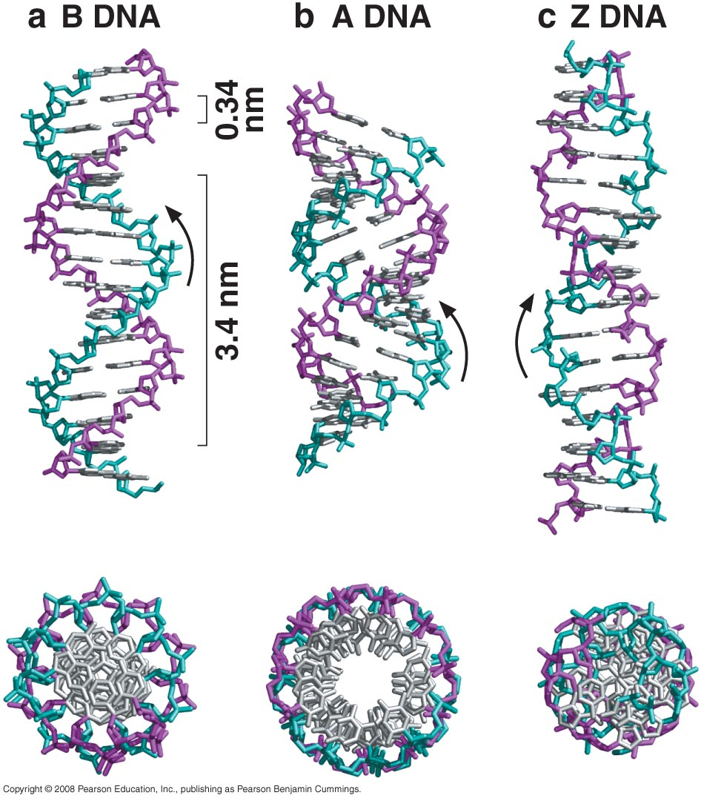
The double helix exists in multiple conformations

Slide 19
CAMBRIDGE, Mass.-- Massachusetts Institute of Technology scientist Alexander Rich, best known for his discovery of left-handed DNA or Z-DNA and the three-dimensional structure of transfer RNA, is the recipient of the $250,000 Bower Award for Achievement in Science.

Slide 20
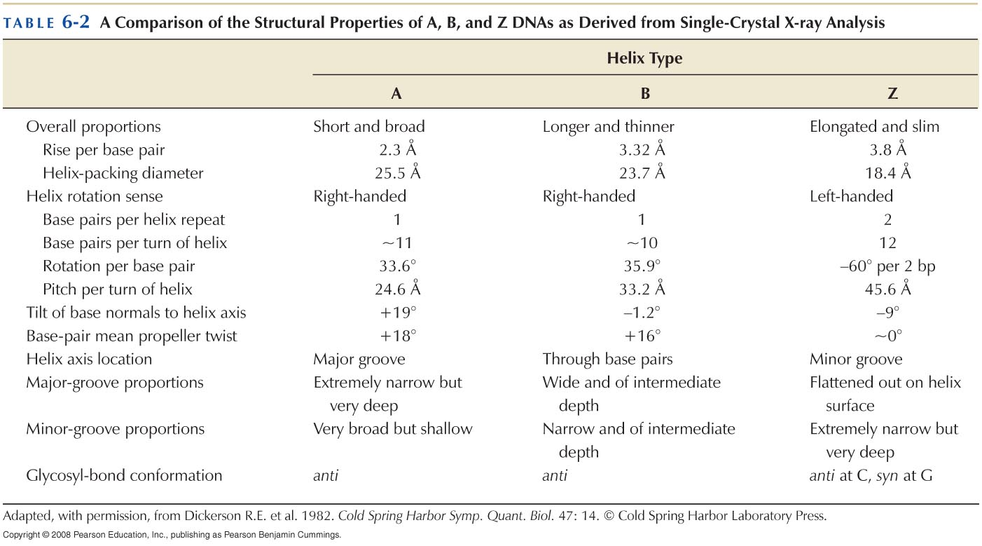

Slide 21
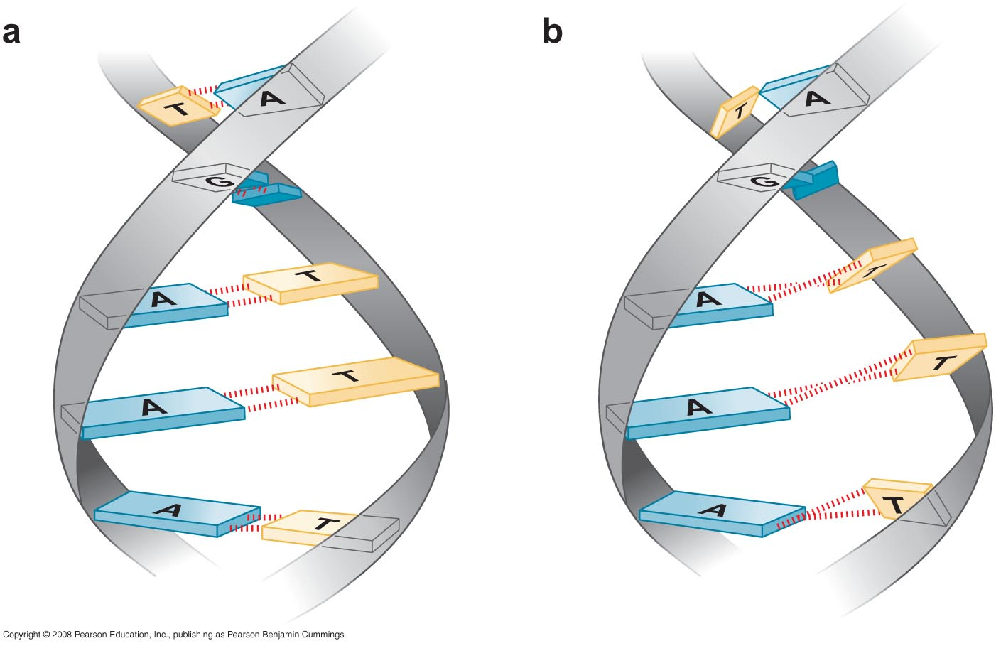
The propeller twist between the purine and pyrimidine base pairs

Slide 22
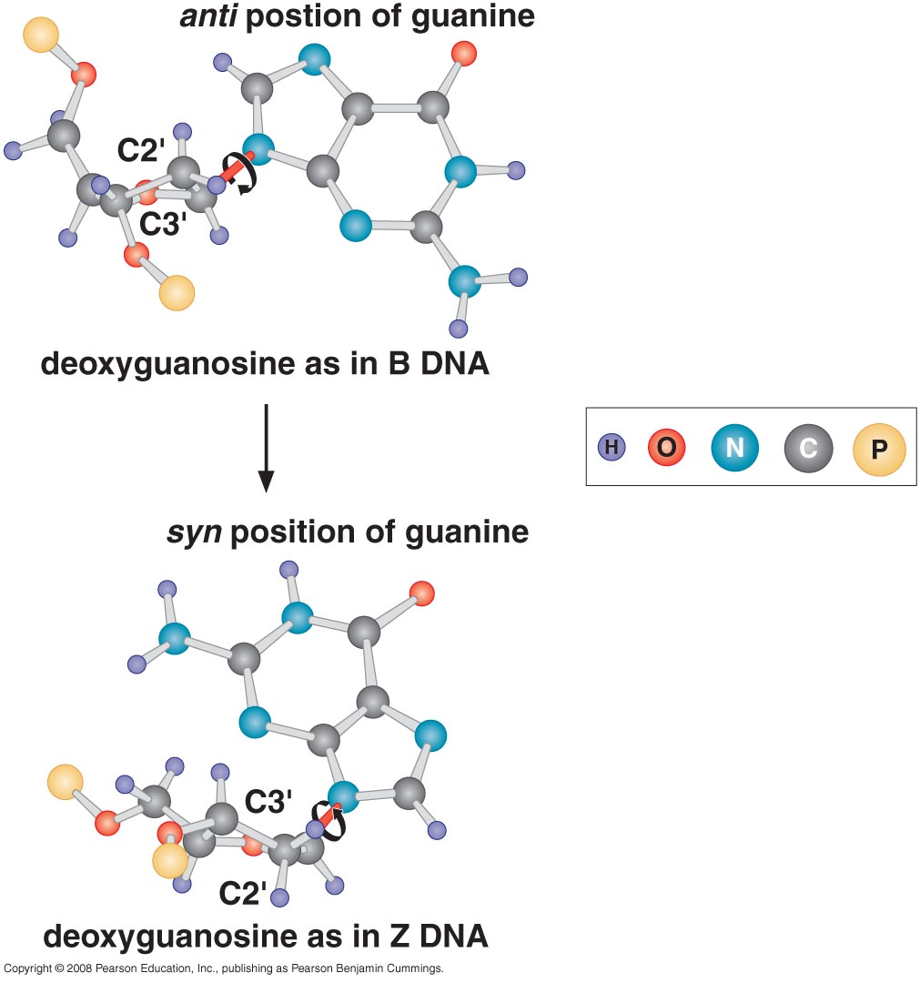
DNA can sometimes form a left-handed helix (Z DNA)

Slide 23
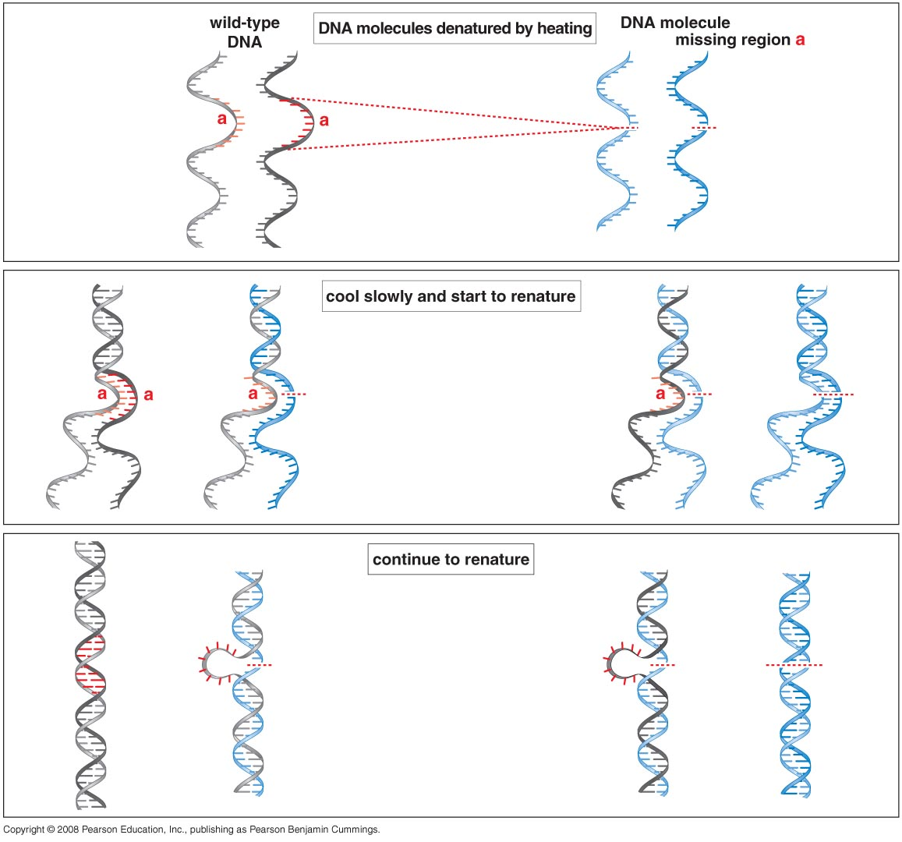
DNA strands can separate (denaturation) and reassociate (hybridization)

Slide 24
Denaturation of DNA
When DNA is heated to 80+ degrees Celsius, its UV absorbance (260 nm) increases by 30-40%
This hyperchromic shift reflects the unwinding of the DNA double helix
Stacked base pairs in native DNA absorb less light
When Temperature is lowered, the absorbance drops, reflecting the re-establishment of stacking

Slide 25
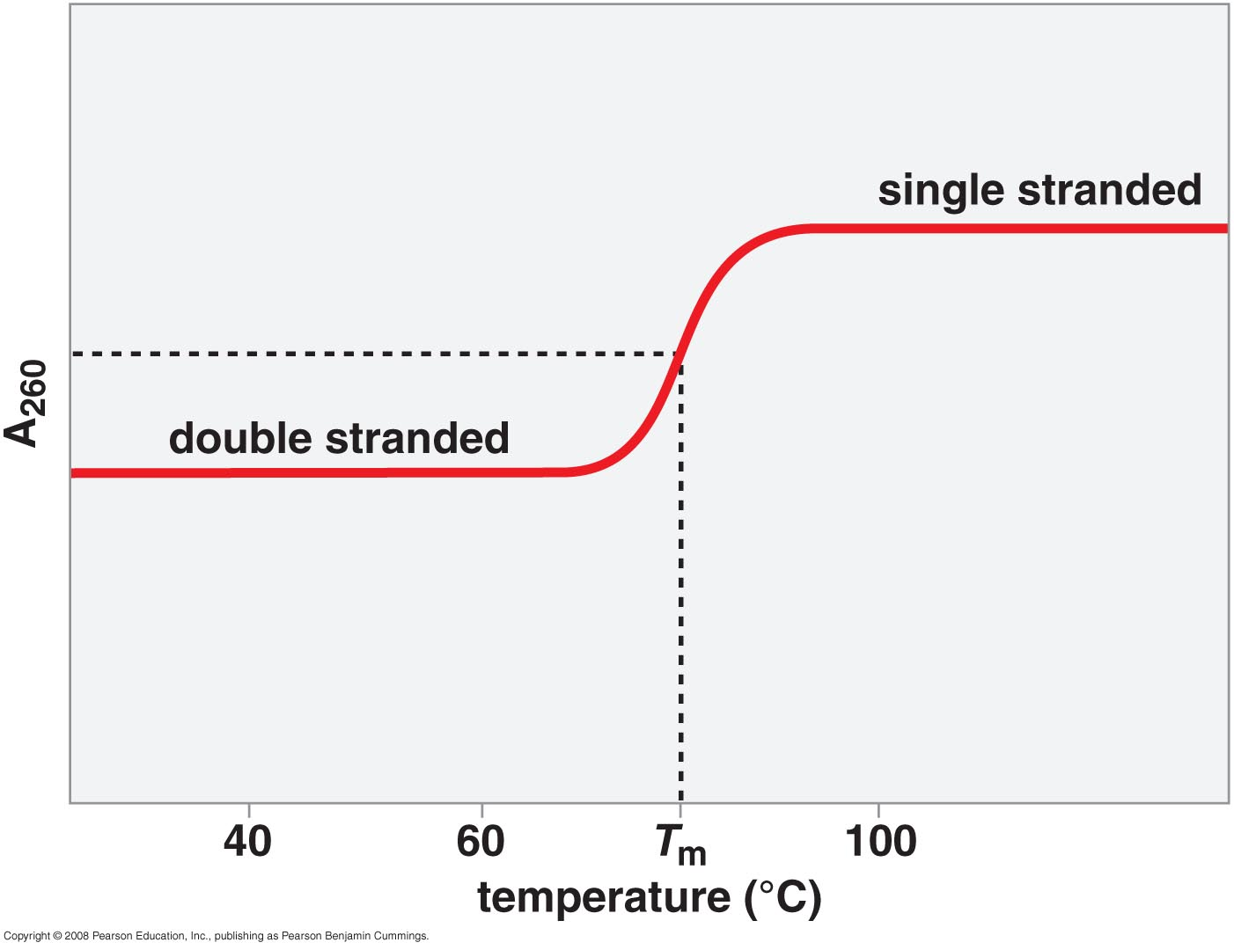
DNA denaturation curve

Slide 26
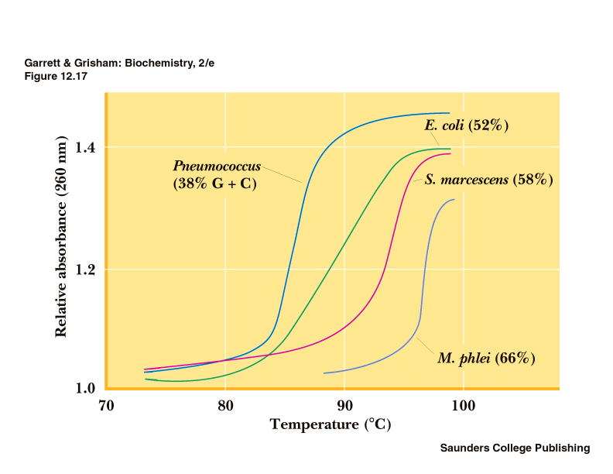
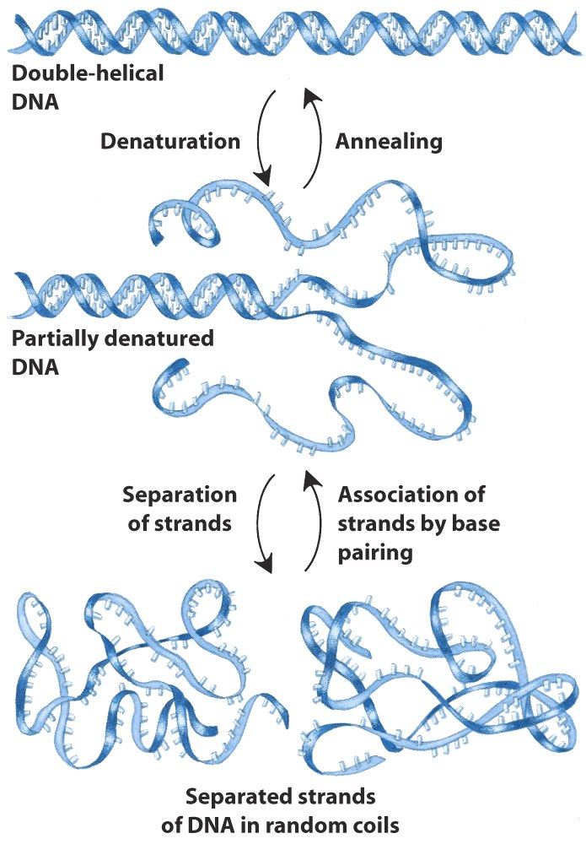

Slide 27
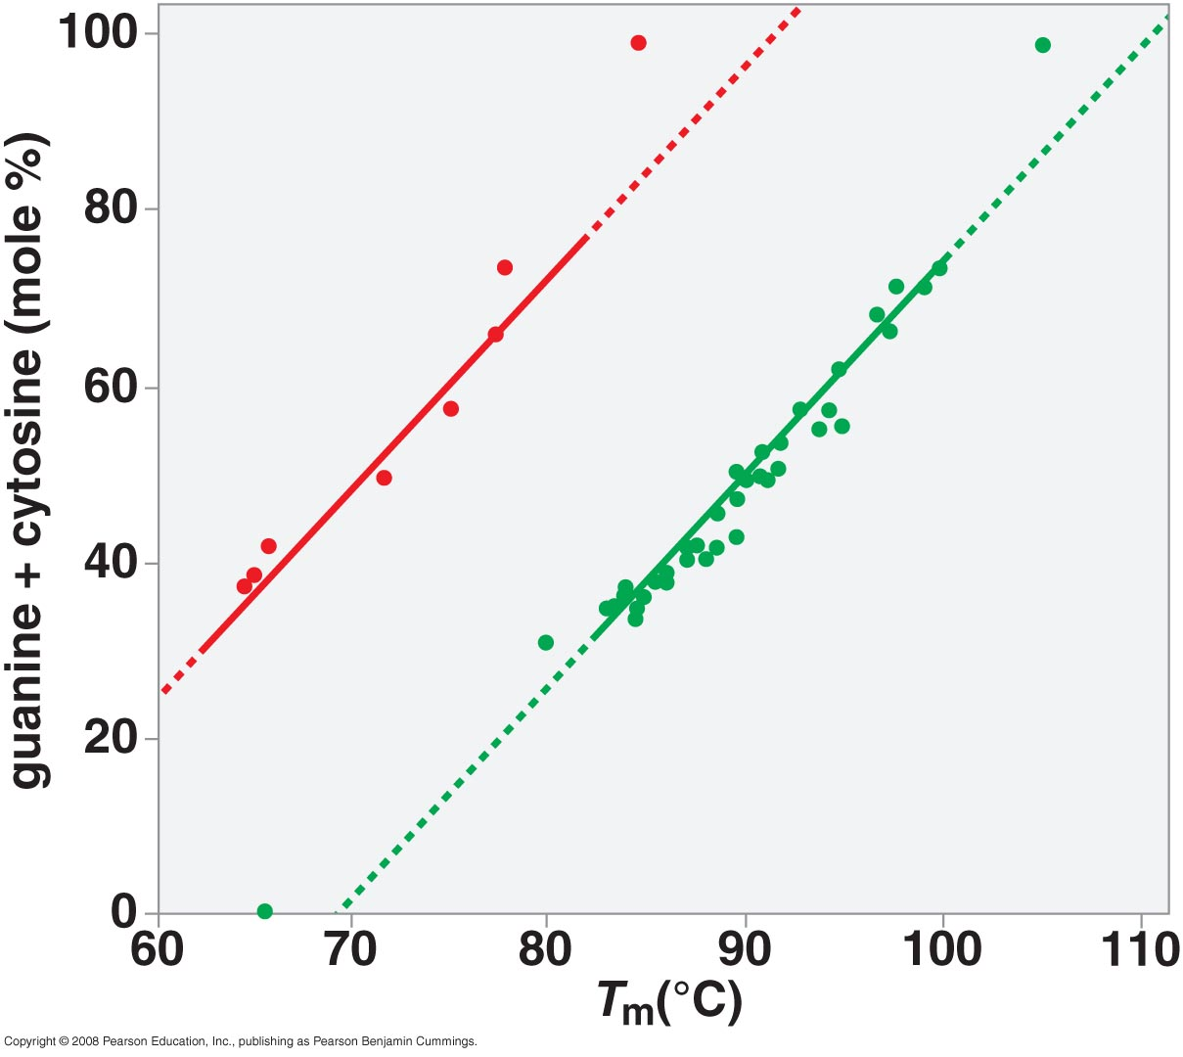
DNA denaturation depends on G+C %, and Salt concentration

Slide 28
DNA TOPOLOGY
In duplex DNA, 10 bp per turn of helix
Circular DNA sometimes has more or less than 10 bp per turn - a supercoiled state
Enzymes called topoisomerases or gyrases can introduce or remove supercoils
Negative supercoiling may promote DNA denaturation

Slide 29
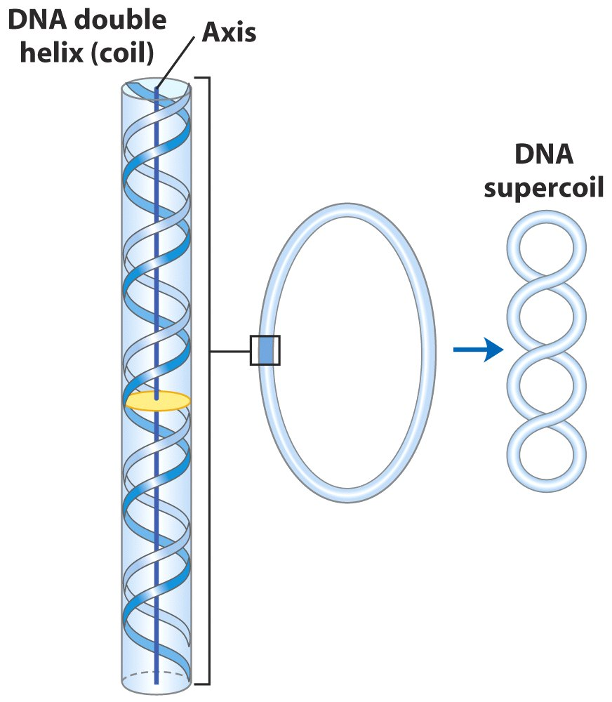

Slide 30
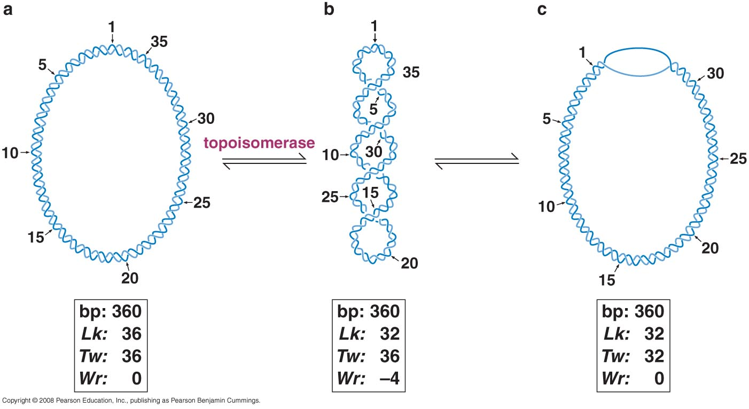
Linking # is an invariant topological property of covalently closed, circular DNA (cccDNA); Linking # is composed of Twist & Writhe
L: Linking #; T: Twist #; W: Writhe # L=T+W; L can never be changed as long as no topoisomerase is used, and there is no nicks in DNA.

Slide 31
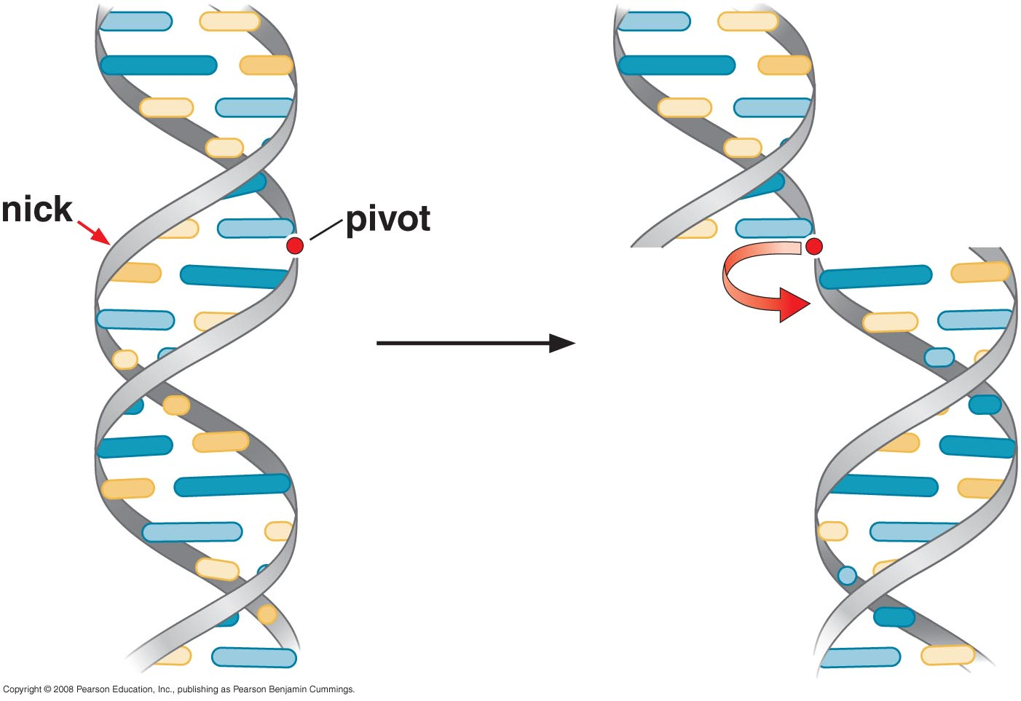
Lk0 is the linking # of a fully relaxed cccDNA under physiological conditions
Relaxing DNA with Dnase I

Slide 32
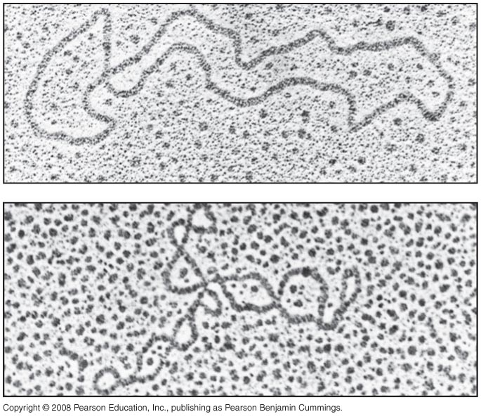
DNA in cells is negatively supercoiled
Superhelical density: σ = ΔLK/Lko

Slide 33
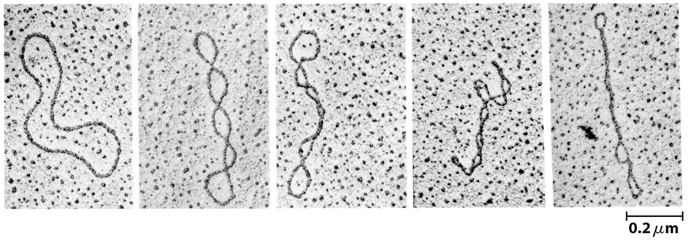

Slide 34
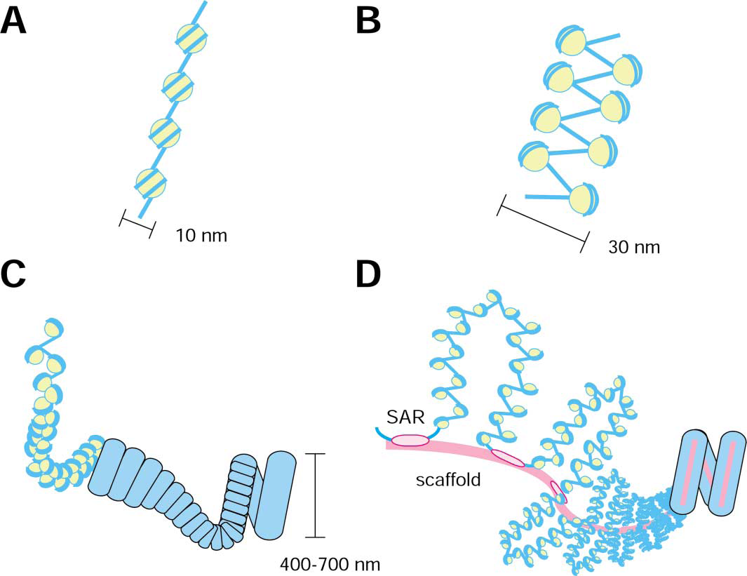
Nucleosomes introduce negative supercoiling in Eukaryotes

Slide 35
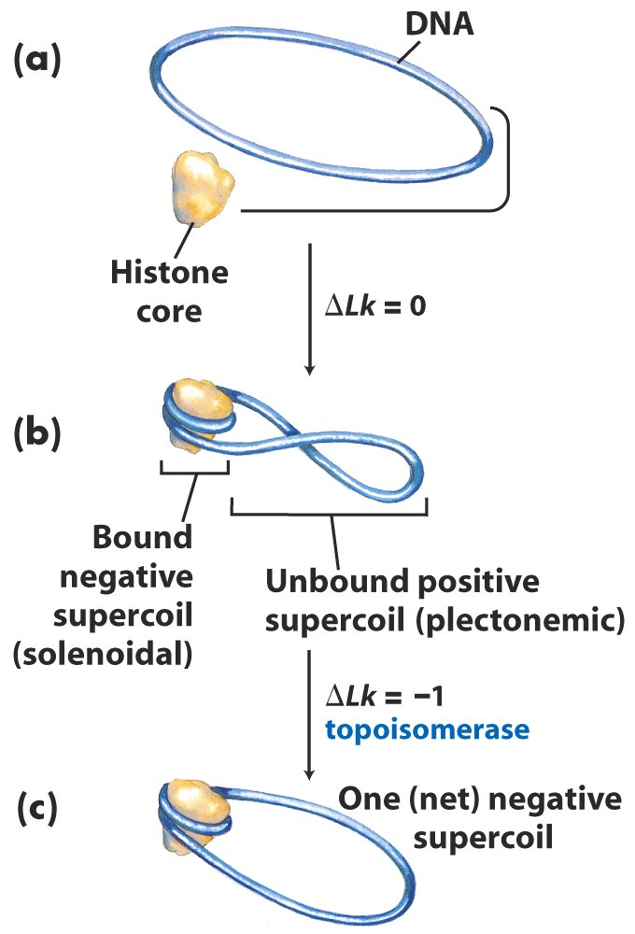

Slide 36
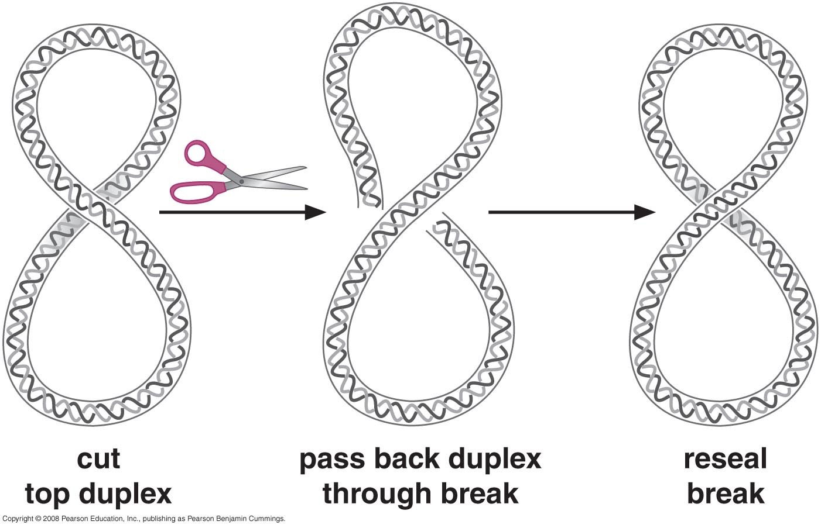
Topoisomerases can relax supercoiled DNA
Changing the linking # with topoisomerase II

Slide 37
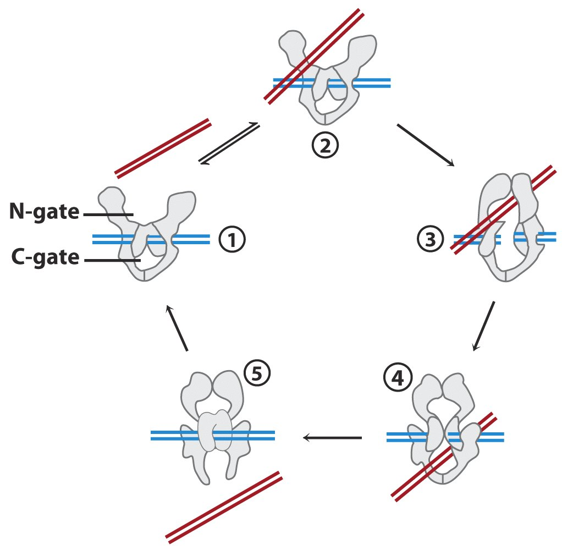
Topoisomerase II, makes a double-stranded break, allows another
Double-stranded DNA (from the same or other molecule) to pass
Through. Requires ATP.

Slide 38
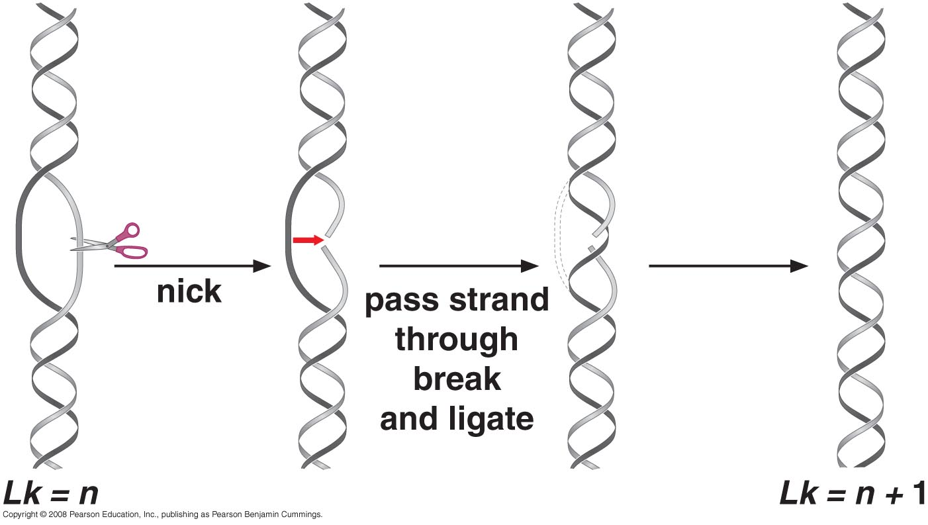
Mechanism of topoisomerase I

Slide 39
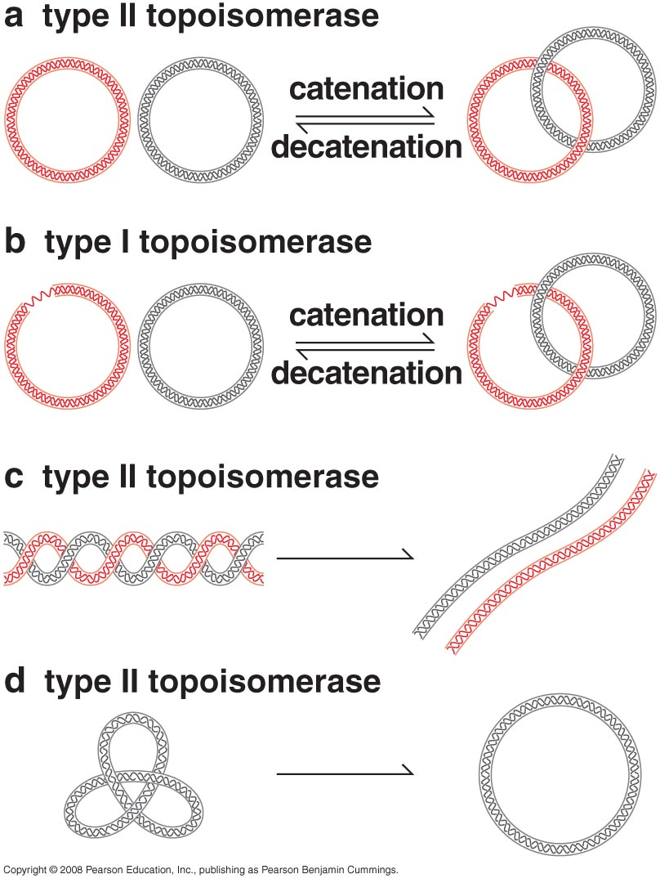
Prokaryotes have a special topo II (DNA Gyrase) that introduces supercoils into DNA; Topoisomerases also unknot and disentangle DNA molecules
If one circle carry a nick or gap

Slide 40
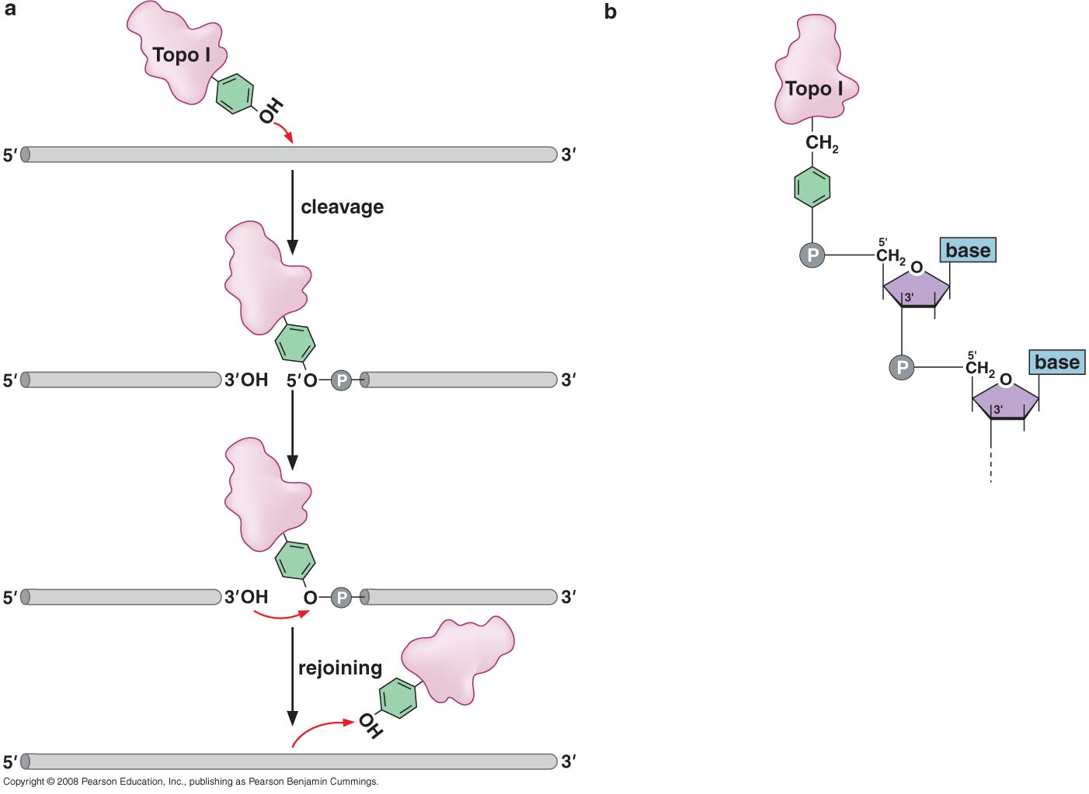
Topoisomerases use a covalent protein-DNA linkage to cleave and rejoin strands

Slide 41
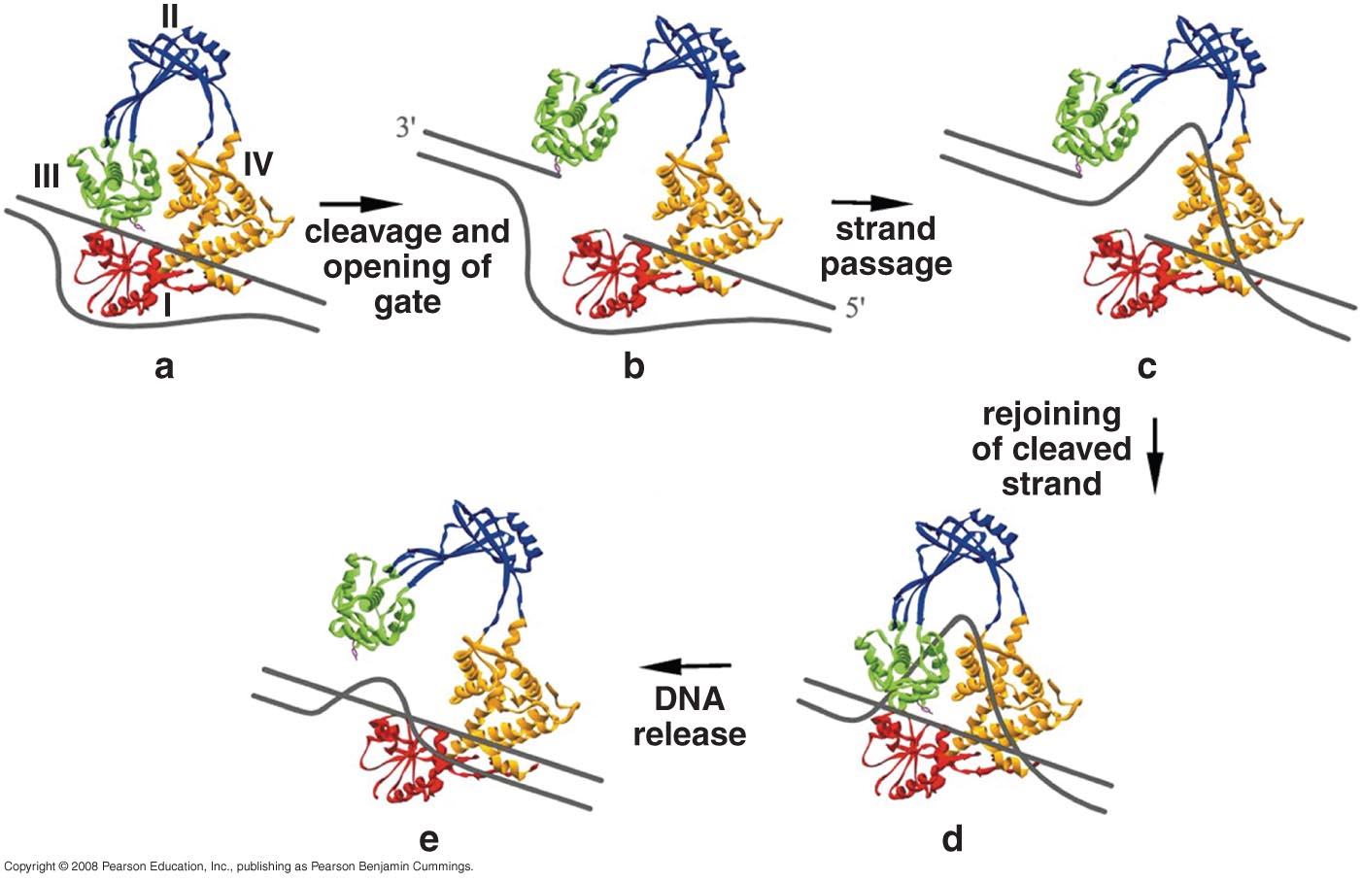
Model for the reaction cycle catalyzed by Topo I

Slide 42
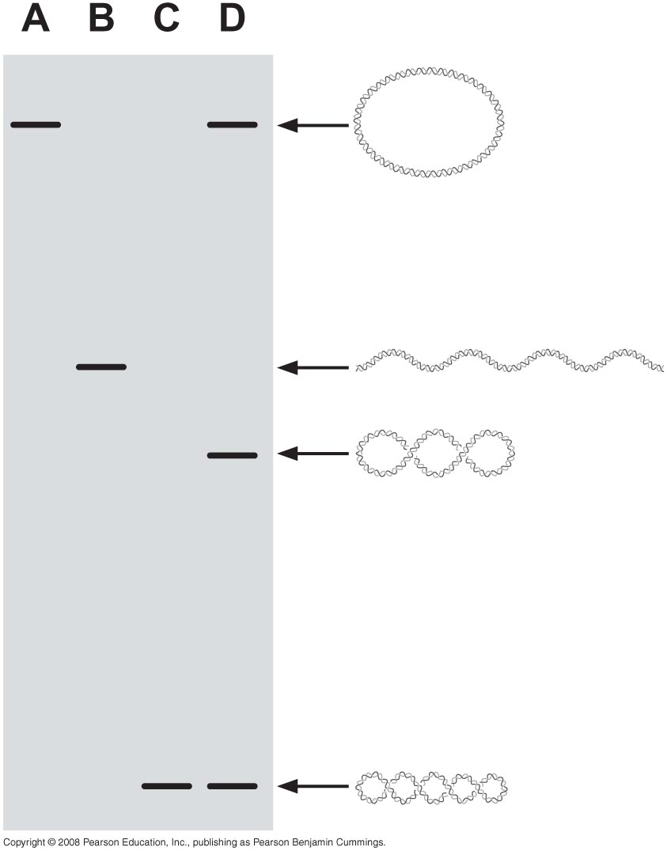
DNA topoisomers can be separated by gel electrophoresis

Slide 43
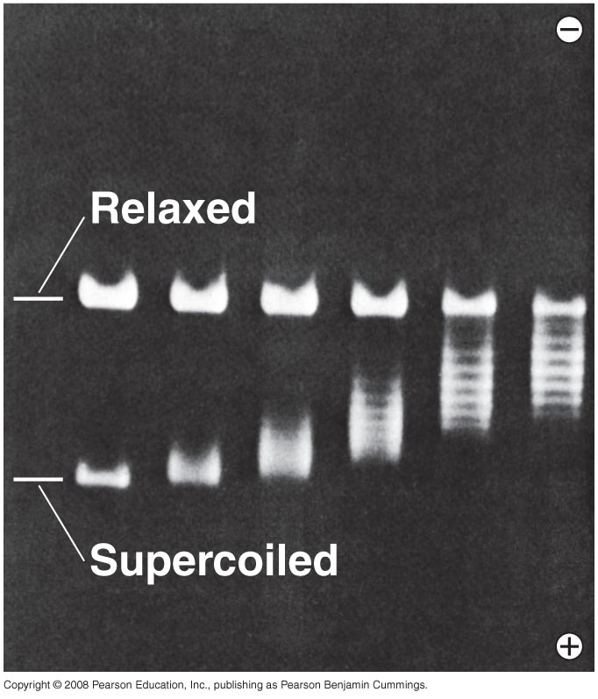
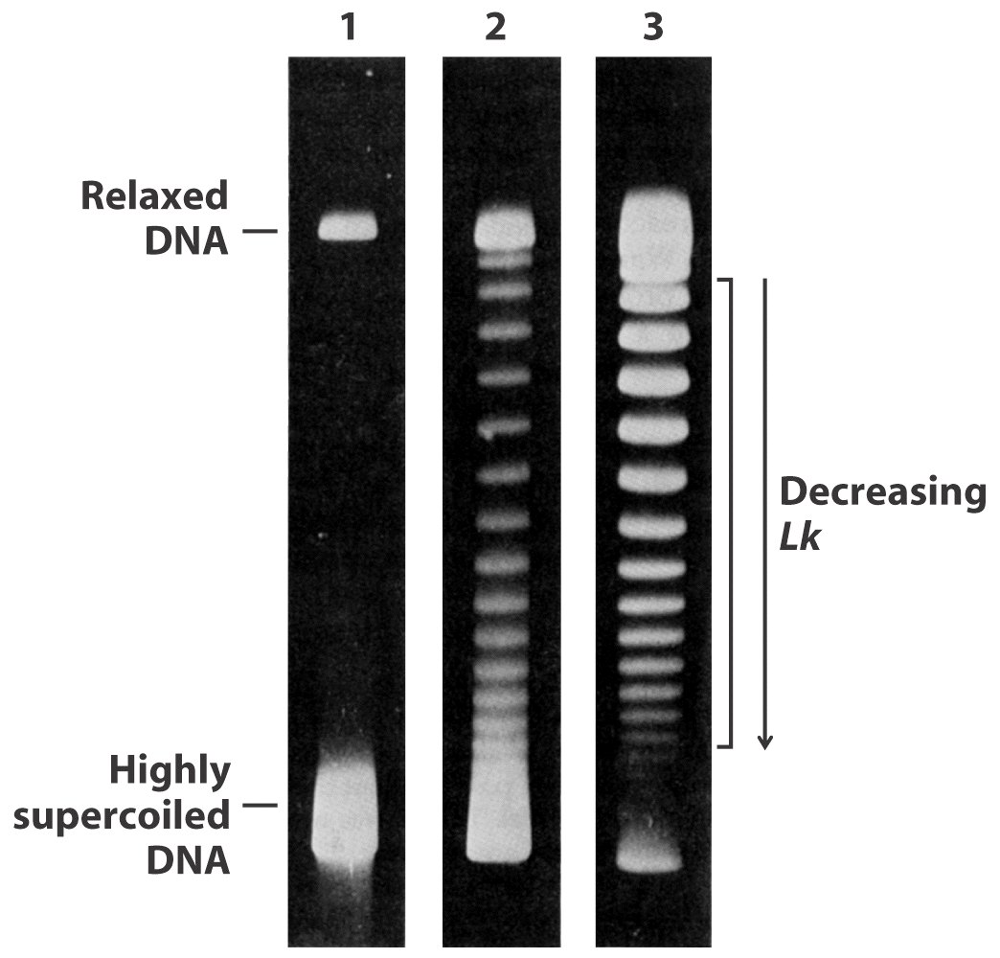

Slide 44
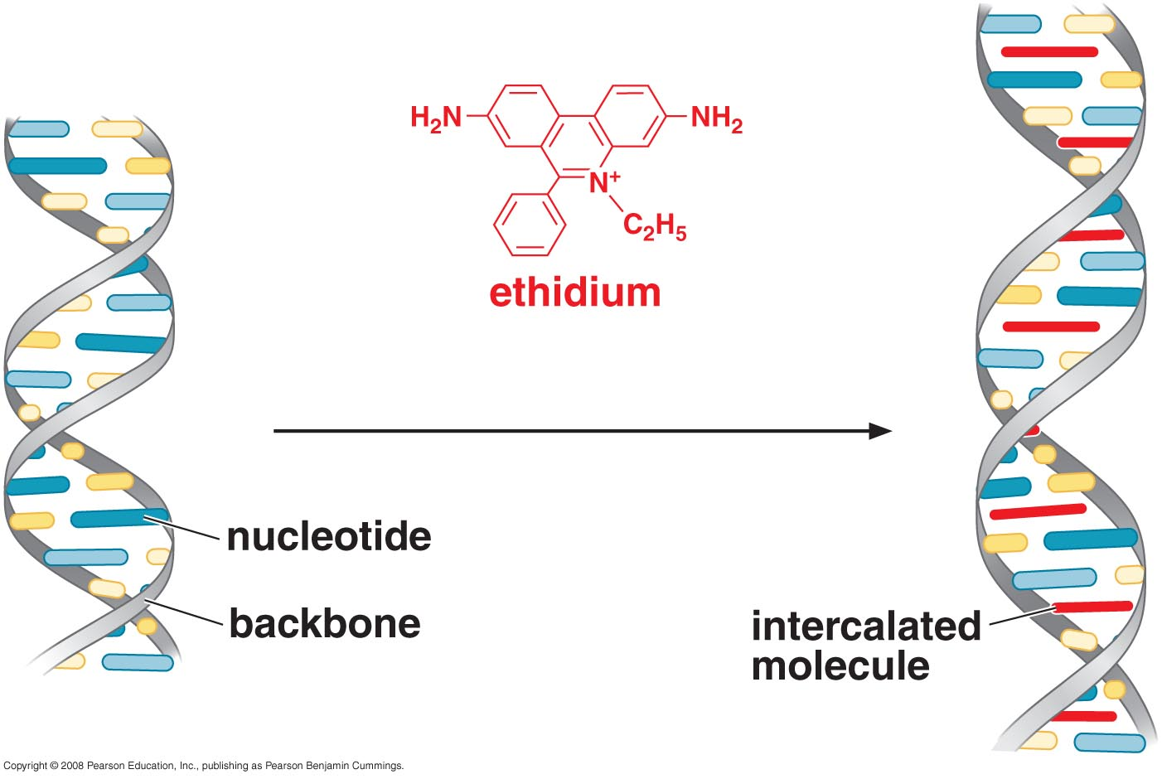
Ethidium ions cause DNA to unwind

Slide 45
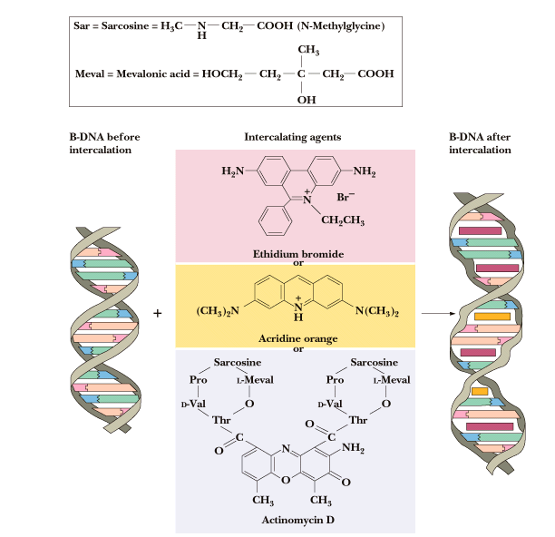

Slide 46
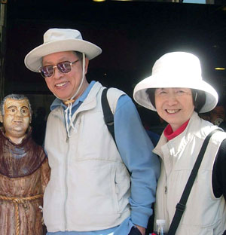
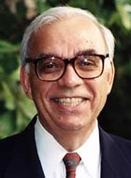
Jim Wang shown here with his wife Sophia in Spain
Forty-one years ago, Jim Wang discovered the first of a family of enzymes crucial to the disentanglement of DNA strands or double helices during various cellular processes involving DNA, including replication, transcription, and repair. He coined the term “DNA topoisomerases” to describe the enzymes, and has been a leader in the field ever since.
Now, the emeritus Mallinckrodt Professor of Biochemistry and Molecular Biology, who retired from MCB and Harvard in 2005, has written Untangling the Double Helix: DNA Entanglement and the Action of the DNA Topoisomerases (Cold Spring Harbor Laboratory Press, 2009)
Nicholas Robert Cozzarelli, editor-in-chief of the journal Proceedings of the National Academy of Sciences and a professor of molecular and cell biology at the University of California, Berkeley. Courtesy of UC Berkeley.

Slide 47
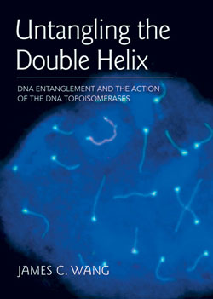

Slide 48
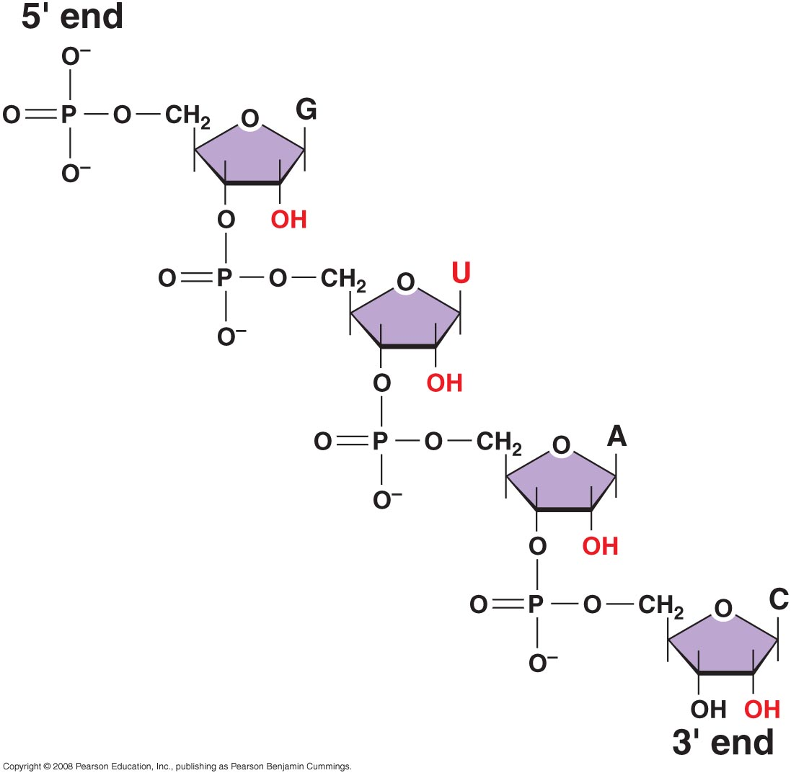
RNA STRUCTURE
RNA contains Ribose and uracil and is usually single-stranded
Structural features of RNA

Slide 49
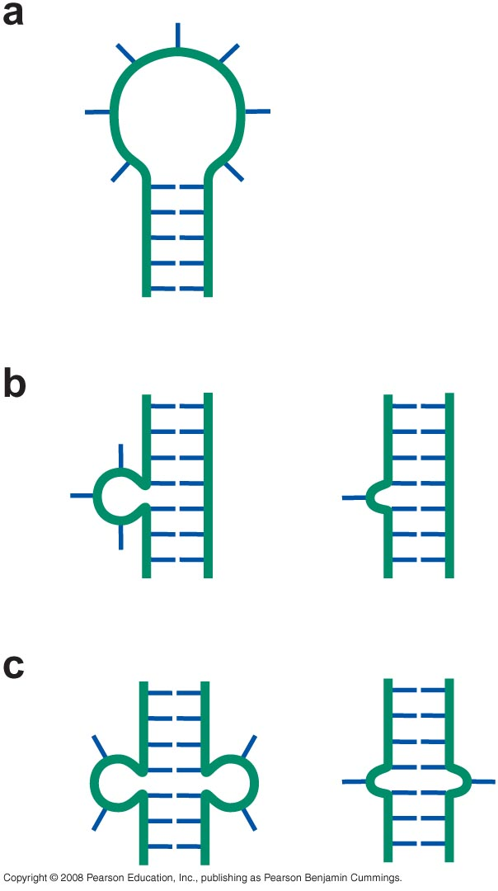
RNA chains fold back on themselves to form local regions of double helix similar to A-form DNA

Slide 50
C(UUCG)G Tetraloop

Slide 51
Pseudoknot

Slide 52
Many non-W-C base pairs involved in the formation of RNA tertiary structures

Slide 53
RNA can fold up into complex tertiary structures

Slide 54
Some RNAs are enzymes (Ribozymes); Rnase P, RNA Self-splicing
A hammerhead ribozyme cleaves RNA by the formation of a 2’, 3’ cyclic phosphate

Slide 56
Did life evolve from an RNA world?

