Slide 1
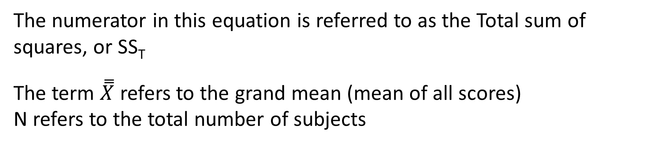
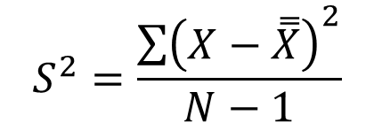
Remember the equation for variance, which is:
$$S^{2}=\frac{\sum{{\left(X−\overset{̿}{X}\right)}^{2}}}{N−1}$$
The numerator in this equation is referred to as the Total sum of squares, or SS_{T}
The term $\overset{̿}{X}$ refers to the grand mean (mean of all scores)
N refers to the total number of subjects

Slide 2
The concept behind ANOVA involves partitioning the total sum of squares into component parts.
In the case of a 1-way ANOVA, there are two component parts:
A within-group sum of squares (SS_{w}), and
A between-group sum of squares (SS_{B})
The total sum of squares equals SS_{w} + SS_{B}

Slide 3


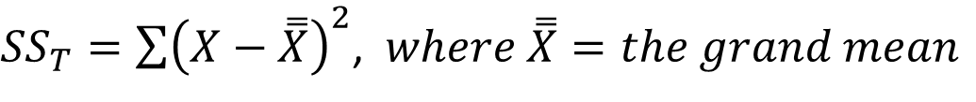


Group 1
Group 2
Group 3
$${\overline{X}}_{1}$$
$${\overline{X}}_{2}$$
$$\overset{̿}{X}$$
$${\overline{X}}_{3}$$
${SS}_{T}=\sum{{\left(X−\overset{̿}{X}\right)}^{2}}$, $where \overset{̿}{X}=the grand mean$
There are a total of N-1 degrees of freedom. For the chart above, df = 15-1 = 14

Slide 4
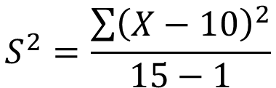
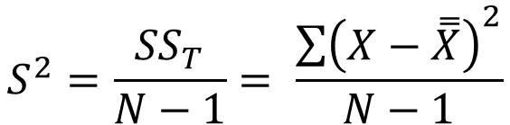
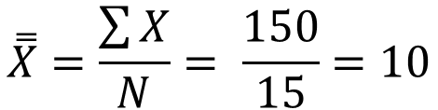
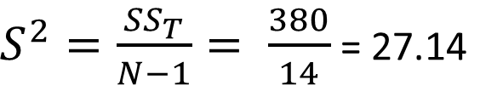
Example: Calculation of Total Variance
$$\overset{̿}{X}=\frac{\sum{X}}{N}= \frac{150}{15}=10$$
a₁ | a₂ | a₃
16 | 4 | 2
18 | 6 | 10
10 | 8 | 9
12 | 10 | 13
19 | 2 | 11
$$S^{2}=\frac{{SS}_{T}}{N−1}= \frac{\sum{{\left(X−\overset{̿}{X}\right)}^{2}}}{N−1}$$
$$S^{2}=\frac{\sum{{\left(X−10\right)}^{2}}}{15−1}$$
$S^{2}=\frac{{SS}_{T}}{N−1}= \frac{380}{14}$ = 27.14

Slide 5




Group 1
Group 2
Group 3
$${\overline{X}}_{1}$$
$${\overline{X}}_{2}$$
$$\overset{̿}{X}$$
$${\overline{X}}_{3}$$
$${SS}_{w}=\sum_{i=1}^{n}{\sum_{j=1}^{k}{{\left(X_{ij}−{\overline{X}}_{j}\right)}^{2}, where n=\# of subjects in each group, k=\# of groups}}$$
Since each group has n-1 degrees of freedom, the total degrees of freedom associated
With the SS_{W} is k(n-1), or 3(5-1) = 12

Slide 6
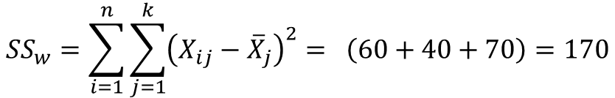
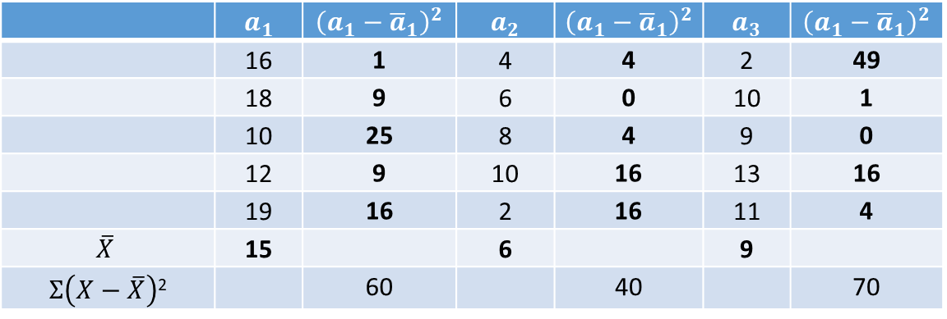
Example: Calculation of Within Groups SS, or SS_{W}
 | $$a_{1}$$ | $${\left(a_{1}−{\overline{a}}_{1}\right)}^{2}$$ | $$a_{2}$$ | $${\left(a_{1}−{\overline{a}}_{1}\right)}^{2}$$ | $$a_{3}$$ | $${\left(a_{1}−{\overline{a}}_{1}\right)}^{2}$$
 | 16 | 1 | 4 | 4 | 2 | 49
 | 18 | 9 | 6 | 0 | 10 | 1
 | 10 | 25 | 8 | 4 | 9 | 0
 | 12 | 9 | 10 | 16 | 13 | 16
 | 19 | 16 | 2 | 16 | 11 | 4
$$\overline{X}$$ | 15 |  | 6 |  | 9
$Σ\left(X−\overline{X}\right)$² |  | 60 |  | 40 |  | 70
$${SS}_{w}=\sum_{i=1}^{n}{\sum_{j=1}^{k}{{\left(X_{ij}−{\overline{X}}_{j}\right)}^{2}= \left(60+40+70\right)=170}}$$

Slide 7





Group 1
Group 2
Group 3
$${\overline{X}}_{1}$$
$${\overline{X}}_{2}$$
$$\overset{̿}{X}$$
$${\overline{X}}_{3}$$
$${SS}_{B}=\sum_{j=1}^{k}{{n\left({\overline{X}}_{j}−\overset{̿}{X}\right)}^{2}}$$
Since there are k groups, the total degrees of freedom associated
With the SS_{B} is k-1, or 3-1 = 2

Slide 8
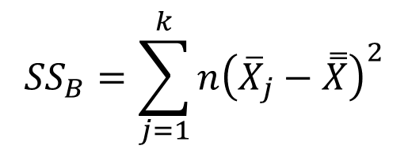
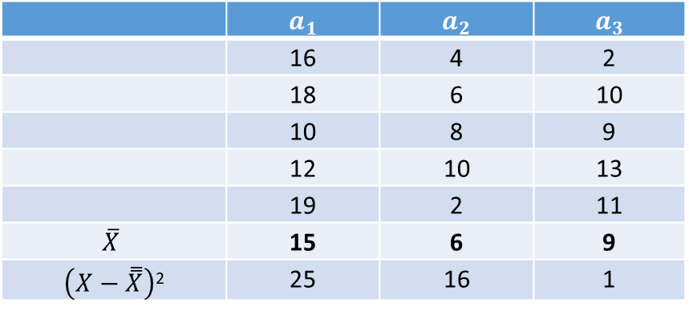
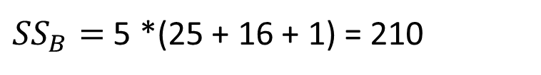
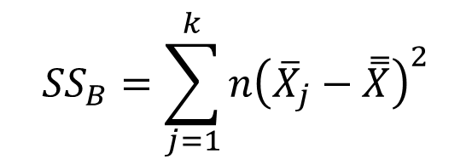
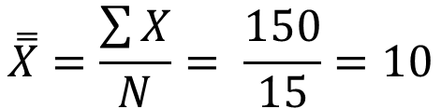
Example: Calculation of Between Groups SS, or SS_{B}
$$\overset{̿}{X}=\frac{\sum{X}}{N}= \frac{150}{15}=10$$
 | $$a_{1}$$ | $$a_{2}$$ | $$a_{3}$$
 | 16 | 4 | 2
 | 18 | 6 | 10
 | 10 | 8 | 9
 | 12 | 10 | 13
 | 19 | 2 | 11
$$\overline{X}$$ | 15 | 6 | 9
$\left(X−\overset{̿}{X}\right)$² | 25 | 16 | 1
$${SS}_{B}=\sum_{j=1}^{k}{{n\left({\overline{X}}_{j}−\overset{̿}{X}\right)}^{2}}$$
$${SS}_{B}=\sum_{j=1}^{k}{{n\left({\overline{X}}_{j}−\overset{̿}{X}\right)}^{2}}$$
${SS}_{B}=$ 5 *(25 + 16 + 1) = 210

Slide 9




Variance is calculated by dividing the sum of squares by the degrees of freedom (n-1).
In a similar manner, the Mean Squares Within (MS_{W}) and the Mean Squares Between (MS_{B})
are calculated by dividing the respective sums of squares by the degrees of freedom.
Consequently,
$${MS}_{B}=\frac{{SS}_{B}}{{df}_{B}}=\frac{{SS}_{B}}{\left(k−1\right)}$$
$${MS}_{W}=\frac{{SS}_{W}}{{df}_{W}}=\frac{{SS}_{W}}{k(n−1)}$$
$${MS}_{B}=\frac{{SS}_{B}}{{df}_{B}}=\frac{210}{\left(3−1\right)}=105$$
${MS}_{W}=\frac{{SS}_{W}}{{df}_{W}}=\frac{170}{3(5−1)}$ = 14.17

Slide 10
If the numbers were randomly assigned to each group, the expected ratio of MS_{B}/MS_{W}
(referred to as the F-ratio) would be around 1.00. This is because we would expect the variance
within each group to be similar to the variance between each group.
Any systematic change to the values within a group that creates a larger difference between group means (perhaps resulting from a treatment) would increase the magnitude of MS_{B}, while the magnitude of MS_{W} would remain relatively unchanged.
Consequently, as the difference between group means increased, so would MS_{B} , along with the resulting F-ratio.
When the F-ratio grows to a magnitude that occurs by chance less than 5% of the time, it is considered
to be significant, which indicates that there’s likely a systematic difference between group means.
It does not indicate whether two group means are different, or whether all group means are different,
only that a difference exists.

Slide 11
Example: Calculation of F-Ratio
From our numeric example, the calculation of the F-ratio would be as follows:
F-ratio = MS_{B} / MS_{W} = 105 / 14.17 = 7.41
The degrees of freedom would be: (df_{b} , df_{w}), or (2 , 12)
The critical F-value associated with these degrees of freedom is 2.8068.
Since our calculated F-ratio exceeds the critical F-ratio, we would conclude that at least one of the groups was significantly different from one or more of the other groups. We would then need to run a post-hoc test on the data to find the exact location of the significant difference(s).

Slide 12
Assumptions associated with ANOVA:
Within-group variances are normally distributed (detected by Kolomogorov-Smirnov test)
Within-group variances are homogenous (detected by Levene’s statistic)
Between-group observations should be independent
Dependent variables should be interval or rational
If assumption #1 is not met (indicated by a significant Kolomogorov-Smirnov test),
then use Brown-Forsythe F or Welch’s F

Slide 13
When more than 2 groups are included in the ANOVA and a significant F-ratio is calculated,
use a post-hoc test to determine where significant differences exist.
Post-hoc tests enable you to compare all means while holding experiment-wise error constant.
The most commonly used post-hoc tests in order of relative stringence are:
Scheffe
Tukey
Bonferroni
Newman-Keuls
Duncan
LSD

