Slide 1



Funding by the NSF Graduate Teaching Fellows Program in K-12 Education (GK-12) DGE 0538555
UD GK-12 Website Development
Jeff Spraggins: www.udel.edu/GK-12

Slide 2
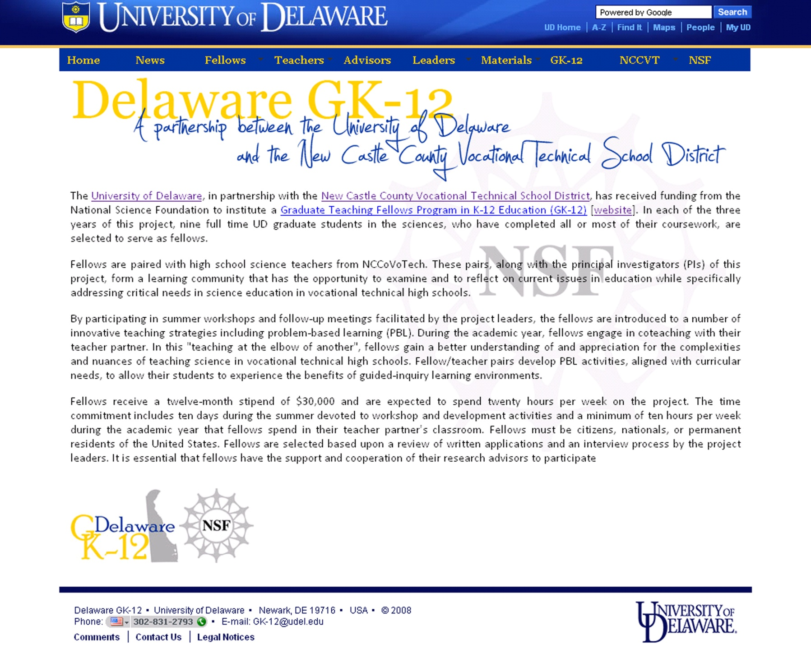
Goals
  Enhance Content
  Develop Written Communication Skills
  Compliance with UD Branding
  Upgrade Appearance
  Develop Web-based Communication Skills
Goals Home Fellows Teachers Advisors Leaders Materials Big Picture

Slide 3
Goals
  Enhance Content
    Student/Leader Profiles
    Materials
  Develop Written Communication Skills
  Compliance with UD Branding
  Upgrade Appearance
  Develop Web-based Communication Skills
Goals Home Fellows Teachers Advisors Leaders Materials Big Picture

Slide 4
Goals
  Enhance Content
    Student/Advisor Profiles
    Materials
  Develop Written Communication Skills
  Compliance with UD Branding
  Upgrade Appearance
  Develop Web-based Communication Skills
Goals Home Fellows Teachers Advisors Leaders Materials Big Picture

Slide 5
Goals
  Enhance Content
  Develop Written Communication Skills
  Compliance with UD Branding
  Upgrade Appearance
  Develop Web-based Communication Skills
Goals Home Fellows Teachers Advisors Leaders Materials Big Picture

Slide 6
Goals
  Enhance Content
  Develop Written Communication Skills
  Compliance with UD Branding
  Upgrade Appearance
  Develop Web-based Communication Skills
Goals Home Fellows Teachers Advisors Leaders Materials Big Picture

Slide 7
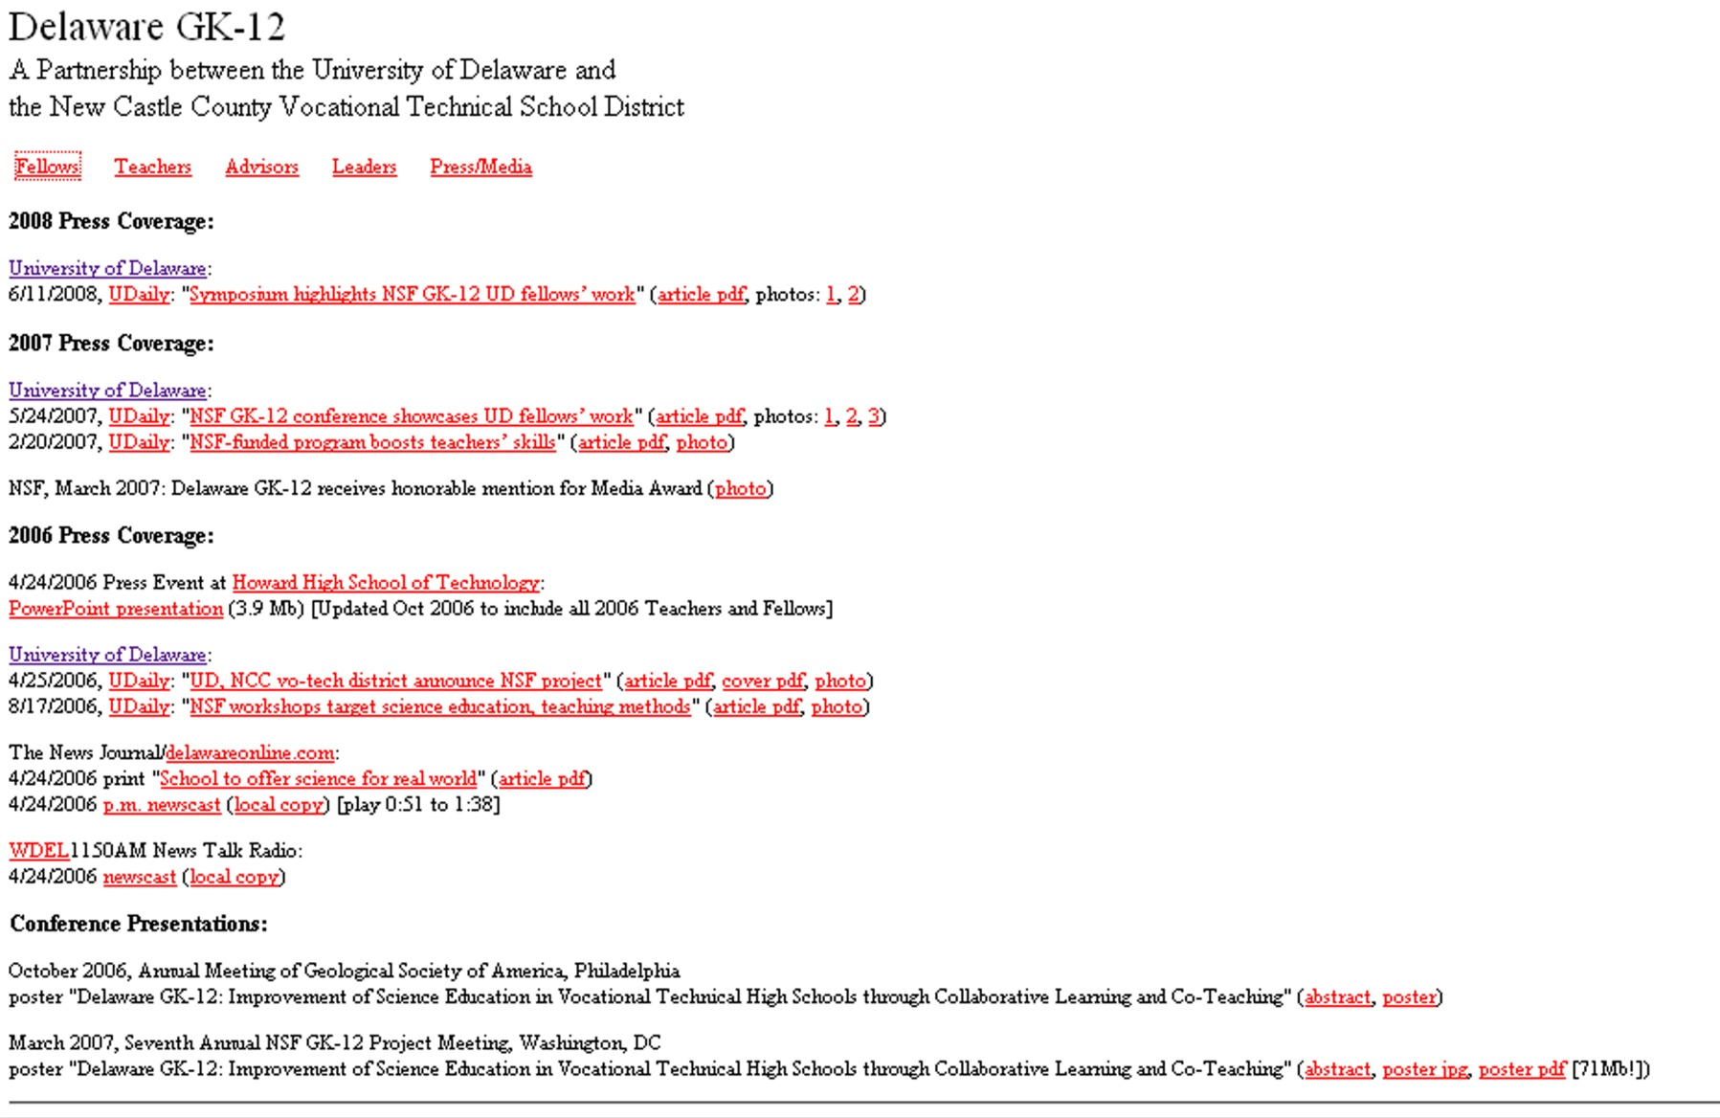
Goals Home Fellows Teachers Advisors Leaders Materials Big Picture

Slide 8
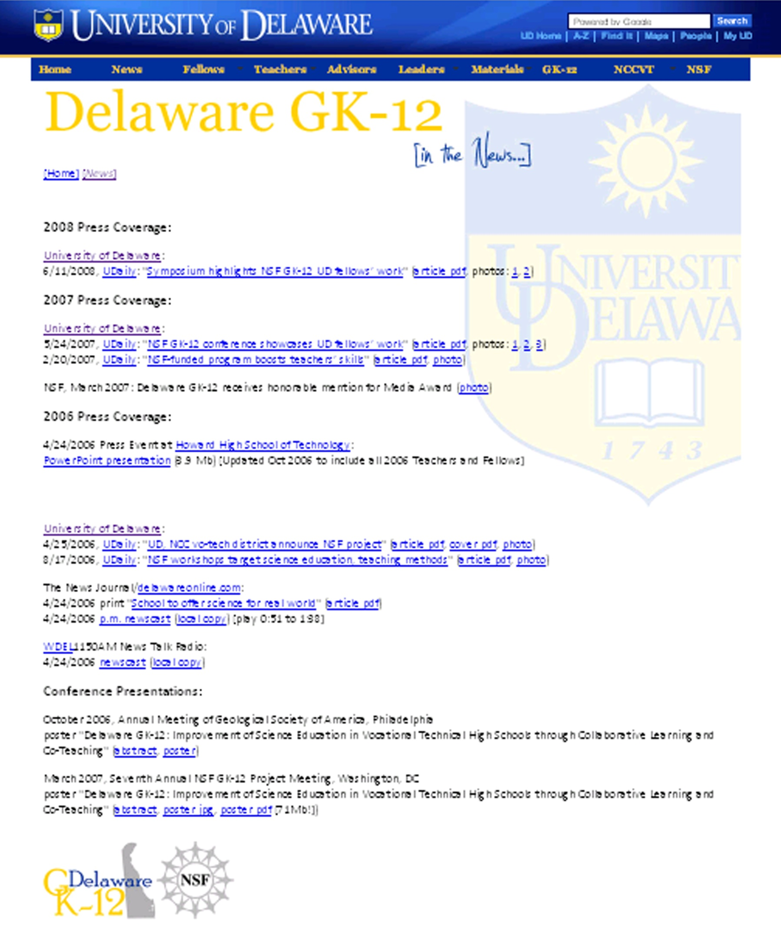
Goals Home Fellows Teachers Advisors Leaders Materials Big Picture

Slide 9
Goals
  Enhance Content
  Develop Written Communication Skills
  Compliance with UD Branding
  Upgrade Appearance
  Develop Web-based Communication Skills
Goals Home Fellows Teachers Advisors Leaders Materials Big Picture

Slide 10
Goals Home Fellows Teachers Advisors Leaders Materials Big Picture

Slide 11
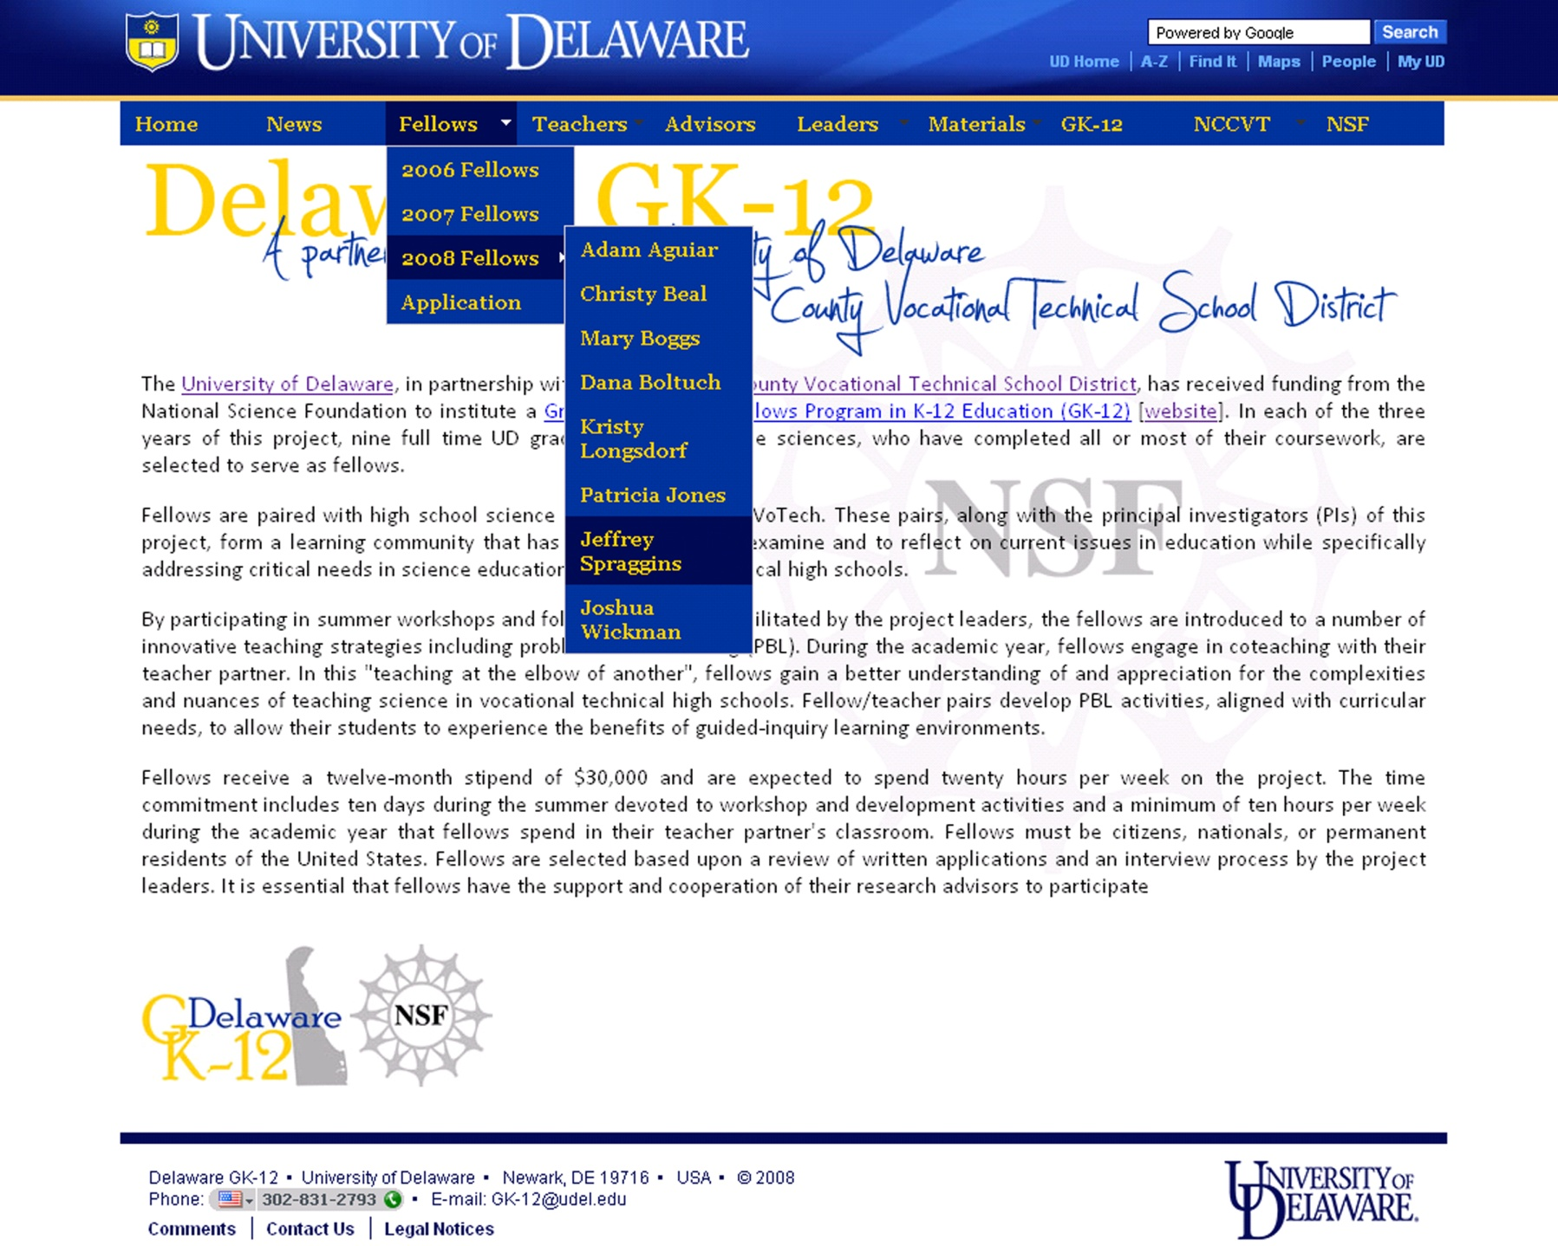
Goals Home Fellows Teachers Advisors Leaders Materials Big Picture

Slide 12
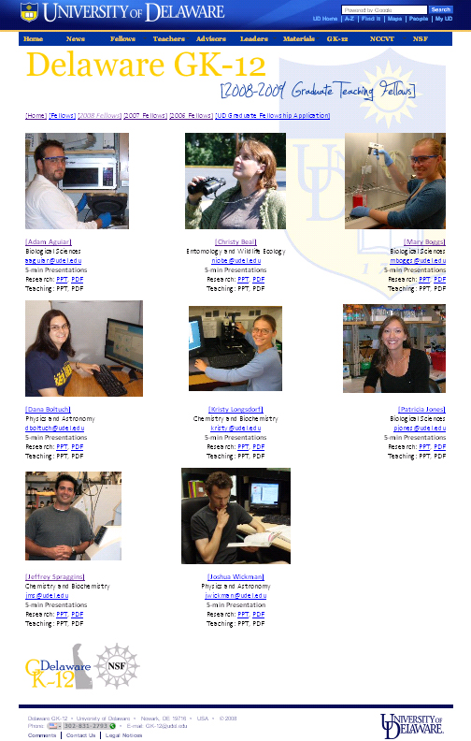
Goals Home Fellows Teachers Advisors Leaders Materials Big Picture

Slide 13
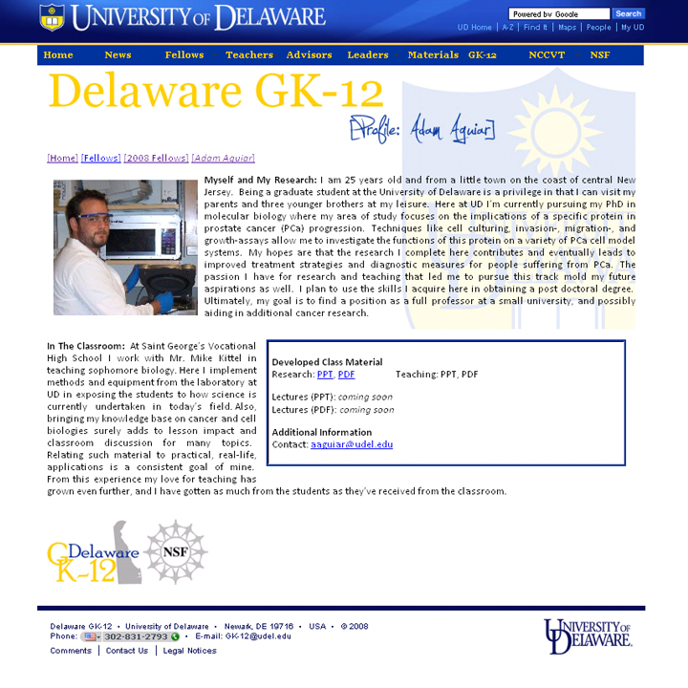
Goals Home Fellows Teachers Advisors Leaders Materials Big Picture

Slide 14
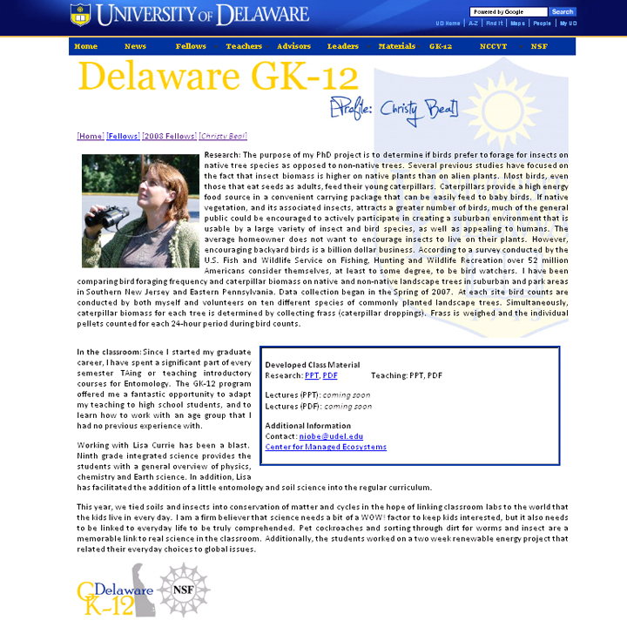
Goals Home Fellows Teachers Advisors Leaders Materials Big Picture

Slide 15
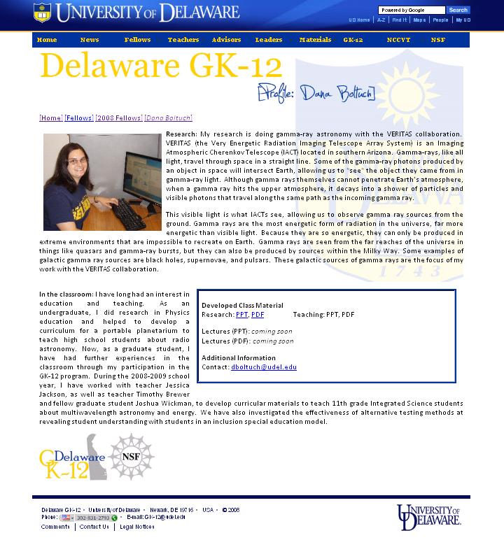
Goals Home Fellows Teachers Advisors Leaders Materials Big Picture

Slide 16
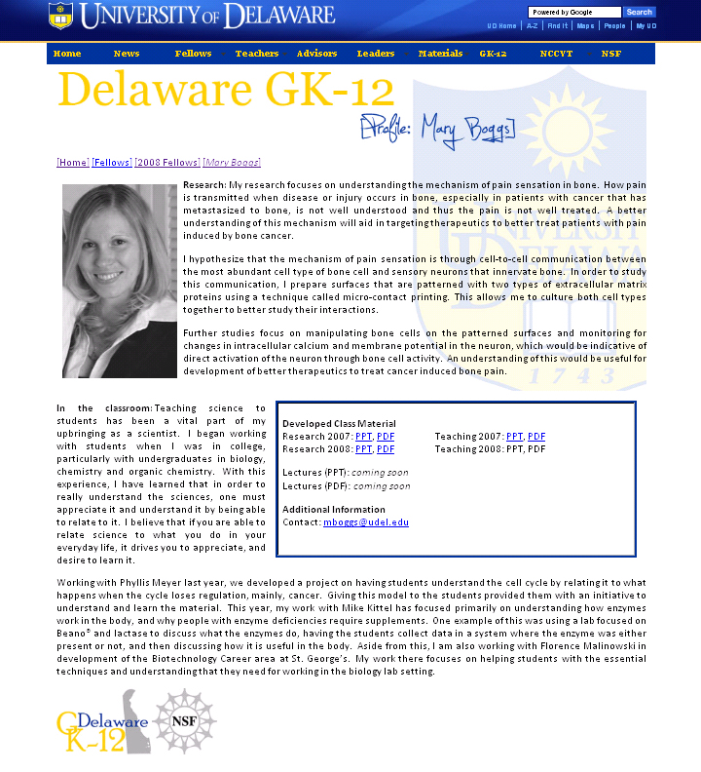
Goals Home Fellows Teachers Advisors Leaders Materials Big Picture

Slide 17
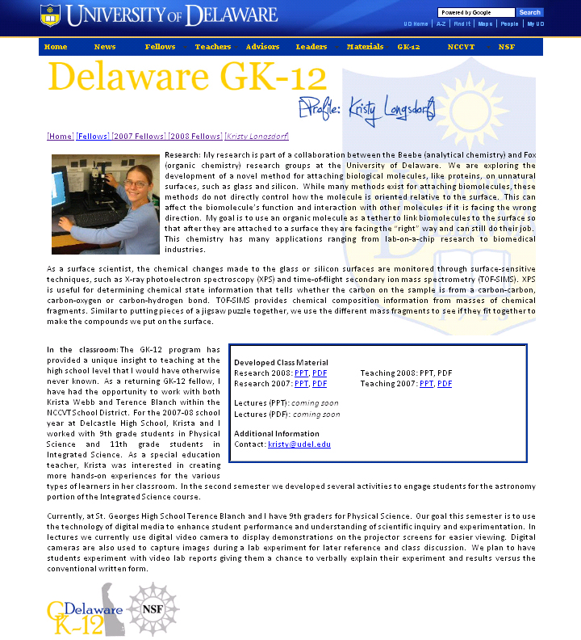
Goals Home Fellows Teachers Advisors Leaders Materials Big Picture

Slide 18
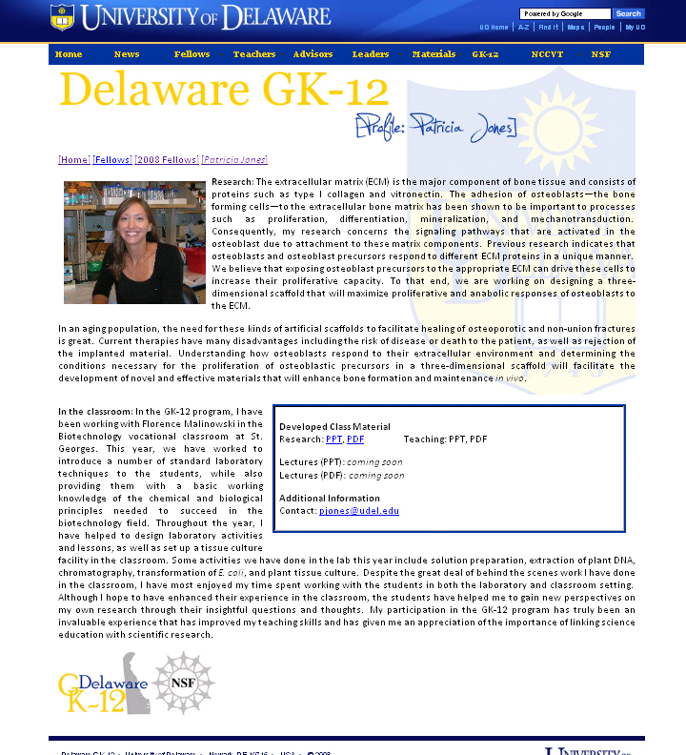
Goals Home Fellows Teachers Advisors Leaders Materials Big Picture

Slide 19
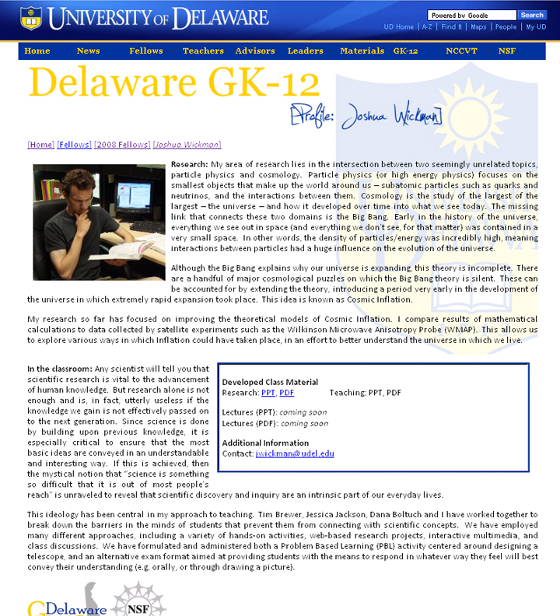
Goals Home Fellows Teachers Advisors Leaders Materials Big Picture

Slide 20
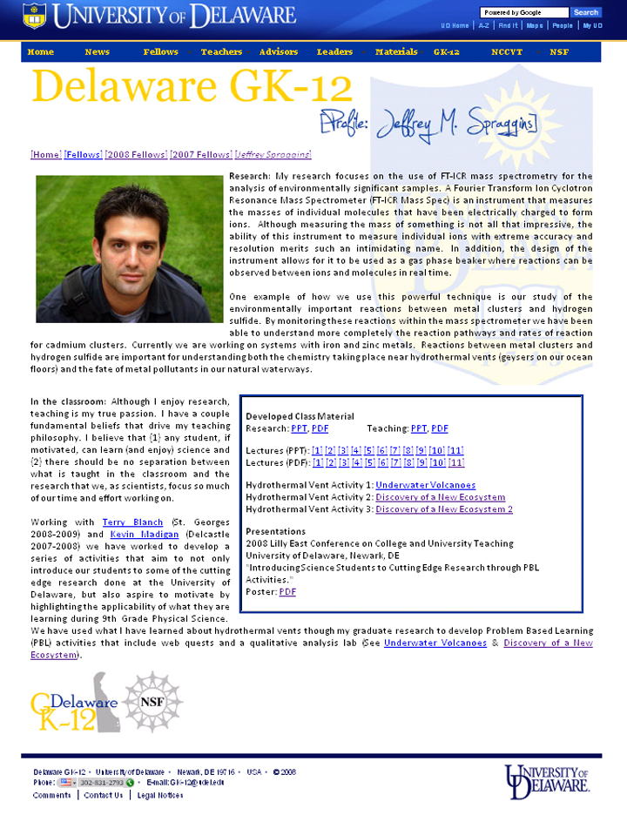
Goals Home Fellows Teachers Advisors Leaders Materials Big Picture

Slide 21
Goals Home Fellows Teachers Advisors Leaders Materials Big Picture

Slide 22
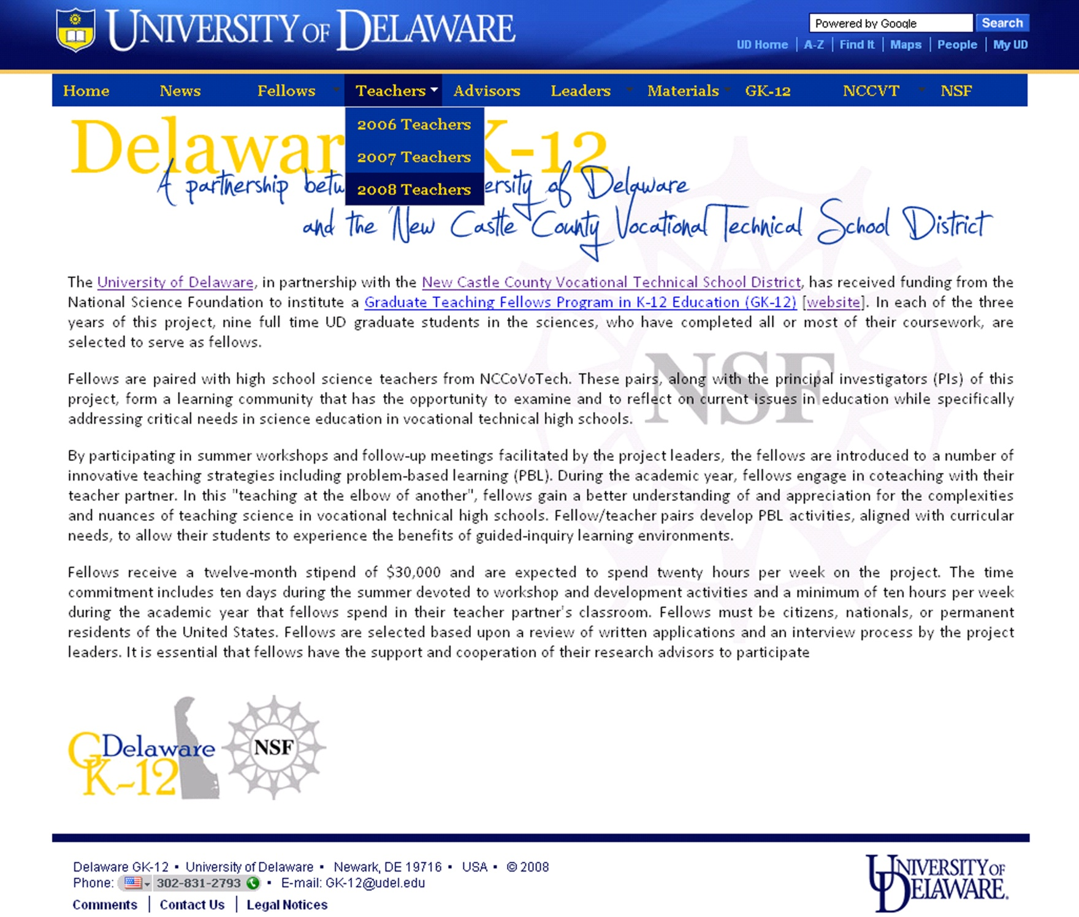
Goals Home Fellows Teachers Advisors Leaders Materials Big Picture

Slide 23
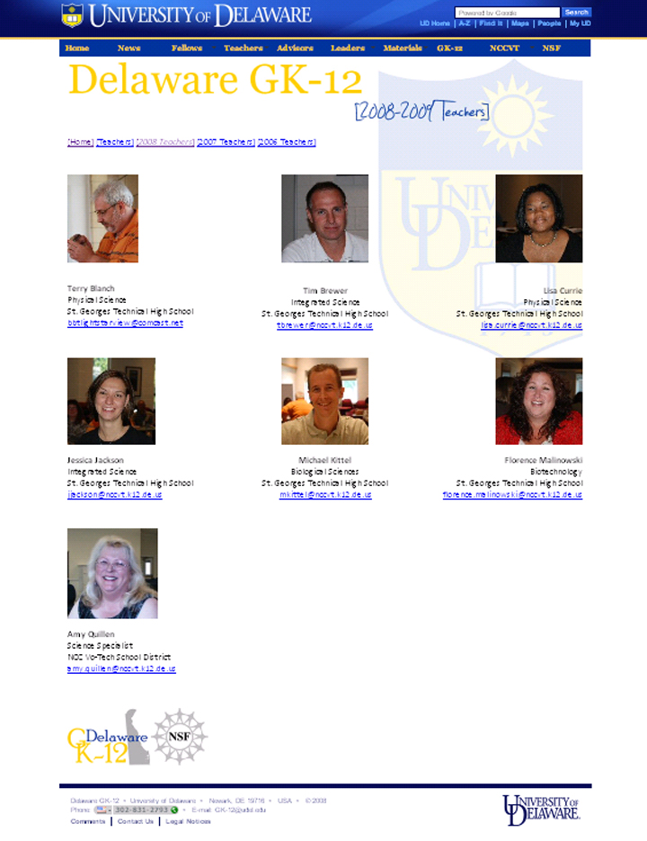
Goals Home Fellows Teachers Advisors Leaders Materials Big Picture

Slide 24
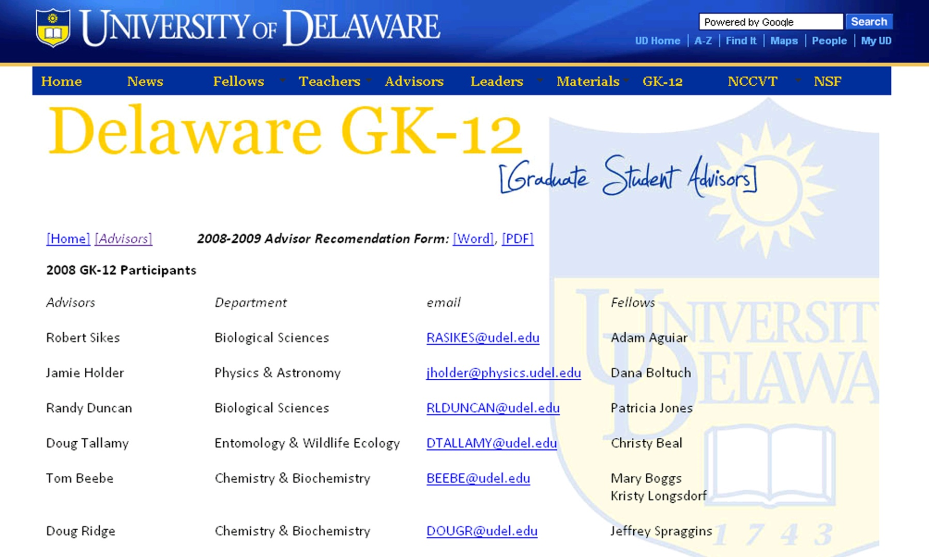
Goals Home Fellows Teachers Advisors Leaders Materials Big Picture

Slide 25
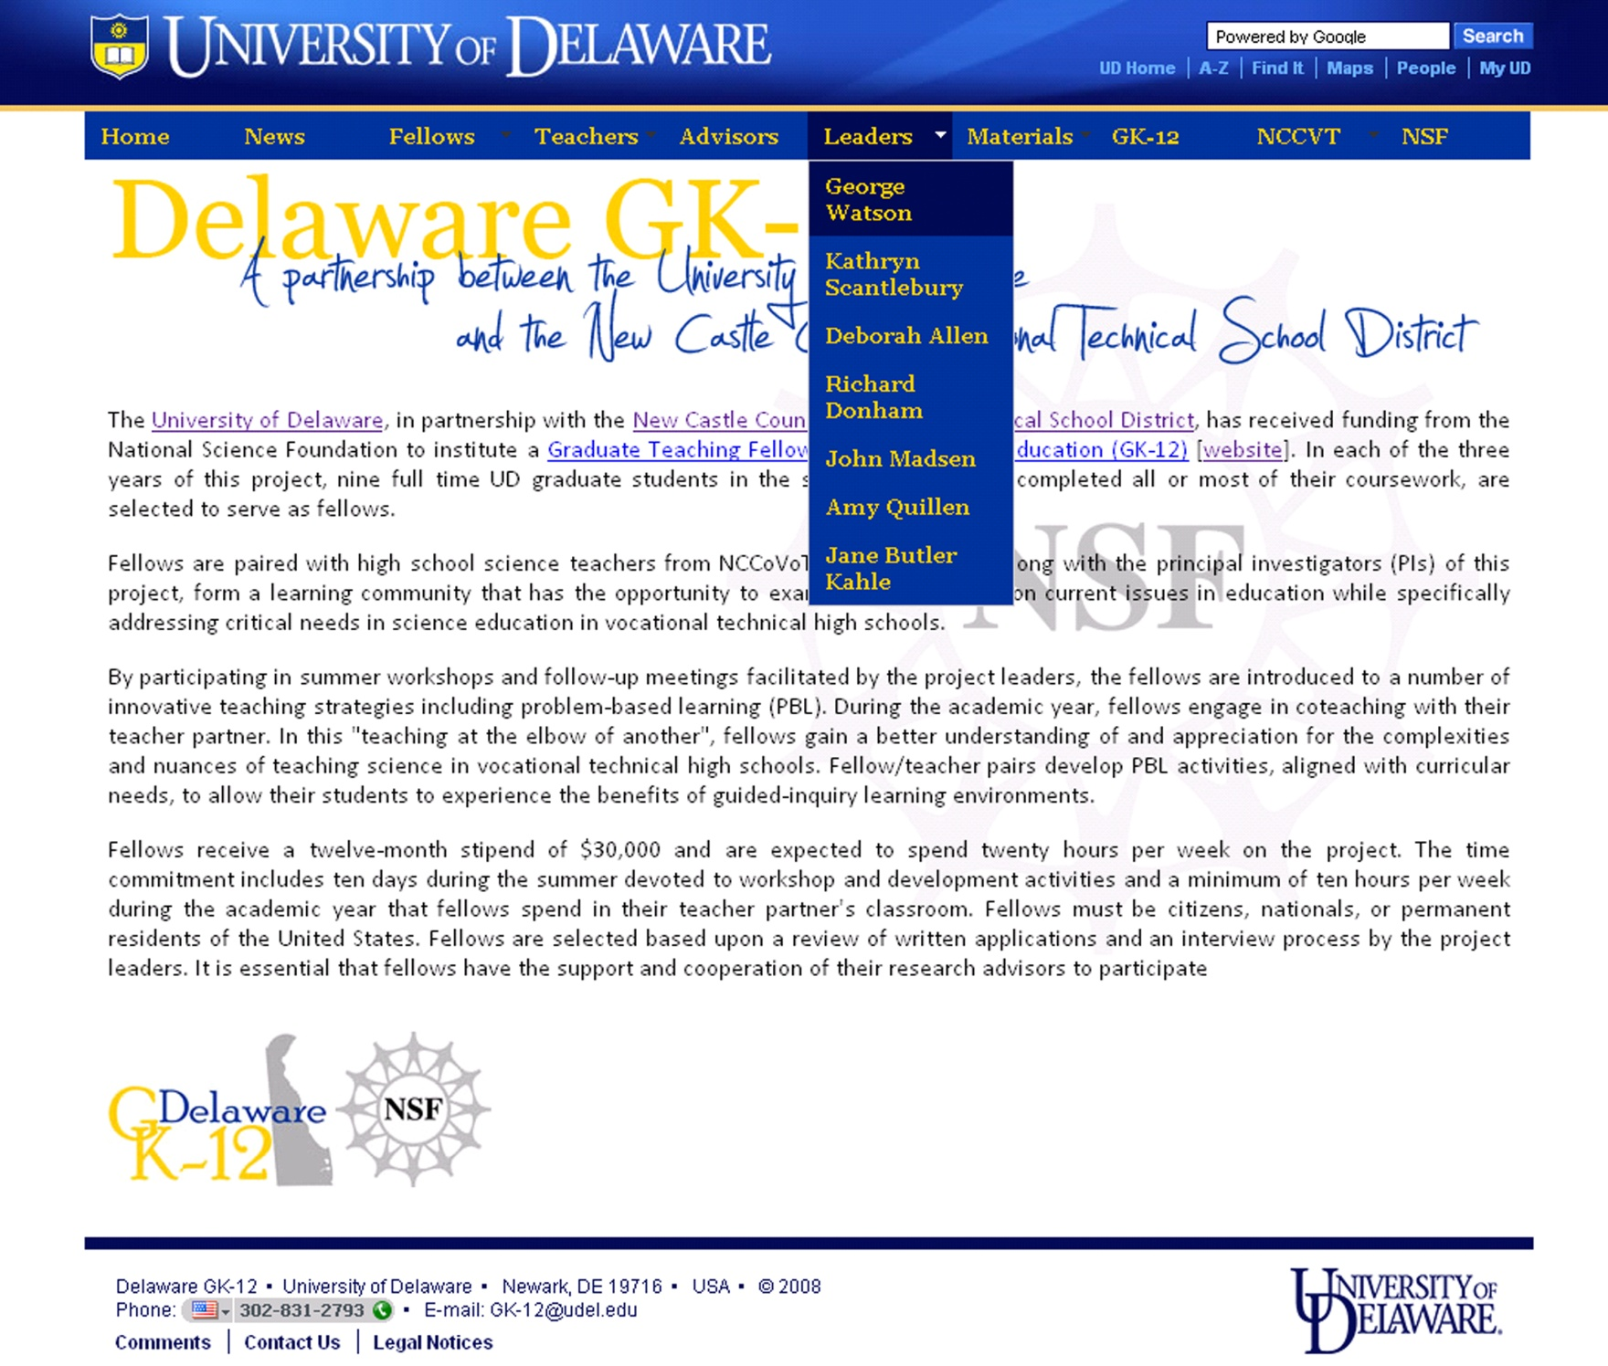
Goals Home Fellows Teachers Advisors Leaders Materials Big Picture

Slide 26
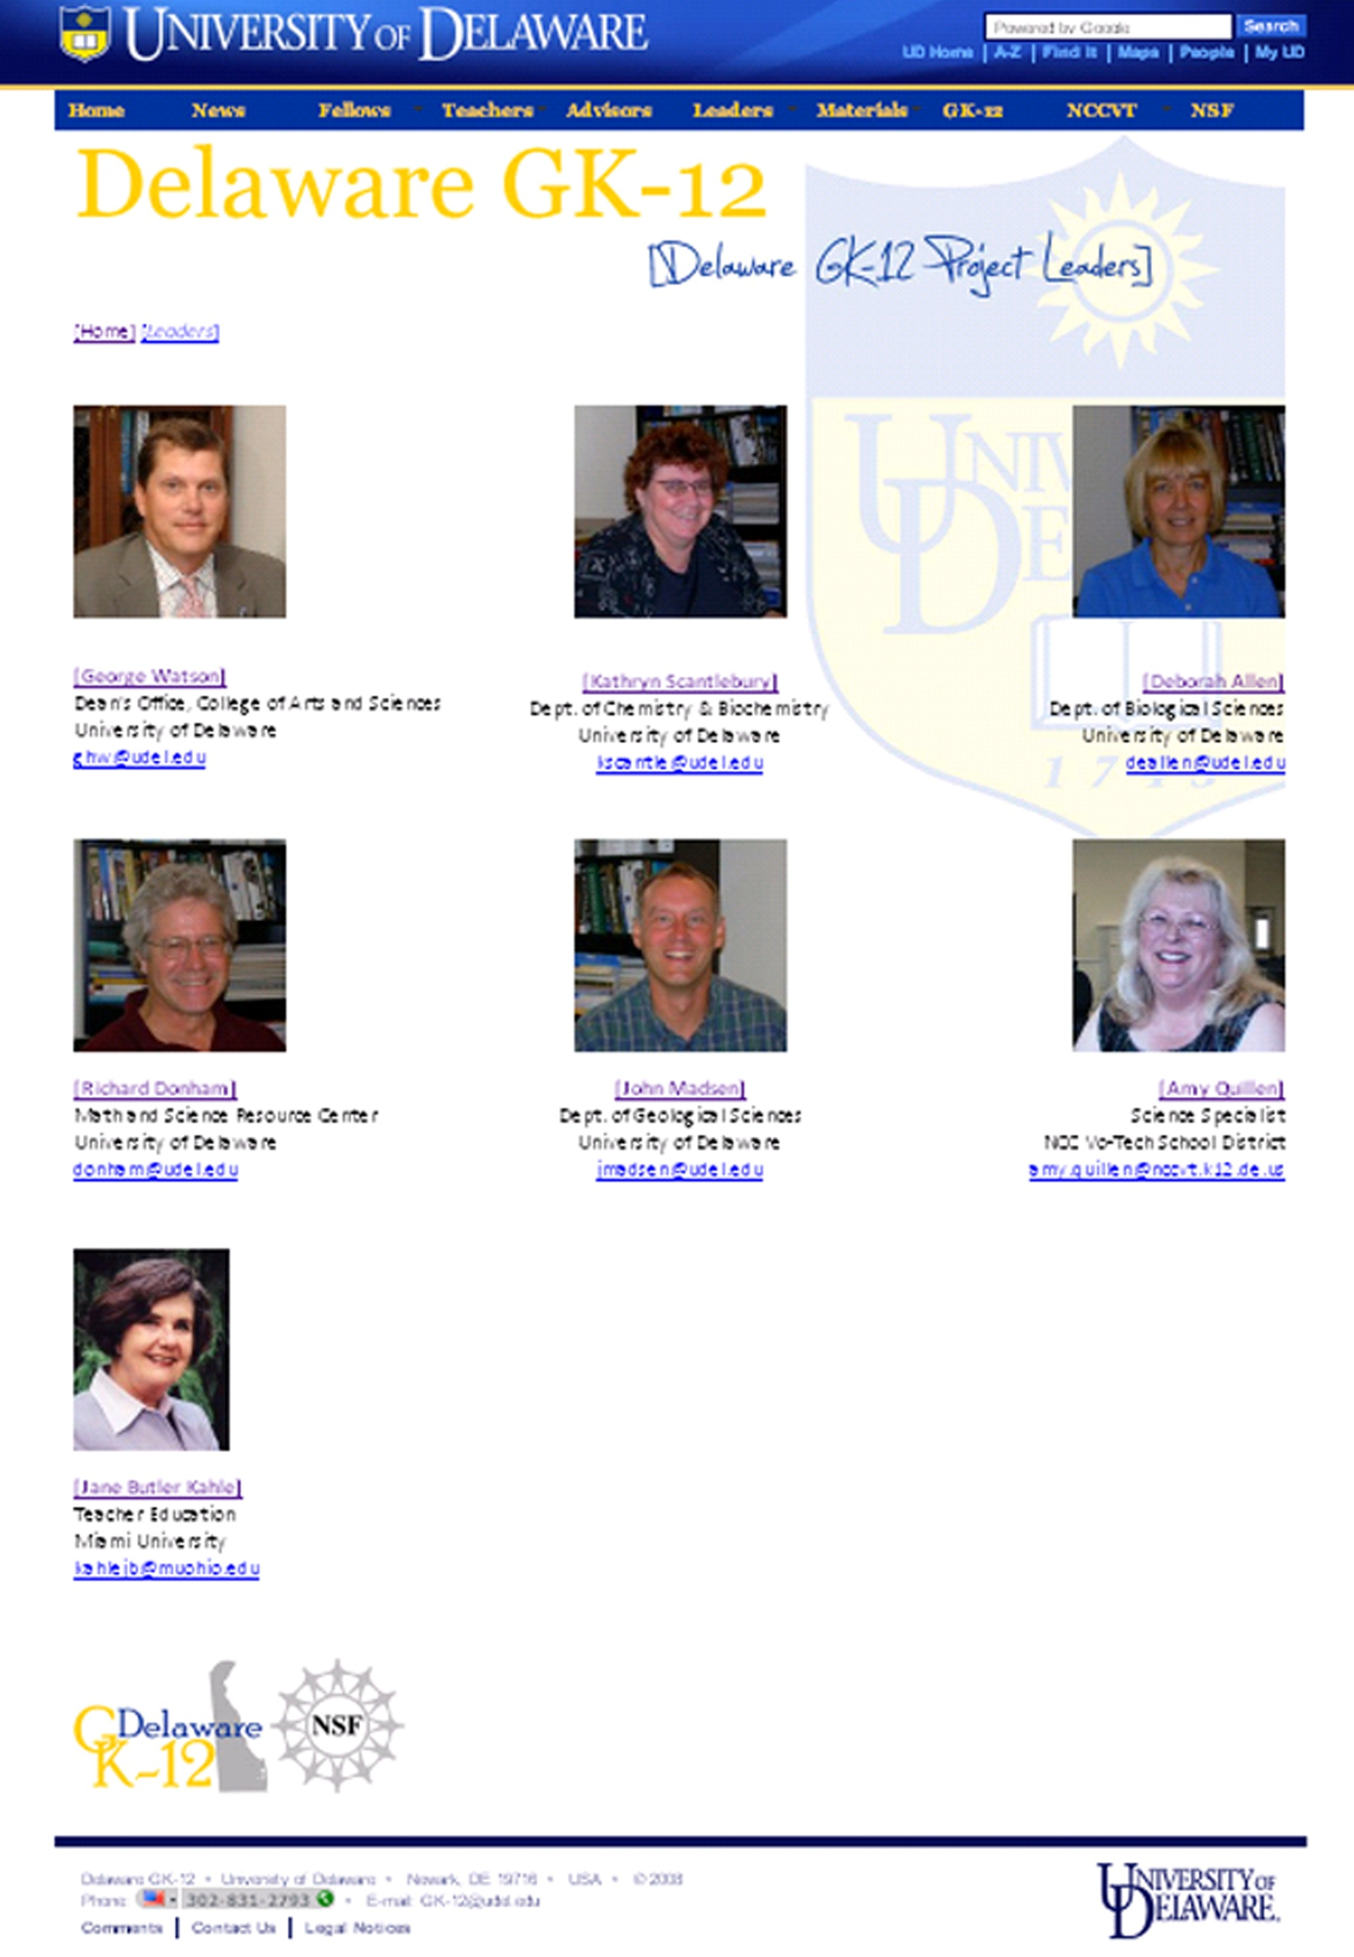
Goals Home Fellows Teachers Advisors Leaders Materials Big Picture

Slide 27
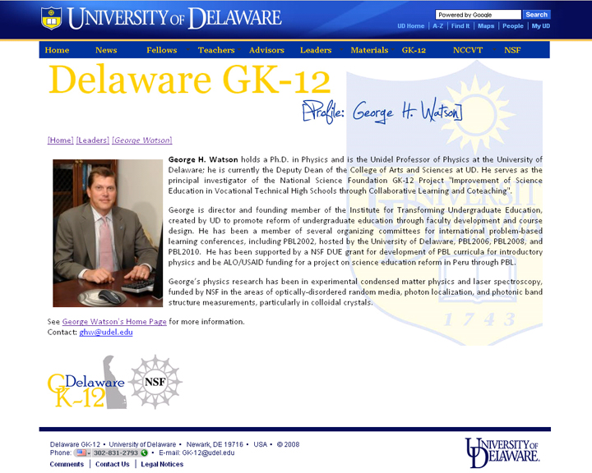
Goals Home Fellows Teachers Advisors Leaders Materials Big Picture

Slide 28
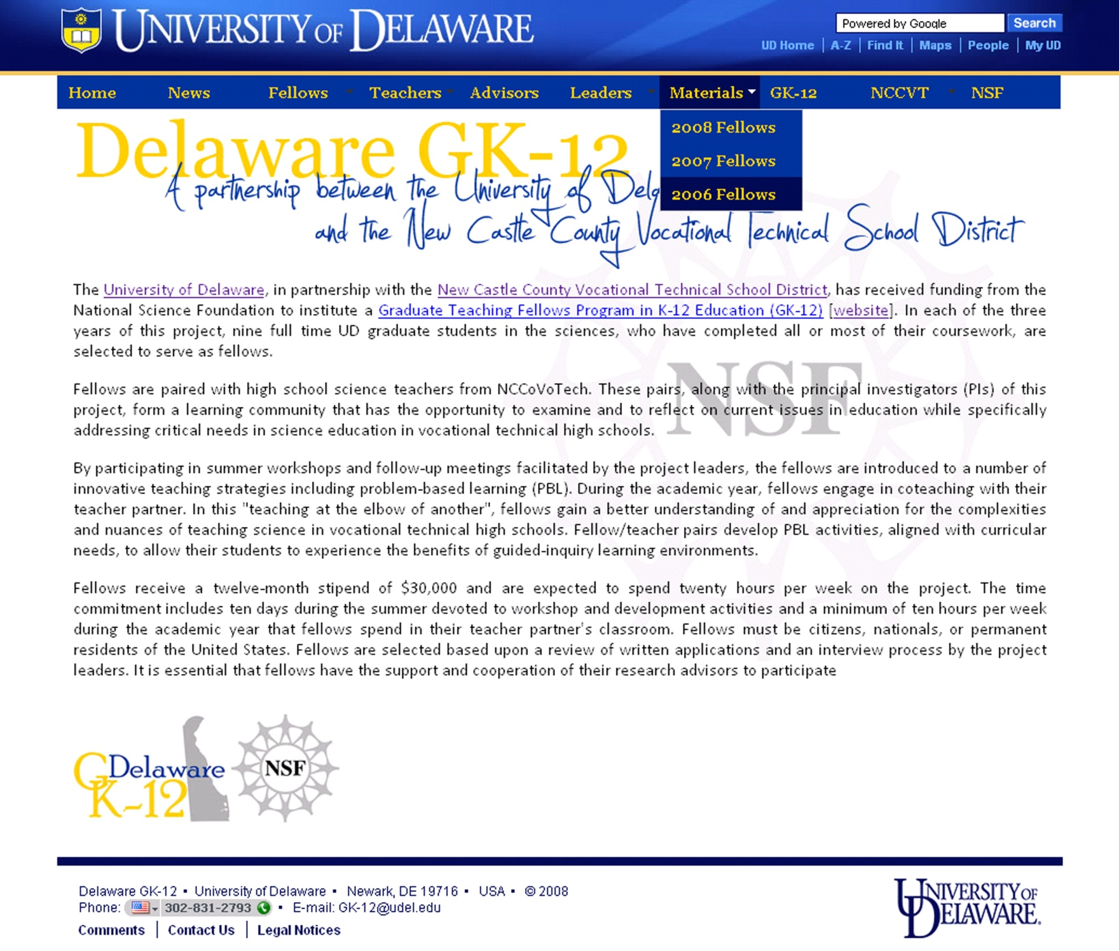
Goals Home Fellows Teachers Advisors Leaders Materials Big Picture

Slide 29
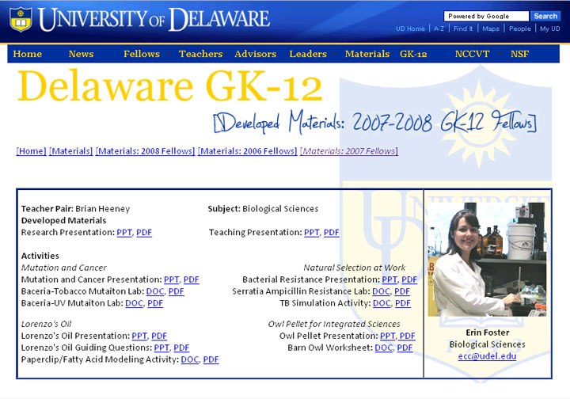
Goals Home Fellows Teachers Advisors Leaders Materials Big Picture

Slide 30
The Big Picture
New GK-12 Website
  Enhanced Web-presence for UD GK-12
  Educational Resource
  Written Communication Skills
  Web-based Communication Skills
Goals Home Fellows Teachers Advisors Leaders Materials Big Picture

