Slide 1
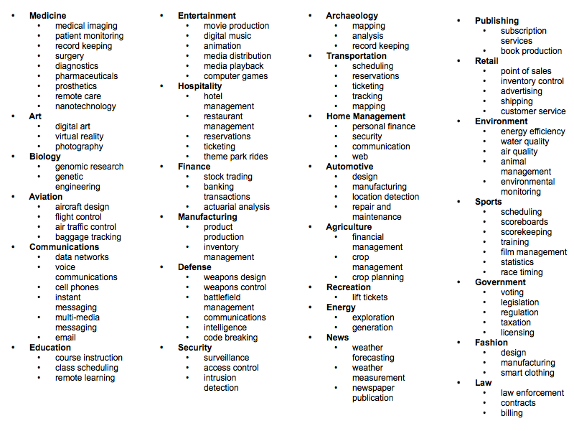

Slide 2
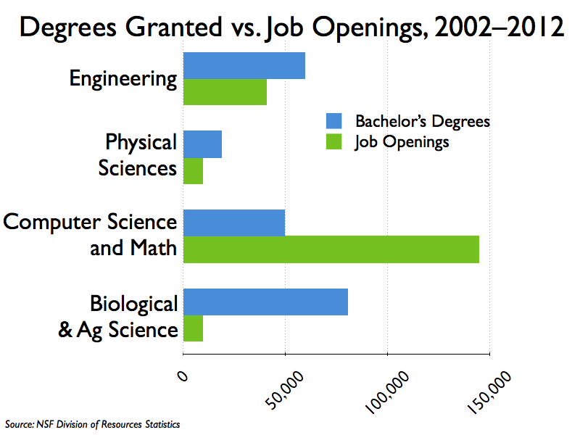

Slide 3
General Computer Science for Engineers
CISC 106
James Atlas
Computer and Information Sciences
2/10/2010

Slide 4
Course Overview
Website:
  sakai.udel.edu
Lab based course
  MATLAB
  TA for each lab
  Most of your learning will be in lab!

Slide 5
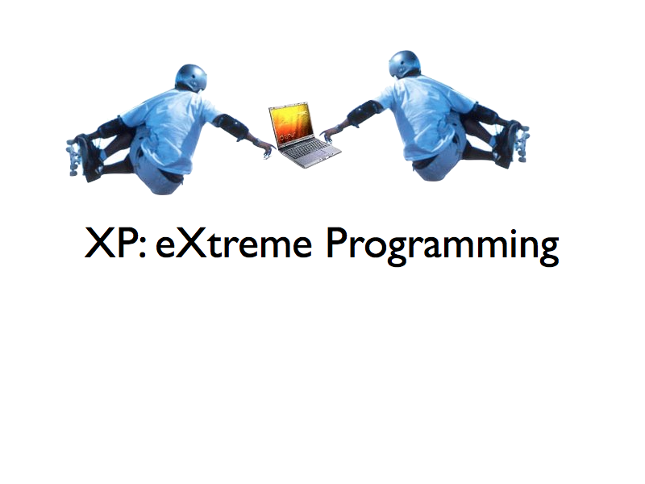
Labs
Pair programming
Labs assigned on Wednesday
Labs always due on the following Tuesday at 11:55PM
Projects are two pairs working together and will be due 2 weeks after assigned

Slide 6
Grading
Labs (20%)
Participation (10%)
Two Projects (10% + 10%)
Quizzes (10%)
Two Midterm Exams (10% + 10%)
Final Exam (20%)
Your final course grade cannot be more than one letter grade higher than your exam average

Slide 7
Course Help
Office Hours
  Tues 1-4PM Thurs 1-4PM
  TAs: Smith 103 (hours TBA)
E-mail
Academic Enrichment Center (AEC) Tutors

Slide 8
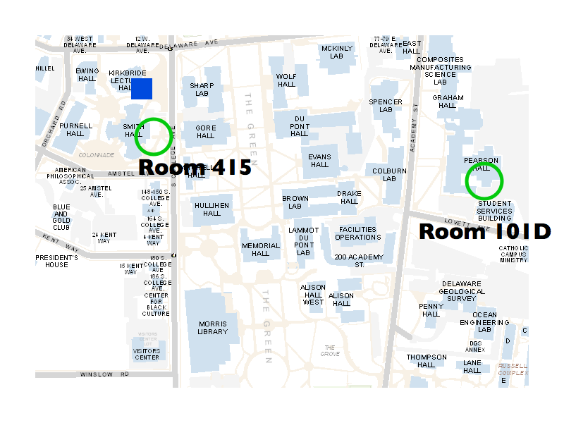

Slide 10
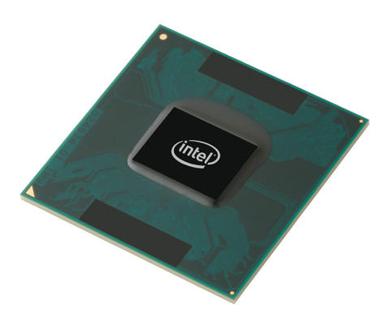
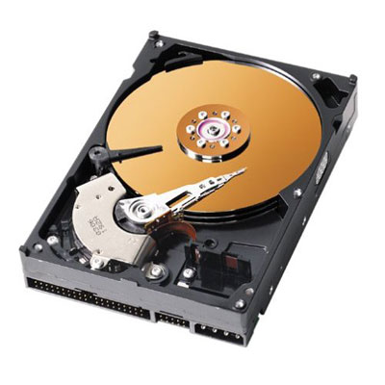
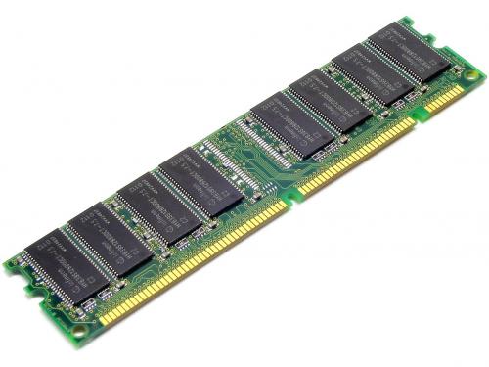
How does our program work?
CPU
Disk
Memory

Slide 11
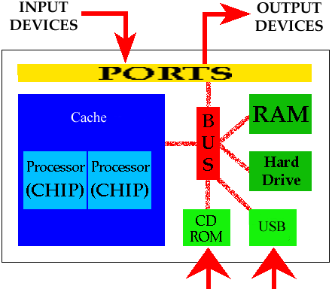

Slide 12
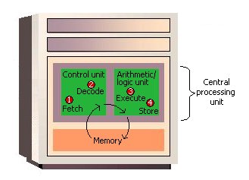

Slide 13

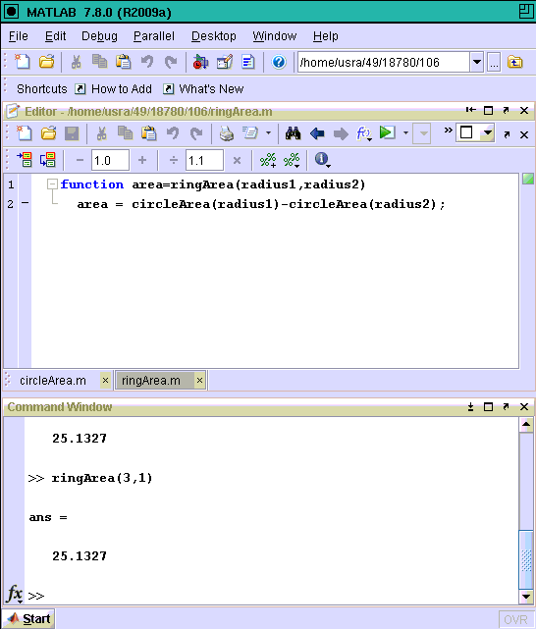
Our Program in Memory
x86 instructions
~~~~~~~~~~
~~~~~~~~~~
~~~~~~~~~~
~~~~~~~~~~
~~~~~~~~~~
~~~~~~~~~~
~~~~~~~~~~
~~~~~~~~~~
. . .

Slide 14
Variables
var = expression
x = 2 * 2
comment = ‘This is a string’
area = circleArea(5)
What type of data is stored in each variable?

Slide 15
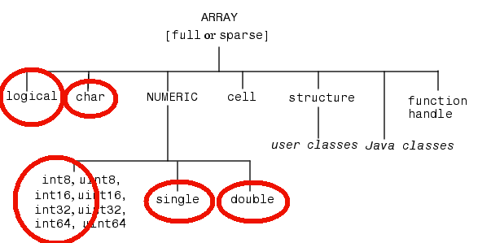
Data Types in Matlab
Floating point number by default
  “double” precision = 64-bits of memory

Slide 16
Operations on Data Types
5.5
single(5.5)
int8(5)
int8(500) ?
int8(‘c’) ?
char(98) ?
>> x = 5.5
>> whos x

Slide 17
Expressions
Data and Operator
  2 + 2
  circleArea(5)

Slide 18
Expressions
Data and Operator
  2 + 2
  circleArea(5)
Nested Expressions
  circleArea(circleArea(5 + 2) + circleArea(3))

Slide 19
Expressions
Data and Operator
  2 + 2
  circleArea(5)
Nested Expressions
  circleArea(circleArea(5 + 2) + circleArea(3))
Expressions produce a value

Slide 20
Lab00 (pre-lab) / Lab01

